Slide 1
PWIE-SP A.1.T-T001-D004: Qualification of W-Heavy Alloys for use in W7-X
H. Greuner, IPP Garching

Slide 2
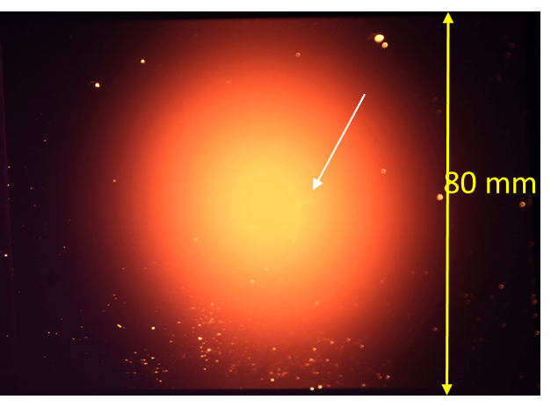
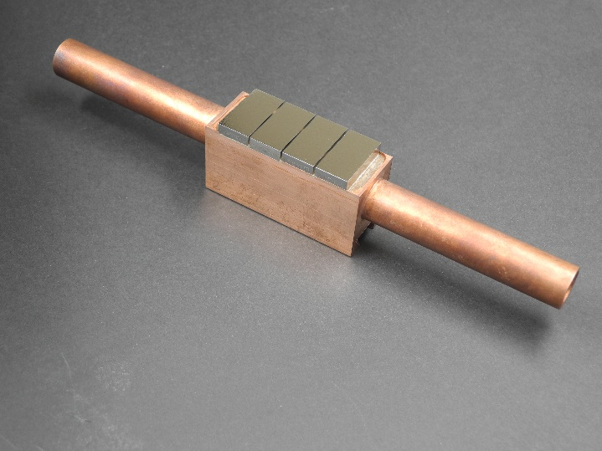
Objective and planned HHF tests in GLADIS
Motivation: Transition of W7-X from graphite materials to W materials for divertor target and baffle plates. Moderate heat fluxes up to 10 MW/m² allow to consider W heavy alloys materials
reduced material & manufacturing costs expected
Objective: Examination and qualification of different commercially available W-Ni-Fe and W-Ni-Cu materials based on metallography and HHF test results.
2022: Cyclic heat loading of actively cooled mock-ups
design heat load of 10 MW/m², 10 s pulse length to reach steady-state 
“1.2 safety margin” 12 MW/m², 10 s 
Finally destructive metallography
Mock-up equipped with W-Ni-Cu tiles
2023: Continuation of examination with short transient overloading
Cycling 40 MW/m², 200 ms similar to NBI shine trough events
Adiabatic loading of castellated (flat tile size) W-Ni-Cu materials to verify the influence of tile size on the cracking behaviour detected on “big samples” in 2022.
➔ Combination of steady-state and transient HHF test results to predict the operating behaviour of W heavy alloys as divertor material for W7-X.

