Slide 1
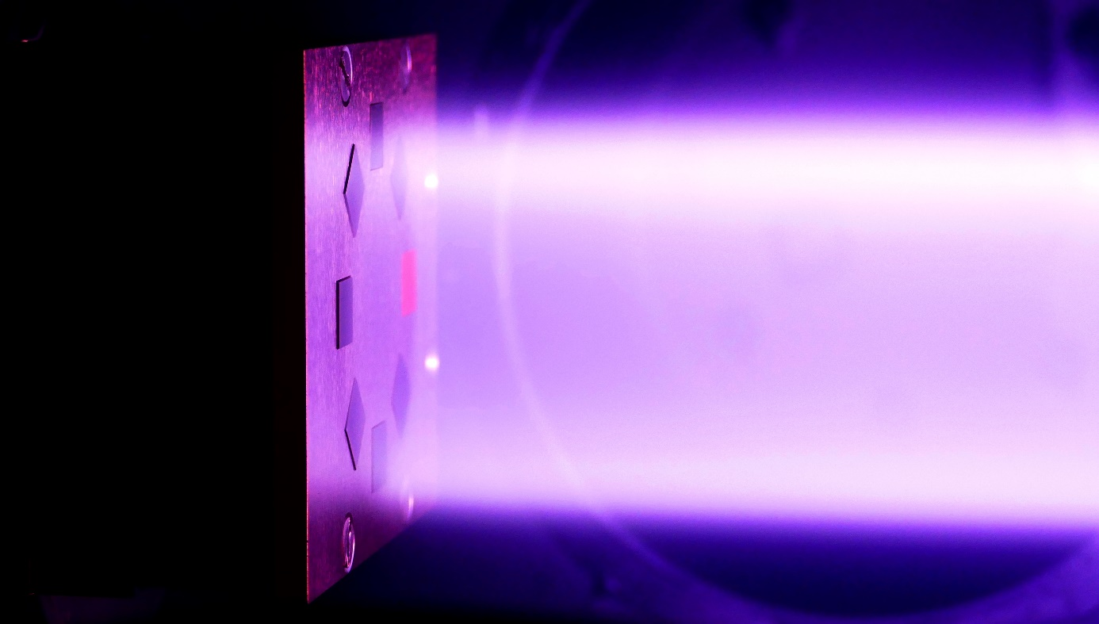
SMART material studies
within the work package PWIE SP A3
P. Bittner, A. Litnovsky, H.R. Koslowski, J.W. Coenen and Ch. Linsmeier
Forschungszentrum Jülich GmbH, Institut für Energie- und Klimaforschung – Plasmaphysik (IEK-4)

Slide 2
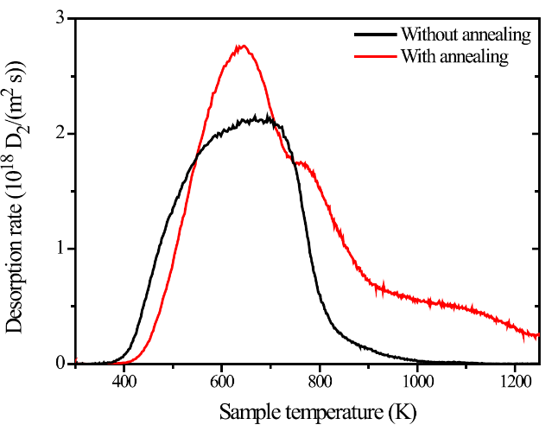
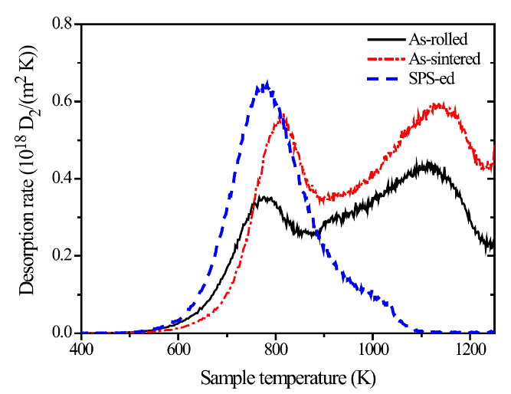
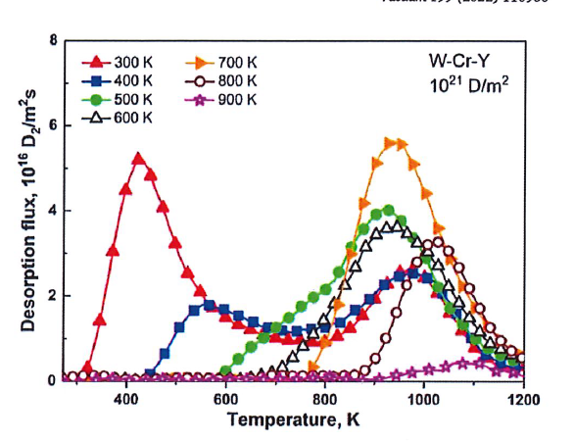
Z. Haratyunyan et al. (MEPhI) (SMART-WCrY)
M. Zhao et al. (IPP Garching) (W-Y₂O₃)
spark-plasma sintered samples annealed at 2170 K for 3 h in vacuum (p ~ 2·10⁻⁶ Pa)
as-sintered: cold isostatic presssing + high temperature sintering
D-loading:
D-loading:
6·10²⁴ D/m²
6·10²⁴ D/m²
570 K
450 K
TDS: 15 K/min
TDS: 15 K/min
higher D-retention in WCrY than pure W
high temperature TDS peak in WCrY
SPS-ed: higher D-retention after annealing
SPS-ed: after annealing desorption is not zero even at 1200 K in TDS
As-sintered/rolled: high temperature TDS peak as in WCrY
non-annealed
annealed
yellow arrows = pores
yellow arrows = pores
Both authors suggest that the HT-peak and additional retention could be caused by (submicron) pores in the material

Slide 3
Study the effect of porosity on D-retention in WCrY SMART
FAST 4827
$$ρ>98 \%$$
FAST 4823
$$ρ>98 \%$$
FAST 4835
$$ρ>98 \%$$
before annealing
FAST 5652
$$ρ≈93 \%$$
FAST 5099
$$ρ≈85 \%$$
after annealing 1000 °C, 7h

Slide 4
Investigate the effect of porosity on D-retention in WCrY
Planning to do two D-loading experiments with PSI-2
Experiment 1: investigate differences in D-retention caused by different porosities
3 x as-sintered $ρ>98 \%$, one of them annealed @1000°C, 7h
1 x as-sintered $ρ≈93 \%$
1 x as-sintered $ρ≈85 \%$
if available, include reference pure W sample for comparison
all samples are already cut into PSI-2 geometry
grinding and polishing will be finished next week
new density measurements on samples with low density after grinding
PSI-2 Deuterium loading
ion energy: $70 eV$
ion flux: $\sim 3∙{10}^{21} \frac{1}{m^{2}s}$
ion fluence: $\sim 5∙{10}^{25} \frac{1}{m^{2}}$
post-characterization (mass loss, etc.) and NRA and TDS after exposure
Experiment 2: check reproducibility with 2-3 new $ρ≈85 \%$ samples
all samples must still be produced → will take $\sim 6$ weeks from now
Experiment 1: expect PSI-2 exposure to be conducted end of March /
beginning of April
$\sim 5 h$ exposure time (and $\sim 8 h$ for whole experiment with preparation etc.)
Experiment 2: PSI-2 exposure
not before end of April

