Slide 1
WPPWIE SPA Kick Off
14th March 2023 I M. Wirtz, D. Dorow-Gerspach, M. Gago, et al.
Forschungszentrum Jülich GmbH, Institut für Energie- und Klimaforschung, 52425 Jülich, Germany

Slide 2
Environmental conditions
Steady state heat loads:
Transient thermal loads:
up to 20 MWm⁻² in ITER (lower loads in DEMO)
up to 60 MJm⁻²
very high thermal loads
(disrupt., ELMs, VDEs)
crackings
melting
dust formation
recrystallization
failure of joints
plasma exposure
neutrons
Plasma loads:
Neutrons:
sputtering
hydrogen
helium
up to 14 MeV
defects
transmutation

Slide 3
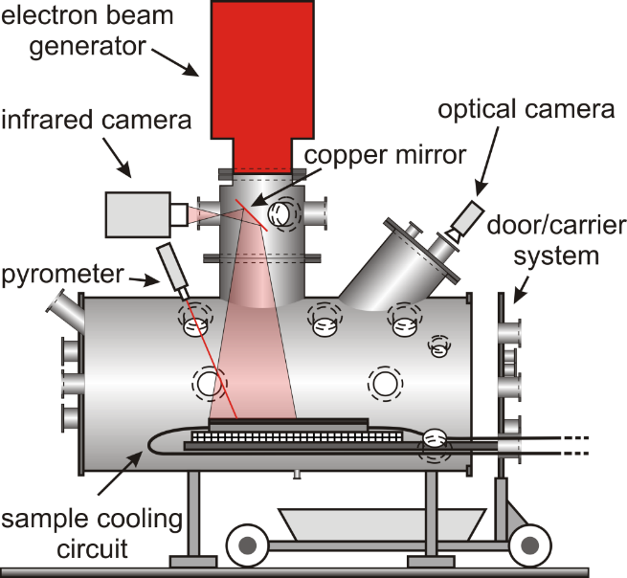
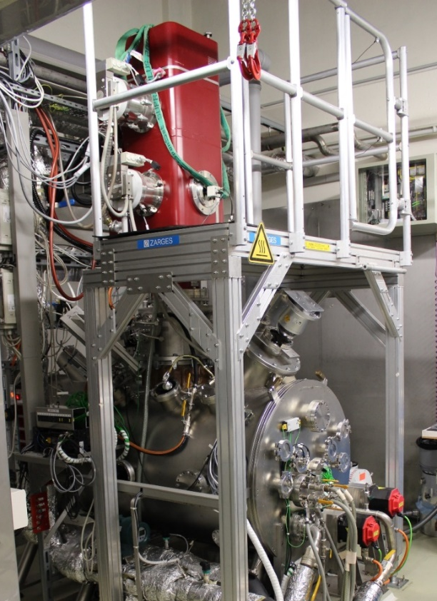
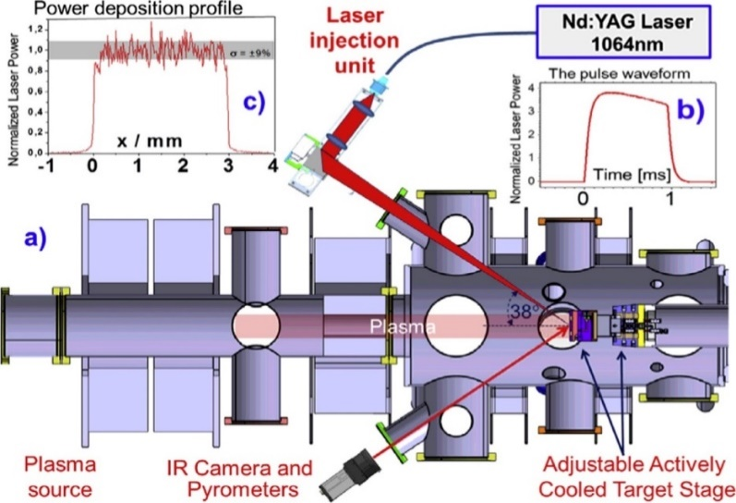
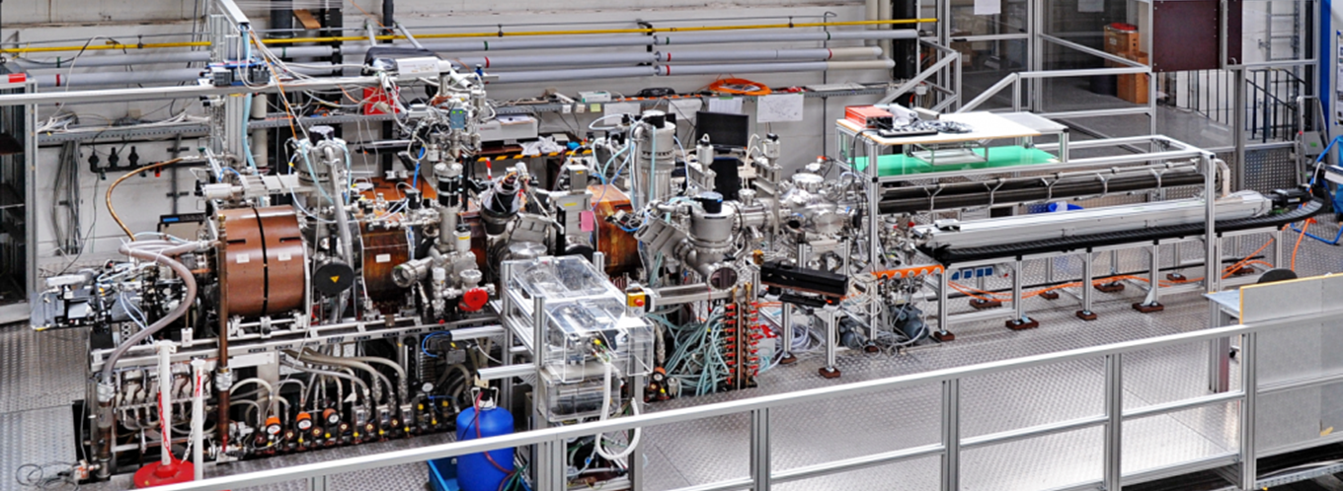
Experimental devices
JUDITH 2
PSI-2
Stationary loads
D, He, Ar plasma
plasma column Ø 60 mm
ion flux ≤ 10²³ m⁻²s⁻¹
incident E_{i} (bias) 10 – 300 eV
ELM-like heat pulse
Nd:YAG laser λ 1064 nm
laser energy 32 J
Machine parameters
total power: 200 kW
acc. voltage: 40 – 60 kV
irrad. area: 40 × 40 cm²
power density: ≤ 2 GWm⁻²
pulse length: 5 µs – cont.
beam FWHM: 3 – 12 mm
(typ. 8 – 10 mm)
Cooling circuit
temperature: 20 – 120 °C max. pressure: 4 MPa
max. flow: 200 l/min
cooling power: ≤ 150 kW
monitoring of water quality

Slide 4
Low pulse number HHF testing procedure
Definition ‟base temperature”: The surface temperature of the material before each transient pulse: T_{base}
T_{base} = RT, 400 °C, 1000 °C
Pulse shape: rectangular
Pre-Qualification: 100/1000 pulses of Δt = 1 ms
Power density L_{abs} = 0.19/0.38 GW/m² (F_{HF} = 6/12 MW/m²s^{1/2})
L_{abs}
Transient load
T_{surf}
L_{max}
$$F_{HF}=L∙\sqrt{t_{pulse}}$$
T_{base}
0
t_{pulse}
t
t

Slide 5
High pulse number HHF testing procedure
Definition ‟base temperature”: The surface temperature of the material before each transient pulse: T_{base}
T_{base} = 700 °C, 1200 °C
Pulse shape: rectangular
Qualification: 10⁴ - 10⁶ pulses of Δt = 0.5 ms
Power density L_{abs} = 0.14/0.27/0.41/0.55 GW/m² (F_{HF} = 3/6/9/12 MW/m²s^{1/2})
L_{abs}
Transient load
T_{surf}
L_{max}
$$F_{HF}=L∙\sqrt{t_{pulse}}$$
T_{base}
0
t_{pulse}
t
t

Slide 6
Qualification criteria for new materials
Location of damage/cracking thresholds (low pulse number test)
elevated temperatures (400 °C and 1000 °C)
0.19 GW/m² (100 pulses) and 0.38 GW/m² (100/1000 pulses)
Better performance (higher threshold values)
→ high pulse number tests at 0.27 GW/m² (700 °C and 1200 °C)
Same behaviour
→ detailed investigation of the surface roughness/crack formation
Better behaviour (lower roughness/crack parameters)
→ high pulse number tests at 0.27 GW/m² (700 °C and 1200 °C)

Slide 7
Summary
Broad range methods/devices to characterize/qualify different materials and components under fusion relevant conditions:
stationary plasmas (PSI-2, JULE-PSI)
electron and laser beam for thermal shock tests (JUDITH 2/3, PSI-2, JULE-PSI)
mechanical, thermal and other analytic methods to characterize material/components before and after testing
Strong interconnection to other subprojects as well as work pages MAT, PRD and DIV allows a much better coordination/planning of tests and identification of interesting material and components designs.

