Slide 1
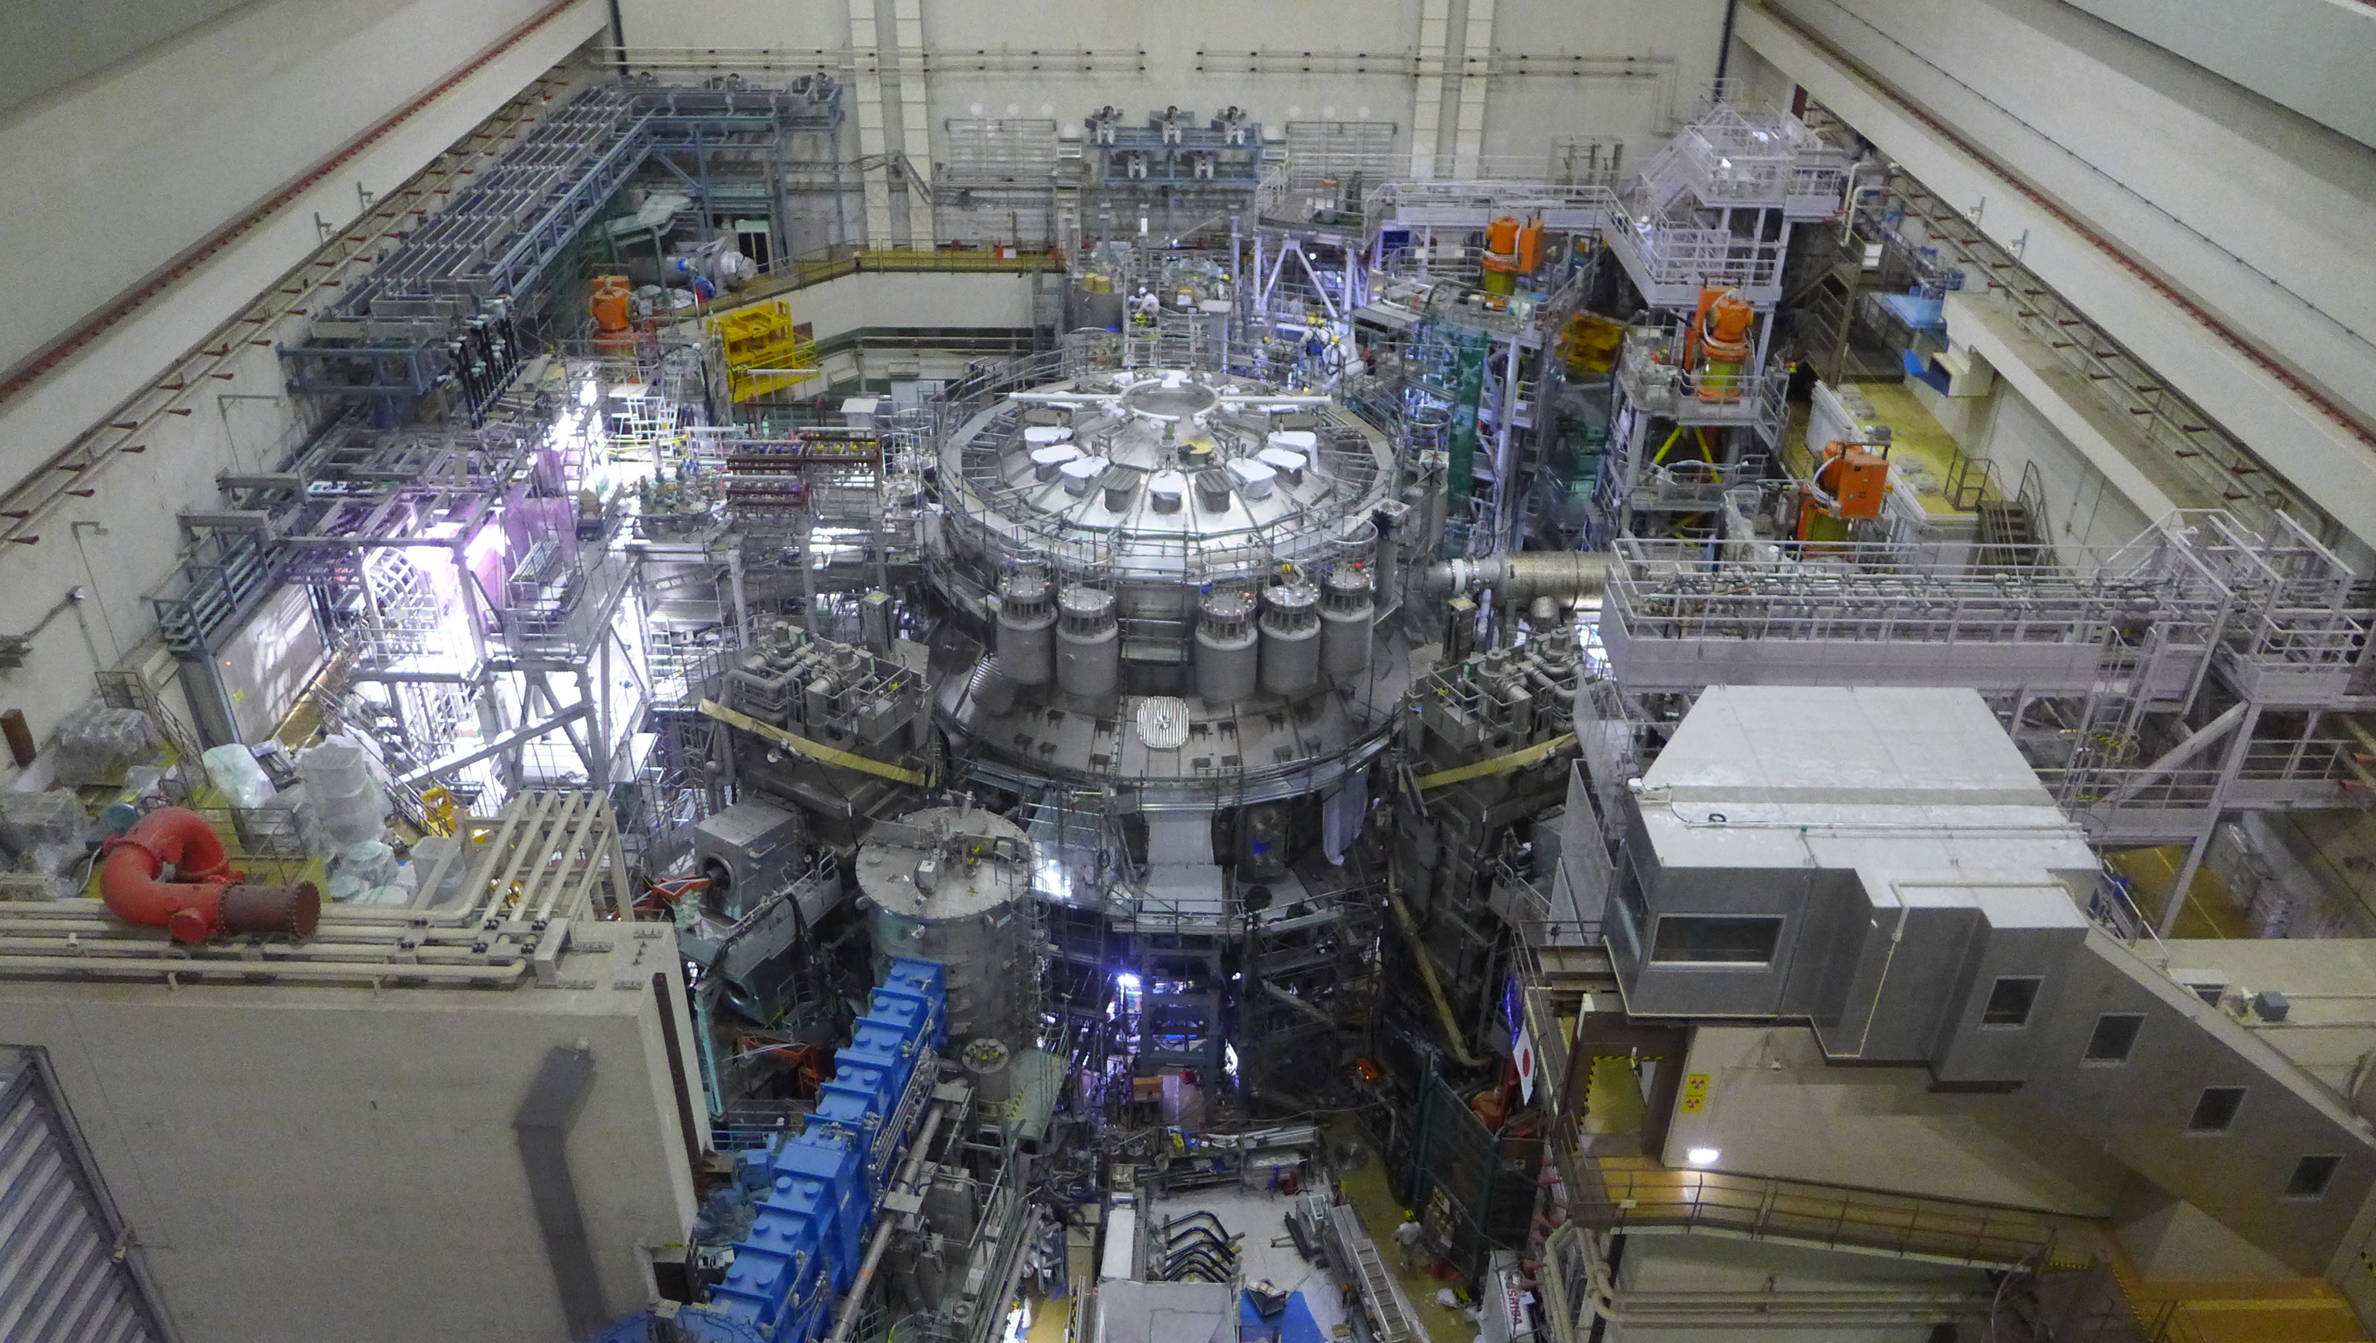
JT-60SA experiment team plans for 2024
J. Garcia on behalf of the JT-60SA Experiment Team Leaders

Slide 2
EUROfusion priorities
Participation of EU scientists to the JT-60SA scientific programme will be lead by the EU Strategic priorities in the JT-60SA research program
  Development and investigation of high performance scenarios compatible with future W-PFCs.
  Avoidance and mitigation of disruptions and runaways
  Fast ion physics
  Development and validation of high level real-time control strategies
Target plasmas
  Complement current European tokamaks
  Explore conditions currently unexplored in Europe

Slide 3
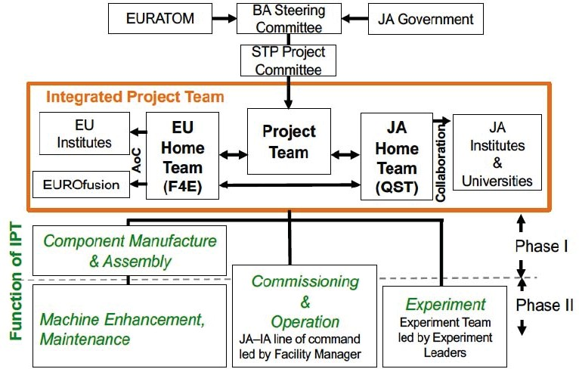
Global structure of the JT-60SA project
https://www.jt60sa.org/wp/

Slide 4
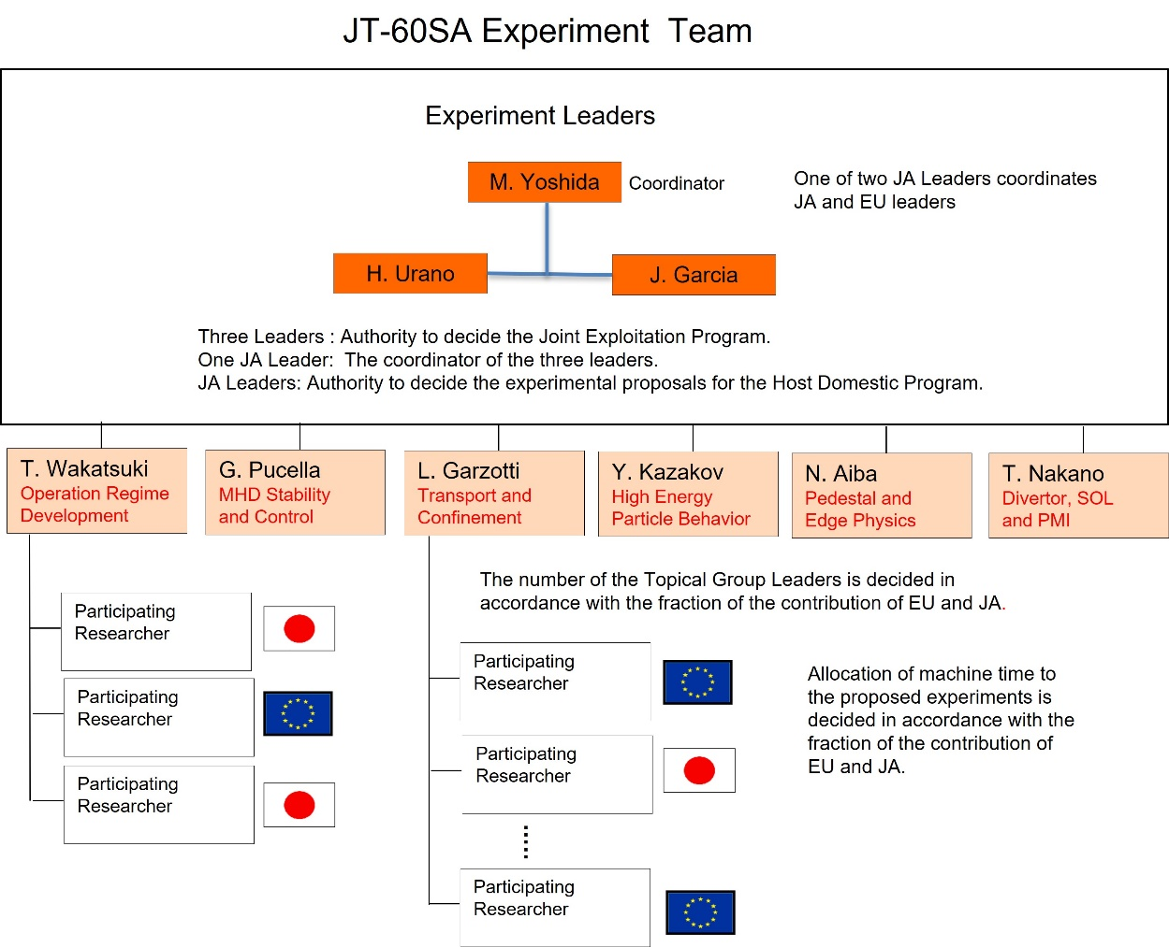
JT-60SA Experiment Team
JT-60SA Project leader and EU and JA Project Managers
The JT-60SA Experiment Team is the unified Experiment Implementation Structure for the JT-60SA experiment
Three Experiment Leaders
  Maiko Yoshida
  Hajime Urano
  Jeronimo Garcia

Slide 5
JT-60SA Experiment Team: experiment leaders
JT-60SA Project leader and EU and JA Project Managers
Experiment Team Leaders are responsible for:
Jointly develop the Annual Experiment Programme and submit it with the Annual Experiment Report to the Project Managers (PMs) and to the Project Leader (PL)
Jointly assessing, prioritizing, and allocating machine time to experimental proposals
Jointly direct and supervise the Experiment Team in the implementation of the Annual Experiment Programme
Jointly coordinate and validate the publications related to the Experimental Team activity.
Jointly receive, assess and make proposals for machine enhancement from the experiment team
Jointly contribute to the evaluation of the machine enhancement proposals

Slide 6
Specific working groups
Several topics have implications in the Experiment team and operational aspects
Several working groups are being organized:
Working group: Real time control (creation, development, implementation) led by the Operation Regime Development TG
Working group: Disruption avoidance techniques and disruption database led by MHD Stability and Control TG

Slide 7
The role of the Experiment Team
The Experiment team is formed now by EL+TGL
Some experts (mostly from WPSA) have been invited to participate on scientific discussions
Work done until now has been useful towards:
  Reinforce collaborative work
  Improve joint leadership
  Exchange of ideas towards the initial operation phase
  Modification of the Project Plan
  Drive JA-EU sides towards a common goal
  Coordinate joint modelling between JA and EU
  Solve misunderstanding issues

Slide 8
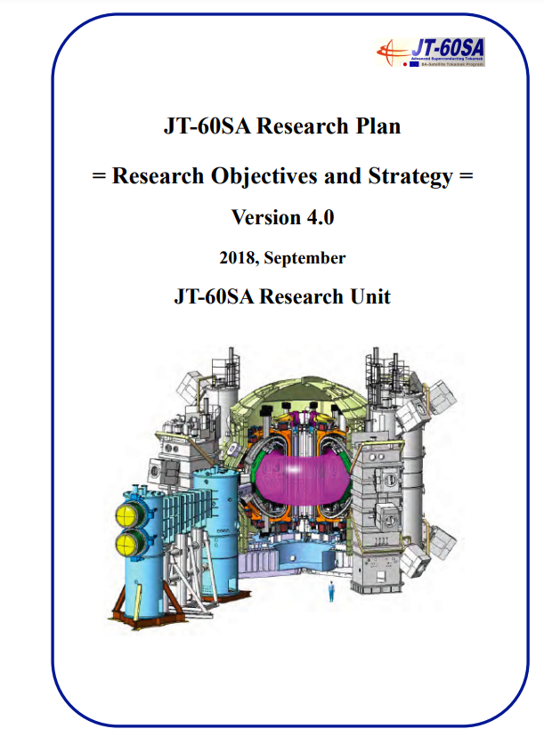
Experiment team: Beyond the research plan
JT-60SA research plan is a key pillar to understand our scientific objectives https://www.jt60sa.org/pdfs/JT-60SA_Res_Plan.pdf
Research plan is giving generic scientific objectives, mainly focus on key goals
Need to define the main scientific topics for the initial campaigns, coherent with
  Required Machine Enhancements
  Analysis and simulation codes available

Slide 9
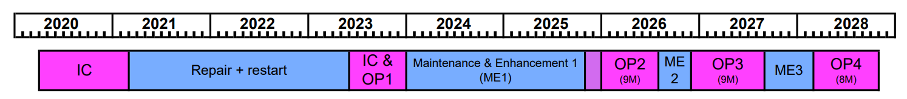
JT-60SA Timeline
Experiment team focuses on the scientific preparation of Initial Research phase I and II
Coordination of IC+OP1 analyses
Commissioning phase also necessary in Research phase I
Risk of delaying relevant scientific output
More detailed assessment have been performed within the ET

Slide 10
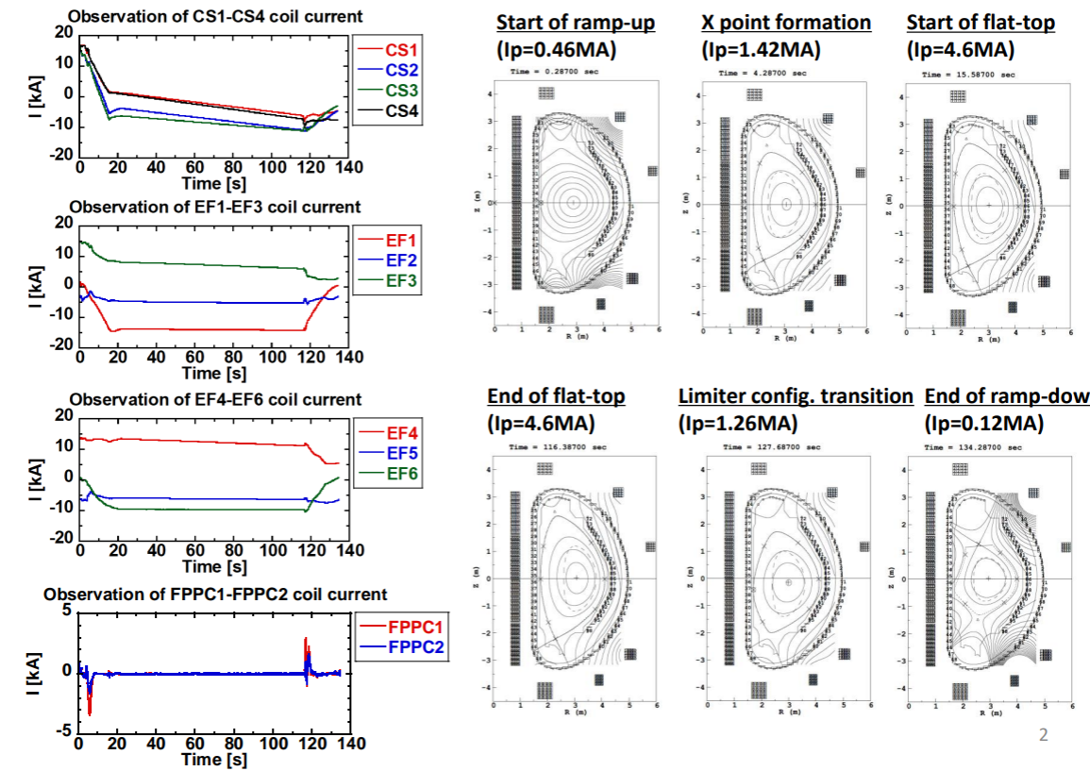
Strategy towards initial phases
Initial simulations performed with the free boundary Japanese code MECS
Further studies to be performed with more sophisticated codes in WPSA and QST
In the future, lower Ip plasmas will be studied
Detailed studies about specific topics to be done in these scenarios

Slide 11
JT-60SA global plan
Research phase | Focus of exploitation | Operation Campaign | Expected operation schedule |  | Annual neutron limit | Divertor | Installed NB power | ECRF | Max. usable aux. power
- | Integrated pre-plasma Commissioning | Op-1 | 2020-2021 (6M) 2023 (6M) First plasma 2023 | H | - (N_{2 ­} in VV interspace) | Open upper inertially cooled carbon | 0 | 1.5 MW (2 Gryo.) | 1.5MW
Initial research phase I | Initial stable and reliable operation H operation for commissioning towards D operation. Stable operation at high current heated plasma
 |  | Op-2 | 2026 (9M) |  |  | Inertially cooled lower pumped carbon | 16MW (with H) 23.5 MW (with D) PNB 8 units, plus NNB) | 1.5 MW (4 gyro) | 19MW
 |  |  |  | D |  |  |  |  | ~26MW x 2-3s (limited by divertor cooling)
Initial research phase II | ITER and DEMO regime access (high power and high Ip with short pulses) Acces to the ITER standard scenario High beta access ITER risk mitigation (ELM, disruption) | Op-3 | 2026-2027 (9M) |  | 3.2e19 (N_{2 ­} in VV interspace)
 |  | Op-4 | 2027-2028 (8M) |  |  |  | 30 MW (PNB 12 units, plus NNB) |  | 33 MW
Integrated research phase I | High beta long pulse Burning plasma relevant ITER standard and hybrid stationary (~2-3tR) High beta steady-state (~2-3tR), DEMO contribution | TBD | TBD |  | 4e20 (water in VV interspace) | Actively cooled lower pumped carbon |  | 7MW (9 gyro.) | 37MW
Integrated research phase II | High beta and metal wall compatibility Radiative divertor with impurity seeding Impurity pumpout from core | TBD | From ~2030 (TBC) |  | 1e21 (water in VV interspace) | Actively cooled lower pumped tungsten
Extended research phase |  | TBD | >5y |  | 1.5e21 (boronated water in VV interspace) | Actively cooled tungsten advanced structure (Upper div. TBC) | 34MW |  | 41MW

Slide 12
Timeline and main scientific topics
Initial research phase I
(Includes commisioning)
Initial research phase II
2023
2026
2027
2028
Commissioning with H plasmas for D plasma operation
  Commissioning NB injectors into plasma, including monitoring of shine-through vs energy (esp. N-NBI)
  Step-by-step increase of plasma current up to 5.5 MA
  Test of plasma control schemes: current, position, density, heating
  Break down and plasma formation studies
ITER risk mitigation
  Studies of L-H transition comparison between H and D and considering the addition of He
  Disruption studies including suppression of disruptions with MGI;
  Runaway Generation and mitigation techniques
Scenario development
  Initial integrated scenarios development towards ITER standard H-mode
Consolidate results from OP2
ITER risk mitigation
Optimise ELM control and disruption mitigation with a focus on risk reduction for ITER
Advanced studies about the destabilization of Alfven modes by N-NBI and impact on fast ions confinement and plasma turbulence
Scenario development
Further development of integrated scenarios including advanced real time control techniques
Initial steps towards radiative integrated scenarios
Initial steps towards high beta scenario development for ITER and DEMO and specific transport and turbulence studies in this regime

Slide 13
Main activities in 2024
Coordinate Integrated Commissioning analyses (call expected in 2024)
  Break-down IC results per TG
Further modification of project plan, notably, in view of ITER research plan changes
Coordinate joint EU-JA modelling that is focused on the initial JT-60SA campaigns (call proposed in 2023 but not issued yet)
Continuous evaluation and monitoring of machine enhancement proposals/installation
Definition of new IC to be performed during OP2
Revision of CQMS regarding Experiment Team
Proposal of machine upgrades to ensure quick scientific relevance
  Increase ECRH power
  Bring forward W-divertor
  Possibility of ICRH antenna
  Speed-up N-NBI use at full energy

Slide 14
Main activities in 2024
Promote coordination and EUROfusion views on real-time control and disruption mitigation/suppression
Promote participation of EUROfusion on JT-60SA operation
Promote the use of IMAS
Ensure that the scientific tools for participation, data analyses, pinboard etc (developed by QST) are ready on time and can be smoothly used by EUROfusion participants
Ensure that EUROfusion scientific priorities are well aligned with the JT-60SA scientific programme
Ensure a minimum level of coordination with WPTE
Ensure that up-to-date JT-60SA information is properly transferred to EUROfusion members and WPSA project leader

Slide 16
Main scientific topics in OP2
Operation Regime Development
Safe increase of toroidal current up to 5.5MA
Test of plasma control schemes: current, position, density, heating
Break down and plasma formation studies in conditions of low loop voltage
Initial integrated scenarios development towards ITER standard H-mode scenario
MHD Stability and Control
Disruption and runaway electrons studies
Creation of disruption databases
Sawtooth activity and modification by ECH
Transport and Confinement
Heat transport in electron heated dominated plasmas in L-mode and/or low β
Characterization of L-mode confinement
Initial characterization of H-mode confinement
Isotope studies by comparison of H and D plasmas
High Energy Particle Behavior
Shine-through studies in H and D, especially with N-NBI
Initial studies of Alfven modes destabilization by N-NBI
Characterization of fast ions loses
Neutron emission studies and reproducibility with codes
Pedestal and Edge Physics
L-H power threshold characterization in H and D
ELMs generation studies in different plasma conditions
Divertor, Scrape Off Layer and Plasma-Material Interaction
SOL width scaling at high Ip
Neutral compression by the V-shaped corner

Slide 17
Main scientific topics in OP3
High Energy Particle Behavior
Studies of Alfven modes destabilization by N-NBI in high beta plasmas and impact on fast ion confinement
Characterization of fast ions loses at high N-NBI power with FILD
Interplay between fast ions and turbulence. Transport reduction by fast ions
Compatibility of RMP with fast ion confinement
Pedestal and Edge Physics
Characterization of the access to type-I ELMs and comparison to plasmas with no/small ELMs
ELMs control with RMP and pacing pellets
Divertor, Scrape Off Layer and Plasma-Material Interaction
Neutral compression by the V-shaped corner, He pumping
Initial seeding studies and impact on the heat flux to divertor
Operation Regime Development
Consolidate the access to ITER standard H-mode scenario towards integrated scenario demonstration
Initial development of the access to high beta integrated scenarios
Integration of advanced real time control techniques , e.g. q-profile and pressure profile in transient phase, beta or ELMs control, in scenario development
MHD Stability and Control
Neoclassical tearing modes destabilization with ECH/ECCD and NBI
Neoclassical tearing modes control with ECCD
Resistive wall mode studies
Transport and Confinement
Heat transport in electron heated dominated plasmas in H-mode
Heat, particle and impurity transport in high β plasmas
Characterization of H-mode confinement in type-I ELMs plasmas
H/D ratio control by gas-puff and pellet

