Slide 1
TSVV11: Validated Frameworks for the Reliable Prediction of Plasma Performance and Operational Limits in Tokamaks Update, Thrust 5
C. Bourdelle
07/06/2023

Slide 2
Integrated modelling landscape, preparing tokamak operation
Model integration, longer plasma time frames
Requires faster yes accurate physics models
Physics understanding |  | Prepare (ITER) operation |  | Design future devices (DEMO)
1st principle codes | High Fidelity Pulse Simulators |  | Flight Simulators |  | System codes
Validation against measurements
Real-time capacity
The focus of the TSVV11 activity is on the physics understanding side of the coin.
7 ppy + 3 ppy in ACH

Slide 3
Integrated modelling landscape, preparing tokamak operation
Model integration, longer plasma time frames
Requires faster yes accurate physics models
Physics understanding |  | Prepare (ITER) operation |  | Design future devices (DEMO)
1st principle codes | High Fidelity Pulse Simulators |  | Flight Simulators |  | System codes
Validation against measurements
Real-time capacity
The focus of the TSVV11 activity is on the physics understanding side of the coin.
7+2 ppy 3 ppy ACH

Slide 4
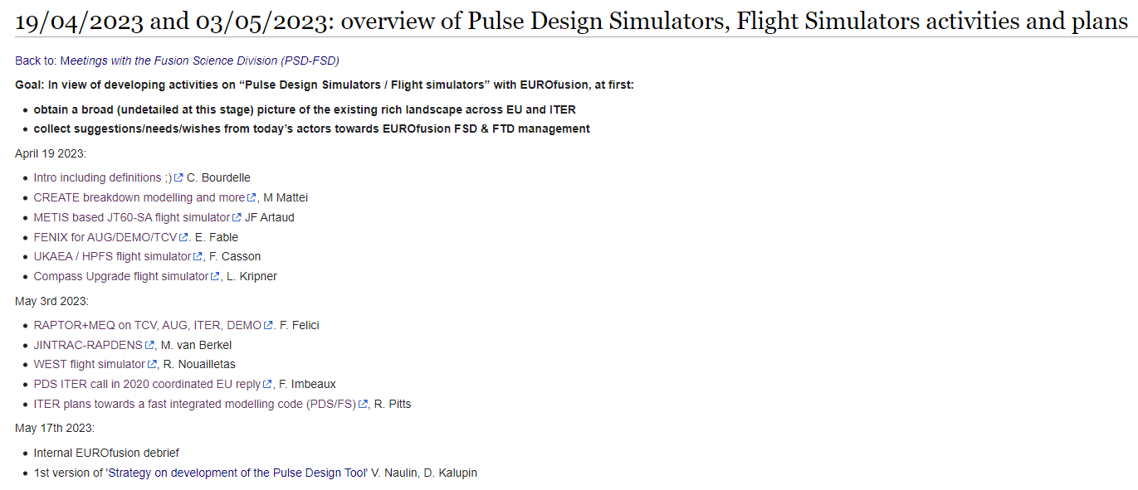
TSVV11 extended to Pulse Design Tool
https://wiki.euro-fusion.org/wiki/19/04/2023_and_03/05/2023:_overview_of_Pulse_Design_Simulators,_Flight_Simulators_activities_and_plans
General EF Assembly, April 6-7: 2ppy per year (starting 2023) on « Pulse Design Simulator & control developments for ITER & DEMO »
Strategy on development of the Pulse Design Tool (PDT) by V Naulin, D Kalupin to be discussed within ETASC SB. 2ppy in 2023
New lead for the IO PDS development. Mireille Schneider, previously within the Plasma Modelling and Analysis Section in the IO Science Division, will move to Experiments and Plasma Operations Section from June 1 2023 as Coordinating Scientist for Pulse Design.

Slide 5
TSVV11 : « Validated frameworks for the Reliable Prediction of Plasma Performance and Operational Limits in Tokamaks »
All the physics that we master now has to be available from ITER control room
Guiding principles:
Align with ITER technical choices in terms of integrated modelling workflow and database management
Improve and validate advanced physics modules focusing on high priority modelling extensions that will be needed for multi-physics full predictive modelling, with the help of other TSVV activities and in coherence with WPTE priorities
Demonstrate validation of full pulse predictive modelling from breakdown to termination, including a realistic assessment of operational limits extension to Flight Simulators
Support extended validation against EU operating tokamaks by providing to users outside this TSVV yearly training on the integrated modelling workflow, a detailed and clear documentation on the workflow and the embedded physics modules, a user friendly interface and automated validation tools

Slide 6
TSVV11 7 ppy 2023, update
name | 2023 pm | 2023 changes
Yann Camenen (01-CNRS) | 64.8
Clarisse Bourdelle (CEA) | 6
Jean Francois Artaud (CEA) | 4,8
Patrick Maget (CEA) | 4,8 6
Pierre Manas (CEA) | 6
Jorge Morales (CEA) | 6
Francis Casson (UKAEA) | 6
Žiga Štancar (UKAEA) |  | 6
Emmi Thorus (UKAEA) |  | 6
Florian Köchl Nathan Cummings (UKAEA) | 6
Jonathan Citrin (DIFFER) | 6 | 2.8
PhD (Alex Pañera from 11/23) (DIFFER) | 10.8 | 2
Aaron Ho (DIFFER) | 6
Michele Marin (SPC) | 6
Clemente Angioni (MPG) | 4,8
Emiliano Fable (MPG) | 4,8
Giovanni Tardini (MPG) | 6
Karel van de Plassche (DIFFER) | 4,8
Pulse Design Tool |  | +2 ppy
total | 7ppy | 9 ppy
2024 and 2025 will continue with
7 ppy TSVV11 + 2ppy “Pulse Design Tool”

Slide 7
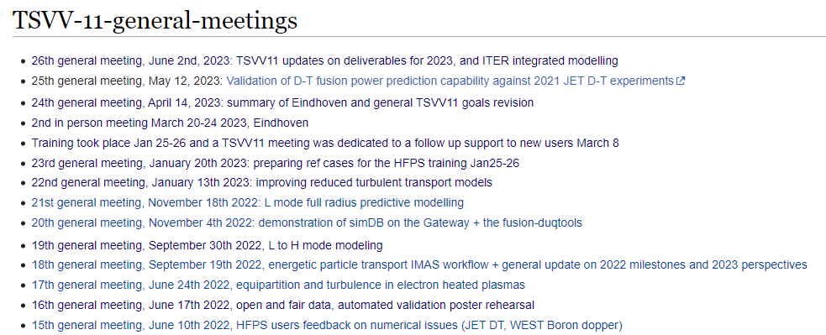
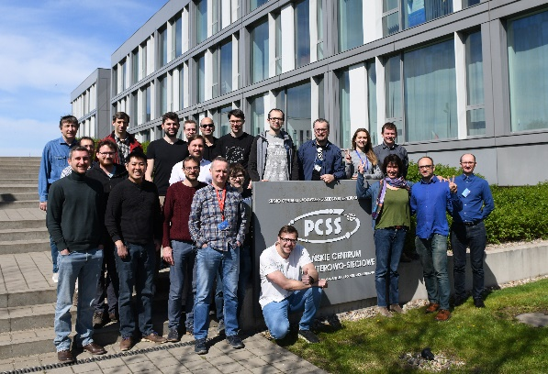
TSVV11 team building!
Regular meetings open to TSVV11 members and “friends”
https://wiki.euro-fusion.org/wiki/TSVV-11
1st in person meeting April 2022 Poznan

Slide 8
2nd in person meeting March 20-24, Eindhoven, DIFFER Joined with NL eScience center synergistic project on tools for large scale validation
This flexible format allowed having 37 persons meeting on-site from
TSVV11 (EUROfusion financed)
And more participants financed thanks to the NL eScience center grant from:
new HFPS users
NL eScience center
Ignition Computing company
Advanced Computing Hub of Poland
Advanced Computing Hub of Finland
ITER Organization
This 2 year project with the NL eScience center is managed by J. Citrin, A. Ho at DIFFER and S. Smeets, V. Aziz at the NL eScience center.
Within Feb 2024, another meeting taking advantage of this synergy will be organized, maybe hosted at ITER (tbc).
Thanks to Jonathan Citrin!

Slide 9
outline
WP1: HFPS Workflow orchestration and module coupling framework (coordinator: F.J. Casson, 2.5 ppy incl. 1.5 ACH)
WP2: HFPS key physics modules validation (3.5 ppy incl. 1 from ACH)
WP3-HFPS full pulse modelling capability demonstration (coordinator: E. Fable, 2 ppy)
WP4-HFPS systematic validation (coordinator: A. Ho, 1ppy incl. 0.5 from ACH)
WP5- HFPS initial ITER phase modelling (coordinator: J. Citrin, total effort 0.5 ppy)

Slide 10
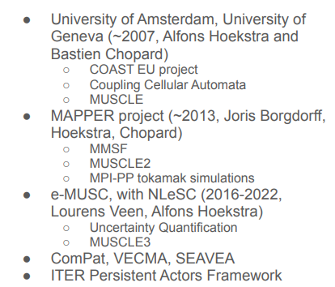
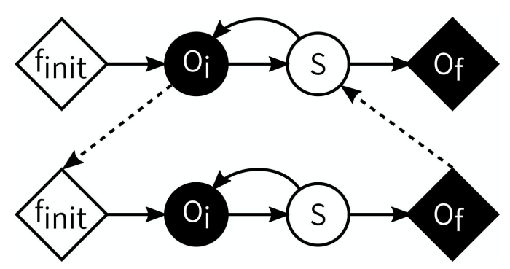
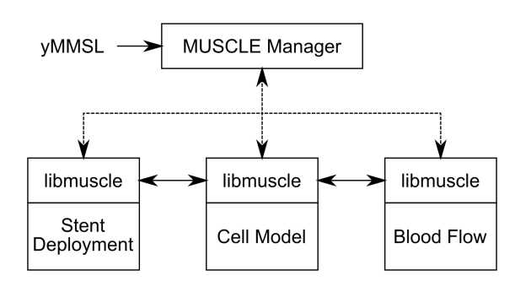
WP1: HFPS Workflow orchestration and module coupling framework, F. Casson Persistent Actor Framework
Context: Persistent Actor Framework contract (1.5 year started ~Feb 2022- end inAugust 2023) between ITER and DIFFER, NL eScience center, Ignition Computing, PSNC (coord. J. Citrin, Daan Van Vugt).
MUSCLE3: a Multiscale Modelling and Simulation Framework dealing with separate persistent processes. It has a long devt history, not fusion specific. IMAS updated for sending IDSs with MUSCLE3
Example:
Lourens Veen (NL eScience center)
Simple config file
Library (not a framework)
Compatible with: Fortran, Python, Matlab/Simulink, C++

Slide 11
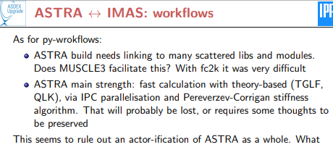
WP1: HFPS Workflow orchestration and module coupling framework, F. Casson status of the HFPS and synergies with ETS/ASTRA and ITER
HFPS: F. Casson
ETS: D. Coster
The HFPS is a collection of IMAS actors used together in a python workflow
Already combines ETS components (HCD) and all JINTRAC components
Planned: DINA coupling, reduced SOL models, reduced pedestal models, surrogate transport models, new TSVV models, FBE
Coupling framework prototypical but functional: we hope it will grow further
Status
All actors take physics input / output from IDS via argument
Actors wrapped via FC2K -> Plan to migrate to MUSCLE3 (Skip IWrap for JINTRAC actors)
Each actor handles code specific params in it’s own way
JAMS GUI collects all input files in one folder, launches workflow.
Non JINTRAC actors provide their own GUI (JAMS can launch) to configure parameters
MDS+ and HDF5 backends supported, but trouble with HDF5 inputs (getslice interp?)
Some performance (AL) and memory (FC2K) issues compared to non-IMAS JINTRAC usage
How it could evolve
Agree standards for IMAS python workflows, converge on common methodology / tools
Evolve the generic python driver loop to match these standards and to be truly generic
Add new actors as they are adapted to python
A common GUI
Couple to a control framework
Most JINTRAC components containerized, deployed to cloud resources
ASTRA:
G. Tardini
Starting now, great opportunity to share strategies
IMAS input/output : all on the same page
Code modularity level : Iwrap or not Iwrap
Persistent actor workflow choice: Muscle3 or not
GUI: autoGUI based workflow or not
Proposing: 2 meetings/year HFPS/ASTRA/ETS (and ITER)
ITER: M. Schneider
Muscle3 for flexibility with Iwrap for modularity
Tested on IDA, tested IMAS-PCSSP proto (fueling, DINA), in HCD

Slide 12
WP1 deliverables for 2023
WP1 Planned milestones for 2023 | status
Milestone 1.2 M3 Adapted existing HFPS components (for SOL, MHD, pedestal and breakdown/burn-through) to follow new Python workflow specifications- Dec 2023 | Planned for 2023 HFPS workflow to Muscle3 with support of PAF contract and ACH in Poznan. Need to interact with ITER on flexibility vs modularity and make sure HFPS muscle3 EF/ITER is aligned.
Milestone 1.3.M1 Adapted existing HFPS components to workflow settings management specifications Dec 2023
Milestone 1.4.M4 All existing HFPS components configurable from common GUI and integrated with common simulation cataloging system Dec 2023 | Cataloguing OK, post-pone to Dec 2024
 | Demonstrate JINTRAC with IMAS input in HDF5 format from at least two EF tokamaks Demonstrate containerised JINTRAC-IMAS running in the cloud Demonstrate multi-container workflow with JINTRAC + HCD
With WP2 | MISHKA and CASTOR: output in IDS (Florian, test: Patrick) Δ' calculation (Florian, test on Ip ramp Patrick) Er boundary condition free to be user chosen (Florian, test: Clarisse) FACIT coupling and test (Francis, tests Patrick, Pierre) QLKNN-edge in TCI/HFPS (Jonathan, tests: Clarisse, Pierre) HFPS-HCD with LHCD/ICRH demonstration (Nathan, tests: Théo, Patrick) HPI2 in HFPS on GW (Florian, test: Clarisse) Verify TGLF impurity transport decomposition in SANCO against ASTRA and fix if needed.

Slide 13
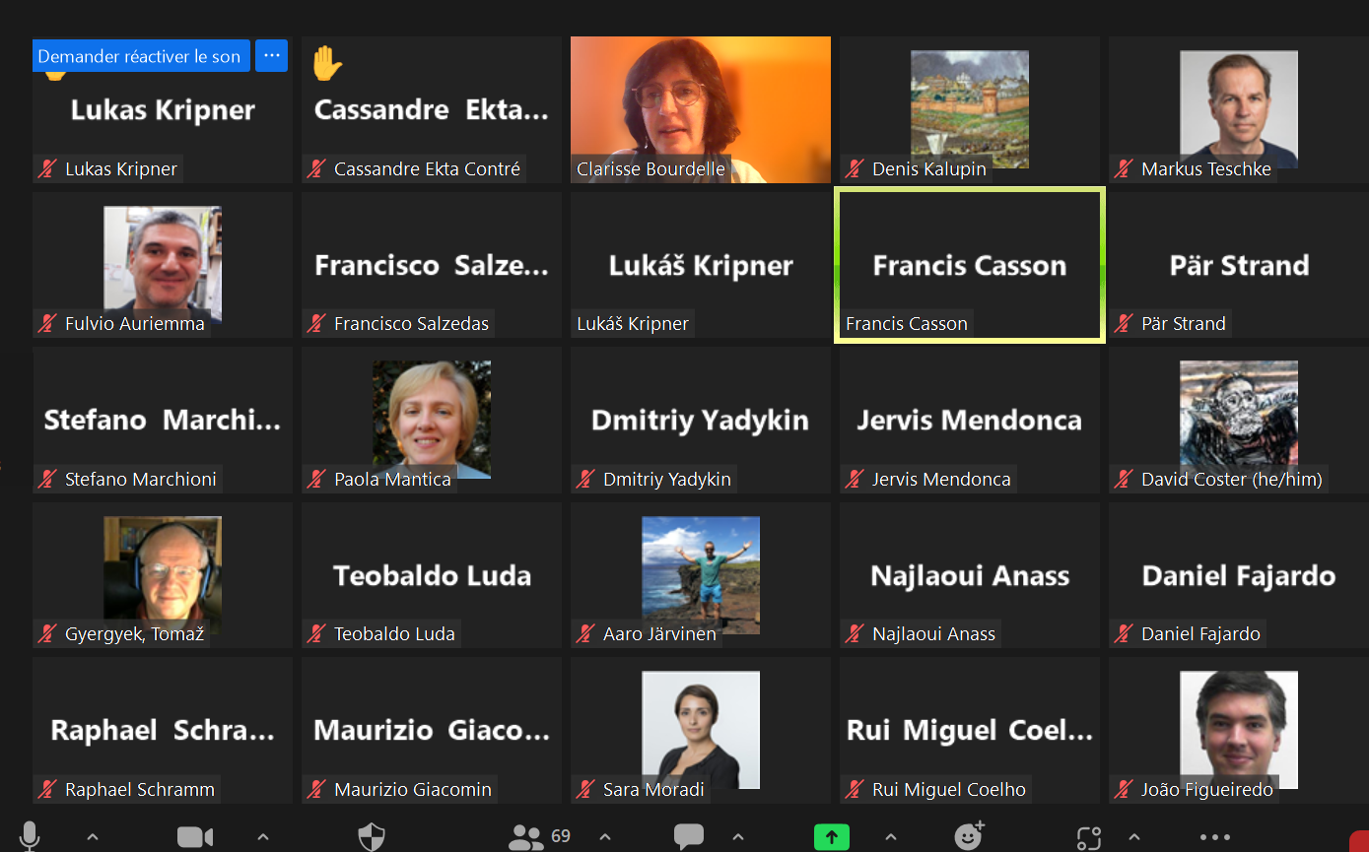
1st HFPS training open to all EUROfusion
Wed. Jan. 25th 10.30-12.30 CET | General introduction and overview (open to all, no registration needed): · Recent achievements of integrated modelling · What is the High Fidelity Pulse Simulator?
Wed. Jan. 25th 14.30-17.30 CET | 2.30 CET: all, Intro/demo interpretative case: F. Casson Breakout rooms as needed (ref. supervisor see table below) 5 pm CET: all, update on progresses/issues
Thur. Jan. 26th 9.30-12.30 CET | 9.30 CET: all, intro/demo predictive case with QLKNN Breakout rooms as needed (ref. supervisor see table below) 12.00 CET: all, update on progresses/issues
Registered participants 13 persons
JET, AUG and TCV
Using zoom and breakout rooms.
In the mean time every 3 months we will have TSVV11 meetings dedicated to debugging/analysis support to older and newer HFPS users.
Will be repeated yearly

Slide 14
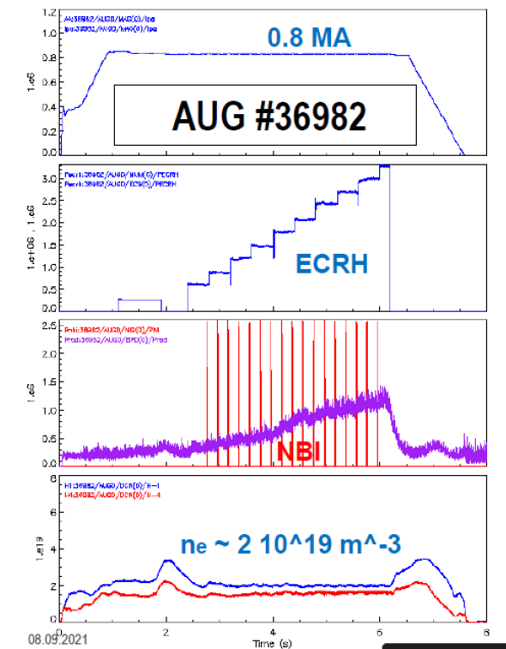
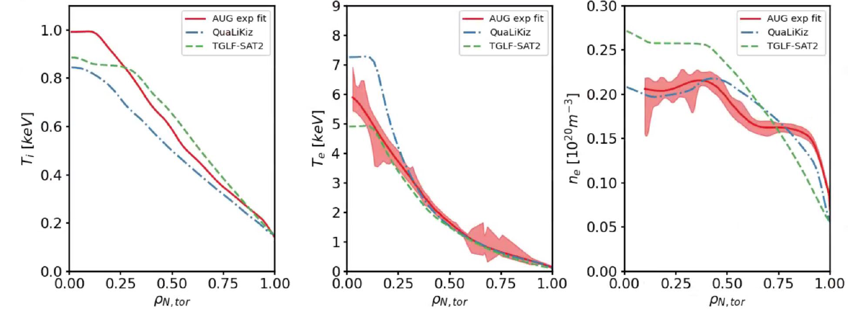
IMAS AUG data modelled by the HFPSL mode up to the LCFS
L mode on AUG, 1.2 MW of ECRH
HFPS-QuaLiKiz or TGLFsat2-FRANTIC (neutrals at 5eV)
Predictive modeling up to separatrix, heat and particle
[Citrin ITPA Oct. 2022]

Slide 15
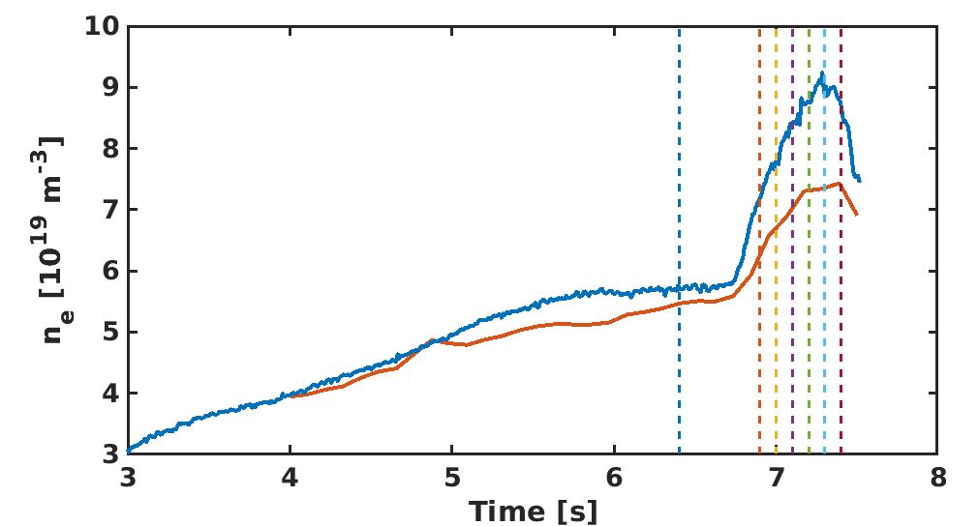
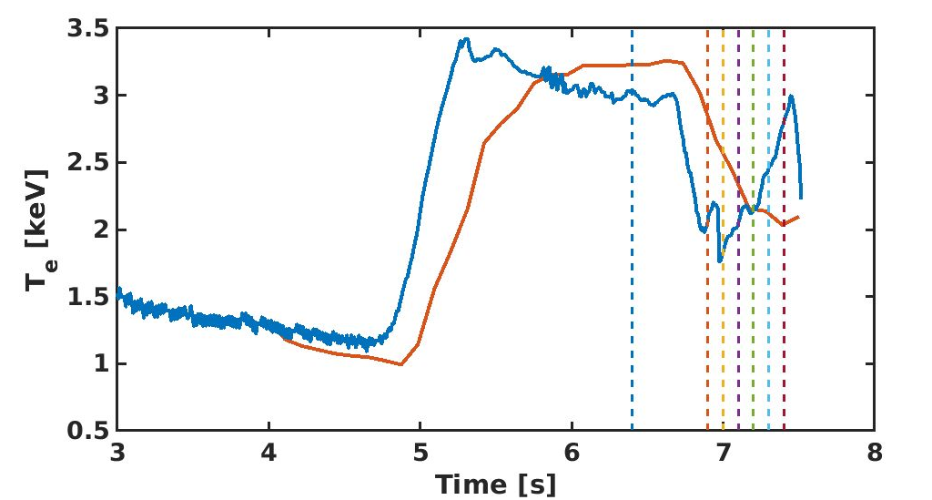
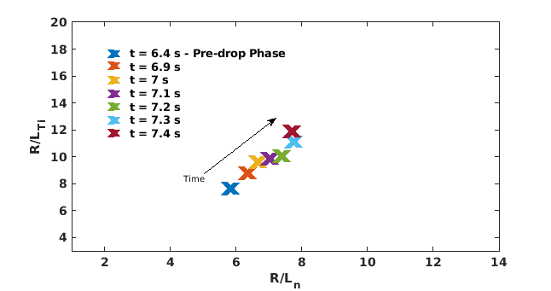
IMAS WEST data modelled by the HFPS Boron dropper enhancing L mode confinement
HFPS-QuaLiKiz
Predictive modeling up to ρ=0.9, heat and particle over 3.5 s of plasma evolution
Largest Boron powder injection in WEST LHCD heated L mode,
leads to increased energy content [Bodner NF2022]
Key role of enhanced Z_{eff} and collisionality on turbulence stabilization
#56920
Expt
HFPS-QuaLiKiz
Expt
HFPS-QuaLiKiz
$$ρ=0.5$$
$$ρ=0.5$$
$$ρ=0.5$$
[G. Bodner, P. Manas et al]

Slide 16
outline
WP1: HFPS Workflow orchestration and module coupling framework (coordinator: F.J. Casson, 2.5 ppy incl. 1.5 ACH)
WP2: HFPS key physics modules validation (3.5 ppy incl. 1 from ACH)
WP3-HFPS full pulse modelling capability demonstration (coordinator: E. Fable, 2 ppy)
WP4-HFPS systematic validation (coordinator: A. Ho, 1ppy incl. 0.5 from ACH)
WP5- HFPS initial ITER phase modelling (coordinator: J. Citrin, total effort 0.5 ppy)

Slide 17
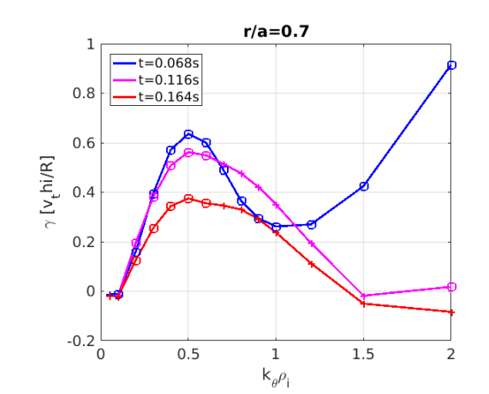
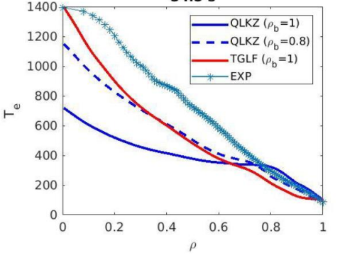
WP2-D1: Turbulent transport reduced models targeted validation, Y. Camenen Ip ramp up
M. Marin’s HFPS on TCV, using QuaLiKiz, good agreement
But still some tests (energy of neutrals, etc) before using dUQtools
Ramp up, TCV, GKW modelling Y. Camenen
TEM stabilized as rIp ramps up confirming previous E. Fable’s work
P. Manas,
HFPS on WEST
Not as good, need to understand why
Milestones planned 2023 | status
Milestone 2.1.M1: Validated L mode edge capability for TGLF and QLKNN in Ip ramp up extended QLKNN for edge. T1 2023 Milestone 2.1.M2 in Ip ramp down Dec 2023 | OK for ramp up : EPS, TTF and M. Marin publication QLKNN edge (L. Chôné, J. Citrin et al) now available for testing in HFPS Ramp down postponed to 2024

Slide 18
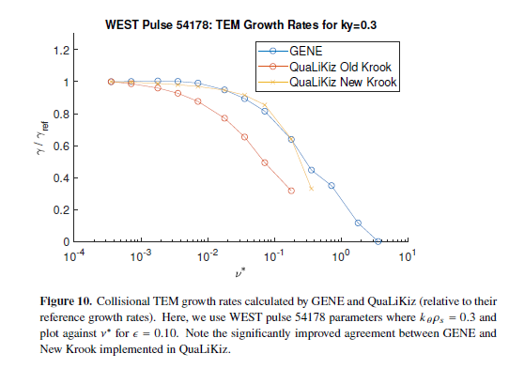
WP2-D1: Turbulent transport reduced models targeted validation, Y. Camenen QuaLiKiz, QLKNN for edge etc
Status of NN turbulent transport models available in HFPS
QuaLiKiz with collisionality operator improved [Stephens PhD and paper to be sub. soon]
QLKNN-10D 300 millions datapoints hypercube trained on previous collisionality operator [VandePlassche PoP2020]. Recommendation is to apply 0.25 to collisionality when using it… [Ho NF2022 Ip ramp in JET as ref].
Database 11D 2.8 billion QuaLiKiz new collisionality operator points exists, but no NN training… open source it to zenodo, find someone to do NN (on-going)
QLKNN-15D 21 million datapoints, JET specific [Ho PoP2021]
QLKNN-edge by L. Chôné soon available in TCI-HFPS, very valuable for Ip ramps, L mode etc. (TSVV11 meeting Jan 13, 23) last checks + strategy QLK-QLKNN-edge switches J. Citrin
Plans: project FASTER to train NN on higher fidelity GK codes . (see TSVV11 meeting Jan 13, 2023)
QuaLiKiz itself in L mode does not capture the Ip scaling unlike TGLF [C. Angioni], issue in the q scaling of the TEM mode width identified [C. Stephens]. Work discussion May 4th. To impact strategy for NN regression. Hypercubes are heavy to make, unsmart, but great production tools… cf QLKNN-10D.

Slide 19
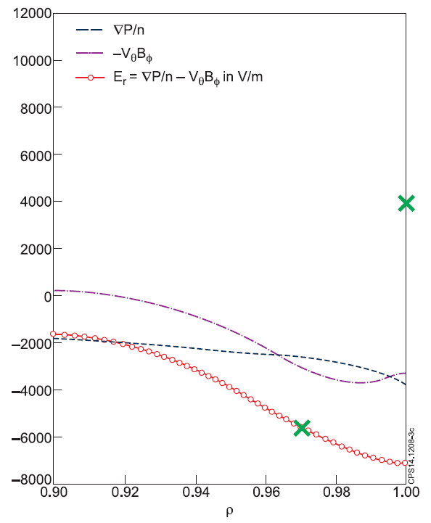
WP2-D2: Core-edge-SOL coupling targeted validation, C. Bourdelle
Er boundary condition to be chosen freely as also the width over which Er from force balance to SOL BC
See Bonanomi’s ASTRA talk TSVV11 meeting Sept 30 2022
ASTRA routine shared by Clemente to Florian, will be soon available in HFPS
Longer term, synergy with ENR project A. Järvinen, S. Wiesen, A. Kit, et al
[Bourdelle NF2015]
Milestones planned 2023 | status
Milestone 2.2.M1 validated reduced SOL model in the HFPS. Milestone 2.2.M4 validated reduced pedestal models in the HFPS | ENR synergy so milestones rather for 2024 IMEP in ASTRA for now not in HFPS, maybe 2024 EUROPED NN to be implemented? Tested? Need physics driven topic, synergy MHD stab For 2023: tests of Er separatrix to fixed value on WEST/JET L modes ITER-DEMO sep scaling avail. HFPS tests on WEST L mode. Some EDGE2D coupling validation should be done (see ETS warning by D. Coster) but lack of experts in TSVV11

Slide 20
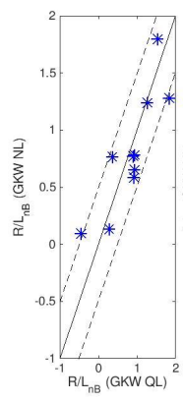
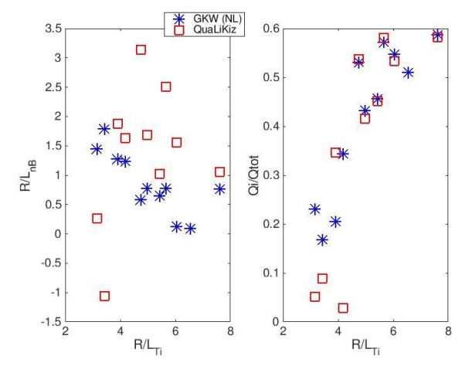
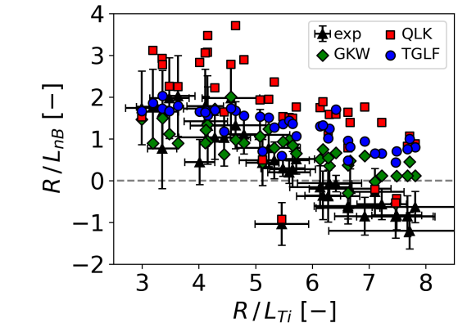
WP2-D3: Impurity transport, development of reduced models, verification and targeted validation. C. Angioni
Reduced model validation for turbulent transport of impurities
D. Fajardo,
ρ=<0.4-0.6>
Boron, AUG database,
QuaLiKiz Boron peaking at ρ=0.5 more scattered than GKW-NL,
GKW QL~GKW NL
P. Manas
TTF+publi
QL
Impurity transport in ASTRA for AUG [D. Fajardo et al, @TTF]
FYI S. Gabriellini JINTRAC Ne seeding JET (Sept21 talk) sub to NF
Milestones planned (2022) 2024 | status
Milestone 2.3.M2: Validated impurity collisional and turbulent transport capability for the new neoclassical code and the QLK-NN incl. impurities in Ip ramp conditions. - Dec 2022 Milestone 2.3.M3: Validated impurity collisional and turbulent transport capability for the new neoclassical code and the QLK-NN incl. impurities in presence of poloidal asymmetries. - Dec 2024 | FACIT coupling available soon, for tests in Ip ramp up and other cases, Francis. On-going verification QuaLiKiz, TGLF vs GKW for impurity turbulent transport. Would need QLKNN-11D to extend to NN. AUG NBI+ECRH cases, WEST ICRH cases, ramp ups…

Slide 21
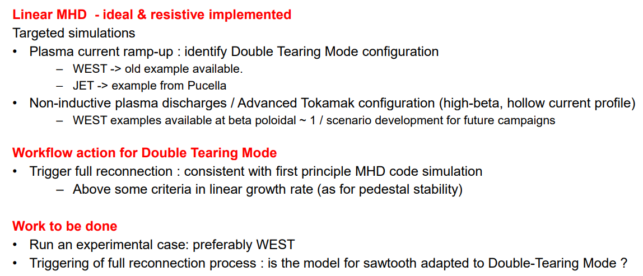
WP2-D4: MHD modules targeted validation, P. Maget
Milestones planned (2022) 2024 | status
Milestone 2.4.M1: validated ideal MHD limit calculation in the HFPS- Dec 2021 Milestone 2.4.M3: validated Double-Tearing Mode model available in the HFPS- Dec 2023 Milestone 2.4.M4: validated impurity transport model in presence of magnetic island available in the HFPS-Dec 2024 | Ideal MHD stand alone done Within TSVV11 not yet MHD limit tests using HFPS -Planned for Ip ramp up modelling (TCV-WEST), in particular Double tearing modes (Delta prime routine in HFPS, Florian’s support) -computing linear MHD from MISHKA/CASTOR in IDS

Slide 22
WP2-D5: Plasma initiation (Breakdown and burn-through and MHD equilibrium) integration and validation. J-F Artaud
Milestones planned 2022-2023 | status
Milestone 2.5.M1: IMAS database of plasma initiation phases having data from more 5 plasma descriptions from at least 2 tokamaks- Dec 2022 Milestone 2.5.M2: Validated coupling between the breakdown and burn-through models and the self-consistent equilibrium and plasma evolution - Dec 2023 | WEST database OK, adding MAST using DYON IMAS coupling (on-going under WPPrIO), soon OK WPPriO meeting May 24. interfaces WPSA, WPTE… Coupling FBE after breakdown, loose coupling might be enough, w/o FBE, will be tried with METIS on WEST, post poned to Dec 2024

Slide 23
WP2 HFPS key physics modules validation 2023 deliverables, additional revisions?
might appear in the Pulse Design part?
Other topics discussed at Eindhoven | Potential changes within TSVVV11 for 2023-2025
Pellets: HPI2 available from HFPS on gateway, on-going a workaround possible with Florian’s help for now | V. Konrad at JET, T. Luda at AUG, Alex Panera on WEST/AUG, key for ITER/DEMO incl. for flight simulator, controller training. On-going HPI2 refactoring

Slide 24
outline
WP1: HFPS Workflow orchestration and module coupling framework (coordinator: F.J. Casson, 2.5 ppy incl. 1.5 ACH)
WP2: HFPS key physics modules validation (3.5 ppy incl. 1 from ACH)
WP3-HFPS full pulse modelling capability demonstration (coordinator: E. Fable, 2 ppy)
WP4-HFPS systematic validation (coordinator: A. Ho, 1ppy incl. 0.5 from ACH)
WP5- HFPS initial ITER phase modelling (coordinator: J. Citrin, total effort 0.5 ppy)

Slide 25
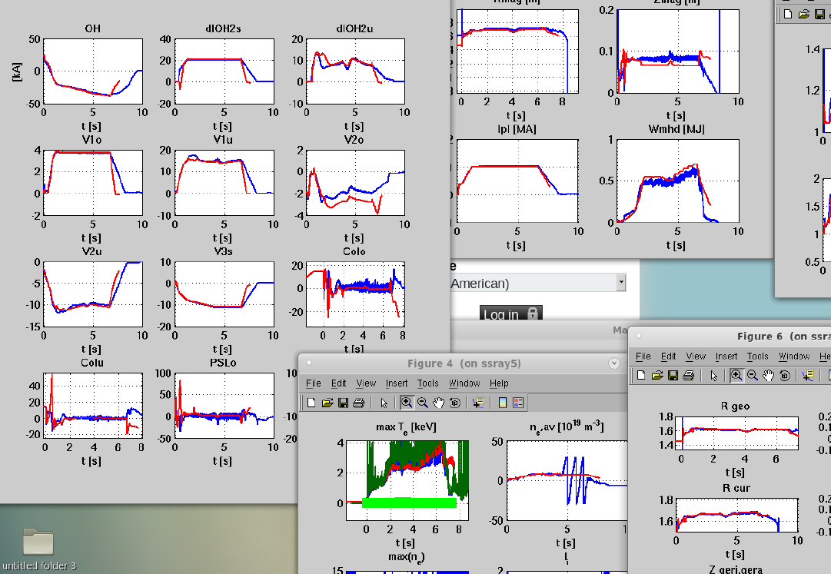
WP3-HFPS full pulse modelling capability demonstration, E. Fable
FENIX
Expt
Reminder, last year in Poznan, current diffusion only was compared btw FENIX and HFPS on AUG case
AUG H-mode discharge #40446, 0.8 MA, and has both NBI and ECRF heating applied (ICRF is also present in the later part of the pulse, but it is ignored for the modeling).
Here, natural extension towards “Pulse Design Tools”, test of control schemes, optimization etc
Milestones planned 2023 | status
Milestone 3.1.M2: demonstrated full pulse capability for current, heat and main ion particle predictive mode including a SOL model - Dec 2023 Milestone 3.1.M3: demonstrate the automated validation of 0D and 1D quantities of a full pulse simulated by the HFPS- Dec 2022 | OK, strategy: Ohmic pulse of AUG used with Fenix full pulse modelling will be modelled with the HFPS including current, heat and particle (TGLF and QLK). E. Fable and G. Tardini For the automated validation should be a goal for 2024, once steady state large scale validation has taken place

Slide 26
outline
WP1: HFPS Workflow orchestration and module coupling framework (coordinator: F.J. Casson, 2.5 ppy incl. 1.5 ACH)
WP2: HFPS key physics modules validation (3.5 ppy incl. 1 from ACH)
WP3-HFPS full pulse modelling capability demonstration (coordinator: E. Fable, 2 ppy)
WP4-HFPS systematic validation (coordinator: A. Ho, 1ppy incl. 0.5 from ACH)
WP5- HFPS initial ITER phase modelling (coordinator: J. Citrin, total effort 0.5 ppy)

Slide 27
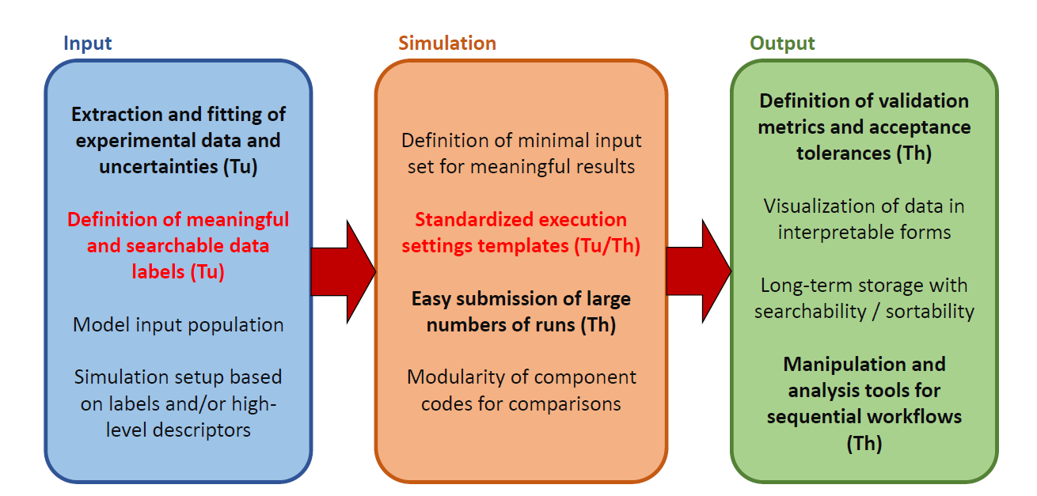
WP4-HFPS systematic validation, A. Ho: framework
Input:
JET database IMAS format
5500 time average datasets
Aaron Ho,
WEST could easily provide 3800 time average points
dUQ tools see next slide
ACH VTT Emil Amnell, Aaro Järvinen
1st project defined on Bayesian optimization of LHCD

Slide 28
WP4-HFPS systematic validation, A. Ho: large scale simulation launching
Stef Smeets, Victor Azizi
NL eScience center

Slide 29
WP4-HFPS systematic validation, A. Ho: large scale simulation launching
After discussions/training in Eindhoven, quite a few project related to duqtools emerged:

Slide 30
WP4-HFPS systematic validation: 1st project on Bayesian Optimisation
Reminder:
Milestone 4.4.M1 implemented additional validation metrics via Bayesian inferential techniques Dec 2024
Project starting: WEST L mode LHCD heated modelled database (Théo Fonghetti, PhD CEA)
With ACH-VTT
Emil Amnell and Aaro Järvinen
Gaussian process regression, with Bayesian optimisation to optimize the required number of simulations needed to find the LHCD power on-axis needed to match the measured temperature.
Project ‘kicked off’
Poster planned at TTF by Théo
Publication ~end of year
METIS-QLKNN10D

Slide 31
WP4-HFPS systematic validation, A. Ho: 2023 milestones revision
Milestones foreseen for 2023 | Suggested modifications
Milestone 4.2.M1: demonstrated 0D data consistency, e.g. Wth<WMHD, li, neutron flux, Prad-div, Prad_bulk, <Zeff>, <n> on more than 10 plasmas Dec 2022 Milestone 4.2.M2 demonstrated 1D data consistency, e.g. core profiles Te, Ne, Ti, Vtor, Zeff, Er on more than 10 plasmas from more than 2 tokamaks Dec 2022 Milestone 4.2.M3 demonstrated 2D line-of-sight synthetic diagnostics (e.g. SXR, bolometer, UV, Langmuir Probes, IR) on more than 10 plasmas from more than 2 tokamaks Dec 2023 | By Dec 2022 we demonstrated on a reduced dataset a 0D check on AUG, JET, TCV and WEST Dec 2023: more than 1000 steady state plasma phases on 2 tokamaks demonstrated data consistency checks for current diffusion, heat and particle transport predictions on 0D and 1D data Dec 2024: addition of other tokamaks and of synthetic diagnostics for bolometry, SXR
Higher level deliverable towards EU commission through WPPrIO: “Report on the procedure for an automated and systematic validation of predictive integrated modelling including uncertainty quantification ( TSVV11 responsibility)”, Sept 2023 | OK, based on EPS TTF A. Ho contributions

Slide 32
outline
WP1: HFPS Workflow orchestration and module coupling framework (coordinator: F.J. Casson, 2.5 ppy incl. 1.5 ACH)
WP2: HFPS key physics modules validation (3.5 ppy incl. 1 from ACH)
WP3-HFPS full pulse modelling capability demonstration (coordinator: E. Fable, 2 ppy)
WP4-HFPS systematic validation (coordinator: A. Ho, 1ppy incl. 0.5 from ACH)
WP5- HFPS initial ITER phase modelling (coordinator: J. Citrin, total effort 0.5 ppy)

Slide 33
WP5: HFPS initial ITER phase modelling, J. Citrin
Milestones foreseen for 2023 | status
Milestone 5.2.M1: modelled Ip ramp-up (Dec 2022) and ramp down L-mode plasmas. Estimate the requirements on ECRH for controlling W in ramp-up, avoiding operational constraints, and avoiding (2,1) mode onset, for various W boundary condition assumptions (Dec 2023) | ECRH in L mode modelling of AUG plasmas [C. Angioni with ASTRA and J. Citrin with HFPS] Extrapolation towards ITER L mode C. Angioni
Milestones foreseen for 2024 2025 | Proposed revision
Milestone 5.2.M2: modelled full pulse H and He PFPO-1 simulations, up to the LCFS, focusing on operational limits, H-mode accessibility, ramp up and ramp down phases with respect to the timing of LH and HL transitions, transport characteristics in the low <ne> ECH heated H-mode itself. Analyze scenario for predicted pedestal heights, as well as reduced pedestals assuming degradation due to ELM control (Jul 2024) Milestone 5.2.M3 modelled full pulse H and He PFPO-1 as above including both reduced SOL model as well as more advanced EDGE2D-EIRENE model including heat and particle exhaust related operational limits Dec 2024 | ITER Research Plan being revised Florian now at ITER, Jonathan not in TSVV11 anymore In 2023/2024: Possible work in synergy with DEMO Central Team (C. Bourdelle, Transport RO) with ITER as a logical 1st step before DEMO ;) ‘towards reduced transport models for burning plasmas’ ‘in burning plasmas, explore the non-linear interplay between fast ion stabilized turbulence and fast ion enhanced diffusion due to fast ion triggered modes’ with Ph. Lauber TSVV10

Slide 34
Publication and conferences foreseen in 2023
Coming conferences:
EPS in Bordeaux:
Aaron Ho’s poster on large scale validation, JET data
Y. Camenen TCV GKW ramp up modelling
TTF in Nancy:
overview talk by myself on "Understanding of near-edge physics in L-mode, H-mode and ELM-free regimes” in the context of TTF such talks are more there to share existing works, likely shown in the session following the talk and trigger discussions
M. Marin: TCV ramp up modelling using HFPS and incl. WEST
Y. Camenen TCV GKW ramp up modelling
D. Fajardo AUG integrated modelling with impurities + QLK-TGLF-GKW validation
Aaron Ho on large scale validation likely extended to JET+WEST
G. Tardini: ASTRA modularity and IMASification for integrated modelling workflows
Shengyu Shi HFPS used on WEST long pulses
J-F Artaud on METIS+QLKNN on Ti saturation modelling in electron heated WEST plasmas
P. Manas on Boron transport in AUG
Théo Fonghetti on WEST LHCD heated pulses using Bayesian optimisation of HFPS runs needed
…
IAEA: Bayesian Optimization overview, Aaro Järvinen

Slide 35
Publication and conferences foreseen in 2023
Journal publications foreseen to be submitted within end of 2023, using HFPS on Gateway and incl. uncertainty quantification, optimization (duqtools)
A. Ho et al JET based large scale uncertainty exploration for HFPS validation
M. Marin et al TCV ramp up modelling incl. GKW vs reduced models and WEST ramp up sensitivity
T. Fonghetti et al WEST central LHCD deposition optimization thanks to BO on large database
TSVV11 related publications:
D. Fajardo et al AUG integrated modelling L and H mode with impurities
P. Manas et al Ion temperature saturation in electron heated WEST plasmas using METIS-QLKNN

