Slide 1

TSVV-14: Multi-Fidelity Systems Code for DEMO
J. Morris, M. Coleman, J. Cook, O. Funk, I. Maione, T. Pomella-Lobo, H. Saunders, O. Wong
Thrust 5 meeting – 7th June 2023
Contract for the Operation of the JET Facilities Co-Funded by Euratom
This work was funded by the RCUK Energy Programme [Grant number EP/W006839/1]

Slide 2
Outline
Work 2022-2023
TSVV-14 - reactor design framework requirements
Carrying out a series of 0-D to 3-D design and analysis tasks in a self-consistent manner
Optimising a reactor design point and various sub-systems
Performing a range of whole-plant performance analyses and sub-system analyses, to varying degrees of fidelity
Creating 3-D CAD models and preparing inputs for neutronics, finite element, and other 3-D analyses
UKAEA + KIT – 2.4 PPY + 0.6 ACH
Features
Minor updates
Complementary work
Developers/users
Outlook
Summary

Slide 3
Features
Parameterised CAD
Reactor workflow
Coupling transport solver to FBE
Balance of plant
3-D CAD updates
Systems code coupling

Slide 4

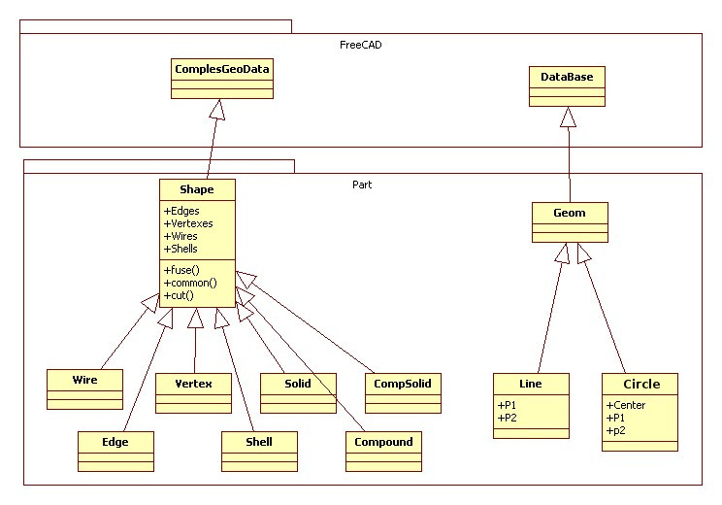
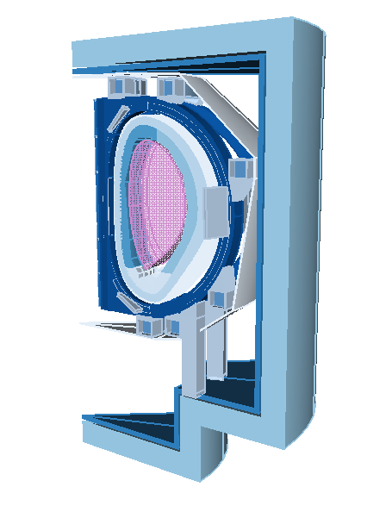
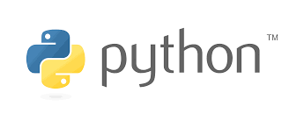
Features
Parameterised CAD
The geometry module of bluemira is based on FreeCAD, an open-source parametric 3D modeler that mostly satisfies all the requirements identified for the creation of a FPP CAD. – Allows for move to parametric FEA.
FreeCAD parametric objects (i.e. wire, face, shell, solid) have been wrapped into bluemira geo objects. A python FreeCAD api has been implemented to expose ….
Arch
Assembly
Base
Draft
Expression
FEM
GCS
Part
PartDesign
Path
Sketcher
…

Slide 5
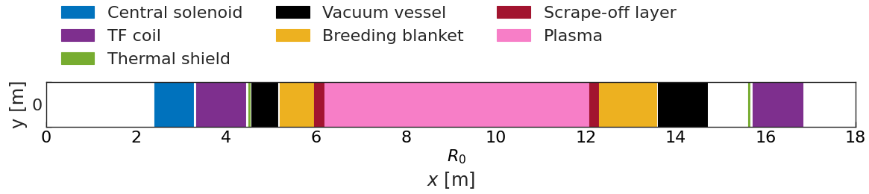
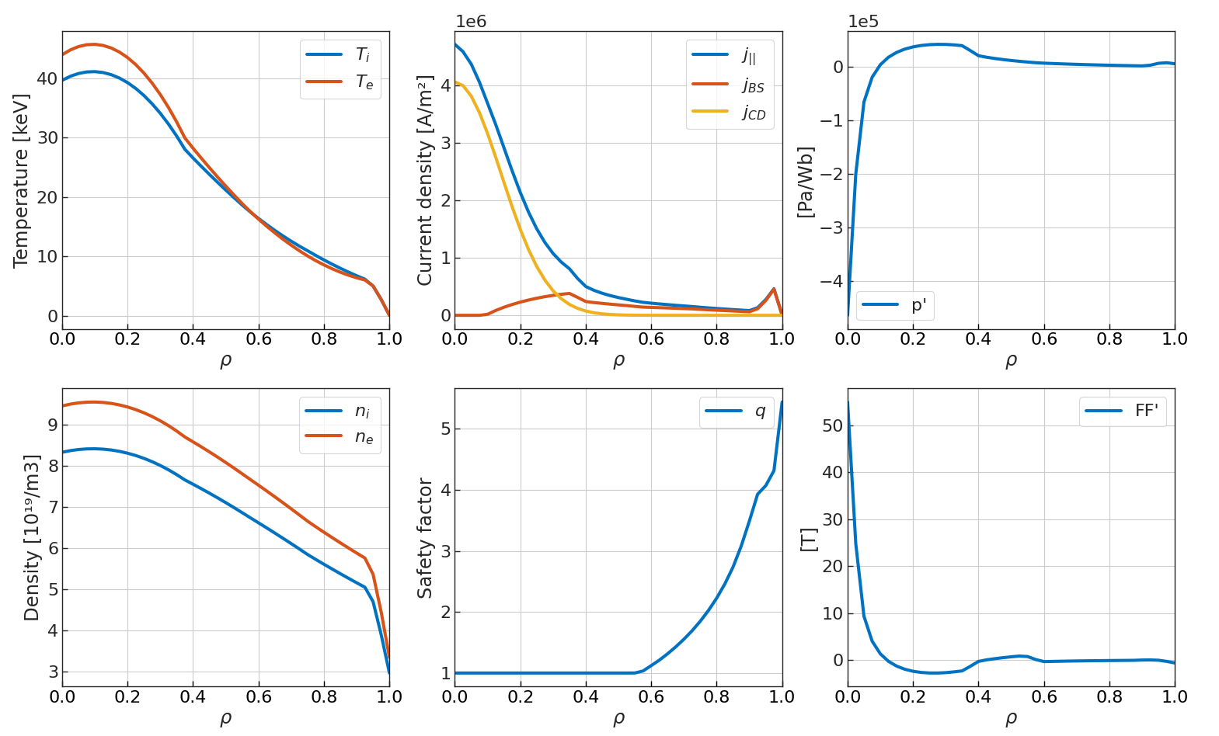
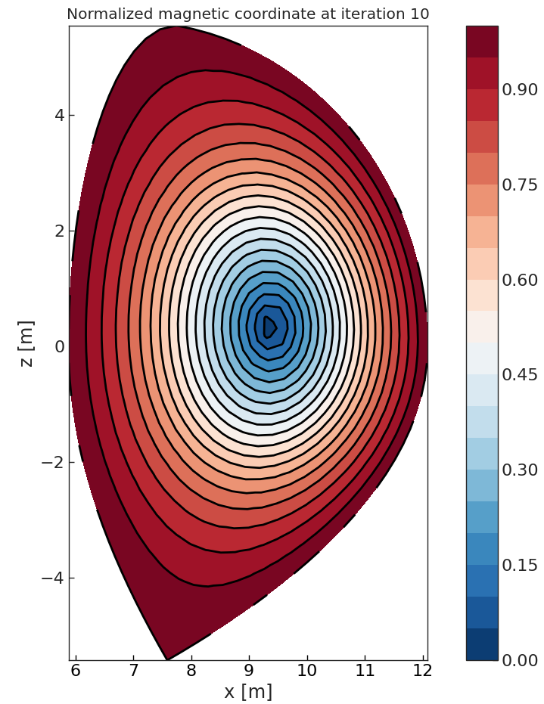
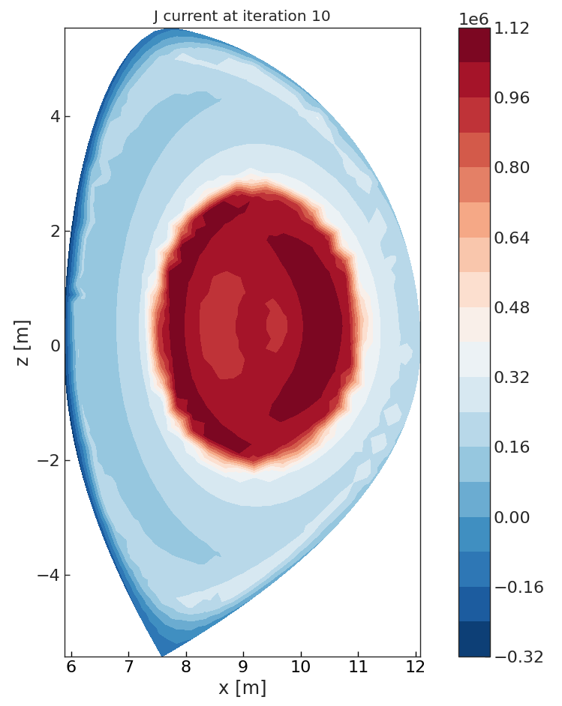
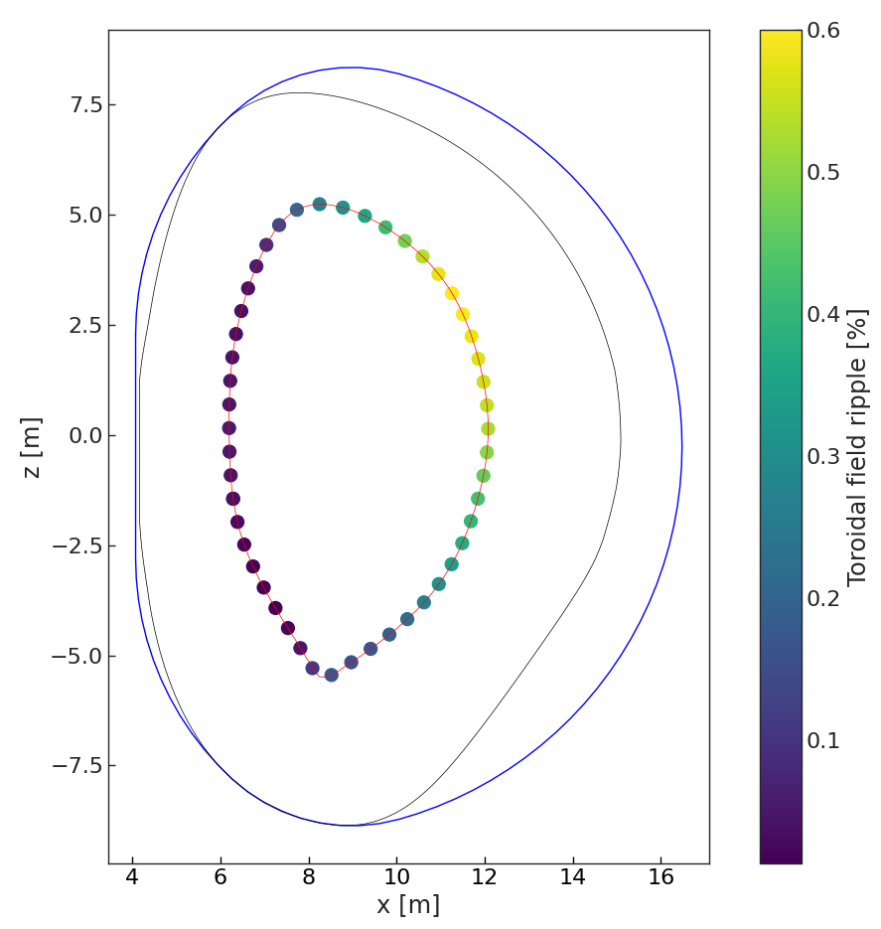
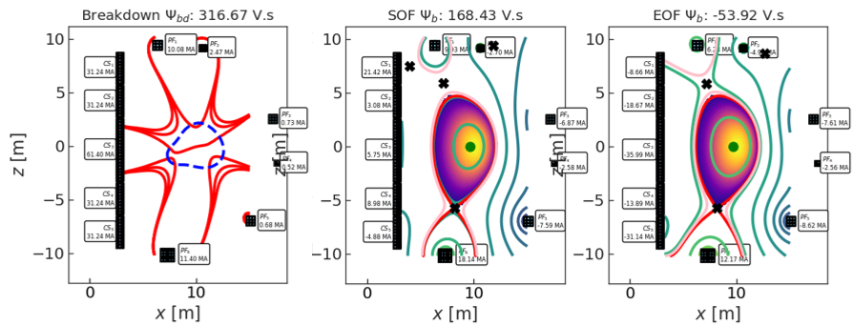
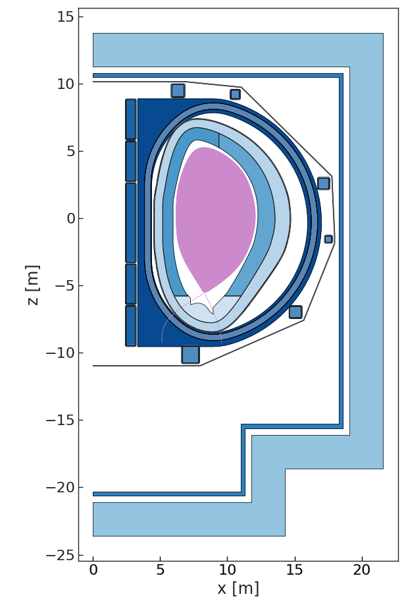
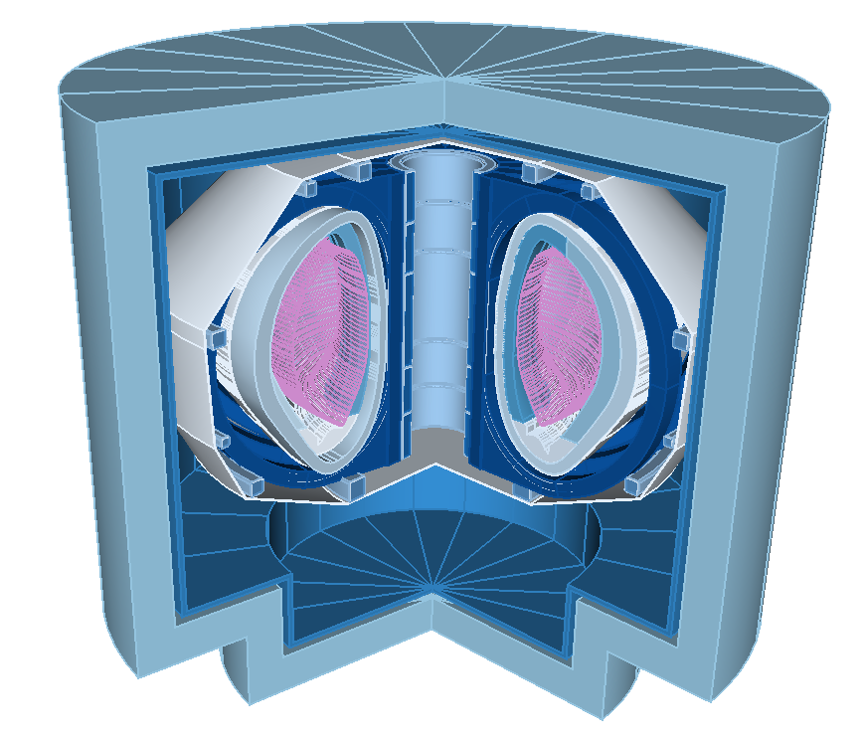
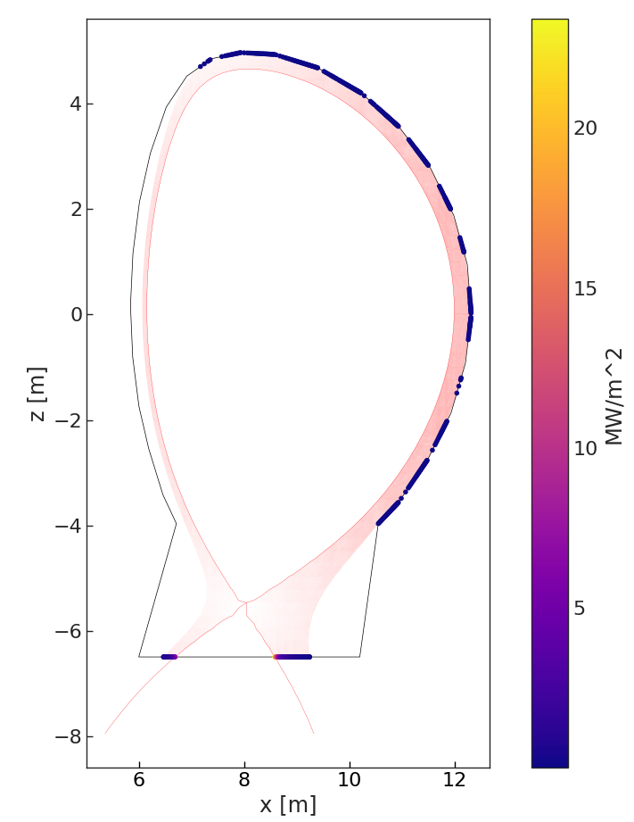
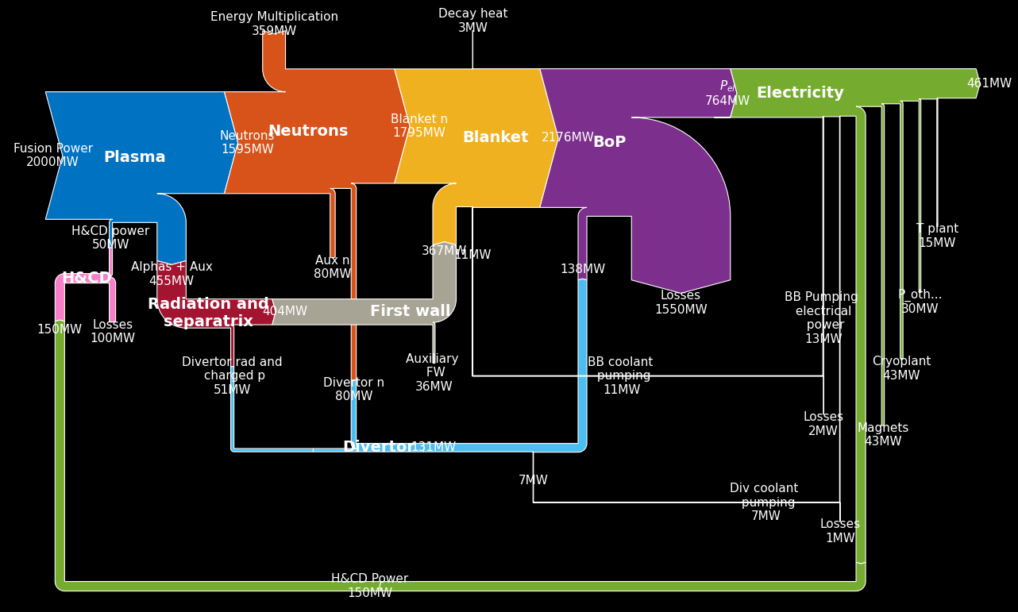
EU-DEMO workflow in BLUEMIRA
PROCESS
Choose inputs:
Values, constraint values
Constraints, objective functions
Geometry parameterisations
PLASMOD
2-D fixed BE
2-D free BE
FW design
Choose calculations:
Sequences
Optimisation problems
Solvers, builders
Convergence criteria, stop conditions
TF design
Equilibrium + PF design
FW design
Machine design
BOP calc
TSVV-14 - Thrust 5 - June 2023

Slide 6
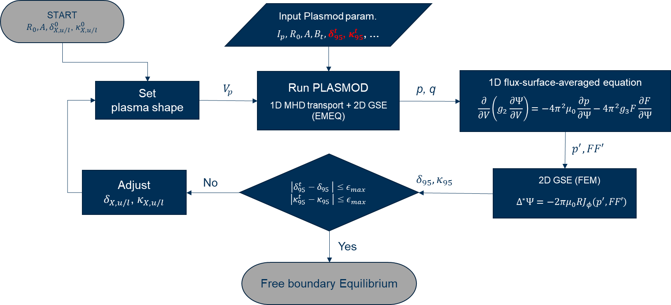
Features
Coupling transport solver to Fixed Boundary Equilibrium
Objective: Use plasma profiles from a transport solver, matching target plasma shape parameters, in free boundary equilibrium.
Iterate between PLASMOD and fixed boundary equilibrium solver
  Match plasma volume
  Adjusting boundary shape parameters
  Reach target 95th flux surface shape parameters
Pass from fixed boundary equilibrium to free boundary equilibrium

Slide 7
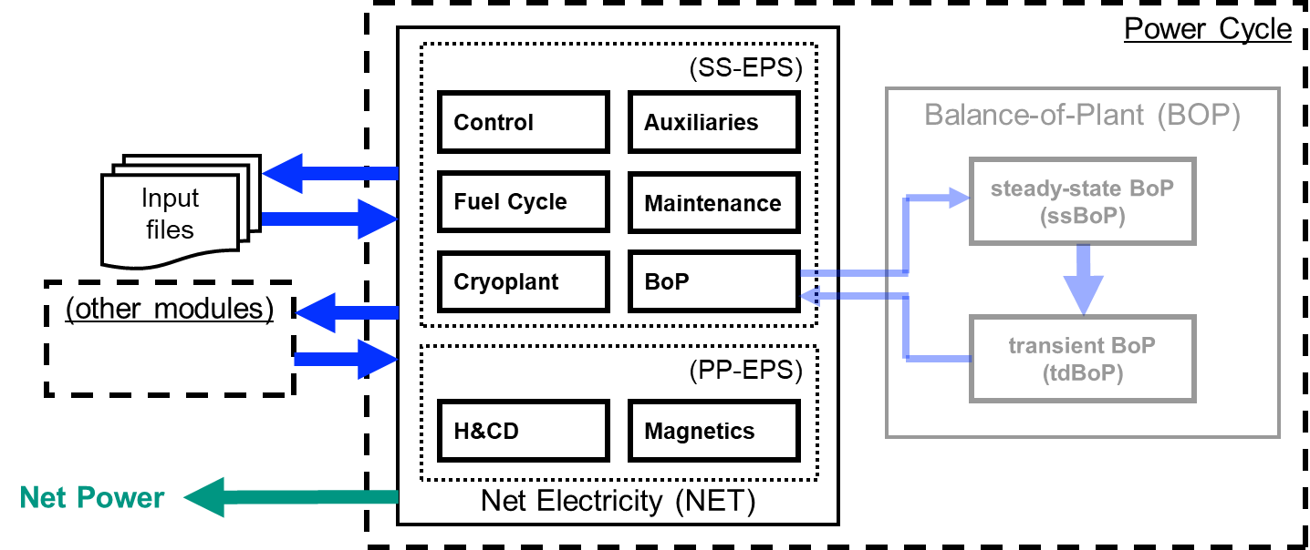
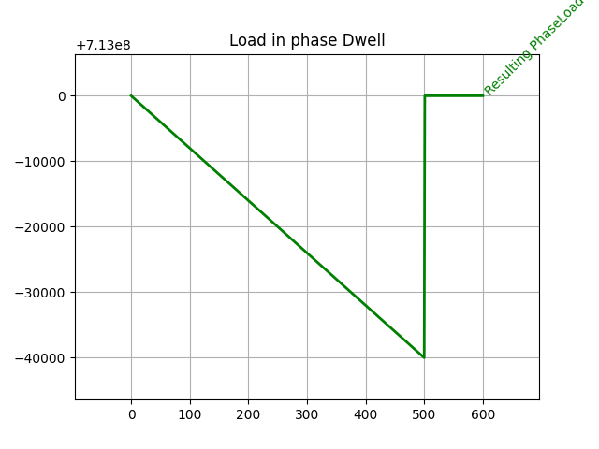
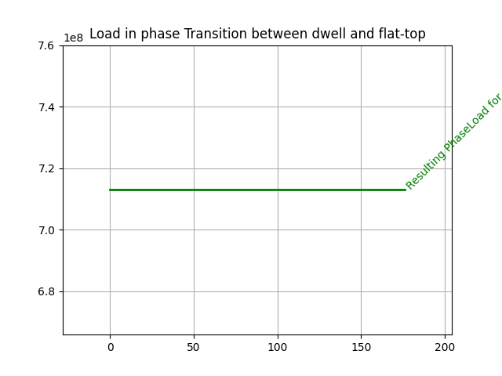
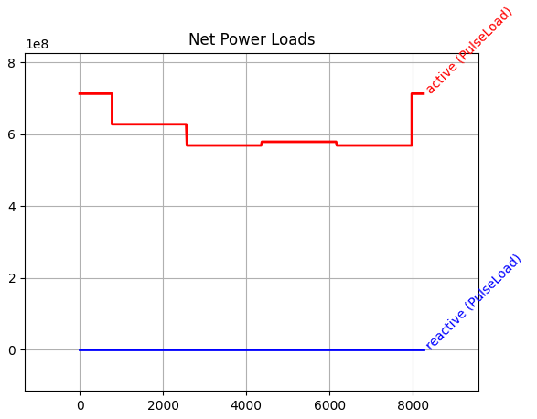
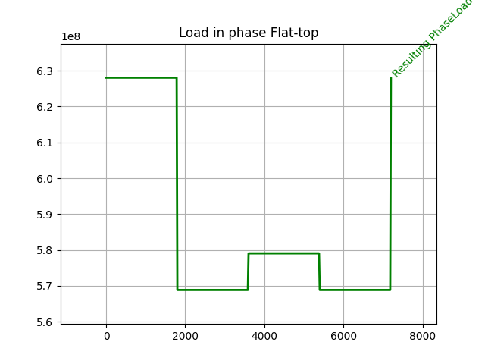
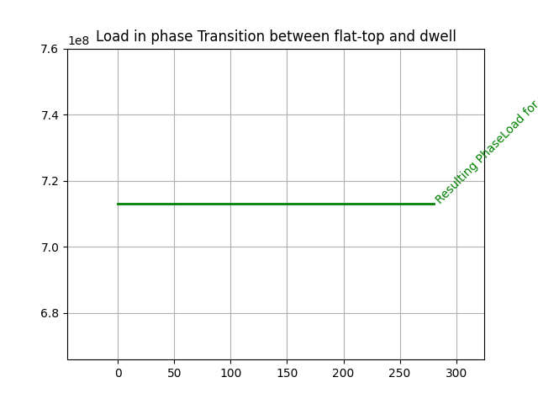
Features
Balance of plant
Simple example
Inputs: ECH, “All Field Coils“ & “CS recharge“, simplified BOP, no reactive powers.

Slide 8
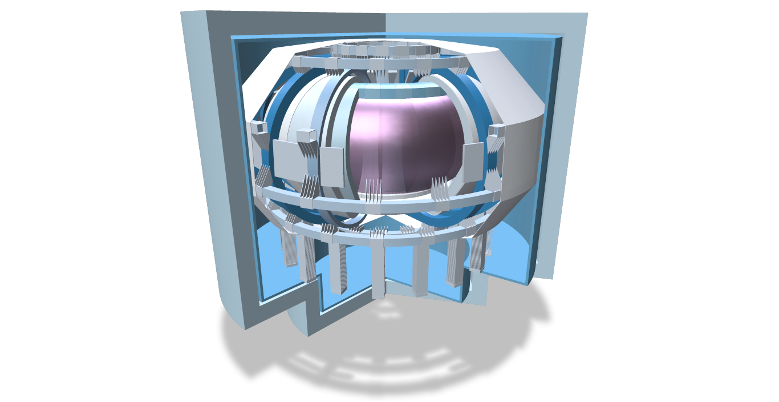
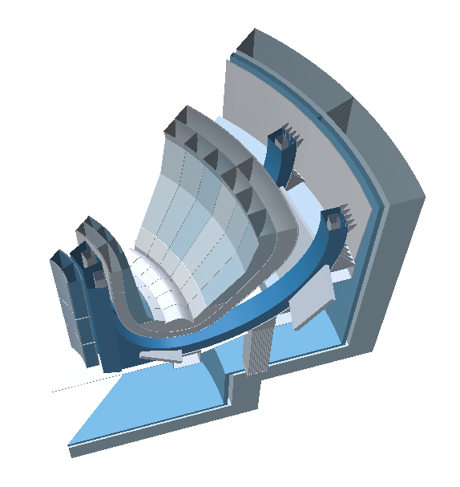
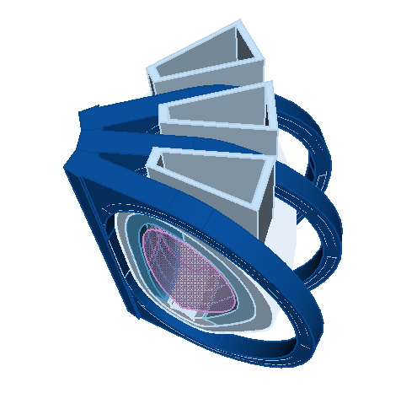
Features
3-D CAD updates
From EUDEMO: Added ports, optimised blanket panelling, inter-coil support structures
CAD sectoring, component level filtering (void space) and selection
Polyscope viewer
Expanded set of FreeCAD API's

Slide 9
Features
Systems code coupling
Generic "Solver" API to Interface with external systems codes
  PROCESS interface implemented
Encapsulates 3 stages of running a program
  Setup – transfer data from bluemira and create input
  Run – execute systems code
  Teardown – process output of systems code and transfer data to Bluemira objects
High level interface completely abstracted (eg variable I/O, high level configuration)
Low level interface available to expert users (eg. Low level configuration, direct interaction with code I/O)

Slide 10
Minor updates

Slide 11
Minor updates
QoL, minor features, performance, …
Object orientated reactor design
  Reactor objects hold various component managers
  Component managers hold CAD and functions that
Split between "Designers" and "Builders"
  Designers solve optimisation problems and produce minimal geometry
  Builders produce the final geometry based on designers output
Efficient CI pipelines scale contributors to the project. PR's are tested for code quality and test coverage. All tests must pass and code owners must review and approve
CAD outputs are tested on the domain on of their parameterisations, improving their robustness
Bluemira can be access through a Docker image and in the future will be available on PyPi

Slide 12
Complementary work
STEP – Spherical harmonics for equilibrium solving
STEP – Arbitrary cross-section analytical magnetic source

Slide 13
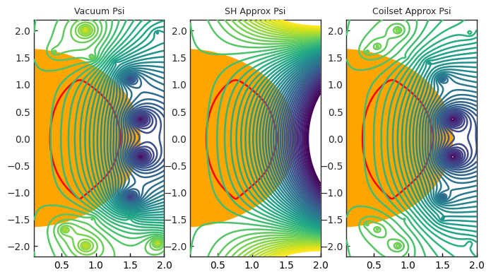
Complementary work
STEP – Spherical harmonics for equilibrium solving
Spherical Harmonics can be used as a constraint when positioning PF coils
    Constraint used on vacuum psi with the plasma psi isolated
    Keeping the vacuum psi constant within orange zone avoids equilibrium psi recalculation
    Optimising coil positions aims to reproduce original vacuum psi
    Possible secondary use case as a divertor constraint
Figure created by G. Graham

Slide 14
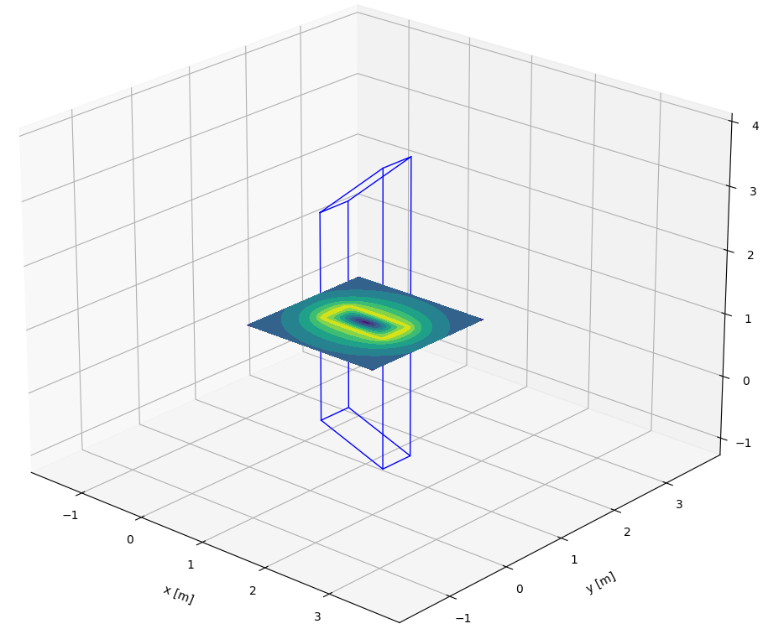
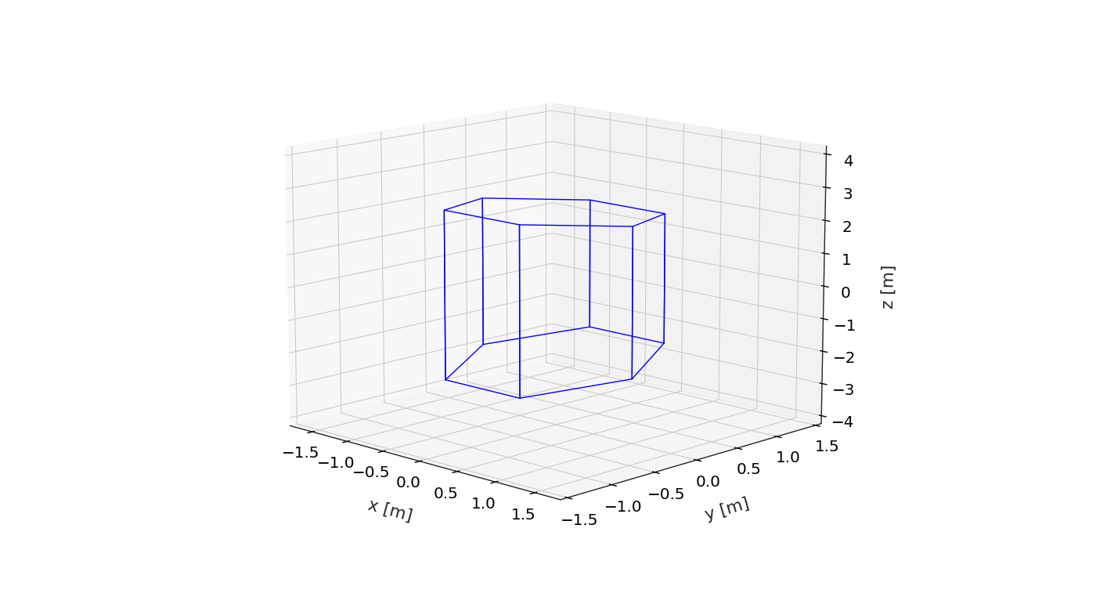
Complementary work
STEP – Arbitrary cross-section analytical magnetic source
Generalising the existing rectangular analytical current sources for any cross-section magnets (work ongoing)
Courtesy of J. Matthews
Existing functionality - rectangular prism
Work in progress – hexagonal prism

Slide 15
Users and developers

Slide 16
Users and developers
BLUEMIRA community
Core development team – 8 Members (UKAEA – 5, KIT – 2, IPP – 1)
Users/followers/contributors – UKAEA – 11 (RACE, STEP, Digital), External – 21 (VTT, STEP EDP, TE, PPPL, GA)
To drive usage and community engagement with Bluemira we have undertaken several usability improvements to reduce the onboarding learning curve where possible. This includes:
  • Providing examples explaining how to use certain aspects of the code
  • Creation of training material to enable a wider dissemination of knowledge
  • Training individual users on Bluemira enabling them to contribute back to the code
  • Interacting with users on the repository, helping solve user’s problems.
  • Maintaining and improving test coverage
  • Versioning of Bluemira to provide referenceable and stable points for users to build tools from

Slide 17
Outlook
Neutronics
TF winding pack
Vertical stability
Radiation
Baseline

Slide 18
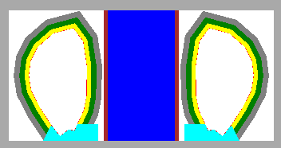
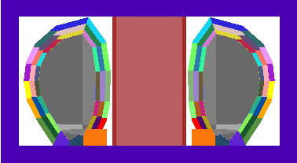
Outlook
Neutronics
Using OpenMC to calculate the neutronics quantities
  TBR, heating, wall loads, etc.
  Integrated into the optimisation and design of the first wall.
Axis-symmetric 3-D case to enable fast optimisation use in bluemira:
Future:
  Handle more complex geometries, using pluggable parametric plasma source
OpenMC Geometry
Divided into cells for tallying

Slide 19
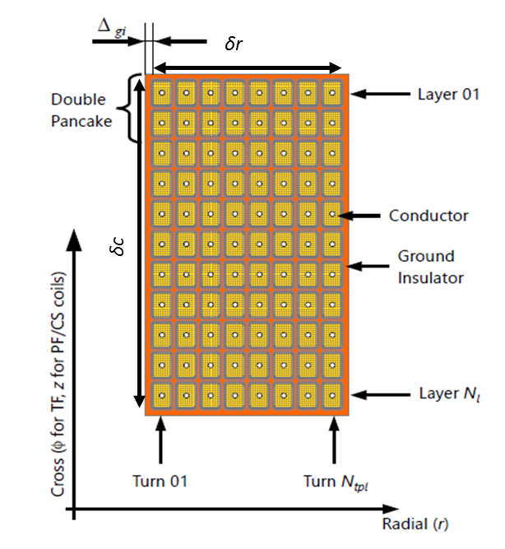

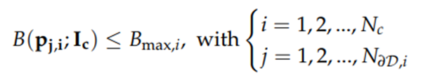
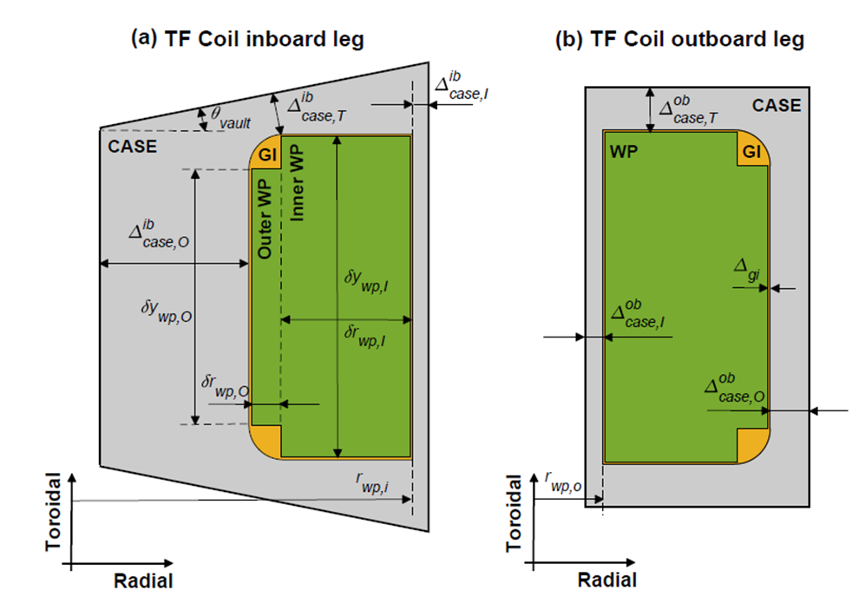


Outlook
Coils Winding pack
The 2-D Winding Pack module to be implemented in bluemira shall address both direct and indirect problems and be applicable to the central solenoid, poloidal, and toroidal field coils. It shall consider both geometrical, electromagnetic and structural constraints in a formulation suitable for bluemira.
currents
Magnetic field
EM loads
Temperature margin

Slide 20
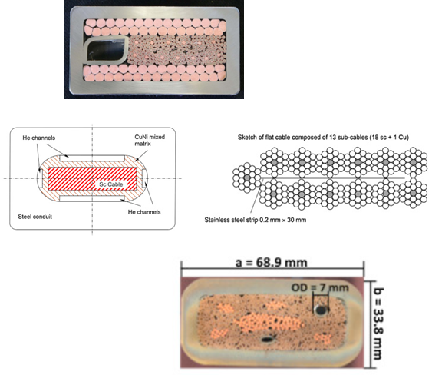
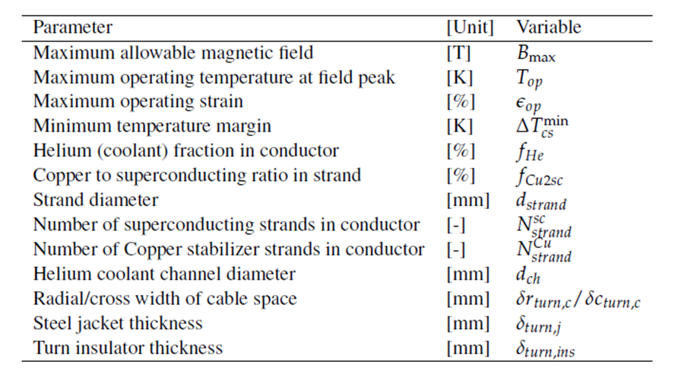
Outlook
Coils Winding pack
The code shall be capable of accommodating various superconducting cable options, based on the technological solutions explored for ITER and DEMO.

Slide 21
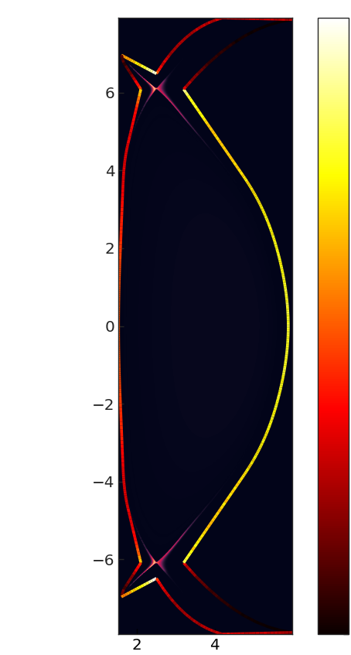
Outlook
Radiation
Calculation of
  The line radiation source
  First wall radiation heat flux
Improve first wall design problem
  Starting point for first wall shaping algorithms
  Directly account for radiation and particle heat loads.
Feature implemented in branch and under initial review
Courtesy of D. Vaccaro

Slide 22
Outlook
Baseline
Next EU-DEMO baseline to be issued in Q3 2023
BLUEMIRA not scheduled to be "officially" used to produce the baseline, but we will produce a baseline design point once the input parameters have been decided
Continuous interaction with EUROfusion regarding EU-DEMO:
  Ensure the parameterisation in BLUEMIRA is as intended
  Ensure input parameters and sub-models are up-to-date

Slide 23
Summary

Slide 24
Summary
Progress and outlook
Move to parameterised CAD completed and most of CAD component builders done – some port/shield interaction still to be done
  Remote maintenance considerations – some already but would like to expand to more detailed allowances for support structure and space needed for ports.
Coupled transport solver (PLASMOD) to fixed boundary equilibrium solver.
EU-DEMO workflow constructed and will attempt to use to create equivalent of 2023 baseline as a test.
Balance of plant model implemented.
Winding pack tool and neutronics coupling key features for rest of this year/early next year.

