Slide 1
Annual Work Plan 2024 Advanced Computing (WPAC)
F. Jenko, D. Kalupin & V. Naulin

Slide 2
WP Organization: Overview
WPAC aims at supporting a coherent research programme to advance the physics understanding in key areas and the development of respective predictive capabilities, including a high-quality suite of “EUROfusion Standard Software”
Scientific Objectives of TSVVs were pre-defined by the E-TASC SB, prior to the TSVV CfP (2021-2024)
Scientific Objectives of ACHs are defined following requests by code developers with approval by the E-TASC SB (annual)
Monitoring of Activities is by the E-TASC SB and the PMU

Slide 3
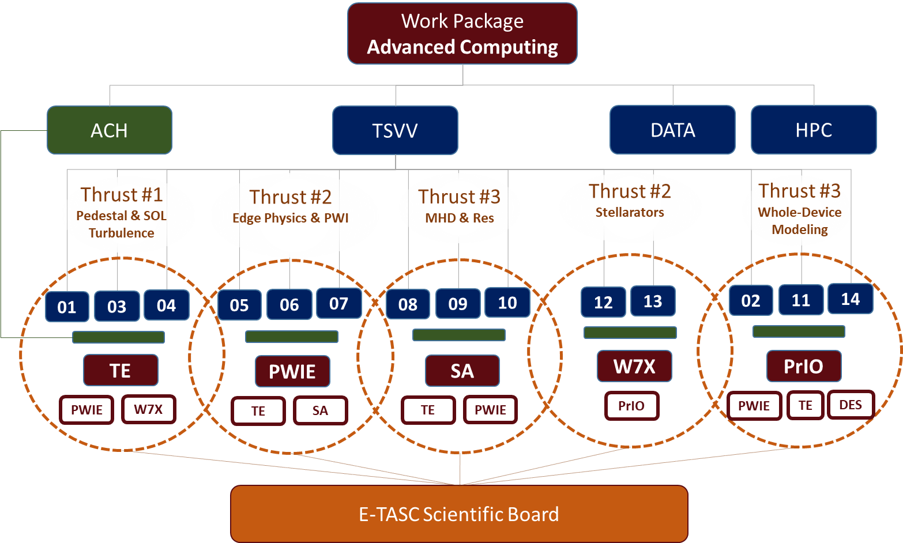
WP Organization: Thrusts
ToR:
A Thrust serves as a communication platform among a group of related TSVVs and WPs, on behalf of the entire E-TASC SB.
It consists of a set of TSVV leaders, E-TASC SB members, and relevant PLs/TFLs and is coordinated by a facilitator chosen among the latter.
The facilitator provides feedback on the Thrust activities and proposes corrective actions for the TSVV work programmes to the E-TASC SB if and when needed.
Organize regular Thrust meetings (≥ 2 per year)
Coordinate V&V activities (if needed: request data or specific experiment)
Provide feedback to the E-TASC SB

Slide 4
Progress towards EUROfusion Standard Software

Slide 5
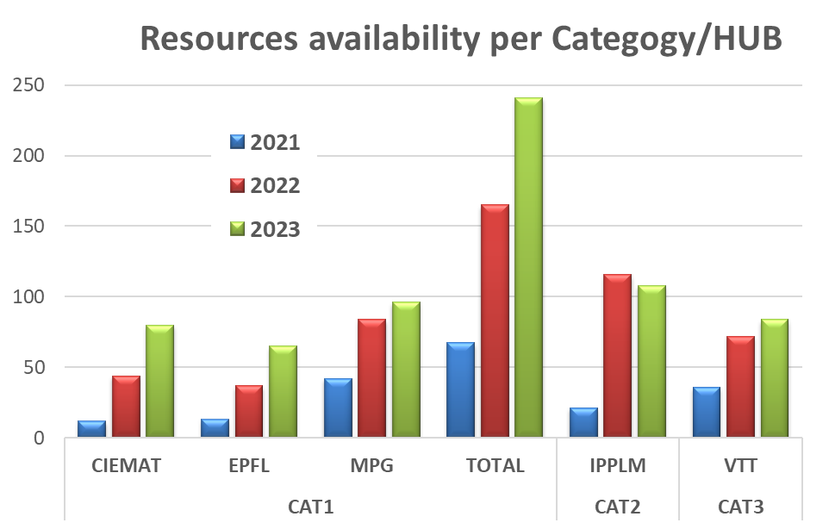
Overview of ACH resources
5 ACHs were established (in 3 categories):
Cat. 1 – HPC [CIEMAT, EPFL, MPG] ~52%;
Cat. 2 – Integrated Modeling [IPPLM] ~27%;
Cat. 3 – Data [VTT] ~21%
2023 onwards – ACHs are finally running at ‘full speed’
Expected use of total ACH resources by the end of 2023: 47.6%
[RISK]: Due to the difficulty of attracting and retaining IT experts, some ACHs might be forced to reduce the provided support.
As mitigation measure, the inclusion of experts working remotely is considered.
The majority of TSVVs are spending their ACH resources according to the original plan [35-55%].
Several other tasks (up to 220 PMs in 2021-23) are covered by the ACHs in addition to the TSVV support (small projects in other WPs and services for the entire community).

Slide 6
Key developments and events in 2023
TSVV
Continue with TSVV project execution following the work plans originally approved by the E-TASC SB
Mid-Term Review
Indicative timeline
13-14 Sept 2023 – EUROfusion seminar with the respective PIs presenting the main project achievements of all 14 TSVVs
22 Sept 2023 – Deadline for submission of written recommendations by the Thrust Facilitators
3-4 Oct 2023 – E-TASC SB meeting (discussions with Thrust Facilitators and PIs as necessary)
20 Oct 2023 – Recommendations on the TSVV program and individual project evaluation reports to be sent to the PM
ACH
Continued support for TSVVs and other EUROfusion activities following the task allocation by E-TASC SB (https://indico.euro-fusion.org/event/2248/)
Planning of 2024 activities (two-step process, to be finalized in November 2023)
HPC
New HPC system (extended gap in early 2024) & Gateway (installation in January 2024)
DATA
JDC: Implementing agreement (pending the association of UK to EURATOM)
DMP: Project start in March 2023; prototype for technical implementation

Slide 7
TSVVs & ACHs: Continued project execution in 2024
Some key aspects:
TSVVs are expected to gradually increase their impact on the wider community
This includes, in particular, the dissemination of EUROfusion Standard Software
The goal is to engage and enable colleagues outside the code development teams
With the help of newly developed tools, outstanding open questions can be addressed
ACHs will finally be at full speed and are expected to provide valuable support
Networking & communication within and beyond the E-TASC ecosystem will be vital

Slide 8
TSVV Mid-Term Review: Key questions to be addressed
What is the project performance in terms of code development & dissemination?
Software engineering (incl. code porting & optimization)
Interfaces (incl. IMAS)
VVUQ (incl. specific V&V activities)
Documentation
Dissemination
User support
What is the project performance in terms of helping to address open science questions?
Activities within the TSVV project
Activities in other WPs, facilitated by the TSVV project
General impact on the wider scientific community
How does the TSVV team engage with the community in identifying and updating the science questions their code(s) should help to answer?
Did the project deviate from the plans in the original scientific proposal?
Achievement of deliverables and milestones?
If the project did deviate from the plan, how and why?
Were there unforeseen challenges and/or opportunities?
Is the project implemented efficiently and effectively?
Are the chosen methods suitable to address the respective topic in a timely fashion?
Is the team balanced in its expertise and collaborating well?
Is the team managed well?
Are there any obstacles to project performance that can be removed?
Are there suggestions for specific corrections to improve the interactions with WPs?
To be based on the written recommendations by the Thrust Facilitators, including possible changes of the project objectives to reflect the current state and updated needs of Work Packages
Are tools and results from the TSVV project disseminated to WPs? How can this process be continuously improved?
http://idm.euro-fusion.org/?uid=2P9MS8

Slide 9
Development of a Pulse Design Tool
Objectives | Fundamental physics understanding, analysis | Understanding a full pulse, assess the performance | Optimizing and predicting a pulse | Predicting a pulse and developing the controls | Controlling partial or up to a full real pulse, runs parallel to experiment
Class | 1st principle stand-alone plasma codes | Integrated Workflows (discharge simulator) | Pulse Design Tool (Feed Forward) | Flight Simulator (Closed loop) | Real Time capable tool (in loop with real plasma)
Required interfaces between modules | manual file exchange | automated workflow engines chosen by author | automated recommended engines, e.g. MUSCLE-3 | automated recommended engines, e.g. MUSCLE-3 | automated using engines compatible with RT
Structure (modularity index) | low hard-coded connections | medium Interchangeable | high Easily interchangeable | high Easily interchangeable | n.a. modularity can be reduced to allow RT
Required data format | private | IMAS compatible | IMAS | IMAS | n.a. determined by machine
Expected simulation effort | high much slower than experimental time scales | medium-high much slower than experimental time scales | medium reasonable time, allowing easy simulation scans | low-medium ~10 × real time | low real time
Acceptable fidelity level | multiple levels for each physics aspect | multiple levels for each physics aspect | medium | low-medium | low
Required coupling to experiments | loose | loose | medium Linked to Actuators (Multi Machine Capable), check limits of actuators | tight Runs the PCS, sensor input from a plasma simulation, output to actuators | tight Embedded in the PCS, sensor input from real plasma, output to actuators
Examples | Equilibrium, Gene, RF, NBI, Pellets, … | HFPS, ETS, JINTRAC, ASTRA-SPIDER, … | HFPS, … | FENIX | RAPTOR, …

Slide 10
Pulse Design Tool: Developments from now until 2025
Workplan of 2023
Objectives:
Select existing tools to be included in a PDT
Identify missing components and necessary improvements
Improve, if necessary, the modularity of presently available tools
Start development of reduced models
Start development of generic control package (activity shared with WPTE)
Deliverables:
Demonstrate of the potential towards a PDT. Modular discharge simulator, with the minimum set of modules (i.e., FBE, transport, auxiliary heating) for similar scenario at three machines (i.e., ITER, JET and AUG, with DEMO as an optional extra case). The results of such similarity validation test, including a comparison of the modules in terms of accuracy and speed, shall be presented at a FSD science meeting at the end of 2023 (to be planned).
Selection of prioritized set of reduced models, whose development shall be prioritized in 2024-25.
Based on evaluation of the progress made in 2023, priorities 2024-25 will be defined, and funds will be made available to project as needed (~2 PPY/year).

Slide 11
Data Management Plan
Following the recommendation of the 40th EUROfusion GA the Call for Implementation of the Data Management Plan (DMP) was sent to beneficiaries. As the result, a new DMP project, consisting of:
Coordinator [VR];
CORE team [IPPLM] (in charge of developing , testing and supporting the DMP infrastructure); and
SITE/Machine teams [CEA, EPFL, MPG] (in charge of local installation of DMP infrastructure and data support)
for the time period of 2023-2025 is set up. (Kick-off in March 2023)
The design and main elements of the proposed infrastructure are described in the DMP blueprint.
The data management plan defines 4 scenarios of increasing ambition in terms of data access and F.A.I.R.ness (Findable, Accessible, Interoperable and Reusable), from which:
Scenario A (fully): making metadata only available and searchable using IMAS data subsets for interoperable definitions of quantities [F,(I)];
Scenario B (prototype level): adds to Scenario A by allowing a subset of the data to be accessed using common tools (for example UDA). Facilities are responsible for the access level and qualification of data through the data mappings [F,A,I,(R)];
Will be implemented by the DMP project (included machines: AUG, TCV and WEST).
The infrastructure should be built on the Fair for Fusion provided software tools and developed practices and it is expected that the portal interface and development activities will be hosted on the Gateway where additional virtual machines will be made available for the effort. The documentation, software and ticketing tools should be integrated with the existing PSNC based gitlab and Jira services.

Slide 12
Additional support on IMASification
Following requests on IMASified data from TSVVs;
Reinforce DMP project to make faster transition to scenario B
Use existing tools (legacy from ITM and WPCD) as intermediate solution
Support machine data experts for development of mapping files

Slide 13
Word of warning: HPC resources in 2024
It is to be expected that during the first half of 2024, HPC resources will NOT be available.
This will present a big problem to all E-TASC related activities, inducing significant delays.
Applications to existing and future experiments will also suffer; be prepared.
Presently unclear if and how at least some activities can be continued (on a small level).

Slide 14
Some points for discussion
Work Plan
Possible corrections to the long-term objectives of the TSVVs (WP input to Mid-Term Review)
Requests and suggestions by the community regarding TSVV-developed tools (dissemination of codes, feedback to developers, enlargement of user community etc.)
Challenges
Impact of migration of TSVV personnel (loss of resources and knowledge)
Impact of unavailability of HPC resources during the first half of 2024
Networking & Communication
How can the interactions within and beyond the E-TASC ecosystem be further strengthened?
Is the Thrust structure effective?

