Slide 1
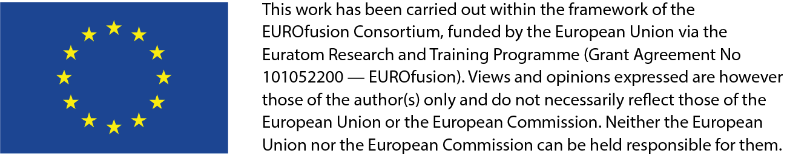
TSVV3 project (Edge Fluid Modelling):
update focused on WPTE applications
P. Tamain
In name of the TSVV3 team
ETASC Thrust 1 meeting | 03/05/2023

Slide 2
Reminder of project structure
TSVV2
TSVV5
TSVV6
Coordinate and rationalize effort
- Task 0: project coordination
- Task 10: evaluate and select approaches
Improve models
- Task 1: gyrofluid models
- Task 2: sheat BCs
- Task 3: reduced turbulence models
Improve codes capabilities
- Task 4: codes optimization
- Task 5: neutrals physics
- Task 6: multi-species plasmas
- Task 7: complex geometry
Validate
- Task 8: IMAS-ification and synthetic diagnostics
- All tasks: test new capabilities against experiments
Disseminate
- Task 9: make verified codes available to WPs
TSVV1
TSVV4
ACHs
ACHs
WPs
WPs
ACHs

Slide 3

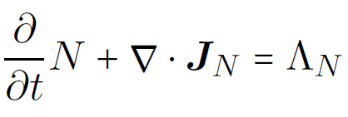
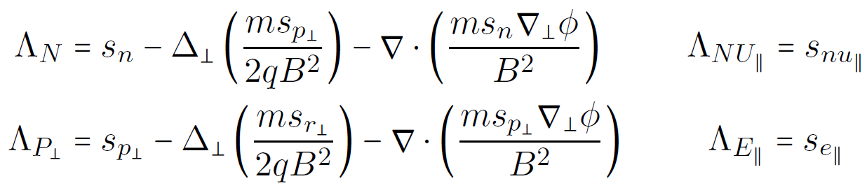
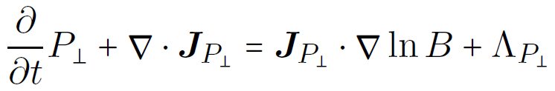
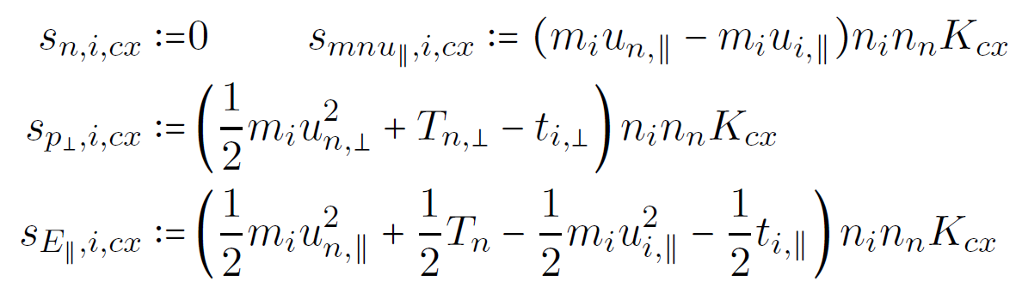
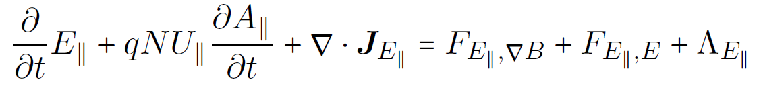
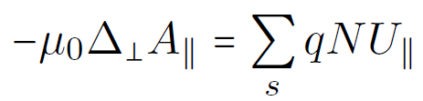
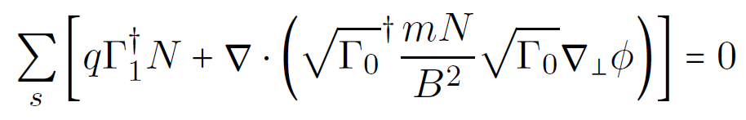
Gyro-fluid including collisions
Design of gyro-fluid model including collision and reaction terms
  Based on systematic method to transpose fluid-drift equation into gyro-fluid
  => gyro-fluid model compatible with neutrals and multi-species physics
  Implementation in FELTOR quasi-completed, with applications to WPTE
  [M. Wiesenberger et al., Journal of Physics : Conference Series 2022]

Slide 4

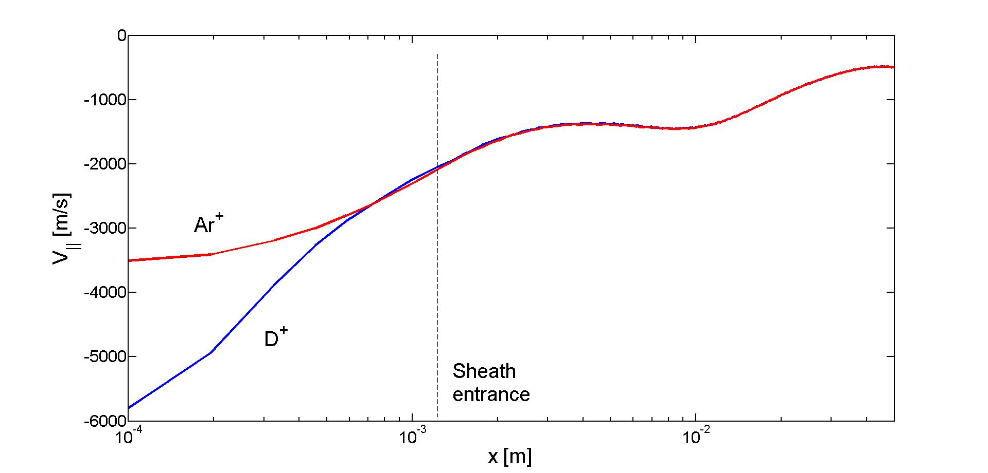
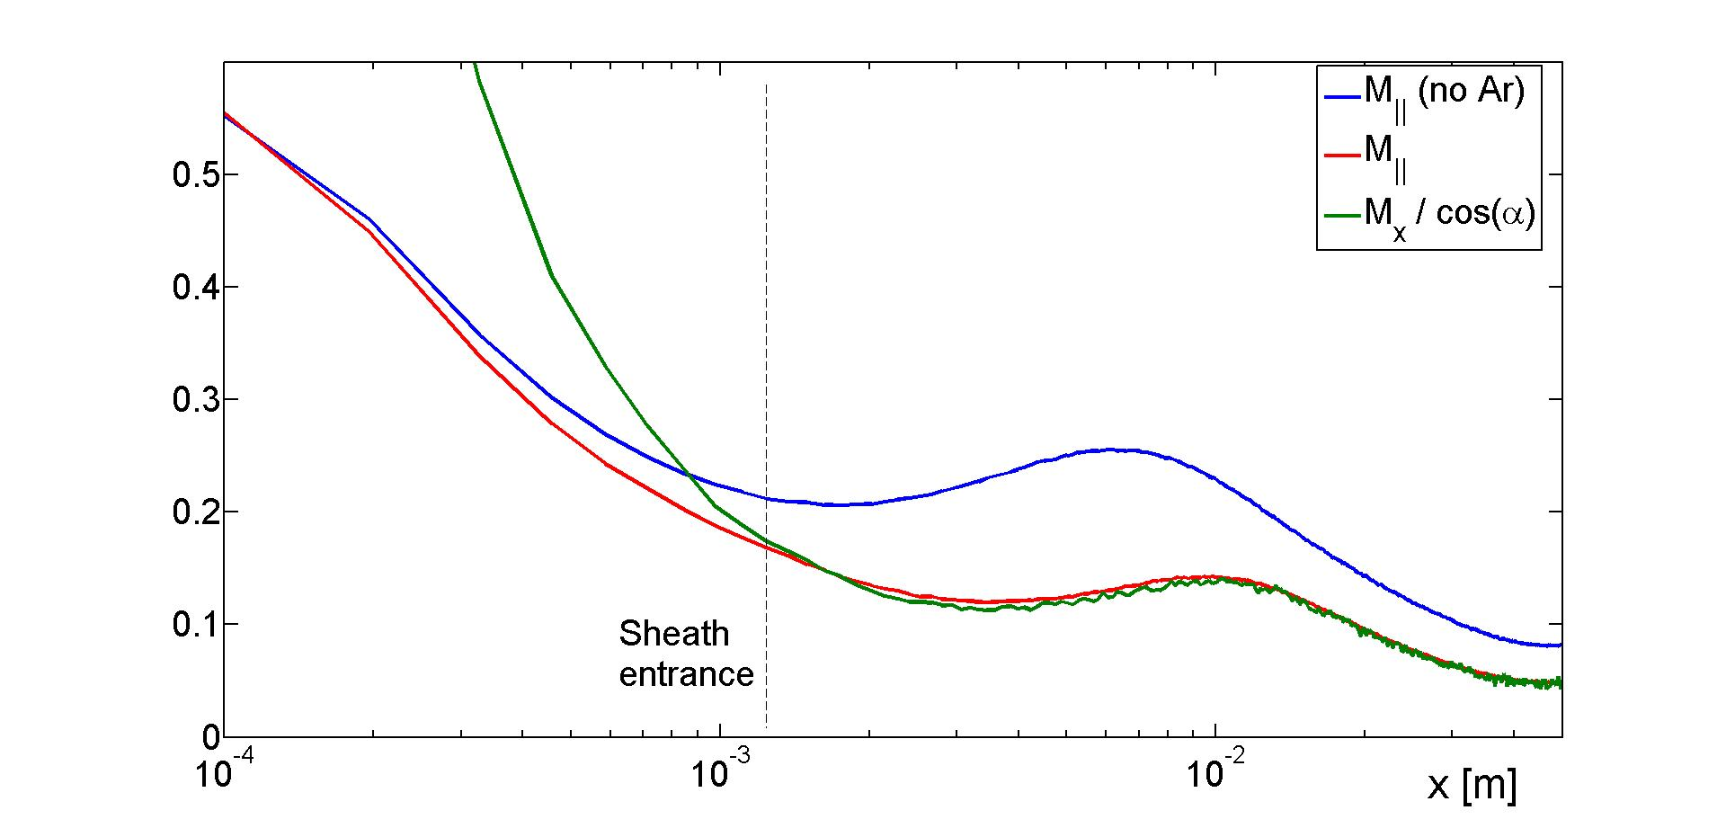
Reliable boundary conditions
Boundary conditions with impurities in highly collisional plasmas?
  Simulations with BIT1 code
Previously: strong effect of neutrals on boundary conditions
  proposed correction to standard Bohm BC => implementation scheduled
New result: minority species don’t change boundary conditions
  Dragged at main ion’s flow velocity
  Perturb little main ion’s flow

Slide 5
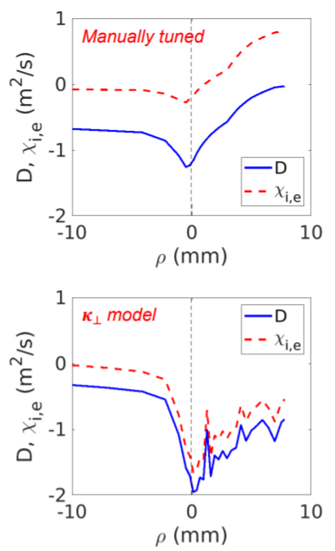
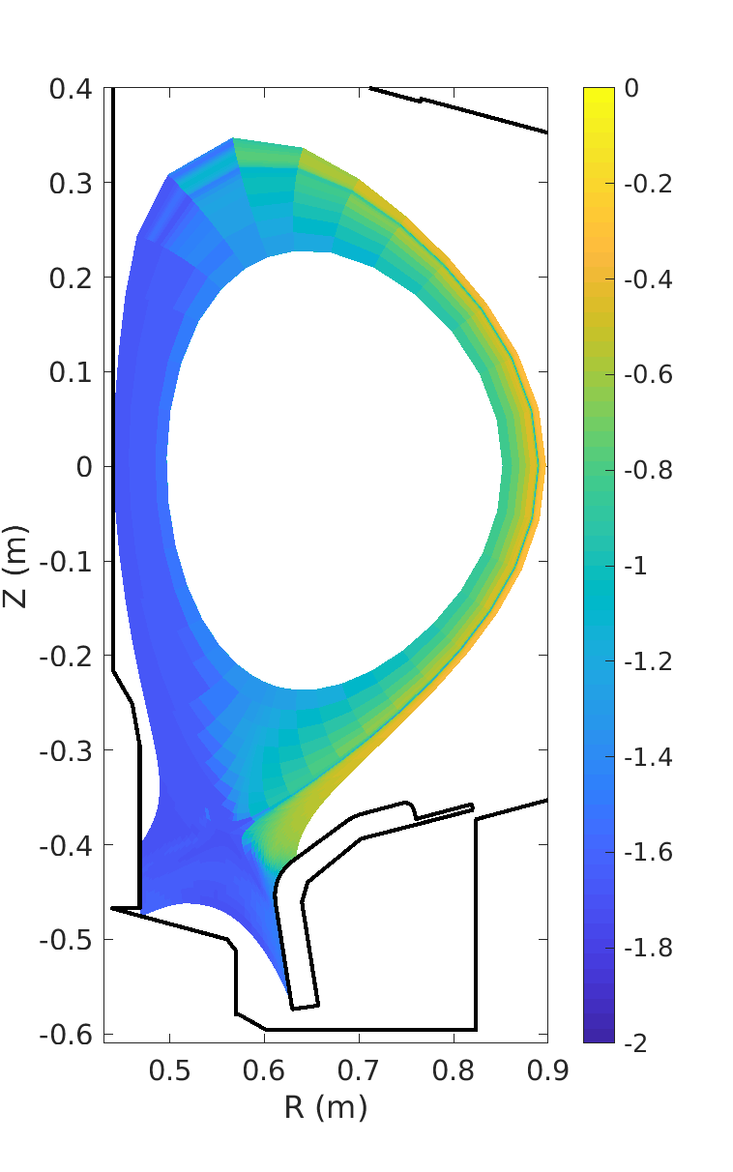
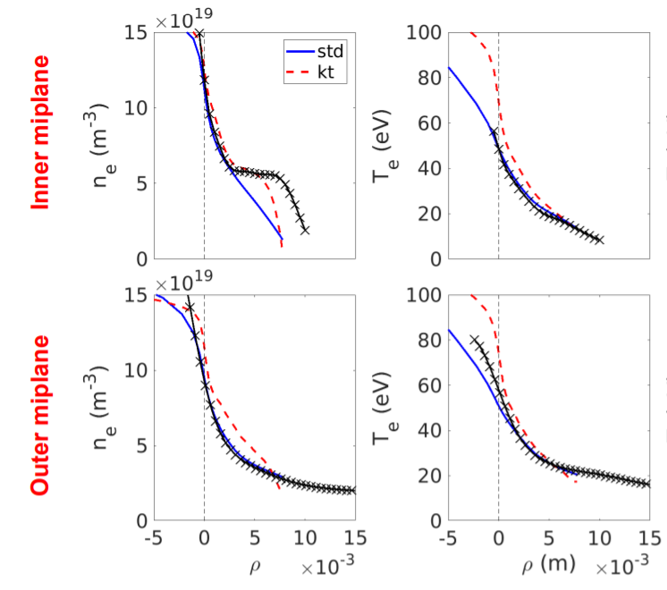

Reduced turbulence models towards 3D
Reminder: RANS models = intermediate level of description to get minimal turbulence physics at low cost (self consistent transverse transport coefficients)
  Available in SOLPS and SOLEDGE3X codes
[Dekeyser, NME 2021; Dekeyser, CPP 2022]
D (log)

Slide 6
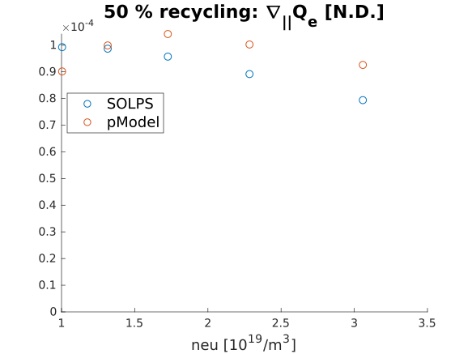
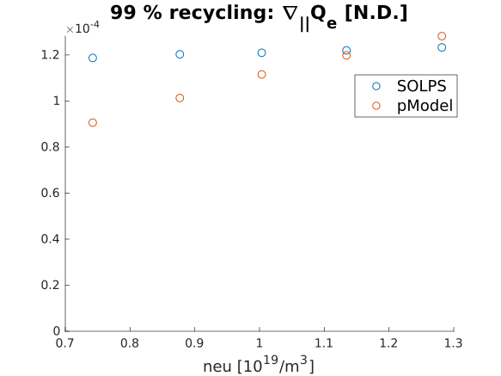
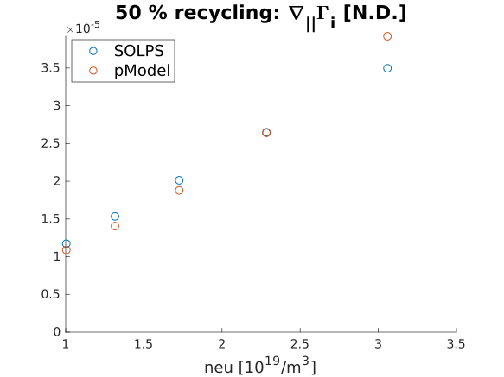
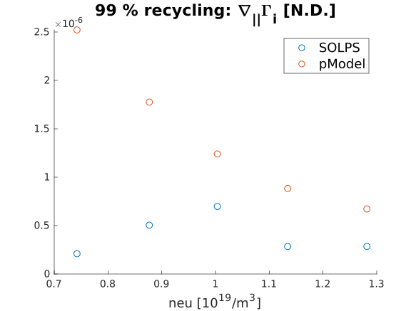
Reduced turbulence models towards 3D
Reminder: RANS models = intermediate level of description to get minimal turbulence physics at low cost (self consistent transverse transport coefficients)
  Available in SOLPS and SOLEDGE3X codes
Initially tuned based on database of 2D turbulence simulations
Now adding description of parallel transport physics
R = 0,5
R = 0,99

Slide 7
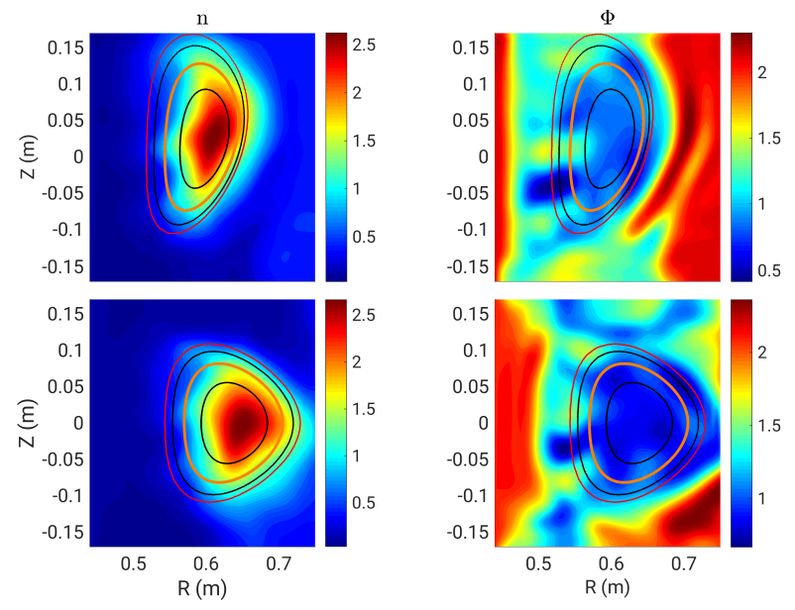
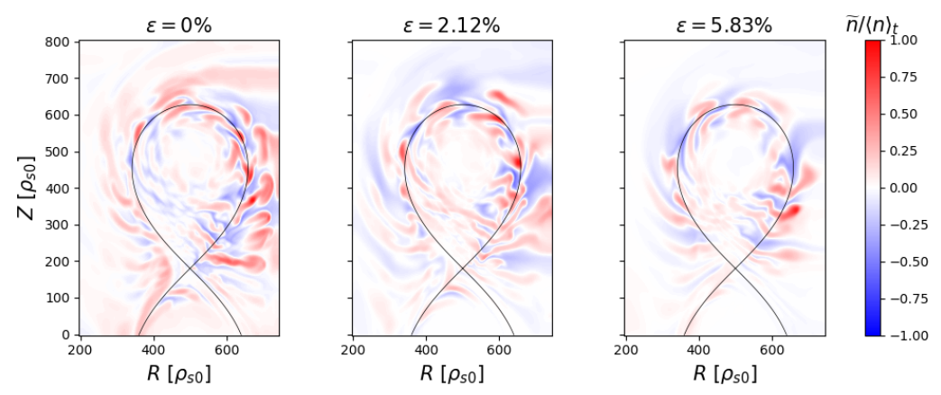
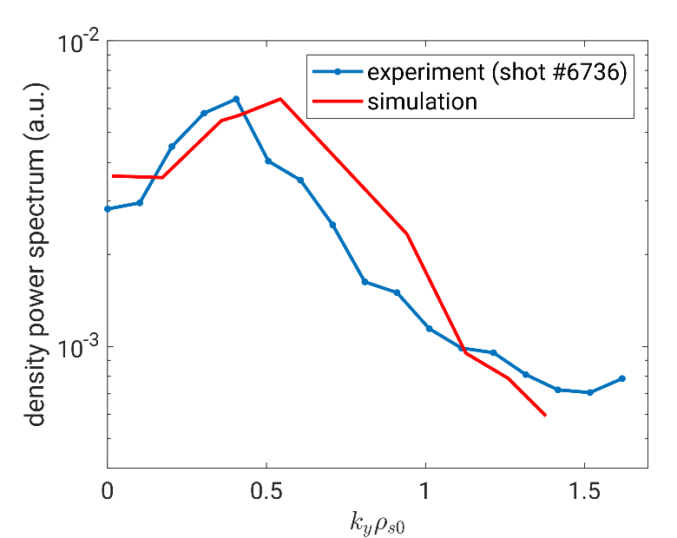
3D non-axisymmetric equilibria
GBS extended to 3D non axisymetric equilibria
Validation against TJ-K stellarator
[A.J. Coelho et al 2022 Nucl. Fusion 62 074004]
On-going study with RMPs in TCV

Slide 8
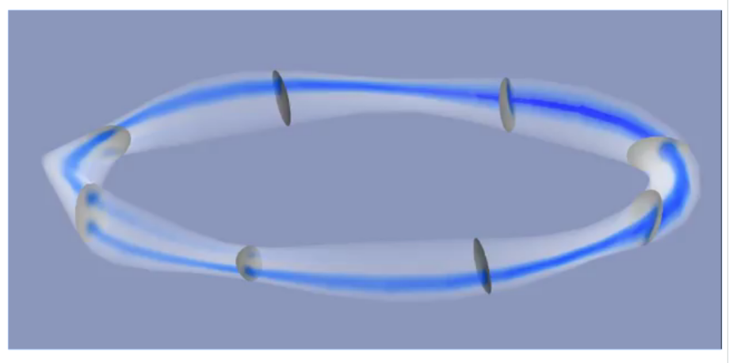
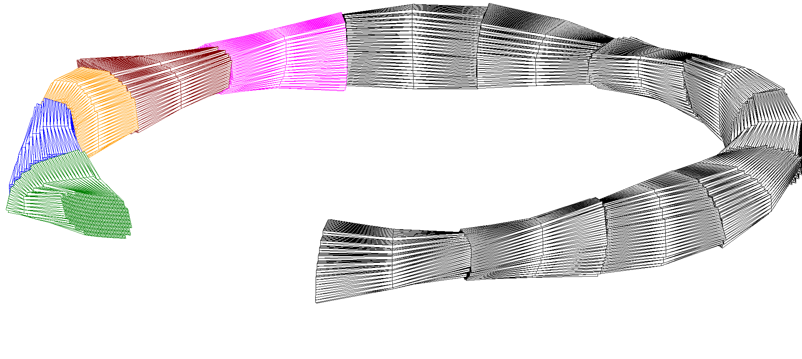
3D non-axisymmetric equilibria
GBS extended to 3D non axisymetric equilibria
Validation against TJ-K stellarator
[A.J. Coelho et al 2022 Nucl. Fusion 62 074004]
On-going study with RMPs in TCV
Similar capabilities soon available in GRILLIX (final adaptations on-going)
  First planned application: W7-X
FCI mesh

Slide 9
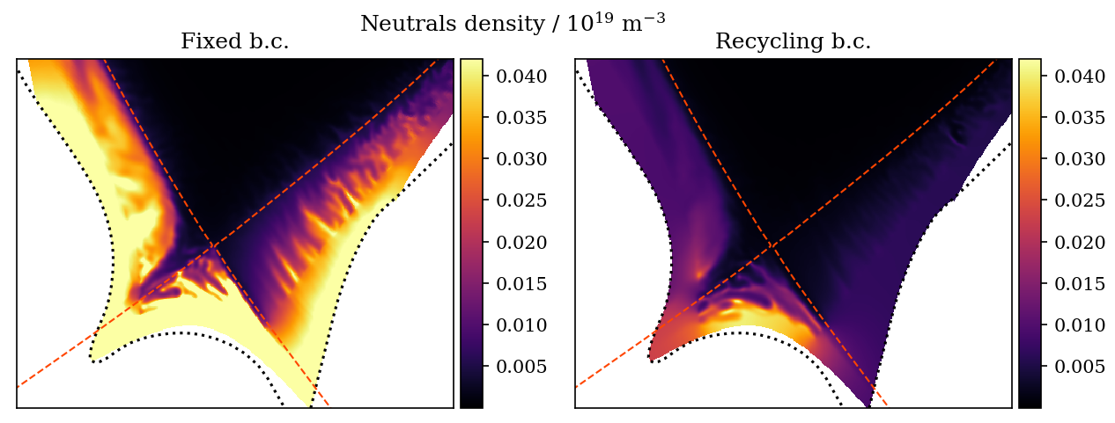
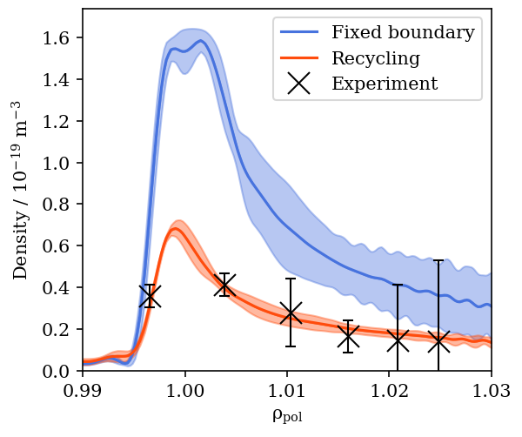
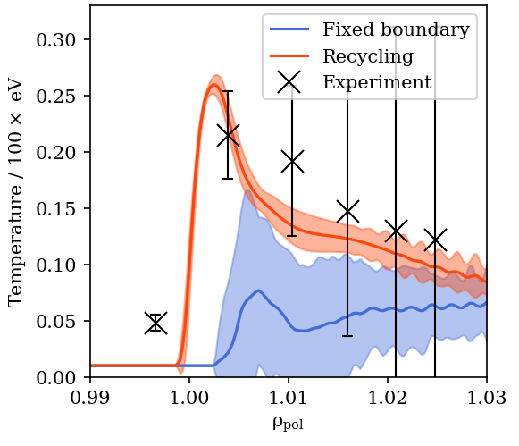
Turbulence towards high density regimes
Further progress to extend usage of neutrals in 3D turbulence simulations
GRILLIX: implementation of recycling boundary
OLD: Fixed ad-hoc value for neutral density at divertor
NEW: Neutral inflow = plasma outflow
Low field side divertor target profiles

Slide 10
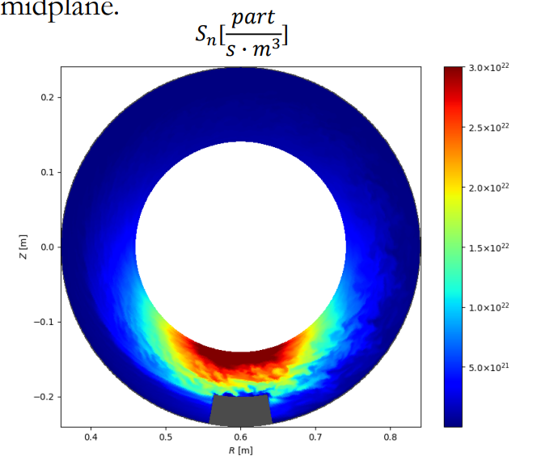
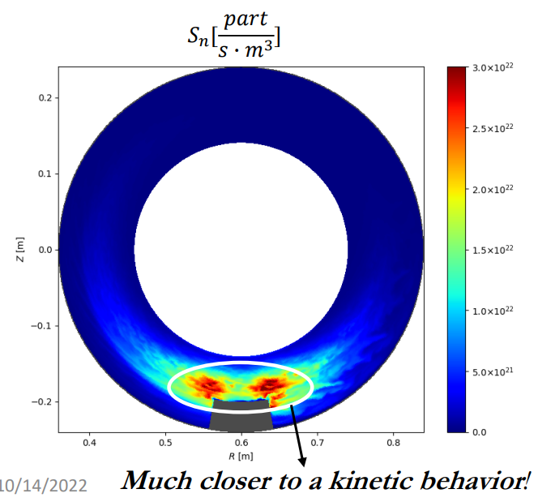
Turbulence towards high density regimes
Further progress to extend usage of neutrals in 3D turbulence simulations
GRILLIX: implementation of recycling boundary
GRILLIX and SOLEDGE3X: implementation of advanced fluid neutrals model (Horsten et al., NF 2017] completed
FELTOR: implementation of collisional gyro-fluid model
Constant diffusion model
Pressure-diffusion CX dominated model

Slide 11
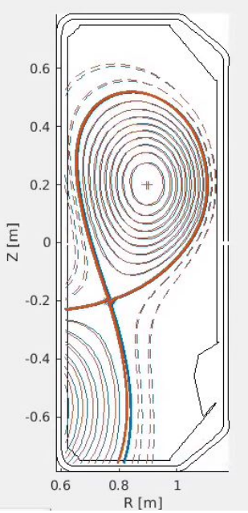
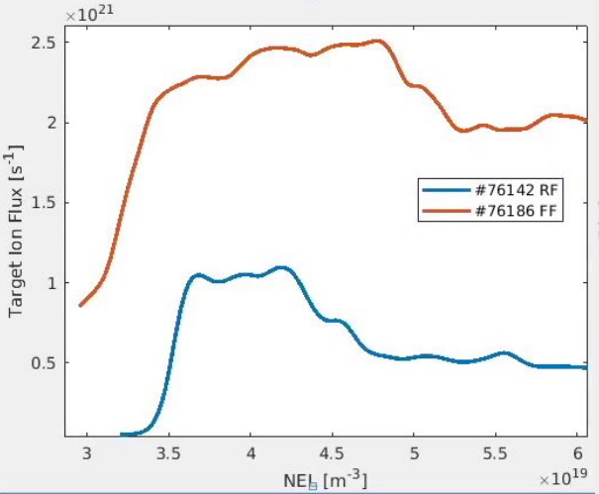
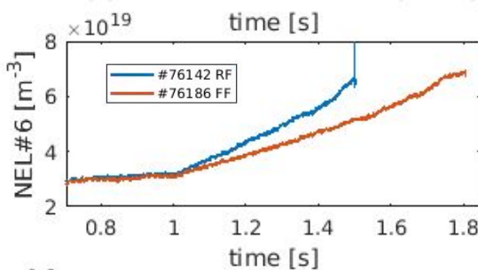
TCVX23 validation exercise
Dedicated TCV experiment for turbulence through density regimes (RT22-05):
  density scans in low field discharges adapted for modelling
  max diagnostics coverage for turbulence and profiles
Chosen as reference case for all TSVV3 codes

Slide 12
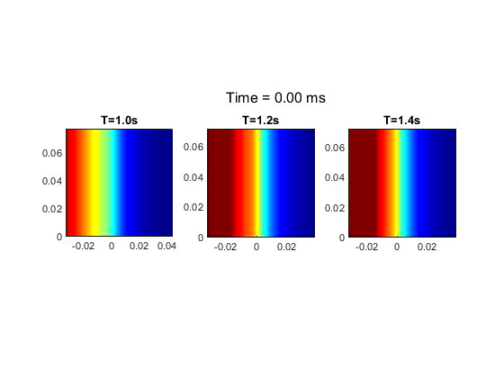
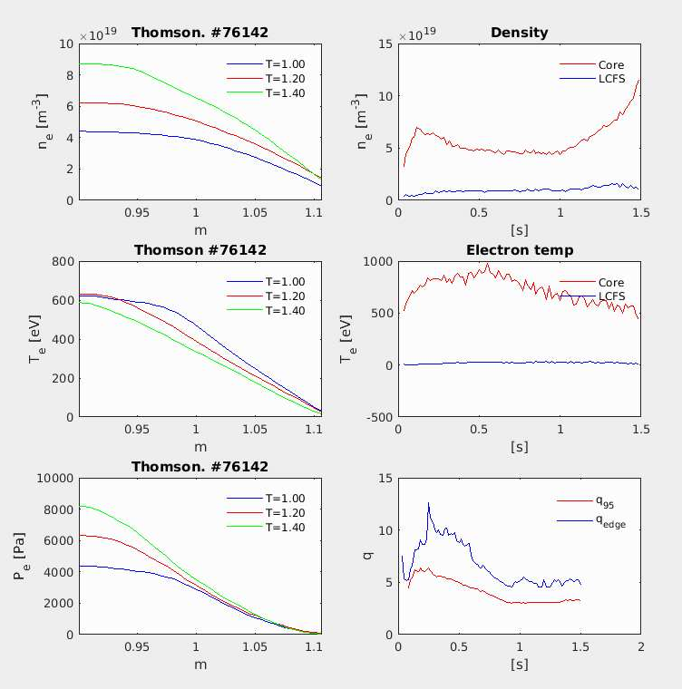
TCVX23: HESEL
Experimental data
TCV#76142
TCV 76142
B = 1.05 T (on axis)
B0 = 0.82T (outboard midplane)
q95 = 3.05
R0 = 0.88 m , r0 = 0.25 m

Slide 13
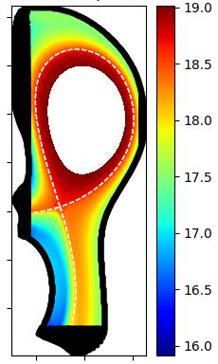
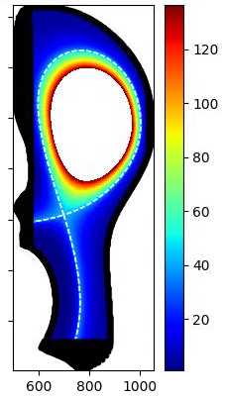
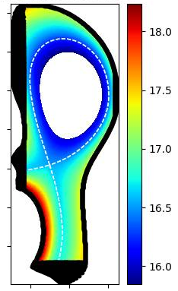
TCVX23: SOLEDGE3X
Log₁₀(n_{e} [m⁻³])
T_{e} [eV]
Log₁₀(n_{n} [m⁻³])
WIP… not for publication

Slide 14
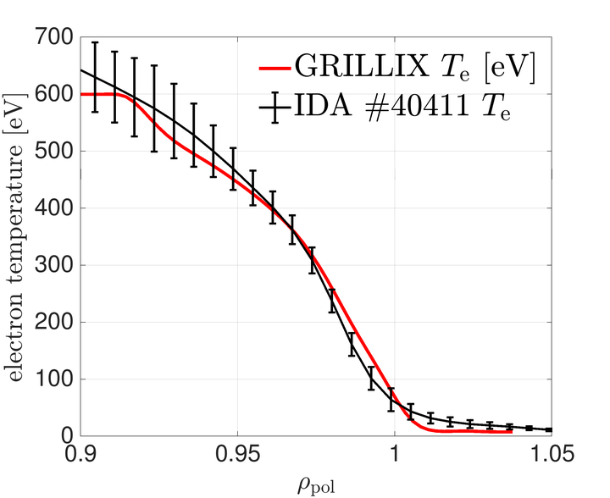
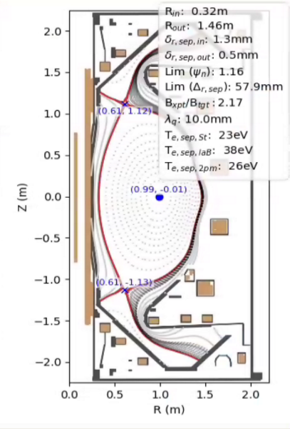
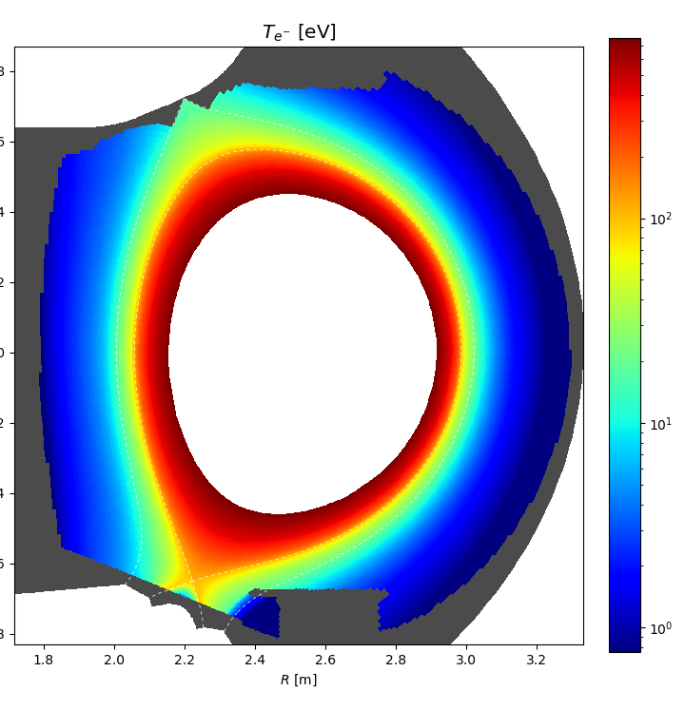
Other WPTE related validation exercises
FELTOR: MAST-U
GRILLIX: AUG H-mode
SOLEDGE3D: WEST high fluence (RT22-06)
MAST-U#46678
AUG H-mode plasma studies unlocked by recent code developments

Slide 15
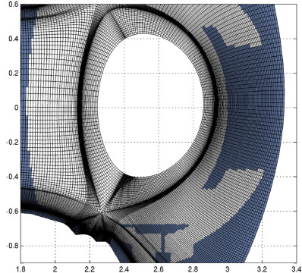
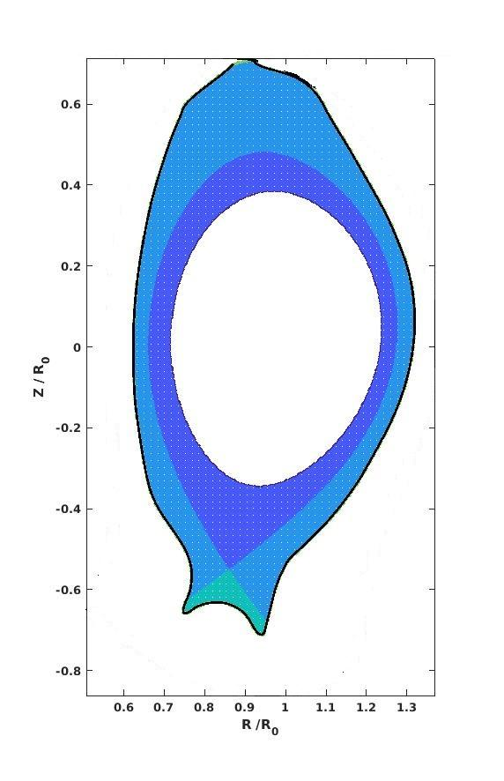
Wall compliance still challenging
Wall conformity necessary for reliable description of detachment physics
In SOLEDGE3X already available from 2D cases
  Working on optimizing robustness in 3D turbulence cases
Numerical schemes in GBS and GRILLIX being adapted to describe wall geometry following 2 different routes due to discretization schemes
  Solutions identified and being implemented
©SOLEDGE3X
@GRILLIX
@GBS

Slide 16
Impurities turbulent transport challenging
  Limits of Braginskii closure: close to unit mass and density ratios
    Not applicable to D-T plasmas among others
  Zhdanov closure implemented in SOLEDGE3X and applied to JET D-T-Ne disharges
    D/T far from uniform with possible implications for exhaust
[Bufferand, PPCF2022]

Slide 17
Impurities turbulent transport challenging
  Limits of Braginskii closure: close to unit mass and density ratios
    Not applicable to D-T plasmas among others
  Zhdanov closure implemented in SOLEDGE3X and applied to JET D-T-Ne disharges
    D/T far from uniform with possible implications for exhaust
  Extension to 3D turbulence on-going
    Objective: propose first self-consistent simulation of turbulent transport of impurities (incl. W) by beginning of 2024
    First application: WEST X-point radiator (RT22-05)
[Bufferand, PPCF2022]

Slide 18
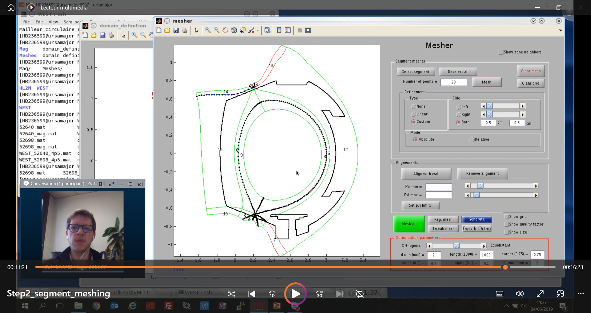
Making tools accessible
Strong effort in project to make numerical tools accessible to the community
  Codes accessible (or soon to be) either through Gateway repository or web-page
    EBC: https://gitlab.eufus.psnc.pl/tsvv3/ebc
    GBS: https://gitlab.eufus.psnc.pl/gbs/gbs-mirror
    SOLEDGE3X: https://gitlab.eufus.psnc.pl/tsvv3/soledge3x (and https://www.soledge3x.com)
    FELTOR: https://github.com/feltor-dev/feltor
    GRILLIX: up-coming soon (licence under discussion)
  Documentation and video tutorials in preparation (available mid 2023)
  IMASification of IO to allow easy set-up and post-treatment with experiments (synthetic diagnotics)
    Definition of specific IMAS structures close to completed
Video tutorial for SOLEDGE3X mesh generator

Slide 19
Summary
Plasma and BC models developed to extend hierarchy of models
Continuous development in code capabilities:
  3D magnetic geometries available in GBS, soon to be in GRILLIX
  Neutrals implemented to a point where density regimes addressable
  Wall conformity and impurities remains a numerical challenge
Step-up of validation effort capitalizing on new capabilities
  TCV validation experiment at high density (“TCVX23”)
  Applications to AUG (GRILLIX), MAST-U (FELTOR), TCV (GBS), WEST (SOLEDGE3X) experiments
Further developments in support of codes’ usage by community: IMASification, synthetic diagnostics, tutorials…

Slide 20
Additional slides

Slide 21
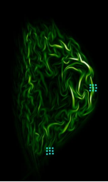
Facilitating comparison with experiments
Action started to port I/O of codes to IMAS
  Decision to do it via wrappers (e.g, Python) not internally
  Step 1: commonly agreed definition of needs in terms of data input / output - done
  Step 2: identify need or not for new IDSs (existing incomplete “edge turbulence” IDS) – on-going
Progress on synthetic diagnostics
  Standard for embedded Langmuir probes synthetic diagnostics defined and being implemented
  Coupling to standard libraries (e.g. CHERAB) through IMAS
Langmuir probes in FELTOR (illustration)

Slide 22
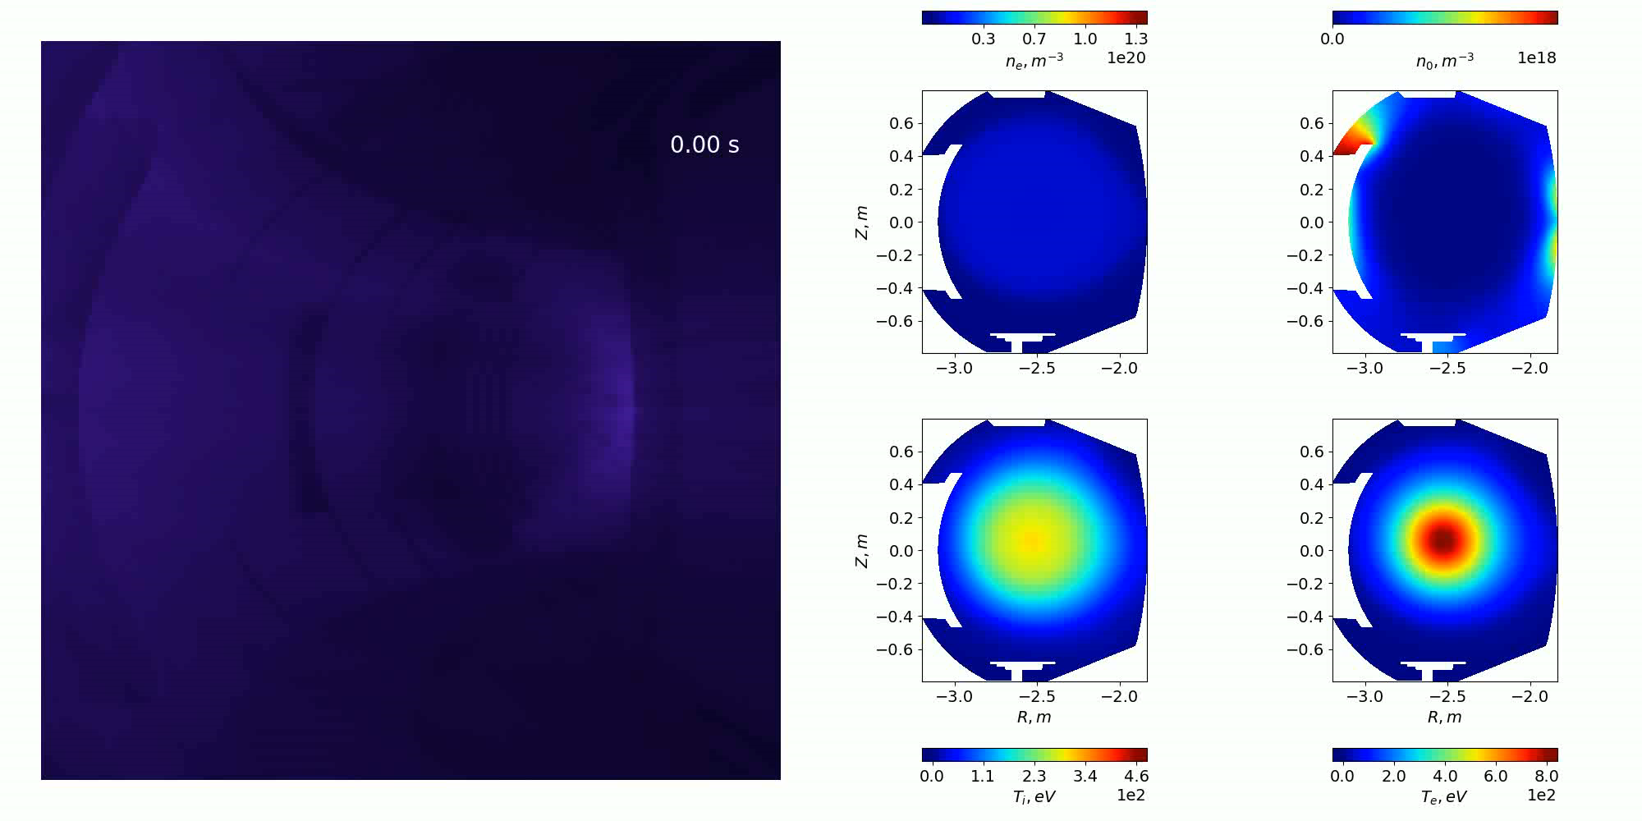
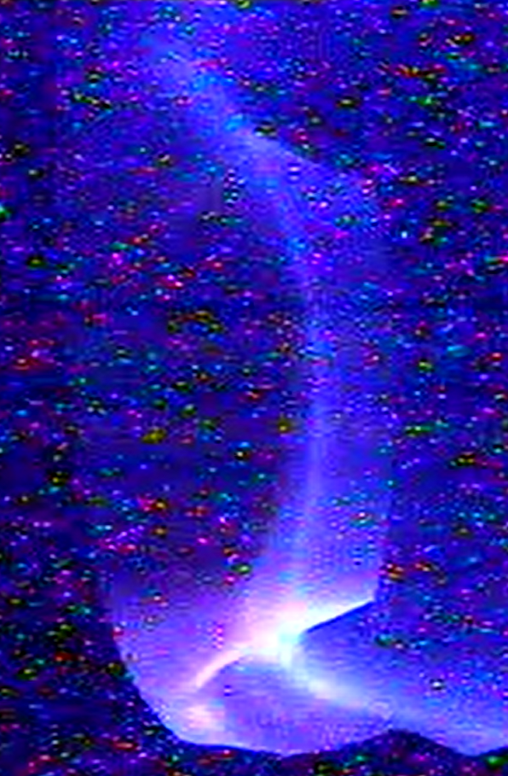
A first application: WEST visible camera
WEST pulse
© SOLEDGE-HDG
[Courtesy A. Medvedeva, M2P2 laboratory]

Slide 23
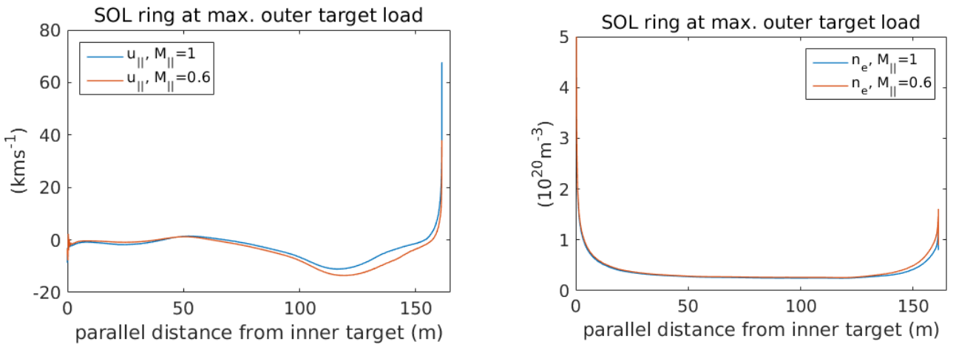


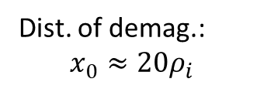

Revised model for BC tested in SOLPS
$$α=V_{∥}^{D}/V_{∥}^{D+}$$
  Analytical model fits well PIC data:
$$χ=\frac{\left(ν_{mt}\left(1−α\right)+ν_{ei}\right)x_{0}}{2c_{s}\sin{θ}}$$
Dist. of demag.:
$$x_{0}≈20ρ_{i}$$
$$M_{∥}=1+χ−\sqrt{χ^{2}+2χ}$$
[Tskhakaya, EPS 2021;
D. Moulton, ISFN 09/2021]
Ion-atom momentum transfer frequency
Incidence angle
  First application in SOLPS => 60% difference in target density, likely to impact divertor regimes
  Generalization to multi-species plasmas on-going

Slide 24
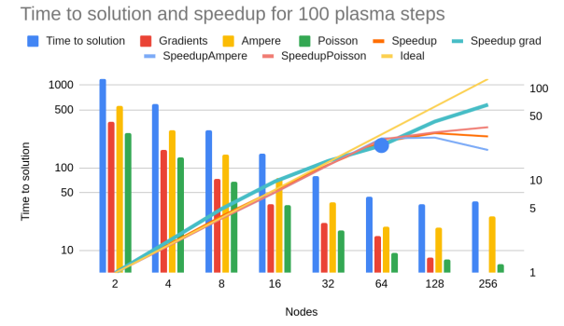
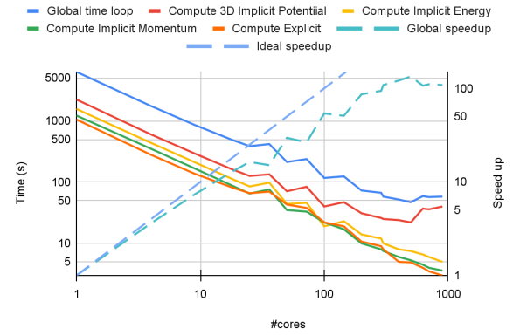
Codes performance optimization
Strong collaboration with ACH focusing on:
  Implicit solvers optimization (common botteleneck) => HYPRE as attractive option (good perf., hybrid paralleization, GPU version (AMGX))
  Codes profiling completed, started implementing recommendations => essentially porting to GPU, but also load balance optimizations…
[https://wiki.euro-fusion.org/images/9/9f/Report_2021_TSVV3_ACH_EPFL_Task4_code_optimization.pdf]
GBS scaling report
SOLEDGE3X scaling report

Slide 25
Beyond the Zhdanov closure
  Several limitations to Zhdanov’s closure: single ion temperature, small departure from mass-average flow velocity
  On-going theoretical developments to go beyond these limitations
    Practically implementable generalization of Zhdanov’s closure
    On-going implementation in FELTOR, GRILLIX and SOLEDGE3X
[Raghunathan, PPCF 2022]

