Slide 1
Summary of the EUROfusion data management project
Pär Strand, Chalmers, for EUROfusion and DMP SiCo team
EF-IO coordination meeting| 2023-10-10

Slide 2
EUROfusion Data management Plan
The data management plan defines 4 scenarios of increasing ambition
Scenario A: making metadata only available and searchable using IMAS data subsets for interoperable definitions of quantities [F,(I)].
Scenario B: adds to Scenario A by allowing a subset of the data to be accessed using common tools (for example UDA). Facilities are responsible for the access level and qualification of data through the data mappings [F,A,I,(R)].
Scenario C: builds on the previous stages and allows for enhanced data provenance and referencing through PID’s [F,A,I,R].
Scenario D: adds a lightweight layer for open access to non-embargoed metadata and where allowed by the facilities also data access for export in human readable formats (CSV files) [F,A,I,R] and open.

Slide 3
EUROfusion Data management Plan
The data management plan defines 4 scenarios of increasing ambition
Scenario A: making metadata only available and searchable using IMAS data subsets for interoperable definitions of quantities [F,(I)]. Implement!
Scenario B: adds to Scenario A by allowing a subset of the data to be accessed using common tools (for example UDA). Facilities are responsible for the access level and qualification of data through the data mappings [F,A,I,(R)]. )]. Prototype! Start implement!
Scenario C: builds on the previous stages and allows for enhanced data provenance and referencing through PID’s [F,A,I,R]. Defer. Resource restricted but important!
Scenario D: adds a lightweight layer for open access to non-embargoed metadata and where allowed by the facilities also data access for export in human readable formats (CSV files) [F,A,I,R] and open. Defer.

Slide 4
Implementation
The portal interface and development activities will be hosted on the Gateway Supported by a Core team for the central services
Documentation, software and ticketing will be integrated with the existing PSNC based gitlab and jira services.
The Infrastructure will be built on the Fair for Fusion provided software tools and developed practices, e.g., Blueprint architecture
Initial sites are proposed to consist of
AUG, JET, MAST-U, TCV and WEST
Requirements driven by user and in particular user applications TSVV/ENR and other FSD/FTD projects

Slide 5
Central services
Core Facilities
Portal
Helpdesk
Prototyping
Deployment and Hardening
Maintenance
Ticketing system
User Support
UDA support
Enhancements
Production use
Portal extensions
Focus 2023 -
Exp. profiles
2024-

Slide 6
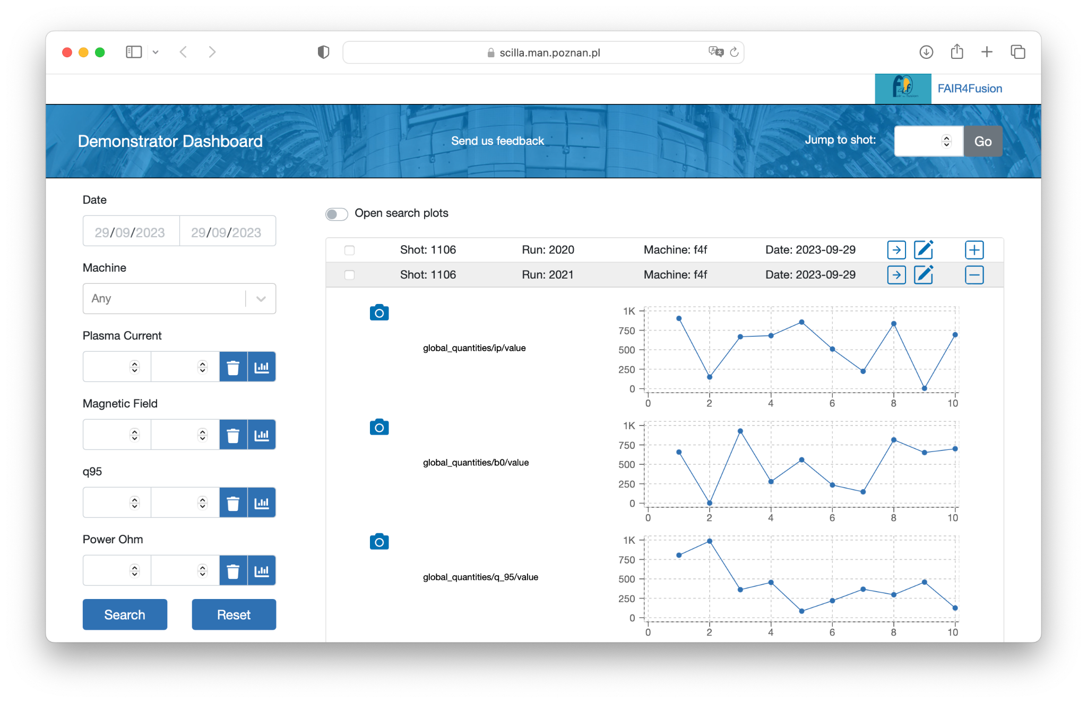
Core Services - for the users
Users (researchers) will mostly focus on the search engine and user interface
Metadata access, next step allow for downloading of a subset of experimental data in IMAS format
Give it a try and tell us
what you think!
DMP Feedback Google Form
https://scilla.man.poznan.pl/dashboard/

Slide 7
Core Services
Current development is focused on
Developing the User Interface and improving User Experience
Delivering improved performance (highly responsive application)
Looking at optimization of data retrieval/collection
Next stage work
providing unified and simplified access to experimental data
Technology underpinnings:
Authentication and Authorization Infrastructure
new data sources for Catalog QT 2 (e.g. HDF5 / CSV / simDB)
developments related to `UDA` - e.g. Docker based server / client
General approach
delivering software based on state of the art software development practices: Unit Tests, Integration Tests, automatic delivery of all the components (CI/CD, test releases, nightly builds)

Slide 8
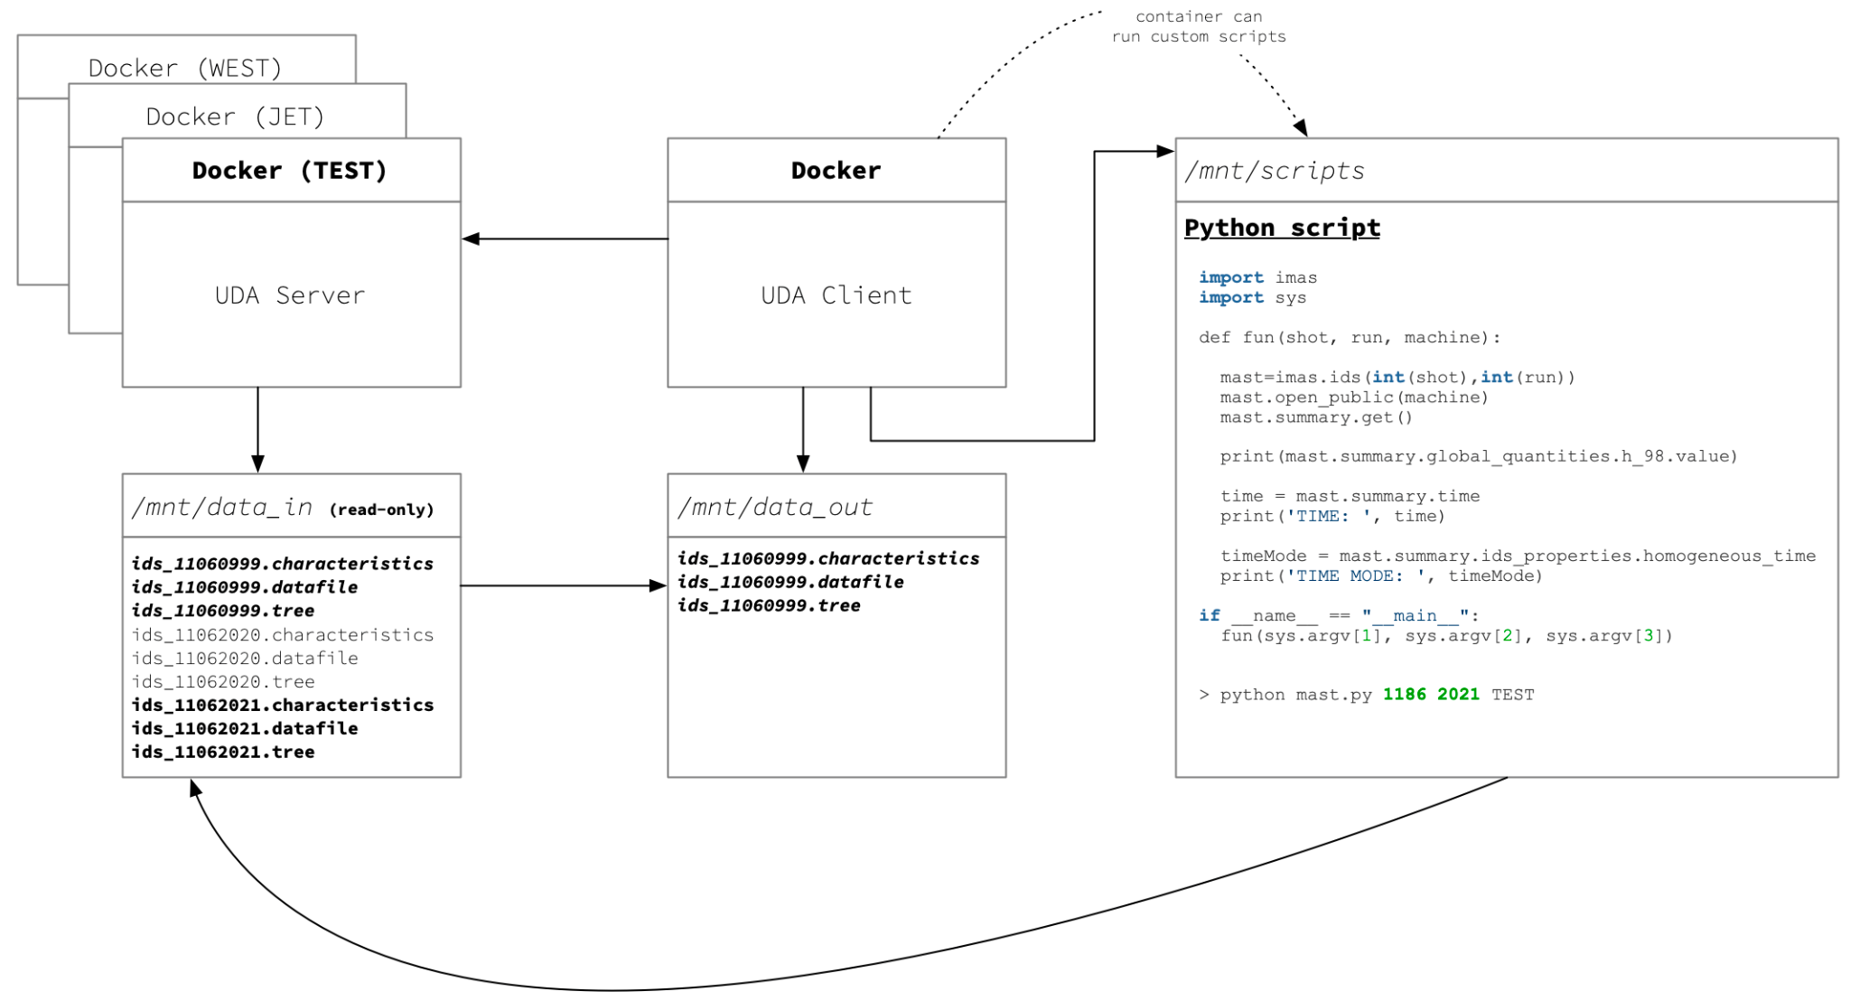
Core Services - for the data owners
Data owners can benefit from Docker based `UDA` solution - client / server
https://gitlab.eufus.psnc.pl/containerization/imas/imas-installer/-/tree/main#uda

Slide 9
Site activities
Sites
Data Access Services
Data Mappnings
Workflow
Prototyping
IMAS Infrastructure
Metadata DB
Integration (push data to portal)
UDA support (data access, workflow)
Scenario B
- AAI necessary
- UDA call from portal
- Local to users
(No secondary storage of exp data)
Extended data mappings
Scenario A
Static uploads
test data
Available
Extensions 2023/24
Push data
(automagic)
To be developed
2024?
AAI integration
Installation
and testing
Autumn 2023
Data mappings continous activity growing based on users needs (applications driven) (CCFE tool + JSON mapping file,…)

Slide 10
Site Services
Discussions with AUG,WEST, TCV, MAST-U, JET, (W-7X), COMPASS-Upgrade. (ongoing)
Restarted due to reformulation of the scenario B implementation
Bespoke tools to provide ”static” metadata CSV or similar for use in portal/dashboard testing. (available/data extensions needed)
Aim is to allow for automatic updates pushed from the data providers (development work 2023/24)
May be supported by UDA installations
Installation and testing of IMAS/UDA installations on each site (started on most sites)
Mapping existing tools and knowledge to project needs - join forces with ITER work on experimental data mappings? (not yet or barely started)
Discussions with users /code owners/developers and the TSVV projects to define scope of data mappings. (to be started this fall but input available for some stakeholders already)
Important external dependency AAI to secure that access is properly authorized. (started but implementation pace is not clear for all parties).

Slide 11
Status and reflections - discussion points?
Status:
DMP scenario A on path, scenario B reformulated with new resource allocations.
Concerns on integration with modelling/simulation data! LTSSF?
Reflections (collected from stakeholders and “others”)
Disruptive update for DD4/AL5 (non backwards compatible changes - fundamental change of geometry description)
Experiments: wait to push experimental mappings until fully available?
Customer side delays anticipated - rewrite of code base, revalidation, revisit already done IMASification work! IMASification already slow and questioned!
In general:
mature enough infrastructure to invest in? Fit for purpose? Governance and steering! BUT, probably the way to go.
Muddled responsibilities/task separation ACH/TSVV vs ITER contractors
Risk for overlap and duplication?
What interfaces to use for charges?

