Slide 1

IMAS Status and Plans
O. Hoenen, ITER Organization
On behalf of contributors within ITER Members, contractors and IO

Slide 2
Outline
IMAS Progress Status
  Data Model
  Generic Tools
  Applications for ITER
Future Plans, Licensing and Communication

Slide 3

IMAS Progress Status
Applications
Data Analysis
Generic Tools
Data access
Data-Dictionary 3
Heating & Current Drive workflow
Data Model
Data visualization
Workflow and coupling tools
Database management
High-Fidelity Plasma Simulator
Experimental data mapping survey
Pulse Design Simulator
Status of Data-Dictionary 4
Documentation and tools
Other Activities

Slide 4
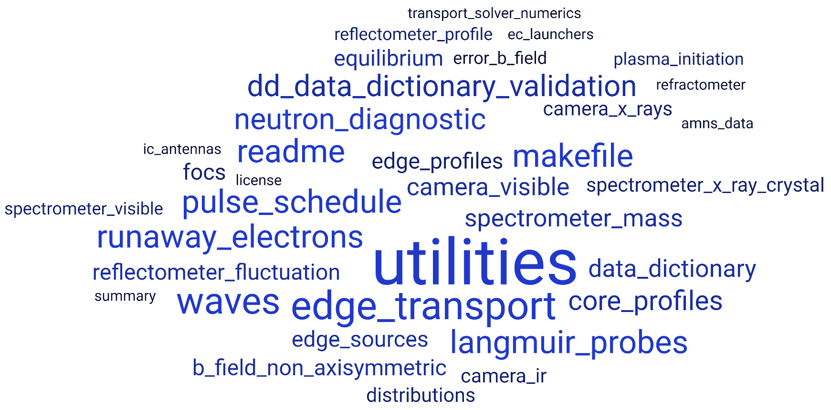

Data-Dictionary 3
Releases 3.38.1 and 3.39.0
Data-Dictionary support (FWC=IMAS Framework Contract)
IO - IPA (ITER Project Associate) + contrib.
4 new IDSs
Revisions and changes
Improved checks in CI
Fix coordinate inconsistencies
Install and query tool in Python
new spi and pf_plasma
redesigned em_coupling and gyrokinetics_local
in develop/3:

Slide 5




Data-Dictionary 4
Data-Dictionary support (FWC)
IO-IPA + contrib.
Development started on branch develop/4
Available for testing on SDCC
  Develop-based build for DD4/AL5: module load IMAS/dd4-intel-2020b
Remove obsolescent nodes |  | Remove time node from constant IDSs
Redesign dataset_description |  | Atomic mass and nuclear charge
Explicit alternate coordinates explicit |  | Circuit definition in pf_active
Definitions of elongation in equilibrium |  | Segments in pulse_schedule
Clarify poloidal flux (remove COCOS dep.) |  | Sync with 3.39.0 (and with new DD3 tags)
Names and language consistency

Slide 6
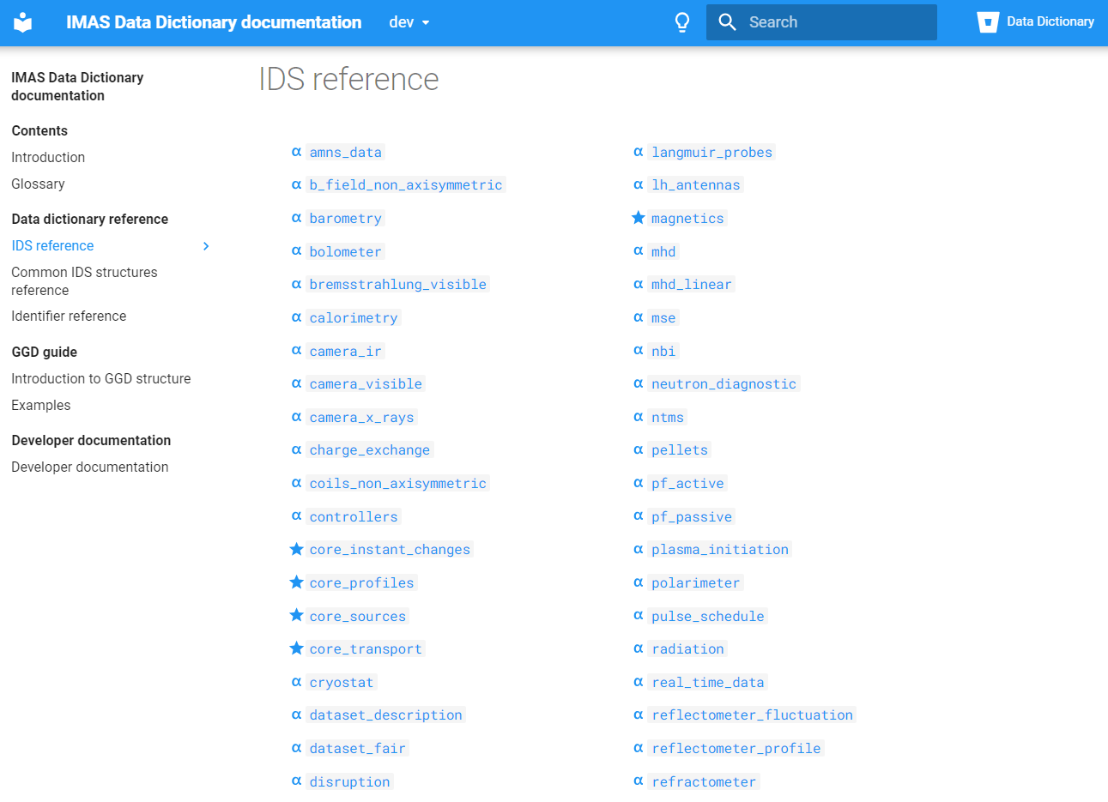

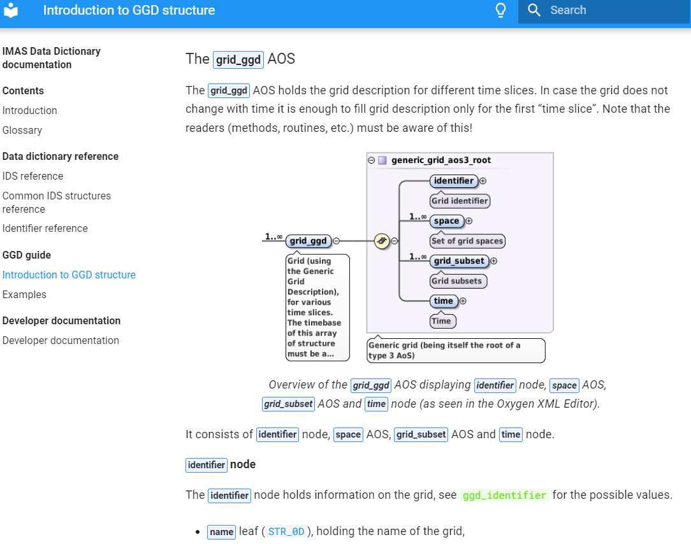
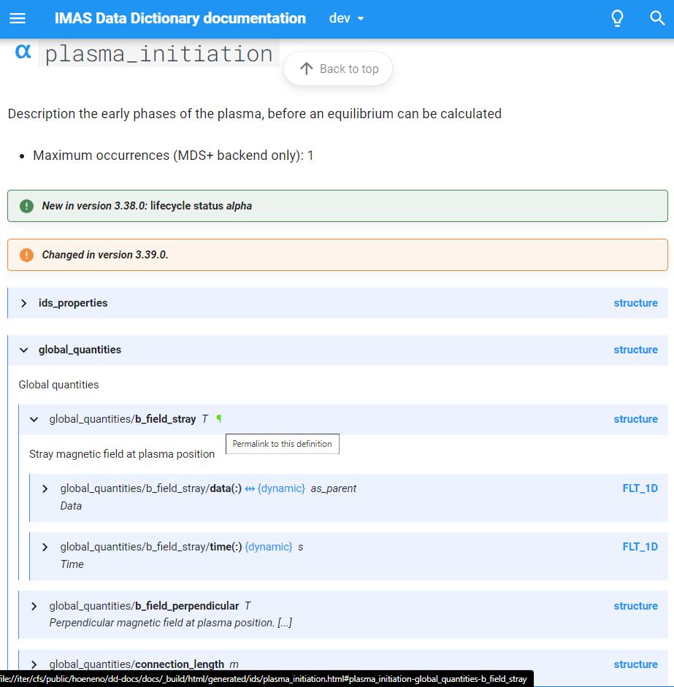
Data-Dictionary Documentation
try me
Data-Dictionary support (FWC)
New Sphinx-based documentation
  Will replace current doc (static html pages)
  Integrates introduction from PDM and GGD doc
  Navigation tree, permalinks, shared identifiers, …
  Open points: flat view?

Slide 7
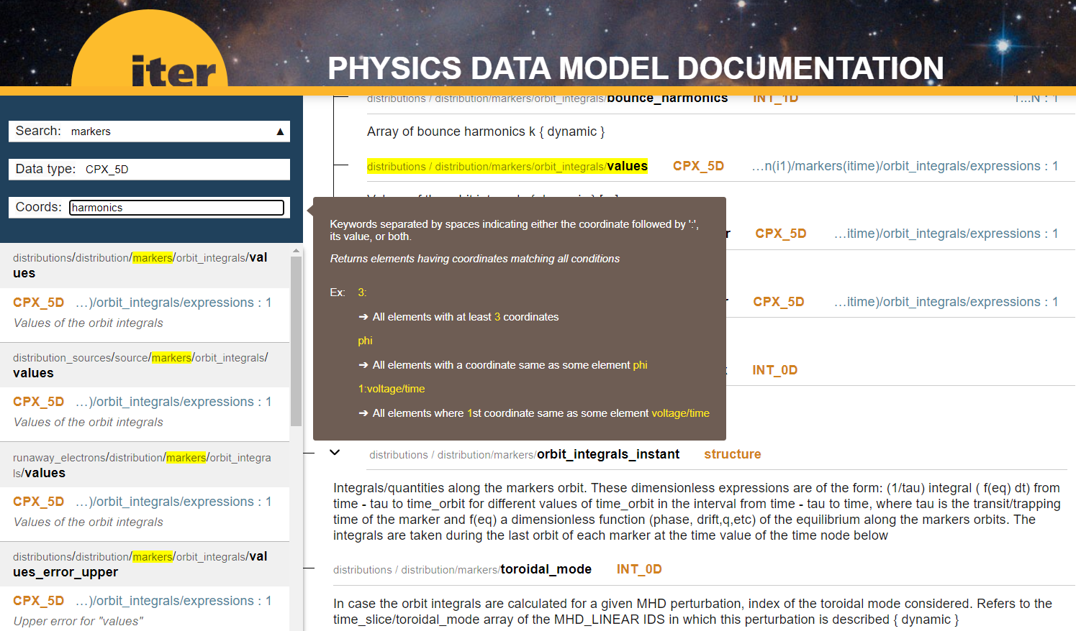
Data-Dictionary Search Tool
Data-Dictionary support (FWC)
try me
New search tool to query information from the Data-Dictionary
  Based on JavaScript / jQuery
  Search through field’s name, path, description and meta-data (type and coordinates)
  Open points: features, relevance, performance, integration with Sphinx documentation

Slide 8
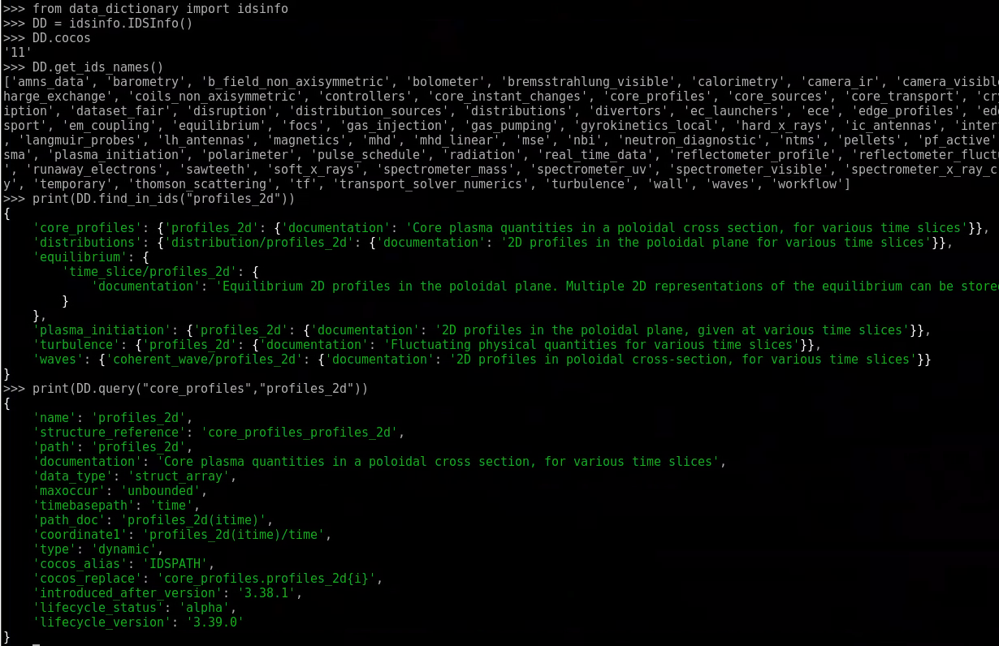
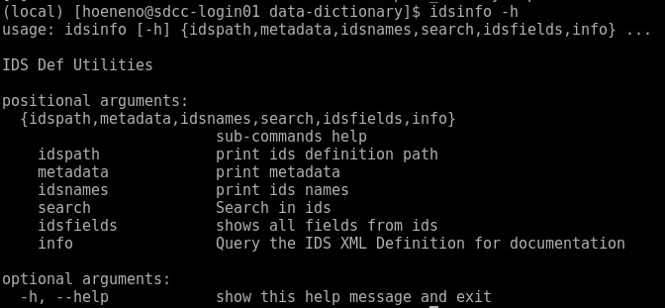
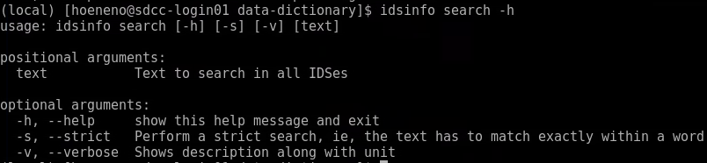
Data-Dictionary Python package
Data-Dictionary support (FWC)
IO-IPA
Search and query information on the DD
  Installed with pip together with IDSDef.xml
  In a Python script with the data_dictionary package
  From the command line tool idsinfo

Slide 9
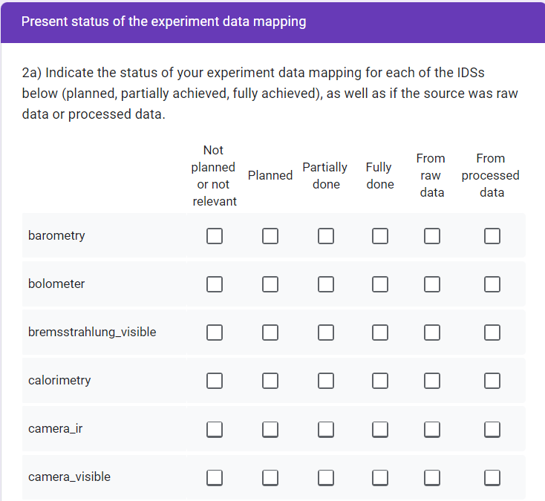
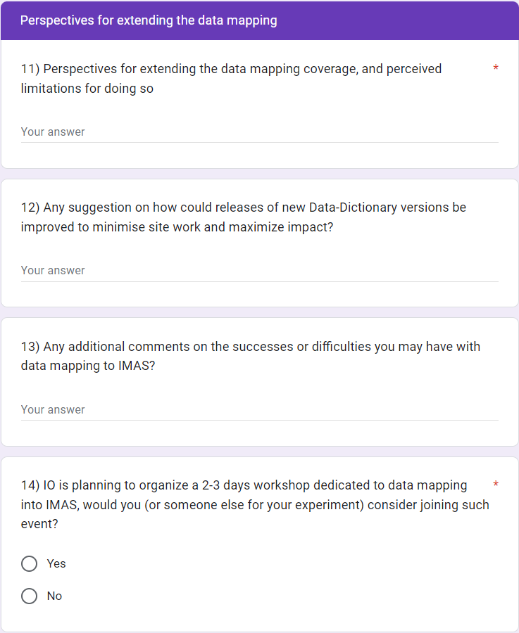
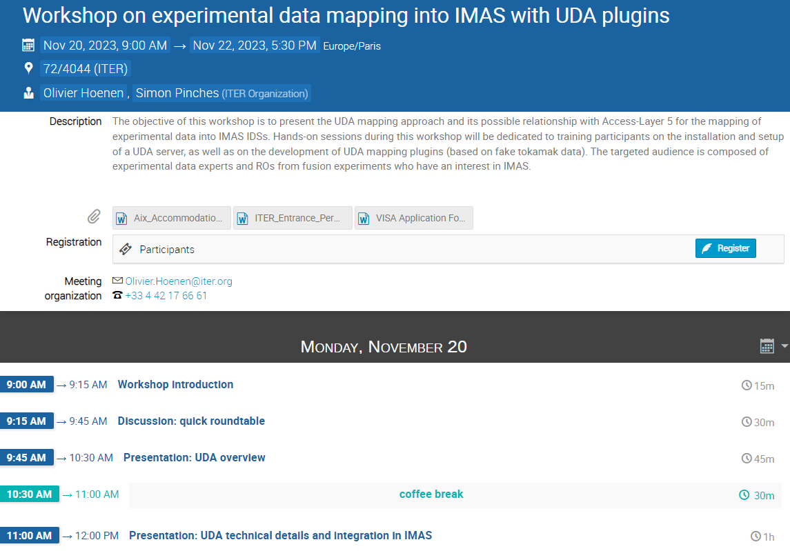

Experimental Data Mapping
More details in presentation Data Mapping: Preliminary overview
Current mapping status at experiments
  A short questionnaire with 15 items
  Sent on Aug 3rd to ~16 ROs
  Received answers from 9/10 tokamaks
Data-Dictionary support (FWC)
Implementing Agreement UKAEA (Task 6 + 5)
Preparing a workshop on data mapping
  20-22 November, hybrid format
  UDA and UDA mapping plugin training
  Registration is open
More details in a dedicated presentation

Slide 10
IMAS Progress Status
Applications
Data Analysis
Generic Tools
Data access
Data-Dictionary 3
Heating & Current Drive Workflow
Data Model
Data visualization
Workflow and coupling tools
Database management
Experimental data mapping survey
Status of Data-Dictionary 4
High-Fidelity Plasma Simulator
Pulse Design Simulator
Documentation and tools
Other Activities

Slide 11
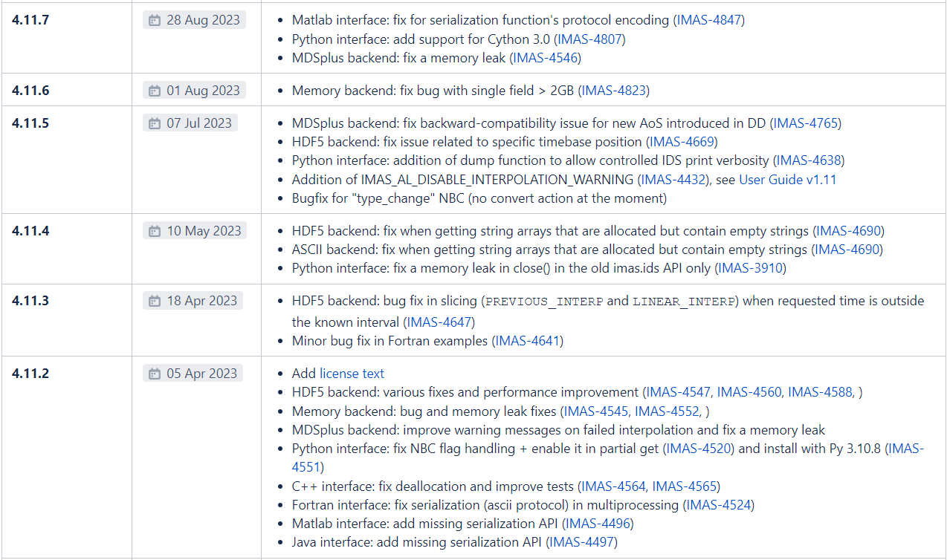
Access-Layer 4
Persistent Actor Framework
Access-Layer support (FWC)
IO-IPA + contrib.
Bug fix releases 4.11.2 → 4.11.7
  Fix memory leaks, interpolation, serialization
  Fix field > 2GB in MDSplus
  Support for Python 3.10.8 and Cython 3.0
  Finale update of User Guide in IDM

Slide 12
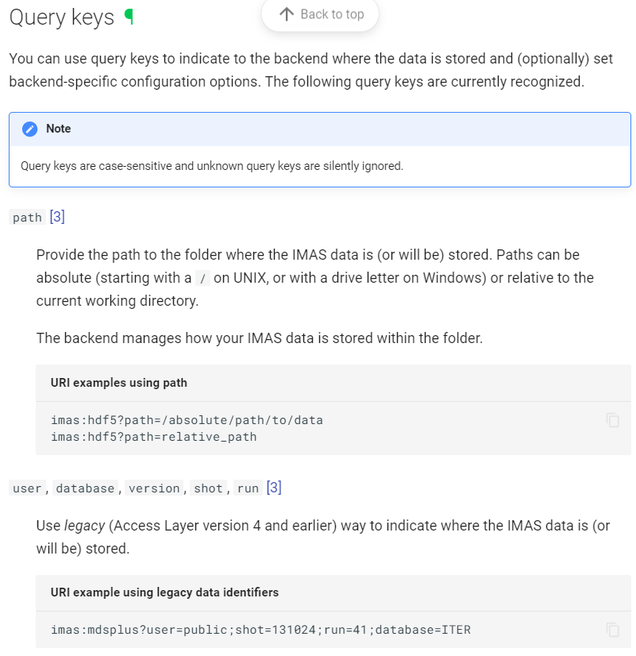
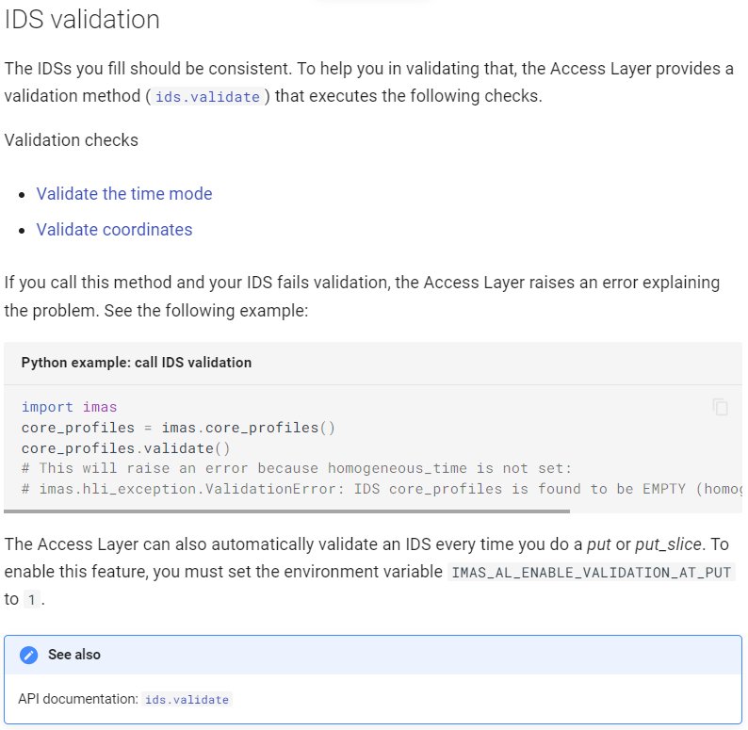
Access-Layer 5
SimDB/UDA
Access-Layer support (FWC)
IO-IPA + contrib.
First release 5.0.0 (Aug 4th)
  New UDA backend (requires UDA ≥ 2.7.1 with Cap’n’Proto)
  Remove limitation of MDSplus (new file layout)
  New open(URI) API (can take legacy arguments)
  Simplified lib and pc files names (no compiler dependency)
  Consistency of lowlevel functions names (UAL→AL)
  New plugin infrastructure (with a few examples in beta)
  Remove old APIs (imas.ids Python, matlabinterface)
  New coordinates check function (Python only for 5.0.0)

Slide 13
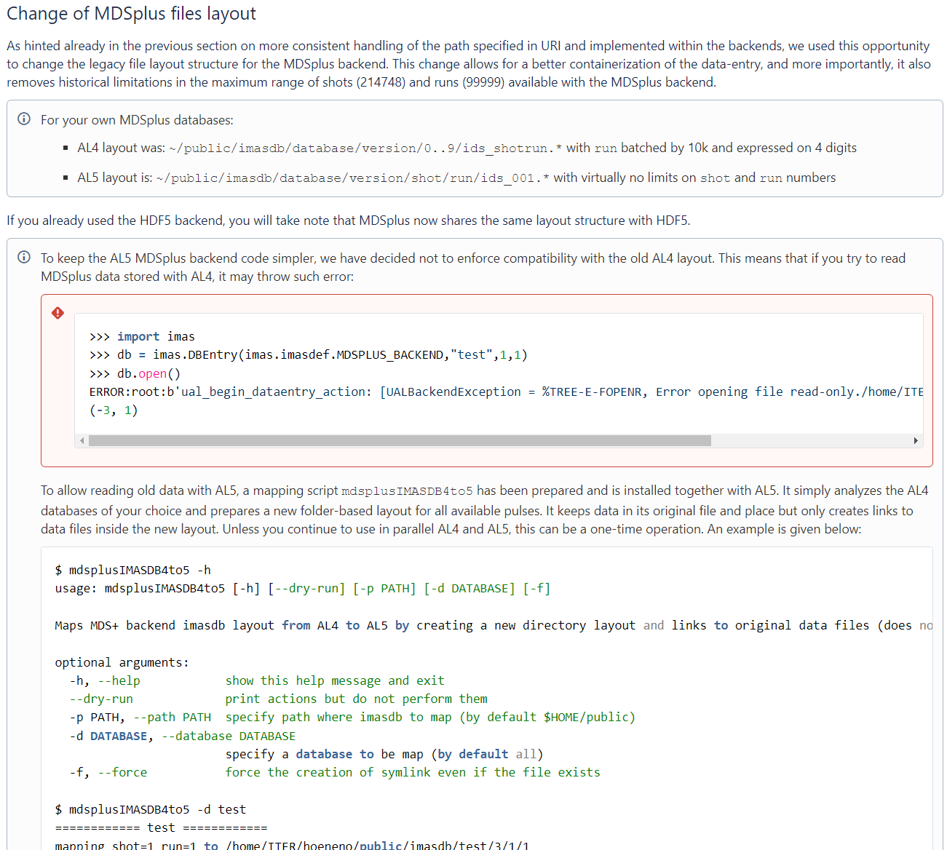
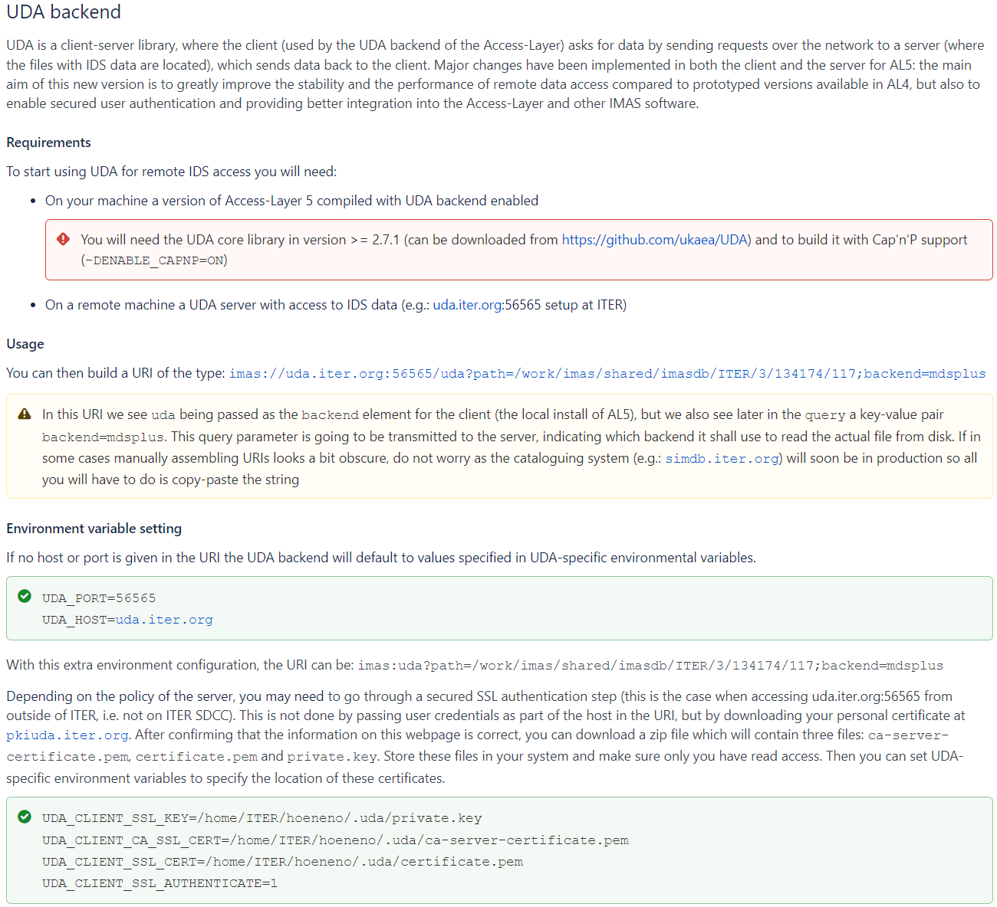
AL5 Cheat Sheet
Check it here
Tips to support users in migrating from AL4 to AL5
  Compatibility and changes (API, lib and pkg-config names)
  Script to convert MDSplus databases to the new layout
  UDA client configuration for servers with authentication

Slide 14
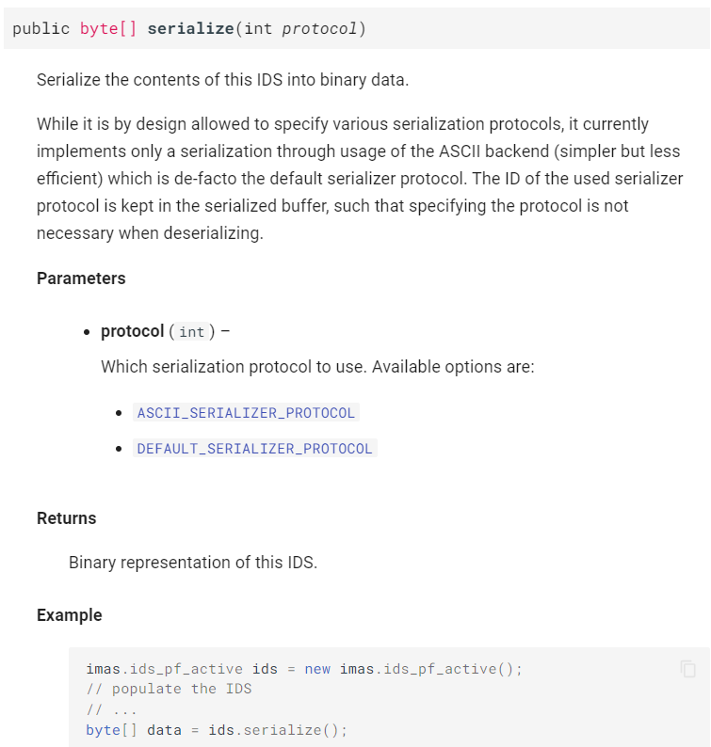
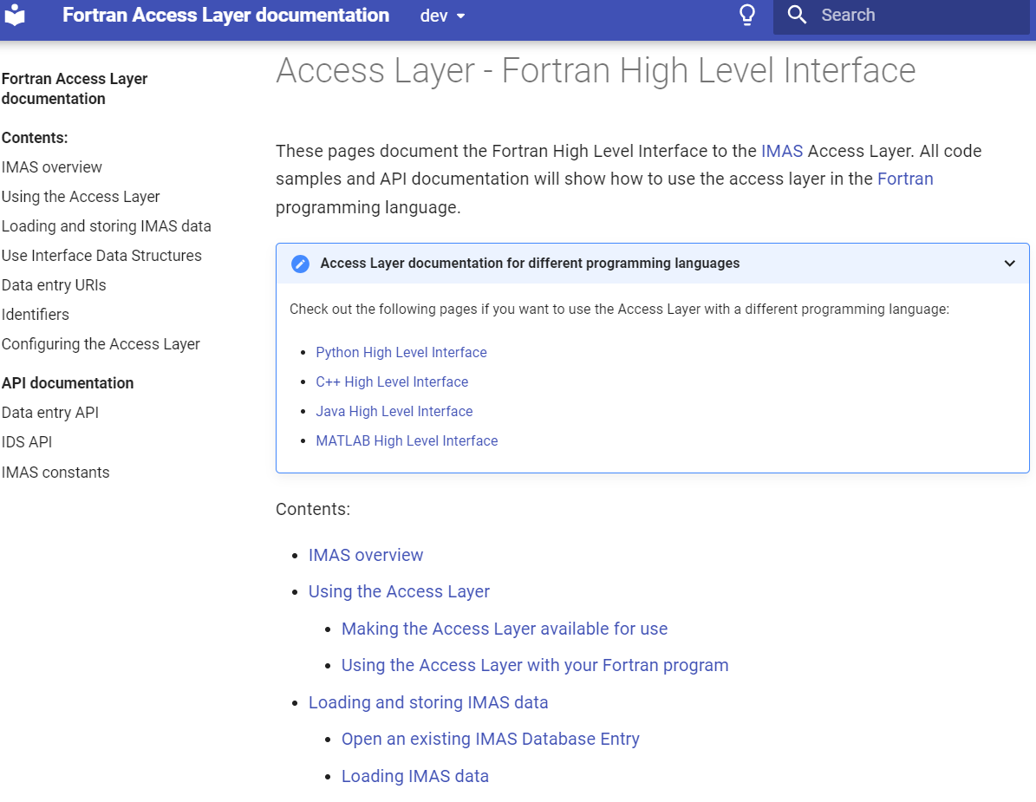
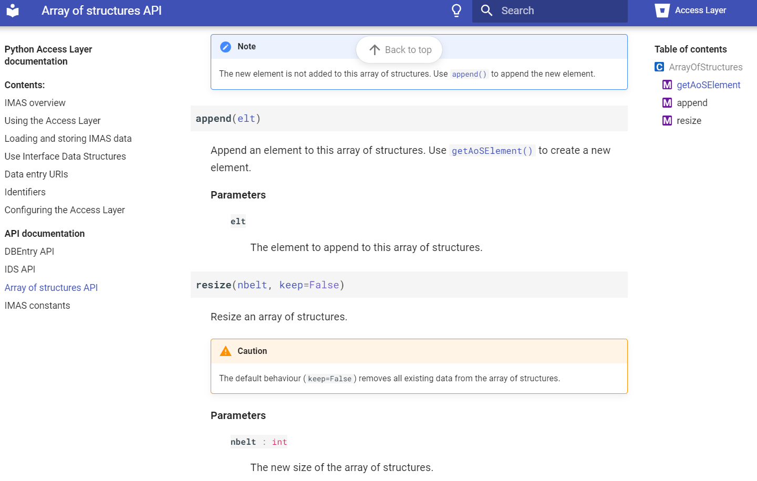
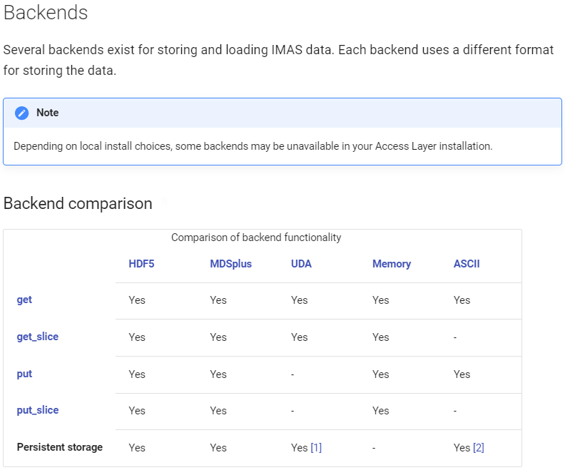
AL5 Documentation
Access-Layer support (FWC)
New Sphinx-based documentation
  Separate languages: Fortran, C++, Python, Matlab, Java
  Includes examples and use-cases
  User and API documentation

Slide 15

AL5 Developments
Access-Layer support (FWC)
IO-IPA
Ongoing and planned developments in AL5
Latest version for testing (based on develop branch)
  Load module IMAS/dd3-intel-2020b (or IMAS/dd4-intel-2020b for DD4)
Feature | Status | Release | When
Finalize validate function for all languages and alternate coord (DD4) |  | 5.0.1 | Q4 2023
Add documentation for plugins framework |  | 5.0.1 | Q4 2023
Add support for constant IDSs (no timed field - DD4), fix tests accordingly |  | 5.x.y | Q4 2023
Add functions in all languages to list occurrences and their meta-data |  | 5.x.y | Q4 2023
Split the repository and install separately (using EasyBuild on SDCC) |  | - | Q1 2024
Add the Hierachical Dynamic Container (HDC) interface |  | - | Q1 2024
Add functionality to retrieve IDS data for a specific time-range |  | - | Q2 2024

Slide 16
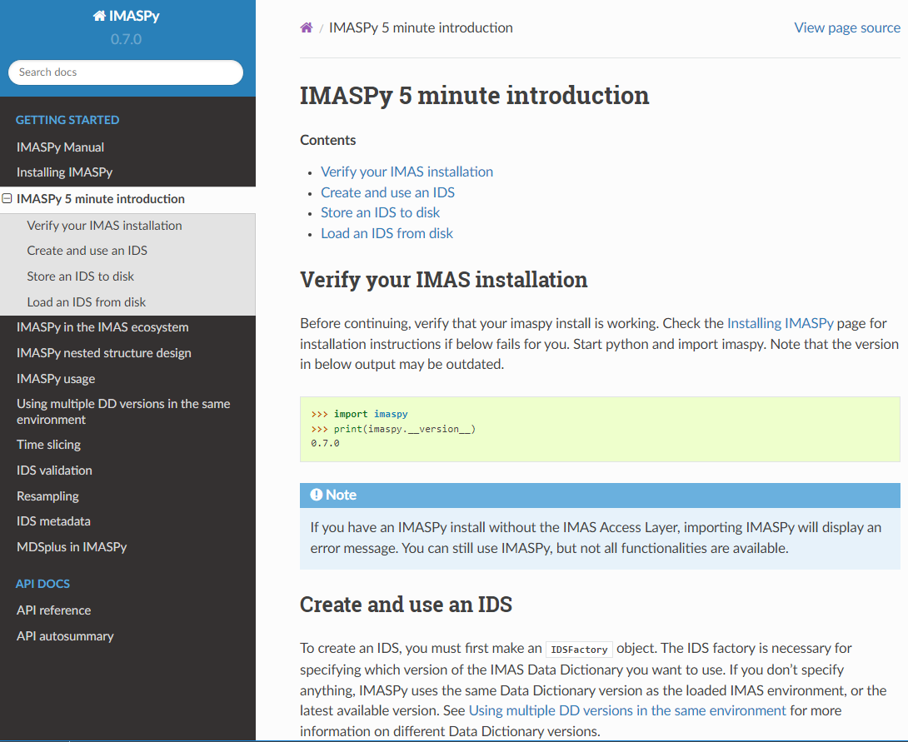
IMASPy
IMASPy support
Releases 0.6.0 to 0.7.1
  Improve CI, tests, build, documentation
  Add support for complex numbers
  Add API to retrieve meta-data
  Add serialize and validate functions
  Modify API (add DBEntry and IDSFactory)
  Add in-memory conversion between DD versions
Ongoing developments
  URI API and compatibility with AL5
  Lazy data loading
  Enable data nodes duck typing
  Training material for beginners/advanced users
  Benchmarking incorporated to CI pipeline (asv)
v1.0.0
More details in presentation IMASPy: Status and plans

Slide 17
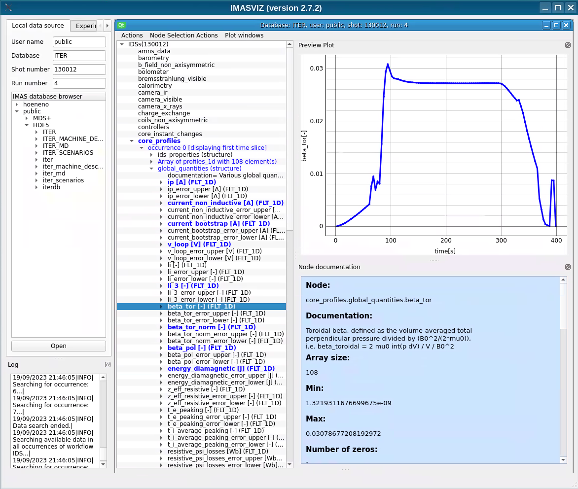
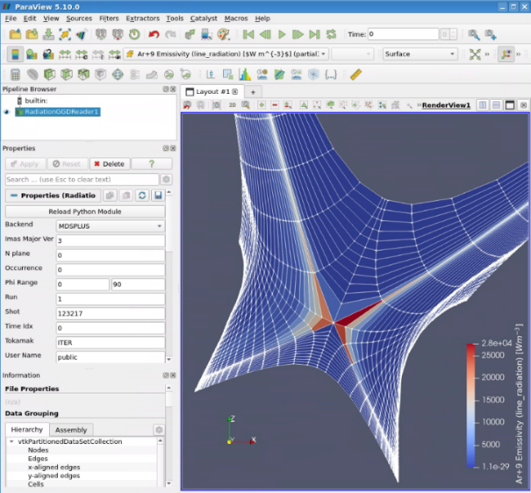
Visualization and Command Line Tools
IO-IPA + contrib.
GGD-VTK 0.2.x
  Improve logging
  Add units retrieval
  Update DD support to 3.39.0
Viz release 2.7.x
  Pure technical update
  Use PySide6 rather than PyQt5
    More flexible LGPL license
  2.7.2 not yet compatible with AL5 ☹
IDStools releases 1.14.x
  Add geqdsk2ids (EQDSK file → equilibrium IDS)
  Add validate_db_entry (validate IDS against pre-defined rules)
  Support matplotlib ≥ 3.5 (scenplot, kinplot, pressureplot, rotationplot)
  1.14.1 compatible with AL5 ☺ (+ patch imasdbs tool to deal with dual AL4/AL5 DBs)
More details on ongoing effort in presentation IDStools 2: Overview and plans

Slide 18
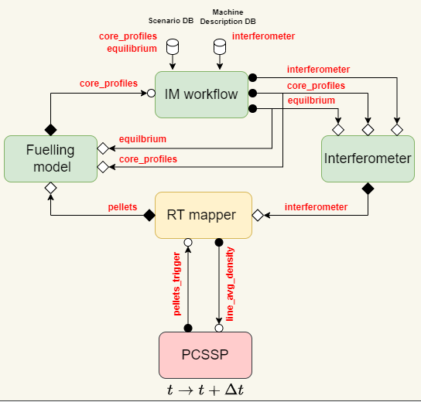
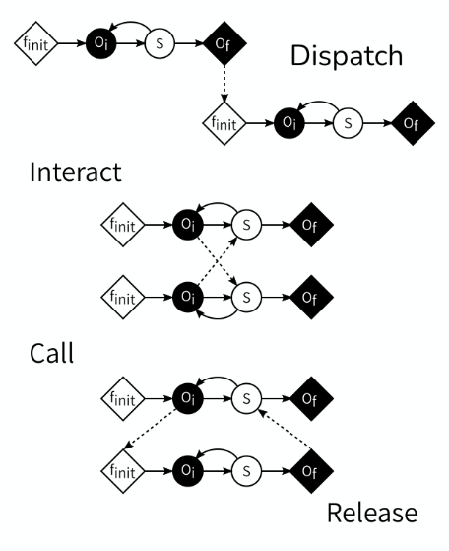
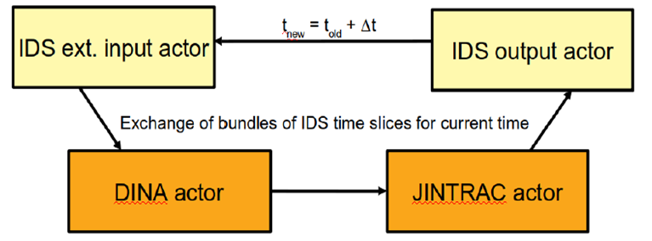
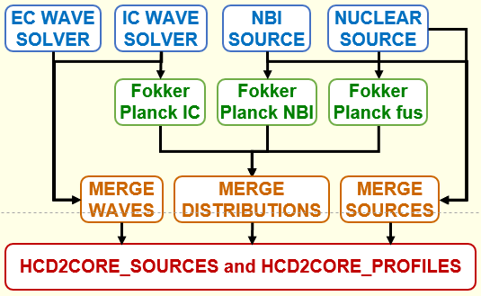
Coupling & Workflow Tools
Persistent Actor Framework
iWrap support
IO-IPA + contrib.
Persistent Actor Framework
  Based on MUSCLE3
  For building more complex applications
  Actors running in separate processes
  Distributed logic (declared in config. file)
  Some actors can be generated by iWrap
iWrap
  For rapid prototyping in Python
  Actors called by an orchestrator
  Centralized logic (implemented in script)
  Extended to generate MUSCLE3 actors
More details in presentation IMAS-PCSSP co-simulation with MUSCLE3
More details in presentation iWrap: Status and plans

Slide 19

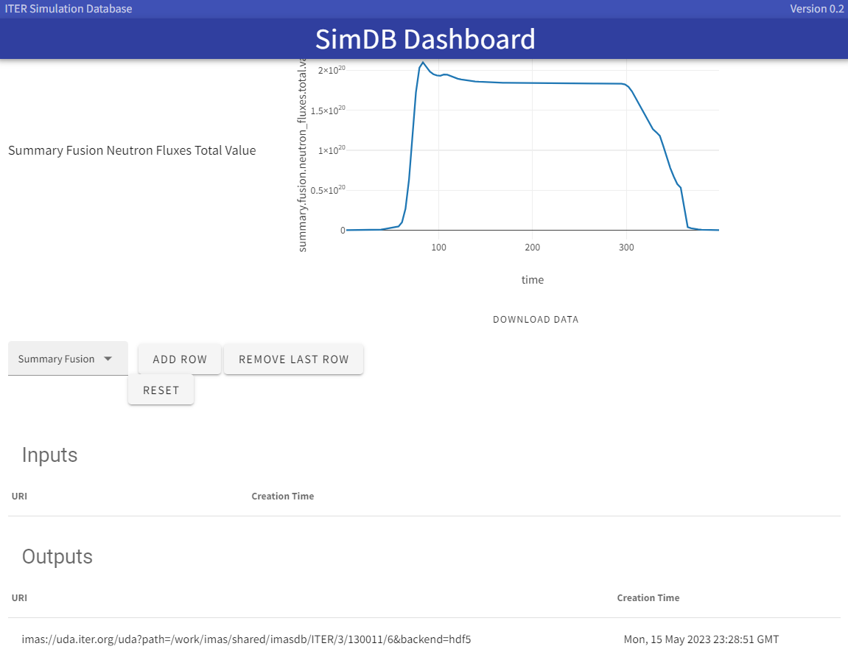
Databases Tools
SimDB/UDA
IA UKAEA (task 6)
IO + contrib.
Status of IMAS databases for ITER
ITER_DISRUPTIONS simulations ( ~120)
ITER_SCENARIOS ( ~1000)
ITER_MD ( ~110)
Catalog is now accessible from everywhere: https://simdb.iter.org/dashboard/
SimDB releases 0.8.0 → 0.10.0
Implement IMAS URI (AL5)
Ingest legacy (yaml) as dataset_description IDS
New option to ingest only metadata
Option for authentication behind firewall (from headers)
Allow push/pull files in IMAS format
Cleaning alias creation
Dashboard release 0.2.0
Integration with SSO (at ITER, no need for token)
Production ingestion
and handover soon
More details in presentation SimDB services and rules for the ITER scenarios DB

Slide 20
IMAS Progress Status
Applications
Data Analysis
High-Fidelity Plasma Simulator
Generic Tools
Data access
Data-Dictionary 3
Heating & Current Drive Workflow
Data Model
Data visualization
Workflow and coupling tools
Database management
Experimental data mapping survey
Status of Data-Dictionary 4
Pulse Design Simulator
Documentation and tools
Other Activities

Slide 21
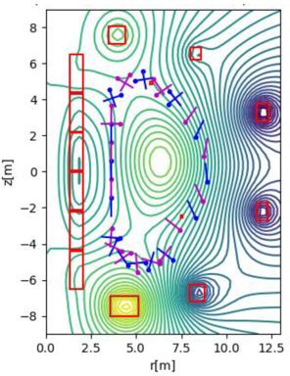
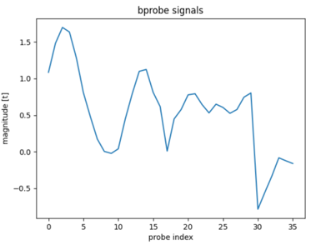
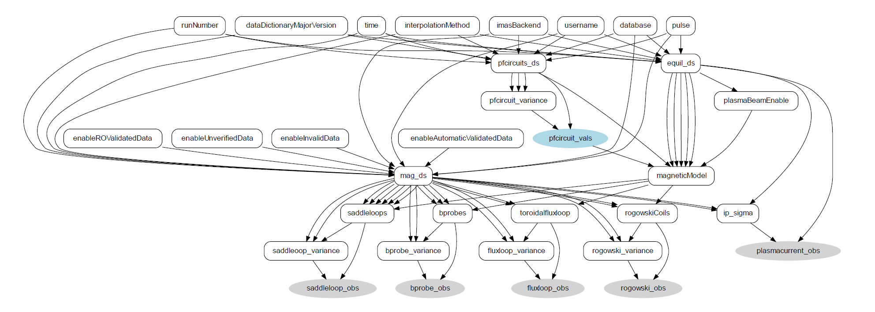
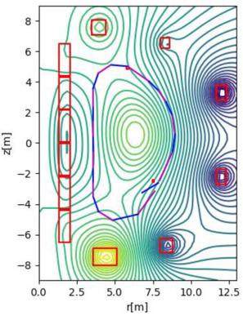
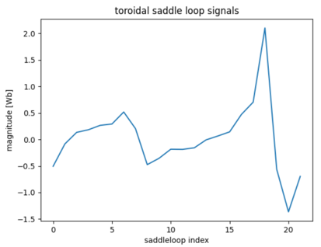

Data Analysis
Data Analysis Framework (Minverva)
IA UKAEA (Task 4+5)
IO-IPA-PostDoc + contrib.
Minerva Bayesian modelling framework
  Model for magnetic diagnostics
    From IMAS Machine Description (location and orientation of the magnetic probes, location of saddle loops)
    To the prediction of ITER pickups and saddle coils
Prototype plasma reconstruction chain for ITER (including CODAC)
More details in presentation Data processing at ITER: Status, plans and opportunities

Slide 22
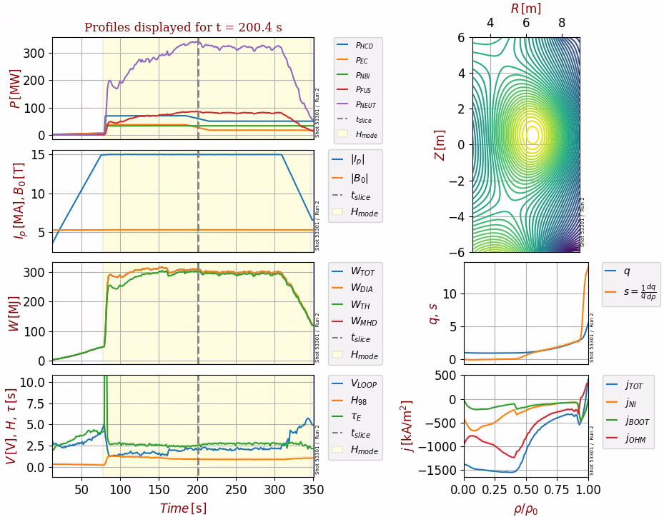
High-Fidelity Plasma Simulator
HFPS-DINA and HFPS-JINTRAC
IA with UKAEA (task 7)
IO-PostDocs + contrib.
HFPS based on JINTRAC (core/edge/SOL transport) and DINA (FBE)
Two coupling schemes are implemented and demonstrated to preserve both accuracy and performance
  Loose coupling = iterative exchange of scenario segment simulations
  Close coupling = explicit scenario data exchange at a small time-step (~ms) to maintain overall simulation performance
Ongoing efforts to include the generation of consistent 2D time-evolving edge / SOL grids
Technical demonstration of DINA-JETTO-TGLF close coupling for ITER 15 MA 5.3 T DT baseline scenario with P_{AUX} = 53 MW
More details in presentation HFPS: Status, plans and opportunities

Slide 23
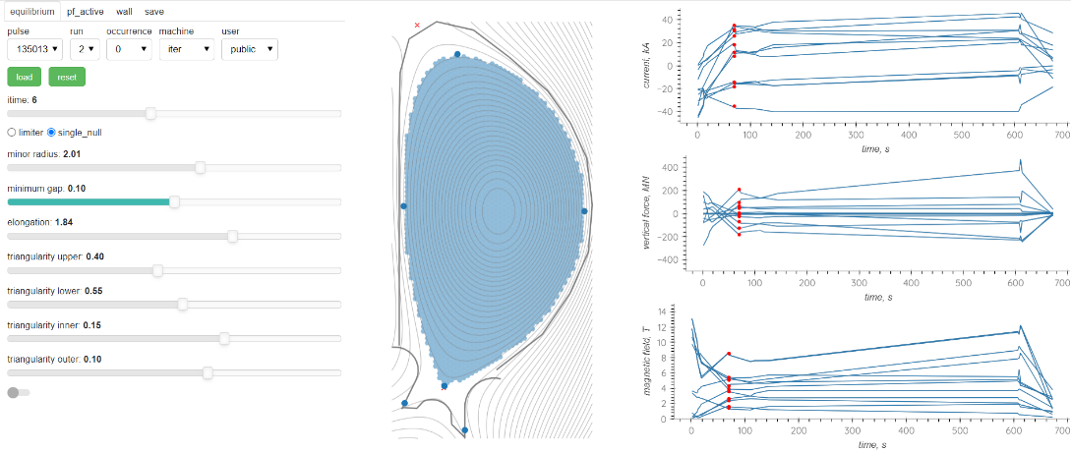
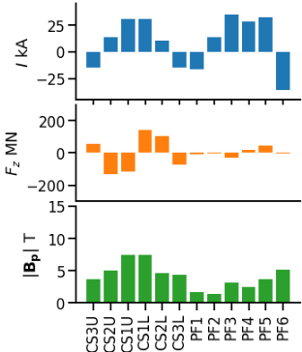

Pulse Design Simulator
PDS-TRANSMAK/SCENPLINT
PDS-Workflow
IO-IPA
Multi-component tool for the rapid design and simulation of ITER pulses that are ensured to operate within predefined limits and conditions
  TRANSMAK and SCENPLINT (plasma initiation)
  DINA (free boundary equilibrium)
  NOVA (rapid equilibrium waveform designer)
  A Qt framework to compose the GUI
Further analysis and revised plans are
being established by the new RO
More details in presentation PDS: Status, plans and opportunities

Slide 24
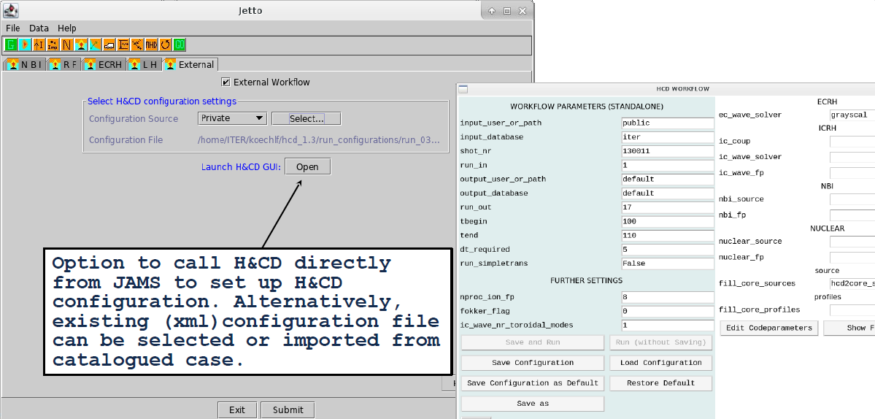

Heating & Current Drive Workflow
IO-IPA + contrib.
Prototype JINTRAC+HCD coupling (demonstrated in 2020)
Both workflows and their components evolved separately
  H&CD: configurable algorithm (synergies), iWrap, Wftools, Waveform-cooker
  JINTRAC: workflow IDS-based driver, FC2K, JAMS
Re-enabling this coupling proved challenging ☹
Ongoing effort to better define the H&CD Python workflow API
  Introduce a WF class for a better encapsulation
  Separate initialize, step and finalize functions (⬄ iWrap’s actor API)
  Use of the workflow IDS to specify time triggers for heating processes
  Clarification, generality and improvement of the WFtools package
  Check-pointing, documentation, versioning and provenance, MUSCLE3, …
→ Q1 2024
Status and latest news here:

Slide 25
Disruption Simulation Activities
DINA Disruption Simulator
IO-IPA-Intern + contrib.
New IDS to cover modelling needs → runaway_electrons (3.39.0)
and spi (develop/3)
Code development activities and interface to IMAS
Plan to augment the ITER Disruption DB with existing JOREK and DREAM soon
Code (description) | Activities (to-do, on-going, done)
DINA DS (disruptions simulator) | Read inputs from ITER Scenarios DB, fill IDSs, internal modular structure with IDSs I/O, GUI
JOREK (disruptions, ELMs and others) | Fill IDSs: mhd, radiation, core_profiles, equilibrium, wall, pf_active Read directly IDS (now Python script prepares inputs from ITER Scenario DB) MUSCLE3 interface: simple proof of concept
Radiation workflow (calculates heat fluxes from radiation sources) | Raysect Python actor: parameters in XML, read radiation IDS, I/O wall and bolometer IDSs
DREAM (runaway electron formation) | Read ITER Scenario DB, fill runaway_electrons IDS

Slide 26
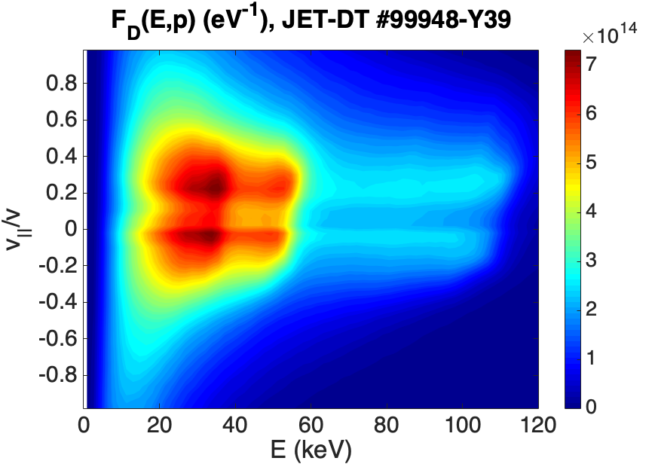
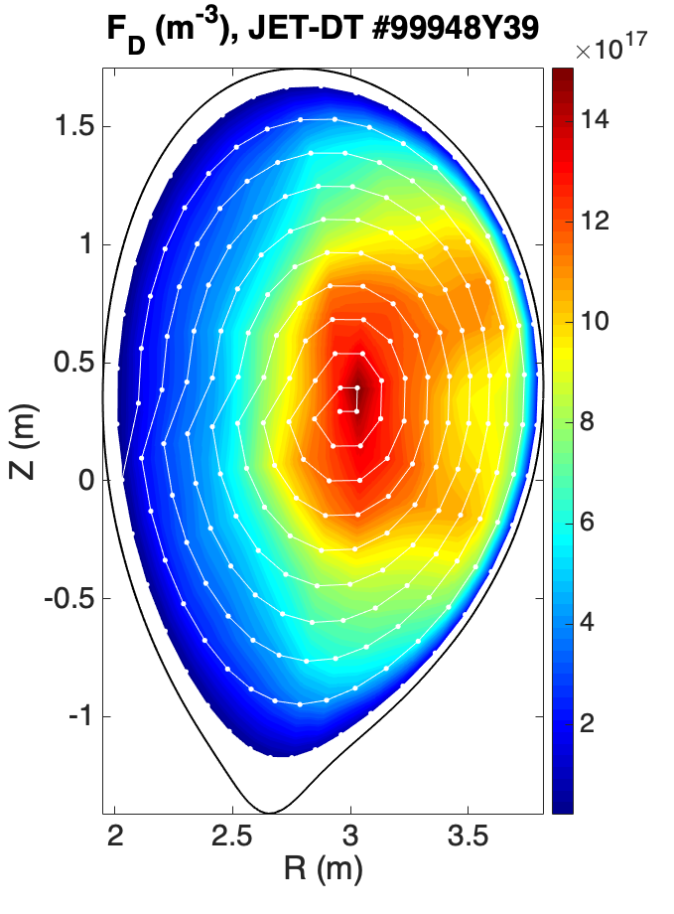
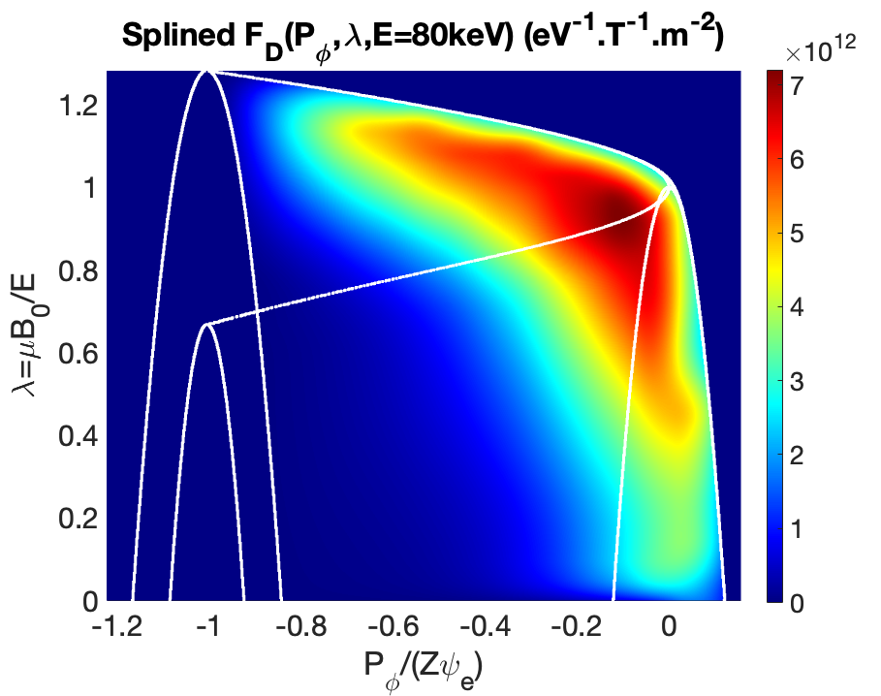

Distributions for EP and kinetic studies
IO-PostDoc + contrib.
NUBEAM velocity space
NUBEAM physical space
CoM space (fixed energy E=80keV)
+
→
Fortran code (OpenMP/MPI) to convert marker distributions into constant of motions (CoM) distributions
Used for the accurate initialization of EP stability workflow and kinetic-MHD/gyrokinetic simulations
Currently takes inputs from TRANSP/NUBEAM (netdcf data)
Ouputs are 𝒞² spline coefficients on a 3D cartesian CoM grid (𝐸,𝑃_𝜑,𝜆)
Other important quantities on the CoM grid for scenario analysis
  CoM Jacobian, particle frequencies (𝜔_𝑏,𝜔_𝑑), (𝑅,𝑍,𝑣_∥) orbit trajectory, nature of orbits
Adaptation to IMAS (equilibrium, distributions, GGD) is ongoing

Slide 27
Future Plans and Organizational matters

Slide 28
Ongoing and planned IMAS activities from IO
IMEG 14
IMEG 15
P. Abreu
J. Lee
New staff
F. Poli
F. Koechl
IO
PostDoc
IPA
M. Schneider (PDS RO)
P. Sawantdesai
D. Maroo
Ongoing
calls
Minerva support and extension
FWC IDS / Data-Entry validation
FWC NetCDF self-described IDS
PDS refinements and extensions
GGD-VTK support and extension
Under
preparation

Slide 29
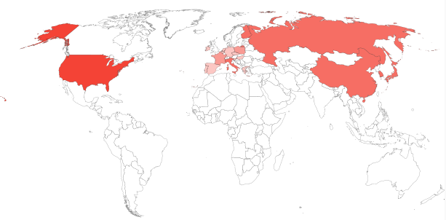
IMAS CA and Licensing
4
Access via IMAS Cooperation Agreement
  38 have been signed so far (5 include access for 3rd parties)
  17 are under discussion
3
Signed CA per country
2
1
IMAS licence added to repositories if missing
  Based on 3-clause BSD + 2 extra conditions
Use and redistribution, for peaceful purposes only, are granted solely to the ITER Members (the People's Republic of China, the European Atomic Energy Community, the Republic of India, Japan, the Republic of Korea, the Russian Federation, and the United States of America), with the right to sub-license within their territory for the purpose of fusion research and development. Organizations, bodies or individuals of non-ITER Members shall seek specific written permission from the ITER Organization before use or redistribution of this software.
All modifications/derivatives shall be made available to the ITER Organization.
Continue to push for a release of IMAS infrastructure under Open licences
  Data Dictionary as Creative Common
  Access-Layer and other tools as Apache 2.0 / LGPL 3.0 or equivalent

Slide 30
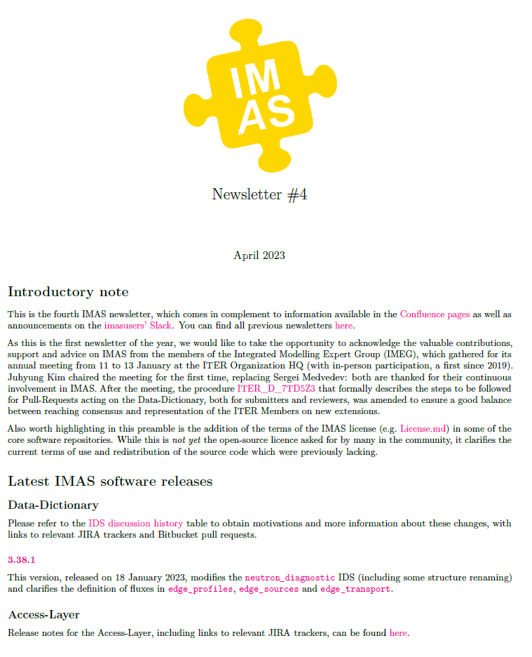
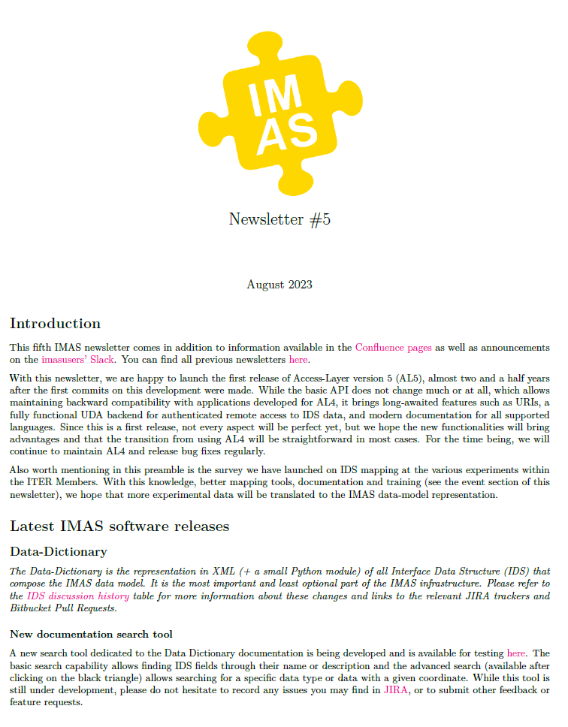
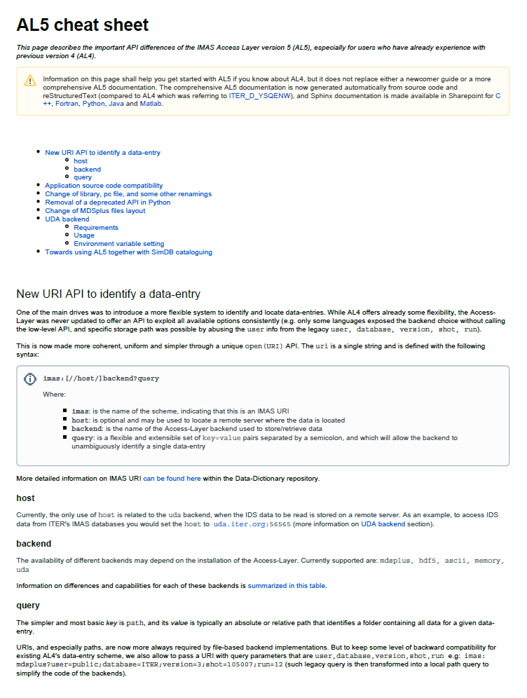
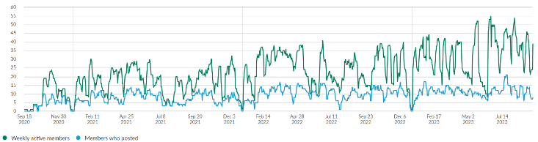
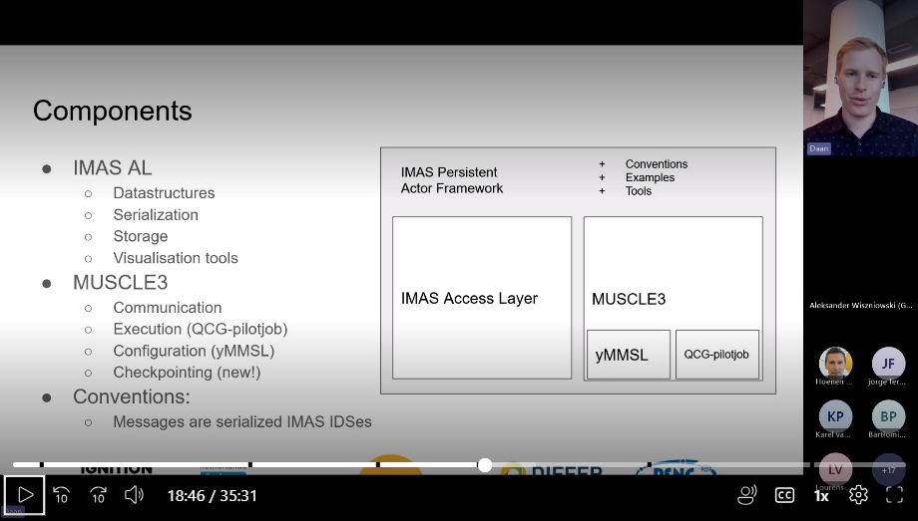
Communication and Training
Regular newsletters sent to 600+ recipients
Regular communication and support meetings
  Monthly for Data-Dictionary
  Bi-monthly for Access-Layer
imasusers.slack.com
  Open to all (~150 members)
Specific IMAS events in 2023
  MUSCLE3 training (24-27 January)
  Persistent Actor Framework webinar (20 September)
  IMASPy webinar / training (20 October)
  UDA data mapping workshop (20-22 November)

Slide 31
Questions?

Slide 32
Backup Slides

Slide 33
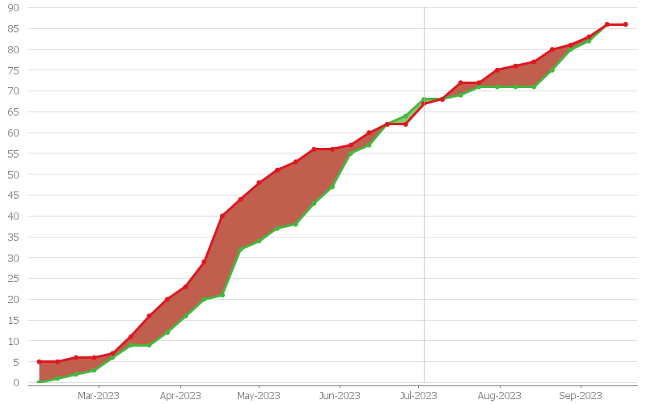
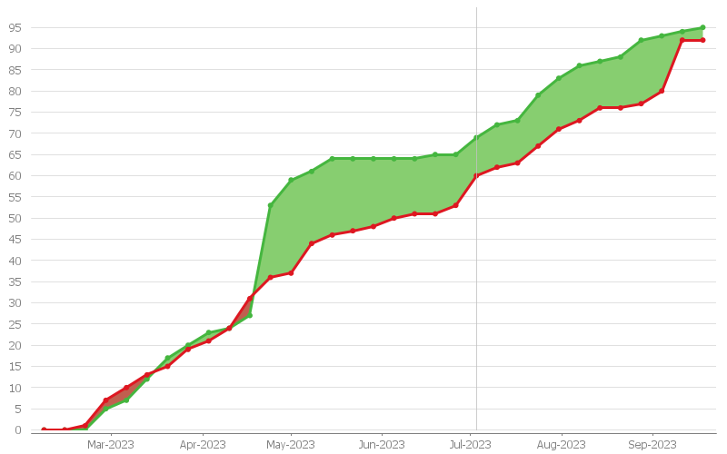
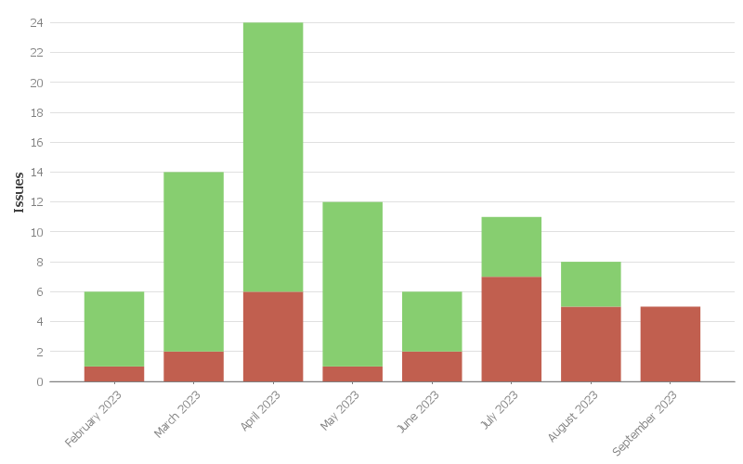
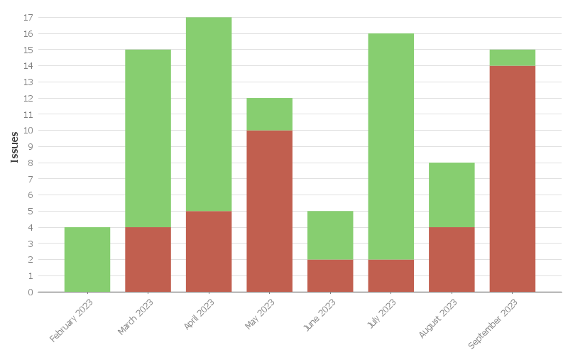
DD & AL Support Overview
Overall number
of issues:
created
and resolved
Data-Dictionary
FWC LOT2-TO1
IO + contrib.
Access-Layer
FWC LOT1-TO1
IO-IPA + contrib.
Recently created
issues:
resolved or
unresolved

Slide 34
Communication Meetings Attendance

Slide 35





Other examples powered by Minerva
Model for PoPola polarimeter
Gaussian process models for electron density and temperature
Predict Faraday rotation angle and ellipticity angle
Data Analysis Framework (Minverva)
IO-IPA-PostDoc + contrib.
ITER hard x-ray detector: MCMC sampling of runaway electron energy distribution function from synthetic input distribution
Predicted observations from all samples

Slide 36

IDS Coverage (3.39.0)
barometry bolometer bremsstrahlung_visible calorimetry camera_ir camera_visible camera_x_rays charge_exchange ece focs hard_x_rays interferometer langmuir_probes magnetics mse neutron_diagnostic polarimeter reflectometer_fluctuation reflectometer_profile refractometer soft_x_rays spectrometer_mass spectrometer_uv spectrometer_visible spectrometer_x_ray_crystal thomson_scattering
disruption gyrokinetics mhd mhd_linear ntms plasma_initiation radiation runaway_electrons sawteeth turbulence
Diagnostics
Physics phenomena
distribution_sources distributions ec_launchers
ic_antennas lh_antennas nbi waves
H&CD
Core
transport
Fuelling
gas_injection gas_pumping pellets
core_instant_changes core_profiles core_sources core_transport
Electro-
Magnetics
Edge
transport
edge_profiles edge_sources edge_transport
b_field_non_axisymmetric
coils_non_axisymmetric em_coupling equilibrium iron_core pf_active pf_passive tf
Data Management
amns_data controllers dataset_description dataset_fair pulse_schedule real_time_data summary temporary transport_solver_numerics workflow
Other plant systems
cryostat divertors wall

