Slide 1
Kick-off meeting SP X2 Optimization of laser-based surface analysis diagnostics
Hennie van der Meiden

Slide 2
SP X.2: Optimization of laser-based surface analysis diagnostics
Announcements
Accelerator DIFFER operational, NRA analysis samples LIBS campaign done But contradictions found between LIBS and NRA (influence seeding):
- NRA: highest D retention with Ne seeding, lowest with He seeding - LIBS: highest retention N₂, lowest He
Also doubts about given oxygen content ➔ Investigation to be continued!
Magnum-PSI/PSI-2 operational
We need samples for linear devices and Be campaign. ➔ Antti will comment
LIBS project in JET on-hold, awaiting outcome internal discussion at JET
In this work package: using LIBS as a tool for investigating samples/tiles from toroidal device is removed. In this work package only LIBS techniques/physics
Notes:
Facilties: JUST GIVE the integral numbers for the groups
PD: Plasma devices (MAGNUM, PSI-2, UPP, TOMAS, GyM)
HHF: JUDITH, GLADIS, QSPA, OLMAT
Analysis station: Ion beam
If Facilties, Modelling, Link not applicable, remove the lines. I assume that it is EITHER EXPERIMENT or MODELLING, thus 1 more line for TASKS or Deliveables.

Slide 3
SP X.2: Optimization of laser-based surface analysis diagnostics
Main tasks for this year 2023:
Optimized conditions for LIBS in absolute content and depth resolution at pressures up to 1 bar air
Absolute quantification of D and composition in Be-mixed layers (with depth resolution)
Influence of T_{surface} and impurities (seeding products) on absolute fuel retention and outgassing values
Machine learning
Notes:
Facilties: JUST GIVE the integral numbers for the groups
PD: Plasma devices (MAGNUM, PSI-2, UPP, TOMAS, GyM)
HHF: JUDITH, GLADIS, QSPA, OLMAT
Analysis station: Ion beam
If Facilties, Modelling, Link not applicable, remove the lines. I assume that it is EITHER EXPERIMENT or MODELLING, thus 1 more line for TASKS or Deliveables.

Slide 4
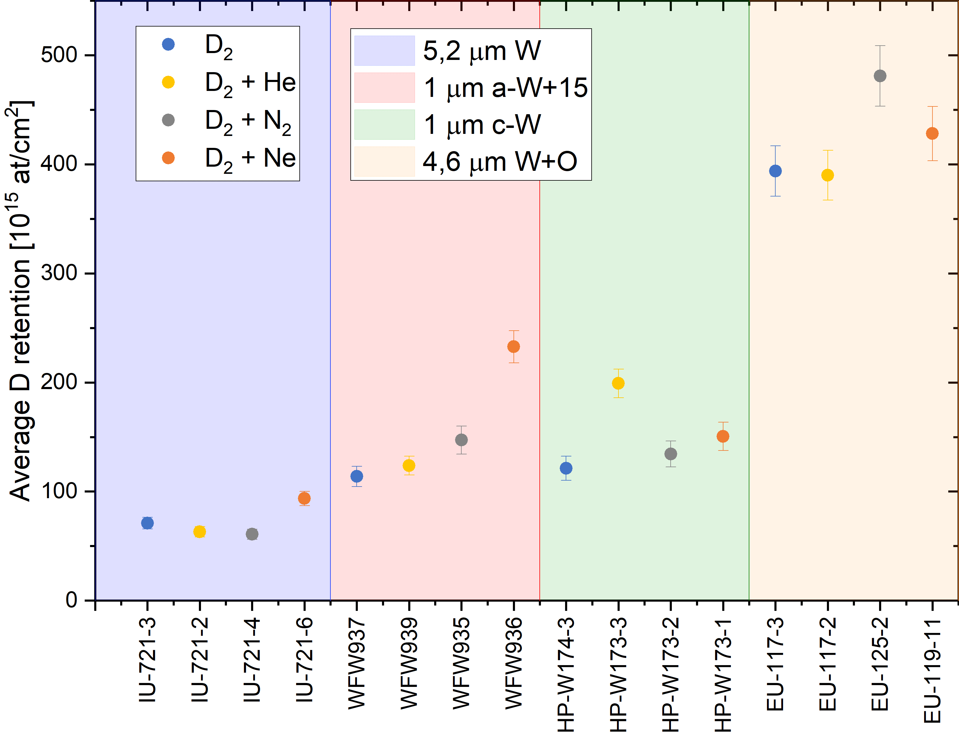
Back-up
IBA retention:
IU → WFW – HP → EU
LIBS retention (average intensity)
IU: 10-60
HP: 20-90
EU: 20-100
WFW: 5-200
Why does D retention in EU and IU differ so much?
Notes:
Facilties: JUST GIVE the integral numbers for the groups
PD: Plasma devices (MAGNUM, PSI-2, UPP, TOMAS, GyM)
HHF: JUDITH, GLADIS, QSPA, OLMAT
Analysis station: Ion beam
If Facilties, Modelling, Link not applicable, remove the lines. I assume that it is EITHER EXPERIMENT or MODELLING, thus 1 more line for TASKS or Deliveables.

