Slide 1
KoM WP PWIE SP X2
Salvatore Almaviva, ENEA, Frascati Research Center, via Enrico Fermi 45, 00044 (Italy)

Slide 2
Deliverables
Comparison Single Pulse vs. Double Pulse LIBS (or alternative LIBS signal enhancement methods) regarding absolute material composition and D content in ITER- and DEMO-relevant W including self-damage W and reference coatings
CF-LIBS on produced reference samples before and after He loading

Slide 3
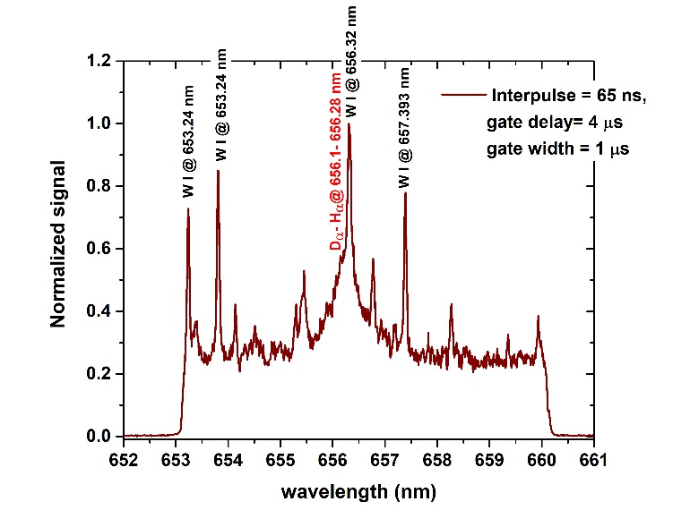
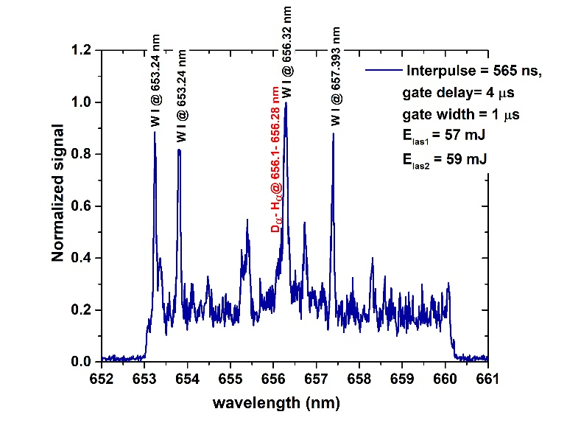
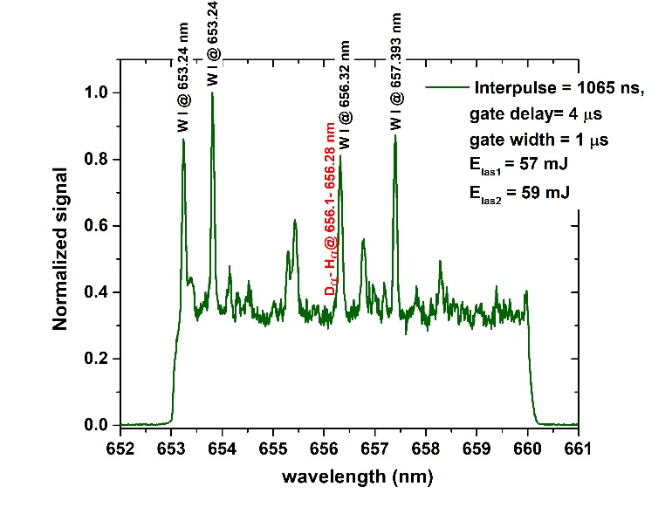
Deliverable 1
Comparison SP vs. DP LIBS, or alternative LIBS signal enhancement methods: absolute fuel content in W samples and composition
The obtained results suggest that the best detection of hydrogen (and its isotopes) is achieved in DP configuration when the two laser pulses are separated by a few tens of ns.

Slide 4
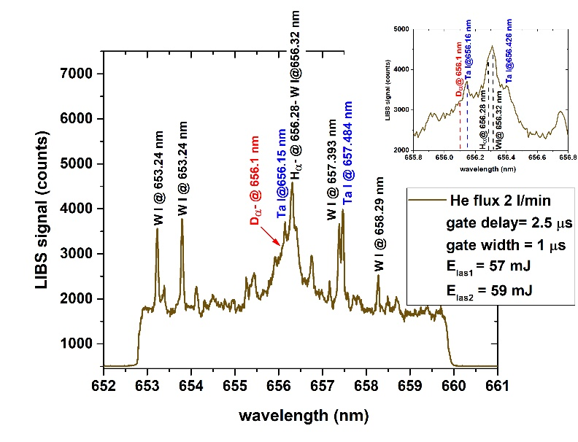
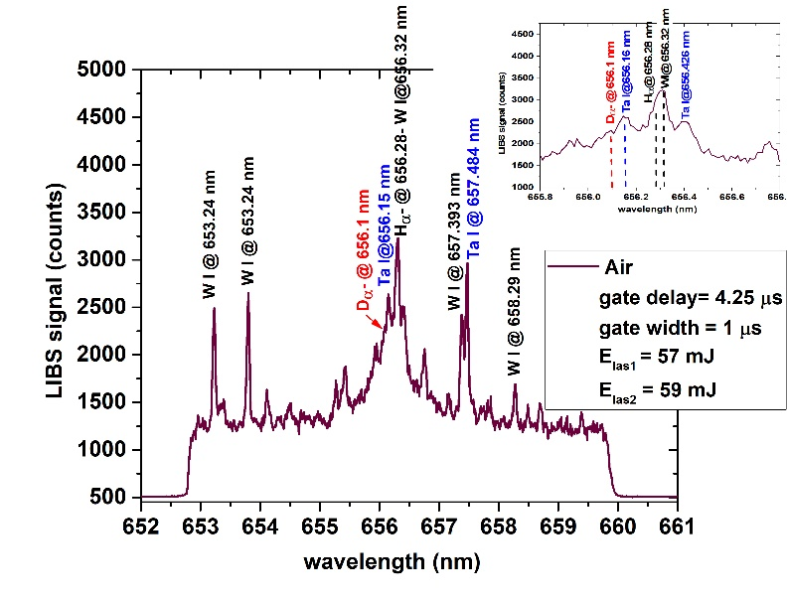
Deliverable 1
Comparison SP vs. DP LIBS, or alternative LIBS signal enhancement methods: absolute fuel content in W samples and composition: EU2-59-3_W-Ta(5%)+D(10%) sample
Alternative signal enhancement were obtained by performing LIBS under background gases, e.g. He flux (up to 2 l/min), in comparison with standard LIBS in air.
Key aspects comparing LIBS under He flux or air for the D_{α}- H_{α} lines are:
reduced spectral broadening in He which results in a better discrimination of the two nearby lines, although the SNR is reduced -> it is necessary to reduce the gate delay (from 4.25 μs in air to 2.0 - 2.5 μs in He).
higher emission intensity in Ar, but worst discrimination between D_{α}- H_{α}. This is due to a stronger plasma confinement in Ar compared to He because of the heavier Ar atomic mass (m_{Ar} = 40 amu, m_{He} = 4 amu) and denser plasma plumes (Higher T_{e} and n_{e}).
Further analysis in Ar atmosphere are ongoing

Slide 5
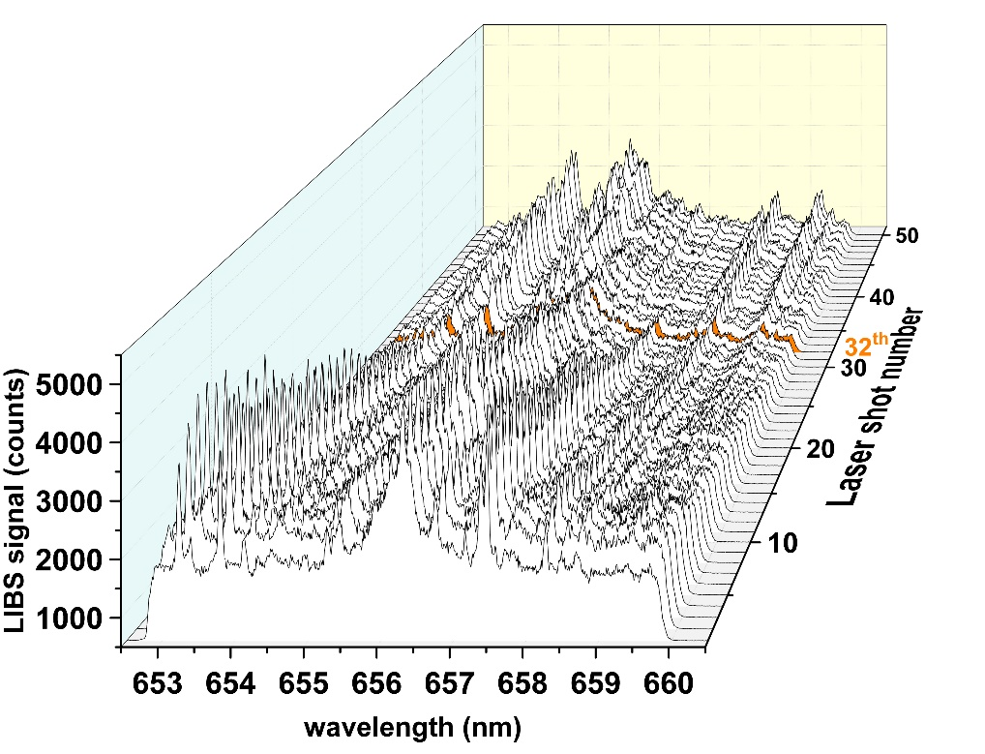
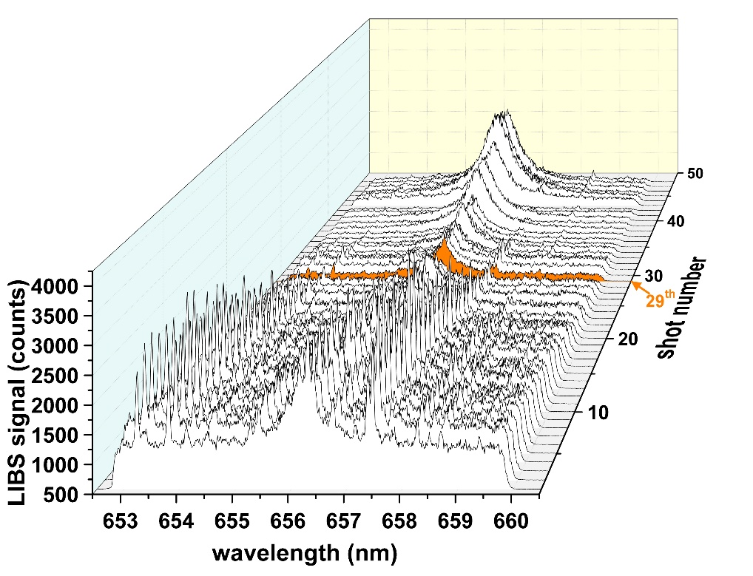
Deliverable 1
Comparison SP vs. DP LIBS, or alternative LIBS signal enhancement methods: absolute fuel content in W samples and composition: EU2-59-3_W-Ta(5%)+D(10%) sample
Coating thickness ~ 3 μm → average ablation rate (AAR) ~ 100 nm both in air or under He flux
Different spectroscopic features can be observed under He or Air when the Mo substrate was reached.
A higher D signal is observed in the near surface layers, both in air and under He flux → Could D, once deposited/implanted in the metallic coating be desorbed via diffusion in the near surface regions?
He
Air

Slide 6
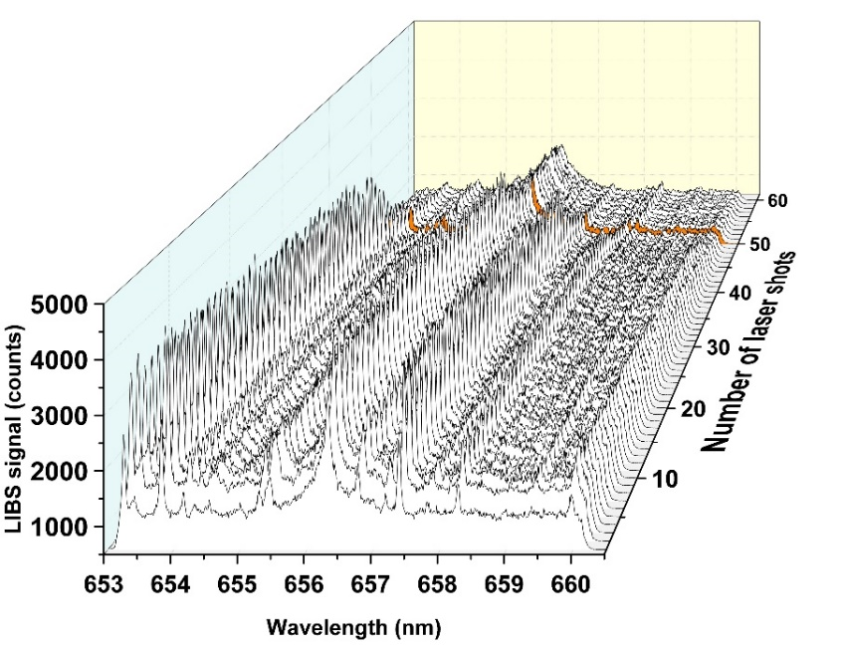
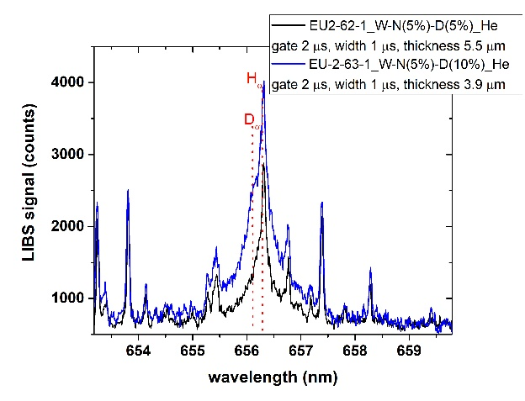
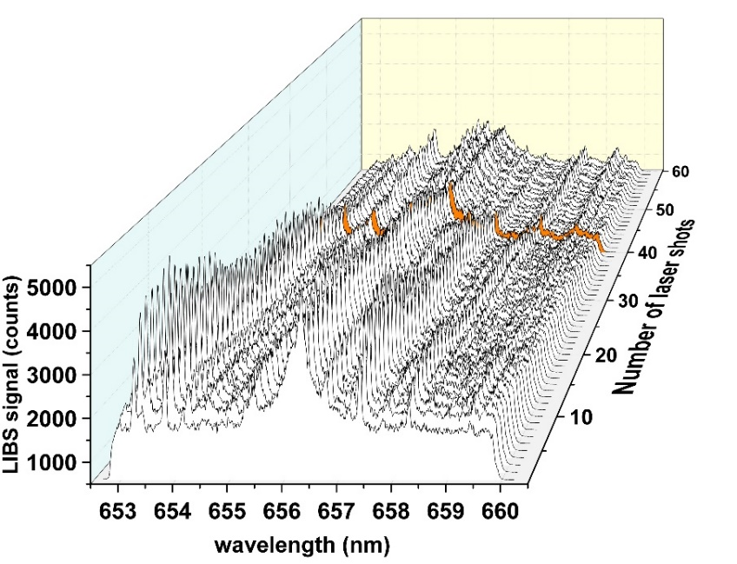
Deliverable 1
Comparison SP vs. DP LIBS, or alternative LIBS signal enhancement methods: absolute fuel content in W samples and composition: EU2-62-1_W-N(5%)+D(5%) - EU2-63-1_W-N(5%)+D(10%)
EU2-62-1, 5.5 μm; AAR ∼ 0.11 μm
Sample ID | Coating thickness | Type of coating
EU2-62-1 | ∼ 5.5 μm | W-N(5%)+D(5%) on Mo substrate
EU2-63-1 | ∼ 3.9 μm | W-N(5%)+D(10%) on Mo substrate
EU2-63-1, 3.9 μm; AAR ∼ 0.1 μm

Slide 7
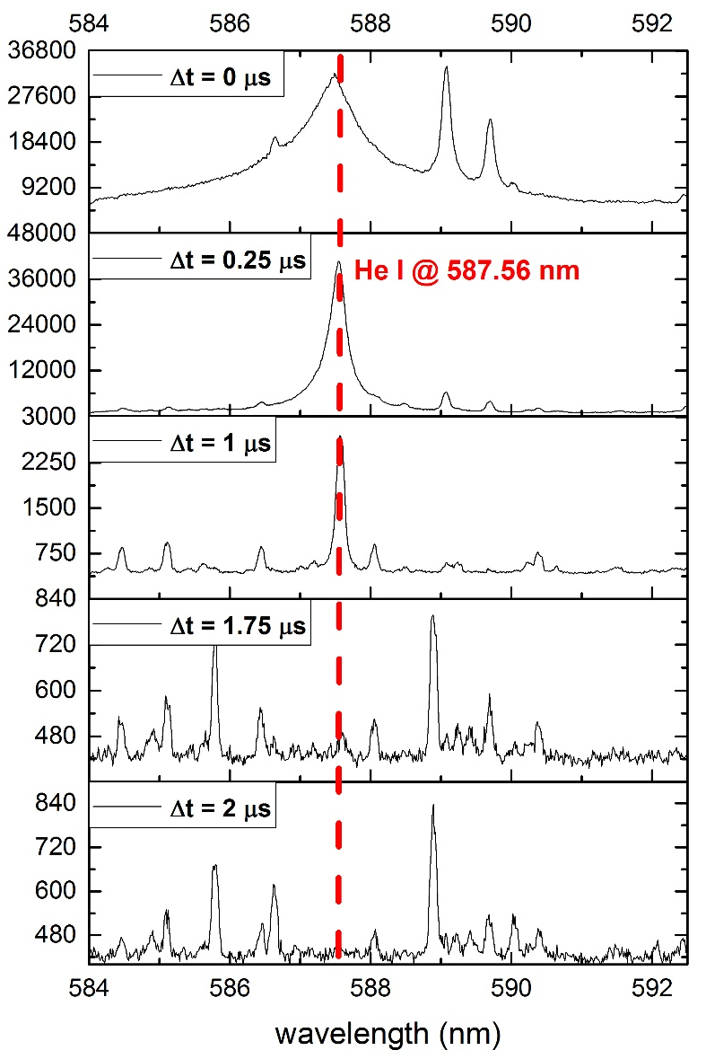
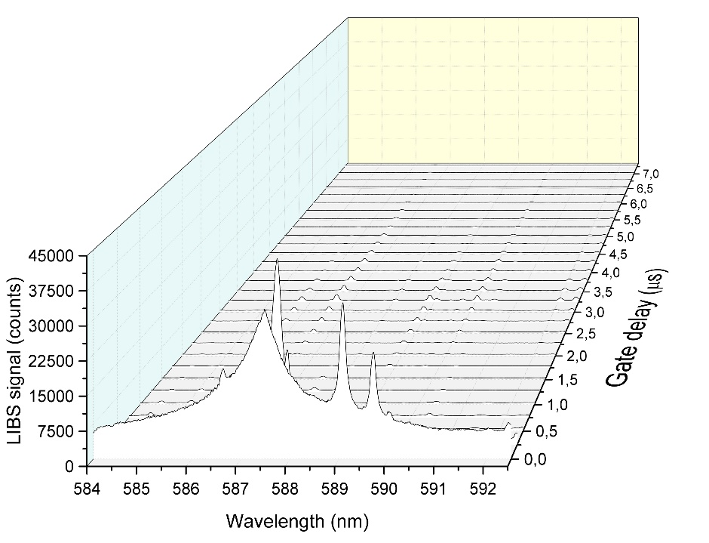
Deliverable 2
(CF)-LIBS results on He loaded samples and surface modifications
The work already done included the LIBS analysis of reference coatings under He flux, to identify the best spectral region to detect both He and the materials of the coating.
The analyses have been performed on sample EU2-63-2_W-N(5%)-D(10%)
under He flux ≤ 0.5 l/min
The 587.56 nm He I line I was detected free of interference at low DP laser ener-
gies (E₁ = 20 mJ E₂ = 21 mJ, interpulse 65 ns) at different delays up to 1.75 μs
Increasing the pulse energies allows to detect He I at longer delays or at lower
concentrations which could be of interest to both detect H/D and He
(for example in air, at gate delay Δt ≈ 4.25 μs that seems to be optimized
for the H_{α} - D_{α} emission lines)
E₁= 20 mJ
E₂= 21 mJ

Slide 8
ENEA proposal for 2023
ENEA is available to analyze and characterize samples from different fusion machines, provided that they don’t contain Tritium or Beryllium.
ENEA is available to analyze He-loaded samples in air or under Ar flux.

