Slide 1
FZJ plan for 2023
Investigation of cluster formation in DP-ps-LIBS of graphite (for LAMIS application):
catching clusters with different configurations (SP, DP355-1064 nm, DP 355-355 nm) and analysing cluster sizes
Measuring D content of plasma exposed, pre-damaged tungsten samples with DP-ps-LIBS
Investigation of influence of different gas atmospheres on DP-ps-LIBS parameters
Continue the development of multi-pulse scanning ps-LIBS for:
Composition measurement in mix materials by CF-LIBS quantative analysis method
depth profiling
hydrogen isotopes measurement
Investigation of dynamical deuterium retention by ns-LIBS in different types of tungsten samples (annealed under different temperatures, pre-damaged, fiber-reinforced...) during and after plasma loading in PSI-2 under different fluences and plasma fluxes

Slide 2
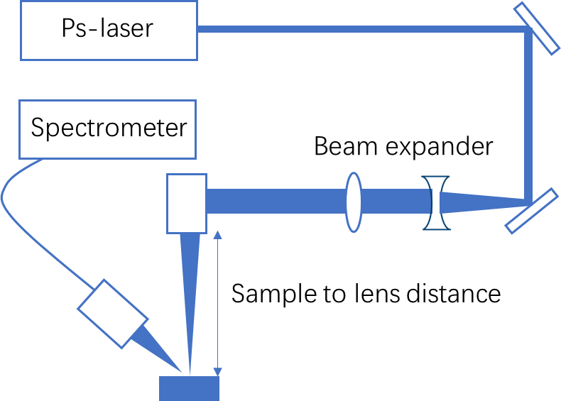
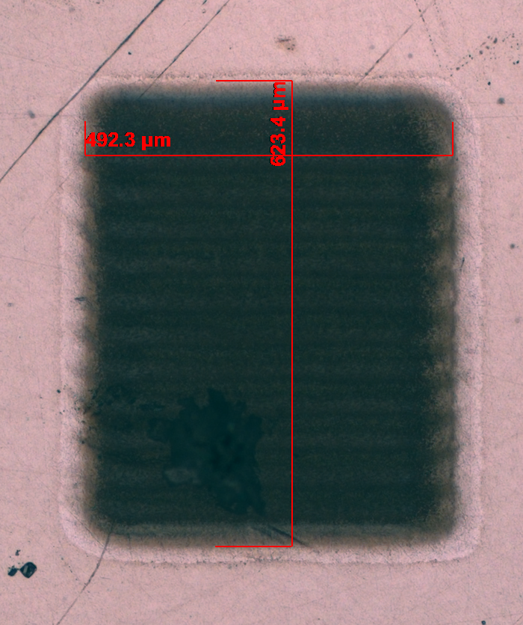
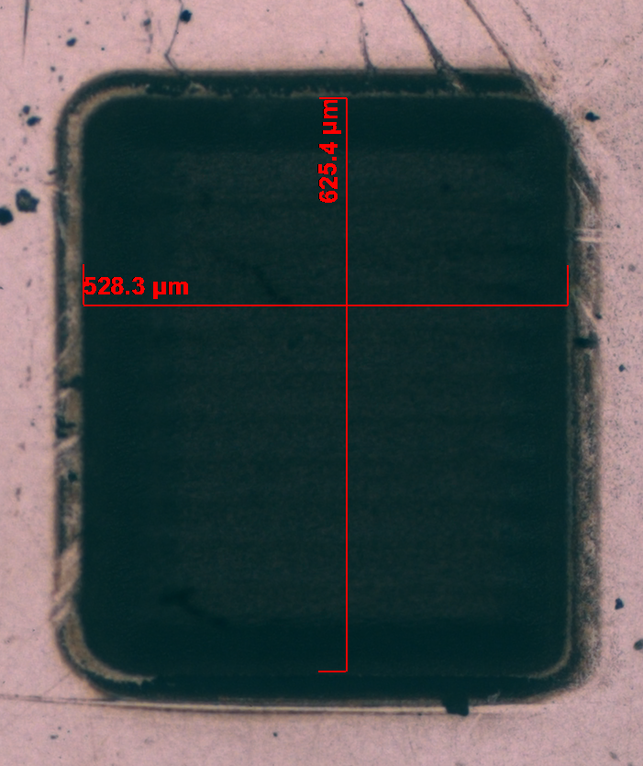
Multi-pulse scanning ps-LIBS
High repetition ps-laser (1030nm, 50kHz - 2MHz, pulse duration 2 ps, pulse energy < 35μJ) equipped with 2-axis galvo scanner with f-theta lens f= 500 mm or f= 80 mm
X-Y galvo scanner
1 scan
492x623 μm²
100 scans
528x625 μm²
Y
Time resolved spectra
X
13.5 nm

