Slide 1
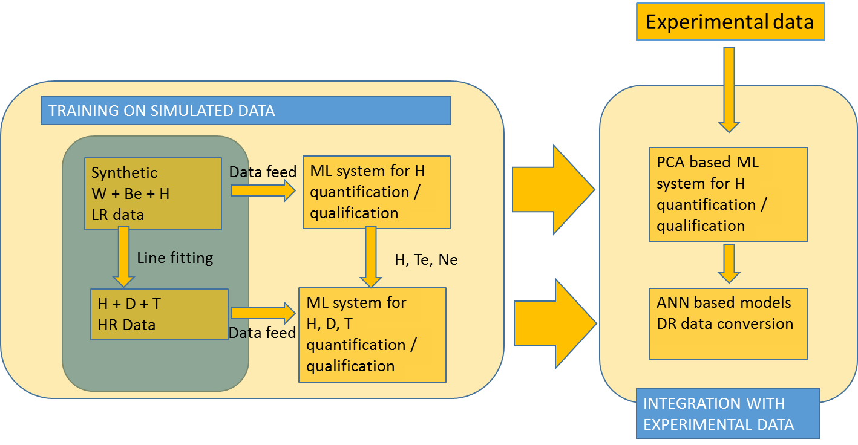
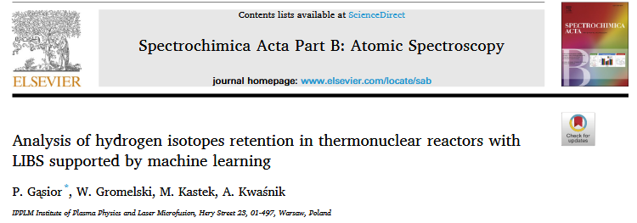
ML for LIBS concept
General scheme of ML system for LIBS for retention monitoring.
Machine learning models for LIBS adaptation for thermonuclear fusion have been used and described in scientific publication for the first time in the world.
The models operated on synthetic data, which recently has been recognized as a novel and promissing trend in data science.
Focus on this part

Slide 2
Machine Learning for LIBS: Progress in 2022 (IPPLM, Poland)
Accomplishment of ML algorithm for separation of hydrogen isotopes (simulation of the HR spectrometer measurement).
Development of the software for spectroscopic data processing with background removal, normalisation, depth-profiling and data export (upgraded mostly for the need for analysis of data from experiments conducted at VTT).
Analysis of experimental data from the Be campaign including pre-processing and depth-profiling.
Upgrade in the SimulatedLIBS packet (https://pypi.org/project/SimulatedLIBS/).
Detailed analysis of PCA performance for Be, W, H mixes (important block of ML system).

Slide 3
Machine Learning for LIBS: Plans for 2023 (IPPLM, Poland)
Investigation of the influence of set-up transmission on validation and training (quasi-experimental signals, bootstrapping)
Investigation of correlations between PCs of synthetic and experimental/quasi-experimental signals
Attempts on ML classification and regression of experimental signals.

