Slide 1
Triangularity studies with global gyrokinetic simulations
G. Di Giannatale^{a)}, S. Brunner ^{a)}, M. Murugappan^{a)} , L. Villard^{a)} and the ORB5 team
^{a)} EPFL, SPC, CH-1015 Lausanne, Switzerland

Slide 2
ORB5 - Code, equations and approximations
ORB5 is a full $f,$ EM, flux-driven, global, PIC GK code
ORB5 solves a full-f Vlasov equation, in spite of $δf$ splitting used as control variate. The total distribution function is represented as $f=f_{0}(ψ, t)+δf$and only $δf$is discretized using markers
It leads to noise reduction (under PIC-Monte Carlo considerations)
The initial phase space is sampled with markers. Such markers are evolved and their orbits are followed during the simulation in the 5D phase space
Fields solved with 2nd and 3th order B-splines
For the two angular coordinates the solver works in Fourier space. Assuming that the perturbations are almost field aligned it solves the fields for few modes per radial location

Slide 3
Story of the simulations
2 TCV equilibria have been taken, #60797 for positive triangularity (PT), #58499 for negative triangularity (NT), $δ±0.5$
Decaying turbulence simulations for adiabatic electrons did not show any significant difference between the configurations → a kinetic description of heavy (${m_{i}}/{m_{e}}=100−200$) trapped electrons has been adopted (hybrid electrons model)
The hybrid model does not change the story.. Still similar turbulent features!
Flux driven simulations led to same conclusions..

Slide 4
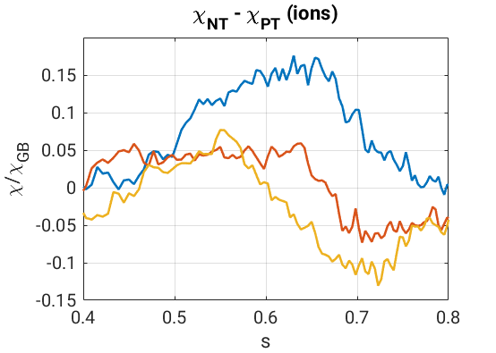
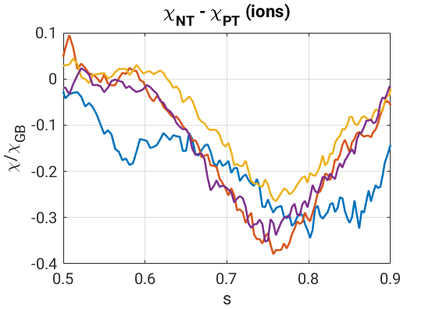
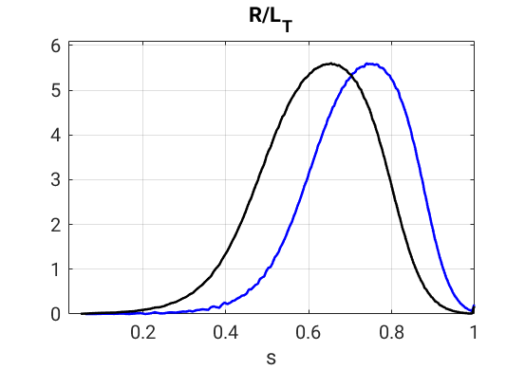
Successful simulations
Simulations done with hybrid model (kinetic response of trapped electrons, adiabatic response passing electrons)
The game changer was the electron mass→ Lighter (but still heavy) electrons are used $\frac{m_{i}}{m_{e}}=500$
A logarithmic gradient $(R/L_{T}=5.6)$ peaked at the radial location where $δ= ±0.3$ is used → NT shows a reduction of $χ_{i}$ of about 30%
The logarithmic gradient has been moved outward (in a higher shaped radial region) → the difference between the two configuration becomes bigger!
reduction around 20-30%
reduction around 50%
$δ∼ ±0.3$
time
$δ∼±0.35$

Slide 5
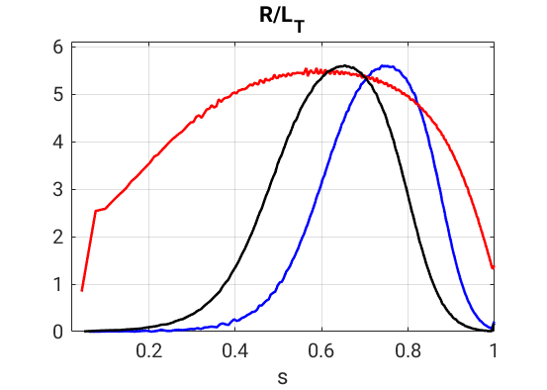
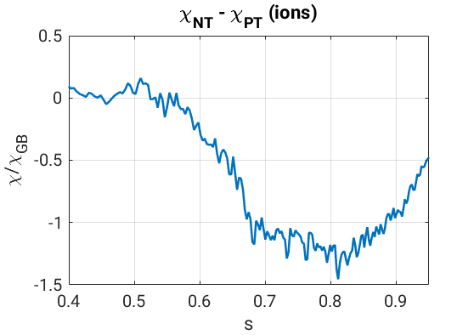
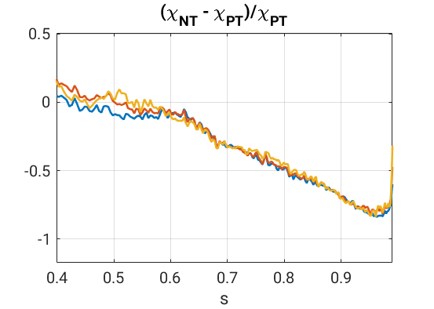
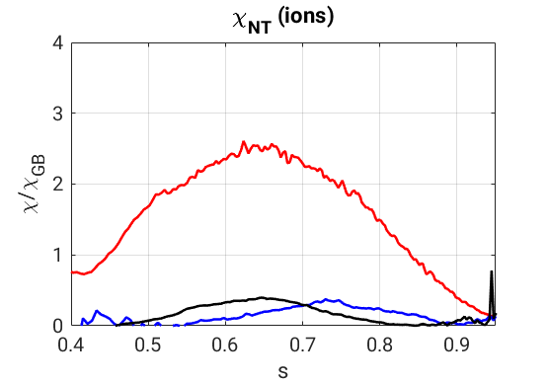
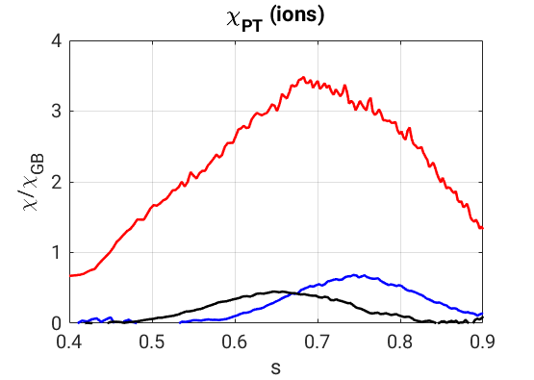
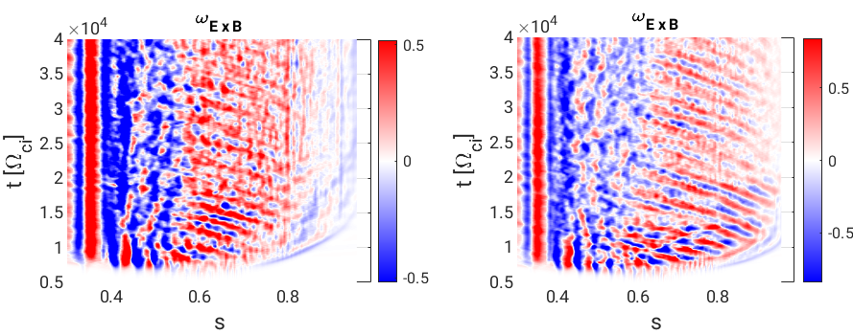
Towards more realistic profiles
Same kind of kinetic profiles but with an extended flat-top value of the ${R/L}_{T}$
This changes drastically the amplitude of transport coefficients: there is a decrease of the $ρ_{eff}^{∗}$.
PT more features more systematic avalanches
NT
PT
q=2

Slide 6
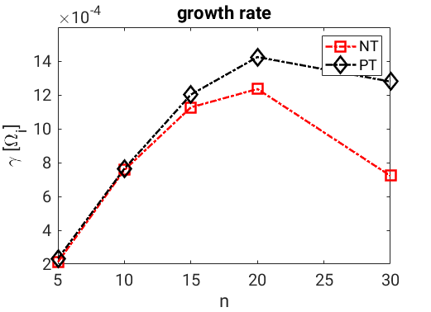
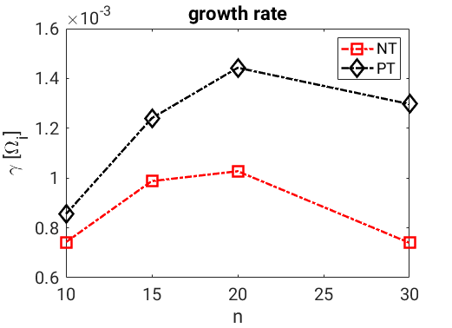
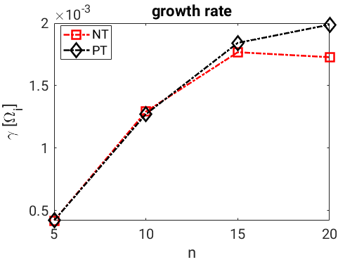
Linear simulations
Linear simulations have been performed
no substantial difference between PT and NT has been found for the wide profile
Some differences have been found with more localized profiles → these differences increase with radius
Localized middle (black)
Localized outward (blue)
wide (red)
TEM
TEM-ITG
Internal modes are much stronger than external ones: no triangularity effect
on the wide profile!

Slide 7
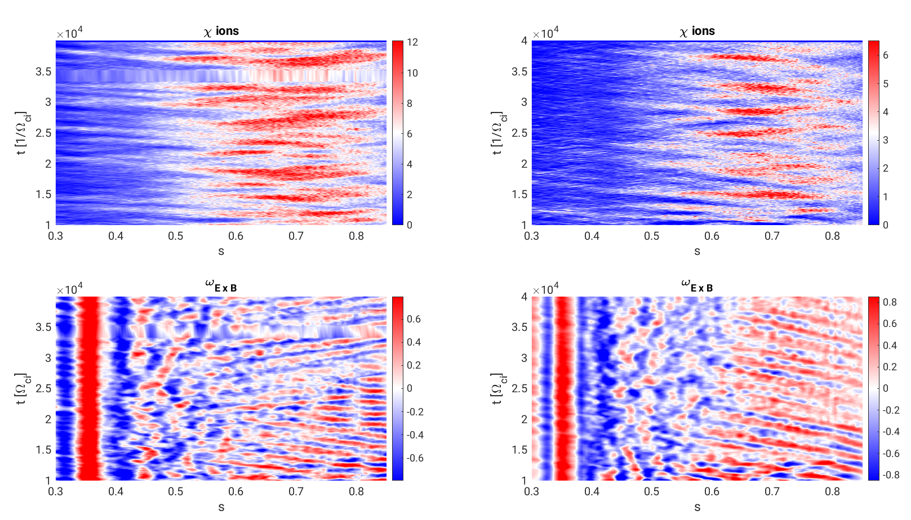
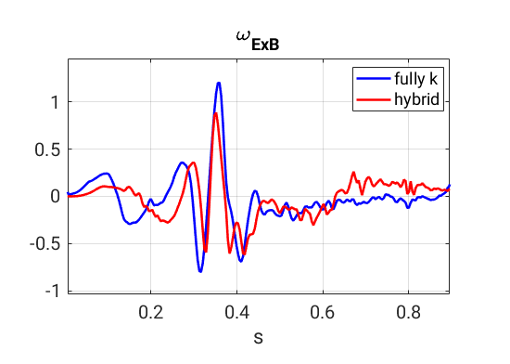
Towards fully kinetic electrons (work in progress)
Impact of fully kinetic electrons response is evaluated
Broadening of transport
Effect on the ExB shear: inversion of propagation direction and corrugation
Fully kinetic
hybrid
Average ExB shear changes sign →
change of direction of front propagation

Slide 8
Hurst exponent
It is coefficient that gives information on the non-locality of the transport
Many Hurst estimators have been proposed to analyze the long range dependent time series
Example, R/S estimator: For a given time series of length N, R(n) is the range of the data aggregated over blocks of length n, and $S^{2}(n)$ is the sample variance.
$E\left[\frac{R\left(n\right)}{S\left(n\right)}\right]∼C_{H}n^{H}$ as $n→ ∞$
Long story short: $H<0.5$corresponds to sub-diffusive dynamics, $H>0.5$corresponds to super-diffusive dynamics
Fractional Brownian motion can be written explicitly as function of the Hurst exp. (for H=0.5 is the usual Brownian motion)
H does also directly linked to the order of fractional derivatives (in time and space) of a diffusion equation → $H∼α/μ$ ($α$ order in time, $μ$ order in space)

Slide 9
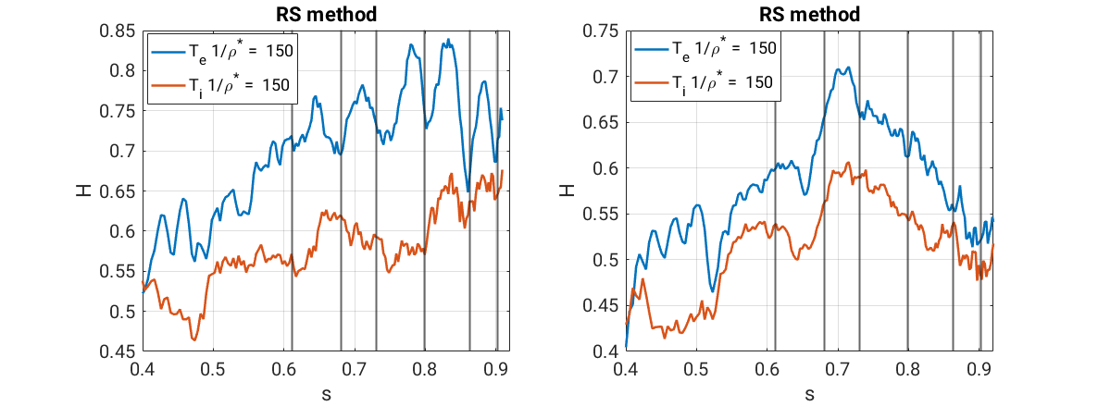
Towards fully kinetic electrons (work in progress)
Shearing rate corrugation reflects on corrugation of the Hurst exponent
Fully kinetic
hybrid

Slide 10
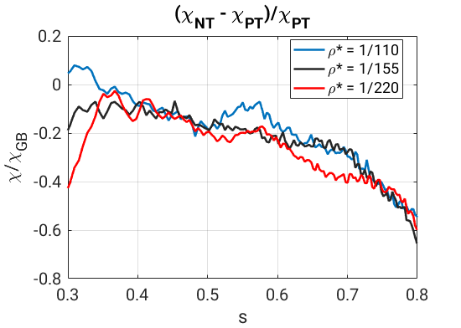
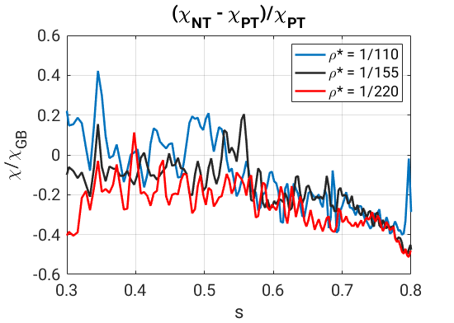
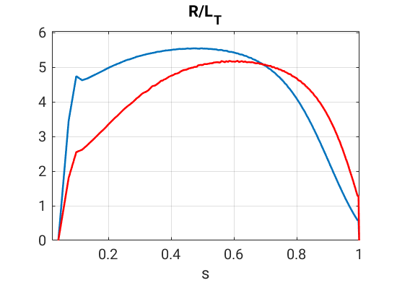
Back to hybrid model - $ρ^{∗}$ scan
If turbulence reach the edge boundary conditions may matter
Simulation for wide turbulent region but shifter more on the core
We are farer from rational surfaces, the passing electron response
Linear simulations show very similar growth rates (even more than what seen before)
4 $ρ^{∗}$ have been scanned (4 different “machine sizes”) at s=0.6
$1/ρ^{∗}$ = 110 (TCV), 155 (bigger than TCV), 220 (DIIID ?), 330 (quite big machine! Simulations on going..)
ions
electrons

Slide 11
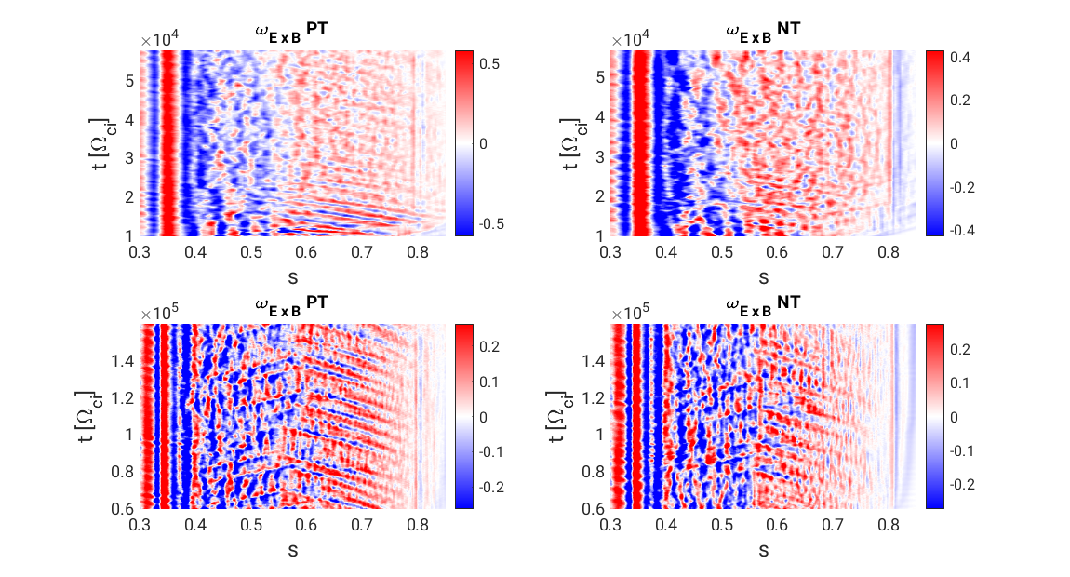
Back to hybrid model - $ρ^{∗}$ scan
$${1/ρ}^{∗}=110$$
$${1/ρ}^{∗}=220$$

Slide 12
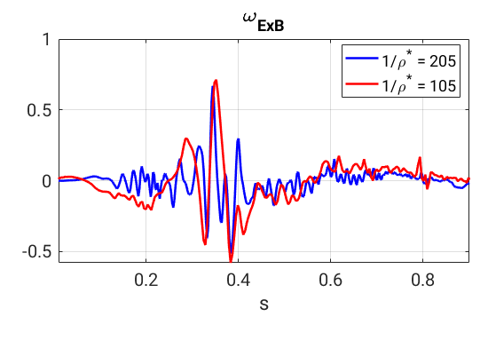
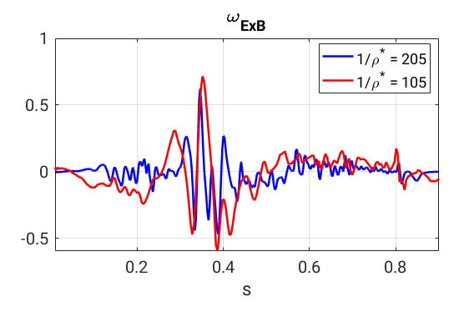
Back to hybrid model - $ρ^{∗}$ scan
PT
NT
$${1/ρ}^{∗}=220$$

Slide 13
Transport evaluation through Hurst exponent

Slide 14
Transport evaluation through Hurst exponent
PT →
NT →

Slide 15
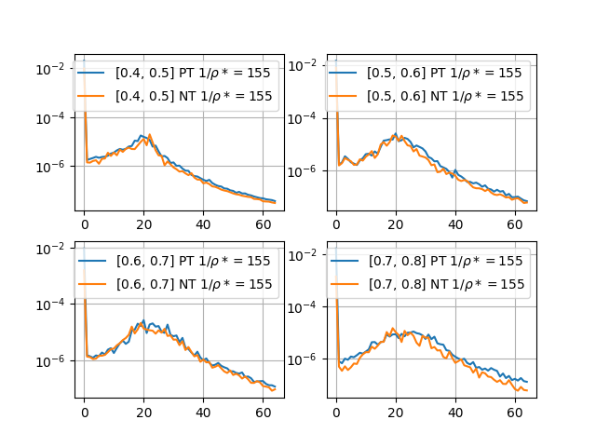
Linear physics is not enough

Slide 16
Conclusions
The ion electron mass ratio played a major role for systematically obtaining lower transport coefficients in negative triangularity
Now we systematically observe negative triangularity transport reduction
Positive triangularity features higher non-local transport
Higher Hurst exponents for Temperature time series (both for ions and electrons)
More clear and coherent avalanches
$ρ^{∗}$ effects have been studied
New zones appear when doubling the system size
Increasing “coupling” of ion-electron dynamic is observed at higher system size for PT, NT does not show huge changes
The improvements of NT wrt PT do not fade out with lower $ρ^{∗}$ (almost better at lower $ρ^{∗}$)
Fully kinetic electrons simulations show not negligible effects where there are many rational surfaces

Slide 17
Usage of M100 resources
So far TCV plasmas have been simulated with $1/{ρ^{∗}}∼ 150$. It required:
32 nodes for hybrid simulations to reach (with good signal to noise ratio) $t∼{10}^{3}\left[a/{c_{s}}\right]$ in 7 days of 24h computation
32 nodes for fully kinetic simulations to reach $t∼160\left[a/{c_{s}}\right]$ (basically nothing!) in 2 days of 24h computation with border-line signal to noise ratio
With 32 nodes we are limited in GPU memory and thus on the number of markers → these simulations cannot be done if resources at our disposal are not increased
When moving to bigger machines number of markers has to be increased as well → physically relevant studies cannot be done with nowadays resources
With LEONARDO with expect to simulate larger things IF M100 LEONARDO resources will be converted 1 to 1.
Our experience underlined some criticalities on the number of nodes that are available on the EUROfusion dedicated partition and how the low priority queue is managed

Slide 18
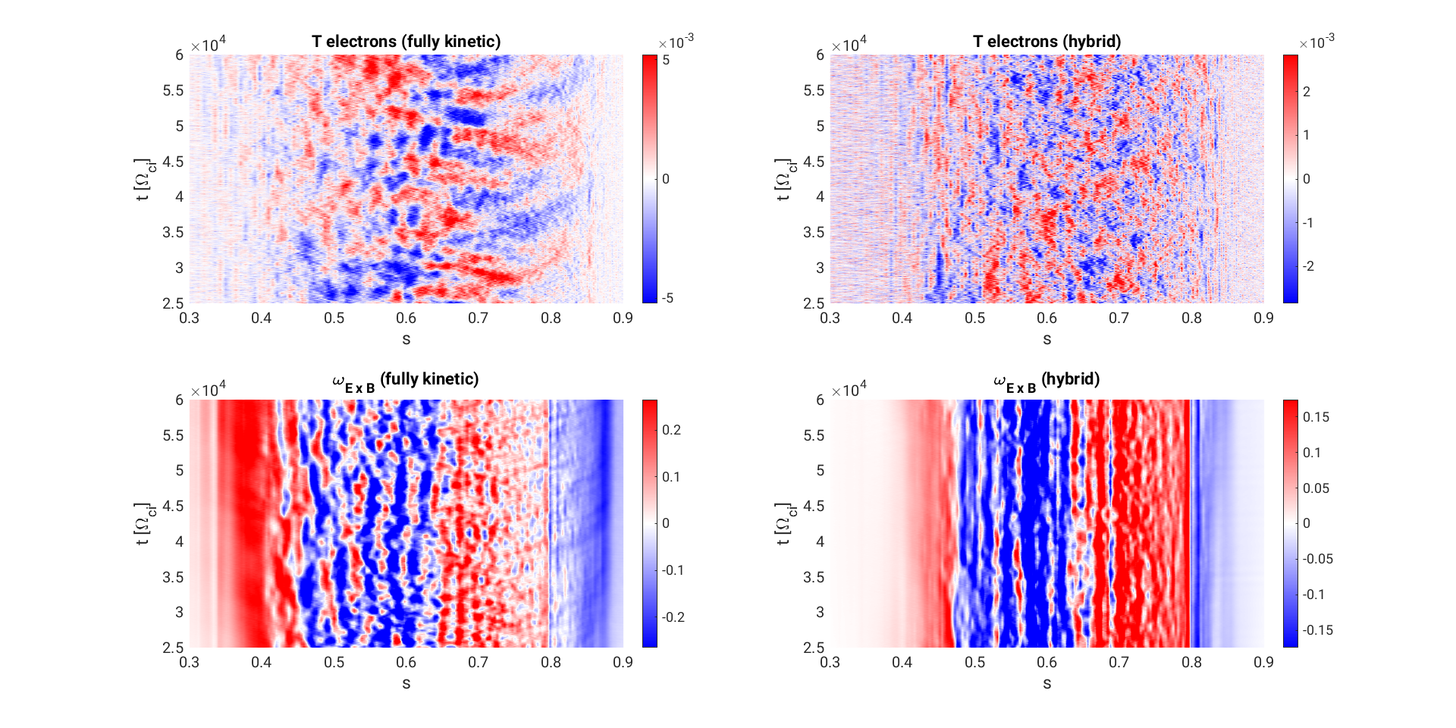
Towards fully kinetic electrons-1 (work in progress)
Impact of fully kinetic electrons response is evaluated
Simulation for narrow turbulent region
Fluxes are higher, NT reduction is about 30-35% (20-30% for hybrid model), turbulence spreading more on the outside

Slide 19
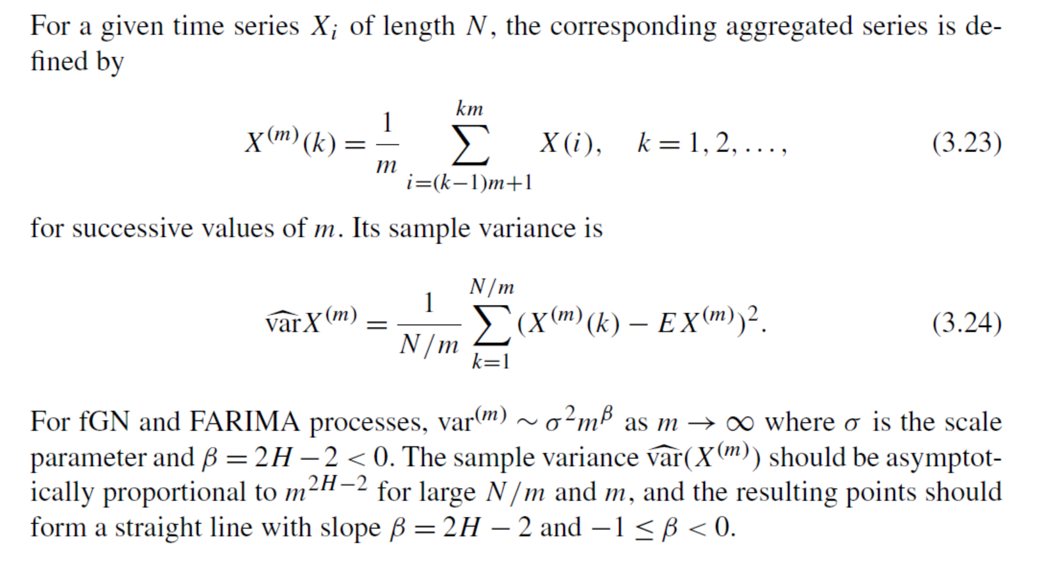
Aggregated variance method

Slide 20
Hurst exponent
The long range dependent processes have some important properties. The variances of the sample mean are decaying more slowly than the reciprocal of the sample size →
Classical statistical tests lead to the wrong results, many Hurst estimators have been proposed to analyze the LRD time series
Example, R/S estimator: For a given time series of length N, R(n) is the range of the data aggregated over blocks of length n, and $S^{2}(n)$ is the sample variance.
$E\left[\frac{R\left(n\right)}{S\left(n\right)}\right]∼C_{H}n^{H}$ as $n→ ∞$
Long story short: $H<0.5$corresponds to sub-diffusive dynamics, $H>0.5$corresponds to super-diffusive dynamics
Fractional Brownian motion can be written explicitly as function of the Hurst exp. (for H=0.5 is the usual Brownian motion)
H does also directly links to the order of fractional derivatives (in time and space) for a fractional with memory diffusive process → $H∼α/μ$ ($α$ order in time, $μ$ order in space)

Slide 21
Code, equations and approximations(3) - Equations
The formalism of ORB5 comes from the field-particles Lagrangian
All the approximations have to be done on the following equation:
Variation with respect to the potential: Quasi neutrality equation
Simplest functional form of polarization density,
Works until $k_{⊥}ρ_{i}<1$

Slide 22
Successful simulations
$ρ^{∗}=1/150$at $s=0.8$. This makes $ρ^{∗}\left({r_{R{/L}_{T}}}_{max}\right)∼1/130$
reduction around 20-30%
reduction around 50%
$δ∼ ±0.3$
time
$δ∼±0.35$

