Slide 1

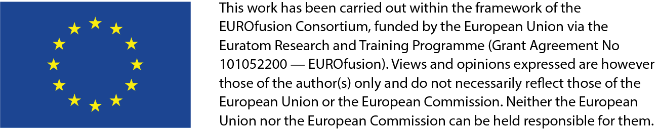
FSD Planning Meeting 9/2022:
Status WPPWIE
Sebastijan Brezinsek
J.W. Coenen, A. Hakola, K. Schmid, A. Kirschner,
H. v. d. Meiden, J. Likonen, M. Reinhart

Slide 2
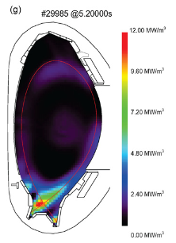
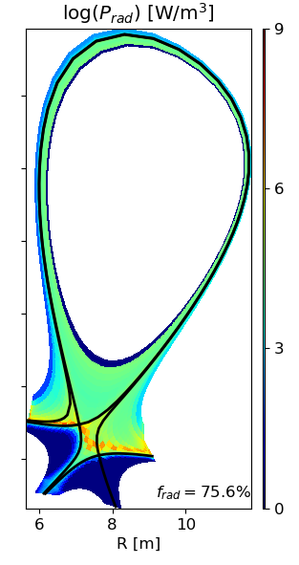
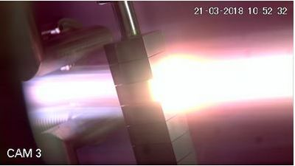
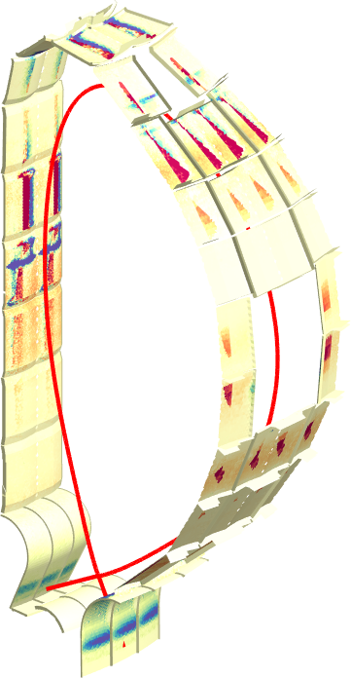
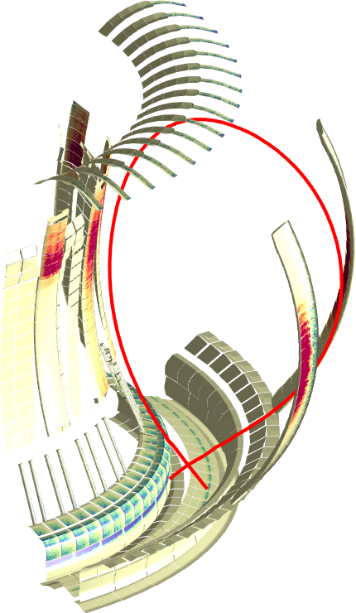
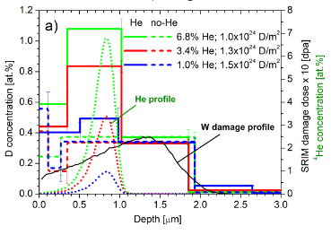
Plasma-Wall Interactions and Exhaust 2024
Focus on ITER and DEMO materials, H and isotopes, He, seeding gases, and impurities
Radiative divertor
Tungsten +
seed gas (Ne, Ar, Kr)
Advanced Divertor Solutions
Tungsten
Particle and heat flux
Tungsten + Deuterium
Goal: steady-state operation
MAGNUM
AUG
Additional
ITER focus: FIRST
WALL W PFCs during ramp-up / transients
DEMO
Experiments in WPTE
DEMO transferred to
DES / DCT
Reduced modelling
activities (tbd)
[T. Morgan]
Additional
ITER focus: CXN and
impurity FW erosion by
seed impurities / transients
JET
ITER
[M. Bernert]
[L. Aho-Mantila ]
[J. Romazanov]
[S. Markelj]
Support in WPW7X exploitation
operating with Graphite
towards Tungsten PFCs
New ITER focus: FIRST
WALL W+B+steel mix
Additional
ITER focus: W at low
temperature with 1dpa
3D erosion & deposition modelling
Beryllium
Fuel (Tritium) retention
Tungsten + Deuterium/Helium

Slide 3
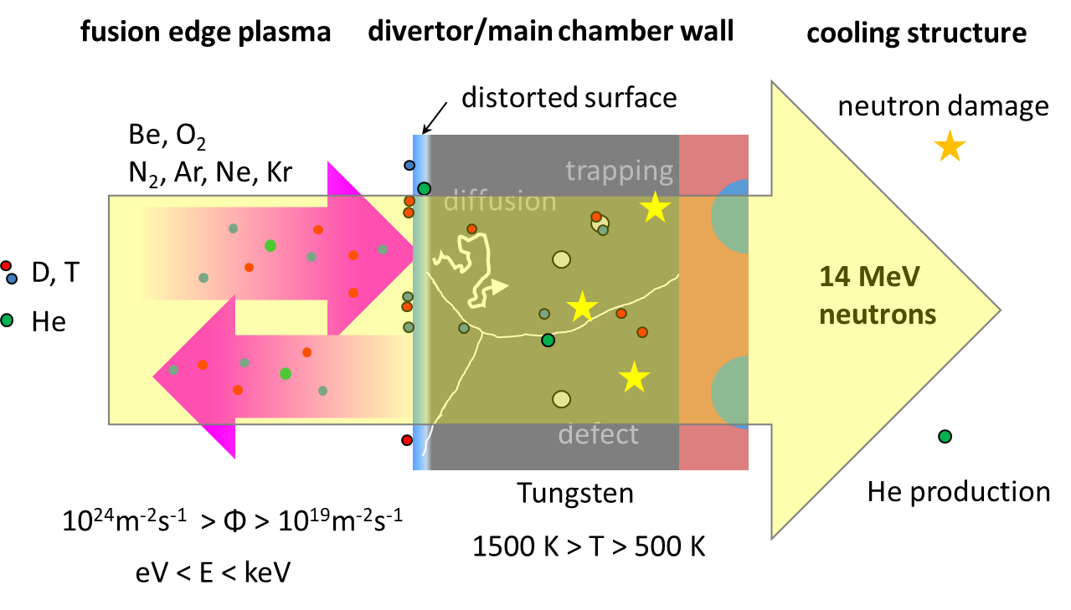
Basic physics studies 2024
Re-crystallization, surface morphology changes by plasma/heat load
Properties of damaged and re-deposited W incl. role of impurities
We must do additional studies not
foreseen in the plans and not covered
with budget (re-focus on ITER
and don‘t forget DEMO )
Now include W layer stability and release
Effective sputtering yields and 3D effects
General melting and dust release mechanisms
Now focus B + W + steel
and start-up / CX conditions
H in metals and PFCs: synergies with He and n/ion/proton damage
Retention, exchange, and release of hydrogen isotopes from metals
Now adding B layers + D/T retention + D/T release
Atomic, molecular & surface processes relevant for/in detachment
Material mixing and segregation modelling in advanced materials
Now adding B layers + steel + W (mixing) and atomic data CX with W
[T. Schwarz-Selinger]
In-situ ion-beam / laser-based analysis techniques in linear devices
In-situ material characterization (retention / material composition)
Moderate request to increase budget
In specific areas
/ mostly shift from Be towards B+W /
closure of studies (e.g. Be dust)
Now adding B layers + D/T retention in such layers
LID-QMS/LIBS from W and steel in lab systems and tokamaks (JET)

Slide 4
Key Contributions to ITER (until 2023)
WPPWIE strongly supports ITER with experimental studies and modelling related to Roadmap Mission 2
Regular inclusion of high priority topic according to ITER Research Plan, ITPA DivSOL, and IO interaction
WP PWIE supports ITER with experimental studies and modelling related to EUROfusion Mission 2
Identification of topics according to ITER Research Plan, ITPA DivSOL, and direct interaction with IO
Support ITER in lifetime estimations for the W divertor and Be first wall components [budget approach]
  Plasma (He, D) and high heat flux exposure of reference / pre-damaged / re-crystallised materials
  High fluence experiments (MAGNUM-PSI, WEST) / repetitive loads / fatigue of W PFCs
Support ITER in fuel retention estimations and fuel recovery schemes [housekeeping approach]
  Tritium monitor diagnostic: retention location identification and quantification (LID-QMS and LIBS)
  ITER tool box: baking, ICWC and ECWC, GDC including laboratory experiments (e.g. TOMAS)
Support ITER in material migration, fuel retention and dust production estimations
  Modelling of global material migration and transport to remote areas and ducts (e.g. JET mirror stations)
  He-Be and He-W interaction and its impact on erosion and deposition pattern including W fuzz formation

Slide 5
Contributions to ITER; re-focus 2024
WPPWIE strongly supports ITER with experimental studies and modelling related to Roadmap Mission 2
Regular inclusion of high priority topic according to ITER Research Plan, ITPA DivSOL, and IO interaction
WP PWIE supports ITER with experimental studies and modelling related to EUROfusion Mission 2
Identification of topics according to ITER Research Plan, ITPA DivSOL, and direct interaction with IO
Support ITER in lifetime estimations for the W/steel first wall and divertor components [budget approach]
  Plasma (He, D) and high heat flux exposure of reference / pre-damaged / re-crystallised materials
  High flux/fluence experiments (MAGNUM-PSI, WEST) / repetitive loads / fatigue of W and steel (first wall)
  Medium flux/fluence experiments (PSI-2) mimic first wall conditions (CXN with bias / seeding) W and steel
Support ITER in fuel retention estimations and fuel recovery schemes with BORON and TUNGSTEN + X
  Tritium monitor diagnostic: retention location identification (modelling) and quantification (LID-QMS and LIBS)
  in laboratory experiments and in JET / WEST if accessible
  ITER toolbox: baking, ICWC and ECWC, GDC including laboratory experiments (e.g. TOMAS) and modelling
  T retention in low n-damaged W (~1dpa) and comparison with p-damaged and ion damaged mimic ITER 2nd phase
Support ITER in material migration, fuel retention and dust production estimations (now incl. B and W)
  Modelling of FIRST WALL EROSION source, global material migration and transport to remote areas and ducts
  He-Be and He-W / Ne-W interaction and its impact on erosion and deposition pattern (synergies)

Slide 6
Contributions to DEMO
WPPWIE works hand in hand with the DCT in the general area of PWI and Exhaust
WPMAT (+PRD) provides plasma-facing materials and WPDIV provides plasma-facing components
Joint exploration and assessment of PEX solutions for DEMO with WPDES and WPTE
Supports DEMO baseline scenario via WPDES: vital input to the conceptual design
  Testing of DEMO PFCs solution (FW and Divertor) on plasma and combined plasma and transient heat load
  Improved PSI modelling regarding first wall erosion under steady-state conditions (CX) and transients (VDE)
  Re-deposited W layer stability and corresponding dust conversion factors in steady-state
  Dust assessment from transient events and restart
  Fuel inventory predictions based on implantation and neutron damage in W-based PFCs
Recommends alternative DEMO-compatible plasma exhaust solutions (tbd with DES)
  Physics basis for alternative power exhaust solutions (highly radiative LSN divertor as reference / WPDES)
  Predictive plasma edge modelling for alternative divertor solutions and their exploitation (PEX)

Slide 7
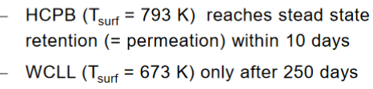
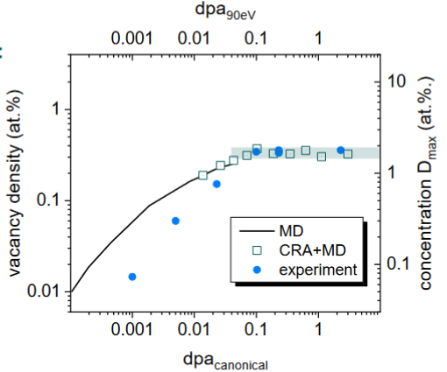
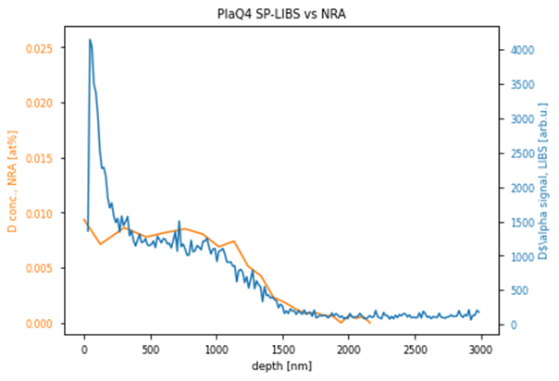
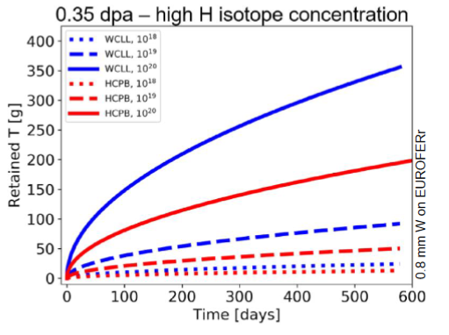
Example DEMO with FSD => Now ITER relevant
LIBS in 2023 with in-situ capability comparing with NRA
ITER
D in pre-damaged W
at 0.2 dpa
T. Schwarz-Selinger et al. PFMC 2023
E. Wüst et al. 2023
Recent retention studies in W at low “self”-damage indicated at <0.2 dpa critical damage reached and remains
Fuel retention will be therefore determined by: T in B co-deposition, T in W co-deposition, and T in damaged W
Contributions will change with operational time! Measurement? Laser techniques LIBS/LID-QMS/LIA-QMS
Proposal: physics studies in SP B, C and D + X => Include TSVV-6 and TSVV-7 and USE full-W and full-W + B
Studies of p-damaged, W self-damaged, and neutron-damaged once available

Slide 8
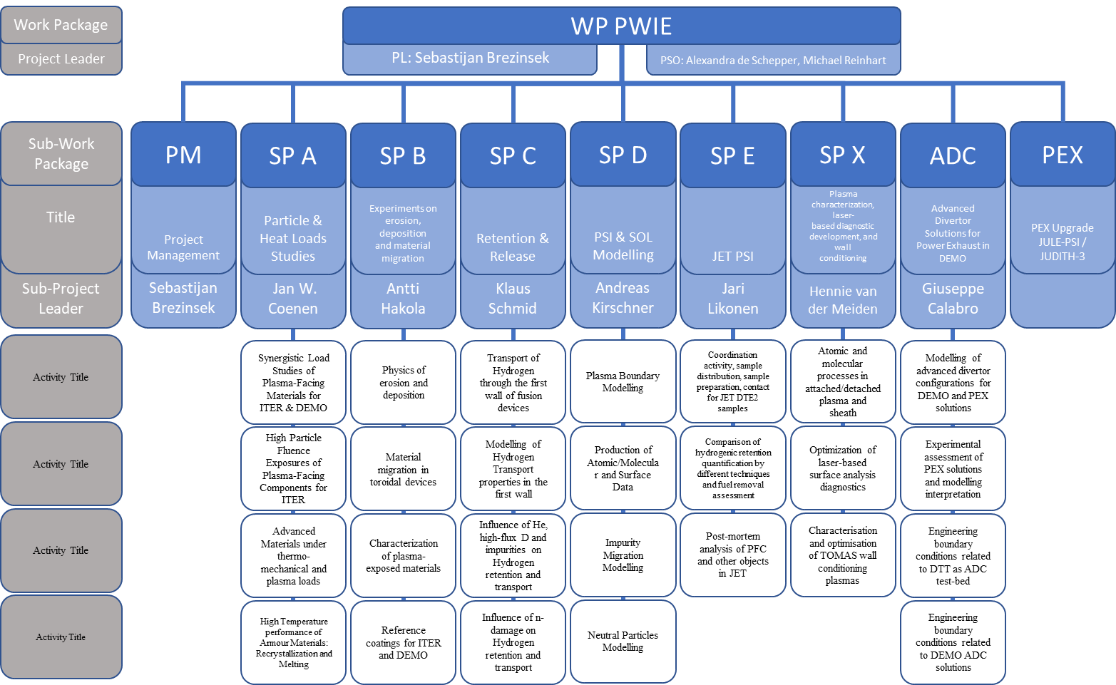
WPPWIE Structure 2023/2024
SP F
Detachment
A&M data in
Lin. plasmas
Wall conditioning
TOMAS
Boronisation
in lab + tokamak /stellarator cooperation
Include W armor for ITER and RE issues
T retention
Release from B layers
Post-mortem
tile analysis
LIBS RH
and analysis
W dust
for DEMO
Now focus
on B layers
Now focus
on CXN

Slide 9
Critial „new“ topics for WPPWIE
Wall Conditioning:
Boron(isation) test facility to develop coatings to learn how to treat B-D,T layers and remove D,T (WPPWIE)
Boronisation tests with ITER-like conditions regarding number of anodes and volume and distance. GDC optimisation. Test of D GDC with B₂D₆. (WPPWIE/WPTE/WPW7X)
Plasma-start up erosion with full W (lifetime and source)
B-W-O mixed systems and how they impact on T-retention and outgassing
Quantification of D,T in B layers by in-situ methods (LIBS, LID-QMS) (WPPWIE)
Experiment and simulation of B erosion and deposition on W in the full device. B migration, B/W mixing and dust formation as safety info (WPPWIE/WPTE)
On top all experiments and simulations regarding W alone (erosion, influx, transport, core pollution, migration, RF) coming from the main chamber (WPPWIE/WPTE)
Support of the W qualification program with the selected W/steel FW solution in ITER (WPPWIE)
RE+Disruptions in full-W ITER (JUDITH/tile analysis) and recovery (WPTE/WPPWIE)
Fuel retention and removal with B:
W erosion source, migration, retention:
ITER first wall W PFC (+ x) qualification:

Slide 10
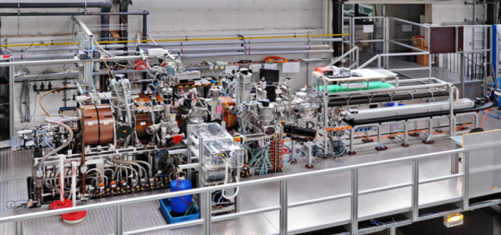
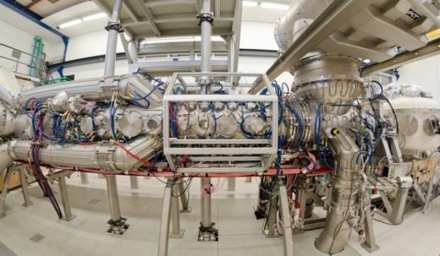
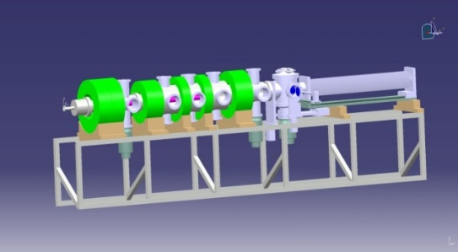
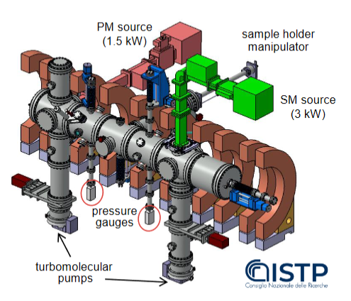
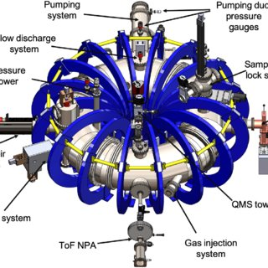
Plasma facilities: 2024 resource allocation
PSI-2:
Medium flux and fluence
(~70 days)
add LIBS
& ITER steel
Support TSVV5
MAGNUM-PSI
and UPP:
High flux and
fluence
(45 and 15 days)
Support TSVV5
GyM:
Low flux and fluence
(20 days)
ITER steel
JULE-PSI:
Medium flux and fluence
[W + T ]
(~10 days )*
Transfer into HML
TOMAS:
Wall conditioning and fuel removal
(40 days)
Wall conditioning
& LIBS?
Need for Boronisation lab!
[B layers with magnetron sputtering]

Slide 11
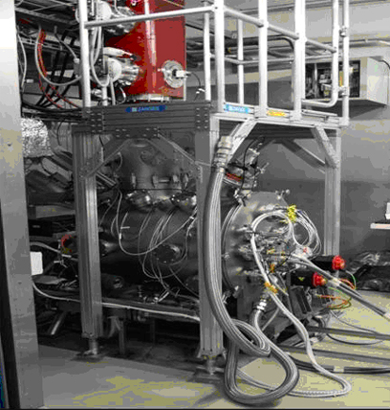
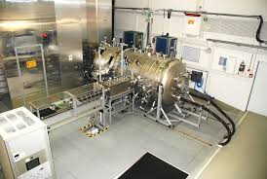
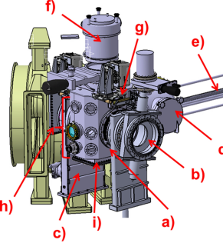
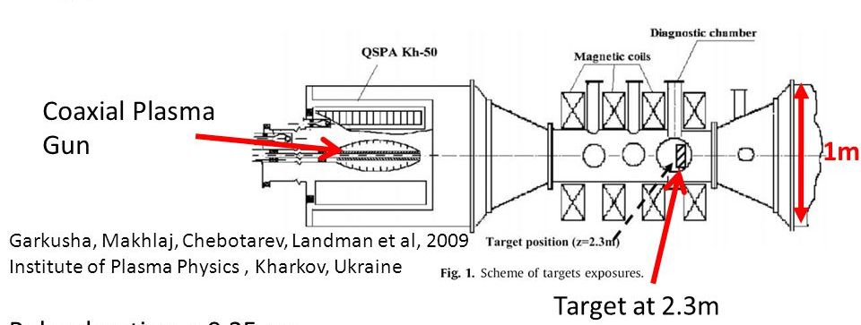
High heat flux facilities: 2024 resource allocation
JUDTIH 2 / 3 (PEX: Be & n)
E-beam:
Steady-state and transient loads
(~25 days*)
GLADIS
(Neutral Beam):
Steady-state load
(~10 days)
Request of dedicated experiments using tokamak and stellarator MPM + sectors
MAGNUM and PSI-2:
pulsed or laser for transients
QSPA / QSPA-m
Plasma Gun:
Transient loads
20 days > 2024
OLMAT (at TJ-II)
(Neutral Beam):
Transient loads
(~15 days*)

Slide 12
Analysis facilities: preliminary 2024 resource allocation
Check facility capabilities, techniques, materials, sample sizes, availability (proton + ion damage + B)
Distribution of work with inclusion of interest of labs in topic as much as possible done
Focus on ion beam facilities in financial support (accelerators and associated analysis stations)
Support of T and other facilities if possible (Saclay, HML)
Not enough funding to support other techniques TDS, PALS, Microscopy, FIB, Microscopy etc.
  => Assume it comes in-kind from the research units
RUs | Facility | Days
DIFFER | Accelerator | ~20
FZJ | Accelerator | ~25* proton damage
IST | Accelerator | ~12*
JSI | Accelerator | ~20
MPG | Accelerator | ~55
NCSRD | Accelerator | ~15
RBI | Accelerator | ~15
VR | Accelerator | ~20
VTT | Accelerator | ~5

Slide 13
PCR: Wall Conditioning and Boronisation
Integrated boronisation: simulation of ITER-like boronisation in W7-X and ASDEX Upgrade using manipulators (50 nm B layer).
ITER-like materials pre- and post-characerised samples within PWIE
Analysis of first wall erosion of those layers or equivalent from labs in W7-X and ASDEX Upgrade
Diagnostic tests on those thin layers => in-situ assessment on lifetime
with LIBS and LID-QMS (ITER techniques)
Cleaning and fuel removal tests in TOMAS
Artificial B layers for physics studies: stability, fuel content, efficiency
Need of test facility for boronisation or upgrade of an existing lab?

Slide 14
PCR:
LIBS at JET: increase scope to cover steel and mixed areas with W
  More complex analysis with metals (Fe, Cr, Ni)
  Calibration of data linked to more detection systems
  Link to analysis work in WEST (support AIA studies)
  Artificial Intelligence in analysis
Request for more human resources and mission days in 2024
New diagnostic in MAGNUM-PSI / UPP ready to study ro-vibrational in place
  Resolves in-situ H₂, D₂, HD molecules with rotational resolution
  Validation of atomic and molecular data in attached/detached conditions => Input to TSVV-5 => EIRENE (New Neutral Particle Model)
Requires additional experimental days on MAGNUM-PSI and human resources

Slide 15
Grant Deliverables FP9
SyGMa ID | Title | Due Date
PWIE.D.01 | Post-mortem analysis of plasma-facing components exposed in W7-X (graphite) and WEST (ITER-like tungsten PFUs) in FP8. Reports on campaign integrated material migration pattern and modelling in both devices. | 31.12.2021
PWIE.D.02 | Diffusion and trapping modelling in W PFCs under combined D+He impact and ion-induced self-damage for ITER / DEMO-like conditions. Report on underlying physics and fuel recovery strategies. | 31.12.2021
PWIE.D.03 | Optimization of laser-based diagnostics for ITER and other long-pulse devices regarding material composition and fuel retention quantification. Selection of most suitable approaches [report]. | 31.12.2022
PWIE.D.04 | Interpretative PSI modelling of material migration and fuel retention in WEST, JET, ASDEX Upgrade and initial predictive PSI modelling for W7-X with full-W PFCs [report]. | 31.12.2022
PWIE.D.05 | Initial assessment on the impact of material damage (pre-irradiation) on fuel retention in W [report]. | 31.12.2022
PWIE.D.06 | Damage matrix from the exposition of advanced W materials in HHF and plasma devices [report]. | 31.12.2023
PWIE.D.07 | PSI modelling of DEMO main chamber erosion, deposition and fuel retention. PIC modelling of the sheath in the DEMO divertor (with TSVV-7) | 31.12.2023
PWIE.D.08 | Neutral gas kinetics modular code upgraded and midterm verification/validation (with TSVV-5). | 31.12.2023
PWIE.D.09 | Initial PSI modelling of W sources, screening, transport and core concentration in full W-devices (with TSVV-6) | 31.12.2023
PWIE.D.10 | Recommendation to IO on Material Research Laboratory on the ITER site regarding T, Be and neutron-activated materials: minimum requirement and auxiliary systems | 31.12.2023
PWIE.D.11 | Comprehensive catalogue on dust in metal devices: generation, migration, quantity, impact of moisture on dust generation | 31.12.2023
PWIE.D.12 | In-situ fuel inventory assessment with the use of laser induced desorption techniques to monitor T retention in JET. | 31.12.2023
PWIE.D.13 | Report on the demonstration of LIBS as T detection technique in JET using remote handling. | 31.12.2024
PWIE.D.14 | Properties of JET bulk tungsten and beryllium after extensive test under reactor conditions | 31.12.2024

Slide 16
Grant Deliverables FP9
SyGMa ID | Title | Due Date
PWIE.D.15 | Initial exploration of HML (PEX Upgrade) capabilities regarding JUDITH-3 and JULE-PSI usage | 31.12.2024
PWIE.D.16 | Exploitation of experiments (WEST, JET, ASDEX Upgrade) related to material migration, fuel retention, and fuel recovery including interpretative plasma-edge and PWI modelling | 31.12.2024
PWIE.D.17 | Assessment of LID-QMS as in-situ fuel retention technique in JET and extrapolate to ITER conditions. | 31.12.2024
PWIE.D.18 | Simulation of JET and PEX Upgrades results in view of ITER divertor and DEMO/DTT alternative configurations. Quantitative comparison of potential benefits alternative configurations with respect to conventional solutions in view of exhaust performances and core compatibility (input to overarching PEX.M1 milestone). | 31.12.2024
PWIE.D.19 | Characterization and predictive modelling of plasma-wall interactions in He und He/H mixed plasmas for ITER in Pre-Fusion Power phase | 31.12.2025
PWIE.D.20 | High fluence exposition of mono blocks made of references W and advanced W materials for DEMO, JT60-SA, DTT in MAGNUM-PSI and UPP including pre- and post-characterisation | 31.12.2025
PWIE.D.21 | Fuel retention studies in self-damaged and neutron damaged materials exposed in JULE-PSI | 31.12.2025
PWIE.D.22 | Comparison of in-situ (LID-QMS in JET) and ex-situ examination (FREDIS, TDS) of the laser-irradiated components regarding fuel/tritium content | 31.12.2025
PWIE.D.23 | PSI modelling of DEMO main chamber erosion, deposition and fuel retention. PIC modelling of the sheath in the DEMO divertor (with TSVV) | 31.12.2025
PWIE.D.24 | Neutral gas kinetics modular code upgraded and final verification/validation report (with TSVV). | 31.12.2025
PWIE.D.25 | PSI modelling of W sources, screening, transport and core concentration in full W-devices (with TSVV) | 31.12.2025
Note: Some Deliverables can‘t be done or need rephrasing (B instead of Be). One might be brought forward if we complete simply Be studies.

Slide 17
Grant Milestones FP9
SyGMa ID | Title | Due Date
PWIE.M.01 | Initial tile analysis of WEST PFUs and W7-X TDU PFCs completed | 31.12.2021
PWIE.M.02 | Comparative modelling of first set of revised advanced divertor solutions executed. | 31.12.2021
PWIE.M.03 | Modelling of fuel retention in W under combined D+He exposure and self-damaged W by diffusion and trapping executed. | 31.12.2021
PWIE.M.04 | High fluence experiments in deuterium (L-mode) discharges on ITER-like PFUs in WEST executed. | 30.06.2022 = > 31.122023
PWIE.M.05 | Incorporation of turbulence in multi-fluid calculations using physics-based diffusion coefficients (with TSVVs). | 30.06.2022
PWIE.M.06 | Comparative experiments of different LASER-based techniques on W and other reference samples executed. | 31.12.2022
PWIE.M.07 | Interpretative modelling of W migration and D retention in WEST high fluence discharges completed. | 31.12.2022 => 31.12.2023
PWIE.M.08 | Exposition of initial set of reference and advanced W materials for DEMO and JT-60SA in HHF and plasma devices executed. | 31.12.2023
PWIE.M.09 | 3D Modelling of first wall erosion and fuel retention in the DEMO-1 reference scenario completed (TSVV7). | 31.12.2023
PWIE.M.10 | Initial neutral particle code development done and interface to plasma boundary code coupling specified (TSVV5). | 31.12.2023
PWIE.M.11 | FZJ PEX facility with JULE-PSI and JUDITH-3 is fully operational and ready for scientific exploitation. | 31.12.2024
PWIE.M.12 | Exposition of initial set of reference and advanced W PFCs for DEMO and JT-60SA to fluence up to 10³⁰m⁻² in MAGNUM-PSI and UPP executed. | 31.12.2024
PWIE.M.13 | Helium plasmas and fuel/He recovery experiments in WEST executed and samples removed. | 31.12.2024
PWIE.M.14 | Potential PFCs solutions for an all-W W7-X identified and reference samples exposed in HHF and plasma devices to stellarator relevant power loads and fluence. | 31.12.2025
PWIE.M.15 | Exposition of neutron-damaged and self-damaged W samples in JULE-PSI. | 31.12.2025

Slide 18
Thrust 2: TSVV 5-6-7
In general: good progress in all 3 TSVVs
TSVV-5: New neutral particle code / mixed kinetic/fluid models benchmarked
TSVV-6: TIM – EIRENE module / SOLEDGE-3D modelling in WEST development
TSVV-7: Initial ERO2.0 for DEMO (SN + Ar seeding) performed
Next: Review meeting
Proposal: ADD new ITER full-W cases into TSVV-6 and TSVV-7 (shift/replace some benchmark cases)
TSVV-6: Currently Be/W mix with RMP and W erosion at lobs => go to full-W and used EMC3-EIRENE
TSVV-7: Waiting for new DEMO plasma … => include new ITER case as benchmark and focus on a wide-grid ITER plasma with SOLPS-ITER with Ne or Ar (no Be) and estimate T retention etc.
Who would provide a full 3D plasma background – discussion with IO?

Slide 19
International Collaborations / Travel
ID | International Collaboration in WP Activities | Planned year(s) of engagement | Status
IC01 | SP D.3: EU-Japan (LHD, NAGDIS) | 2021-2025 | Running
IC02 | SP D.3: EU-US (UCSD, PISCES) | 2021-2025 | Renewed
IC03 | SP D.3: EU-China (EAST) | 2021-2025 | Running
IC09 | SP E.2: EU-Japan (Rokasho/Broader Approach F4E) | 2022-2023 | F4E visit needed
IC10 | SP B.1: EU-US (UCSD, PISCES) | 2022-2025 | Renewed
IC12 | ITER collaboration (e.g. SP D and SP E) | 2021-2025 | -
IC13 | ITPA collaboration (e.g. SP A and SP X) | 2021-2025 | -
IC14 | IAEA collaboration (e.g. SP C and SP X) | 2021-2025 | -

Slide 20
Summary
Key questions regarding PWI and PEX for ITER and DEMO addressed and input given to IO and FTD
In general good progress in WPPWIE activities in 2022 within the given boundaries (examples given)
Delays in different activities due to Corona or technical issues (MAGNUM and WEST restart soon)
Significant support of WPTE => coordinated experiments e.g. in Helium experiments
Significant support of WPW7X => C erosion, transport and deposition if full 3D geometry
Minor support for WPPrIO and WPSA so far. JT60-SA material testing and timeline needs to be clarified
Support of WPDIV, WPDES, WPSAE within limitations done

Slide 21
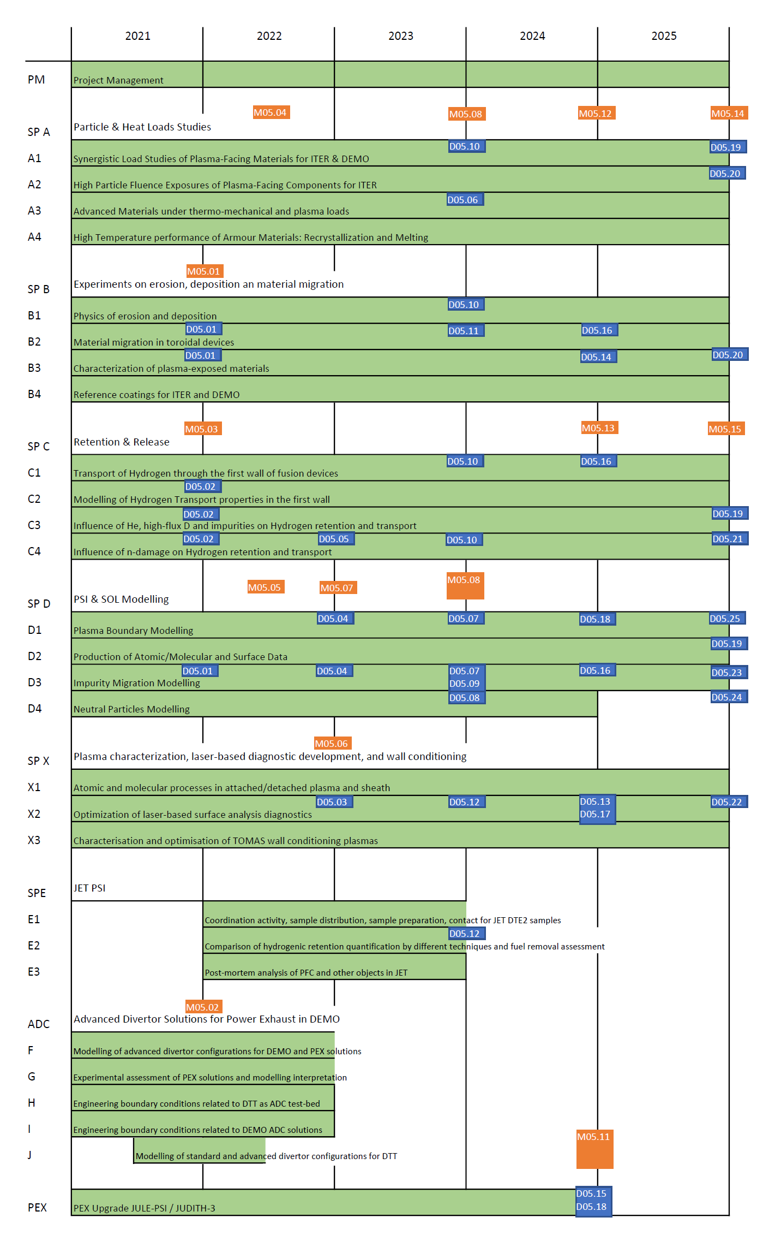
Gant chart

Slide 22
Back-up

Slide 23
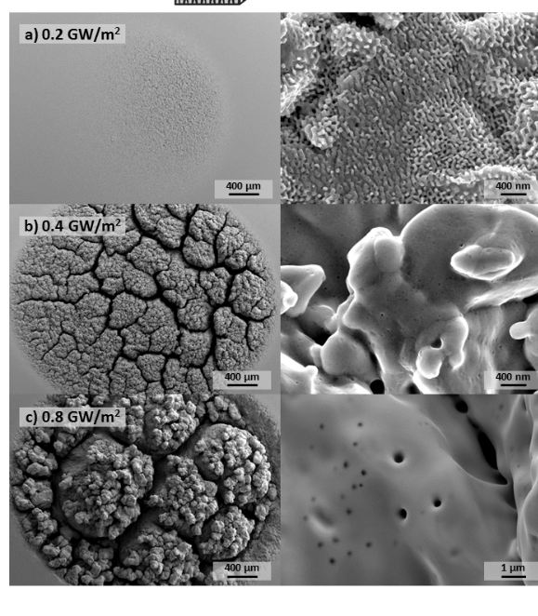
SP A - Example
Particle and heat load studies in preparation of the exploitation of ITER and DEMO
SPL: J.W. Coenen
Total: 129 PM (with 60 KIPT)
PSI-2:
Tungsten ITER-grade
damage development:
D plasma exposure combined with laser transients mimic
large ELM events
Input to damage
matrix of W
Repeat with He/D
SP A.1 Synergistic Load Studies of Plasma-Facing Materials for ITER & DEMO
SP A.2 High Particle Fluence Exposures of Plasma-Facing Components for ITER
SP A.3 Advanced Materials under thermo-mechanical and plasma loads
SP A.4 High Temperature performance of Armour Materials: Recrystallization and Melting
Participants: CEA, CIEMAT, DIFFER, DTU, FZJ, JSI, KIPT, LPP-ERM-KMS, MPG, VR
M. Gago et al. SOFT 2022
Note: TOKES activity expected in EEG

Slide 24
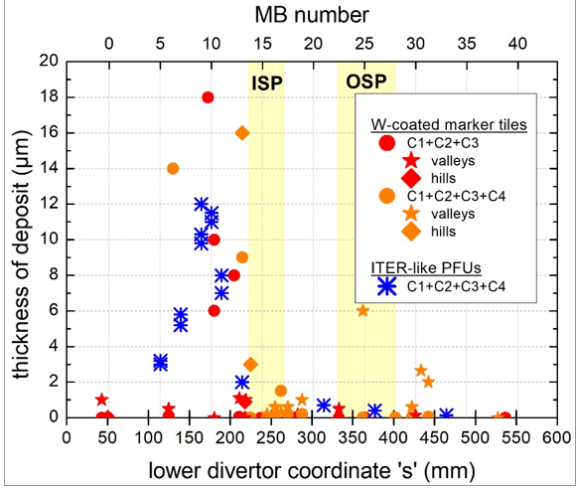
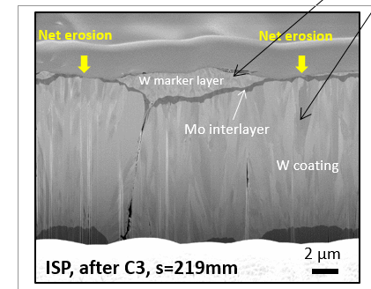
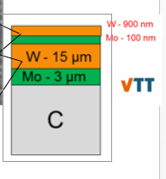
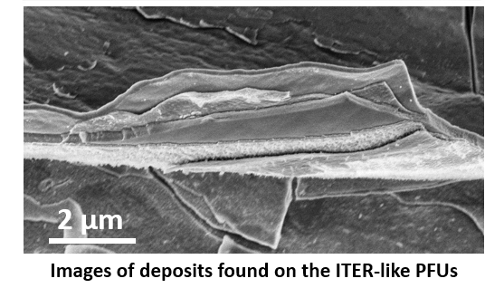
SP B - Example
Experiments on erosion, deposition and material migration
W erosion zone
SPL: A. Hakola
Total: 99 PM
SP B.1 Physics of erosion and deposition
SP B.2 Material migration in toroidal devices
SP B.3 Characterization of plasma-exposed materials
B + O + C + W deposition zone
WEST W PFUs after 4 campaigns
Strong W erosion (like in AUG with ELMs => impurities)
Layerd deposition (origin unclear, but B + C + O +W) layers -
Role of FW erosion and W flux into divertor
SP B.4 Reference coatings for ITER and DEMO
Participants: CEA, CIEMAT, DIFFER, ENEA, FZJ, IAP, IPPLM, IST, JSI, MPG, OEAW, RBI, VR, VTT
M. Diez et al. PSI 2022
M. Balden et al.
Note: Collaboration experiments
with WPTE and WPW7X

Slide 25
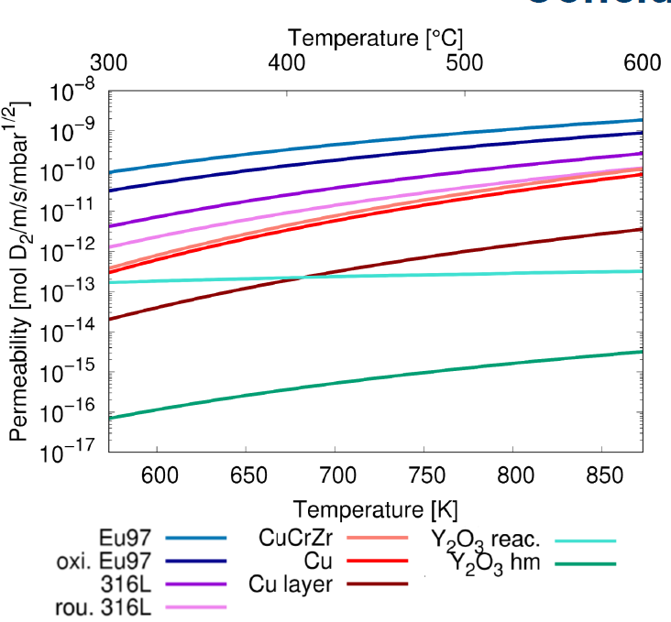
SP C - Example
Retention and Release
SPL: K. Schmid
Total: 96 PM
D permeations studies
of DEMO and ITER steels and components
Relevant for tritium retention in DEMO
Role of permeation barriers in FW
Next step:
pre-damaged steel
and tunsten
SP C.1 Transport of Hydrogen through the first wall of fusion devices
SP C.2 Modelling of Hydrogen Transport properties in the first wall
SP C.3 Influence of He, high-flux D and impurities on Hydrogen retention and transport
SP C.4 Influence of n-damage on Hydrogen retention and transport
Participants: CEA, DIFFER, ENEA, FZJ, IPPLM, JSI, MPG, OEAW, VR, UKAEA
A. Houben et al. PSI 2022
Note: - ERG J. Denis linked to JET simulations
- New EEG T retention in DEMO FW

Slide 26
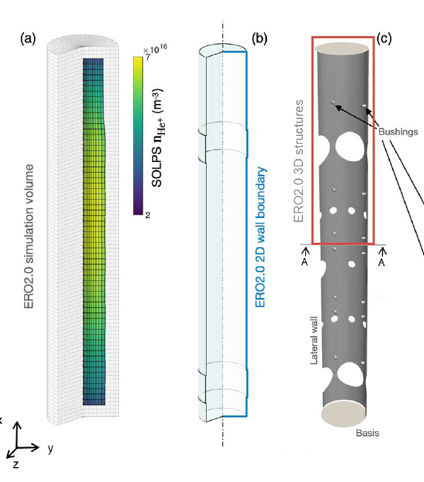
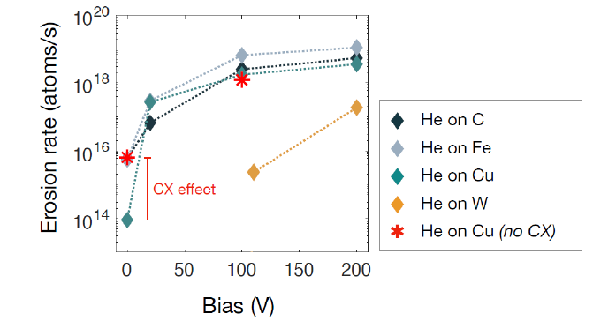
SP D - Example
Plasma-edge and Plasma-wall Interaction Modelling
He plasmas in linear plasma GyM with W and steel plate
He plasma with SOLPS-ITER
ERO2.0 PWI modelling in He
Role of He CX data on n_{e} and T_{e} and sputtering of different materials (steel, W, C)
SPL: A. Kirschner
Total: 90 PM
SP D.1 Plasma Boundary Modelling
SP D.2 Production of Atomic/Molecular and Surface Data
SP D.3 Impurity Migration Modelling
SP D.4 Neutral Particles Modelling
M. Passoni et al. PSI 2022
Participants: CEA, DIFFER, ENEA, FZJ, IPP.CR, KIT, MPG, OEAW, VR, VTT

Slide 27
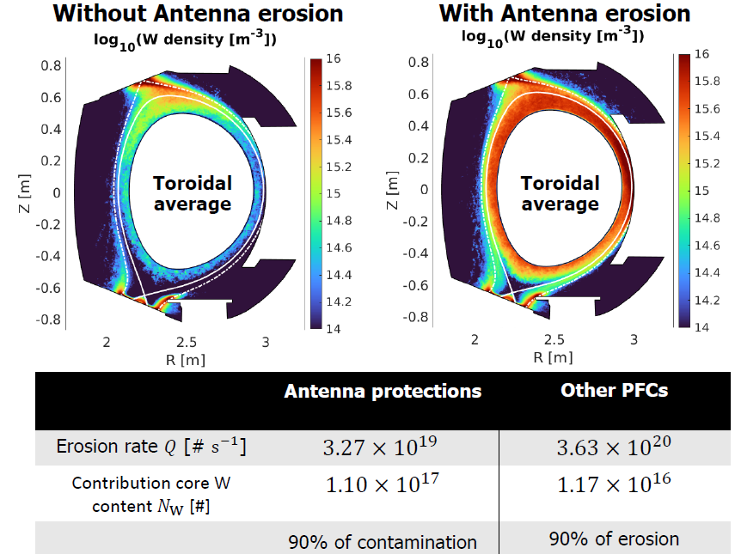
SP D - Example
Plasma-edge and Plasma-wall Interaction Modelling
Role of 3D effects in W erosion
SPL: A. Kirschner
Total: 90 PM
WEST:
First SolEdge3X +
ERO2.0 simulation
for D plasmas in 3D
(no ripple)
Uncertainties in W
source and content
estimation and modelling
Deeper analysis and long-exposure experiments for gross/net W erosion
SP D.1 Plasma Boundary Modelling
SP D.2 Production of Atomic/Molecular and Surface Data
SP D.3 Impurity Migration Modelling
SP D.4 Neutral Particles Modelling
Participants: CEA, DIFFER, ENEA, FZJ, IPP.CR, KIT, MPG, OEAW, VR, VTT
S. Di Genova et al. PSI 2022

Slide 28
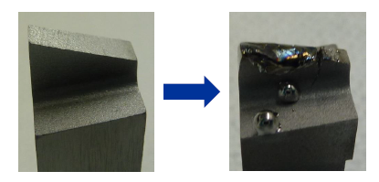
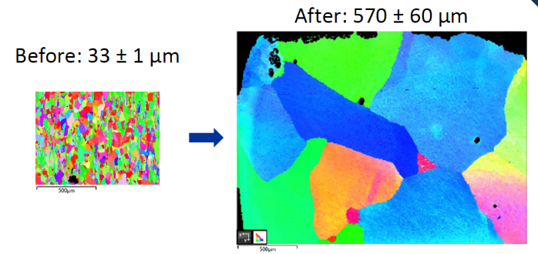
SP E - Example
PWI with Be, T and neutrons: focus on JET post-mortem analysis and its interpretation
SPL: J. Likonen
Total: 89 PM
Analysis of pre-DT samples like molten W Langmuir Probes in divertor
Analysis of W material properties and link to SP A experiments and modells
SP E.1 Coordination activity, sample distribution, sample preparation, contact for JET DTE2 samples
SP E.2 Comparison of hydrogenic retention quantification by different techniques and fuel removal assessment
SP E.3 Post-mortem analysis of PFC and other objects in JET
Participants: VTT, CU, FZJ, IAP, IPPLM, ISSP-UL, IST, MPG, NCSRD, VR, UKAEA
Existing sample preparation ongoing and new samples send to labs for analysis
R. Kerr et al. PSI 2022

Slide 29
SP E: Plans for 2024 and beyond?
No DTE3 in 2023
  LID-QMS studies
  Analysis of components exposed to DTE2 and clean-up campaign
  No cooling period
  In-vessel LIBS analysis
  Preparation of samples from divertor and wall tiles takes ~3 months at VTT and IAP, in total ~6 months
  Dust collection (vacuuming half divertor)
  Same components as in scenario 1 for post mortem analyses
  Inner wall cladding tiles and inserts, sticking monitors
  Mirrors, rotating collectors, outer wall dust collectors
  Be limiters tiles (DP, IWGL, OPL) => toroidal and poloidal distribution
    Damaged materials from RE or disruption
  Divertor tiles => toroidal and poloidal distribution
New modelling will set-in addressing e.g. poloidal/toroidal asymmetries etc.
This is a programme for 2024-2027!
Larger number of labs available
Note: vessel baking over months not included here ….
… needs all to be discussed with UKAEA
DTE3 will be executed towards the end of 2023
  Limited clean-up and LID-QMS studies (after DTE3)
  Cooling period of ~1 year causes a delay in handling JET components
  Limited in-vessel LIBS analysis
  After the cooling period T inventory so high that only 1 tile at a time can be handled at VTT/IAP (Widdowson PFMC 2015)
  Preparation of samples from divertor and wall tiles takes 6-8 months/lab including shipments (c.f. currently ~3 months/lab)
  Total time required for preparation of samples ~12-18 months
  Dust collection (vacuuming half divertor) after cooling period
  Inner wall cladding tiles and inserts, sticking monitors
  Mirrors, rotating collectors, outer wall dust collectors
  Be limiters tiles (DP, IWGL, OPL) => toroidal and poloidal distribution
    Damaged materials from RE or disruption
  Divertor tiles => toroidal and poloidal distribution
New modelling will set-in addressing e.g. poloidal/toroidal asymmetries etc.
Training opportunity for ITER personal on relevant material
This is a programme for 2024-2030!
New labs activated and will be ready to receive a limited amount of samples

Slide 30
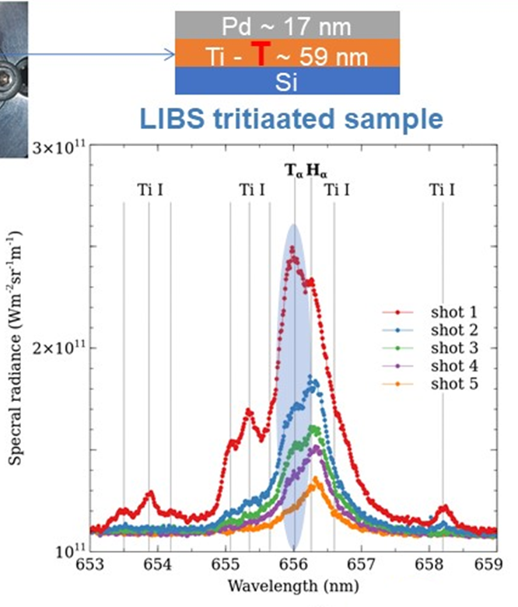
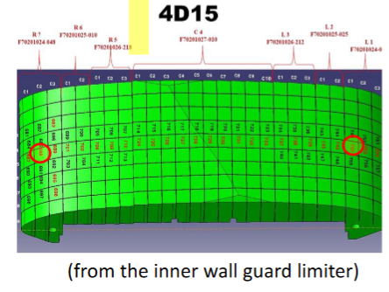
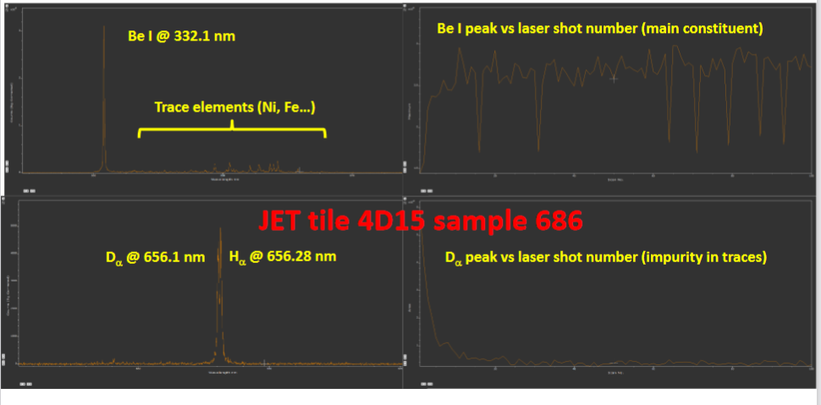
SP X - Example
Plasma characterization, laser-based diagnostic development, and wall conditioning
SPL: H. van der Meiden
Total: 72 PM
Analysis of pre-DT Be samples in VTT
ns-LIBS laser system with real Be wall
limiters. Comparison with other analysis
Composition analysis and depth analysis
Fuel retention (Balmer lines) critical
SP X.1 Atomic and molecular processes in attached/detached plasma and sheath
LIBS team from SPX2 => A. Hakola et al. as host
SP X.2 Optimization of laser-based surface analysis diagnostics
SP X.3 Characterisation and optimisation of TOMAS wall conditioning plasmas
Participants: CEA, CIEMAT, CU, DCU, DIFFER, ENEA, FZJ, IPPLM, ISSP-UL, KIPT, LPP-ERM-KMS, UT, VR
T testing in CORIA (CEA)
Waiting for JULE-PSI ….
Note: - ERG grant A. Goriaev
- EEG grant Rayaprolu

