Slide 1
WPPrIO Preparation of ITER Operation
AWP-2024 High level objectives
Culham, UK, 2023/09/20-21
X. Litaudon (PL) , G. Falchetto (PSO) and the sub-project coordinators: E. Belonohy, U. Fantz, V. Toigo, S. Villari on behalf of PrIO team, J. Figueiredo PMU

Slide 2
Few words of introduction
The PrIO presentation will focus on the main project changes requested in 2024
Presentation is structured per sub-project
PrIO is taking into account the new context with ITER re-baselining
The PCR proposals are adressing the following « hot topics »
  New heating mix with increased ECRH power
  Tools (operational tools, synthetic diagnostics, operational tools, nuclear tools) well validated, tested and ready to be transferred for ITER application & first operation
  Gap in expertise for operation & scientific exploitation with ITER delays: how to maintain the operational knowledge ?
  used of Artificial Intelligence tools : database, operation
  Two steps nuclear licenses process with full W environnement + Boron deposit

Slide 3
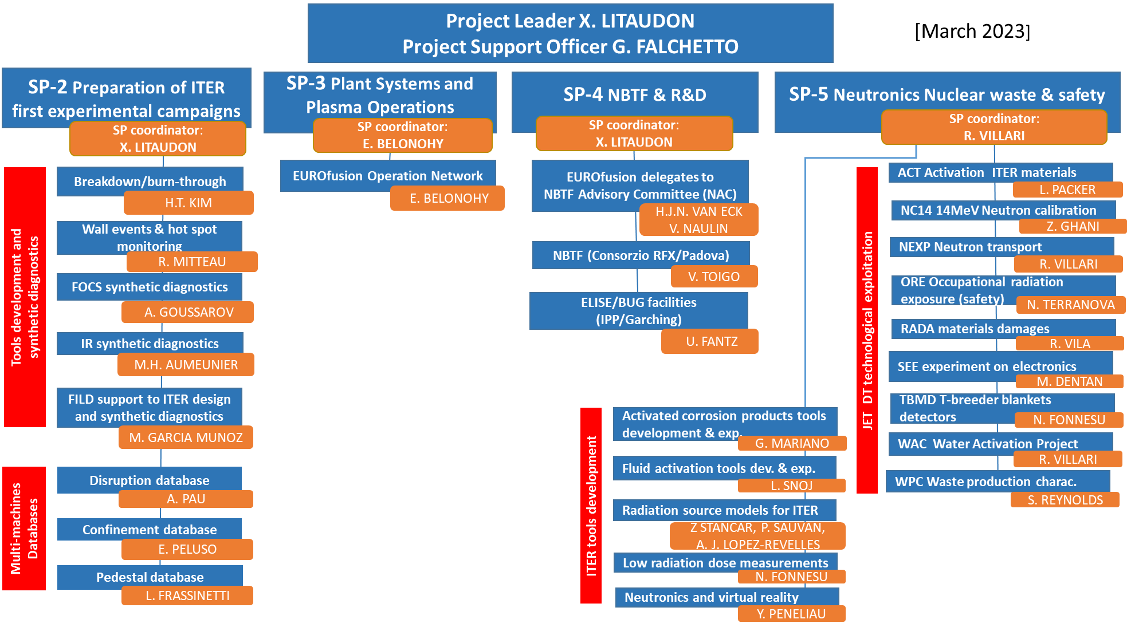
Project structure and 2024 evolution with end of JET
[EUROfusion role in ITER operation & scientific exploitation EUROFUSION GA (20) 32 - 4.7 ]
SP-1
12 proposals @ FEC 2023: 1 OV poster & 2 orals
Overview @ ISFNT + 3 orals

Slide 4
SP-2. Preparation of ITER first experimental campaigns
2024 PrIO-2 IR synthetic diagnostics | IMAS adaptation of IR synthetic diagnostics | Beyond the scope baseline. Additional deliverable in 2025 following feasibilities studies in 2023 | +6PM
2024 Validation of the FOCS Synthetic diagnostics using JET magnetic data | JET has poloidally distributed Internal Discrete Coils (IDS) located relatively close to the FOCS: − magnetic sensor output can be used to reconstruct the magnetic field along the fibre and used to simulate FOCS operation. The simulated results can be compared with the actual FOCS measurements. + Effect of radiation on fibre (DTE3) | Extended scope | 3PM + support from JET magnetic data expert
Additional support for the EUROfusion multi-machine databases | Implement deep learning algorithms for pedestal and disruption predictions. Additional support for JET/AUG/MAST-U data and 1D transport database. | Extended scope | 6PM / Year
Support to ITER diagnostics procured by EU with the development of synthetic diagnostics | Europe is responsible for roughly 25% of all Diagnostics in ITER. The phase between FDR and operation can be between 2 – 8 years. During this period, low level of resources are foreseen by F4E to EU labs. | Beyond the scope baseline. Additional deliverable to strengthen EUROfusion role in ITER diagnostics analysis and operation | requires increase of budget
2024 PrIO-2 Participation in the development of tools to analyse multiple diagnostics - Integrated data analysis | In support to PrIO.2 Tasks. In complement to ITER contract. To be agreed with IO. | Beyond the scope baseline. Additional deliverable with EUROfusion participation in data analysis/validation for ITER | +6-12PM /year

Slide 5
2024 plans for Pedestal database
Context :
  From August 2023 all the JET, AUG and TCV pulses in IMAS on the Gateway thanks to ACH support
  The final version of the web interface will be deployed on the Gateway only when the new machine will be installed (in 2024).
Extend the EUROfusion pedestal database including the JET pulses from the 2023 campaign
Update the present version with more validated pulses.
Extend the EUROfusion pedestal database including the recent TCV pulses.
Final test and deployment of the web interface to download the pedestal database →ACH support
Work on MAST-U and AUG will be done only if help from the local team is provided.

Slide 6
Examples: use of the EUROfusion Pedestal database – to be further expanded -
Pedestal database : Frassinetti et al., NF2021 https://doi.org/10.1088/1741-4326/abb79e
A. Gillgren et al., Enabling adaptive pedestals in predictive transport simulations using neural networks 2022 Nucl. Fusion 62 096006 https://doi.org/10.1088/1741-4326/ac7536
A. Kit Developing deep learning algorithms for inferring upstream separatrix density at JET Nuclear Materials and Energy22 December2022 https://doi.org/10.1016/j.nme.2022.101347
A. Kit et al, Supervised learning approaches to modeling pedestal density Plasma Phys. Control. Fusion 65 (2023) 045003, https://doi.org/10.1088/1361-6587/acb3f7
A. Kit et al., PSI2023 ” Developing deep learning algorithms for determining ne,sep at JET”
A. Kit et al., TTF2023 ”Enabling online pedestal stability analysis with machine learning”
Gregoire Clarte et al., ICDDPS-4, “Maximizing Pedestal Pressure Height through Bayesian Optimisation”
A. Jarvineen ICDDPS4 “Representation learning algorithms for inferring machine independent latent features in pedestals in JET and AUG” (PoPpaper to be submitted)

Slide 7
SP-3. Plant systems and plasma operation
2024-2025 PrIO-2-3 AI in support of operation | Machine learning on EUROfusion operation database to develop natural language ‘Chat GPT’ like to support Session Leader decision- new call in 2024 | Extended scope | Additional resources required to cover 2024-25
2024 PrIO-3 Foundation courses on Session Leader | for the presenters to prepare the course 1 week per presenter | knowledge management in operation and session leading. 1 week course on session leader | +6PM + Missions
2024 PrIO-3 training on ECRH commissioning + ECRH network (like the NBI network) | opportunity : new activities in support of ITER re-baselining and the new heating mix. F4E wishes to improve collaboration on ECRH and create a network of experts to share information. There is an urgent need of test stands and new experts/engineers in this field. In this context, we can develop a training scheme where experts are trained in our EU facilities before moving to ITER, and EUROfusion-F4E could play an important role. | new | Additional resources required to cover 2024-25

Slide 8
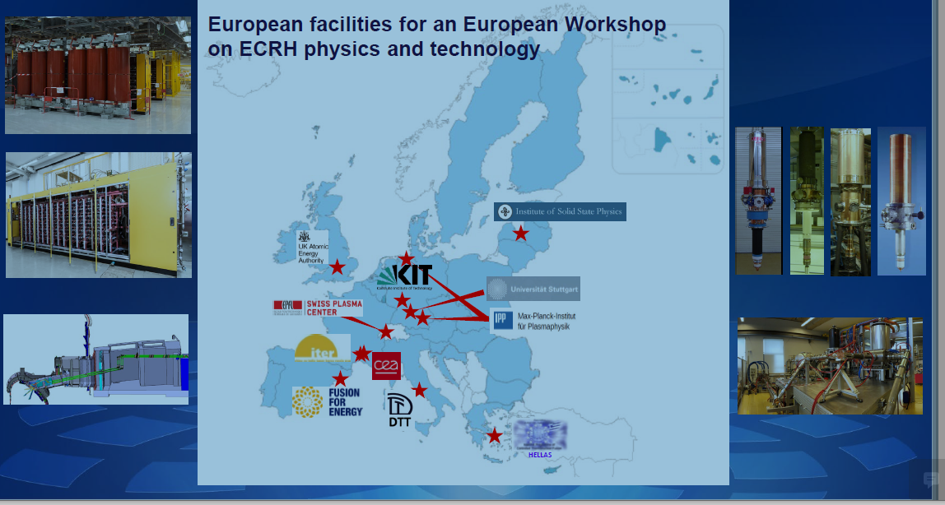
training on ECRH commissioning + ECRH network (like the NBI network)
Significant transition from 1 Gyrotron procurement/year to above 10/year for 10 years + commissioning on test beds
New initiative from F4E Sánchez Arcos Paco (F4E) Francisco.Sanchez@f4e.europa.eu who is organising joint EU brainstorming (IO + UKAEA + CEA/MPG/KIT/EPFL + DTT) with ECRH experts /upcoming users

Slide 9
SP-3 EON Foundation Course on Session Leading – pending resources-
Course outline- possible structure- :
Introduction, Operations Management
Coils and power supplies
Plasma shape control
Vacuum conditioning abd Fueling (gas and pellet injection)
Heating systems (NBI, ECRH, ICRH)
Disruptions, predictions and mitigation (MGI, SPI)
Diagnostic setup
Breakdown and current ramp up, runaways
Protection systems and Real-time networks (scientific)
Termination and event handling
Operational tools
Continuous plant systems and IT systems
Plant and Plasma Control
Operation of stellarators
Scaling up operation towards ITER
Aims:
Provide basic machine-independent background on tokamak/stellarator operation + machine dependent implementations
What is operations for newcomers (from fission, other industries or other engineering/physics roles)
Improve preparation of experimental proposals and experimental sessions
Target audience:
Students (MSc, PhD, Post-doc)
EEGs and ERGs
Scientific Coordinators, task force leaders
Engineers, Researchers
Newcomers (from fission or other fields)

Slide 10
SP-4 ITER Neutral Beam Test Facility and R&D
From 20 experts funded down to 18 in 2023-2025
  down from 14 to 13 at NBTF & 6 down to 5 at IPP-Garching
  Reduction due to budgetary constraints whereas NB project requires more staff…
“Now that, SPIDER will be equipped with it’s full capability to deliver ITER NB parameters, it is required that experimental time, which is precious, to be utilized with primary focus to look for that NB performance while other checks, verifications and validations to the collaborating laboratories. “ NAC May 2023
  collaborating laboratories to provide data complementary to SPIDER & increase efficiency towards ITER
2024-25 PrIO-4 expert on physics of beam formation and transport (stripping of negative ions) on BUG/ELISE/SPIDER and extrapolation to MITICA and ITER NBI | gap in expertise has been analysed - call for one extra secondee- collaborative project- |  | 12PM/2024

Slide 11
International collaboration
F4E-EUROfusion discussion on JT-60SA/ITER NBI collaboration
  Meeting on the 30/08 organised by EB with IPP, RFX , EUROfusion, F4E and UKAEA experts
  Optimization of RF source and injector in support to ITER
  Training
  commissioning and operation of the JT-60SA negative and positive NBI systems
  Long term: JT-60SA testbed to condition the NBI beams outside the tokamak

Slide 12
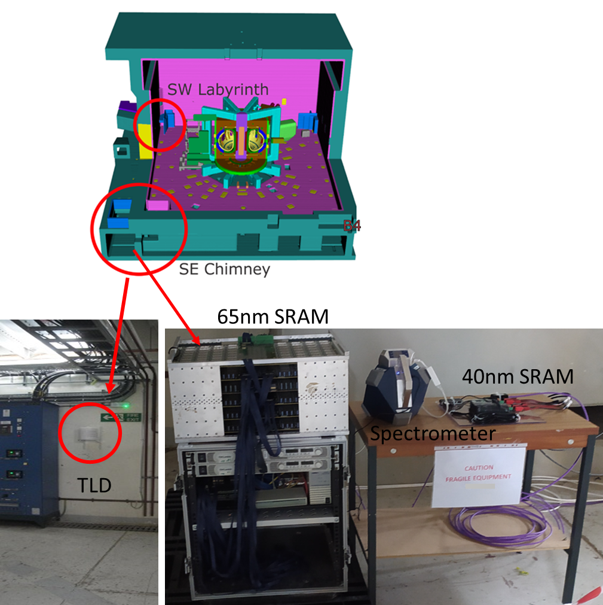
SP-5 DTE3-neutron effect on electronics
Normalized average spectrum, position B6, C45 campaign

Slide 13

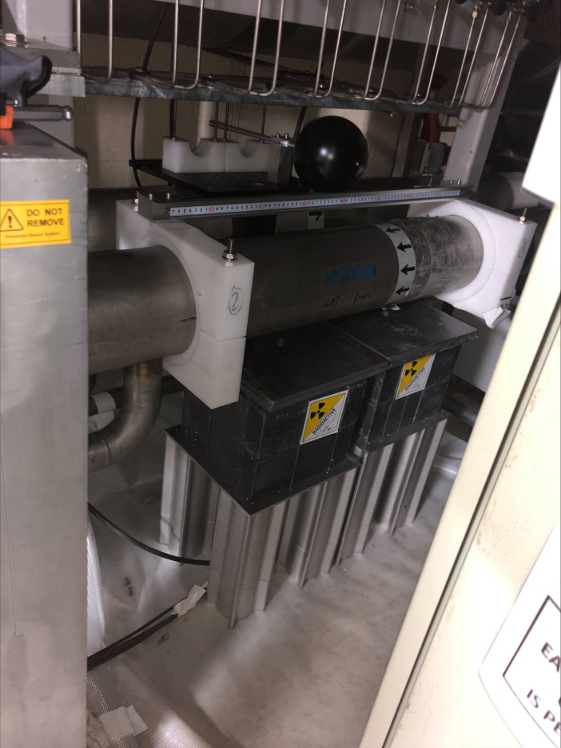
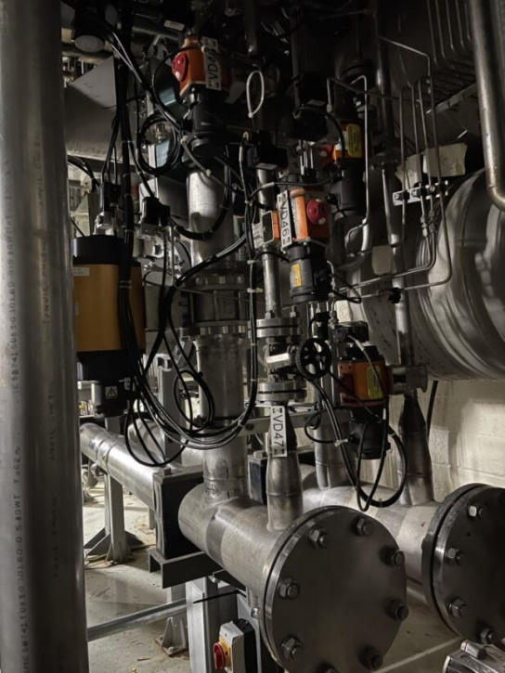
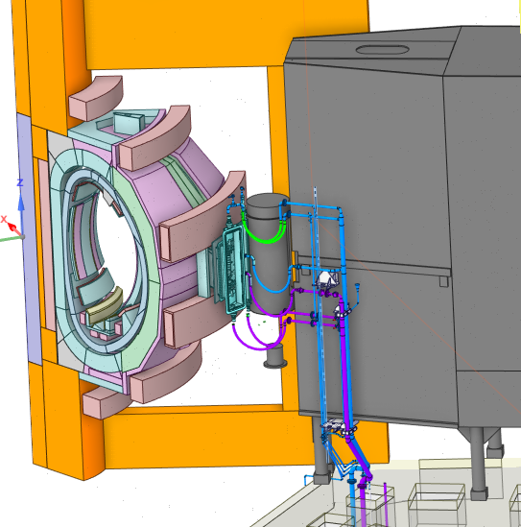
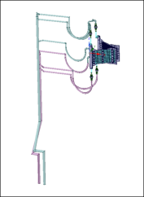
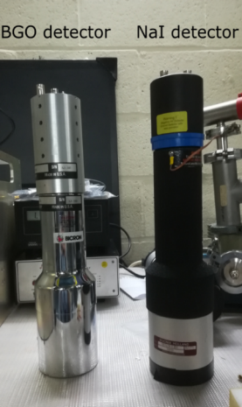
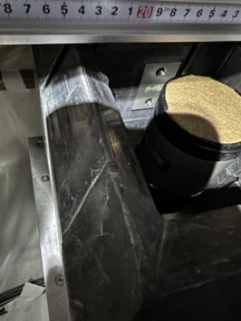



SP-5 JET water activation experiment during DTE3
Unique experiment in real tokamak water cooling loop under DT for the validation of water activation predictions in ITER
NBI duct scraper cooling loop Oct 4
Location of WACT system
Outlet horizontal pipe
WATER ACTIVATION EXP ASSEMBLY
Ionization Chamber
Oct 4 Basement
Pipe forest
NaI
BgO
  Detectors
  Gamma spectrometers: NaI & BGO
  Dose rate: Ionization chamber
Basement of octant 4
Measurements of γ from ¹⁶N decay
Online acquisition-CODAS
13

Slide 14
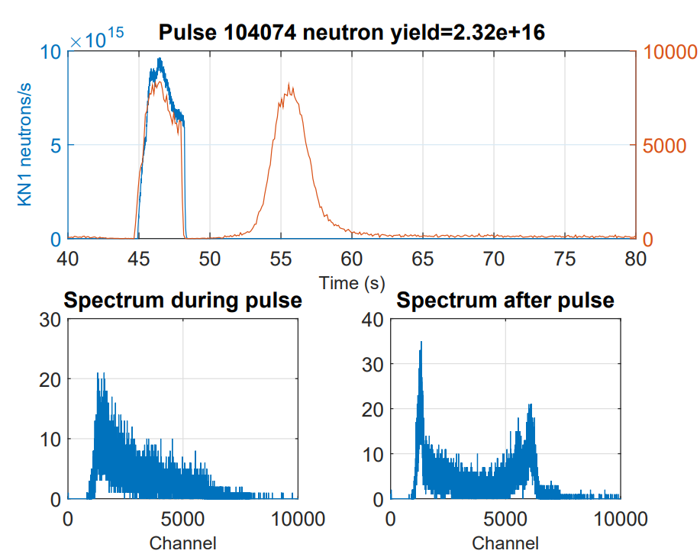
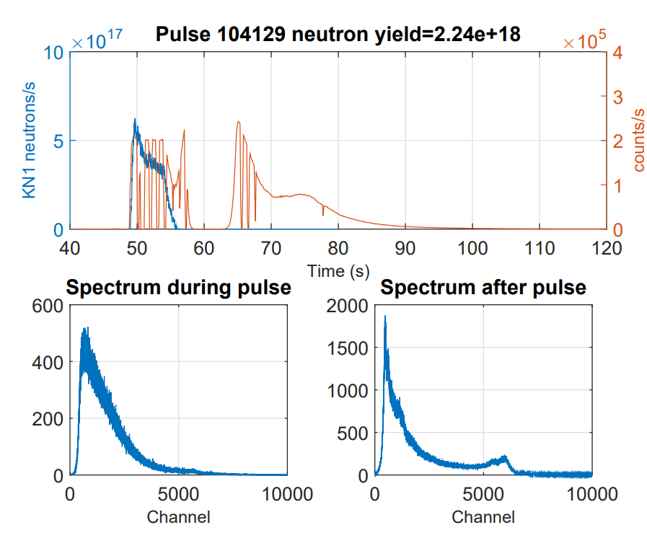
SP-5 JET water activation experiment- first measurements in tokamak !!
C45 DD campaign
DTE3 campaign
DT neutrons from T burn-up ~1% total N yield
BGO - WACT
BGO - WACT
Delayed signal due to activated water
Water activation 6&7 MeV peaks!!
Ionisation Chambers and NaI detectors not working
Calibration planned in 2024
- Post-analysis with Actiflow/Gammaflow, RSTM (F4E), FLUNED & DEMO tool in 2024 in collaboration with F4E
14

Slide 15
SP-5 Neutronics, Nuclear waste and Safety
2024 PrIO-5.3 Neutronics analysis of DTE3 campaign | Resources agreed in 2023 not transferred in IMS to PrIO to cover 2024, pending DTE3 + post analysis SSE (2PM) |  | 32PM/2024 (w/o UKAEA)
2024-25 PrIO-5.2: Neutronics calculations in the context of the ITER re-baselining | Adapt radiation transport coupling methodologies and neutronics tools with the new ITER materials (full W wall & Boron deposits) and configuration to characterise neutron/gamma sources in pre-DT and in DT phase based on expertise developed at JET with Be + W wall ​ Transfer know-how on the stepwise neutronic approach + calibration from JET to ITER together with JET operator | Extended scope | 6-8PM/year
sub-project 5.2.2 (ACPs + in synergy with the EEG SN) | Analysis/simulation of the experimental test to investigate the corrosion and erosion processes for ITER materials (CuCrZr) in baking conditions | Following call in 2023 | 4PM/2024
2024-25 PrIO-5.2 Radiation qualification of safety electronics in support to ITER in 2024/2025​ | Qualification approach for ITER's safety electronics in order to guarantee its operation. ​ Proposal consists in the demonstration of equivalence of the optimized neutron environment of the Radiation Protected Areas (RPAs) with the natural terrestrial atmospheric neutron environment at ground level​ Detailed study of the sensitivity of general modern electronics to neutron-induced SEEs​. Call in 2024 | Extended scope following DTE3 | 6PM/year

Slide 16
Other SP-5 aspects to be adressed
Request for missions in 2024
  Calibration at JET of water activation detectors
  Participation to PrIO neutronic meeting in early January 2024 at Culham/JET
Request to the JET operator in 2024 under elaboration
  Retrieval of materials , Optical fibre and shipment for analysis
  Detectors calibration for Water activation experiment
  Neutron calibration , ORE data
  Nuclear Waste data
  Removal of TBM and calibration
  FOCS fibre
SV had Unformal discussions with China
  Strong interest to get DT data to validate nuclear codes used in CN ?

Slide 17
2024 Grant Deliverables and actions
SP-2:
  Validated models for plasma burn-through and breakdown adapted to ITER conditions (June 2024)
  Advanced reduced model for SOL, pedestal, neutral gas dynamics validated (Responsibility of TSVV11) – to be updated following ETASC SB review
  2025 : Report on the simulations of the first ITER operational phase (simulation of dynamic phases at 1/3 and 1/2 magnetic field in H and He plasmas) (Responsibility of TSVV11) to be updated with ITER rebaselining
SP-3:
  Report on the EUROfusion plan/programme for the involvement and contribution to ITER operation (June 2024)
SP-4:
  Report on EUROfusion participation in ITER NBTF, ELISE and BUG activities
SP-5 in 2023 to be shifted in 2024 to include DTE3 results ?
  Report on JET neutronics experiments, validation of nuclear data and codes in JET DT
  Report on neutron induced activation in ITER materials & radiation damage in functional materials at JET following DT op.
  Report on the implication of JET DT technological program for ITER

Slide 18
Conclusion
PrIO project is on track with already significant contributions in conferences
IO, EUROfusion, F4E major transitions
We are adressing the impact of ITER re-baselining on our current activities and it opens new opportunities to increase our support to ITER
Pending extra resources new tasks can be launched in 2024 in support to ITER
  Diagnostics (new synthetic diagnostics, calibration procedure etc)
  Commissioning & Operation: AI to support SL, generic SL courses, ECRH network
  Neutronics: DTE3 analysis, radiation sources estimates (W & Boron) and electronics
  erosion-corrosion simulations

Slide 19
Back-up slides

Slide 20
Context: EFPW-2022 on EUROfusion role in ITER operation & scientific exploitation
Re-optimization of assembly and ITER Research Plan to be carried out in order to minimize impact on start of DD+DT operation. Various options under discussion within IO
  Two stages nuclear licenses, W wall, increase ECRH, merge campaigns … ?
“Research team with large participation of ITER Members specialists is required to execute research and experiment program”
“Time from now to start of operation should be used to develop full capabilities for ITER scientific exploitation: Support from ITER Members R&D institutions is essential”
Main Areas for Collaboration with ITER partners to the Preparation and Execution of ITER Integrated Commissioning and Operations have been identified
[A. Loarte EFPW]
[A. Loarte EFPW ]
[I. Nunes EFPW ]

Slide 21
ITER partners contribution to the Preparation and Execution of ITER Integrated
Commissioning and Operations [I Nunes IO EFPW 2023]
Operations
  Training, REX, operation of systems and of the ITER plant, etc.
Commissioning
  Preparation and execution of Systems and Integrated
Technical Documentation and Procedures
  scarce resources, system procedures, etc.
Machine Protection
  Analysis of protection strategy, risk assessment, documentation, etc.
Diagnostics
  Commissioning, Calibration, Operation
Tools for Operation and systems
  Monitoring, execution, data analysis/validation and visualisation, etc.
Execution of Experimental Program

Slide 22
WPPrIO Significant on-going meetings and discussions in particular with IO
SP-2:
  Coordination meeting on Breakdown/Burnthrough with PrIO, TE , SA and IO (03 May & 24 May)
  IMAS synthetic diagnostic (IR) with IO (M. Schneider, 20 June)
  IO meeting on diagnostic calibrations procedure (IR diagnostics on 05 June)
  Regular progress meetings between EUROfusion and IO (M Kocan) on the FILD
  On ITER modelling & contibution with the new W Wall (A Loarte 20 June) (+ Thrust 5 meeting on 07 June )
SP-3 :
  Integrated Commissioning and Operation (with I Nunes 20 June)
SP-4:
  NBI at the recent NAC meeting with IO in May and October (NAC at IO)
    Organisation of the meeting with EUROfusion secondees the week of NAC at IO ?
SP-5:
  On neutronic & technology (with IO , Y. Le Tonqueze and his group on 13 June and regular discussions with F4E, M. Fabbri)
In addition, a set of individual meetings with most of the EUROfusion labs representatives involved in WPPrIO

Slide 23
SP-2. Preparation of ITER first experimental campaigns
SP-3. Plant systems and plasma operation
SP-4. ITER Neutral Beam Test Facility and R&D
SP-5. Neutronics, Nuclear waste and Safety

Slide 24
SP-2 General comments
Good progress on tools development and IMAS transition
Extended activities beyond already agreed in the new ITER context ?
  Data validation tools, Diagnostic calibration and synthetic diagnostic
    Long gap between FDR and commissionning : EU should play an active role otherwise expertise and competence will be endanger: EUROfusion &/or F4E
  ITER modelling for assessing the consequences of transition to W wall & preparation of DD , DT1 campaigns including breakdown/burnthrough ?
    Strengthen the link with ITPA groups (IOS)

Slide 25
SP-2: Validated Breakdown/Burn-through tools for ITER first operation
First ITER Ohmic plasma initiation (new wall materials, B impurity ?) modelling with full electromagnetic DYON
First DYON run with the input data from IMAS
  Development of the IMAS interface is in progress, with the aim of integrating DYON into the high fidelity plasma simulator (TSVV11)
Validation of operation space prediction capability against multi-devices data
  EU facilities + VEST (International collaboration), JT-60SA (with TE and SA)
Scenario optimisation: Coupling with a free boundary equilibrium solver (FIESTA)
  extend the use of DYON to the Ip ramp-up + better calculation of the radial force balance & vertical stability
ITER predictive simulations with a CREATE-BD/BKD0/GRAY strong coupling scheme & Improved model for ECRH absorption in the very initial phase of the breakdown

Slide 26
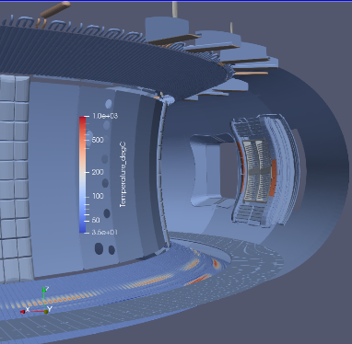
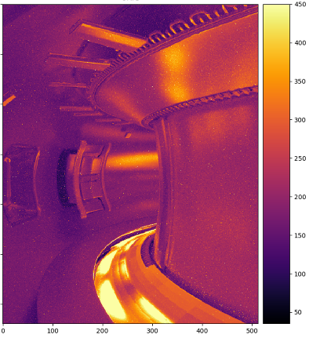
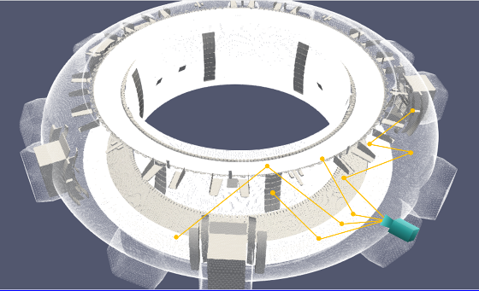
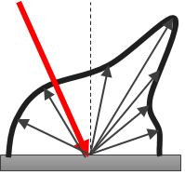
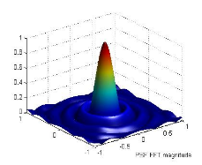
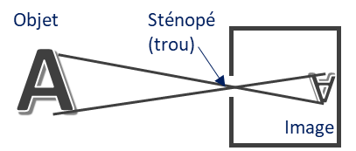
SP-2: IR synthetic diagnostic
1
3D Thermal Scene
An end-to-end simulation able to reproduce with high fidelity IR image, taking into account all physical phenomenon involved in the IR measurement chain: from source to optical response of instrument
WEST Temperature Field
Infrared Synthetic Image
4
Photon Transport Model
T°C
3D CAD model
2
Materials Optical
Properties
Emissivity, Reflectivity
BRDF
3
Camera Model
PSF

Slide 27
2024 objectives with inputs following IR calibration meeting at IO
Development of direct model for IR artificial images
  Integrate Bremsstrahlung radiations in IR synthetic diagnostic (IO IR workshop)
  Simulation of transients events in IR images
  Thermal scene modeling from SMITER tools including 3D ripple & thermal computations
Development of inverse model (ML/IA inversion and gradient-descent inversion)
  Developing numerical method for in-situ emissivity measurement in ITER baking scenario (IO IR workshop)
  Investigating the way to use in-situ measurement of bidirectional reflectivity on some punctual points and in visible (800 nm) (with IVVS) for getting more reliable IR Bidirectional Reflectance Distribution Function model ? (IO IR workshop)
  Providing tools for discriminating reflections patterns from real thermal events
Benchmarking activities for testing and validating direct model & inverse methods
  Laboratory experiments (test-bed MAGRYT) and test on fusion facilities (WEST etc )
Integration of first model of synthetic diag. in IMAS (low fidelity model)
  check interface/inputs-outputs data , definition of new ids structure and support from ACH to be requested in 2024 ?

Slide 28
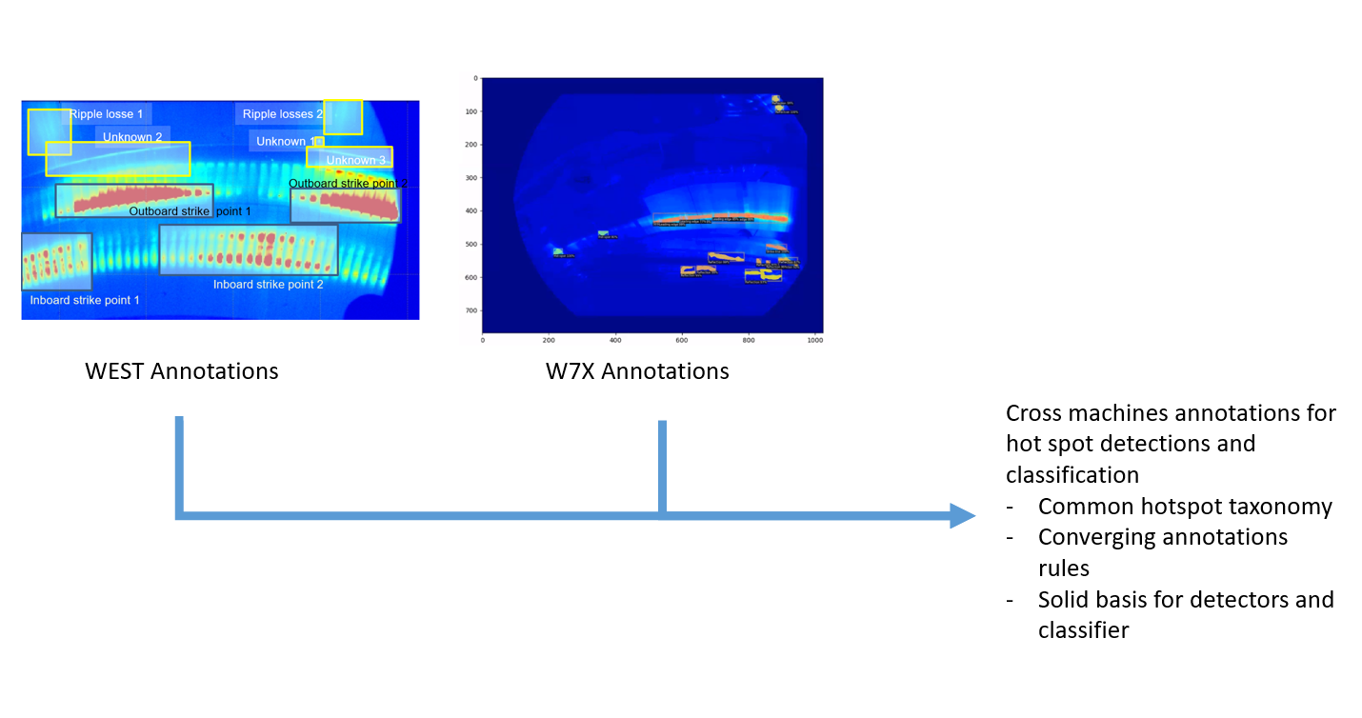
SP-2: IR synthetic diagnostic & wall monitoring for real time protection
Towards multi-machine Validation of automatic hot spot detection methodology

Slide 29
SP-2 FILD : joint activity EUROfusion, IO , UKAEA and UoS
Implementing Agreement with University of Seville has been signed
IO has started preliminary discussions with UKAEA about extending the scope of work on the ITER FILD beyond August 2024
  subject to new Cooperation Agreement between IO and UKAEA
IO Internal discussions about how to accelerate the schedule for delivery of ITER FILD in-vessel components (reciprocating system, probe head, 2 mirror boxes)
Key milestones for EUROfusion (VTT, UoS, UKAEA), IO, UKAEA and UoS
  CDR by November 2023 (Design integration review in May 2023)
EUROfusion 2024:
  Update of the simulated FILD performance
    construct synthetic signal with up-to-date design / iterative process
    consequences of the new magnetic configuration on Fast ion losses
    calculations of fast ion losses due to static magnetic field perturbations, the interaction of fast ions with Alfvénic instabilities

Slide 30
SP-2 : FOCS Synthetic diagnostic (pending resources in 2024)
IMAS FOCS synthetic diagnostic should be complete in 2023
Proposal for 2024: Validation of the FOCS SD using JET magnetic data
  JET has poloidally distributed Internal Discrete Coils (IDS) located relatively close to the FOCS fibre.
  The IDSs output can be used to reconstruct the magnetic field along the fibre and to use these data to simulate FOCS operation. The simulated results can be compared with the actual FOCS measurements.
assessment of neutron radiation on the FOCS performance (following DTE3)

Slide 31
SP-2: multi-machine database
Pedestal Database
  Extend the EUROfusion pedestal database including the JET pulses from the 2023 campaign
  Extend the EUROfusion pedestal database including the recent TCV pulses.
  Test and deploy a web interface to download the pedestal database
  Work on MAST-U and AUG will be done only if help from the local team is provided
Disruption Database
  Extend validation of AUG & TCV DDBs and develop pipelines to access/include WEST & MAST-U data
  Scientific exploitation of the multimachine Disruption Database including full JET-ILW, AUG and TCV with publication.
  Update mapping into IMAS of Disruption standardized characteristic times and parameters for the 3 devices.
  Include full description of events and precursors characterizing most relevant disruption types, together with the development of libraries for automated detection and data-mining.
  Develop web catalogue and interface for data browsing and visualization.

Slide 32
SP-2: multi-machines Database
Transport Database
  Finalize the submission/publication of the paper regarding the exploitation of the 0-D database focusing on the isotope effect on core confinement (H, D, T, DT) in JET and AUG
  Start either the implementation or use of scripts for mapping to IMAS the 0D quantities (ACH support)
  Include 1D profiles for the confinement database (WPTE support)
  Continue including pellets free and high radiative pulses in the 0D DB.

Slide 33
SP-2. Preparation of ITER first experimental campaigns
SP-3. Plant systems and plasma operation
SP-4. ITER Neutral Beam Test Facility and R&D
SP-5. Neutronics, Nuclear waste and Safety

Slide 34
SP-3 General comments
0.5ppy (Thanks but …) has been added in 2024 to initiate a new activity following the list presented by I. Nunes at the EFPW
  Meeting with IO organised and a call to be issued for one expert for 6 months (as a pilot-project)
EON Subnetwork on NBI operation started in May 2022 will continue in 2024
Set-up the ECRH EON subnetwork (hot topics for IO)
Propose workshop online on the “commissioning of super-conducting facilities (present and future machines)“
Participate in the JET operational knowledge capture (video)
Initiate (pending extra resources 0.5ppy + Mission) a generic session leader courses (at IO site ?)
  interest from IO, JT-60SA (SA?) , TE (?)

Slide 35
SP-3 EON Foundation Course on Session Leading – pending resources-
Course outline- possible structure- :
Introduction, Operations Management
Coils and power supplies
Plasma shape control
Vacuum conditioning abd Fueling (gas and pellet injection)
Heating systems (NBI, ECRH, ICRH)
Disruptions, predictions and mitigation (MGI, SPI)
Diagnostic setup
Breakdown and current ramp up, runaways
Protection systems and Real-time networks (scientific)
Termination and event handling
Operational tools
Continuous plant systems and IT systems
Plant and Plasma Control
Operation of stellarators
Scaling up operation towards ITER
Aims:
Provide basic machine-independent background on tokamak/stellarator operation + machine dependent implementations
What is operations for newcomers (from fission, other industries or other engineering/physics roles)
Improve preparation of experimental proposals and experimental sessions
Target audience:
Students (MSc, PhD, Post-doc)
EEGs and ERGs
Scientific Coordinators, task force leaders
Engineers, Researchers
Newcomers (from fission or other fields)

Slide 36
SP-2. Preparation of ITER first experimental campaigns
SP-3. Plant systems and plasma operation
SP-4. ITER Neutral Beam Test Facility and R&D
SP-5. Neutronics, Nuclear waste and Safety

Slide 37
SP-4: BUG/ELISE (IPP), SPIDER/MITICA (RFX) in a step ladder approach for ITER
From 20 experts funded down to 18 in 2023-2025!
  down to 13 at NBTF & 6 down to 5 at IPP-Garching
  Reduction due to budgetary constraints (budget removed from PrIO) whereas NB project requires more staff…
  Renforce EUROfusion secondment at NBTF versus hiring at RFX
  Gap in expertise has been identified
    expert on physics of beam formation and transport (stripping of negative ions) on BUG/ELISE/SPIDER and extrapolation to MITICA and ITER NBI => call for one extra secondee?
EUROfusion experts well integrated within IPP (led by F. Ursel) and NBFT teams (led by V. Toigo)
  NBTF: operation; shutdown activities; design and procurement; analysis and diagnostics, simulation
  BUG/ELISE: operation; analysis of beam and plasma diagnostics; design; simulation, interpretation and extrapolation to support ITER NBI and NBTF program.

Slide 38
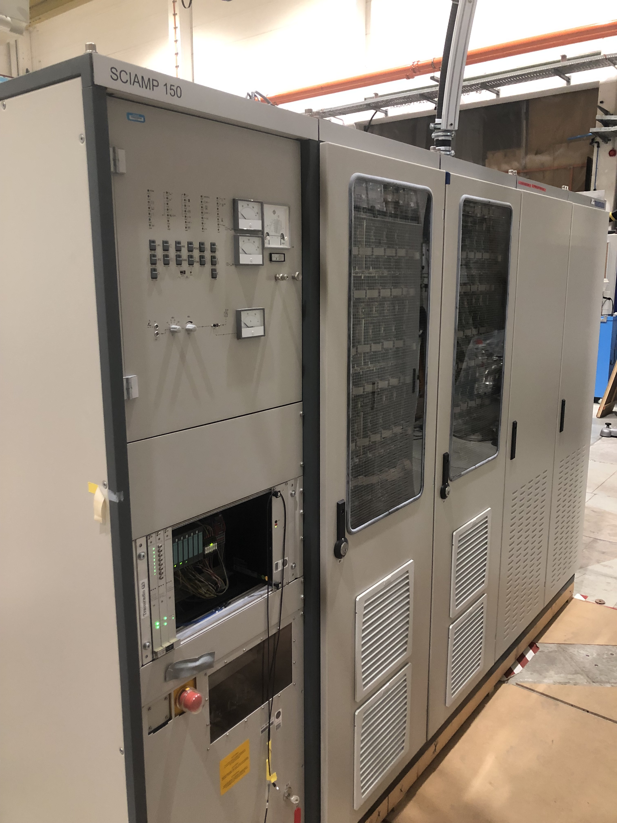
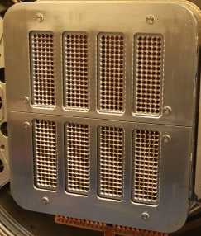
First Lessons learnt and significant contributions to ITER NBI design
Recent contributions to ITER NBI and NBTF followings tests at BUG/ELISE
RF solid state
generators
Separation of
EG segments
Bias plate potential
Mo coating techniques
Improved RF coupling
Vertical resolution of
co-extracted electrons
Electron suppression
and symmetrisation
Qualification for SPIDER
MITICA HV tests (breakdowns produced faults that damaged a 200kV diode rectifier and 1MV insulating transformer): similar additional protection systems implemented in ITER NB reference design
MITICA HVH preliminary layout with LCR Transformer protection

Slide 39
SP-4: BUG/ELISE (IPP), SPIDER/MITICA (RFX) in a step ladder approach for ITER
“Now that, SPIDER will be equipped with it’s full capability to deliver ITER NB parameters, it is required that experimental time, which is precious, to be utilized with primary focus to look for that NB performance while other checks, verifications and validations to the collaborating laboratories. “ NAC May 2023
  collaborating laboratories to provide data complementary to SPIDER & increase efficiency towards ITER NB parameters
    Eg Performance scaling curves ELISE/BUG useful for SPIDER performance progression
NBTF high level timeline remains unchanged since 2 years

Slide 40
2024-2025 high level objectives
BUG/ELISE
  Both facilities have full steady-state capabilities (up to 1h) to be exploited in 2024-2025
  Suppression of co-extracted electrons in Deuterium
  Beam optics
  Pioneering tech. modifications & physics insights (e.g. Cs management)
SPIDER:
  The experimental phase will begin by the end of 2023 and continue in 2024
    Investigation of the source modifications (reversal of Extraction Grid magnets; new permanent magnets in plasma box walls)
    First test of beam operation with entire segment
    Beam physics characterization: demonstration of extraction and acceleration over one full beam segment
  In mid-2024, a shutdown is planned for the installation of the RF solid state amplifiers and the Vacuum Enhancement system
MITICA
  HV test in vacuum in autumn 2023 -until mid-2024 when the repair and improvement phase of the power supplies will begin
  In the second half of 2024, the additional protections together with the new components to replace the damaged ones will be delivered on site and the installation phase will begin, which should be completed by the end of 2024

Slide 41
SP-2. Preparation of ITER first experimental campaigns
SP-3. Plant systems and plasma operation
SP-4. ITER Neutral Beam Test Facility and R&D
SP-5. Neutronics, Nuclear waste and Safety

Slide 42
SP-5 General comments
SP-5 JET activities (2024-2025)
  Finalise DTE2 & DTE3 analysis and publication and consequences for ITER
Assess the impact of ITER rebaselining and new opportunities to increase our support to ITER
ITER-IO is preparing two roadmaps on ACP and nuclear analysis: PrIO will be involved before the summer.
  Meeting organised with Yannick Le Tonqueze and his group to discuss the implications and future plan
New opportunities with the two stages licencing process based on JET experience
  Contribution to the neutronic expertise for building the validation and demonstration for the licensing process
  Validation of radiation dose map in DD/DT-1: develop methodology and neutronic experimental research plan for ITER, transfer know-how and expertise
Stir the neutronic calculation for ITER performed with Be wall to W wall with Boron and DD
  Adapt plasma physics/radiation transport coupling methodologies and Neutronics tools with the new materials and configuration to characterise neutron/gamma sources in pre-DT phase
    W wall, Boron layer? Charged particles, runaways electrons interaction with Boron (based on our experiment with Be)
    Similar methodology as developed for JET with Be wall ​

Slide 43
SP-5.2: Supporting activities in preparation of ITER Nuclear phase 2022-2025
5.2.2 Activated Corrosion Products tools development and experiment for extrapolation to ITER
  ENEA, CCFE, CEA, CIEMAT-UNED
5.2.3 Fluid activation tools development and experiment for extrapolation to ITER
  ENEA, CCFE, IPPLM-IPPLM, CEA, CIEMAT-UNED, JSI, VR, NCSRD, KIT
5.2.4 Radiation source development and simulation of the radiation field in ITER
  Development of radiation source for Pre-Fusion Power Operation (PFPO)
  Calculation of nuclear responses due to neutrons produced in ITER NB cell
  Assessment of the Shutdown Dose rate due to photoneutrons from beryllium
  CIEMAT-UNED, JSI, VR, CCFE
5.2.5 Techniques for low radiation dose level measurement in D-D and D-T plasmas for ITER
  ENEA, CEA, IPPLM-IFJ
5.2.6 Neutronics and Virtual Reality coupling for maintenance operations
  CEA, CCFE

Slide 44
2024 : FLUID ACTIVATION TOOLS DEVELOPMENT AND EXPERIMENT FOR ITER
Execution of fluid activation validation experiments at the JSI TRIGA Mark II reactor:
  Performing experimental campaigns
  perform various water activation based validation experiments
    Shielding experiments using ITER-relevant materials
    Dose field measurements
    Water flow parameters
Analyses of experiments,
  evaluation of experimental and calculational uncertainties,
  comparison of measured and calculated gamma spectra and dose rates
Experiments using ITER-relevant water cooling head: 2025 (maybe already end of 2024)

Slide 45
NEW: Simulation and experiment of erosion-corrosion rates for ITER
The ACPs in ITER represent about 80% of the contribution to the overall dose to workers for the areas in which primary cooling system are installed
Urgent request from IO to EUROfusion : validate the chemical phenomena leading to the mass transport from the region under neutron flux towards the region outside the bio-shield, notably during the baking operation.
The main objective is to perform experiments/simulation to assess corrosion and erosion rates for ITER relevant conditions (e.g. relevant materials, temperature and pressure 240 °C and 4.4 MPa).
  identify possible strategies to reduce the spreading of the contamination
  Assess role of materials (SS & Cu), similar water chemistry and temperature ranges
Validate OSCAR results against ITER relevant conditions, notably during baking operation including sensitivity studies on material/coolant properties (e.g. pipe roughness, pH control, chemical injection)
extension of the already settled activities in the frame of PrIO SP-5 2.2 “Activated Corrosion Products tools development and experiment for extrapolation to ITER" and the complementary Engineering Grant of Simone
New activity pending extra resources in 2024 , possibility to start second semester of 2023 (4PM, 22k€)
  CEA (OSCAR support), CSM-RIINA (ENEA) , UKAEA have already expressed strong interests and have the technical capacity to address the scopes

Slide 46
SP-5.3 JET DT technological exploitation 2022-2025
Post-analyses of TT & DTE2 campaigns + DTE3 – Sept-Oct 2023
Sub-project name | OBJECTIVES within PrIO | BENEFICIARY
NEXP Experiments for neutron transport & activation code validation | Post-analyses of DTE2 Streaming & Shutdown dose rate + new experiments for DTE3 | ENEA, UKAEA, CEA, KIT, UNED, IFJ, JSI, NCSRD + JOC+ US ORNL
ACT Activation measurements for ITER material & data validation | Post-analyses of DTE2 ACT measurements+ new experiments for DTE3 | UKAEA, ENEA, IPPLM, NCSRD,JSI + JOC
RADA Functional material damage studies | Post-analyses of RADA measurements- irradiation under DTE3 | CIEMAT, NCSRD+ JOC
TBMD Test of detectors for tritium breeder blankets | Post-analyses of TBMD measurements- upgrade under DTE3 | ENEA, UKAEA+ JOC
NC14 Calibration of neutron detectors at 14-MeV neutron energy | Validation of 14 MeV calibration and lessons learned | UKAEA
ORE Occupational Radiation Exposure | Collection and processing of ORE data | ENEA, UKAEA
WPC Waste production and characterization | Collection and processing of waste data | UKAEA
WACT Water activation experiment at JET* | Water activation experiment during DTE3 | ENEA, UKAEA, JSI, UniPa, UNED, F4E+ JOC
SEE Single Event Effects on electronics | Compact standalone ITER-relevant neutron SEE experiment on electronics during DTE-3 campaign | CEA, CERN+ JOC
 | Recommendations & implication of JET DT technological program for ITER | All
New

Slide 47
Timeline for DTE3 water activation project in 2023& 2024
Feasibility and scoping studies
Procurement of data acquisition system & Instrument & Control
Installation of cables at JET and Calibration of detectors (NaI & BGO) in lab
Design review and approval for measurements during DTE3 by JO: in progress
Set-up of cubicle & CODAS: in progress
Shield assembly + gamma sources holders preparation by JO: in progress
June: Installation of WACT system in the JET basement
June: Calibration with calibrated gamma source
  Zamir Ghani « we are encountering major signal problems (10-11 June) in two out of three Super screened cables and are trying to trouble shoot the causes of these faults (result of flooding in the basement a few months ago ?) ».
June-July: Integrated test during JET DD experiments + comparison with MCNP modelling
Sept-Oct: DTE3 measurements
Nov-Dec 2023 & 2024: Analyses with different tools and extrapolation to ITER

Slide 48
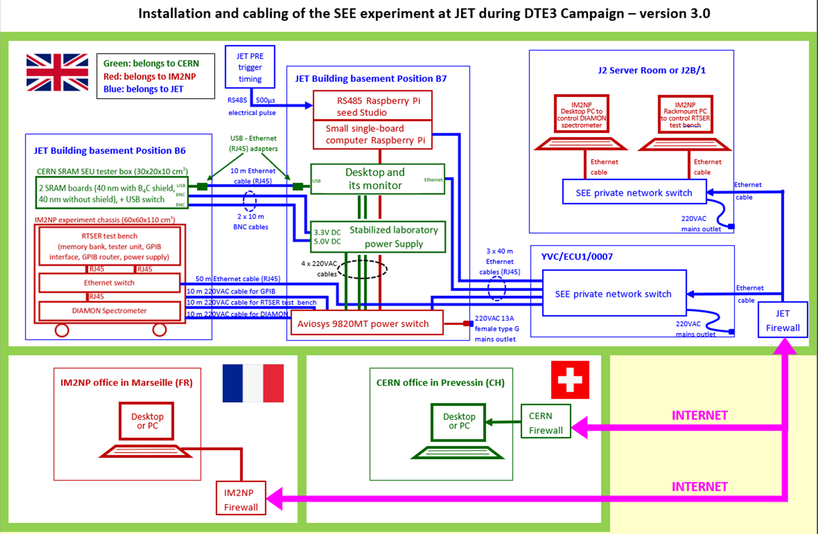
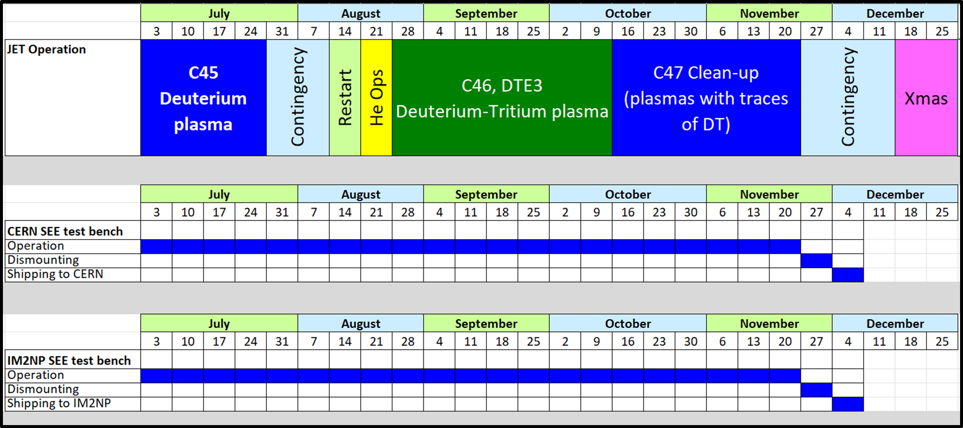
ITER-relevant neutron Single Event Effect (SEE) experiment on electronics during DTE-3
Two test benches installed at JET on 1-2 July
  Test bench from Aix Marseille University (IM2NP) + DIAMON Spectrometer:
  Test bench from CERN:

Slide 49
NEW: Radiation qualification of safety electronics in support to ITER in 2024/2025
French Nuclear Safety Authority (ASN) submitted to IO (Oct. 2022)* a request for information to be processed as a priority concerning the qualification approach for ITER's safety electronics in order to guarantee its operation.
Proposal consists in the demonstration of equivalence of the optimized neutron environment of the Radiation Protected Areas (RPAs) with the natural terrestrial atmospheric neutron environment at ground level
Detailed study of the sensitivity of general modern electronics to neutron-induced SEEs
  To be carried out from a panel of elementary electronic semiconductor devices (memories, power components, digital circuits, etc.) integrating a set of technological nodes representative of general modern electronics
  To take into account the different mechanisms of single event effects induced by neutrons
  based on methods and models that are validated during the preliminary study at WEST & JET, based on a collaboration bringing together ITER, the CEA-IRFM, the IM2NP institute of the University of Marseille, CERN and the industrial STMicroelectronics
  Access to irradiation facilities will be partly financed by the European RADNEXT program led by CERN
  Development of the numerous test benches will be partly financed by the partner laboratories, and partly by European funding Important Projects of Common European Interest (IPCEI)
  open EUROfusion call in 2024 pending extra-resources
[M. Dentan]
*Follow-up letter of the ASN inspection of ITER on October 3, 2022, no. INSSN-MRS-2022-0628

Slide 50
2024 High level objectives Neutron streaming, Shutdown Dose rate and Water activation
NEXP Neutron streaming and shutdown dose rate experiments for code validation (ENEA, CIEMAT, CEA, IPPLM, JSI, KIT, NCSRD, UKAEA) + ORNL
  Perform analysis of the DTE3 measurements and simulations of neutron streaming and shutdown dose rates experiments with various codes
  Assess preliminary C/E and uncertainties with the different codes following DTE3
  Provide interim results of benchmark experiments under DT and implications to ITER
Water activation experiment during DTE3 (ENEA, UKAEA, JSI, UniPa, UNED) + F4E
  Validation of water activation tools under DTE3 and extrapolation to ITER
  Complete analyses of the DTE3 measurements
  Perform Analyses with various tools (UKAEA, UniPa, UNED and F4E)
  Comparisons between calculations & measurements with related uncertainties

Slide 51
Extended ITER structural and functional materials irradiation
A ‘new’ un-irradiated holder was loaded with real ITER materials & dosimetry foils for DTE3
  A few of the CuCrZr, Tungsten, Eurofer, and Al-Bronze were polished to remove potential surface contaminants from machining/cutting
  Expect to complete C/E analysis for all samples for DTE2 & DTE3 (in 2024)
Functional materials
  Optical fibres study had to be cancelled because the last fibre was broken during manipulation
  Post irradiation studies (irradiated during DTE2-3) will be done at CIEMAT and DEMOKRITOS in 2024: optical absorption (plus some emission) and dielectric properties
2024: Provide interpretation of results and recommendations for ITER

Slide 52
SP-5 JET: ORE Occupational Radiation Exposure Database
Maintenance work effort data collection at JET, especially as follow-up of the DTE3 campaign.
Data integration in the new database architecture developed in 2022 and to be implemented in 2024
Validation of existing work effort data with the new experimental evidence, when blind preliminary cumulative dose assessments can be performed.
Critical issue
  UKAEA to provide a reasonable amount of new data in 2024, which are vital for the accomplishment of this activity

Slide 53
Back-up

Slide 54
SP-2: IR synthetic diagnostic – Update on 2023 progress
Deliverable 1 - title: Report on the development of IR synthetic diagnostic and inverse methods for retrieving surface temperature Deliverable Owner / Beneficiary: Marie-Helene Aumeunier (CEA)
Deliverable description (few lines/bullets):
  Integrated tool able to generate thermal scene (3D temperature field) including all physical phenomena causing heat loads on PFCs (conductive power (SMITER), radiative power, ELMs, disruption, etc) and to simulate IR images of thermography systems
    accelerated photon Ray Tracing (RT) code for generating sequences of images ➔ done
    robust IR models of materials emissivity and reflectance in RT code by comparing with experimental measurements in laboratory ➔ paper on-going + Basel University + Nagoya university collaboration
    Benchmark SMITER development from PFCFLUX code and WEST data for modelling heat loads and the 3D resulting temperature on PFCs
    Implement in photonic RT code ELMs simulation and disruptions
Inverse methods development for retrieving surface temperature from IR images and benchmark from dedicated laboratory experiments ➔ good progress with machine learning techniques (A. Juven PhD)
Workplan for implementation into IMAS and input data adaptation ➔ started (2 meetings with IO)

Slide 55
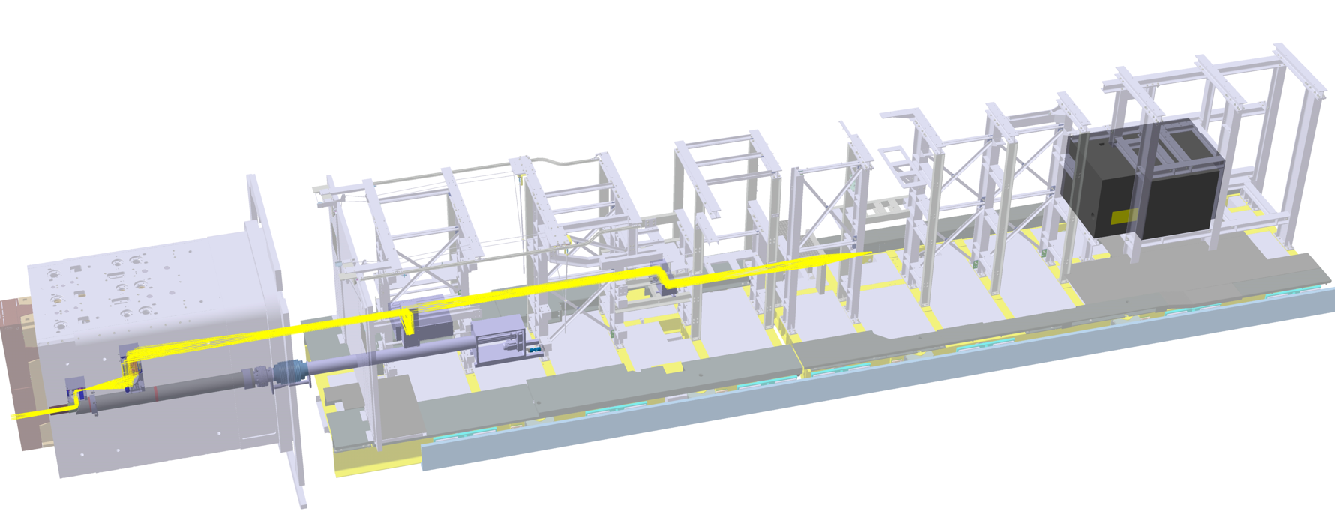
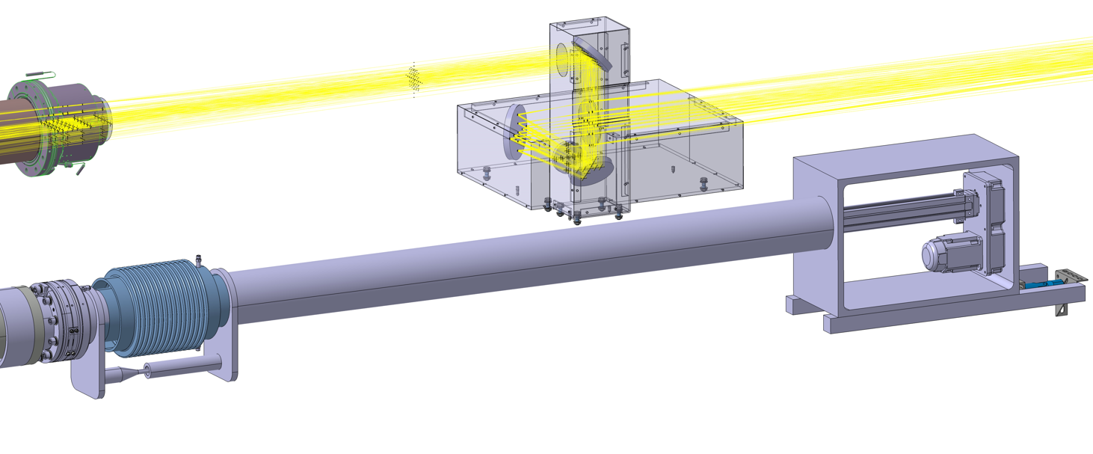
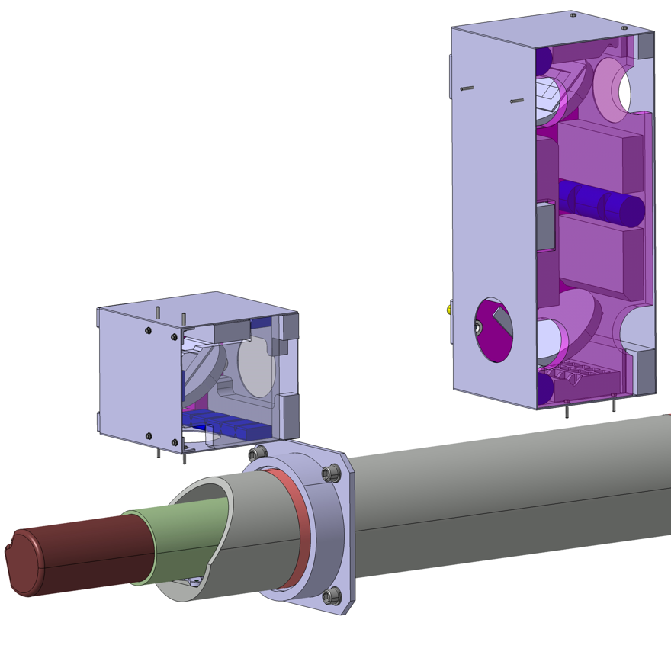

SP-2 update on ITER FILD
Shielded cabinet (cameras and photomultipliers)
Detector in parked position
(inserted ~10 cm in front of DFW)
Active alignment mirror box
Confinement enclosure
Mirror box #2
vacuum window
SIC bellows to compensate displacement VV-building
Electric linear actuator (0.1 m/s)
Mirror box #1
Universal joint
Shaft with vacuum edge-welded bellows

Slide 56
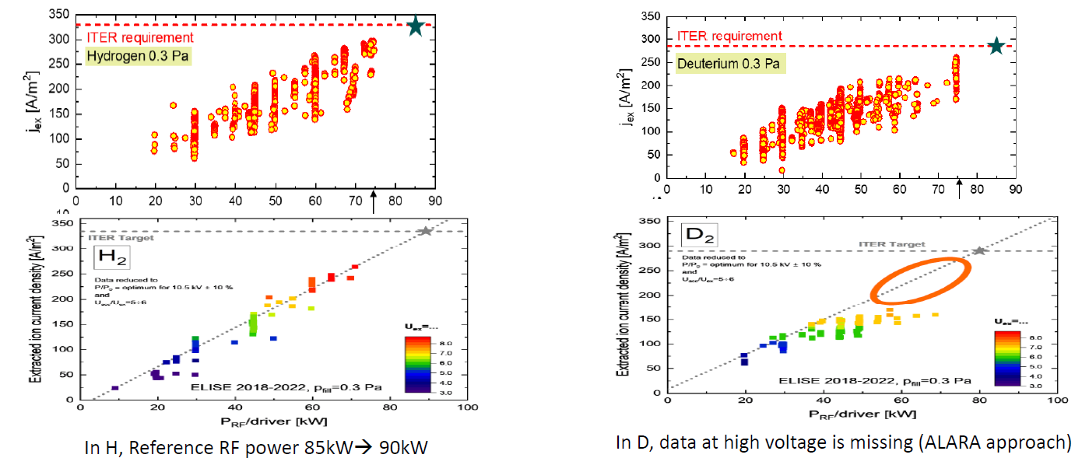
Activities at ELISE & BATMAN Upgrade in support for ITER to be expanded in 2024
Performances scaling wrt the applied RF power around perveance match, for the case of BUG (up to 6 kV extraction) and ELISE (up to 9 kV extraction).

Slide 57
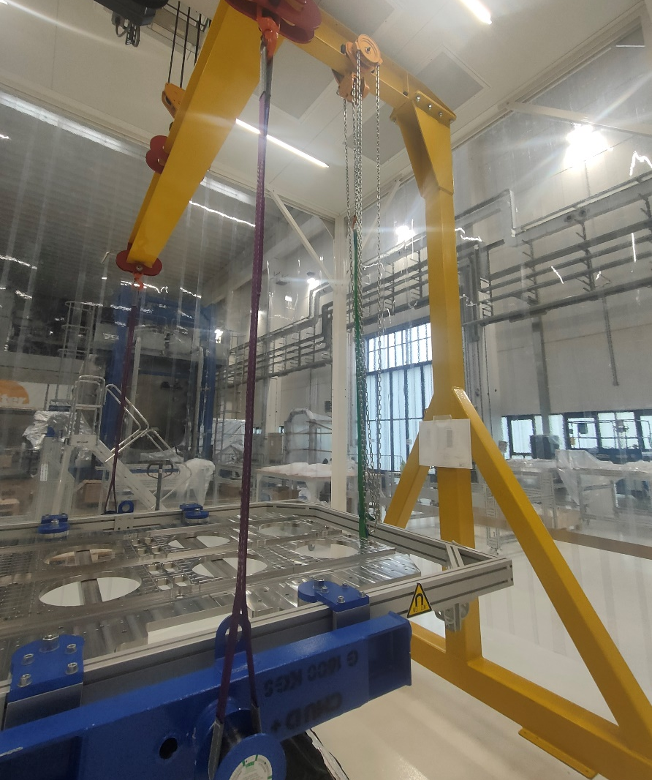
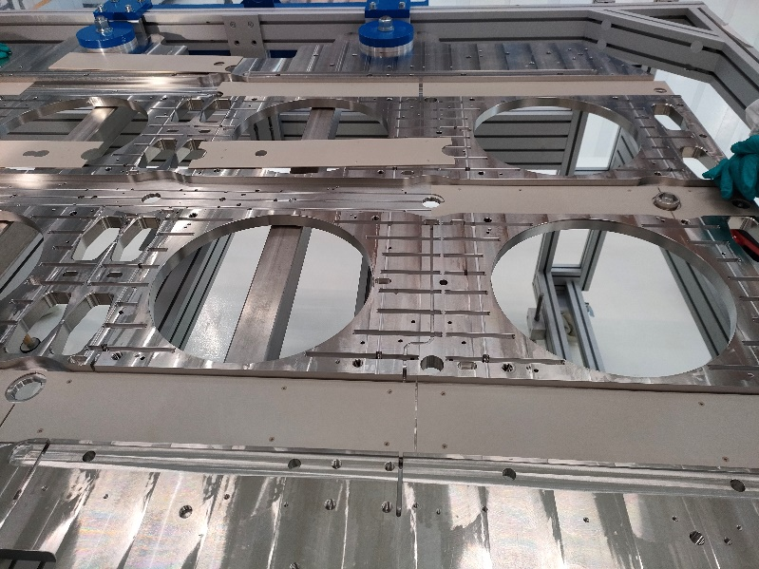
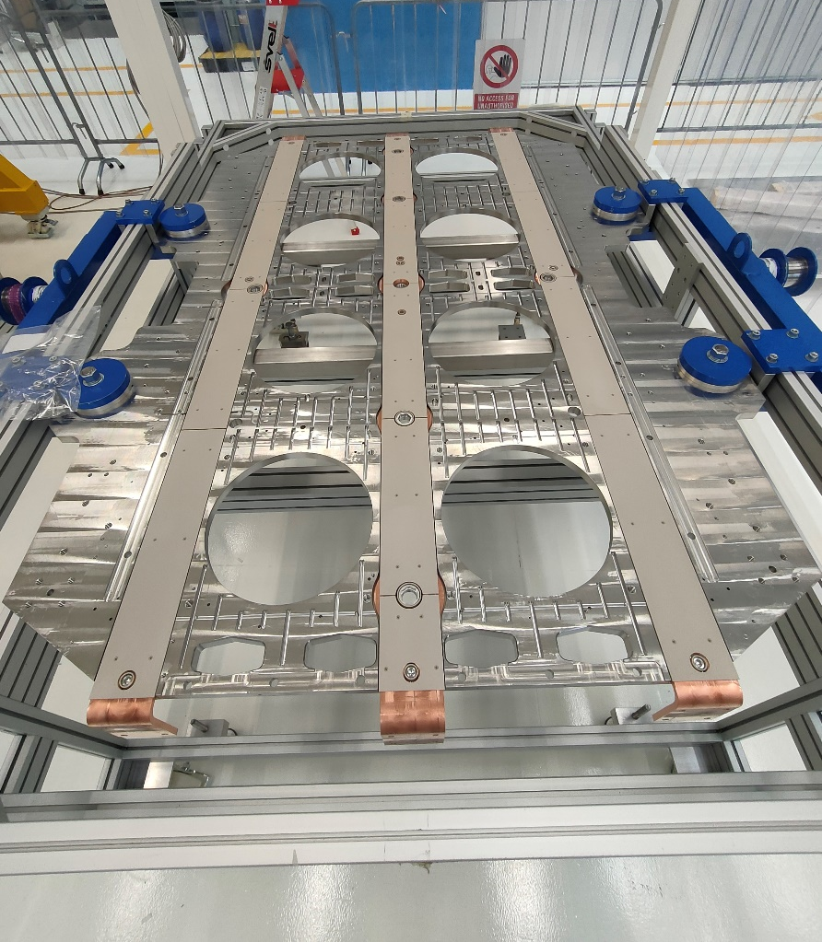
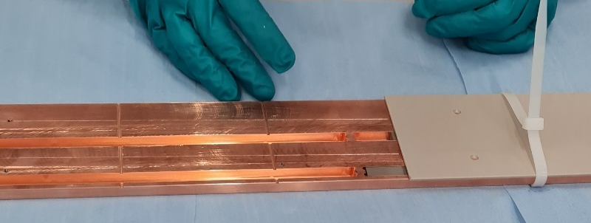
SPIDER: Status of shutdown activities
Beam Source re-assembly
RDP removed from vacuum barrier bag and placed on its horizontal table
Inferior insulation PEEK parts installed on copper embedded bar areas
New embedded copper bars installed on RDP
Magnets insertion on embedded copper bars

Slide 58
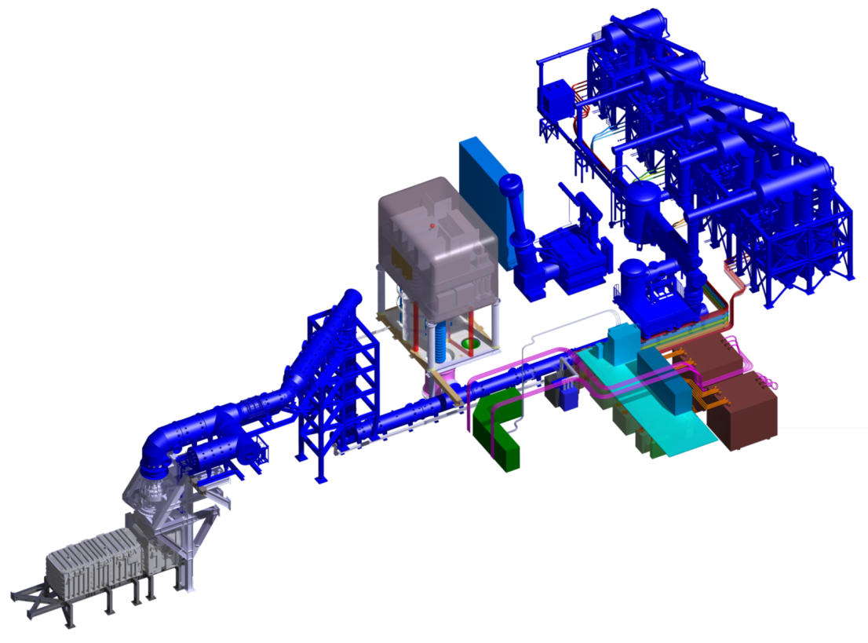
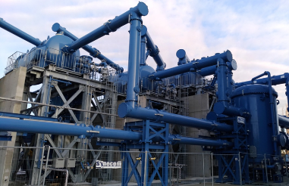
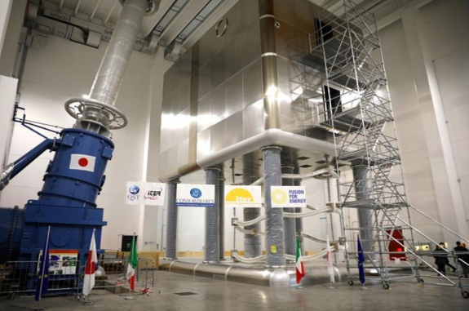

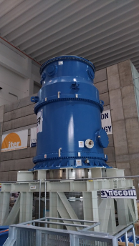
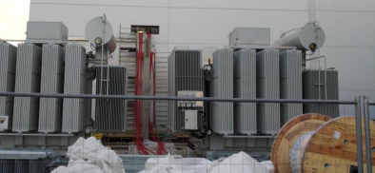
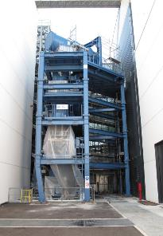
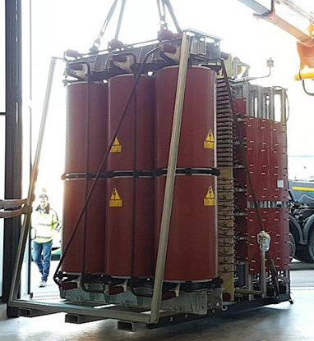
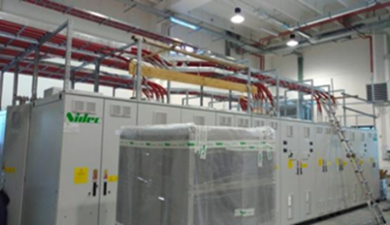
MITICA power supplies: very complex system, first of a kind, beyond limits of modern technologies
1 MV Insulating
Transformer
1 MV
AGPS-DC Generator
HVD: 1 MV Faraday Cage
≈ 100m
AGPS
Conversion system
60 MW CW
HV Bushing
Vacuum Vessel
RIDPS
HV Transmission Line

Slide 59
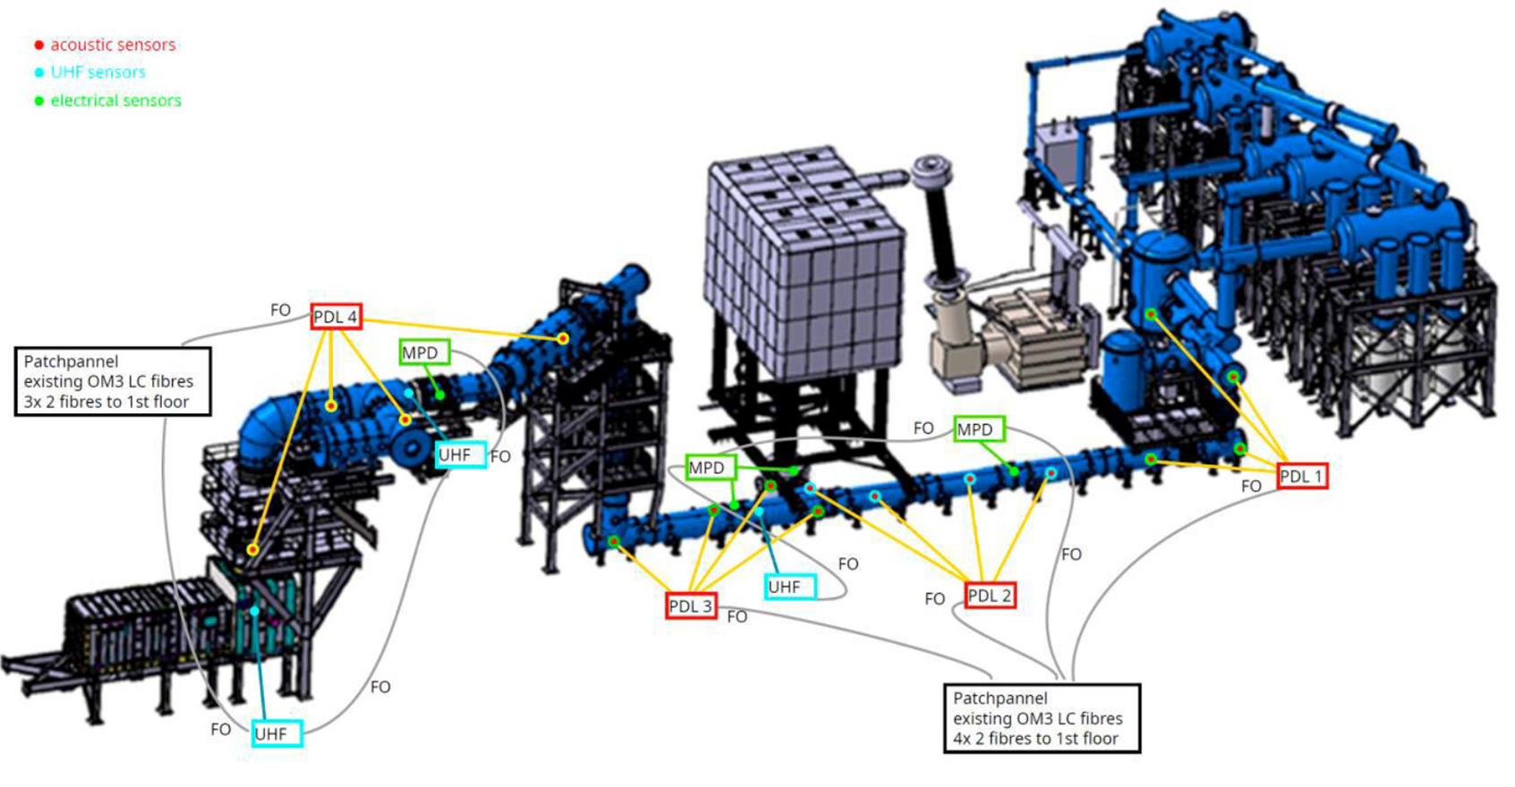
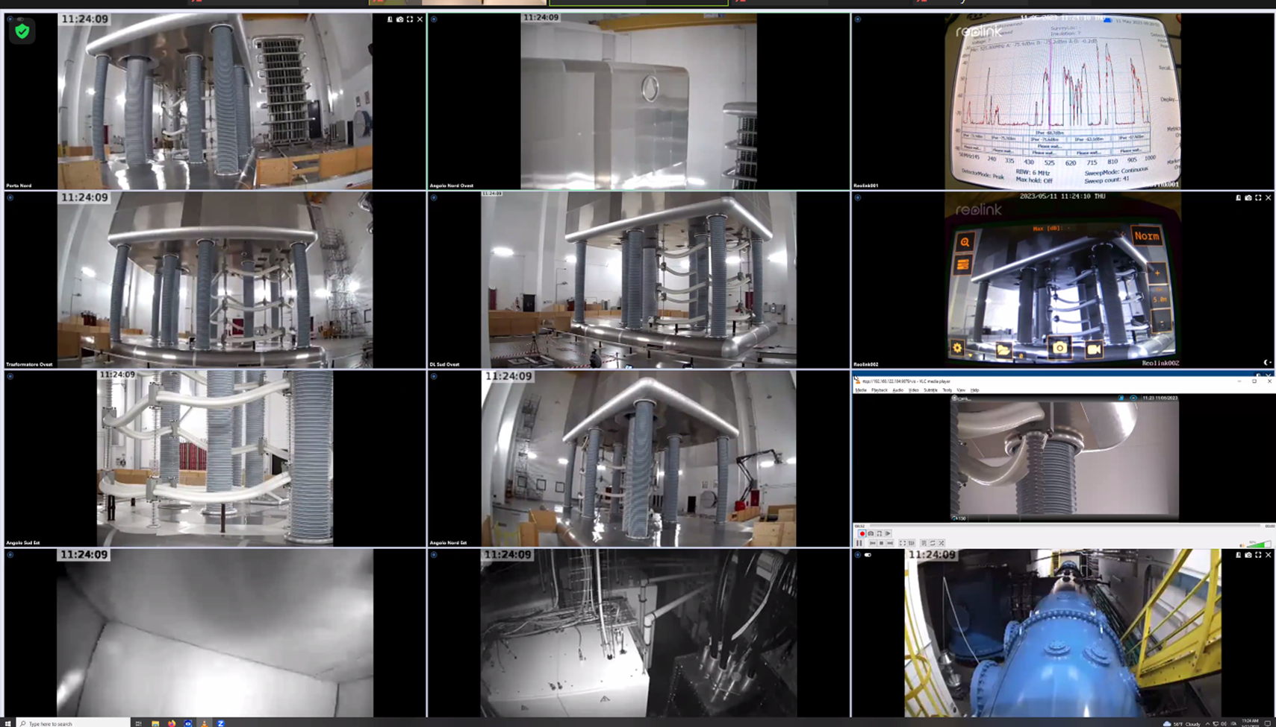
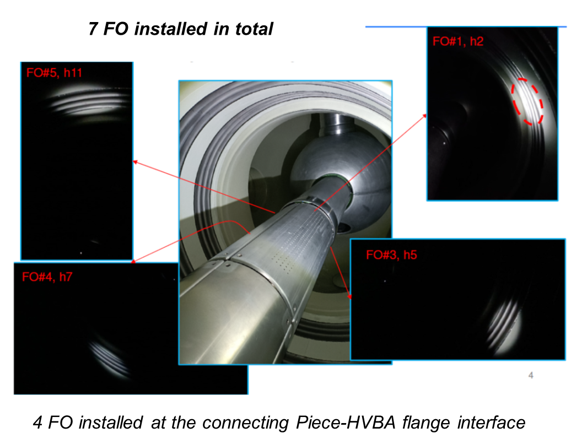
MITICA power supply: Investigation of the Breakdown position
  Paschen discharges detectors in gas system
  NBTF Team visible camera system
  Fiber optics inside 1MV conductor
  PD detectors in air system
Acoustic camera (directional microphone)
Doble PDS100 sensor
(PD radiofrequency sensor)
Capacitive field probes

Slide 60
SP-5.2.6 Neutronics and Virtual Reality coupling for maintenance operations
Analysis of the Artificial Neural Network (ANN) implementation and improvements
  Retro engineering of the first implementation
Background dose rate integration in the ANN metamodel
Validation progress
Improve methodology for the database generation
  to avoid having numerous calculations to perform
ORNL collaboration

Slide 61
ITER-relevant neutron Single Event Effect (SEE) experiment on electronics during DTE-3
Two test benches will be installed at JET on 1-2 July
  Test bench from Aix Marseille University (IM2NP) + DIAMON Spectrometer:
    RTSER (Real Time Soft Error Rate) test bench, made of a bank of 364 memory chips (3.2Gbits in total) of SRAM 65 nm bulk SRAM memories from STMicroelectronics
  Test bench from CERN:
    Two SRAM 32 Mbits 40 nm bulk SRAM memories chips manufactured by ISSI (One of them will be protected by a B4C shield to thermal neutrons)

Slide 62
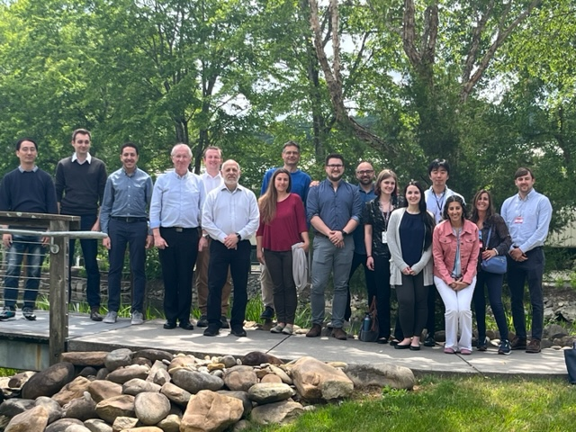
Active Collaboration EUROfusion PrIO SP5
ITER SQD/RBSG group lead by Y. Le Tonqueze
ACP- D. Carloni
Fluid-Activ & Rad. Source development- E. Polunovskiy
Low dose measurements- M. Dapena-Febrer
Neutronics & VR coupling - Y. Le Tonqueze
F4E Analysis and Codes/ITER Delivery Department
Fluid-Activ. At JSI, JET Be photoneutrons & water act. experiment R. Pampin, M. Fabbri, F. Cau & E. Masià
ACP + JET NEXP, ACT- M. Fabbri
DEMO neutronics, design, safety
D. Leichtle, I. Moscato, J. Elbez-Uzan
US ORNL
Collaboration within JET NEXP to benchmark neutronics code – ADVANTG+ R2S-ORNL
& Neu-VR coupling
R.E. Grove, B. Kos, M. Loughlin, T.M. Pandya
EU/US collaboration under JET3 established 2015 through 2018
Extended to 2019-2020 and expanded to PPPT
Extended to end of 2022 under PrIO and DEMO neutronics
Extended and expanded to 2025 (TD/RK-23-19- dated 15/02/2023)
CERN
Collaboration within JET SEE to test electronics
M. Dentan, M. Cecchetto, R. Garcia Alia
First meeting on 13/06 to discuss PrIO support to new ITER baseline
ADVANTG workshop hold on 30 May-1 June 2023 at ORNL- 13 attendees from EU+F4E (7 in person) + 11 ORNL
Applications to JET, ITER & DEMO
S. Villari

