Slide 1
My projects:
MCCC database: inclusion into EIRENE
planned, not started yet
A&M input: GUI for generating and updating EIRENE input file (AMJ4EIR)
available in EireneSupp:
ModCR: CRM solver for standalone use and integration with EIRENE
ongoing
python gui.py

Slide 2
My projects:
MCCC database: inclusion into EIRENE
planned, not started yet
A&M input: GUI for generating and updating EIRENE input file (AMJ4EIR)
available in EireneSupp:
ModCR: CRM solver for standalone use and integration with EIRENE
ongoing
python gui.py

Slide 3
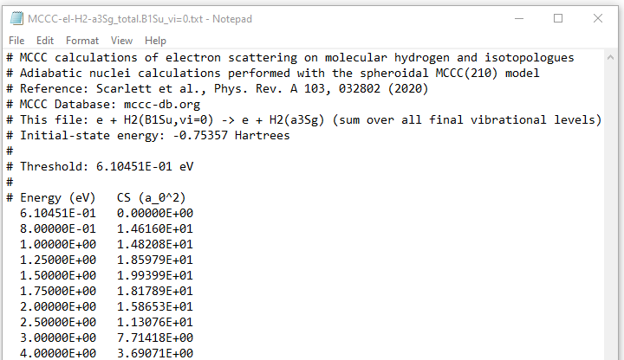
Plan for including MCCCDB into EIRENE
Molecular Convergent Close-Coupling
Electron and positron collisions
Target: H₂ (isot.), H₂⁺ (isot.), HeH⁺
Dissociation, ionizat., excitation + vibrational resolution
output: tabular
FILES: MCCC-el-<target>-….
Dissociation: …DISS.<state_in>.txt
Ionization: …TICS.<state_in>.txt
Excitation: …<state_f>.<state_in>.txt
Excitation&rad decay:
… <state_f>.ERD.<state_in>.txt

Slide 4
Plan for including MCCCDB into EIRENE
reaction
file name
Input file lines:
define input line: _ 1st line: 20 MCCC H.1 <type> EI 0 1
_ 2nd line: <target> <state_f> <state_i>
read_reaclines.f
update read_reaclines.f
Data stream: IR, FILNAM, ….
Loop on DB names:
find source file in Database folder
cinit.f
new params
update cinit.f
include mccc into
Database folder
slreac.f
if FILNAM = ADAS
update slreac.f
read_tab2d.f
eirmod_comxs.f
if FILNAM = MCCC
update eirmod_comxs.f
Data stream: REACDATA
read_tab1d.f
Data type: adas, mccc

Slide 5
My projects:
MCCC database: inclusion into EIRENE
planned, not started yet
A&M input: GUI for generating and updating EIRENE input file (AMJ4EIR)
available in EireneSupp:
ModCR: CRM solver for standalone use and integration with EIRENE
ongoing
python gui.py

Slide 6
EIRENE json input (block4)
PHYSICS MODEL:
--- MANUAL
--- SPECIES_SPEC:
------ REACTIONS:
--------- NREACI:32
--------- REAC_SPECS:
[{IR:1, FILNAM:AMJUEL, H123:H.4, REAC:2.1.5, CRC:EI, MASSP:0, MASST:1, … },
………]
------ ATOMS:
--------- NATMI:3
--------- SPECIES:
[{IATM:1, SPECIES:D, NMASSA:2, NCHAR:1,…,
REACTIONS:[{IREACA:1, IBULKA:115, ISCD1:114, ISCD2:0, ISCDEA:30000, IBGKA:0,…},…]},
………]
------ MOLECULES
------ TEST_IONS
------ PHOTONS
--- BACKGROUND
------ MANUAL
------ BULK_IONS
------ PLASMA
list of reactions
reaction source
reactants mass
list of atoms
particle features*
BGK param
bulk react., products
list of molecules
/test ions/photons
list of bulk ions
*isotope scaling

Slide 7
AMJ4EIR: GUI for generating and updating EIRENE input file
Python module:
it contains functions to construct json input file by repeatedly adding reactions and manipulating the json file ( ).
bulk react., products
Data files:
reactions.txt PLOUTUS datafile
nmc_particles.txt mass, charges for
particle features
reactants mass
Actions:
from reactions (PLOUTUS) input:
ADAS: user-defined reaction parameters + lists of reactants, products
CONST: for BGK reactions, it creates additional BGK ions
user-defined
reaction source
add reactions:
merge particles: if particles with different names in database (ex. H,H(1s))
remove/update reactions
update particle feature: change name/type, isotope rescaling, …
load PLOUTOS output and convert into EIRENE json input.
BGK param

Slide 8
My projects:
MCCC database: inclusion into EIRENE
planned, not started yet
A&M input: GUI for generating and updating EIRENE input file (AMJ4EIR)
available in EireneSupp:
ModCR: CRM solver for standalone use and integration with EIRENE
ongoing
python gui.py

Slide 9
SOLVER
SUNDIALS: SUite of Nonlinear and DIfferential/ALgebraic Equation Solvers
written in C: Modern Fortran interface (modules)
CVODE: solution of IVP
variable-step multistep methods:
ADAMS-MOULTON FORMULAS
BACKWARDS DIFFERENTIATION FORMULAS → stiff problems
Nonlinear solve:
default: Newton iteration based on linear solver
user-defined
Linear solver families:
direct for dense, banded, or sparse matrices
spils: scaled preconditioned iterative (Krylov) linear solvers.

Slide 10
SOLVER
ModCR: integrate with Fortran SUNDIALS modules
script in EireneSupp to download and compile SUNDIALS utilities
check of consistency with other modules (json,..)
define module for solving time-independent (algebraic) and time-dependent (IVP) CRMs with CVODE
Python visualization tools

