Slide 1






TSVV Task 5: “Neutral Gas Dynamics in the Edge”
21.06.2023
Task status overview for internal discussion inside Thrust 2
D. Borodin et al.

Slide 2

TSVV-5: Neutral Gas Dynamics in the Edge
Main simulation tool:
EIRENE code (and EIRENE-CFD packages) http://www.eirene.de/
We aim to transform it to IM- and HPC-ready neutral gas module (EIRENE-NGM) suitable for simulations on ITER and DEMO scale with large focus on (semi)detached divertor plasmas
FP-9 deliverables:
Neutral gas code that allows for an efficient use of HPC resources (towards exascale systems and/or HPC booster techniques) through suitable parallelization methods.
Revised and extended physics basis for the neutral gas model. Further development of the underlying collision-radiative model towards the full vibrational resolution for all hydrogen isotopes and specific impurities for seeding.
Improved (in contents and structure) Atomic and Molecular database for volumetric and surface processes. Database access through generalized interfaces to, e.g., atomic, molecular, nuclear and surface (AMNS) physics data.
Interfaces and boundary conditions necessary for future applications; modularization of the neutral gas code to facilitate coupling to computation fluid dynamics (CFD) codes (2D or 3D codes, turbulence codes, time-dependent) and possibly also to gyro-kinetic/gyrofluid plasma codes.
Strategy towards a validated predictive capability for integrated fusion reactor modelling for (semi-)detached divertor plasmas. Liaison with TSVV Tasks 3 and 4.
Neutral gas code that allows for an efficient use of HPC resources (towards exascale systems and/or HPC booster techniques) through suitable parallelization methods.
Revised and extended physics basis for the neutral gas model. Further development of the underlying collision-radiative model towards the full vibrational resolution for all hydrogen isotopes and specific impurities for seeding.
Improved (in contents and structure) Atomic and Molecular database for volumetric and surface processes. Database access through generalized interfaces to, e.g., atomic, molecular, nuclear and surface (AMNS) physics data.
Interfaces and boundary conditions necessary for future applications; modularization of the neutral gas code to facilitate coupling to computation fluid dynamics (CFD) codes (2D or 3D codes, turbulence codes, time-dependent) and possibly also to gyro-kinetic/gyrofluid plasma codes.
Strategy towards a validated predictive capability for integrated fusion reactor modelling for (semi-)detached divertor plasmas. Liaison with TSVV Tasks 3 and 4.
Code performance, parallelization, refactoring, domain decomposition, I/O for HPC, …
Improved physics and features incl. fluid-kinetic hybridisation (FKH) and improved CRMs
Improved AMNS data, both in structure/physics and content
EIRENE as NGM – restructuring, interfaces to other codes, time-dependent runs, kinetic ions
Validation with experiments and test of predictive capabilities for ITER and DEMO

Slide 3
TSVV-5: IMS WP for 2023
Begin with development of the universal framework for the CFD-EIRENE and other interfaces (e.g. with codes inside TSVV-3, 4, 7). Demonstrate workable schemes on particular examples.
Provide adjoint (AD) approach in Eirene through interfacing with Tapenade in for-/back- ward AD mode. Assess bottlenecks for use of AD with EIRENE, focusing on the context of SOLPS-ITER.
Demonstrate time-dependent simulations for the new modular code including the new features (FKH, CRMs). Consider algorithmic improvements (including theory work if needed) to optimise the performance for the time-dependent runs.
Apply modular EIRENE-NGM with the new version FEM for the FW to MAGNUM-PSI: simulate MAGMUM-PSI plasmas with various degree of detachment as independent snap shots. Validate those with spectroscopy and other diagnostics. Assess performance and other requirements for related time-dependent runs.

Slide 4
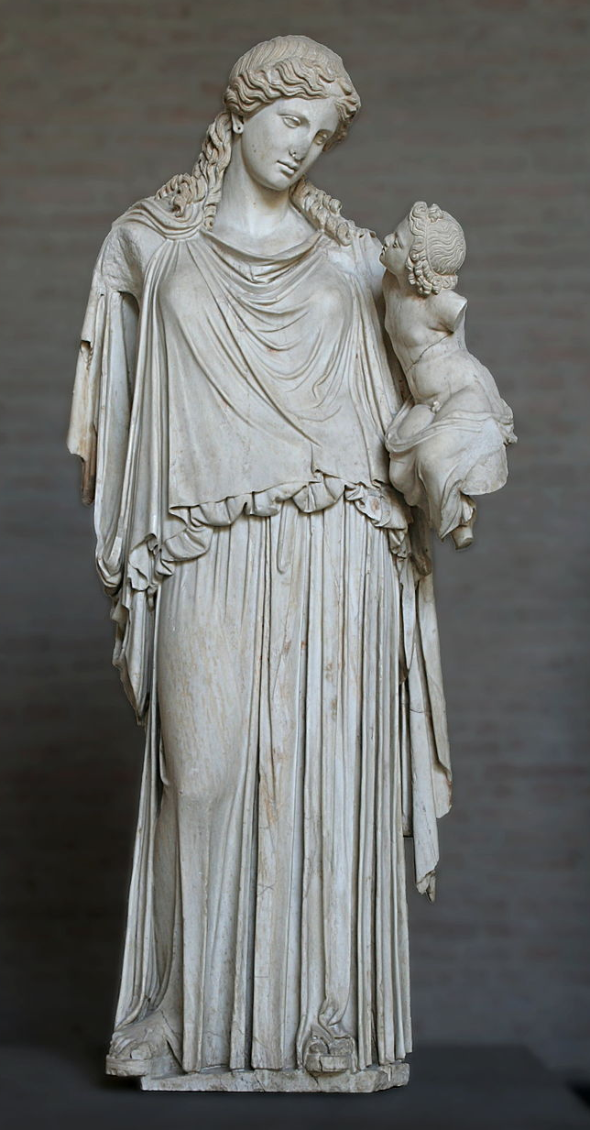
EIRENE-NGM-DEVELOPERS (TSVV-5)
D.V. BORODIN, F. Cianfrani, S. Wiesen, D. Harting, P.Börner, B.Küppers
Forschungszentrum Jülich, Institut für Energie- und Klimaforschung – Plasmaphysik, Germany
W. DEKEYSER, S. CARLI, M. BLOMMAERT, N. HORSTEN, W. VAN UYTVEN, M. BAELMANS
KU Leuven, Department of Mechanical Engineering, Belgium
B. MORTIER, G. SAMAEY, E. LOEVBACK (with ACH-MPG)
KU Leuven, Department of Computer Science, Belgium
Y. Marandet, P. Genesio
Aix-Marseille Univ., France
H. Bufferand
CEA, IRFM, France
E. WESTERHOF, J.G. MUNOZ, P.W. GROEN
DIFFER - Dutch Institute for Fundamental Energy Research, Eindhoven, the Netherlands
M. GROTH, A. HOLM , A.CHanDRA
Department of Applied Physics, Aalto University, Espoo, Finland
H. LEGGATE ← ACH-MPG
DCU
ACH-VTT:
F. Granberg, J. Åström
O.LaPPI
ACH-IPPLM:
D.Yadykin
Yu.Yakovenko
Eirene with the infant Ploutos

Slide 5
FKH Progress 2022/23 summary (KU Leuven)
The fluid, (SpH) hybrid and kinetic neutral models were validated with a realistic JET ILW L-mode plasmas cases [2]
  This not a slab, but a realistic tokamak configuration, incl. voids, molecules, …
  Large fluid-kinetic discrepancies at low density (factor 2), but smaller discrepancies at higher density (50%)
  Fluid-kinetic discrepancies in both density regimes successfully corrected by hybrid approach
Drift and n-n effects are successfully introduced
ITER W/Be case with/without drifts – AFN/kinetic
More work on adjoins (TAPENADE) expected in 2023
Alternative hybrid approach that avoids cancellation errors by construction under development. Hilbert expansion based fluid model derived; both diffusive & hydrodynamic scaling investigated
Release of fluid and hybrid approaches in extended grids version of SOLPS-ITER to the community during dedicated workshop hosted in KU Leuven, November 14-18

Slide 6
DIFFER contribution (mostly J.Gonzalez, left the field)
Surface temperature from SOLPS-FEM (solid line) and pyrometer measurements at the target centre (dashed line) for different neutral pressures in the target chamber.
FEM model for PSI
(based on FreeFem++)
2) Simulations for Magmum-PSI
➔ Testing CRM data, reproducing density etc
➔ EIRENE vs EUNOMIA
3) General code development
➔ regrouping of main variables (data stuctures)

Slide 7
Changes in DIFFER-team contributing to TSVV-5
Left the team: Jorge Gonzalez (PD, 6PM/year)
Code Refactoring / Magnum-PSI / Coupling FEM-wall model
New: Pieter-Willem Groen (3 PM/year, software engineer, EUNOMIA developer)
Code Refactoring / bringing in experience from EUNOMIA
Egbert Westerhof (3 PM/year)
Magnum-PSI (vibrationally resolved H2)/ Coupling FEM-wall model
Hugo de Blank (0 PM on TSVV-5 but full time on Magnum-PSI modelling)
SOLPS-ITER model validation on Magnum-PSI

Slide 8
Code development – version merging
The main focus with regard to development of the EIRENE code in 2022 was on reuniting the various diverging versions of the code used in FZJ and at ITER.
Roughly 20 different code versions have been analysed and merged together. Thereby taking advantage of developments provided by FZJ external developers.
These developments include
  Charge state bundling
  Parallelization of the code using shared memory techniques (OpenMP)
  Extensions of the existing parallelization of the code with message passing techniques (MPI) by implementation of different parallelization schemes.
  Introduction of radiation tallies
  Implementation of species resolved volume averaged tallies and their use with species specific rescaling of calculation results in order to improve the particle balances.

Slide 9
Code development - priorities
Initially version-specific code has been generalized in a way it can be used by all the interested parties (RU or specific architecture related code removed).
All changes to the code are carefully tested (still ongoing!..).
Code modifications affecting simulation results were tracked down to their origin and the reasonability investigated.
Updated reference outputs are provided for the testcases in the continuous integration chain (CI).
We are approaching the 1st milestone (MsV) release of the code, which should be a basis for further joint development also with ITER

Slide 10
EIRENE licencing - User Agreement (UA)
Old UA
acknowledgement of FZJ origin of EIRENE, non-military use, non-commercial use, no cost/liability for FZJ, etc.
www.eirene.de/EPL
New UA “EPL (EIRENE public license)”
Based on copyleft licence (however GPL3.0 occurs to be not suitable).
Similar declarative statements as in the old UA.
More clear statement about the EIRENE-based publications.
Developers and users are divided into “basic” and “associated” ones (AD).
NEW: commercial use of executable for any AD group.
➔ ADs get more rights on decision-making, direct access to the repository, etc.
ADs must keep to the “Developer Code of Conduct” (see at INDICO).
Current status: License is ready and being in a process of exception

Slide 11
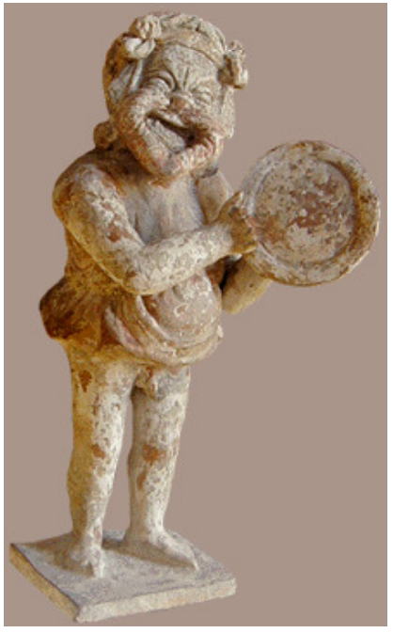

General code development of EIRENE
Main goals and decisions:
  Segregating EIRENE into “starter” and a compact, free of most branching “numeric core” ➔ Optimisation for HPC, transparency and ease of use.
  Unloading the main loop from branching agreed
    Abstractisation of the cell type (removing “geometry” branching)
    Abstractisation of A&M reactions + tracking of internal states
  Version merging scope agreed including synchronisation with SOLPS-ITER
  Uniform coding style (e.g. variable name conventions, use of OOP, etc.)
With support from the ACHs (Advanced Computing Hubs)
  EIRENE “toy model” – EIRON and profiling of EIRENE
  ➔ Test of parallelisation schemes incl. domain decomposition options
  ➔ Can be used for other purposes e.g. optimisation of ML-KDMC
  EUDAT-based simulation catalogue
    Portfolio of simulation cases
  IMASification of the simulation grid (GGD objects) in close contact with
  ITER (X.Bonnin) and utilizing the positive SOLPS-ITER experience
Eiron
Eirene

Slide 12
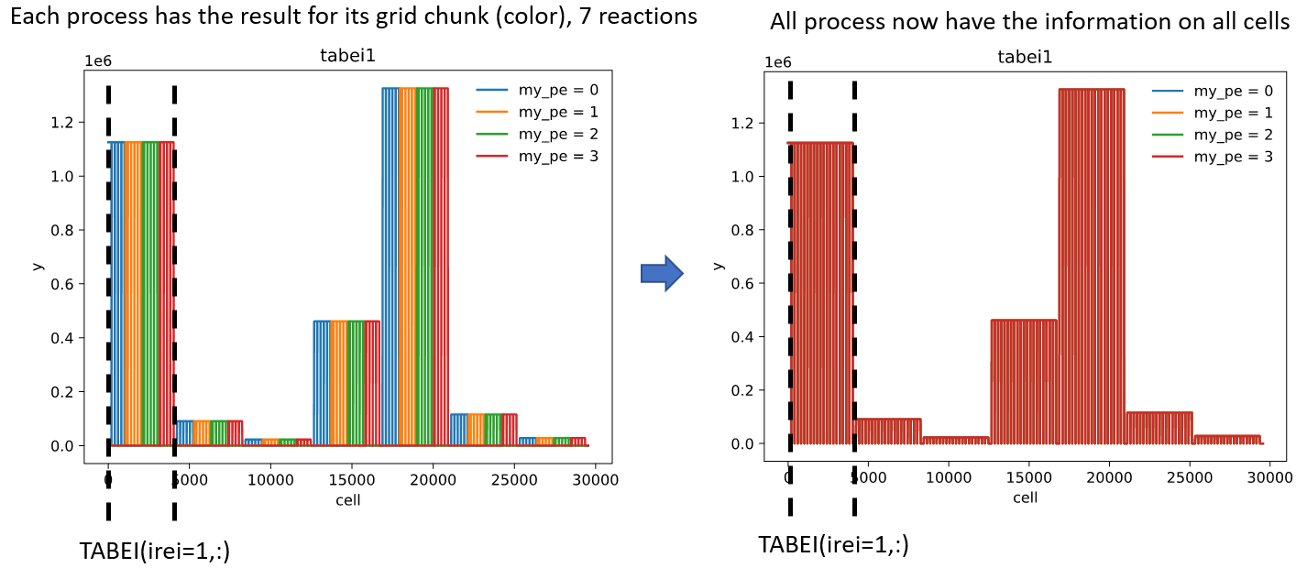
AMU/CEA contribution (Y.Marandet, P.Genesio, N.Rivals, …)
MPI parallelisation of rate coefficient calculation
with support from ACH- MPG and ACH-VTT
(also utilising EIRON)
2) Code restructuring: CRMs in the main loop, data structures, IMASification, technical interfaces, …, merging into new MsV.
3) Interface to TSVV-3:
→ SOLEDGE3X interface planned for 2023 (styx2.0; N. Rivals)
→ Demontration of coupled MPI/OpenMP runs of SOLEDGE3X-EIRENE
→ neutral and hybrid models in SOLEDGE3X

Slide 13
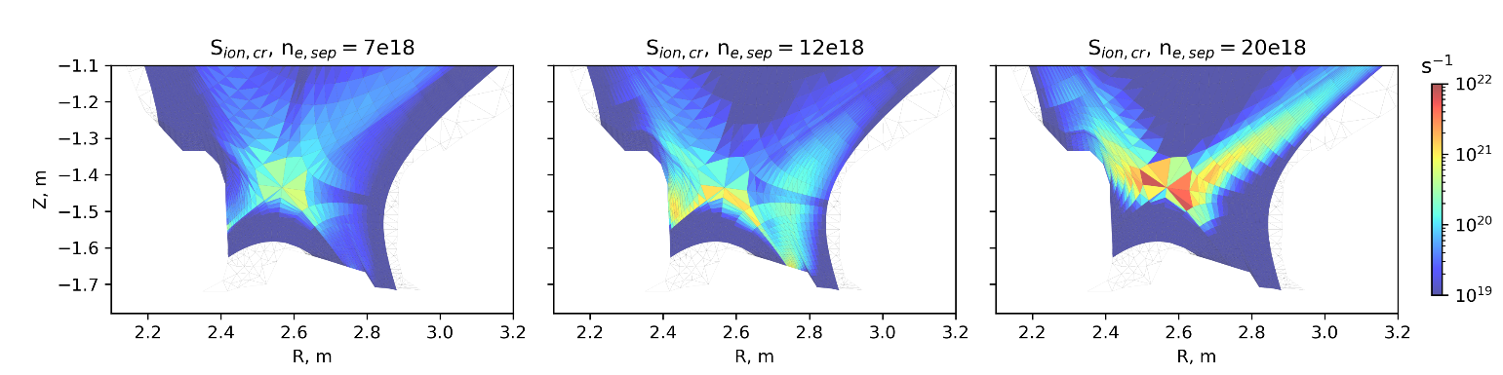
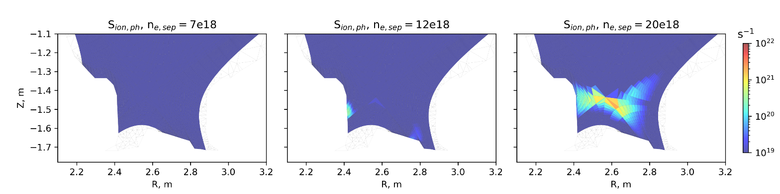
Ly-α and Ly-β opacity -1 (R.Chandra, M.Groth - Aalto)
‘Extra’ ionization contribution from photon absorption (bottom) localized to near CR ionization front (top)
Ly-α and Ly- β absorption increases population of excited D neutrals
➔ extra ionisation
$$S_{eff}=S_{(1)}+\sum_{p}{\left(C_{(1,p)}−R_{1\left(p\right)}(F_{\left(p,1\right)}+\frac{A_{1}}{n_{e}})\right)+\sum_{p}{\left(Γ_{(1,p)}−R_{ext\left(p\right)}(F_{\left(p,1\right)}+\frac{A_{1}}{n_{e}})\right) }}$$
Eff. Ionization rate from collisional-radiative process
Eff. Ionization rate from photon absorption

Slide 14
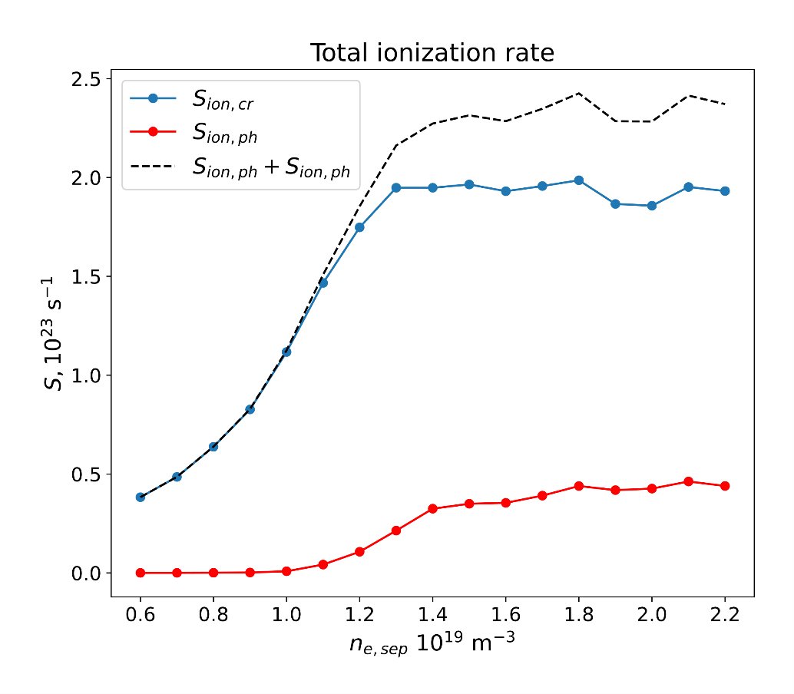

Ly-α and Ly-β opacity -2 (R.Chandra, M.Groth - Aalto)
Photon absorption adds up to ~20% of total CR ionization rate in detached conditions
Ionization rate integrated over the whole plasma volume
No effect in low recycling regimes
New plasma solution required with modified S_{ion} → future coupling to plasma codes

Slide 15
EIRENE: collisional-radiative model (CRM) challenges
treating non-stationary effects
improving performance for simulations on ITER and DEMO scales
metastables (MS) in atoms (e.g. He)
vibrational (and rotational) states in molecules
isotopes: D₂, T₂, H₂, DT, HD, …, Be-H/D/T, N-xxx, …
control the exploding amounts of data

Slide 16

CRM solvers available
CRM (technically) = reaction data + SOLVER
$$\frac{dN_{i}}{dt}=0$$
Most solvers solve algebraic stationary system of equations
in such cases the solver is much less valuable than the A&M data collection
this statement is underlined even by the developers of the very well established and mostly up-to-date YACORA model
CRM containing molecular species is even more complex, e.g. one needs to track more processes and more states (vibrational, rotational).
Tracking all the states as separate species demands enormous CPU and memory resources.
EIRENE pre-calculates rates for each volume cell. It also allows to pre-calculate values for various T_{i}/T_{e} ratios.
D.Wünderlich and U.Fantz,
Atoms 2016, 4(4), 26

Slide 17
CRM FOR MOLECULES
H₂⁺
H₂ + H⁺ → H₂⁺+H
H₂⁺ + e → 2H⁺ + 2e
H₂
H₂ + e → H₂⁺+ 2e
H₂⁺ + e → 2H
SOURCE
background
H₂ + e → 2H + e
H₂⁺ + e → H + H⁺ + e
H₂ + e → H + H⁺ + 2e
H + e → H⁺ + 2e
Plasma parameters:
H
T_{e}=T_{i}=0.2÷30eV.
n_{e}=n_{i}=10¹⁹m⁻³
n_{e}=n_{i}=10²¹m⁻³
JET
Databases:
AMJUEL, HYDHEL
EU-DEMO

Slide 18
CRM FOR MOLECULES : vibral resolution
H₂⁺
H₂(X)
H₂ + H⁺ → H₂⁺+H
H₂⁺ + e → 2H⁺ + 2e
ν = 5
H₂ + e → H₂⁺+ 2e
H₂⁺ + e → 2H
ν = 4
ν = 3
background
ν = 2
SOURCE
ν = 1
ν = 0
H₂ + e → 2H + e
H₂⁺ + e → H + H⁺ + e
H₂ + e → H + H⁺ + 2e
H + e → H⁺ + 2e
Plasma parameters:
H
T_{e}=T_{i}=0.2÷30eV.
n_{e}=n_{i}=10¹⁹m⁻³
n_{e}=n_{i}=10²¹m⁻³
JET
H₂(ν) + e → H₂(ν±1) + e
Databases:
AMJUEL, H2VIBR
EU-DEMO

Slide 19
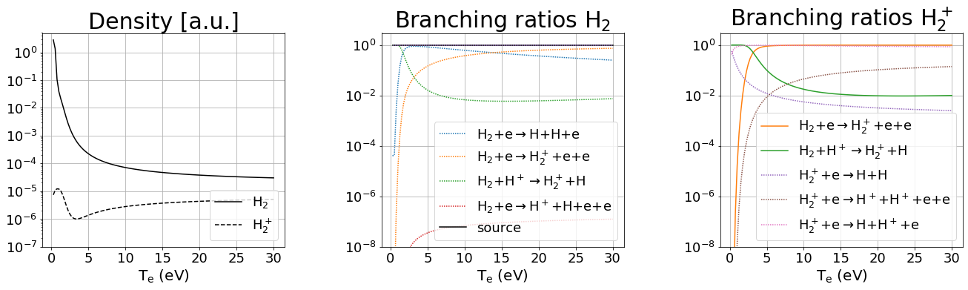
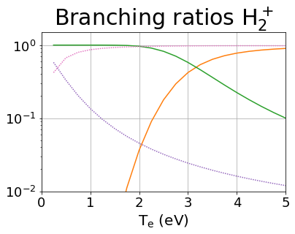
CRM FOR MOLECULES: leading reactions
EU-DEMO
low temperature (T < 2eV) leading reaction chains:
MAD
MAR/MAD competition at very low temperature
H₂+H⁺→ H₂⁺+H H₂⁺+e → H+H⁺+e
H₂+H⁺→ H₂⁺+H H₂⁺+e → H+H
MAR

Slide 20
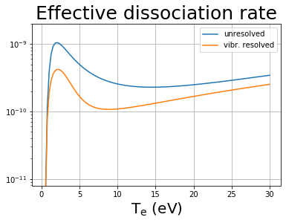
EU-DEMO – effect of resolution by vibrostates
F.Cianfrani et al.,
EPS-2022
Fully in line with the EIRENE and other CRMs:
JET modelling:
“Up to 40% reduction in effective dissociation rate due to transport of vibrational states”
A.Holm, M.Groth, et al.,
PET, CPP 2021

Slide 21
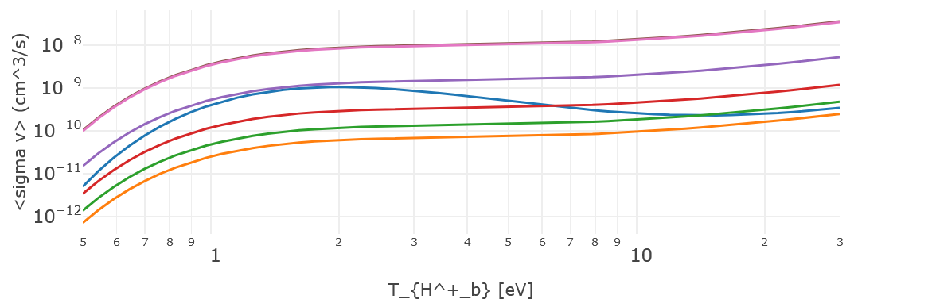
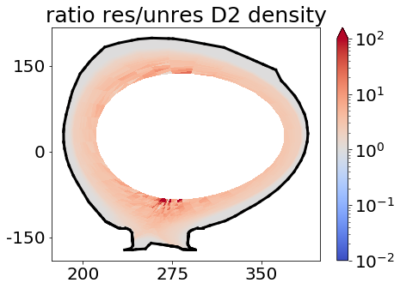
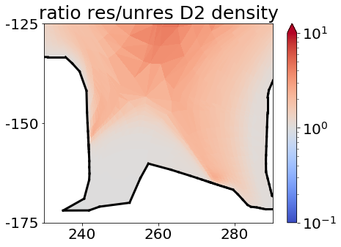
Resolved vs. unresolved on vibrostates CRM in EIRENE
H2VIBR: resolved
AMJUEL: unresolved
Larger molecular density (factor≃2∸3) along the separatrix with vibr. resolution.

Slide 22
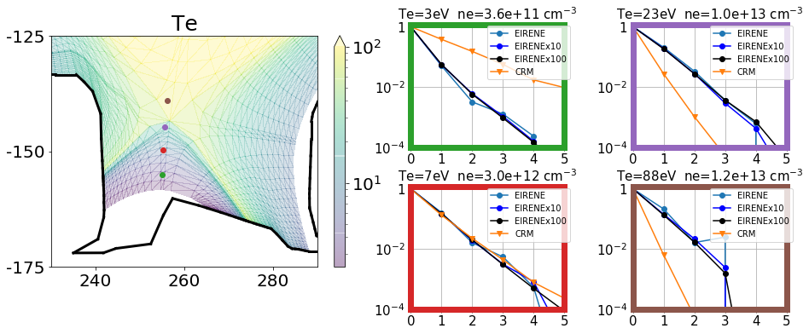



Standalone CRM vs EIRENE – 1 (statistic issues)
EIRENE: 793’300 histories
EIRENEx10: 7’933’000 histories
EIRENEx100: 79’330’000 histories
Simulations: SOURCE v=0
CRM overestimates excited state population at low temperature
$$\text{n}\text{ν}\text{/}\text{n}\text{0}$$
$$\text{n}\text{ν}\text{/}\text{n}\text{0}$$
CRM underestimates excited state population at large temperature
$$\text{n}\text{ν}\text{/}\text{n}\text{0}$$
$$\text{n}\text{ν}\text{/}\text{n}\text{0}$$

Slide 23
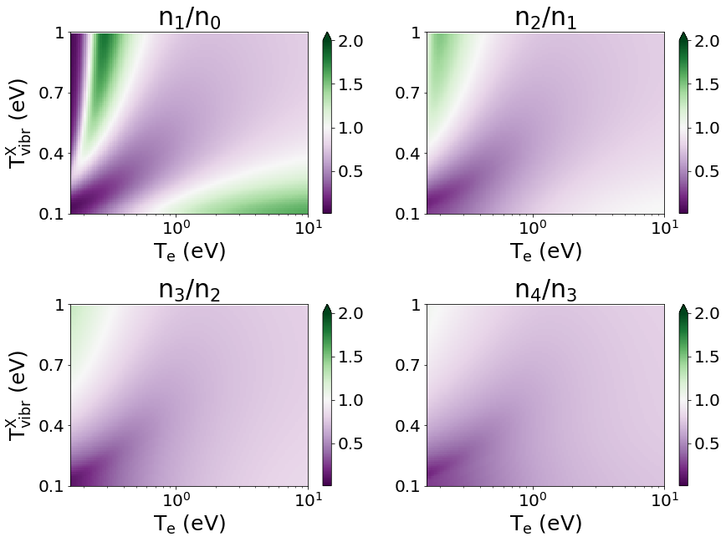
EXCITED MOLECULAR STATES
Model for excited states on top of ground state distribution:
d ³Π_{u}
population coeff. excited state d ³Π_{u}:
n_{i} = n(d,ν=i)
ν = 5
ν = 4
ν = 3
ν = 2
ν = 1
ν = 0
a ³Σ_{g}
spont.
decay
e-impact exc.
Fantz
Wünderlich ADT 2006
MCCC database:
Scarlett ADT 2021
X
ν = 5
Boltzmann distr. T_{vibr}
ν = 4
ν = 3
ν = 2
ν = 1
dissociat./ ionization
ratio of Fulcher band intensities as a proxy for ground state vibr. distribution
SOURCE
ν = 0

Slide 24
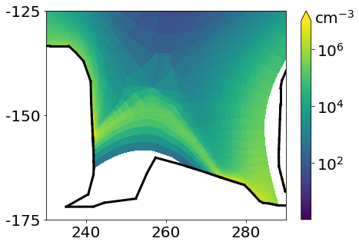

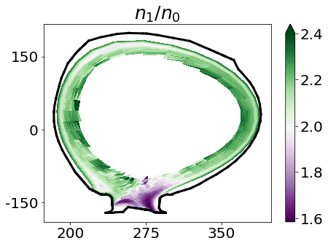
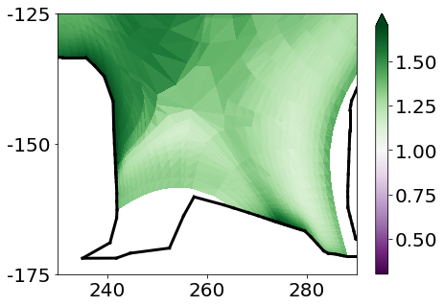
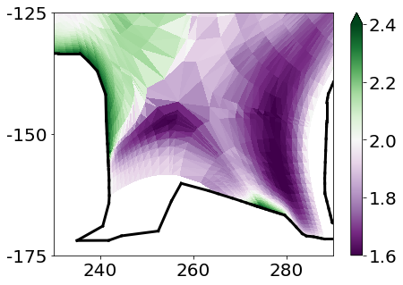
EIRENE: excited molecular states in divertor
Hydrogen (H)
Deuterium (D)
Vibrostate population ratio - 2D distribution
excited
state
d ³Π_{u}:
Vibro-
state
popu-lation
ratio
n₁/n₀:
divertor population coefficients≃1.2
divertor population coefficients≃1.6

Slide 25
CRM tools development
New (or updated) modelling tools :
Ploutos
ModCR
Special thanks to
ADAS (M.O’Mullane et al.) for constant support
YACORA developers (U.Fanz, D.Wunderlich, et al.)
MCCC developers (D.V.Fursa et al.) for providing the database

Slide 26
Standalone CRM Ploutos: what is inside?..
Earlier known as “HydKin”
CRM solver (transport excluded, pure A&M side of the problem) with extensive features
  Stationary and non-stationary solution (assuming velocity and plasma pars)
  Any specie can be treated as “Reservoir”
  “Spectral analysis” based on eigenvalue approach (which reactions are most important?)
  Sensitivity analysis – vary the plasma parameters, solver settings, reactions, etc.
Plotting, solver results visualisation
  Useful for fast consistency checks and trivial analysis while constructing the CRMs
  Good for physics analysis in case one follows established routines
Flexible reaction tables interconnected with the solver and plotting
  Optimised for consistency checks and trivial analysis while constructing the CRMs
  Input/output in various formats (new: JSON) including directly for EIRENE
  Critical things are highlighted, level of information detail controlled by the user.
  Data is grouped by the reactions (even if from various sources).
  Standard or custom initial configurations
Power of web-based
Interface!

Slide 27
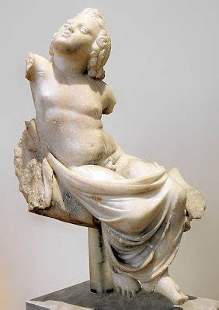
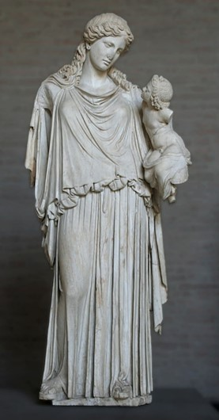
PLOUTOS can be used to
www.eirene.de
to import/export data (JSON, tabular, etc.)
to produce input data for EIRENE and for other codes with CRMs
  ➔ load/improve/save the developed configuration (selected reactions and parameters) including starting from the standard pre-sets
to check data for consistency and abnormal features
do sensitivity studies:
  ➔ understand A&M side of the problem and identify the most significant processes (among the selected ones)
Both statues are at
Glyptothek, Munich.
EIRENE

Slide 28
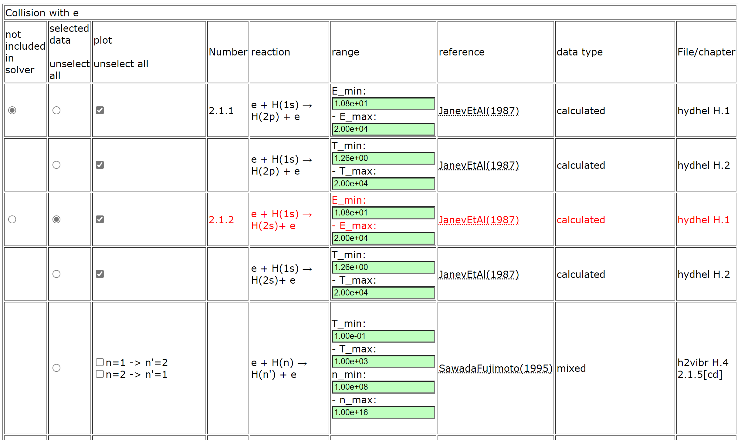
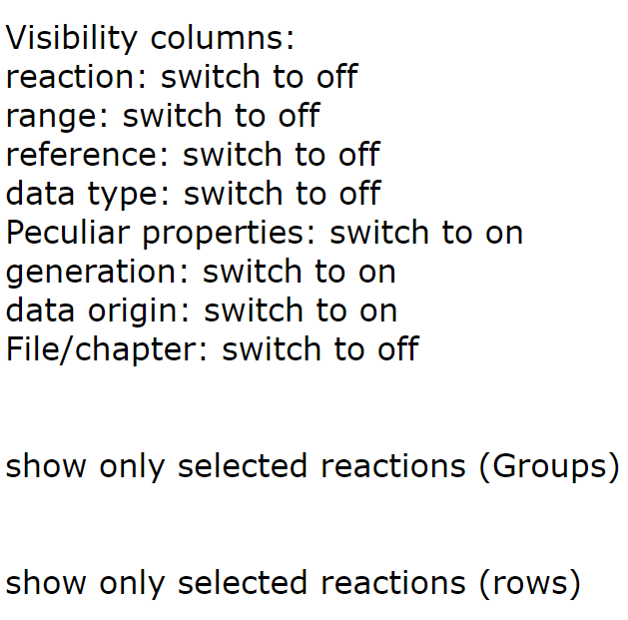
PLOUTOS – (H₂ 2022/23 case)
Buttons to adjust table content

Slide 29
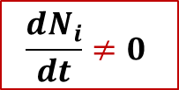
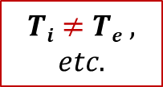

New CRM Solver for EIRENE concepted
This CRM is aimed to precompute rate coefficients accounting for all parametric dependences (n_{e}, T_{e}, but also T_{i}, …) in contrast with currently used polynomial fits (AMJUEL, …) + add a number of levels/processes not accounted for at this time
The internal states (e.g. rovibrational states in molecular species) are to be tracked with a flexible a flexible control over this resolution (as separate specie or variable).
The nonstationary solution for balance equations should be the default one
(with the stationary only as a useful option).
The solver should be modular, thus usable standalone or even in various codes.
The improved A&M data input should be readable and structured (for starters JSON, potentially also HDF5). It should be pre-processed mostly automatic and easily exchanged with other codes and tools. We need tools for visualisation and testing.
  The only way to meet the exploding amounts of data from RMPS and CCC for molecules (with resolution by rovibrational states)
  IAEA GNAMPP assists, but also reveals the challenges
$$Ti≠Te ,$$
$$etc.$$
$$\frac{dN_{i}}{dt}≠0$$
$$Why not$$
$$also ERO?..$$
Not only performance and reliability to be improved, but additional physics can be provided!

Slide 30

New code (also library for EIRENE): “ModCR”
Should provide BOTH standalone and build-in CRM for EIRENE
  Therefore written in modern Fortran
  Linked with Ploutos (uses the same JSON files for I/O)
    (AMJuel, HydHel, H2Vibr, etc are already inside, moreover under flexible web-powered control)
  Non-stationary approach utilising up-to-date Sundails solver (CVODE) for stiff ODE systems
    (algebraic stationary option also available for control)
The whole specie-state and reaction basis is inside, however the code should form the list of “active states”
  Determined by user in JSON parameter file (for few simulations)
  Provide different resolution on states being tracked
  Provide flexible border for tracking of MC species and internal state populations as variables
This
is unique and justifies creation of the new code

Slide 31
Summary – improved CRMs
CRMs are essential part of MC transport codes including EIRENE
Transport and A&M sides of MC transport codes are NOT separable, however using the standalone PLOUTOS approach is often extremely useful
  Gives insight into the A&M physics
  Allows more control, looking into details and straightforward answers
  Particular valuable if standalone and external CRM would be just the same
  Isotope (D vs. H) effect demonstrates the significance of vibro-resolved MCCC data
New CRM (ModCR) is concepted and under development
  The same model should be usable standalone and inside the EIRENE
  PLOUTOS will keep and even strengthen its role as data pre-processor
  It is aimed to provide flexible “border” between particles treated as MC species or variables characterising the internal state
  Opacity and other effects should be available in ModCR, but it is too early to talk about that at the current stage.
Further tools (e.g. EIRENE input editor python-based GUI “AMJ4EIR”) are under development
Further details at www.eirene.de

Slide 32
FZJ team
Left the team: Francesco Cianfrani (PostDoc, 9PM/year)
→ CRM development, DEMO simuations (incl. standalone)
Petra Börner (4PM/year, special contract)
→ Code development leading to the 1st MsV (milestone version), completed
Remaining: Dmitriy V. Borodin (9PM/year)
→ CRMs, code development, PI
Bettina Küppers (~5PM/year)
→ Ploutos development, webmaster, starting as code developer

Slide 33
Summary: TSVV-5 progress and plans
Physics
  Fluid-kinetic hybridisation (FKH) development successfully continues
  A&M CRM improvement (somewhat preparatory work so far…)
  Kinetic ions on the EIRENE side (discussion with TSVV-6)
  Establishing simulation cases (validation, ITER, DEMO) – in progress
Code development
  Parallelisation: OpenMP-MPI hybrid (related code refactoring done; optimisation and restructuring e.g. domain decomposition are necessary)
  Code streamlining (Segregation of the numeric core, etc.) – code camp
  Improved I/O (JSON/HDF5), visualisation, IMASification, etc. – in progress.
Organisational items
  Repository for simulations (EUDAT?.., using JAC catalogue experience) – concept under development, depends on selection of base system.
  New EIRENE license, “infectious open source” (draft discussed with FZJ layers and ITER still in circulation)
Requires communication with other TSVVs
Requires ACH support

Slide 34
Thanks for the attention!

