Slide 1






Concept for “ModCR” (Modular CR model for EIRENE)
Task status overview for internal discussion inside Thrust 2
D. Borodin et al.

Slide 2
EIRENE: collisional-radiative model (CRM) challenges
treating non-stationary effects
improving performance for simulations on ITER and DEMO scales
metastables (MS) in atoms (e.g. He)
vibrational (and rotational) states in molecules
isotopes: D₂, T₂, H₂, DT, HD, …, Be-H/D/T, N-xxx, …
control the exploding amounts of data

Slide 3
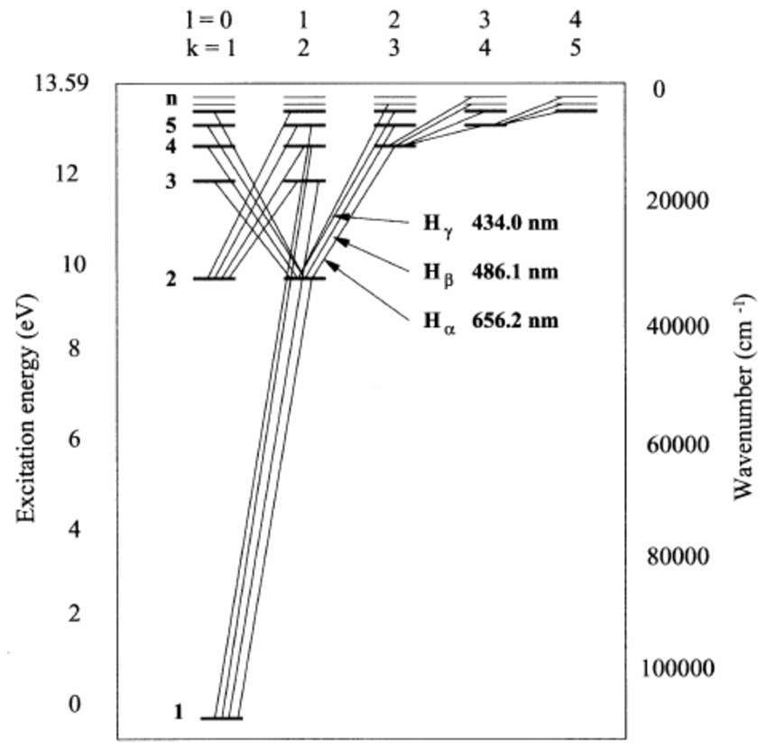
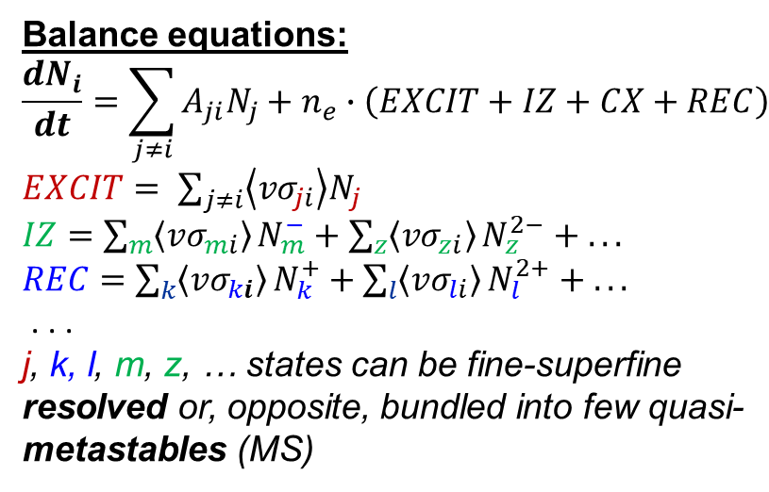
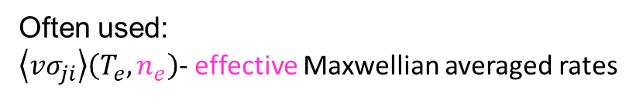
Collisional-Radiative Models (CRM)
Grotrian diagram for atomic H (D, T)
Balance equations:
$$\frac{dN_{i}}{dt}=\sum_{j≠i}{A_{ji}N_{j}}+n_{e}∙\left(EXCIT+IZ+CX+REC\right)$$
$EXCIT= \sum_{j≠i}{\left\langle {vσ}_{ji}\right\rangle N_{j}}$
$IZ=\sum_{m}{\left\langle {vσ}_{mi}\right\rangle }N_{m}^{−}+\sum_{z}{\left\langle {vσ}_{zi}\right\rangle }N_{z}^{2−}$ $+ . . .$
$REC=\sum_{k}{\left\langle {vσ}_{ki}\right\rangle }N_{k}^{+}+\sum_{l}{\left\langle {vσ}_{li}\right\rangle }N_{l}^{2+}$ $+ . . .$
. . .
j, k, l, m, z, … states can be fine-superfine resolved or, opposite, bundled into few quasi-metastables (MS)
Ry=13.6eV
CRM = list of states + transition data
Often used:
$\left\langle {vσ}_{ji}\right\rangle \left(T_{e},n_{e}\right)$- effective Maxwellian averaged rates

Slide 4

CRM solvers available
CRM (technically) = reaction data + SOLVER
$$\frac{dN_{i}}{dt}=0$$
Most solvers solve algebraic stationary system of equations
in such cases the solver is much less valuable than the A&M data collection
this statement is underlined even by the developers of the very well established and mostly up-to-date YACORA model
CRM containing molecular species is even more complex, e.g. one needs to track more processes and more states (vibrational, rotational).
Tracking all the states as separate species demands enormous CPU and memory resources.
EIRENE pre-calculates rates for each volume cell. It also allows to pre-calculate values for various T_{i}/T_{e} ratios.
D.Wünderlich and U.Fantz,
Atoms 2016, 4(4), 26

Slide 5
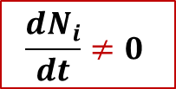
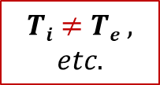

New CRM Solver for EIRENE concepted
This CRM is aimed to precompute rate coefficients accounting for all parametric dependences (n_{e}, T_{e}, but also T_{i}, …) in contrast with currently used polynomial fits (AMJUEL, …) + add a number of levels/processes not accounted for at this time
The internal states (e.g. rovibrational states in molecular species) are to be tracked with a flexible a flexible control over this resolution (as separate specie or variable).
The nonstationary solution for balance equations should be the default one
(with the stationary only as a useful option).
The solver should be modular, thus usable standalone or even in various codes.
The improved A&M data input should be readable and structured (for starters JSON, potentially also HDF5). It should be pre-processed mostly automatic and easily exchanged with other codes and tools. We need tools for visualisation and testing.
  The only way to meet the exploding amounts of data from RMPS and CCC for molecules (with resolution by rovibrational states)
  IAEA GNAMPP assists, but also reveals the challenges
$$Ti≠Te ,$$
$$etc.$$
$$\frac{dN_{i}}{dt}≠0$$
$$Why not$$
$$also ERO?..$$
Not only performance and reliability to be improved, but additional physics can be provided!

Slide 6
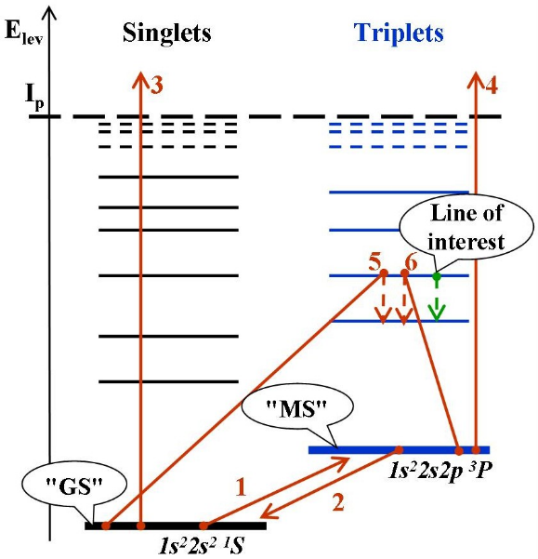
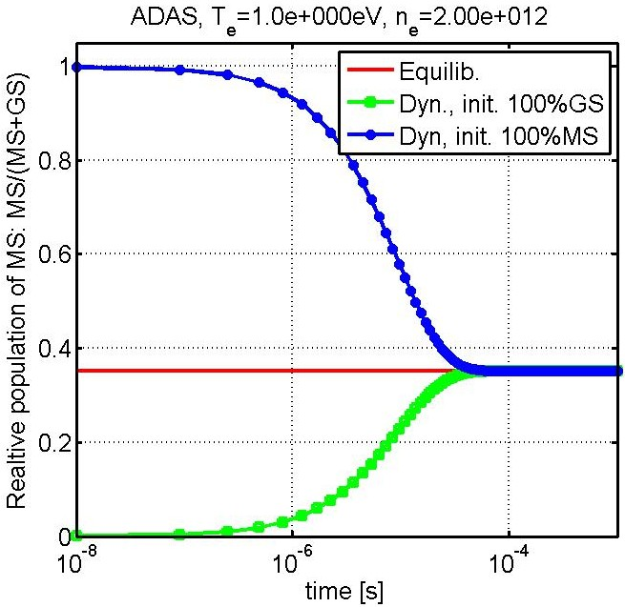
MS-effect for BeI (“generalised” MS 10⁻⁴s)
The system of 2 balance equations can be solved analytically . . .
ADAS, T_{e}=1eV, n_{e}=2*10¹²cm⁻³
Effective rates:
1,2) transitions <Ex..> between "GS" and "MS"
3,4) ionizations <Iz..> from "GS" and "MS"
5,6) line intensity (PEC – photon emission coefficient), contributions from "GS" and "MS"
MS-population tracking was introduced into ERO and demonstrated to be of significance by applications to PISCES-B, PSI-2 and JET-ILW (neutral Be, He, W)
For WI dedicated ADAS dataset was developed; various lower states bundling options (~10) tested etc.

Slide 7
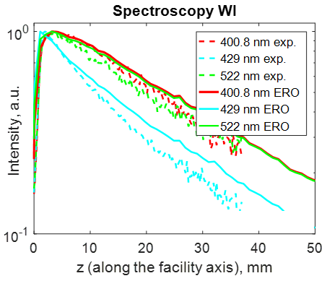
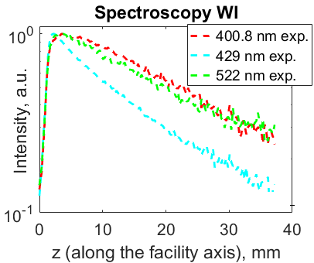
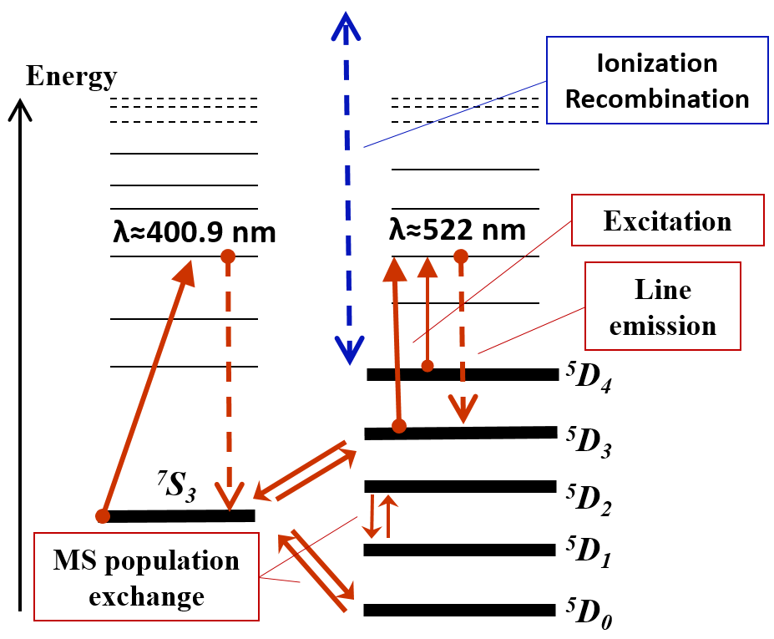


MS-effect for WI (PSI-2 linear plasma device, JET)
(PSI-2)
(PSI-2)
(PSI-2)
W⁰
line Intensity [a.u.]
line Intensity [a.u.]
ERO:
λ = 400, 429, 522 nm
Ar → W
target
Ar → W
target
Multiple options for state bundling are worth considering
Test in tokamak (JET ITER-like Wall): MS tracking reduces simulated line intensity by x1.7!
Dedicated ADAS’18 dataset
A.Eksaeva PhD-thesis, 2020

Slide 8
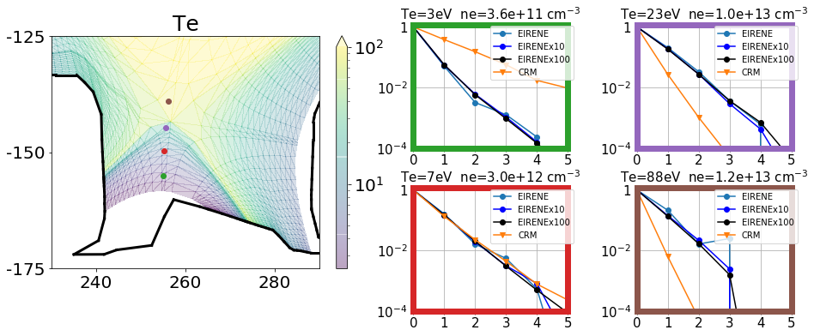



Standalone CRM vs EIRENE – 1 (statistic issues)
EIRENE: 793’300 histories
EIRENEx10: 7’933’000 histories
EIRENEx100: 79’330’000 histories
Simulations: SOURCE v=0
CRM overestimates excited state population at low temperature
$$\text{n}\text{ν}\text{/}\text{n}\text{0}$$
$$\text{n}\text{ν}\text{/}\text{n}\text{0}$$
CRM underestimates excited state population at large temperature
$$\text{n}\text{ν}\text{/}\text{n}\text{0}$$
$$\text{n}\text{ν}\text{/}\text{n}\text{0}$$

Slide 9
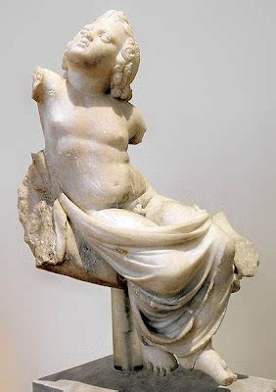
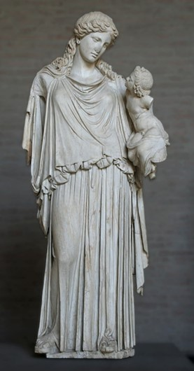
PLOUTOS (web-based) can be used to
www.eirene.de
to import/export data (JSON, tabular, etc.)
to produce input data for EIRENE and for other codes with CRMs
  ➔ load/improve/save the developed configuration (selected reactions and parameters) including starting from the standard pre-sets
to check data for consistency and abnormal features
do sensitivity studies:
  ➔ understand A&M side of the problem and identify the most significant processes (among the selected ones)
Both statues are at
Glyptothek, Munich.
EIRENE

Slide 10

New code (also library for EIRENE): “ModCR”
Should provide BOTH standalone and build-in CRM for EIRENE
  Therefore written in modern Fortran
  Linked with Ploutos (uses the same JSON files for I/O)
    (AMJuel, HydHel, H2Vibr, etc are already inside, moreover under flexible web-powered control)
  Non-stationary approach utilising up-to-date Sundails solver (CVODE) for stiff ODE systems
    (algebraic stationary option also available for control)
The whole specie-state and reaction basis is inside, however the code should form the list of “active states”
  Determined by user in JSON parameter file (for few simulations)
  Provide different resolution on states being tracked
  Provide flexible border for tracking of MC species and internal state populations as variables
This
is unique and justifies creation of the new code

Slide 11


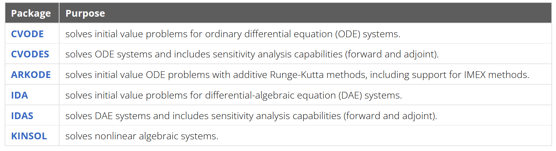
ODE Solver for ModCR
SUNDIALS: SUite of Nonlinear and DIfferential/ALgebraic Equation Solvers
Developed at LLNL - awarded the 2023 SIAM/ACM Prize in Computational Science and Engineering
repository: https://github.com/LLNL/sundials
Modern, powerful and flexible – still it is available in FORTRAN (so suits to EIRENE)

Slide 12
ModCR interaction with EIRENE and other tools
YACORA
EIRENE
CRM condensing
(“ColRad”)
Interface
Standalone
EIRENE
Main loop
(“folneout”)
ModCR
Ploutos
ModCR
Flexible input files (JSON)
EIRENE
Post-processing
(spectroscopy, etc)
Data sources
MCCC, R-matrix, …

Slide 13
ModCR and ColRad
Hardcoded data preparation: H_COLRAD, He_COLRAD and H2_COLRAD
• Reads in 𝑇_{𝑒}, 𝑛_{𝑒} (𝑇_{𝑖}, 𝑛_{𝑖})
• Gives out 𝑆_{ion}, S_{rec}, R_{pop}
• stationary (!..) CRM
ModCR is supposed to:
generalize the CRM use preparatory step for all species
link it to PLOUTOS and provide standalone simulations
take as much as possible from the ColRad development
photon tracing and other features are to be taken over into EIRENE with ModCR
We need an action plan to transform COLRAD to ModCR (code → input files…)
First species to start with in ModCR: H2 and He, next to come is D2 (and T2?..)
Be (incl. molecules) CRM in ModCR is developed for JET and testing purposes as well.

Slide 14
ModCR and the EIRENE Main loop
ModCR is supposed to provide:
“abstract reaction“ approach and this way reduce branching
tracking of internal states as variables
user-defined “border” between states tracked as variables and as species
reverse compatibility with earlier simulations
high performance, seamless interface (so, FORTRAN)

Slide 15

ModCR flow chat (standalone)
Input file (JSON)
CRM
Species
States
Transitions
Settings
New input
file (JSON)
Ploutos
Output file1
(JSON)
CRMs
Output file X
Tasks
Solver(s)
Task
Manipulate CRM
Analyse CRM
Solve (set of) case(s)
Produce output
Stationary
Dynamic
Analysis

Slide 16
ModCR flow chat
Reading Input file (CRM + tasks, JSON)
What is done by now?
Reading CRMs + extra data
Creating total list of species-rates-reactions
→ sorting out and consistency checks
reading JSON
reading PLOUTOS CRM (JSON)
reading ADAS (adf11, adf15)
incorporating of solver (CVODE++)
started with sorting of states and reactions…
Some positive implications for EIRENE already: reorganisation of external libs
ModCR interfaces to EIRENE in pre-calculation phase should be very much alike to COLRAD
Performing data manipulation tasks
Sorting out the “active states” and the reduced reaction data, index abstractisation
solver task
Analysis, sorting, postprocessing tasks
ModCR output (mostly JSON, HDF5?..)

Slide 17
Thanks for the attention!

Slide 18
CRM FOR MOLECULES : vibral resolution
H₂⁺
H₂(X)
H₂ + H⁺ → H₂⁺+H
H₂⁺ + e → 2H⁺ + 2e
ν = 5
H₂ + e → H₂⁺+ 2e
H₂⁺ + e → 2H
ν = 4
ν = 3
background
ν = 2
SOURCE
ν = 1
ν = 0
H₂ + e → 2H + e
H₂⁺ + e → H + H⁺ + e
H₂ + e → H + H⁺ + 2e
H + e → H⁺ + 2e
Plasma parameters:
H
T_{e}=T_{i}=0.2÷30eV.
n_{e}=n_{i}=10¹⁹m⁻³
n_{e}=n_{i}=10²¹m⁻³
JET
H₂(ν) + e → H₂(ν±1) + e
Databases:
AMJUEL, H2VIBR
EU-DEMO

Slide 19
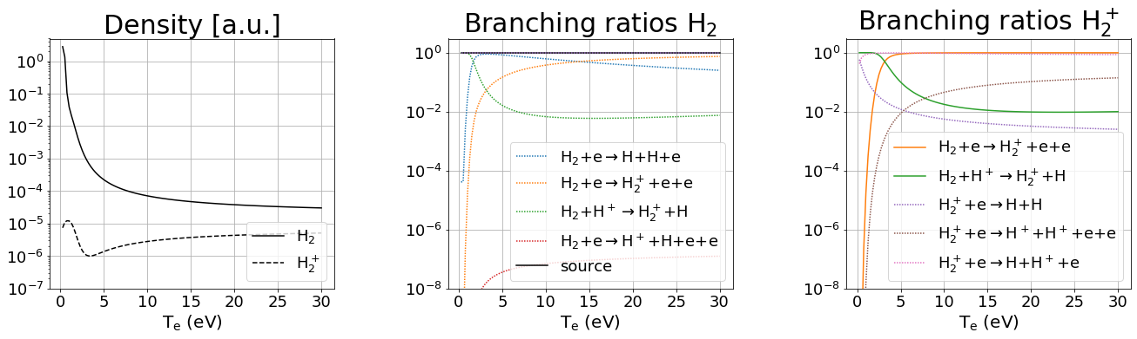
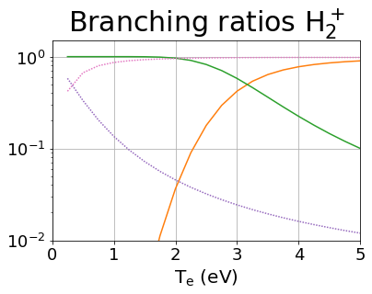
CRM FOR MOLECULES: leading reactions
EU-DEMO
low temperature (T < 2eV) leading reaction chains:
MAD
MAR/MAD competition at very low temperature
H₂+H⁺→ H₂⁺+H H₂⁺+e → H+H⁺+e
H₂+H⁺→ H₂⁺+H H₂⁺+e → H+H
MAR

Slide 20
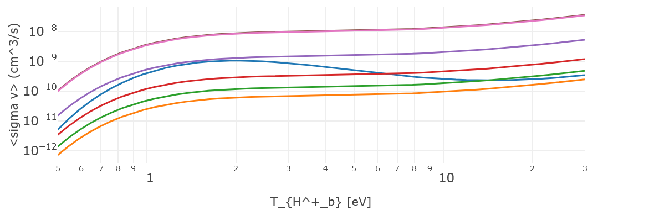
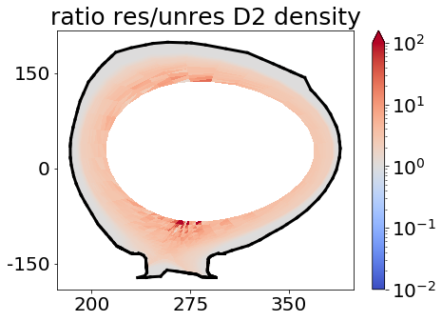
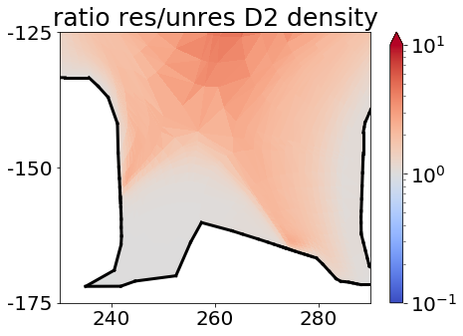
Resolved vs. unresolved on vibrostates CRM in EIRENE
H2VIBR: resolved
AMJUEL: unresolved
Larger molecular density (factor≃2∸3) along the separatrix with vibr. resolution.

Slide 21
CRM tools development
New (or updated) modelling tools :
Ploutos
ModCR
Special thanks to
ADAS (M.O’Mullane et al.) for constant support
YACORA developers (U.Fanz, D.Wunderlich, et al.)
MCCC developers (D.V.Fursa et al.) for providing the database

Slide 22
Standalone CRM Ploutos: what is inside?..
Earlier known as “HydKin”
CRM solver (transport excluded, pure A&M side of the problem) with extensive features
  Stationary and non-stationary solution (assuming velocity and plasma pars)
  Any specie can be treated as “Reservoir”
  “Spectral analysis” based on eigenvalue approach (which reactions are most important?)
  Sensitivity analysis – vary the plasma parameters, solver settings, reactions, etc.
Plotting, solver results visualisation
  Useful for fast consistency checks and trivial analysis while constructing the CRMs
  Good for physics analysis in case one follows established routines
Flexible reaction tables interconnected with the solver and plotting
  Optimised for consistency checks and trivial analysis while constructing the CRMs
  Input/output in various formats (new: JSON) including directly for EIRENE
  Critical things are highlighted, level of information detail controlled by the user.
  Data is grouped by the reactions (even if from various sources).
  Standard or custom initial configurations
Power of web-based
Interface!

Slide 23
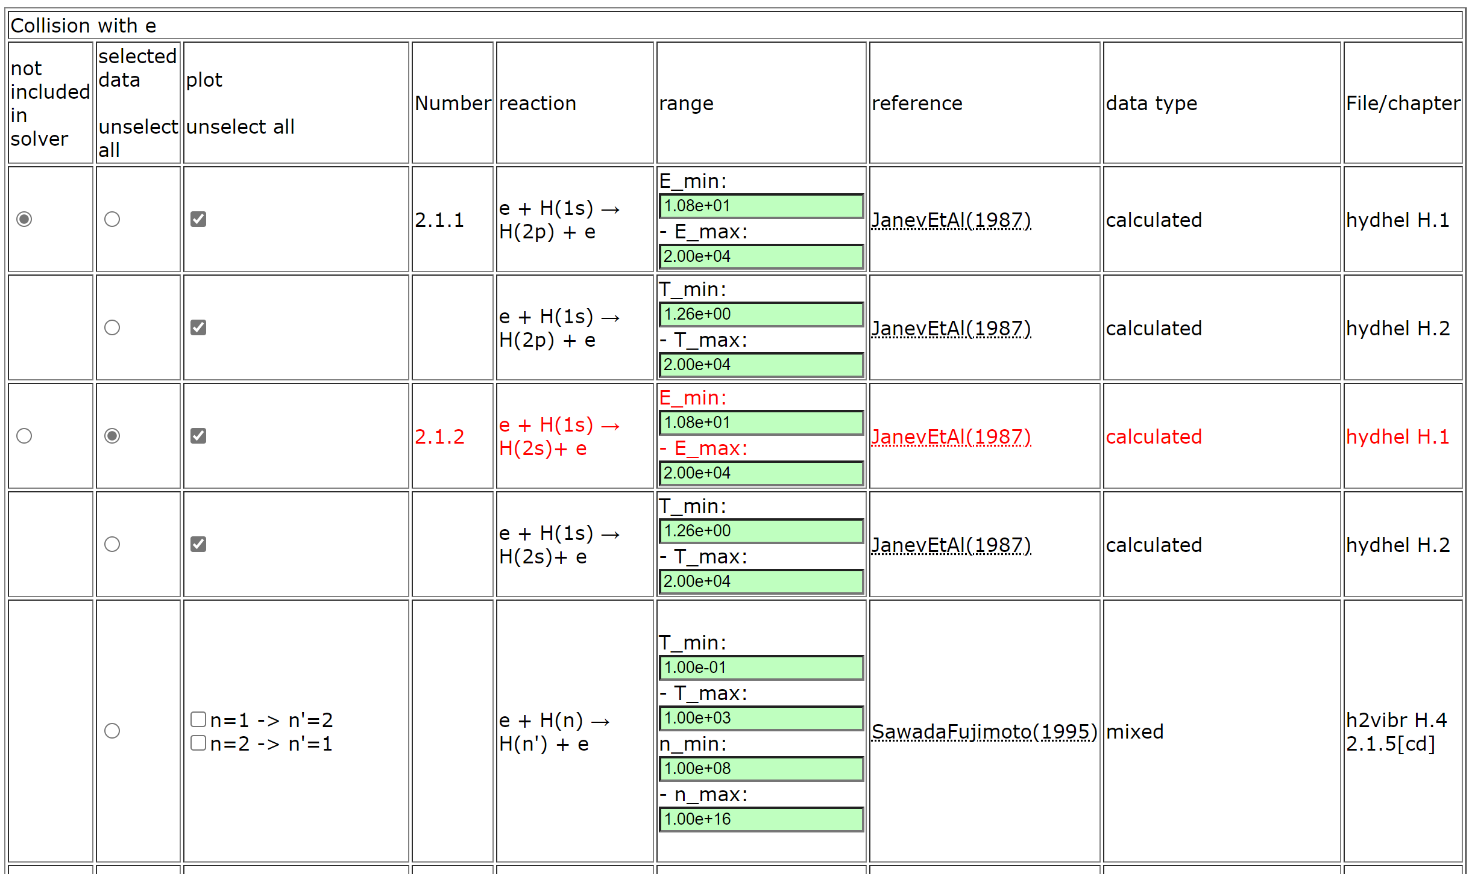
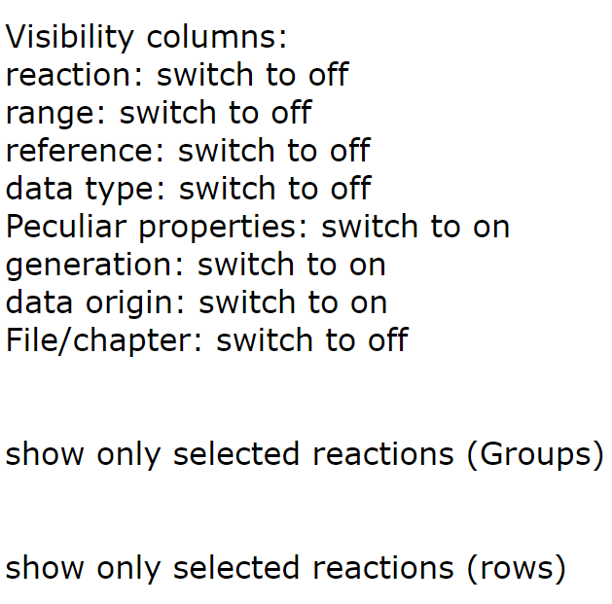
PLOUTOS – (H₂ 2022/23 case)
Buttons to adjust table content

Slide 24
Summary – improved CRMs
CRMs are essential part of MC transport codes including EIRENE
Transport and A&M sides of MC transport codes are NOT separable, however using the standalone PLOUTOS approach is often extremely useful
  Gives insight into the A&M physics
  Allows more control, looking into details and straightforward answers
  Particular valuable if standalone and external CRM would be just the same
  Isotope (D vs. H) effect demonstrates the significance of vibro-resolved MCCC data
New CRM (ModCR) is concepted and under development
  The same model should be usable standalone and inside the EIRENE
  PLOUTOS will keep and even strengthen its role as data pre-processor
  It is aimed to provide flexible “border” between particles treated as MC species or variables characterising the internal state
  Opacity and other effects should be available in ModCR, but it is too early to talk about that at the current stage.
Further tools (e.g. EIRENE input editor python-based GUI “AMJ4EIR”) are under development
Further details at www.eirene.de

Slide 25
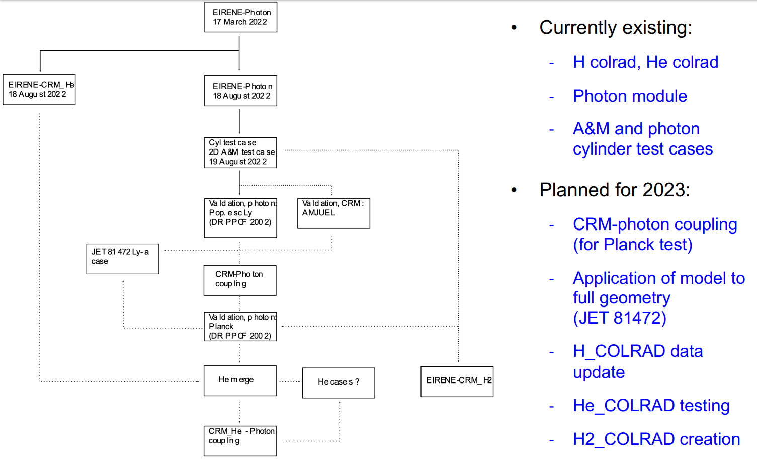
ColRad – plans for 2023

Slide 26
Transport code variations and commons: CRMs
Property | EIRENE | ERO, ERO2.0
Ab initio | Yes (iterations with fluid code, e.g. with B2.5 → “SOLPS-ITER”) | No, test-particle approximation on a given plasma BG (e.g. from SOLPS)
Gyro-motion | Guiding centre approximation | Full-resolved, detailed 3D wall elements, surface sheath
Plasma-wall interaction | Less detailed locally, often no 3D | More detailed: 3D, sheath, etc.
PWI impact on plasma | Yes, also “advanced fluid neutrals”, “wall reservoirs” etc. | In general NO (certain effects were introduced…)
Both approaches have clear advantages and range of appropriate tasks, both packages are highly demanded by ITER, EU-DEMO and other fusion-relevant devices!
➔ Moreover, they often support each other (plasma BGs from various CFD-EIRENE used and tested in ERO)
However, the subtasks for treatment of atomic and molecular processes in plasma are very similar!
Break-up of the molecular species in plasma
Ionisation and other processes affecting charge and energy, thus transport
Synthetic spectroscopy for comparison with diagnostics
Similar A&M process treatment challenges!

Slide 27
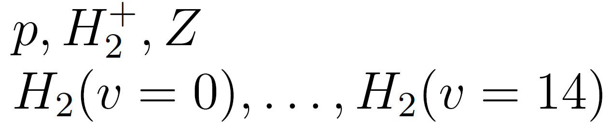
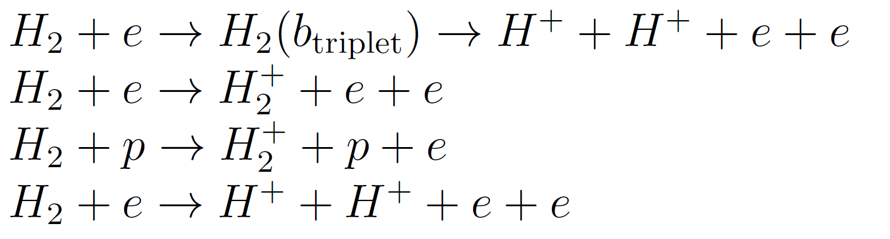
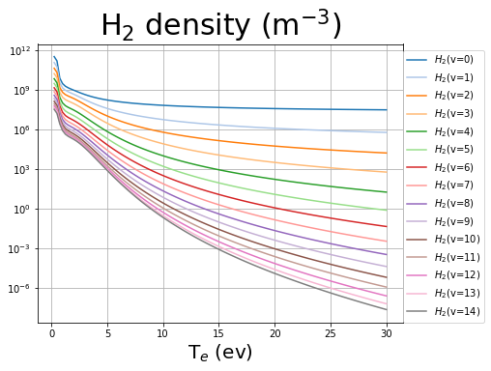
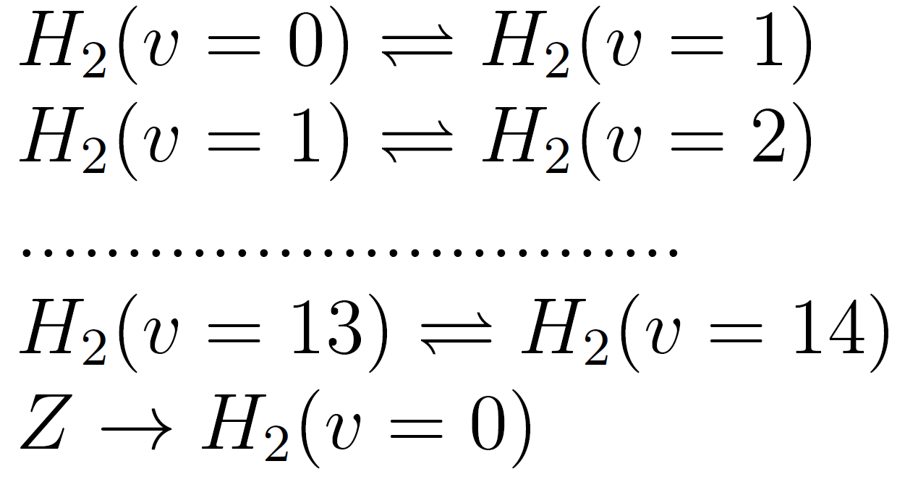
YACORA: inclusion molecular source term
Stationary run vibrationally resolved:
YACORA + Source term
adjustable to the Edge2D-EIRENE
Particle species
F.Cianfrani,
EPS-2022
Reactions
electron impact
proton impact
electron impact
vibrational transitions
H₂ source term

Slide 28
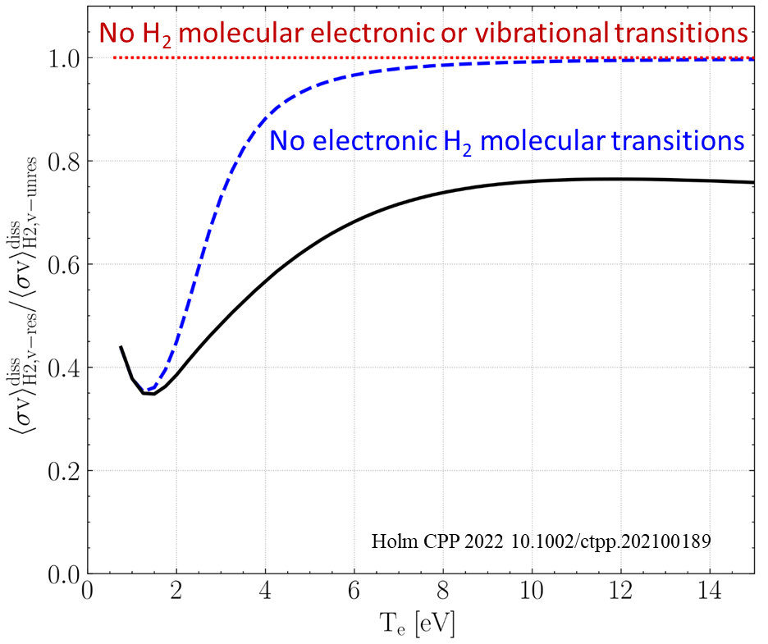
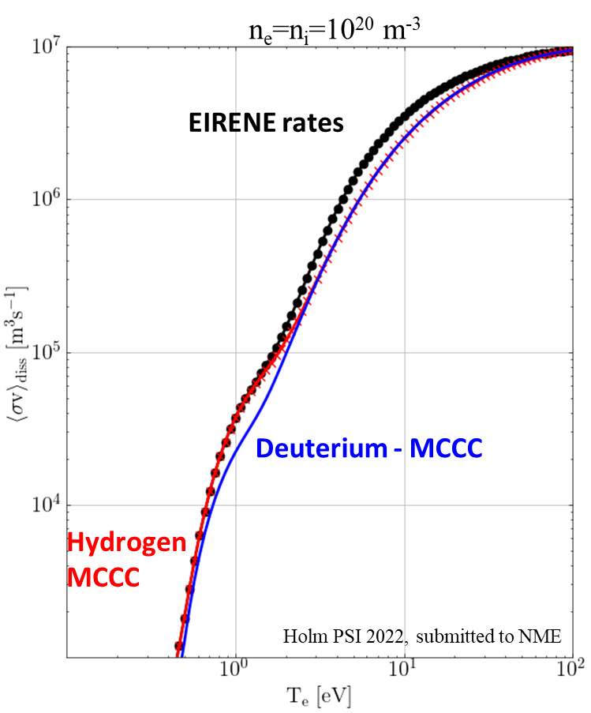
CRUMPET, YACORA simulations (standalone CRM)
Predicted isotope effect strongest for temperatures associated with detachment onset and detached conditions
MCCC data indicates weaker dissociation of both H₂ and D₂ for T_{e} > 3 eV compared to EIRENE data (AMJUEL, HYDHEL, H2VIBR)
Different CR processes cause up to 60% difference in dissociation rates
Impact strongest in the T_{e} = 0.5–4 eV range, where molecular processes strongest
Electronic transitions affect T_{e} > 4 eV
Vibrational transitions affect T_{e} < 4 eV

Slide 29
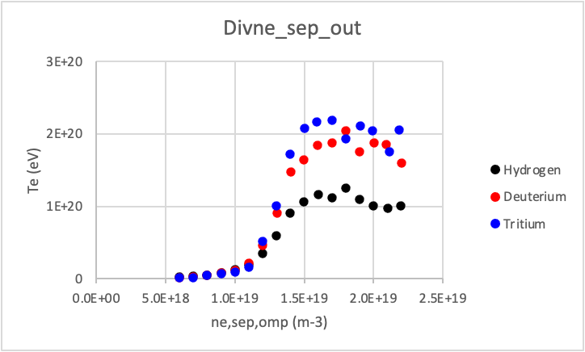
Isotop effect in „full-scale“ EIRENE (M.Groth)
Generic density scan with identical transport coeffs., models
Strong reduction in ion current to outer plate not yet reproduced ⇒ likely to require changes to transport coefficients
T_{e,OT} least affected by isotope species
Higher div. densities for T than for H plasmas observed in
JET-ILW L-mode plasmas, both exp. and in EDGE2D-EIRENE

Slide 30
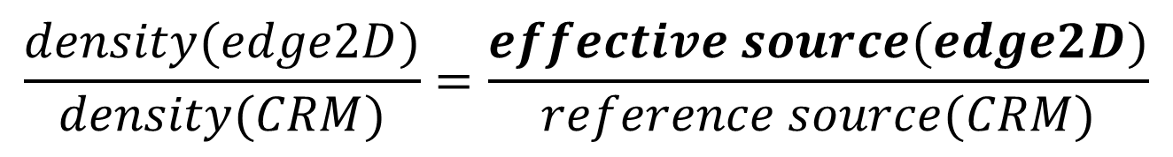
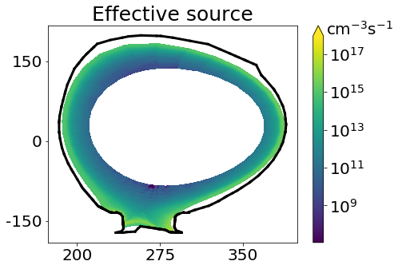
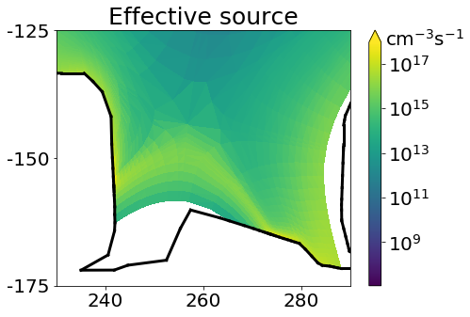
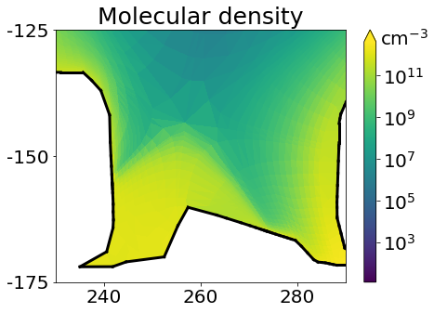
Standalone CRM vs EIRENE: Effective source (JET)
CRM in each simulation cell: molecule density scales linearly with the source → effective source
with isotope rescaling
divertor region: → novel physical conditions (dominance of CX reactions at low temperature)
Based on
EDGE2D-EIRENE simulations
JET shot 81472
Gas puffing
M Groth et al. NF 2013

Slide 31
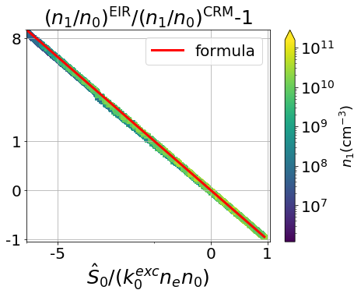
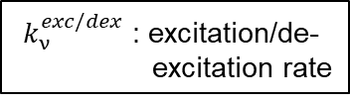


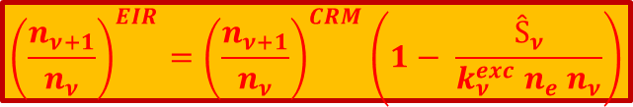
Standalone CRM vs EIRENE - 2
The deviations from CRM are determined by molecular sources:
${ k}_{ν}^{exc/dex}$ : excitation/de-
excitation rate
$${\left(\frac{n_{ν+1}}{n_{ν}}\right)}^{EIR}={\left(\frac{n_{ν+1}}{n_{ν}}\right)}^{CRM}\left(1− \frac{Ŝ_{ν}}{{k_{ν}^{exc} n}_{e} n_{ν}}\right)$$
EIRENE:
X
S^{in}
S^{in}+ S^{EIR}
ν = 5
${ Ŝ}_{ν}$ =$\sum_{\overline{ν}=ν+1}^{N}{S_{\overline{ν}}^{EIR}{\left(\frac{n_{\overline{ν}}}{n_{ν+1}}\right)}^{CRM}}\frac{k_{\overline{ν}}^{dex} ∙ … ∙{ k}_{ν+2}^{dex}}{k_{ν+1}^{exc} ∙ … ∙ k_{\overline{ν}−1}^{exc}}$
ν = 4
transp.
ν = 3
diss./ion./transp.
ν = 2
$$\overline{ν} − ν−1$$
ν = 1
ν = 0
$$ν=0$$
positive deviations at sinks
CRM:
X
S^{out}
ν = 5
ν = 4
ν = 3
diss./ ion.
S^{ref}
ν = 2
negative deviations at sources
ν = 1
ν = 0

Slide 32
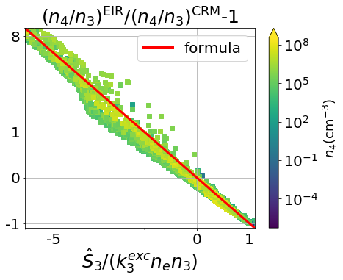

Standalone CRM vs EIRENE - 3
The deviations from CRM are determined by molecular sources:
${ k}_{ν}^{exc/dex}$ : excitation/de-
excitation rate
$${\left(\frac{n_{ν+1}}{n_{ν}}\right)}^{EIR}={\left(\frac{n_{ν+1}}{n_{ν}}\right)}^{CRM}\left(1− \frac{Ŝ_{ν}}{{k_{ν}^{exc} n}_{e} n_{ν}}\right)$$
EIRENE:
X
S^{in}
S^{in}+ S^{EIR}
ν = 5
${ Ŝ}_{ν}$ =$\sum_{\overline{ν}=ν+1}^{N}{S_{\overline{ν}}^{EIR}{\left(\frac{n_{\overline{ν}}}{n_{ν+1}}\right)}^{CRM}}\frac{k_{\overline{ν}}^{dex} ∙ … ∙{ k}_{ν+2}^{dex}}{k_{ν+1}^{exc} ∙ … ∙ k_{\overline{ν}−1}^{exc}}$
ν = 4
transp.
ν = 3
diss./ion./transp.
ν = 2
$$\overline{ν} − ν−1$$
ν = 1
ν = 0
$$ν=3$$
positive deviations at sinks
CRM:
X
S^{out}
ν = 5
ν = 4
ν = 3
diss./ ion.
S^{ref}
ν = 2
negative deviations at sources
ν = 1
ν = 0

