Slide 1




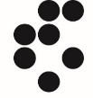


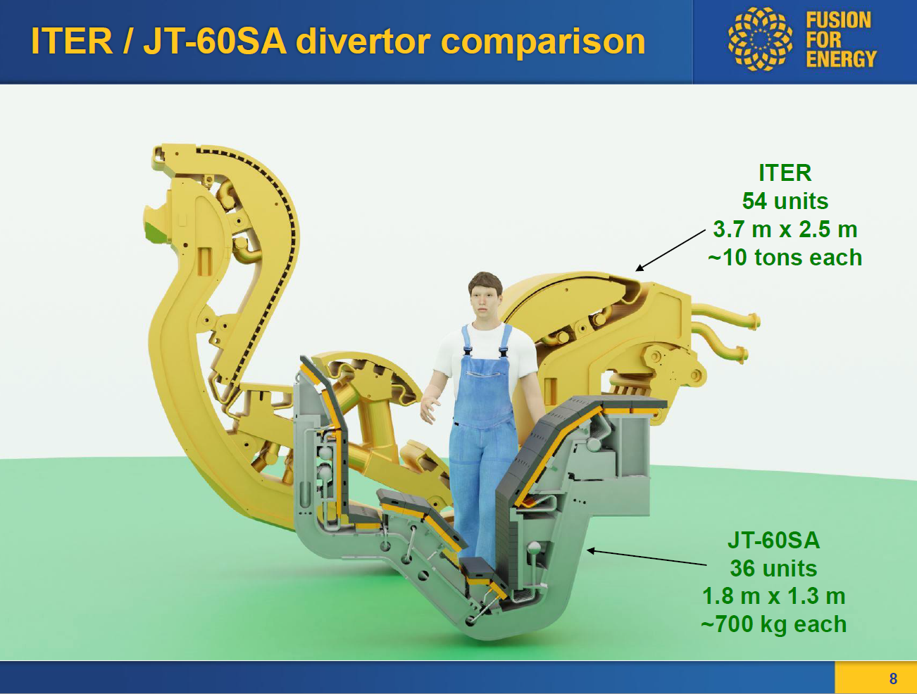
Technological solutions for the W divertor target plasma facing components of JT60SA
18th of July – FSD meeting
CEA, France
F4E, Germany
MPG, Germany
M. Richou¹, M. Firdaouss¹, V. Tomarchio², T. Baffie¹, A. Durif¹, R. Neu³

Slide 2
WPDIV
JT-60SA water-cooled divertor
  2.1 Carbon-Actively Cooled Divertor (C-ACD)
  2.2 Tungsten-Actively Cooled Divertor (W-ACD)
  Requirements
  Conventional flat tile concept
      Thermal analysis
    Enhanced concepts
    Enhanced flat tile concept
    Challenges

Slide 3
1. WPDIV - General
WPDIV
R. Neu
Program manager
M. Richou
WPDIV: DIVERTOR engineering
J-H. You
M. Richou
R. Neu
Eu-DEMO
W7X
JT60SA
IDTT
Fusion Science
Eu-DEMO: Conceptual design
Deliver holistic design concept of divertor (target, cassette) and limiter for DEMO
Prepare the transition from conceptual design phase to engineering design phase
IDTT: Support the design, qualification R&D, fabrication, assembly and installation of the divertor
(PFC+cassette body) and the subsystems which have an interface with the divertor.
W7X and JT60-SA: Develop and demonstrate feasibility of actively cooled W divertor PFCs
Courtesy G.Federici, 2020

Slide 4
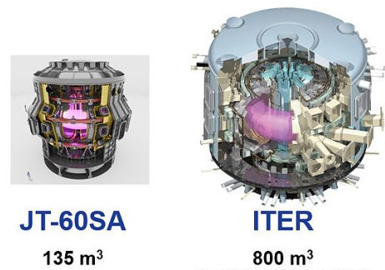
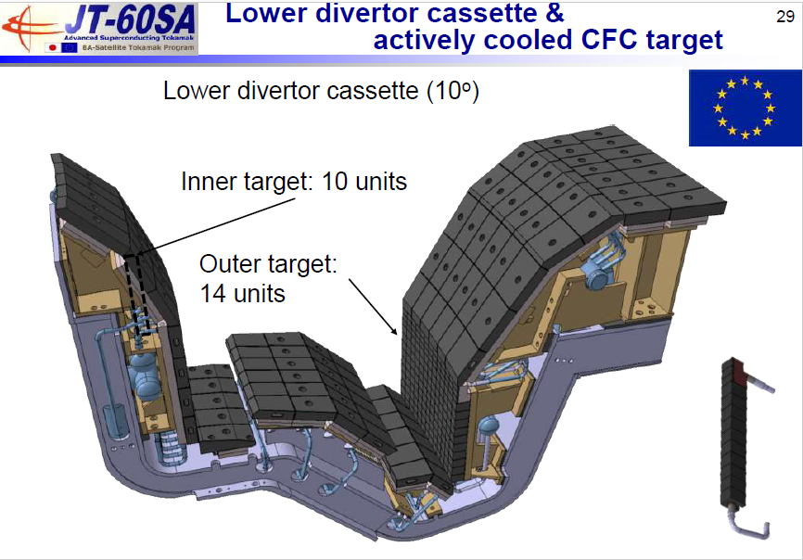
1-WPDIV -JT60SA (Main objectives)
For the carbon-Actively Cooled Divertor (C-ACD), the objective of WPDIV- JT60SA subproject consists in providing support to F4E to run the C-ACD series manufacturing (thermo-mechanical analysis, Electromagnetic loads analysis, mechanical testing, high heat flux tests)
For the tungsten-Actively Cooled Divertor (W-ACD), WPDIV-JT60SA subproject has the responsibility to design and develop the W-ACD by full scale prototype manufacturing and high-heat-flux testing.

Slide 5
2. JT-60SA water cooled divertor

Slide 6
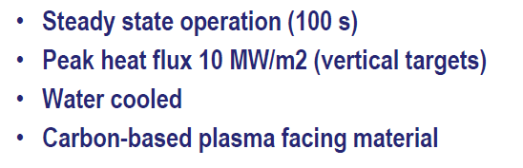
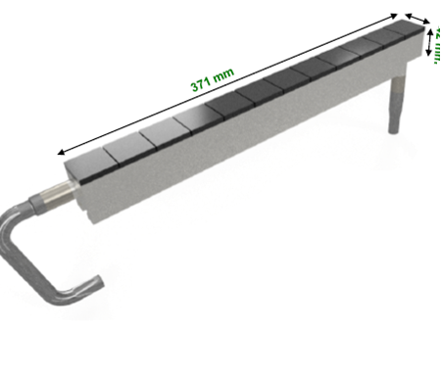
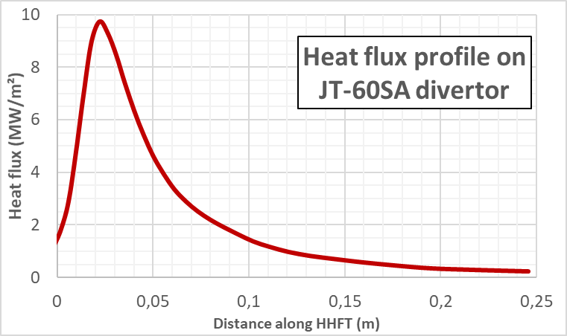
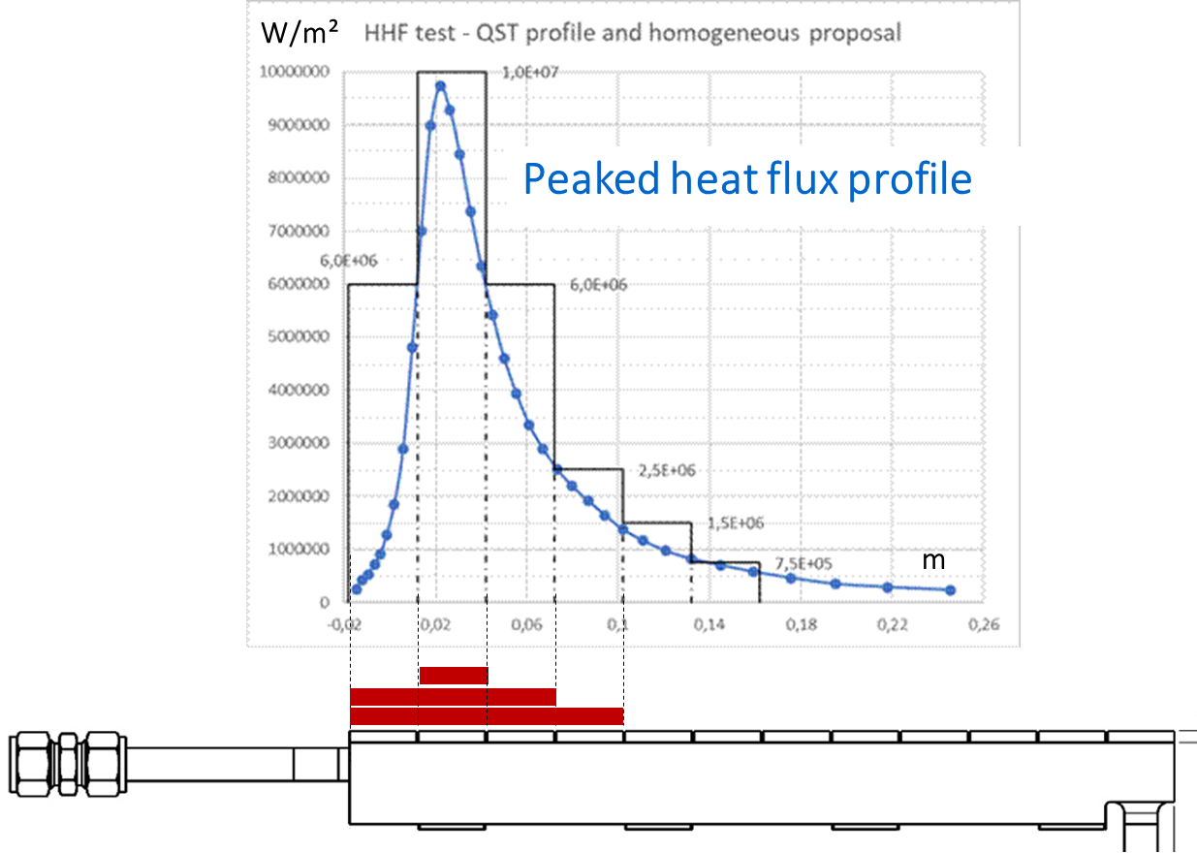
2. 1 Carbon-Actively Cooled Divertor (C-ACD)
Target element :
Conventional flat tile concept
32 mm
Steady state heat loads
Graphite
TZM
Divertor cassette
and plasma facing components
Cooling conditions :
20 bar, 7m/s, 40°C, swirl
Operation of actively cooled graphite divertor in 2029
Target tender (samples, prototypes, series) started in 07/22

Slide 7
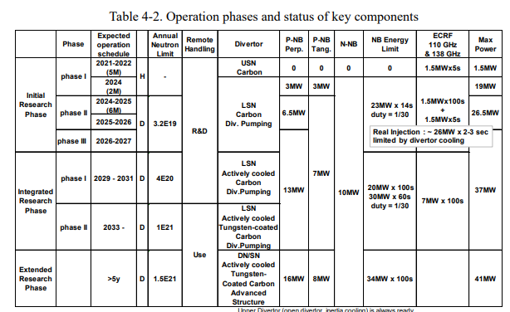
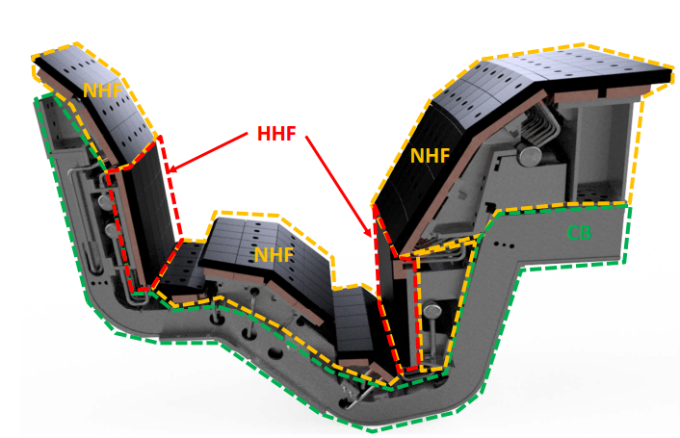
2.2 Tungsten-Actively Cooled Divertor (W-ACD)-> Requirements
  Use of W armor material, to be relevant with fusion power plant plasma facing material
  WPDIV assumptions (in line with F4E to save cost)
    Minimize the interfaces changes (same cassette body ideally)
    Keep the same envelope geometry as for the C-ACD
     Keep the present cooling capability
     Minimize the weight increase
    Industrial fabrication
    Heat loads (higher than JT-60SA C-target)
        15 MW/m² (Steady state)
        ELMs : 10 MJ/m² - 0.2 ms
    Schedule : Geometry defined: 2025; Technology qualified: 2026; Installation: ~2033 (Project plan, BA SC 27-7.4 )

Slide 8
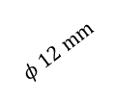
2.2 W-ACD-> Conventional flat tile concept
JT-60SA
W or W alloy…
  Material choice:
    W/W alloy…:
    ductility at RT (alloy), transient resistance
    CuCrZr (“ITER grade”) : good thermomechanical properties, existing feedback from joining feasibility (used for series manufacturing)
    TZM (JT60SA): good thermomechanical properties, material used for series manufacturing but not reactor relevant (activation)
  Rationales for the material geometry and thickness choices:
    Equivalent envelope as for the C-ACD
    W: erosion (> 2 mm), recrystallization
    CuCrZr, TZM: structural resistance
    Interlayer: joining feasibility feedback
CuCrZr or TZM
10-15 MW/m²
Target cross view
W or W alloy – 3 mm
Interlayer – 1 mm
Heat sink ( TZM, CuCrZr…)
3 mm
27 mm
$$φ 12 mm$$
32 mm
8

Slide 9
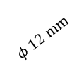
2.2 W-ACD-> Thermal analyses
10-15 MW/m²
W – 3 mm
Interlayer – 1 mm
3 mm
Heat sink ( TZM, CuCrZr…)
  Maximum allowable temperature (loss of mechanical properties)
  CuCrZr - 450 °C
  W - 1200°C
  TZM - 1200°C
27 mm
$$φ 12 mm$$
32 mm
  Results of thermal analysis (FEM)
Heat sink | CuCrZr |  | TZM
Incident heat flux (MW/m²) | 10 | 15 | 10 | 15
Heat sink Max Temp. (C) | 452 | 603 | 963 | 1435
W Max Temp. (C) | 704 | 1015 | 1221 | 1832
Proposed geometry may be able to sustain 10 MW/m² in steady state ✓
What are the technological solutions able to sustain 15 MW/m² in steady state ?

Slide 10
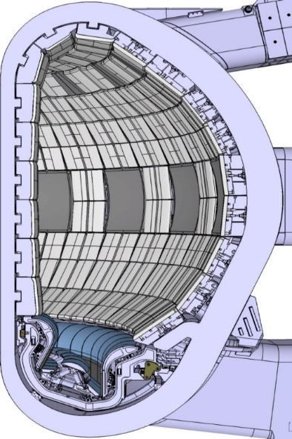
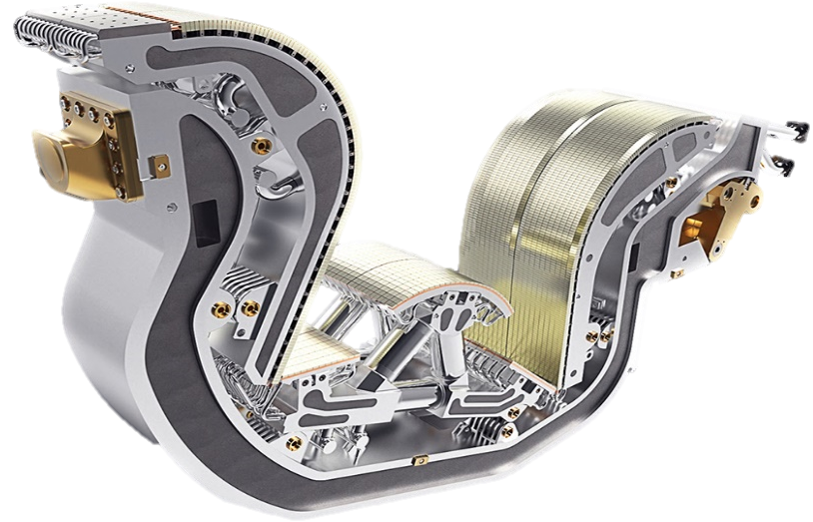
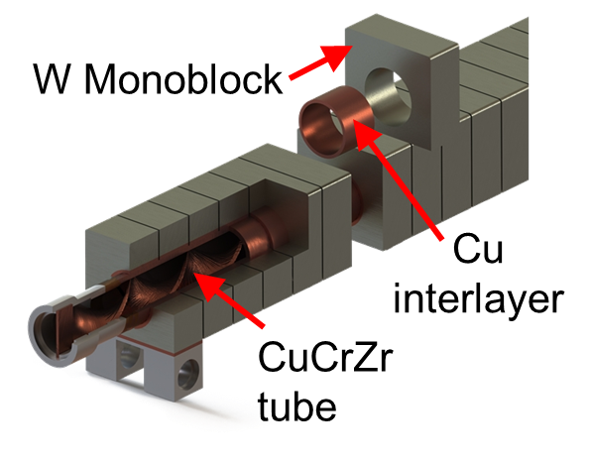
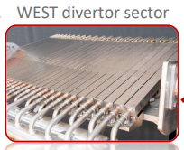
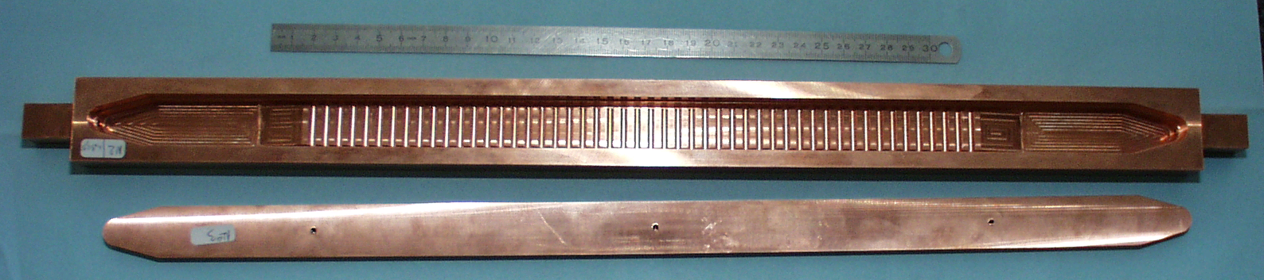

2.2 W-ACD -> Enhanced concepts
Inner and outer vertical targets
(based on monoblock concept)
ITER divertor cassette
20 MW/m²
~28 mm
Dome PFC based on hypervapotron cooling concept
500 mm
Example of Hypervapotron mock-up (2000)
Schematic cut view
10-25 MW/m²
CuCrZr
6
6
6
CuCrZr
491 mm
Able to sustain 20 MW/m² in quasi- steady state
feedback from series manufacturing
☹ Cost, multiple cylindrical joining

Slide 11
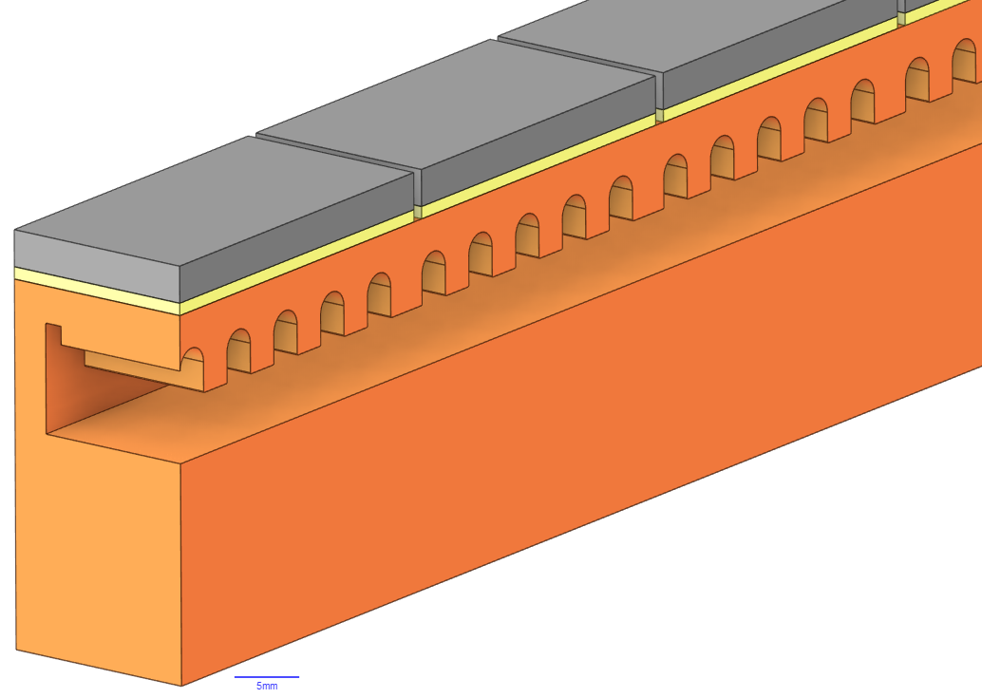
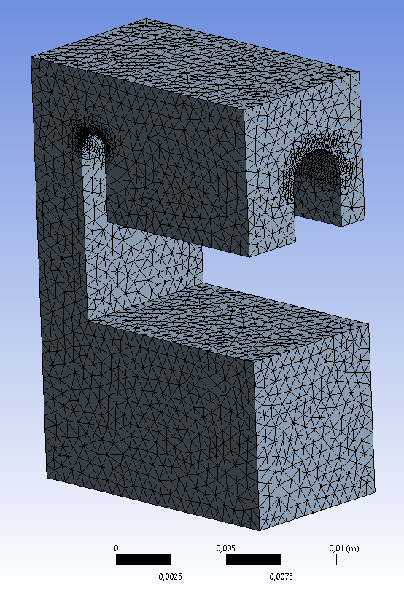
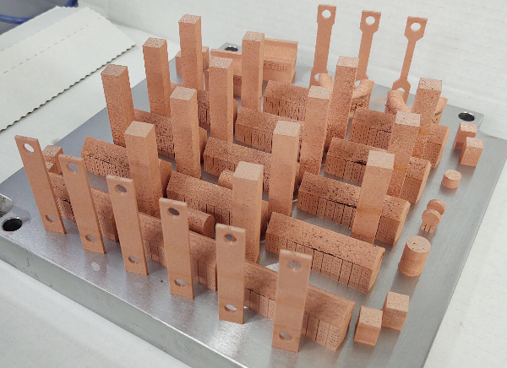
2.2 W-ACD -> Enhanced flat tile concept
10-25 MW/m²
Proposed geometry is able to sustain 15 MW/m² in steady state ✓
The use of FEM is promising to define the most adapted W target hypervapotron geometry
Fluid behavior is particular-> need of modeling (EEG proposal from JSI)
Need of mock-up manufacturing/high heat flux testing (use of CuCrZr additive manufacturing³ for rapid manufacturing)
W
CuCrZr
Experiment²
Thermal analysis (FEM)
2: F. Escourbiac et al, Fus. Eng. and Des., 2003
3. Salvan, 2021

Slide 12
2.2 W-ACD -> -> Schedule and deliverables
WPDIV JT-60SA PEP
Assessment of « Conventional flat tile concept »
“Enhanced flat tile” and monoblock concepts

Slide 13
2.2 W-ACD-> Challenges
Technological concern (materials)
  What plasma facing materials ? Alloyed W (compatibility with plasma operation ? WPDIV W7X and WPW7X)
  TZM or CuCrZr
    Activation calculation planned to be performed by F4E
    Does additive manufacturing applicable for a PFC series manufacturing production ?
Technological concern (Bonding)
  Qualify the fonding of plasma facing material to CuCrZr manufactured by additive manufacturing (2024)
  W/TZM (F4E ?)
Technological concern (Concept)
  Does the enhanced flat tile concept bring an added value (performance vs cost) ? (2024)
  If the conventional flat tile concept is the privileged option: need to adapt the attachment to the cassette (F4E)
  Monoblock option : cost
Model concern-> Heat transfer coefficient for the assessment of the maximum allowable heat flux (EEG proposal JSI)

Slide 14
Conclusions
Divertor water cooled targets with C armor material for JT-60SA will be commissioned in 2029
Divertor water cooled target with W armor material for JT-60SA
  Installations planned in 2033
  Steady state heat loads requirement : 15 MW/m²(JT-60SA)
  Lower loads (heat, neutrons…) compared to the ITER and DEMO divertor targets
  Monoblock, conventional and enhanced flat tile concepts are studied
  Future plans: surface shaping may be studied to propose surface shapes consistent with manufacturing feasibility and plasma shapes
  Similar developments lead within WPDIV for W7X
    Similar design and material choices lead to the sharing of knowledge between the two developments (joining/new materials/manufacturing)
    Technological developments are run with industries
  Still some challenges to solve

Slide 16
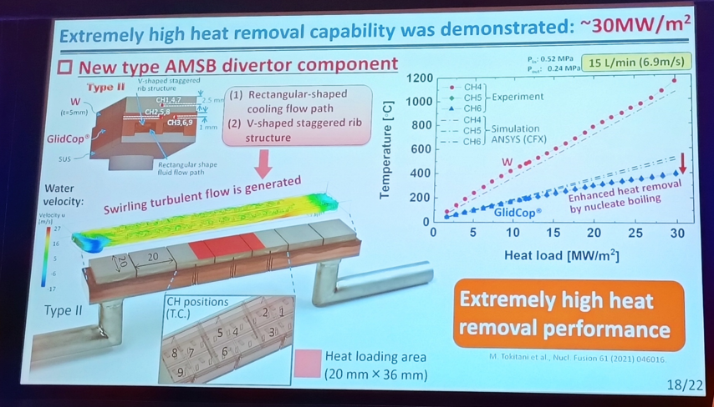
2.2 W-ACD -> Concept studied at QST
M. Tokitani, NIFS

Slide 17
2.2 W-ACD -> Flat tile enhanced concept
10-25 MW/m²
CuCrZr
T° = 81.5°C
V = 4 m/s
P = 33.5 bar
Proposed geometry is able to sustain 15 MW/m² in steady state ✓
The use of FEM is promising to define the most adapted W target hypervapotron geometry
Fluid behavior is particular-> need of modeling (EEG proposal from JSI)
Need of mock-up manufacturing/high heat flux testing (use of CuCrZr additive manufacturing³ for rapid manufacturing)
W
CuCrZr
CuCrZr
Experiment²
Thermal analysis (FEM)
2: F. Escourbiac et al, Fus. Eng. and Des., 2003
3. Salvan, 2021
Notes:
W-Target : W= 32 mm, 3 mm heat sink
For a tested geometry similar to the one needed for the W JT60SA target
Equivalent stress strain curve as for forged CuCrZr
The existing correlations for convected coefficient may be used if final geometry is the same as the one already tested

