Slide 1

Status of radiation transport in EIRENE
Ray Chandra
24 August 2023

Slide 2
Several outstanding issues with code runs and physics models currently investigated
N. Horsten et al.
Separatrix location → n_{e,sep,omp}
Fixing n_{e,sep,omp} vs fuelling/pumping
Impact of vibrationally resolved molecules (c.f., U. Fantz, JNM 2001)
Increase of I_{div} due to inclusion of Ly-a opacity (c.f., B. Lomanowski, PPCF 2020)
Transport of molecular ions
Necessary grid resolution for detached conditions
M. Groth, IAEA-TM CR Properties W & H, Vienna, Austria (2021)

Slide 3
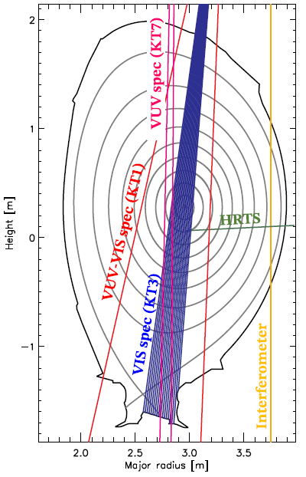
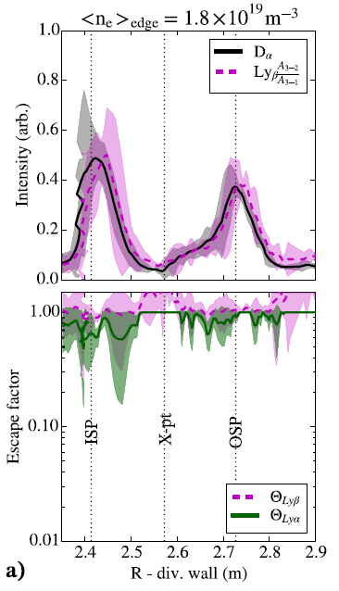
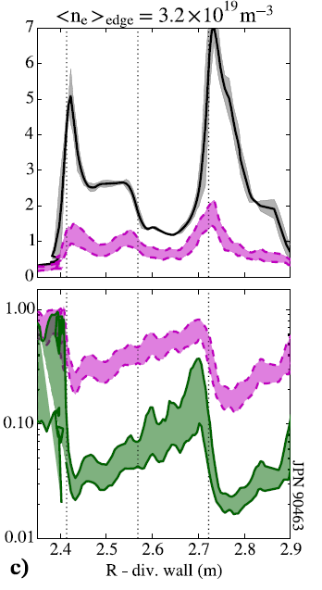
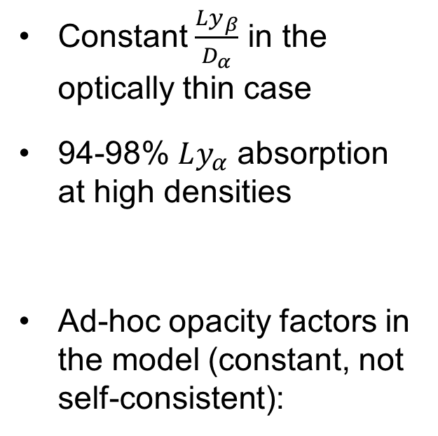
Ly-a opacity experimentally observed with KT1 in JET D L-mode
Constant $\frac{Ly_{β}}{D_{α}}$ in the optically thin case
94-98% $Ly_{α}$ absorption at high densities
Ad-hoc opacity factors in the model (constant, not self-consistent):
Photon transport using EIRENE!
B Lomanowski et al., Plasma Physics and Controlled Fusion 62, 6:065006 (2020)

Slide 4
Line radiation trapping in EIRENE by including Line photons as test-particles
Analog description → D. Reiter et al., Plasma Physics and Controlled Fusion 44, 8:1723–37 (2002)
Requirements:
  Photon sources – for line radiation, excited species of atoms
  Rate coefficients – spont. Emission, absorption: line shape
  Reflections – simple specular model
Result → line absorption tallies Q_{ext}

Slide 5
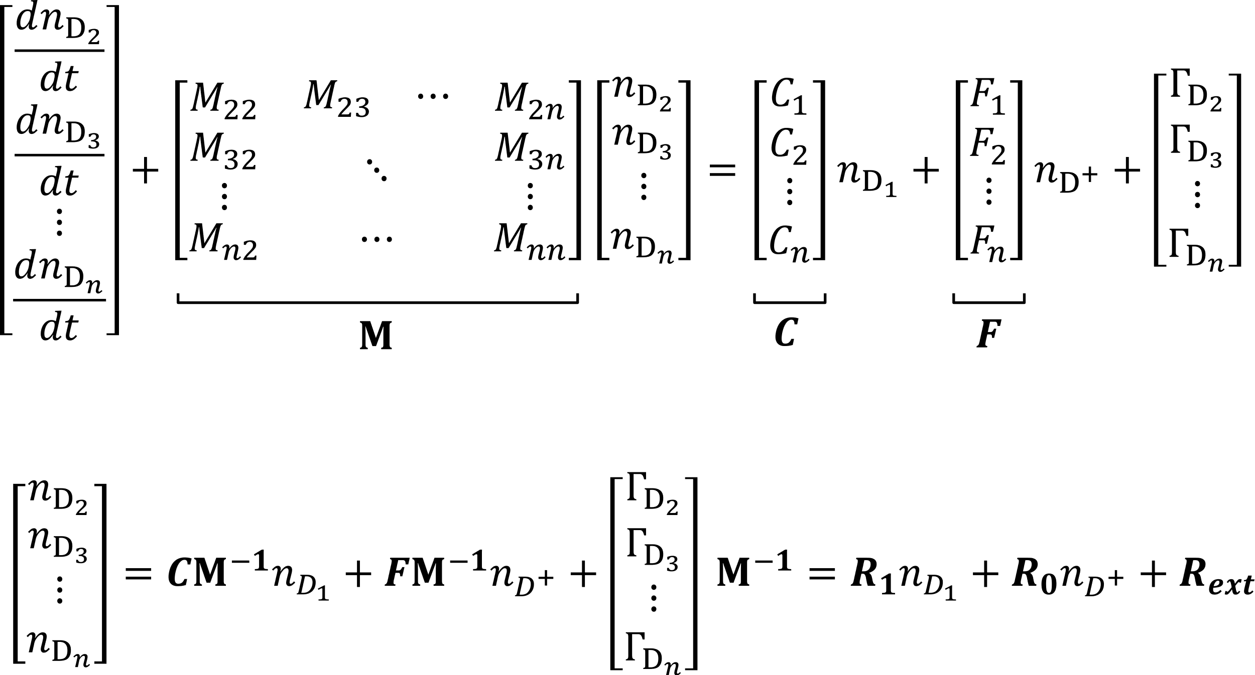
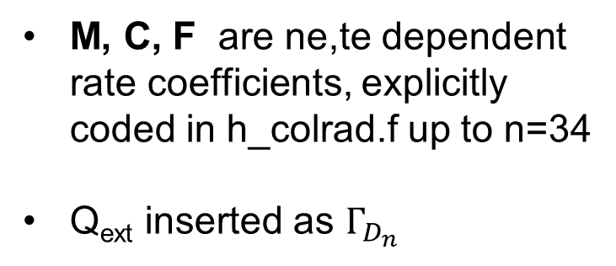
Solving the population of H excited states with collisional-radiative model within EIRENE – h_colrad.f
Based on K. Sawada et al., Journal of Applied Physics 78, 2913 (1995)
M, C, F are ne,te dependent rate coefficients, explicitly coded in h_colrad.f up to n=34
Q_{ext} inserted as $Γ_{D_{n}}$
In steady-state:

Slide 6


New plasma ionization balance and neutral H mfp from modified effective ionization rate coefficient, S_{eff}
$$S_{eff}=S_{1}+\sum_{n}{\left(C_{1,n}−R_{1,n}\left(F_{n,1}+\frac{A_{n,1}}{n_{e}}\right)\right)}+\sum_{n}{\left(Q_{ext,n}−R_{ext,n}\left(F_{n,1}+\frac{A_{n,1}}{n_{e}}\right)\right)}$$
‘Extra’ ionization contribution from photon re-absorption, S_{eff,ph}
S_{eff,cr} normally read from AMJUEL or ADAS files, in this case S_{eff} calculated internally

Slide 7
Individual test cases for photon tracing and h_colrad
Testing h_colrad:
EIRENE 2D grid with ne and Te varied along x and y dimensions
Ne, 20 points, ~1e8 – 1e16 cm3
Te, 200 points, ~0.5 – 1e4 eV
Testing photon tracing:
EIRENE 1D cylindrical grid with 20 radial points
Homogeneous T_{H} = 1 eV, n_{H} = 10¹⁴ cm⁻³ , R = 5 cm
Simulated Ly-a and Ly-b photons (2e6) with volumetric sources (H_{(n=2,3)} as bulk ions)
Line shape only doppler broadening

Slide 8
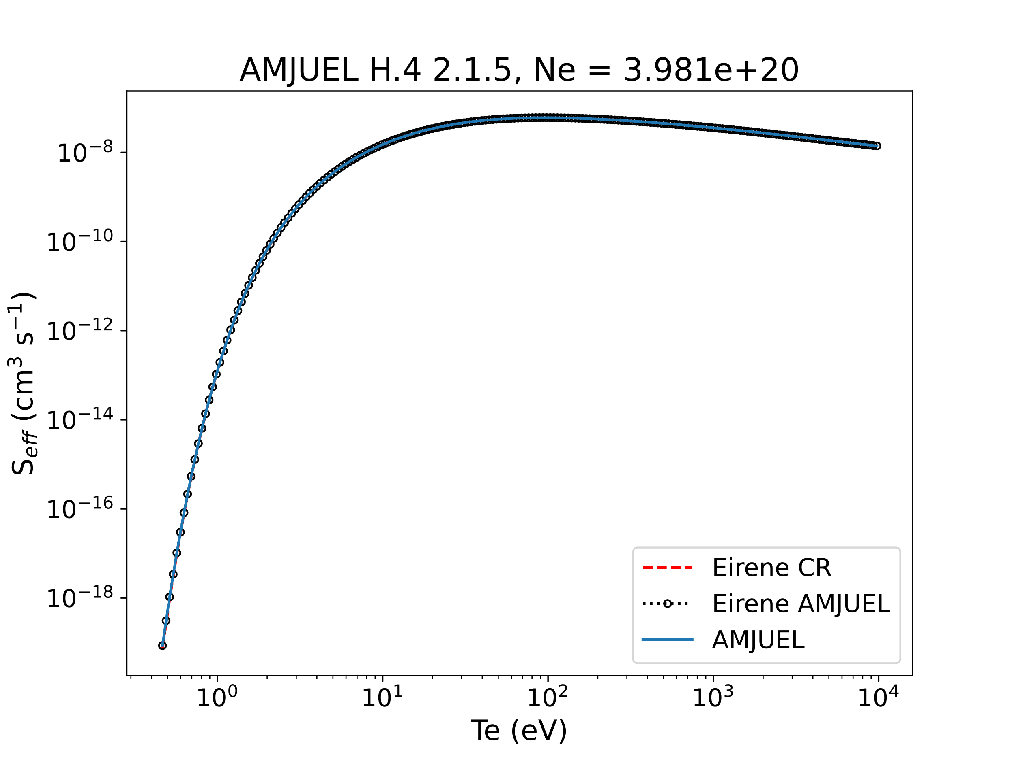
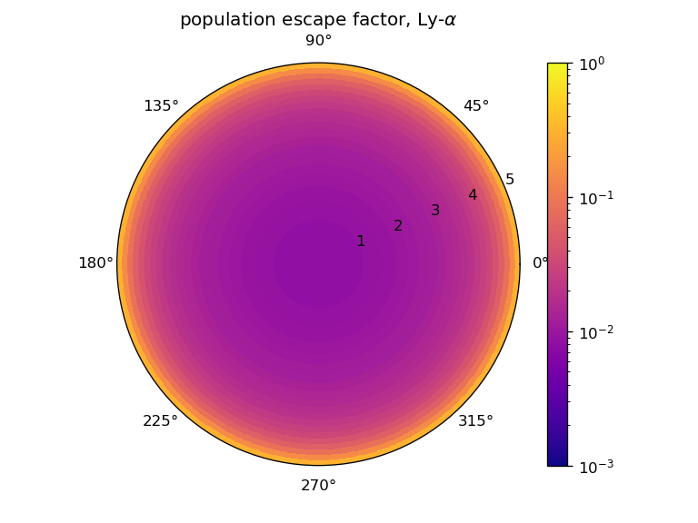
Individual test cases for photon tracing and h_colrad
Testing photon tracing:
Testing h_colrad:
TSVV-5 Code Camp 21-25 November 2022

Slide 9
Photon-gas coupling for self-consistent Q_{ext} → S_{eff} → n_{H}
EIRENE provides Q_{ext} to CRM, CRM provides S_{eff} and n_{D*} (photon sources) to EIRENE
First implementation in EIRENE version coupled to EDGE2D
(March 2023)

Slide 10
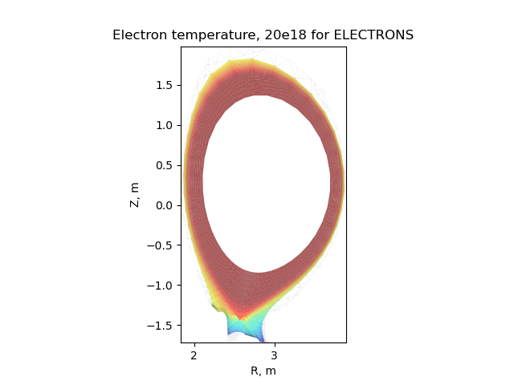
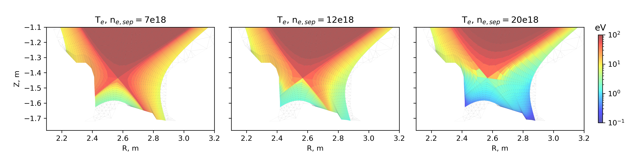
Radiation transport applied to static plasma solutions from JET81472 D+Be EDGE2D-Eirene runs¹
n_{e,sep} = 0.6e19 – 2.2e19
Ly-alpha and Ly-beta as test-particles
Shown for low-recycling, high-recycling and detached
(n_{e,sep} = 0.7e19, 1.2e19, 2.0e19)
¹M. Groth et al., Journal of Nuclear Materials 463 (August 2015): 471–76, https://doi.org/10.1016/j.jnucmat.2014.12.030.

Slide 11
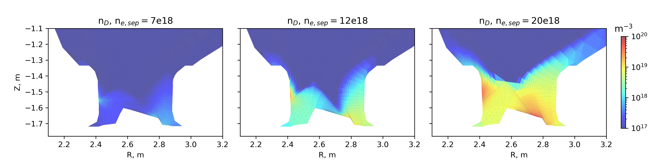
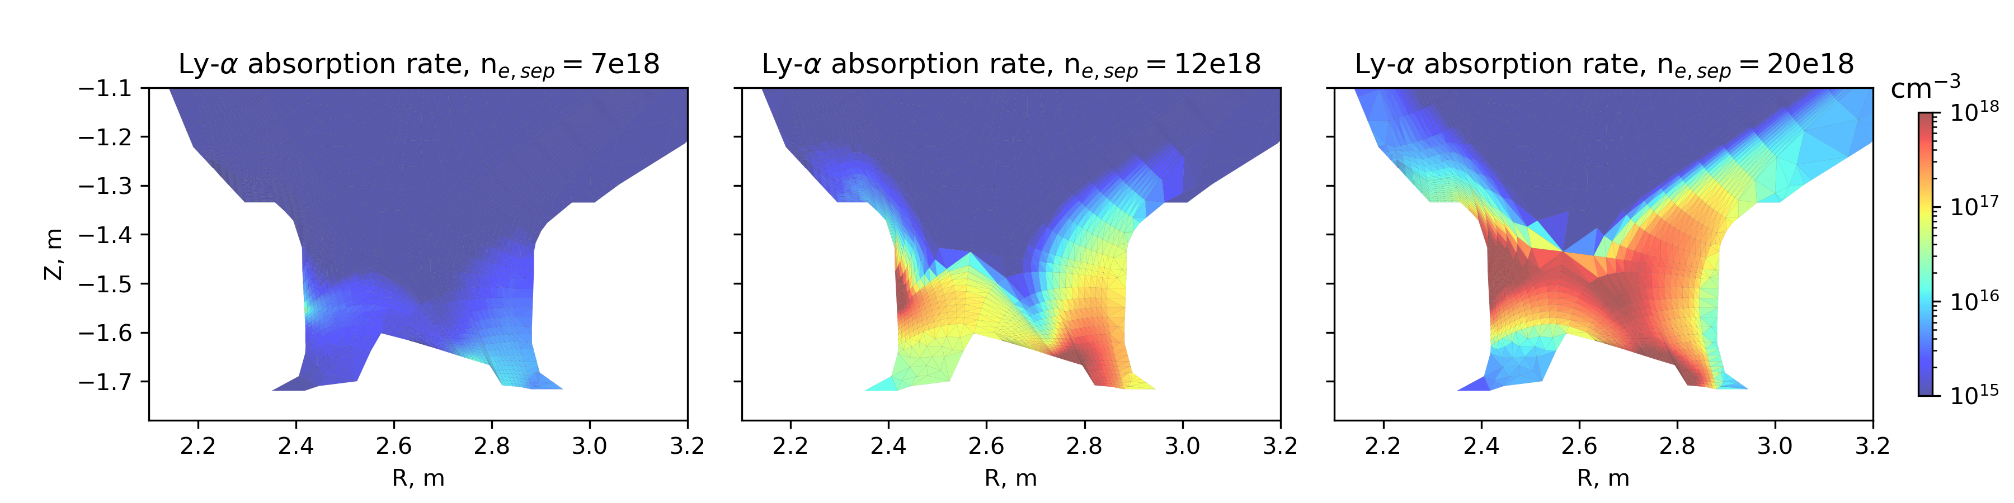
Expected high Ly-alpha absorption rate at high neutral D density
S⁻¹

Slide 12
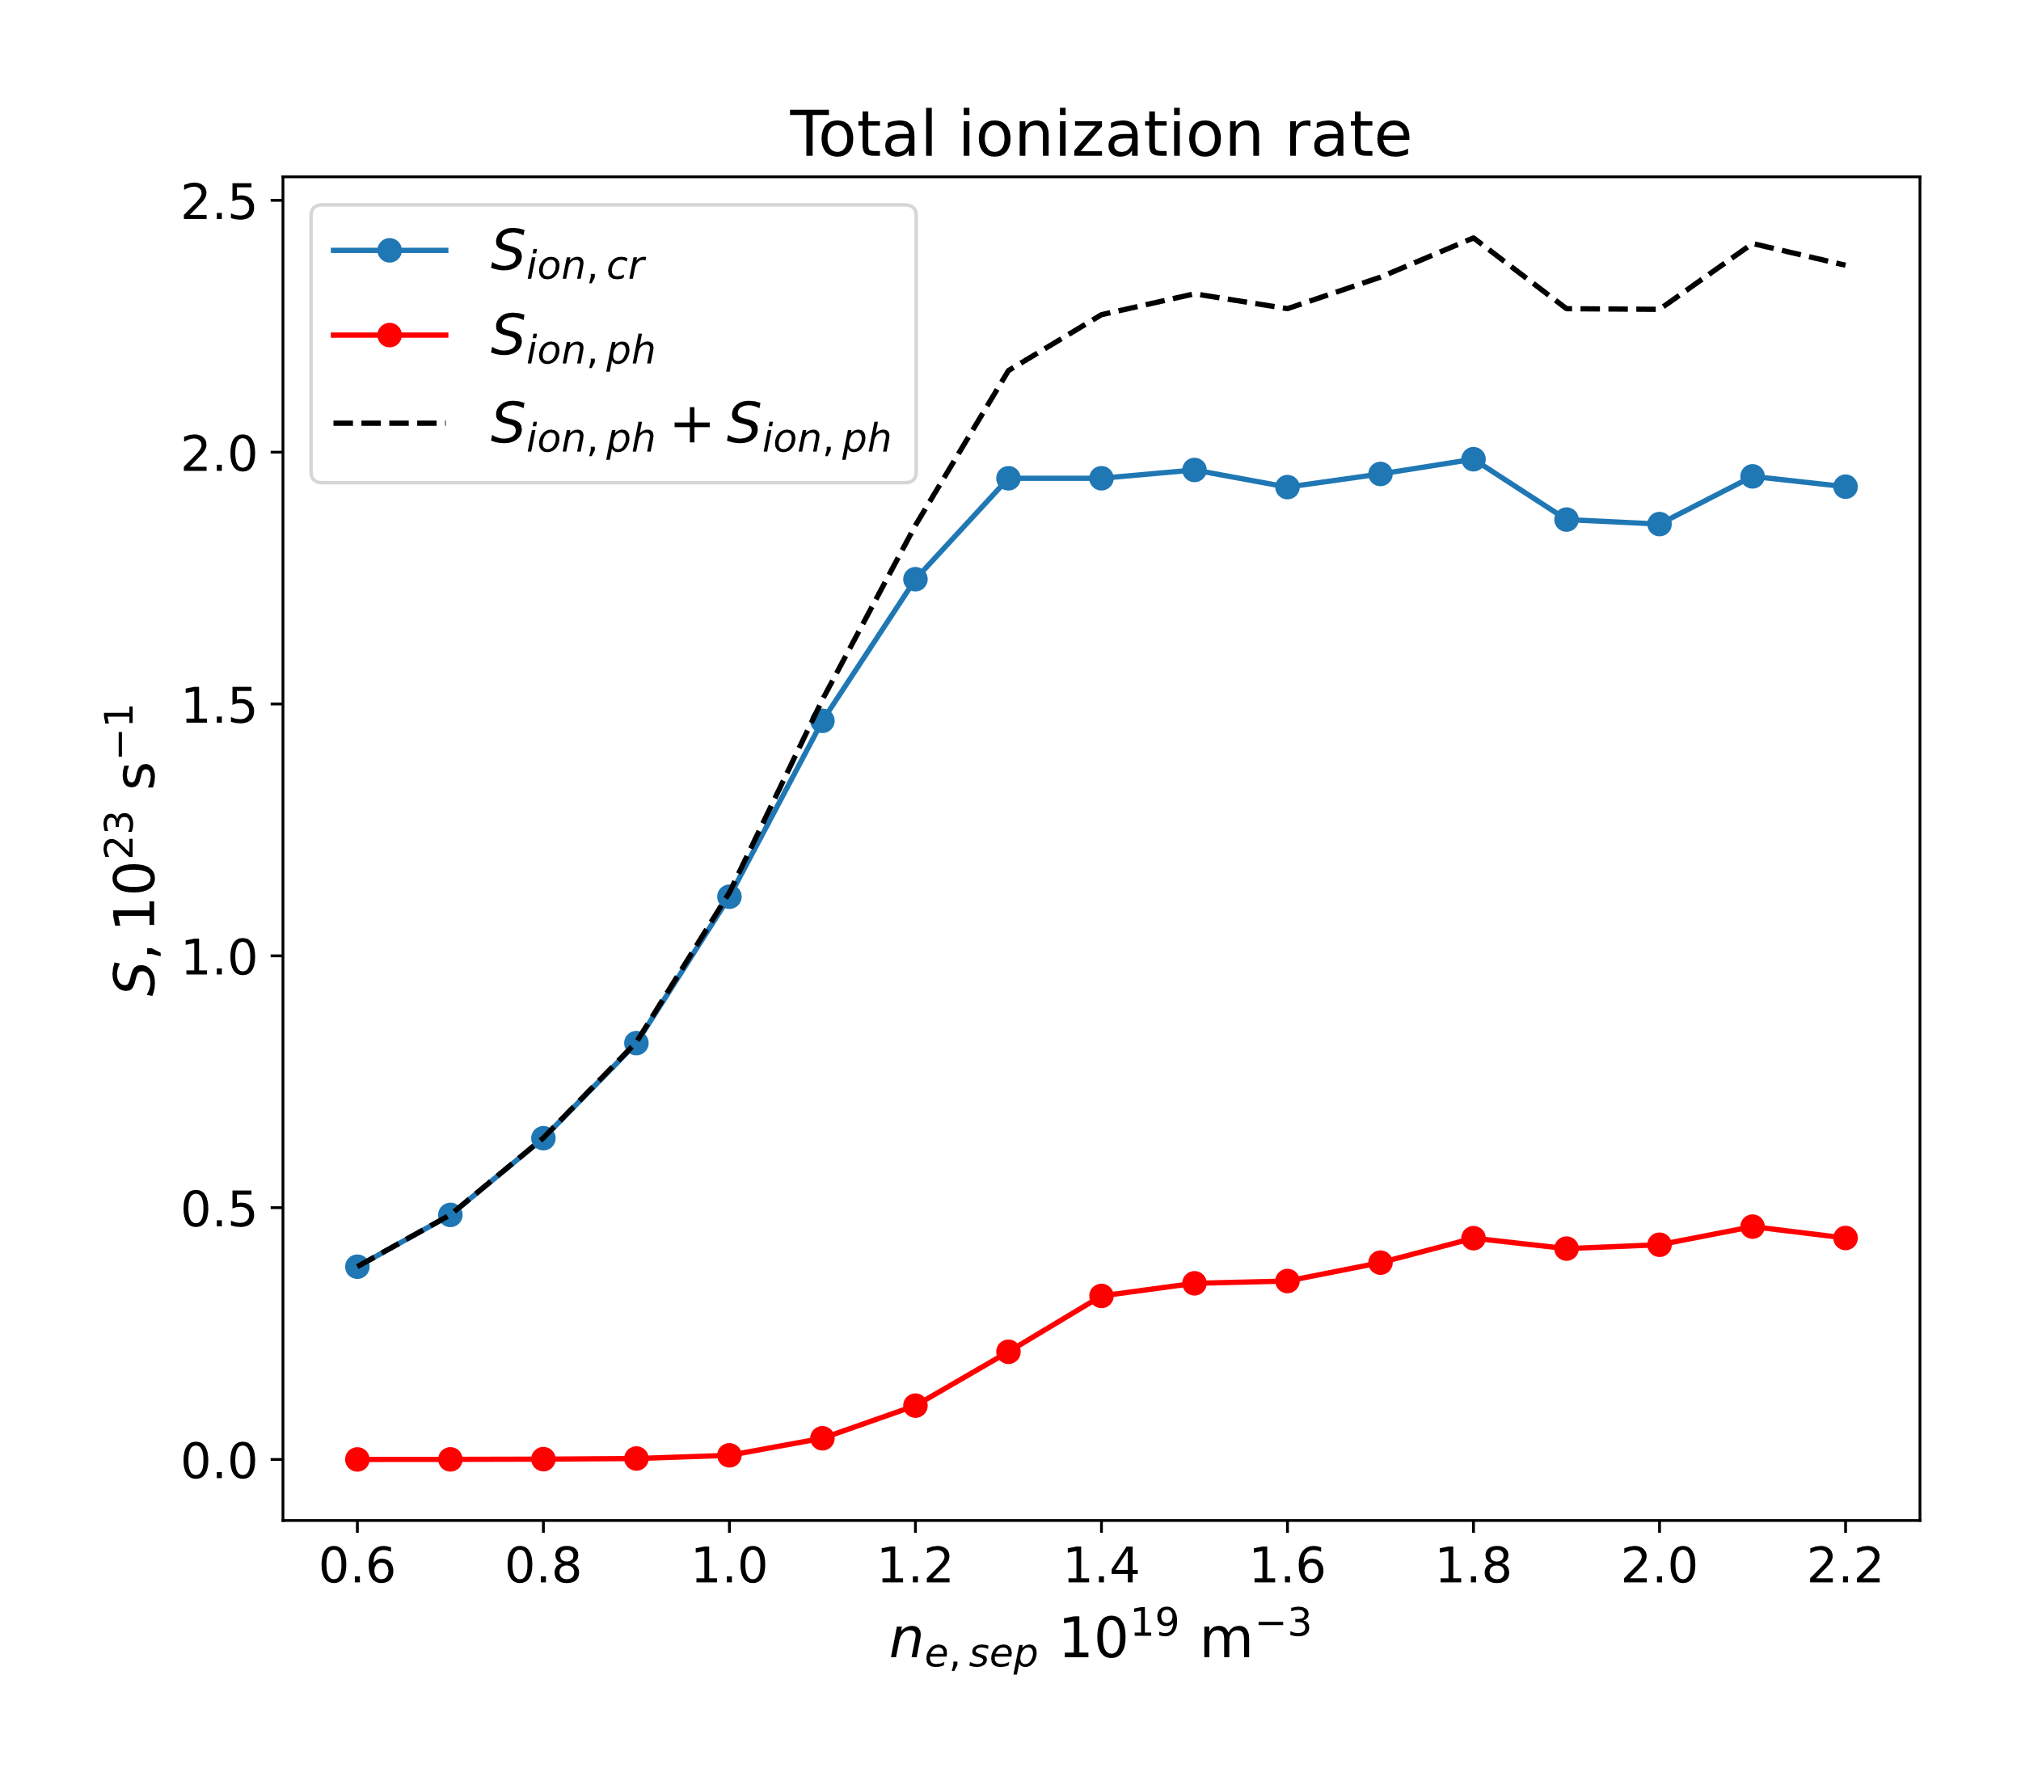
Photon absorption adds up to ~20% of total CR ionization rate in detached conditions
Ionization rate integrated over the whole plasma volume
No effect in low recycling regimes
EPS 2023 poster contribution
(July 2023)

Slide 13

Next: Photon-gas coupling module in SOLPS-ITER
Cherry-pick necessary components for photon-gas coupling from EDGE2D-EIRENE version into release/3.0.8
New branch in git.iter.org → feature/rchandra/photontrace
Testing standalone EIRENE
Status:
  Compilation in triton.aalto.fi
  h_colrad and photon tracing tests
  1 iteration run with static plasma (JET81472)
  Multiple iteration run

Slide 14
Next: similar study with static plasma solutions from SOLPS-ITER JET81472 D runs
Comparison with EDGE2D-EIRENE photon solutions
S_{eff} comparison with modified ADF11 accounting opacity (Lomanowski 2020)
Expanding h_colrad for H2 and H2+ contribution to H*
planned publication for EDGE2D-EIRENE and SOLPS-ITER photon simulation with static plasma (Q4 2023)

Slide 15
Next²: Plasma-photon-gas coupling
Plasma code
Self-consistent n_{e},T_{e} → new high-recycling, detached dynamics (hopefully better I_{div} prediction)
Connect with EIRENE input parallelization work (Yannick, next code camp?)

