Slide 1
TSVV Task 5: “Neutral Gas Dynamics in the Edge” 20.11.2023
EIRENE-NGM infrastructure - Status
D. Borodin et al.

Slide 2
TSVV-5: Neutral Gas Dynamics in the Edge
Main simulation tool:
EIRENE code (and EIRENE-CFD packages) http://www.eirene.de/
We aim to transform it to IM- and HPC-ready neutral gas module (EIRENE-NGM) suitable for simulations on ITER and DEMO scale with large focus on (semi)detached divertor plasmas
FP-9 deliverables:
Neutral gas code that allows for an efficient use of HPC resources (towards exascale systems and/or HPC booster techniques) through suitable parallelization methods.
Revised and extended physics basis for the neutral gas model. Further development of the underlying collision-radiative model towards the full vibrational resolution for all hydrogen isotopes and specific impurities for seeding.
Improved (in contents and structure) Atomic and Molecular database for volumetric and surface processes. Database access through generalized interfaces to, e.g., atomic, molecular, nuclear and surface (AMNS) physics data.
Interfaces and boundary conditions necessary for future applications; modularization of the neutral gas code to facilitate coupling to computation fluid dynamics (CFD) codes (2D or 3D codes, turbulence codes, time-dependent) and possibly also to gyro-kinetic/gyrofluid plasma codes.
Strategy towards a validated predictive capability for integrated fusion reactor modelling for (semi-)detached divertor plasmas. Liaison with TSVV Tasks 3 and 4.
Neutral gas code that allows for an efficient use of HPC resources (towards exascale systems and/or HPC booster techniques) through suitable parallelization methods.
Revised and extended physics basis for the neutral gas model. Further development of the underlying collision-radiative model towards the full vibrational resolution for all hydrogen isotopes and specific impurities for seeding.
Improved (in contents and structure) Atomic and Molecular database for volumetric and surface processes. Database access through generalized interfaces to, e.g., atomic, molecular, nuclear and surface (AMNS) physics data.
Interfaces and boundary conditions necessary for future applications; modularization of the neutral gas code to facilitate coupling to computation fluid dynamics (CFD) codes (2D or 3D codes, turbulence codes, time-dependent) and possibly also to gyro-kinetic/gyrofluid plasma codes.
Strategy towards a validated predictive capability for integrated fusion reactor modelling for (semi-)detached divertor plasmas. Liaison with TSVV Tasks 3 and 4.
Code performance, parallelization, refactoring, domain decomposition, I/O for HPC, …
Fluid-kinetic hybridisation (FKH) and improved CRMs
physics
Improved AMNS data, both in structure/physics and content
EIRENE as NGM – restructuring, interfaces to other codes, time-dependent runs, kinetic ions
Validation with experiments and test of predictive capabilities for ITER and DEMO

Slide 3
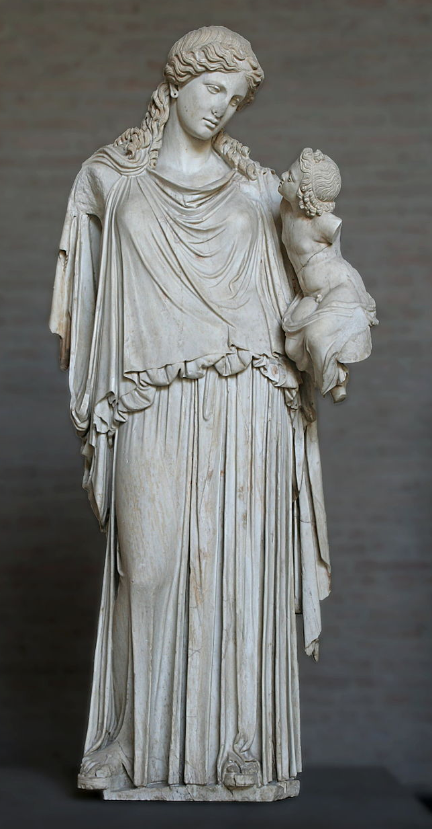
EIRENE-NGM-DEVELOPERS (TSVV-5)
D.V. BORODIN, F. Cianfrani, S. Wiesen, D. Harting, P.Börner, B.Küppers
Forschungszentrum Jülich, Institut für Energie- und Klimaforschung – Plasmaphysik, Germany
W. DEKEYSER, S. CARLI, M. BLOMMAERT, N. HORSTEN, W. VAN UYTVEN, M. BAELMANS
KU Leuven, Department of Mechanical Engineering, Belgium
B. MORTIER, G. SAMAEY, E. LOEVBACK (with ACH-MPG)
KU Leuven, Department of Computer Science, Belgium
Y. Marandet, P. Genesio
Aix-Marseille Univ., France
H. Bufferand
CEA, IRFM, France
E. WESTERHOF, J.G. MUNOZ, P.W. GROEN
DIFFER - Dutch Institute for Fundamental Energy Research,
Eindhoven, the Netherlands
M. GROTH, A. HOLM , A.CHanDRA
Department of Applied Physics, Aalto University,
Espoo, Finland
ACH-VTT:
O.LaPPI
F. Granberg J. Åström
ACH-IPPLM:
D.Yadykin
Yu.Yakovenko
ACH-MPG:
H.LEGGate
Eirene with the infant Ploutos
ITER Organisation:
X.Bonnin

Slide 4
Recent FKH Progress 2022/23 (KU Leuven)
The fluid, (SpH) hybrid and kinetic neutral models were validated with a realistic JET ILW L-mode plasmas cases [2]
This not a slab, but a realistic tokamak configuration, incl. voids, molecules, …
Large fluid-kinetic discrepancies at low density (factor 2), but smaller discrepancies at higher density (50%)
Fluid-kinetic discrepancies in both density regimes successfully corrected by hybrid approach
Drift and n-n effects are successfully introduced
ITER W/Be case with/without drifts – AFN/kinetic
More work on algorithmic differentiation - AD (TAPENADE) is actively ongoing in 2023
Alternative hybrid approach that avoids cancellation errors by construction under development. Hilbert expansion based fluid model derived; both diffusive & hydrodynamic scaling investigated
Release of fluid and hybrid approaches in extended grids version of SOLPS-ITER to the community during dedicated workshop hosted in KU Leuven, November 2022
➔ FKH is also contributed from CEA/AMU with parallelisation for CRMs, “condensation/evaporation”, links to SOLEDGE and TSVV-3 etc.

Slide 5
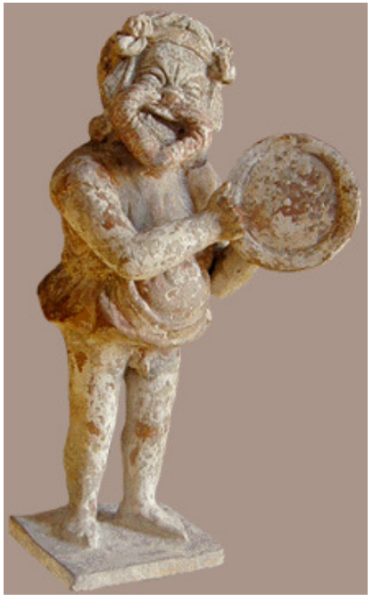
General code development of EIRENE
Main goals and decisions:
Segregating EIRENE into “starter” and a compact, free of most branching “numeric core” ➔ Optimisation for HPC, transparency and ease of use.
Unloading the main loop from branching agreed
Abstractisation of the cell type (removing “geometry” branching)
Abstractisation of A&M reactions + tracking of internal states
Version merging scope agreed including synchronisation with SOLPS-ITER
Uniform coding style (e.g. variable name conventions, use of OOP, etc.)
With support from the ACHs (Advanced Computing Hubs)
EIRENE “toy model” – EIRON and profiling of EIRENE
➔ Test of parallelisation schemes incl. domain decomposition options
➔ Can be used for other purposes e.g. optimisation of ML-KDMC
EUDAT-based simulation catalogue
Portfolio of simulation cases
IMASification of the simulation grid (GGD objects) in close contact with
ITER (X.Bonnin) and utilizing the positive SOLPS-ITER experience
Eiron
Eirene

Slide 6
Code development – version merging
The main focus with regard to development of the EIRENE code in 2022 was on reuniting the various diverging versions of the code used in FZJ and at ITER.
Roughly 20 different code versions have been analysed and merged together. Thereby taking advantage of developments provided by FZJ external developers.
These developments include
Charge state bundling
Parallelization of the code using shared memory techniques (OpenMP)
Extensions of the existing parallelization of the code with message passing techniques (MPI) by implementation of different parallelization schemes.
Introduction of radiation tallies
Implementation of species resolved volume averaged tallies and their use with species specific rescaling of calculation results in order to improve the particle balances.

Slide 7
Code development - priorities
Initially version-specific code has been generalized in a way it can be used by all the interested parties (RU or specific architecture related code removed).
All changes to the code are carefully tested (still ongoing!..).
Code modifications affecting simulation results were tracked down to their origin and the reasonability investigated.
Updated reference outputs are provided for the testcases in the continuous integration chain (CI).
We are approaching the 1st milestone version (MsV) release of the code, which should be a basis for further joint development also with ITER

Slide 8
EIRENE licencing - User Agreement (UA)
Old UA
acknowledgement of FZJ origin of EIRENE, non-military use, non-commercial use, no cost/liability for FZJ, etc.
www.eirene.de/EPL
New UA “EPL (EIRENE public license)”
Based on copyleft licence (however GPL3.0 occurs to be not suitable).
Similar declarative statements as in the old UA.
More clear statement about the EIRENE-based publications.
Developers and users are divided into “basic” and “associated” ones (AD).
NEW: commercial use of executable for any AD group.
➔ ADs get more rights on decision-making, direct access to the repository, etc.
ADs must keep to the “Developer Code of Conduct” (see at INDICO).
Current status: License is ready and being in a process of exception

Slide 9
EIRENE licencing – acceptance status
We have a about 40 BDs activated (10 ADs of “JuelichOrigin”). Noteworthy not all of TSVV-5 members…
7 organisations have submitted the B2 form (simplifying licence obtaining for all own employers).
Few more organisation are considering to join, or have done it via “A1” individual forms.
ITER organization is still in consideration of the EPL.
Website infrastructure and auto e-mail are relatively mature now.
Number | Organisation
1 | Forschungszentrum Juelich GmbH, IEK-4
2 | CEA/CADARACHE - IRFM: Commissariat a l'energie atomique et aux energies alternatives
3 | Tokamak Energy Ltd
4 | Institute of Plasma Physics, Chinese Academy of Sciences (ASIPP), Hefei
5 | W7-X Division, Max Planck Institute for Plasma Physics
6 | Princeton Plasma Physics Laboratory (PPPL)
7 | Institute of Plasma Physics of the Czech Academy of Sciences

Slide 10
Summary: TSVV-5 progress and plans
Physics
Fluid-kinetic hybridisation (FKH) development successfully continues
A&M CRM extension and refinement (large focus on standalone so far…)
Establishing simulation cases (validation, ITER, DEMO) – in progress
Code development
Parallelisation: OpenMP-MPI hybrid (related code refactoring done; EIRON “toy”-model allows testing CPU loading and domain decomposition approaches)
Code streamlining (Segregation of the numeric core, etc.) – concepted
Merging all existing versions into first milestone one (MsV) – 99% complete
Improved I/O (JSON/HDF5), visualisation, IMASification, etc. – in progress
Organisational items
Repository for simulations (EUDAT?..) – TSVV side is clear, waiting for ACH support. Looks like SimDB is the best way to go.
New EIRENE license, “infectious open source”, flexible for later updates - available at www.Eirene.de/EPL, accepting ongoing
Regular VCs and annual Code Camps – next agreed NOV 2023
Requires communication with other TSVVs
Requires ACH support

Slide 11
TSVV-5: IMS WP for 2024 (“description”)
Provide interfaces including the basic framework compatible with IMAS. Demonstrate the resulting HPC performance of SOLPS-ITER (at least matching the one before the development inside the TSVV) and other packages utilizing the EIRENE-NGM including the impact of the interfaces.
Continue coding and theory work
to generalize all FKH options; provide performance analysis and UQ allowing to choose the optimal method or their combination;
to continue restructuration, refinement and extension of the data for CRMs to provide H/D/T isotope effect
Provide rovibrational temperature as parameter and opacity (photon tracing) in the CRMs.
Fix the EIRENE (and CFD-EIRENE) AMNS data formats (it should already be moved to the IMAS platform and ITER SimDB). Provide unification of the database, where possible, with the codes utilized in the related codes from other TSVVs. Check and update the older (e.g. outdated TRIM) data. ACH D support is expected.
Perform validation runs for MAGNUM-PSI and JET-ILW (optionally also for AUG and other devices) with necessary parameter studies for UQ, use the experimental material to prove feasibility of the models and underlying data. Continue testing EIRENE with related ITER and DEMO cases.
Continue with EIRENE general structure and performance improvement. Use the EIRON-based experience.

Slide 12
TSVV-5: IMS WP for 2024 (“deliverables”)
Document CFD-EIRENE interfaces including the basic framework compatible with IMAS. Report on the resulting HPC performance of SOLPS-ITER and other packages utilizing the EIRENE-NGM including the impact of the interfaces.
Report on FKH and CRM development progress; provide necessary documentation.
Together with other involved TSVVs, ITER and ACH D provide a report on the data unification (e.g. IMASification of AMNS). Demonstrate the integration into ITER SimDB.
Report on validation of the code at existing devices (e.g. JET-ILW, TCV) including UQ (providing AD for EIRENE extending the fluid neutral experience), consider UQ or error analysis for ITER and EU-DEMO. A scientific overview paper on this topic is expected as well.
Report on the EIRENE general structure and performance improvement also document the EIRON “toy-model” development and using experience.

Slide 13
Focuses for the current Code Camp - 2023
CRMs development in EIRENE and/or related
➔ ColRad, Ploutos, ModCR, external: YACORA, IAEA
Interfaces to other codes, unification of data, data formats
Fixing the MsV, code refactoring and restyling, documentation
Code performance (MPI-OpenMP hybrid, EIRON, profiling, …)
Establishing practices
Evaluating and correcting future plans up to the end of TSVV-5 in 205
Validation and UQ, also in relation with FKH
“Standard” simulation cases (validation, ITER/DEMO, etc)
Defining coding style and practices (DCoC, simulation repository, Licence, “JuelichOrigin” AD, …)

Slide 14
Thanks for the attention!

Slide 15
TSVV-5: IMS WP for 2021
A dedicated event similar to a code camp for a short circle of the involved developers is necessary to start over with the code leaning. The concerting including selection of particular coding techniques, code reorganization schemes etc will begin already by the preparation of this event and will continue after it with application to a single case to be selected.
The structured list of the "portfolio" cases is already developed as a draft to be reviewed and finalized by the task members during the year. We expect the ACH D to provide assistance in organising the commonly accessible and linkable to HPC resources catalogue of the simulations (e.g. EUDAT-based).
The FEM FW model should be coded and tested by first application to a selected MAGNUM-PSI experiment.
Also establishing the work on the CRM improvement and FKH is expected: definition of the related simulation cases, incorporating new data formats and parameters for CRMs, agreeing on “test bed” cases for FKH approaches etc. This needs status review at regular task meetings.
Assessment of fundamental data (cross-sections and rates) in AMJUEL (AMJUEL, HYDHEL, H2VIBR) against fundamental data used by and derived from other CRMs (e.g., YACORA) using slab models will take place. Development/exploitation of CRM post-processing tools for comparison to JET and MAGNUM-PSI experimental data (e.g., Fulcher band measurements). Assessment of availability of fundamental data for hydrogen isotopes and compare cross-sections and rates.
Code Camp 2021
TSVV-5 requirements and focus group are clear . . .
Ploutos web-based tool

Slide 16
TSVV-5: IMS WP for 2022
Theory/algorithmic development work on FKH combined with application to verification (mostly slab) cases: generalization AFN model for drifts and n-n collisions; Overview and assessment of techniques to reduce bias, cancellation and modelling errors; etc.
Coding and data management effort on CRMs: new molecular data formats (e.g. ADAS “mdf”) and recent RMPS or CCC data including for various H/D/T isotopes; move on using the IMAS; compile ITER/DEMO-relevant data. A contact with data providing groups for instance through the framework provided by the IAEA A&M data unit (GNAMPP).
Code reorganisation: test correctness of the “starter-core” modular EIRENE-NGM version for various geometries. Continue applying the modulated version to further CI and “portfolio” cases, provide necessary bug fixes and code generalisations.
Start over with HPC-related optimisation for the core (load balancing schemes, domain decomposition etc). Some ACH support is expected in particular for HPC code-performance optimisation.
Execute SOLPS-ITER with vibrationally excited hydrogen molecules for and assess their impact on the state of the divertor plasma (JET L-mode). Assess impact of hydrogen isotopes on state of divertor plasma. Utilise CRM post-processors to predict spectroscopic signature of molecules (Fulcher band), for hydrogen, deuterium and tritium.
Assess state of photon tracing model in current EIRENE version, reactivate photon tracing model in standalone EIRENE simulations, execute simple test runs (slab) and actual tokamak geometries (JET).
Goals redefined
EIRON
toy-model

Slide 17
TSVV-5: IMS WP for 2023 (still ongoing!..)
Begin with development of the universal framework for the CFD-EIRENE and other interfaces (e.g. with codes inside TSVV-3, 4, 7). Demonstrate workable schemes on particular examples.
Provide adjoint (AD) approach in Eirene through interfacing with Tapenade in for-/back- ward AD mode. Assess bottlenecks for use of AD with EIRENE, focusing on the context of SOLPS-ITER.
Demonstrate time-dependent simulations for the new modular code including the new features (FKH, CRMs). Consider algorithmic improvements (including theory work if needed) to optimise the performance for the time-dependent runs.
Apply modular EIRENE-NGM with the new version FEM for the FW to MAGNUM-PSI: simulate MAGMUM-PSI plasmas with various degree of detachment as independent snap shots. Validate those with spectroscopy and other diagnostics. Assess performance and other requirements for related time-dependent runs.
Setbacks due to COVID, colleagues missing or changing field etc. Some items were reached later than initially planned.
EIRON, PLOUTOS, Code Camps, MsV, established work with ACHs and ITER, EPL, new www.Eirene.de, joining with IAEA GNAMPP,….

