Slide 1

Status of radiation transport in EIRENE
Ray Chandra
20 November 2023

Slide 2
Several outstanding issues with code runs and physics models currently investigated
N. Horsten et al.
Separatrix location → n_{e,sep,omp}
Fixing n_{e,sep,omp} vs fuelling/pumping
Impact of vibrationally resolved molecules (c.f., U. Fantz, JNM 2001)
Increase of I_{div} due to inclusion of Ly-a opacity (c.f., B. Lomanowski, PPCF 2020)
Transport of molecular ions
Necessary grid resolution for detached conditions
M. Groth, IAEA-TM CR Properties W & H, Vienna, Austria (2021)

Slide 3
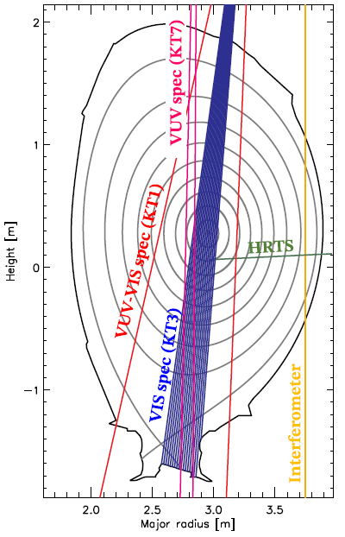
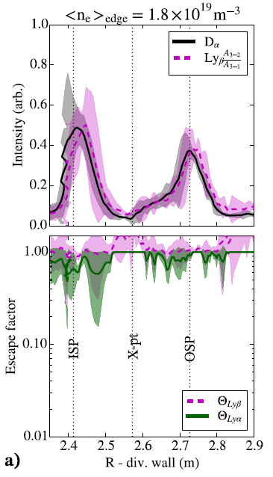
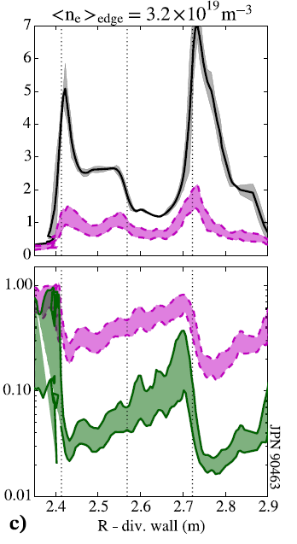
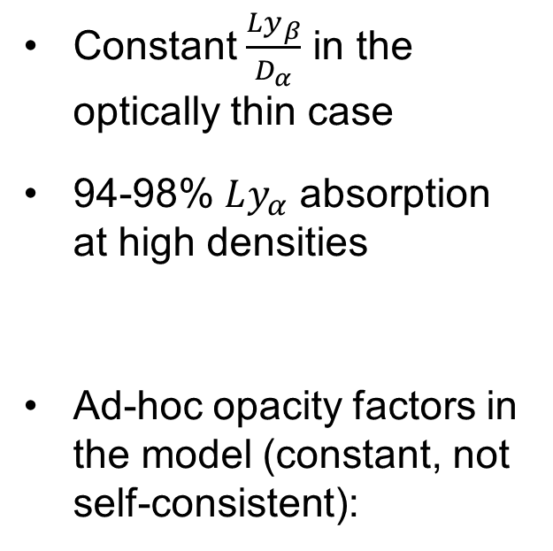
Ly-a opacity experimentally observed with KT1 in JET D L-mode
Constant $\frac{Ly_{β}}{D_{α}}$ in the optically thin case
94-98% $Ly_{α}$ absorption at high densities
Ad-hoc opacity factors in the model (constant, not self-consistent):
Photon transport using EIRENE!
B Lomanowski et al., Plasma Physics and Controlled Fusion 62, 6:065006 (2020)

Slide 4
Line radiation trapping in EIRENE by including Line photons as test-particles
Analog description → D. Reiter et al., Plasma Physics and Controlled Fusion 44, 8:1723–37 (2002)
Requirements:
  Photon sources – for line radiation, excited species of atoms
  Rate coefficients – spont. Emission, absorption: line shape
  Reflections – simple specular model
Result → line absorption tallies Q_{ext}

Slide 5
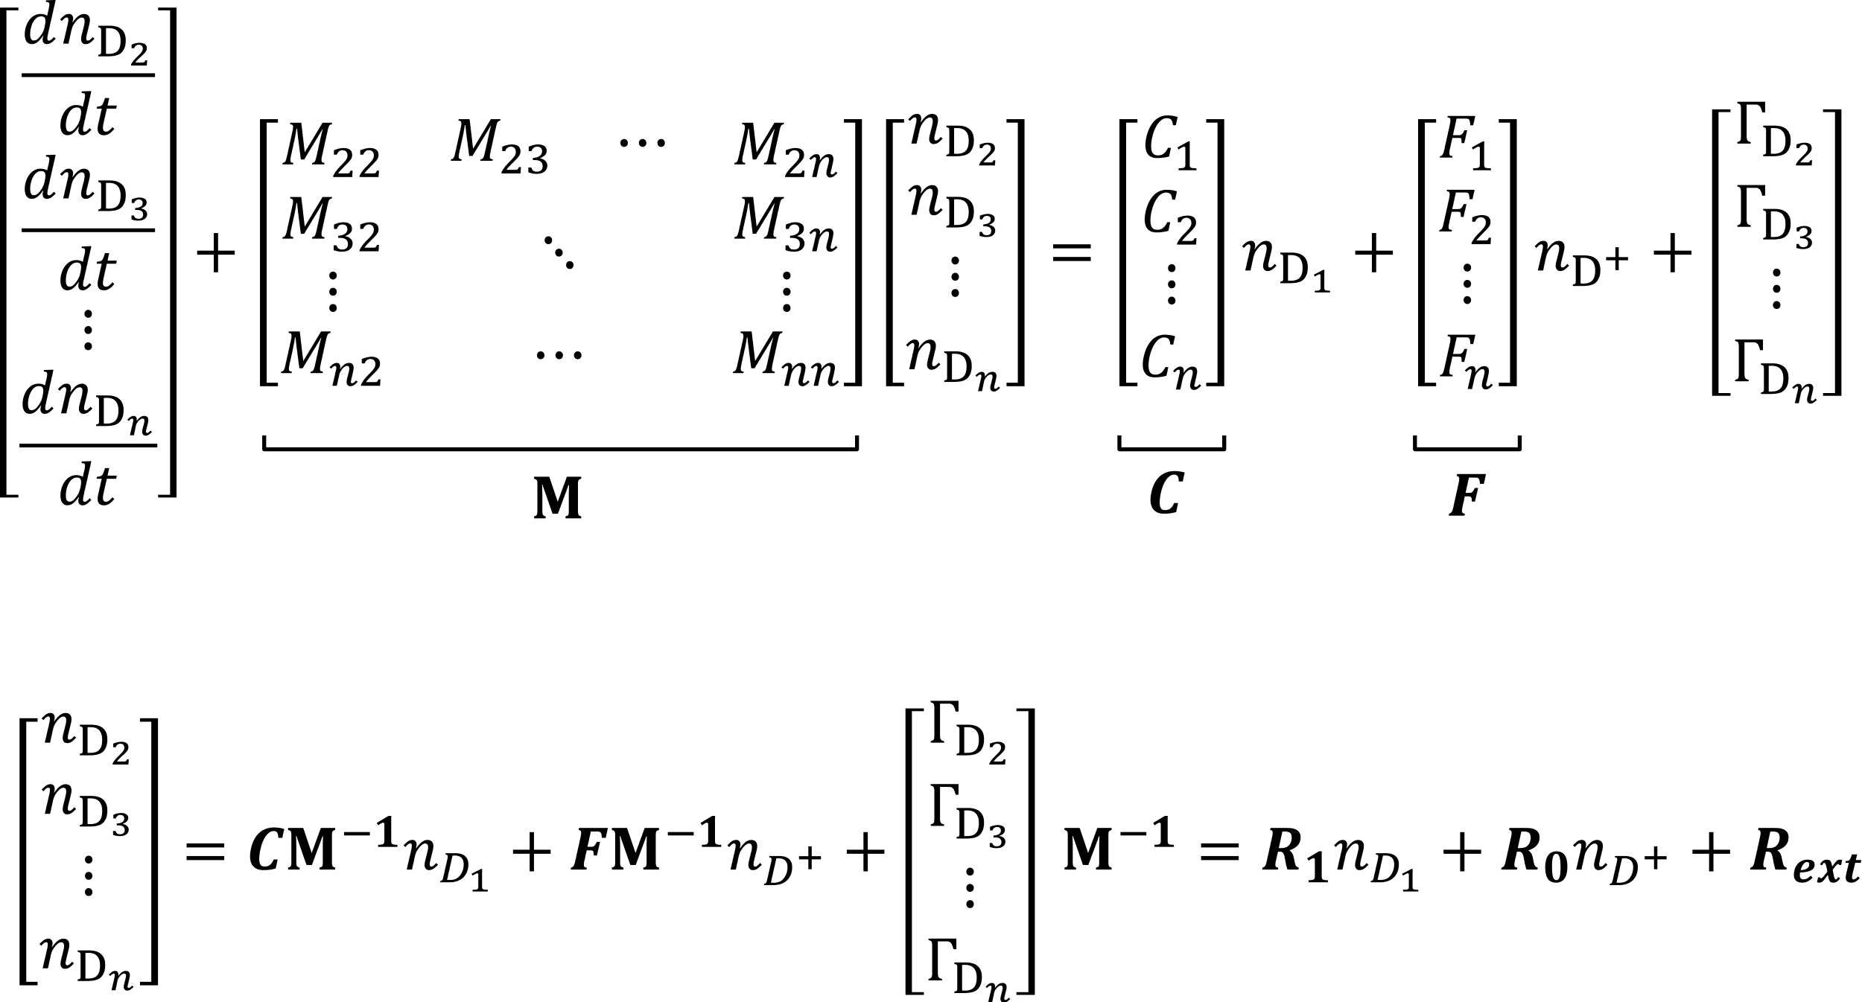
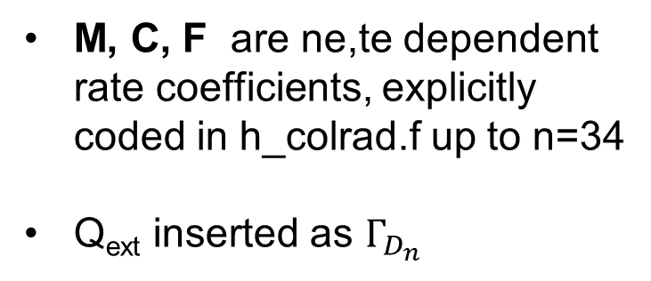
Solving the population of H excited states with collisional-radiative model within EIRENE – h_colrad.f
Based on K. Sawada et al., Journal of Applied Physics 78, 2913 (1995)
M, C, F are ne,te dependent rate coefficients, explicitly coded in h_colrad.f up to n=34
Q_{ext} inserted as $Γ_{D_{n}}$
In steady-state:

Slide 6


New plasma ionization balance and neutral H mfp from modified effective ionization rate coefficient, S_{eff}
$$S_{eff}=S_{1}+\sum_{n}{\left(C_{1,n}−R_{1,n}\left(F_{n,1}+\frac{A_{n,1}}{n_{e}}\right)\right)}+\sum_{n}{\left(Q_{ext,n}−R_{ext,n}\left(F_{n,1}+\frac{A_{n,1}}{n_{e}}\right)\right)}$$
‘Extra’ ionization contribution from photon re-absorption, S_{eff,ph}
S_{eff,cr} normally read from AMJUEL or ADAS files, in this case S_{eff} calculated internally

Slide 7
Individual test cases for photon tracing and h_colrad
Testing h_colrad:
EIRENE 2D grid with ne and Te varied along x and y dimensions
Ne, 20 points, ~1e8 – 1e16 cm3
Te, 200 points, ~0.5 – 1e4 eV
Testing photon tracing:
EIRENE 1D cylindrical grid with 20 radial points
Homogeneous T_{H} = 1 eV, n_{H} = 10¹⁴ cm⁻³ , R = 5 cm
Simulated Ly-a and Ly-b photons (2e6) with volumetric sources (H_{(n=2,3)} as bulk ions)
Line shape only doppler broadening

Slide 8
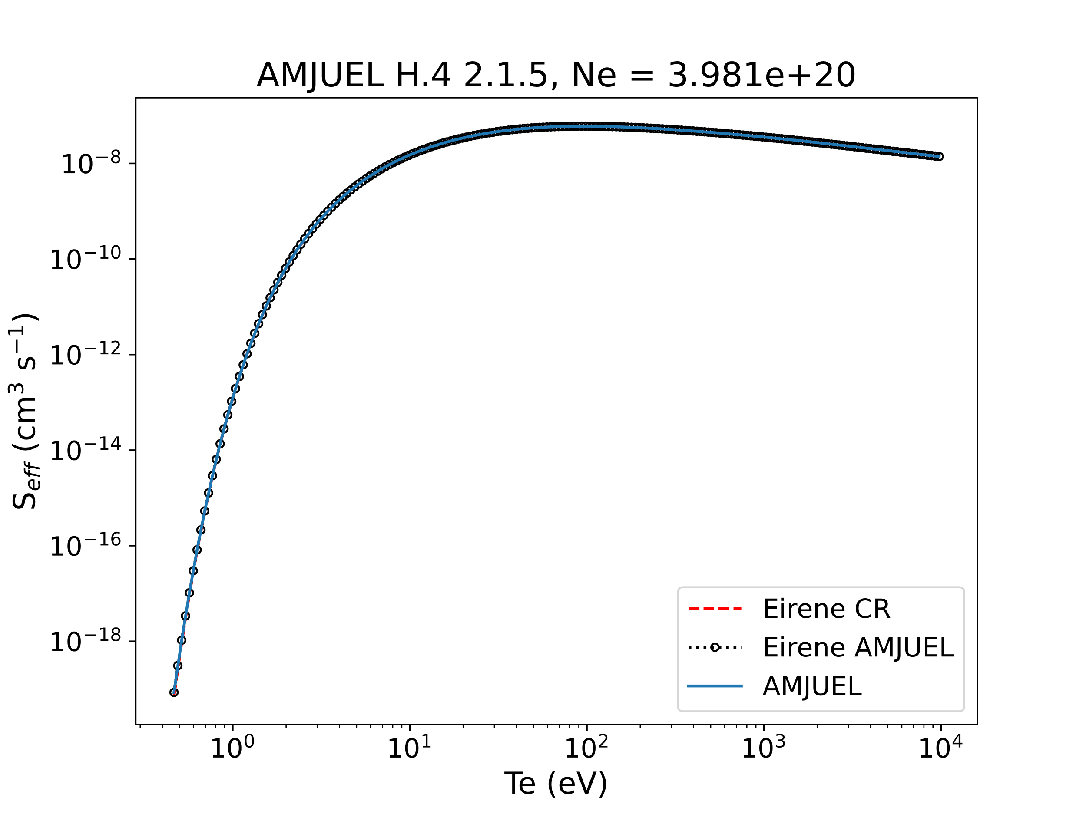
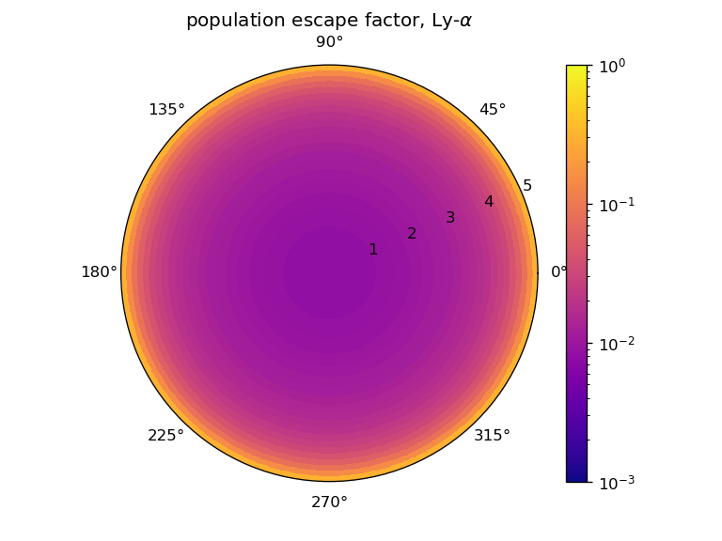
Individual test cases for photon tracing and h_colrad
Testing photon tracing:
Testing h_colrad:
TSVV-5 Code Camp 21-25 November 2022

Slide 9
Photon-gas coupling for self-consistent Q_{ext} → S_{eff} → n_{H}
EIRENE provides Q_{ext} to CRM, CRM provides S_{eff} and n_{D*} (photon sources) to EIRENE
First implementation in EIRENE version coupled to EDGE2D
(March 2023)

Slide 10
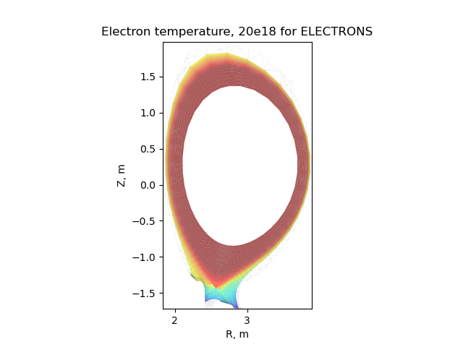
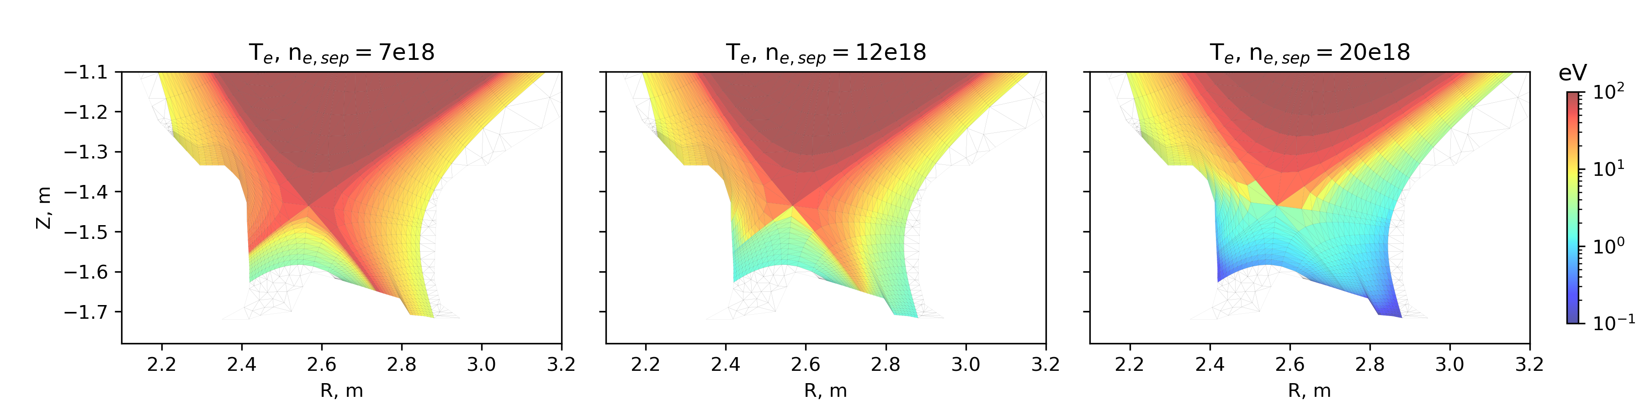
Radiation transport applied to static plasma solutions from JET81472 D+Be EDGE2D-Eirene runs¹
n_{e,sep} = 0.6e19 – 2.2e19
Ly-alpha and Ly-beta as test-particles
Shown for low-recycling, high-recycling and detached
(n_{e,sep} = 0.7e19, 1.2e19, 2.0e19)
¹M. Groth et al., Journal of Nuclear Materials 463 (August 2015): 471–76, https://doi.org/10.1016/j.jnucmat.2014.12.030.

Slide 11
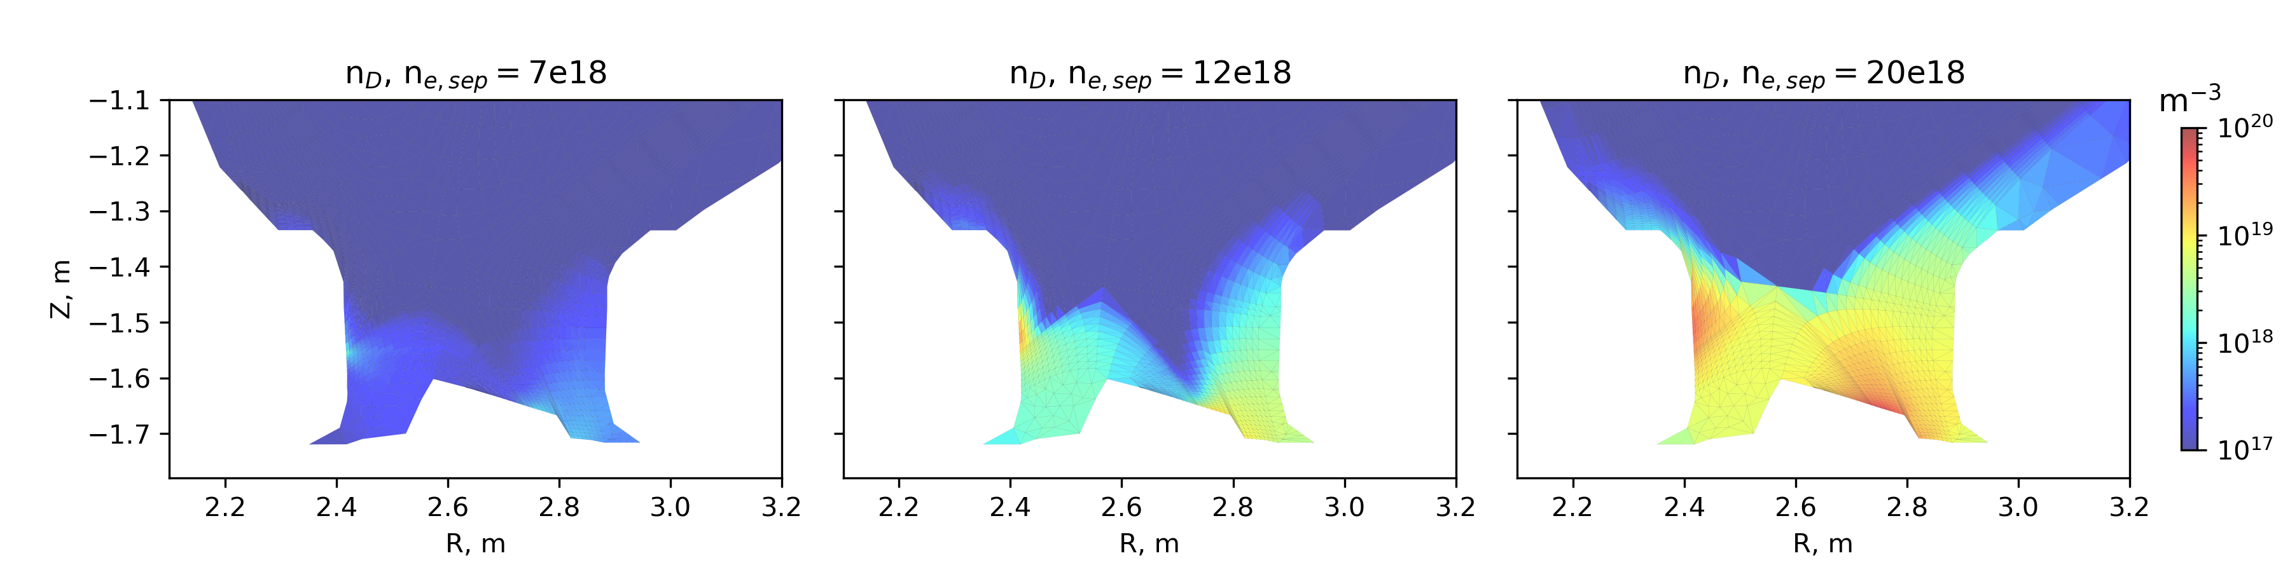
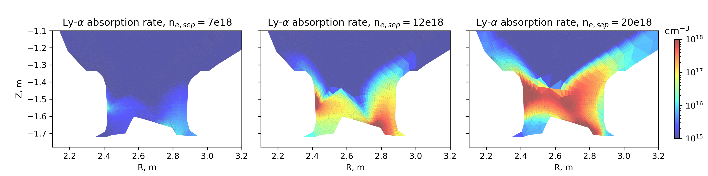
Expected high Ly-alpha absorption rate at high neutral D density
S⁻¹

Slide 12
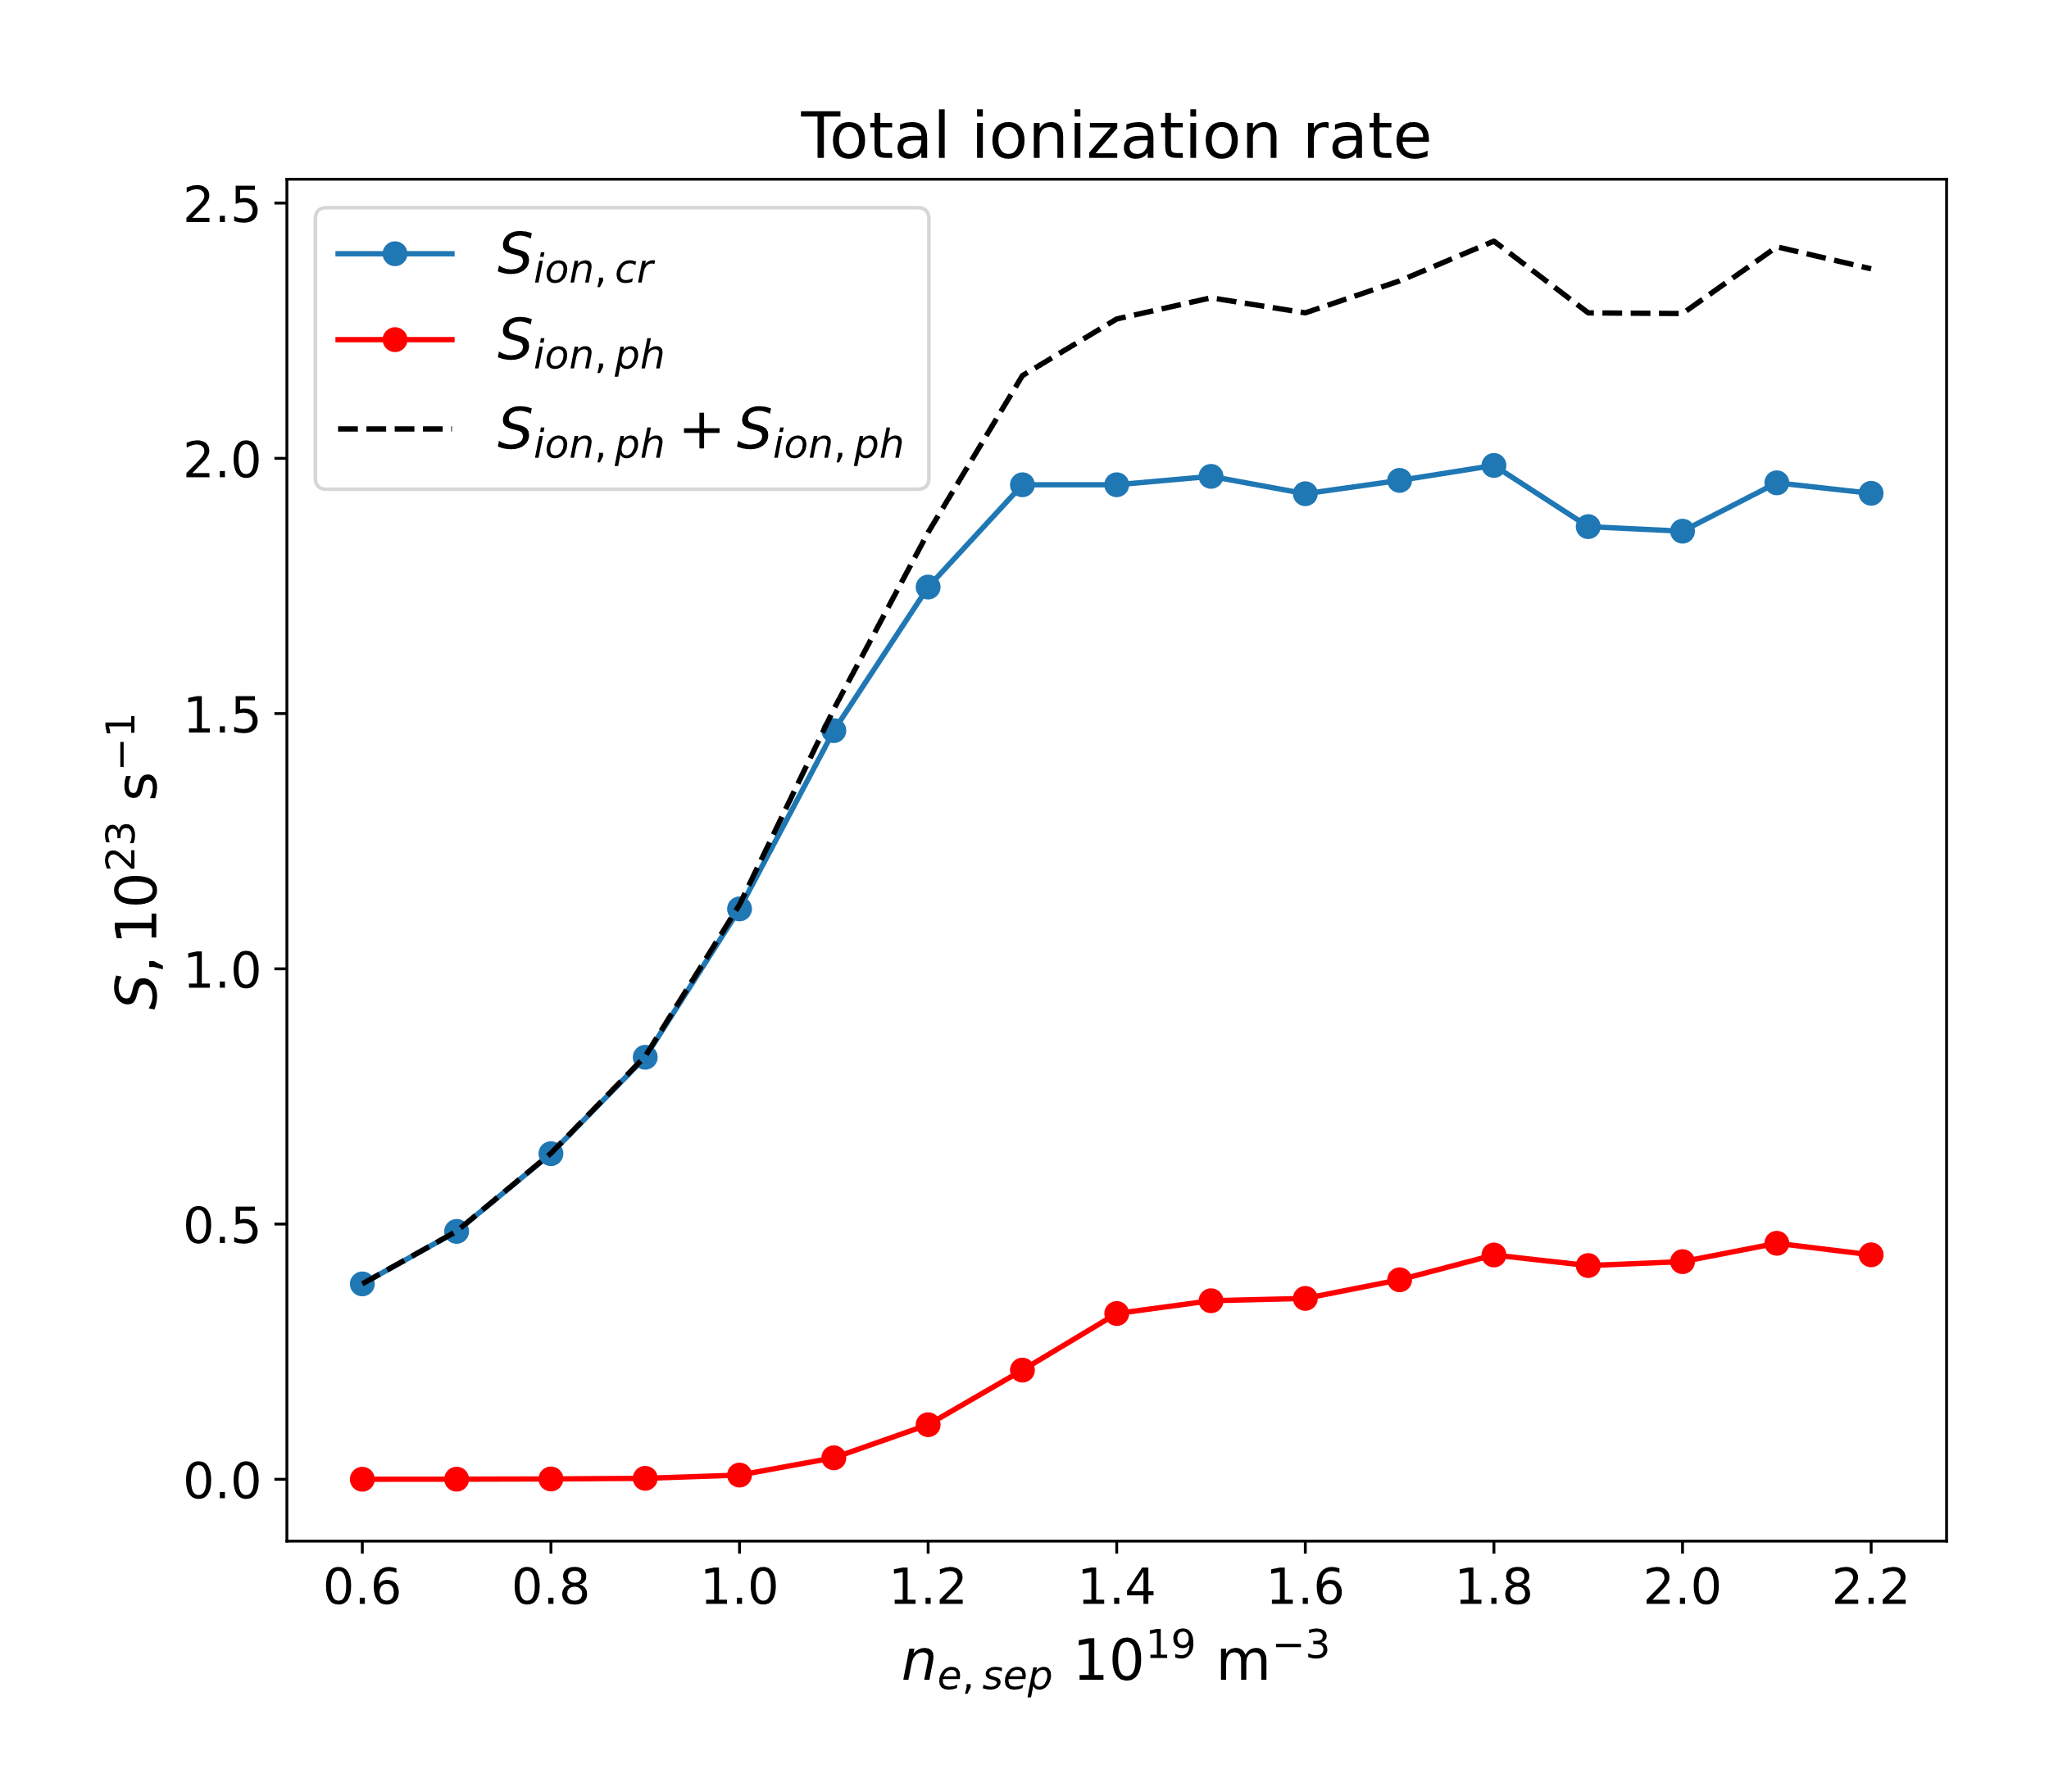
Photon absorption adds up to ~20% of total CR ionization rate in detached conditions
Ionization rate integrated over the whole plasma volume
No effect in low recycling regimes
EPS 2023 poster contribution
(July 2023)

Slide 13
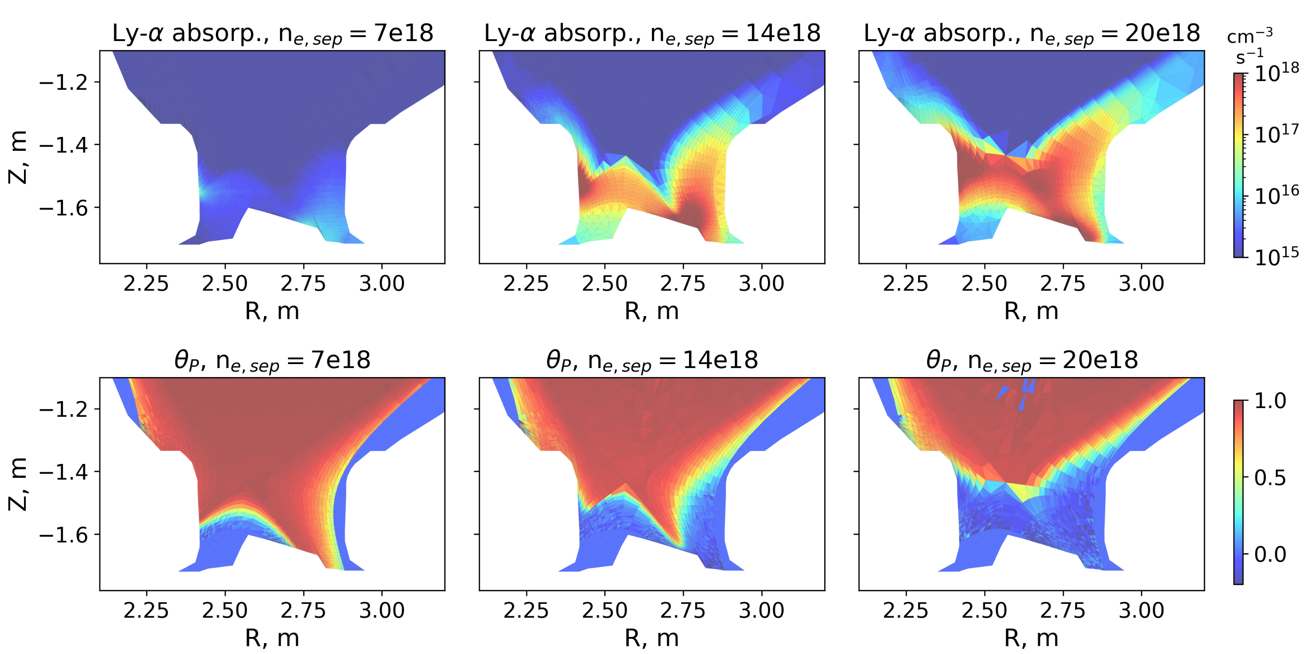
Population escape factors from EIRENE → $θ_{p}=1−\frac{abs}{ems}$
S⁻¹

Slide 14
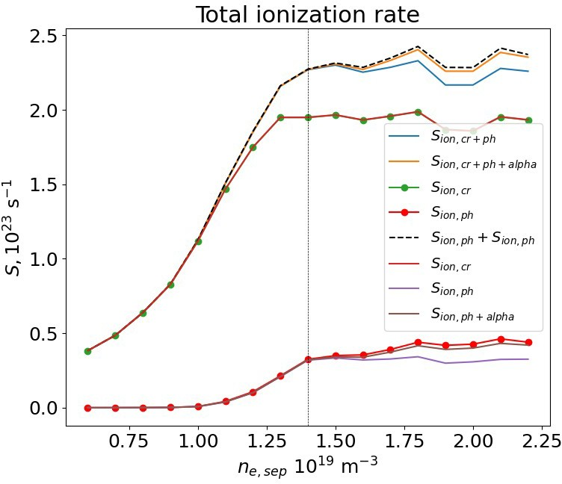

Opacity-reduced CRM using population escape factors from EIRENE
$$A_{eff}=θ_{p}A$$
Applied to SAWADA95 CRM
Ionization rate matches ‘exactly’ to EIRENE values

Slide 15
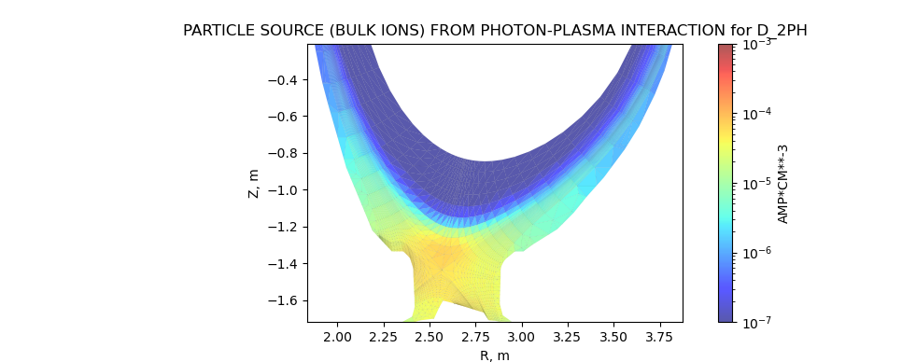
Radiation transport applied to static plasma solutions from JET81472 D SOLPS-ITER runs
n_{e,sep} = 0.6e19 – 2.2e19
Ly-alpha and Ly-beta as test-particles
Photon-gas implementation functional – tested for n_{e,sep} = 9e18 - 12 iterations

Slide 16
To-do lists:
Comparison with EDGE2D-EIRENE photon solutions – JET81472 static plasma opacity study (paper)
Opacity effect on electron cooling rate
Expanding h_colrad for H2 and H2+ contribution to H*
Full SOLPS-ITER simulation for new predictions of JET81472
Grid parallelization for future large CRM calculations
  - For H Lyman lines, MC part still the dominant cpu time

Slide 17

Solving the population of H excited states with collisional-radiative model within EIRENE – h_colrad.f
Based on K. Sawada et al., Journal of Applied Physics 78, 2913 (1995)
M, C, F are ne,te dependent rate coefficients, explicitly coded in h_colrad.f up to n=34
Q_{ext} inserted as $Γ_{D_{n}}$
In steady-state:
$$+ R_{2}n_{H_{2}}+R_{3}n_{H_{2+}}$$

Slide 18
Next²: Plasma-photon-gas coupling
Plasma code
Self-consistent n_{e},T_{e} → new high-recycling, detached dynamics (hopefully better I_{div} prediction)
Connect with EIRENE input parallelization work (Yannick, next code camp?)

