Slide 1
Eunomia inspired suggestions
TSVV-5 Code Camp 2023, EIRENE refactoring
DIFFER / Pieter Willem Groen

Slide 2
Introduction
Eunomia Monte Carlo code for neutral transport [1]
(Rob Wieggers, Pieter Willem Groen; ~2012)
From scratch
Semi OOP (f90 compliant): modules as 'classes' [2]
Design, using 'CRC' (Class Responsibility Collaborator; identifying 'nouns')
Pruning and enrichment (algorithm)
[1] R.C. Wieggers et al. Contrib. Plasma Phys. 52, No. 5-6, 440 – 444 (2012) [2] Decyk, Norton, and Szymanski "Introduction to Object-Oriented Concepts using Fortran90"

Slide 3
Status (as far as I know)
Jorge Gonzalez worked on grouping variables (derived TYPE)
also:
variable names should be clear
PROCEDURES with INTENT definitions (IN/OUT/INOUT)
removal of SAVE statements
Fortan free format (as of f90)
Particular case MODCLF and MODCOL: MODCLF into REACDAT
TYPE REACTION_DATA
TYPE (FIT_FORMS), POINTER :: POT, ..., CRS, ..., PHR
LOGICAL :: LPOT, LCRS, ... , LPHR
...
END TYPE REACTION_DATA

Slide 4
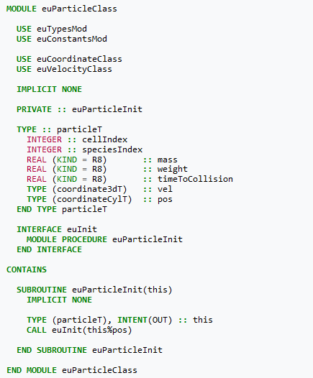
Eunomia: semi OOP (structure)
Example (illustration! Now euParticleT, ...)
Class like functionality in modules (separation of concerns)
Derived type, subroutines with interface
'Main code' imports/uses these 'classes'
Conventions:
(Variables, functions, classes, modules, ...)
Start with 'eu', then camelCase
Class module name ends with 'Class'
'Ordinary' module name ends with 'Mod'
Derive type name ends with 'T'
An instance ends with 'I' (e.g. particleI)
An array of types ends with 'Array' (e.g. particleArray)
...
To pass the type's instance use 'this' 'keyword'

Slide 5
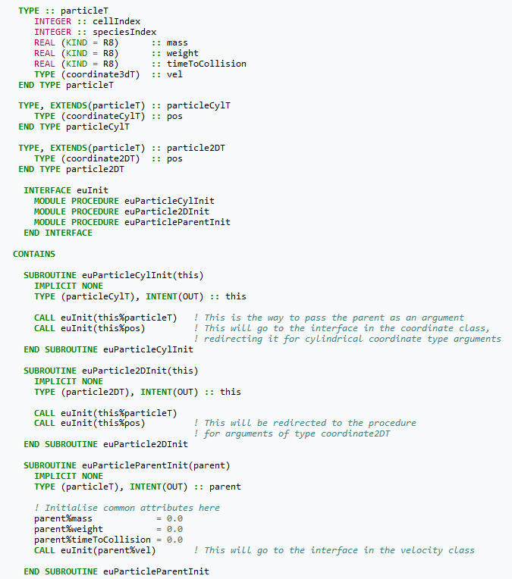
Semi OOP (structure)
Example
Extension of derived type
e.g. to distinguish coordinate system
Interface takes care of corresponding type
E.g. TYPE (particle2DT) :: part CALL euInit(part)
Disadvantage: particle coordinate type determined in preprocessing

Slide 6
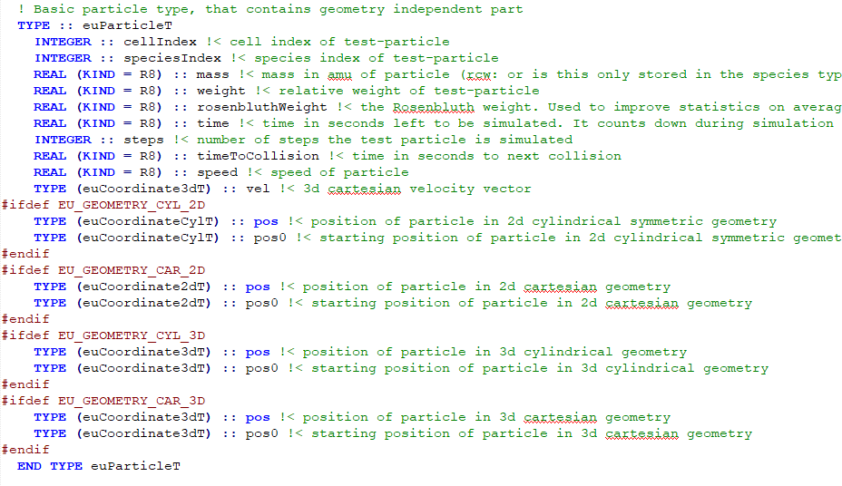
Particle - states
euParticleClass.f90
Particle
speciesIndex
...
Species
type
state
...
euSpeciesClass.f90

Slide 7
euParticleClass.f90

Slide 8
euSpeciesClass.f90

Slide 9
Pruning and enrichment
Rob Wieggers, PhD thesis
Gain more statistics where needed
Inspired by axially symmetric problem (small cells near axis)
Roughly:
In cells where more particles are needed: enrichment
split up test-particle into multiple test-particles
divide the weight
In cells where less particles are needed: pruning
terminate test-particle
or continue with increased weight

