Slide 1
SimDB: A generic tool for building simulations databases in IMAS
O.Hoenen¹, X. Bonnin¹, J.Hollocombe²
¹ ITER Organization ² UKAEA

Slide 2
Outline
Current solutions for IMAS databases and their limitations
SimDB
Motivation
Design
Pre-requisite
Access-Layer 5
UDA (optional)
Usage
Dashboard
Current status at ITER
Summary and future plans

Slide 3
Current IMAS “databases”
With Access-Layer 4 a DB is just a collection of all data-entries in a folder
Arguments to open a data-entry: [backend,]user,dbname,version,shot,run
E.g. DB folder → ~user/public/imasdb/dbname/3/
MDSplus: {0..9}/ids_pulserun.datafile
HDF5: shot/run/{master|idsname}.h5
Public DBs at ITER with metadata added to each data-entry
Describe key values and provenance information in ad-hoc yaml files (human readable)
Manually (ITER_MD) or automatically (ITER_{SCENARIOS|DISRUPTIONS}) with ad-hoc tools (create_db_{entry|entry_disruption})
Browse and search the DB with ad-hoc tools (parsing individual yaml files), e.g: md_summary, scenario_summary, disruption_summary
Any type of simulation can be added,
no validation or control on data
IDStools
Does not scale!

Slide 4
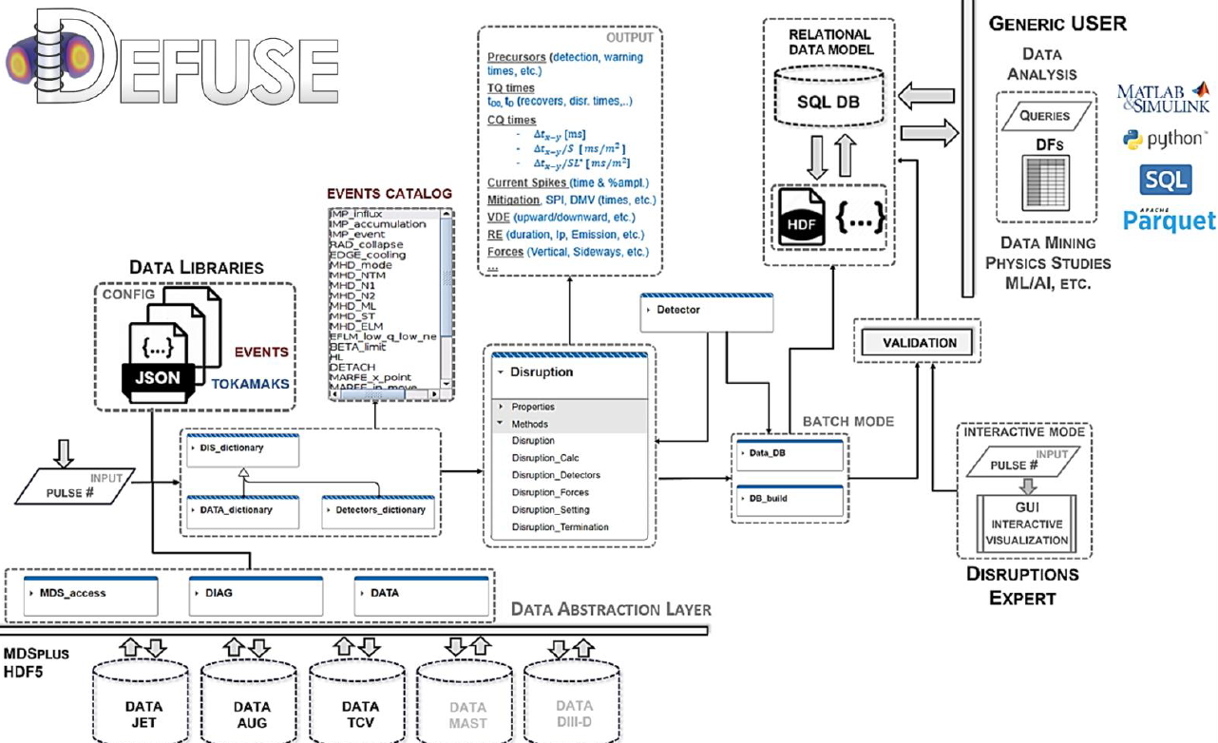
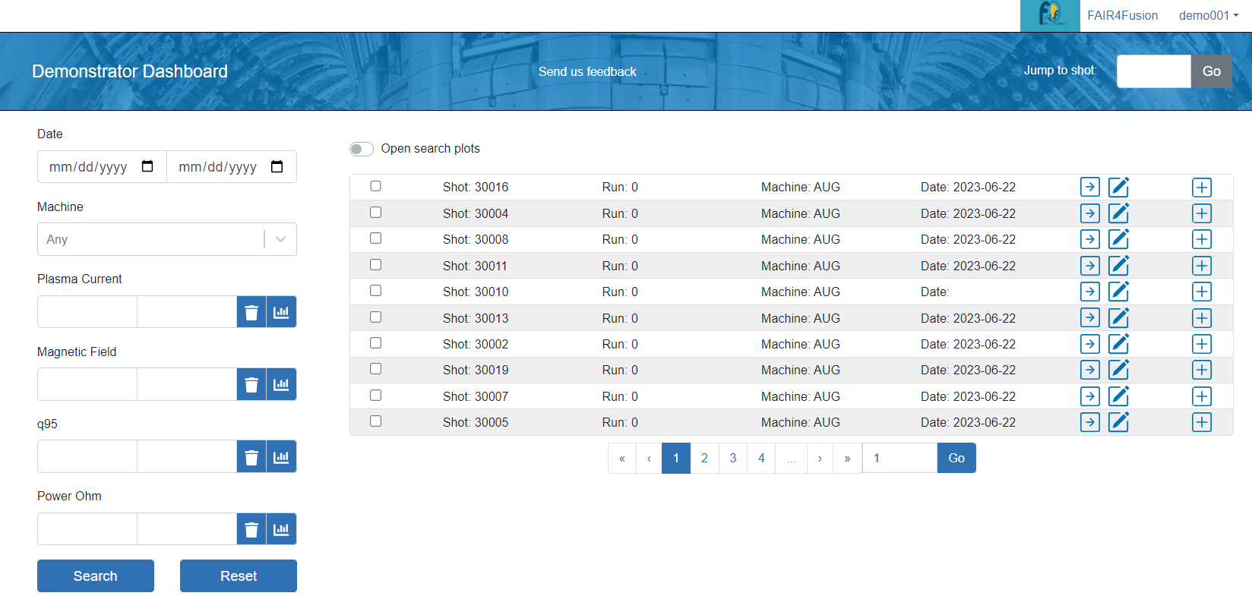
Selected other examples in EUROfusion
DEFUSE
Disruption and Event analysis framework for FUSionExperiments
Pedestal and Confinement DBs
Based on core services maintained by Poznan ACH (AAI, Docker, Dashboard, CatalogQt2)
0D + some 1D profile data stored in summary IDS
Focused only on experimental data
A. Pau / EPFL
M. Owsiak / Poznan ACH / F4F

Slide 5
SimDB motivation
A use-case agnostic Simulation Database management system for IMAS
To provide a generic and configurable solution to handle simulations in IMAS (not just results!)
Describe a simulation by its inputs, configurations, outputs (towards reproducibility)
Gather automatically metadata and key values (from output IDS) to populate a relational DB
Host simulations data locally or on a remote server
Can apply verification checks on simulations pushed to a remote server
Allow queries to retrieve simulation of interest (from a local or remote DB)
Web-based Dashboard for queries on a remote server
Must scale with the number of simulations
Give unique identifiers (UUID) with each data resources and shall follow FAIR principles
Work done by UKAEA under IO contracts
Initial designs ~2020, implementation started in 2021
https://git.iter.org/projects/IMEX/repos/simdb/browse
https://git.iter.org/projects/IMEX/repos/simdb-dashboard/browse

Slide 6
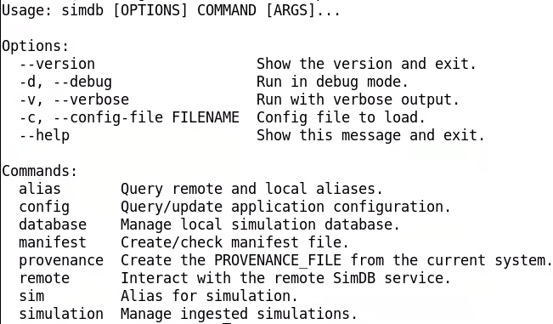
SimDB design
optional
Simulations are described through a manifest file (yaml)
CLI tool is using a git-like sub-command API
Can push and pull simulations from various remote servers
Can list all simulations, query for a matching set and print info (local and remote)

Slide 7
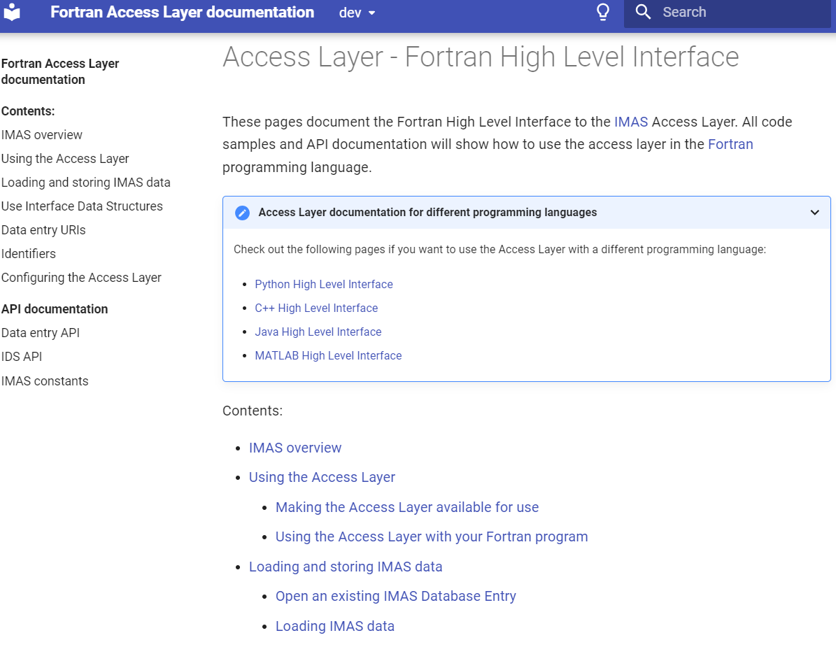
Pre-requisite: Access-Layer 5
SimDB can ingest any type of files and ad-hoc metadata set in the manifest file when registering simulations,
but usage for IMAS simulations is much more powerful as it can leverage IDS for standardizing metadata
New validate() for coordinate consistency checks, new Sphinx documentation
Fortran, C++, Python, Matlab, Java
New open(URI) for data-entries
Compatible with single string description of data resources in manifest file, extensible at will
Compatible with UUID, overcome historical limitations (shot/run number and rigid paths)
Unique API for the various backends and their options (incl. host for remote data access)
client/server based backends
Full syntax available here
imas:[//server:port/]backend?query[#fragment]
[ ]=optional

Slide 8
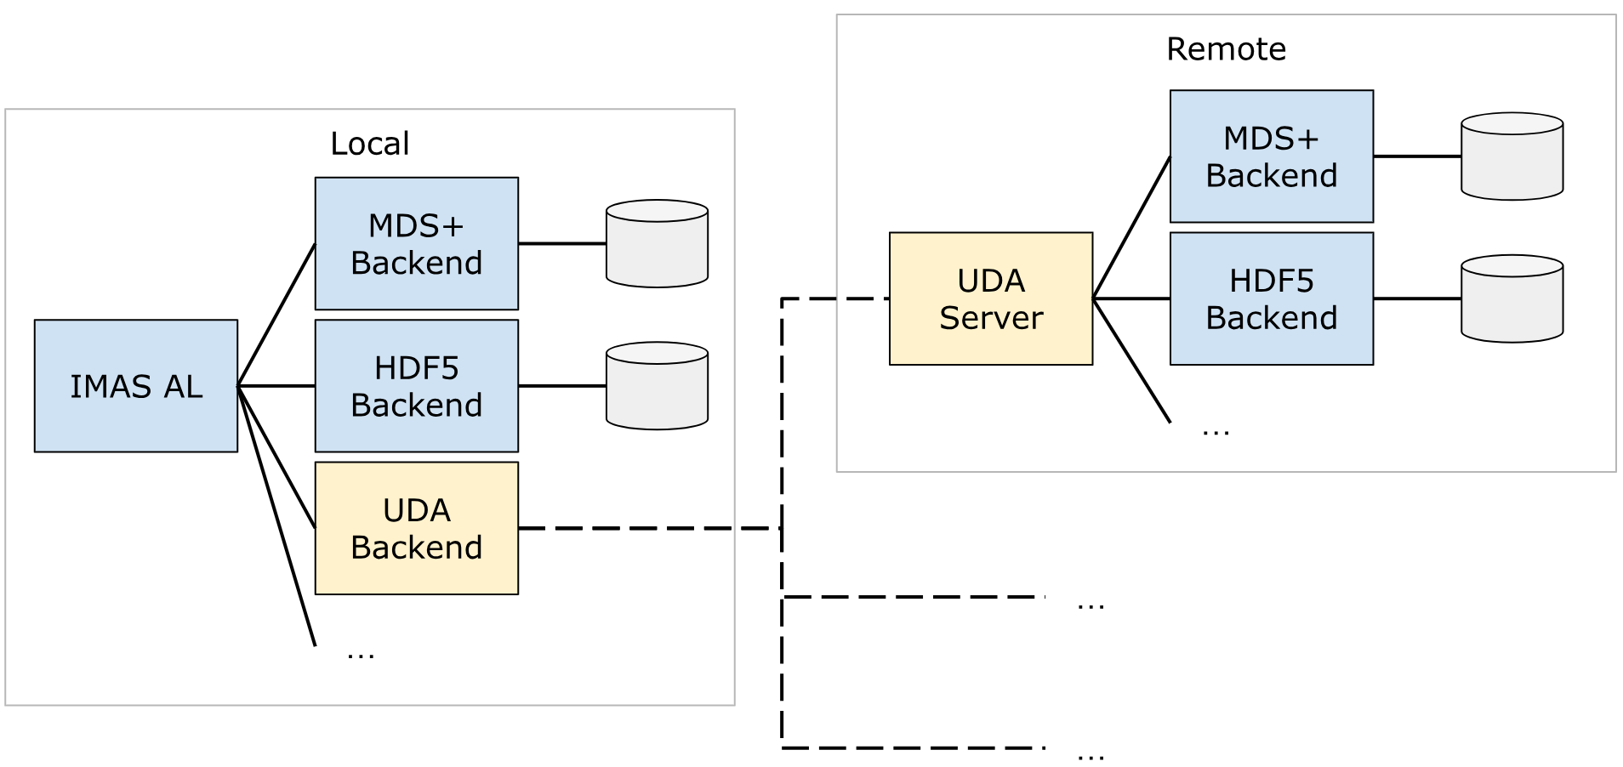
Pre-requisite: UDA
https://github.com/ukaea/UDA
Use IMAS plugin to read IDS files, could use mapping plugin to map experiment data to IDS
Relevant for remote SimDB servers infrastructure
Can pull entire simulations without it, but UDA allows reading specific part of the IDS data (input or output) using the Access-Layer API: get, get_slice, partial_get
AL will use directly a file-based backend if the host in URI is a local server (→ $IMAS_LOCAL_HOSTS)
Send batch of requests over the network to improve performance

Slide 9
SimDB usage
Manage simulation lifecycle
watchers, notifications, approval
obsolescence, update, removal
SimDB Server
Query metadata
Dashboard
UDA Server
Push simulation
upload files
upload metadata
apply specific validation schema
Input for new simulations
IDS data (input or output of stored simulation on the server)
Query
metadata
Pull simulation
download files and metadata
Ingest manifest
extract metadata
calculate checksums
assign UUID
Local SimDB
Local
Simulation
IMAS

Slide 10
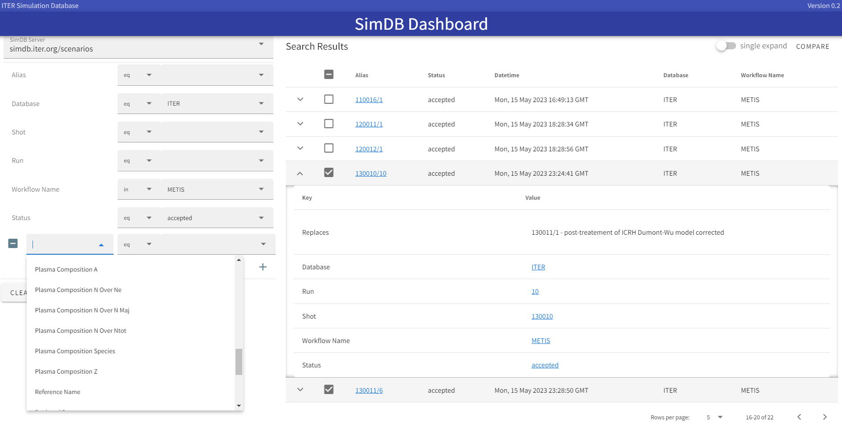
SimDB Dashboard
Configurable
query and selection of hits
Configurable plot and export of 1D data (plotly)
Shareable queries
As URL refers to the UUID of the simulations, e.g: https://tinyurl.com/simdb-query-example

Slide 11
SimDB status at ITER
Special ingestion to port legacy ITER_SCENARIOS files (simulation output)
Metadata from summary and dataset_description IDS, as well as from yaml file
SimDB server at simdb.iter.org
Configured for the ITER scenarios DB but can host other DBs
In test phase with ingested output from existing ITER_SCENARIOS files
Dashboard at simdb.iter.org/dashboard/
Available behind SSO authentication
UDA server at uda.iter.org:56565
Allow remote access to IDS data via AL5
Authentication through personal certificate: pkiuda.iter.org
Foreseen approval workflow
No staging area, pushed simulation that validates will be visible by all
Approval upon request → approved simulations will be guaranteed persistency

Slide 12
Summary and future plans
SimDB is a generic management tool for IMAS simulations
Offer a comprehensive infrastructure to build and manage searchable databases
Rely on Python, Access-Layer 5 and UDA
Highly configurable and adaptable to various use-cases and needs
Targeting FAIR principia → needs open metadata standard
Ongoing plans
Put in production for the ITER scenarios database
Use for the ITER Machine Description database
Use for ITPA databases (needs mapping to IMAS)
Investigate use and limitations for experimental pulse data
Study scalability, improve web frontend and features, etc…

