Slide 1
Tuesday 7th April 2020 – Chair A. Huber
TFL’s news
JET1 Task Force leaders
IOS: J. Mailloux, E. de la Luna, A. Huber,
PTI: C. F. Maggi, D. Douai, J. Garcia, J. Hillesheim

Slide 2
Machine status, 1st April 2020

Slide 3
Conferences and deadlines
Extended deadline for abstract submission for SOFT2020
31st Symposium on Fusion Technology (SOFT2020)
20th – 25th September 2020, Dubrovnik, Croatia
The deadline for abstract submission for SOFT2020, which was originally planned for 27th March, 2020 is extended and new deadline is 15th April, 2020.
Abstracts can be submitted on the following link https://soft2020.eu/Programme2/Abstract-Submission.
So far our plans for holding 31st Symposium on Fusion Technology (SOFT2020) in Dubrovnik from 20th to 26th September 2020 remain unchanged
The list of the confirmed plenary and invited speakers and the important dates can be seen at https://soft2020.eu.

Slide 4
Conference and deadline
IAEA Technical Meeting on Plasma Disruptions and their Mitigation, ITER Headquarters, Saint-Paul-lez-Durance, France, 20–23 July 2020 Please note that the meeting dates has not been changed yet. IMPORTANT DATES: 27 April 2020 Deadline for submission of abstracts through IAEA-INDICO for regular contributions 4 May 2020 Deadline for submission of Participation Form (Form A), Form for Submission of a Paper (Form B) and Grant Application Form (Form C) (if applicable) through the official channels 22 May 2020 Notification of acceptance of abstracts and of assigned awards Please find more information on the web page: https://conferences.iaea.org/event/217/ Conference Deadline for abstracts submission: 27th of April 2020 EUROfusion pinboard deadline: 14th of April 2020
Please think of colleagues who might have done work deserving of an oral, and may need encouragement to come forward!!!!

Slide 5
Other issues
If your SecurID key fob / mobile app expired …
Contact UKAEA IT support via e-mail: support@it.ukaea.uk → triggers an incident on Marval tracker system
State that you need access to JET computer clusters via NoMachine (VPN access via MFA is insufficient)
Currently, IT support contacts “stranded researchers” by Zoom, Skype and Microsoft Teams; IT Support cannot be reached by phone → leave your contact details in the initial e-mail
UKAEA IT support phases out key fob and prefers setup via mobile app
Describe you phone: iPhone or Android, BlackBerry, Windows Phone, Mac 4.x → IT support sends QR code and, separately, unlock code; report via another ticket if neither item arrives

Slide 6
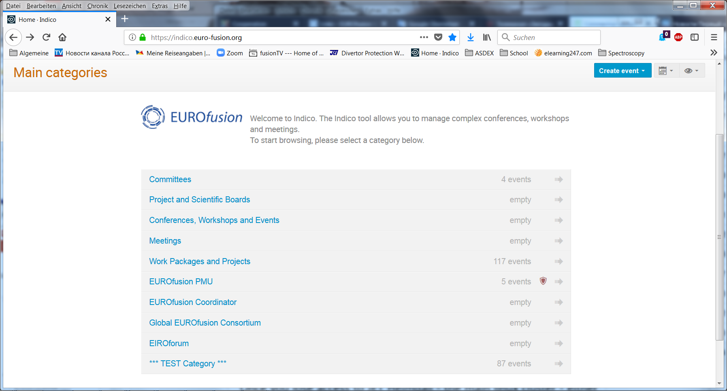
INDICO: to share files
Select
Then Select WPJET1
Indico manuals
FusionTV will be replaced by Indico,

Slide 7
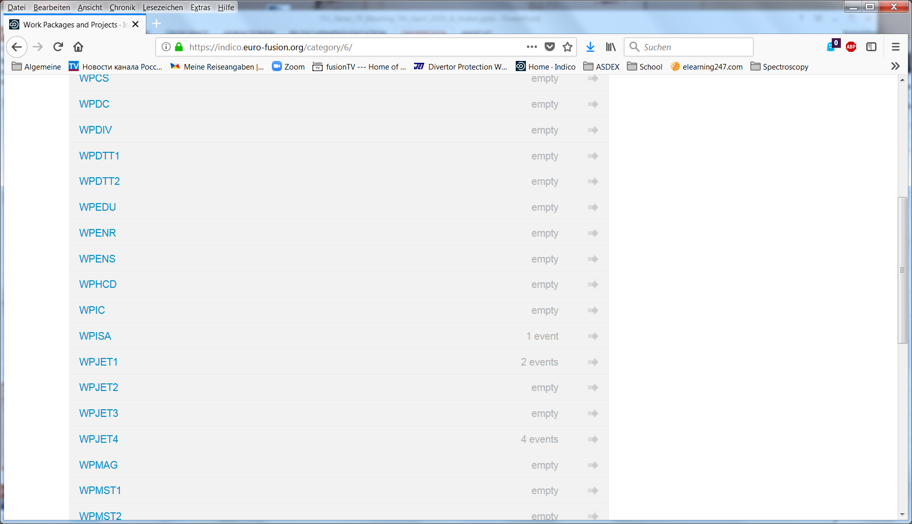
INDICO: to share files
Select WPJET1

Slide 8
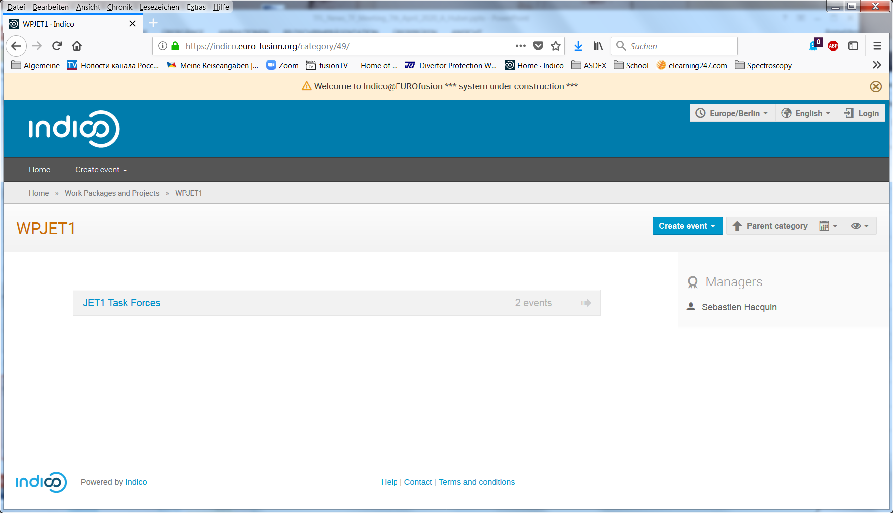
INDICO: to share files
Select JET1 Task Forces

Slide 9
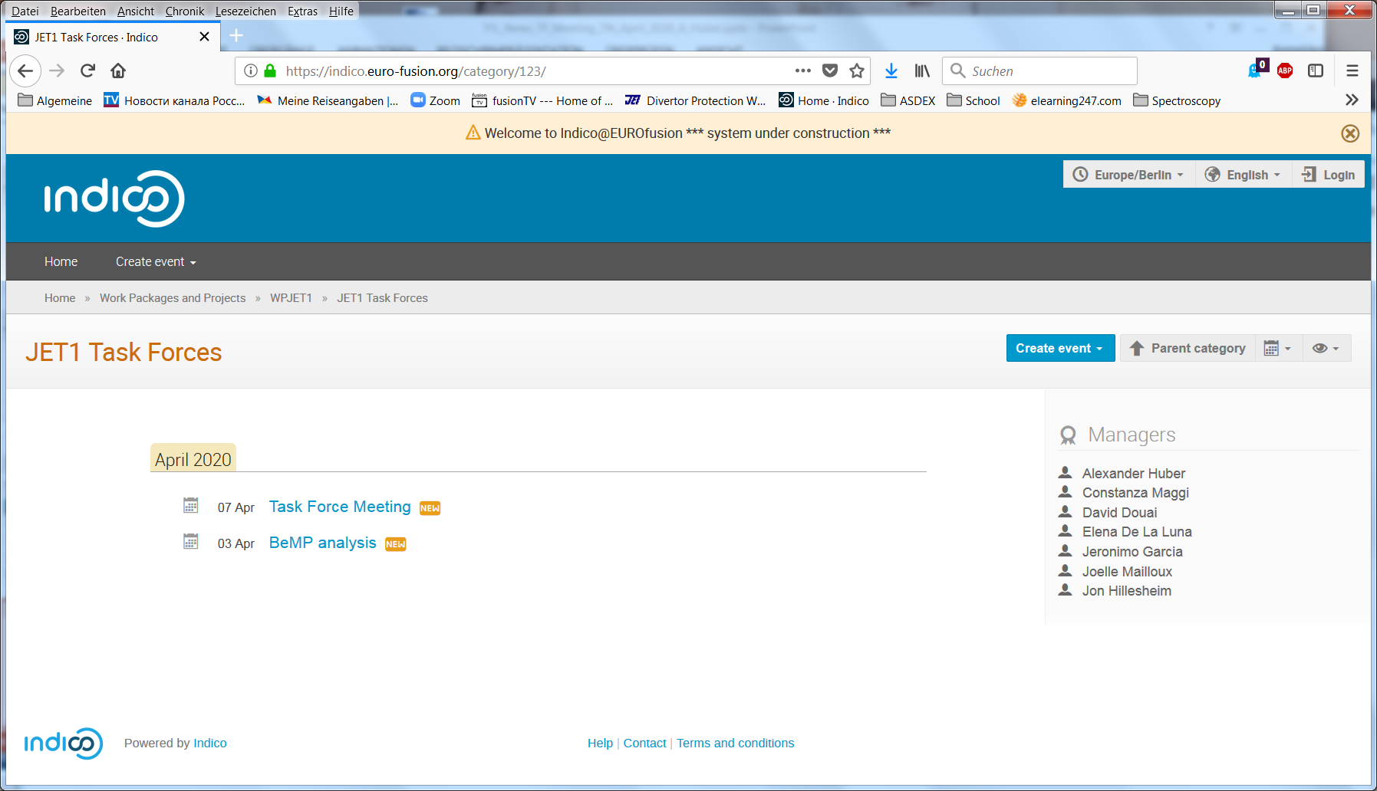
INDICO: to share files
Select the wanted meeting

Slide 10
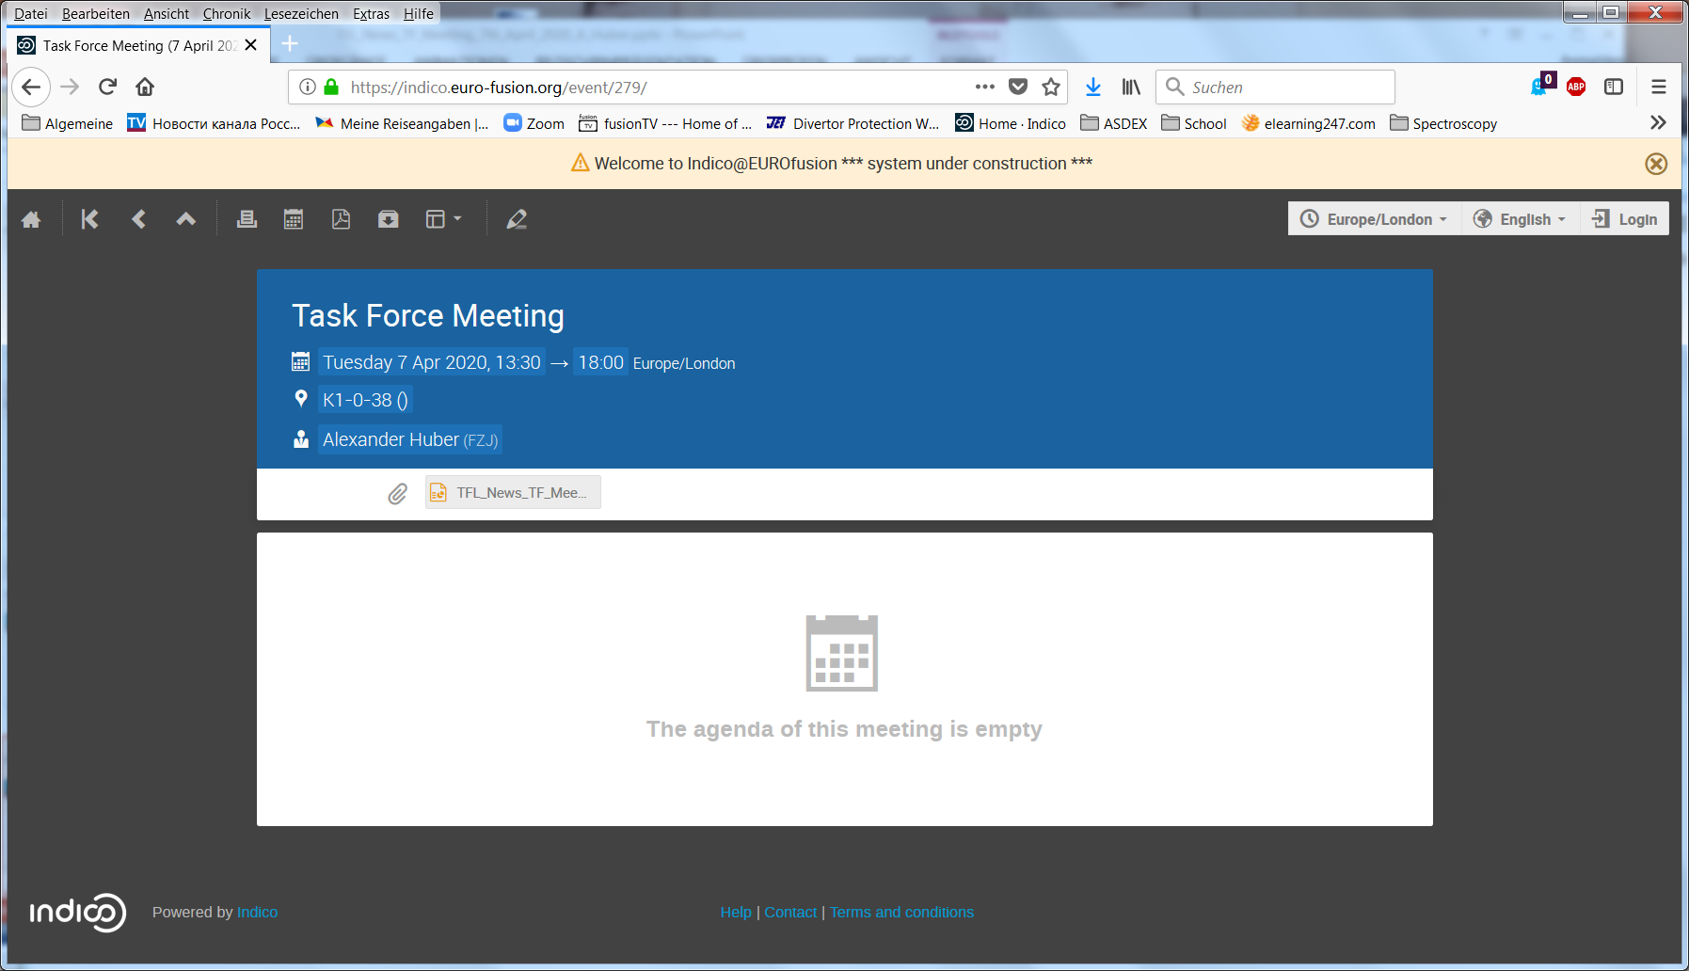
INDICO: to share files
To upload the file login with your IMS password
Click onto the file to down load the file

Slide 11
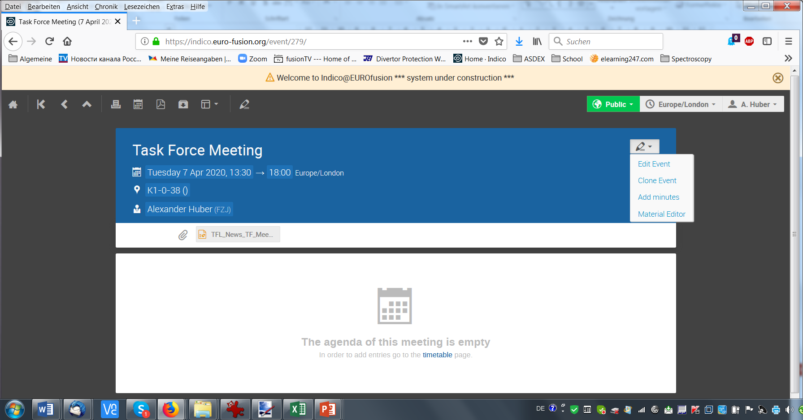
INDICO: to share files
To upload the file=> Material Editor=>upload files

Slide 12
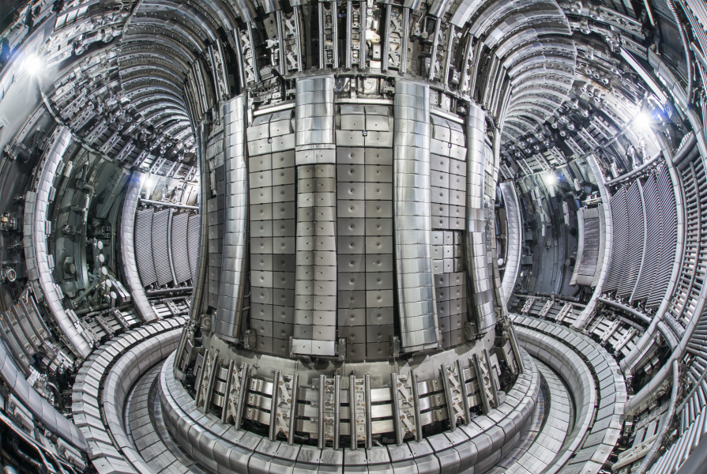
Agenda for today’s meeting
Task Force Meeting on Tuesday 7th April 2020 – Chair A. Huber (K1-0-38 zoom meeting at 13:30 UK time)
A. Huber | TFLs’ news | 13:30
E Aymerich | “A statistical approach for the automatic identification of the beginning of the chain of events leading to disruptions on JET” (paper review) (25'+15') | 13:35
E.Stefániková | Comparison of Peeling-Ballooning limited JET-C and JET-ILW plasmas (paper review) | 14:15
Y. Kazakov | Report of M18-48 | 15:00
A. Tinguely | C39 strategy of M18-03 related to TAEs and the TAE antenna | 15:30

