Slide 1
Knowledge Management and (Operations) Training in
WPTRED Training and Education &
WPPrIO Preparation for ITER Operations
Eva Belonohy
Fusion Science Coordination Meeting, 6 October 2023

Slide 2
Training and Education (TRED) Activities
Understanding the current status and needs
  Human Resources Survey 2023 – every 10 years
  Education Programs Overview 2022 – annually from now on
  Operator roles and training overview under the EUROfusion Operations Network
Development of a Knowledge Management Strategy -> Physics, Engineering, Operations
  Elements of knowledge capture & transfer
  Feedback from diverse set of Stakeholders – ITER, F4E, EUROfusion departments and work packages
  Feedback from TFLs & PLs <- this meeting
Plan forward
  Tools
  Communities of practices
  Education programs – EUROfusion and FuseNet
  Courses – EON Foundation Course on Session Leading and Operations

Slide 3
2023 Human Resources Survey
Objectives:
Understand the current staff and competences in EUROfusion beneficiaries and affiliated entities.
Improve staff retainment and recruitment - movement of staff to/from ITER, F4E, private companies and industry.
Involvement in Education activities.
HR survey panel: PMU, ITER, F4E
Consultations: PMU, FuseNet, European Commission
Identify needs from ITER, F4E and the PMU departments.
Combine with other surveys and make recommendations
to the General Assembly in December 2023.
Total submissions (31 Beneficiaries, 164 affiliated entities, + 3 potential future affiliated entities) | 114 out of 198
Beneficiary submissions | 26 out of 31
Total number of people | 5380
Current staff information (country of origin, year of birth, gender, degree type and level, technical and operational skill, contract type) | 113
Incoming staff in 2019-2022 per technical competence | 62
Outgoing staff in 2019-2022 per technical competence | 54
Involvement in Education | 60
Additional information related to talent retainment and recruitment | 34
Status: Post-deadline. Submissions are still received in August and September 2023.

Slide 4
2023 Human Resources Survey – Survey questions

Slide 5
2023 Human Resources Survey – Survey questions
Gender | Highest degree | General Qualification | Acquired Skills | Operational role
Male | Bachelor Degree | Chemistry | Administration | No operational role
Female | Master Degree | Computer Science | Diagnostics | Engineering Operator - Cryo
Other | PhD | Economy | Engineer - Cryo | Engineering Operator - Engineer Pilot, Engineer-in-Charge
Prefer not to say | Other | Engineer - Chemical | Engineer - High Voltage | Engineering Operator - Heating Systems
 |  | Engineer - Civil | Engineer - Low Voltage | Engineering Operator - Pellet Systems
 |  | Engineer - Electrical/Electrotechnical | Engineer - Magnet | Engineering Operator - Power Supplies
 |  | Engineer - Electronic | Engineer - Nuclear Design | Engineering Operator - Shift Technician
 |  | Engineer - Materials | Engineer - Other | Engineering Operator - Vacuum
 |  | Engineer - Mechanical | Engineer - Remote Handling | Engineering Operator - Other (Specify in comment)
 |  | Engineer - Nuclear | Engineer - Safety & Waste | IT - CODAS/CODAC, Data Acquision, ..
 |  | Engineer - Other | Engineer - Systems Engineering & Design | Safety, Health Physics, …
 |  | Humanistics | Engineer - Vacuum | Scientific Coordinator
 |  | Law | Engineering Analysis - Electromagnetic | Scientific Operator - Cameras
 |  | Mathematics | Engineering Analysis - Nuclear | Scientific Operator - Diagnostics
 |  | Media and Communication | Engineering Analysis - Structural & Mechanical | Scientific Operator - Disruption Mitigation
 |  | Physics | Engineering Analysis - Thermofluid | Scientific Operator - Physics Pilot, Session Leader
 |  | Technician | Health Physics, Radiation Protection | Scientific Operator - Real-time control
 |  | Other | Heating and Current Drive | Scientific Operator - Other (Specify in comment)
 |  |  | IT - Data Acquision, CODAS/CODAC, ..
 |  |  | IT - Instrumentation and Control
 |  |  | IT - Software Development
 |  |  | Materials
 |  |  | Physicist - Computational / Numerical
 |  |  | Physicist - Experimental
 |  |  | Physicist - Other
 |  |  | Physicist - Theoretical / Analytical
 |  |  | Procurement
 |  |  | Project Management
 |  |  | Quality Assurance
 |  |  | Tritium handling
 |  |  | Other

Slide 6
Education Programs Overview
Objectives:
Obtain information annually (starting from 2022) on the education programs per beneficiary particularly on:
  Full programs at BSc, MSc and PhD level
  Individual courses, workshops, Summer/Winter schools
  Internships
  Educational events
  Materials
Status: Received 13 reports from 9 beneficiaries. (TD/TD-23-64) Data collection and analysis is ongoing.
Identify availability of educational courses and material across EUROfusion.
Support current lecturers, share best practices and good ideas, make courses more accessible
Identify gaps and priorities -> work with FuseNet and TRED to influence universities and/or develop courses as needed.
Many fusion physics schools and courses. -> Review availability of engineering and operations courses.
Please let me know when you organize a training course.
Ongoing comprehensive discussion on the EUROfusion education/training activities in the PMU.
Feedback?

Slide 7
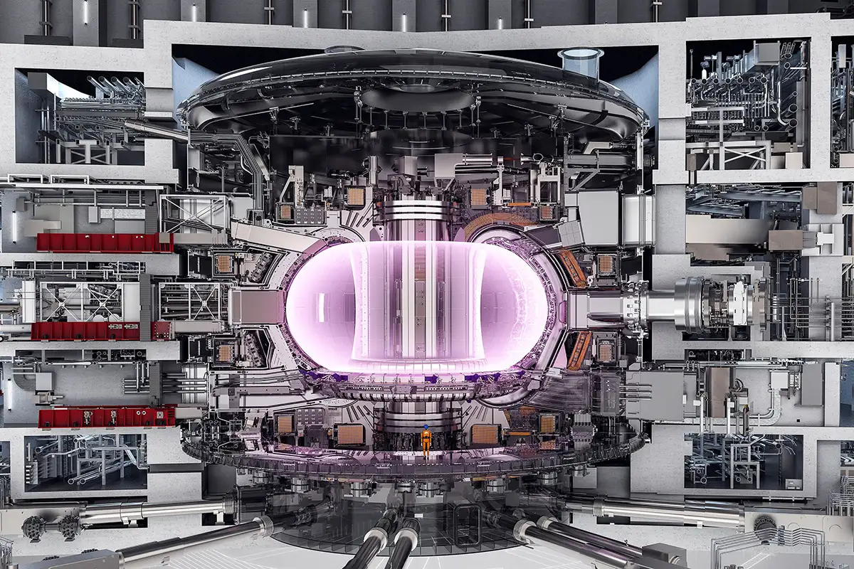
Operations roles and training overview
Operation of large-scale facilities can involve 30-50 roles, areas and ~ 500 people
Site services (water supply, etc.)
Power supplies – magnets, heating systems
Vacuum and gas (vacuum conditioning)
Cryogenics
Dedicated plants for beryllium, tritium
Heating systems – NBI, ECRH, ICRH, LH
Pellets
Diagnostics
Plasma operations
Real-time Control (plant, protection
systems, scientific real-time networks)
IT systems (CODAS/CODAC)
Disruption mitigation (DMV, SPI)
Maintenance services
Safety (personnel and machine)
Health physics, safety case
Protection systems
Waste management

Slide 8
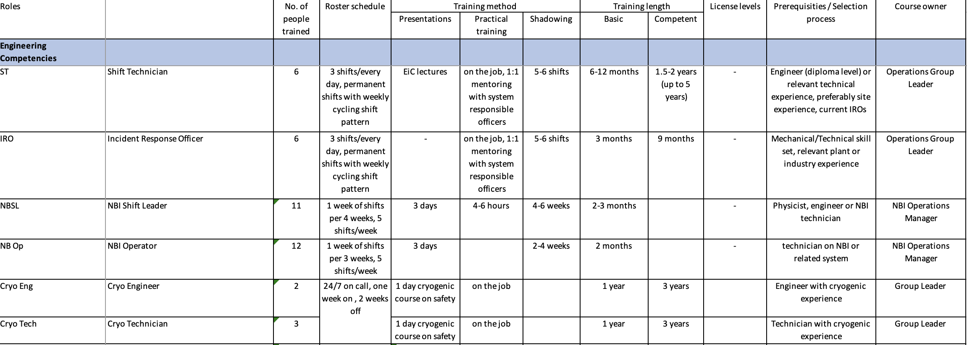
Operations roles and training overview
Under the EUROfusion Operations Network (WPPrIO)
Objectives:
Collect the list of operator roles (rostered and on-call) for each fusion device (tokamak / stellarator) including:
  Number of operators, rostering / scheduling
  Responsibilities
  Prerequisites
  Training – lectures, shadowing, on-the-job, certificates, other
  Length of the training – basic competences, expert
  Qualification process.

Slide 9
Operations roles and training overview
Competence | TJ-II | COMPASS | MAST-U | ASDEX-Upgrade | JET
Engineering | 31 people in 8 roles | 17 people in 3 roles | 37+ people in 9 roles | 111 people in 31 roles | 166 people in 35 roles
Scientific | 48 people in 3 roles | 1 role | 60+ people in 5 roles | 11 roles | 155 people in 11 roles
Support | 15 people in 5 roles | 5+ roles dependent on the experiment |  | 4 roles | 16 people in 4 roles
Training | Practical / On-the-job | Notes/wiki, on-the-job, presentations, | Course for EiC, SL, SC, rest on the job | Certification, seminars, manuals & handbooks, on-the-job | Courses, on-the-job, documentation,
Complete with missing devices
Input into the HR survey, ITER Operations Network
Ongoing discussions with ITER (ITER operational role planning)
Identify training activities to share and/or develop through communities of practice(s) or dedicated courses
Feedback?

Slide 10
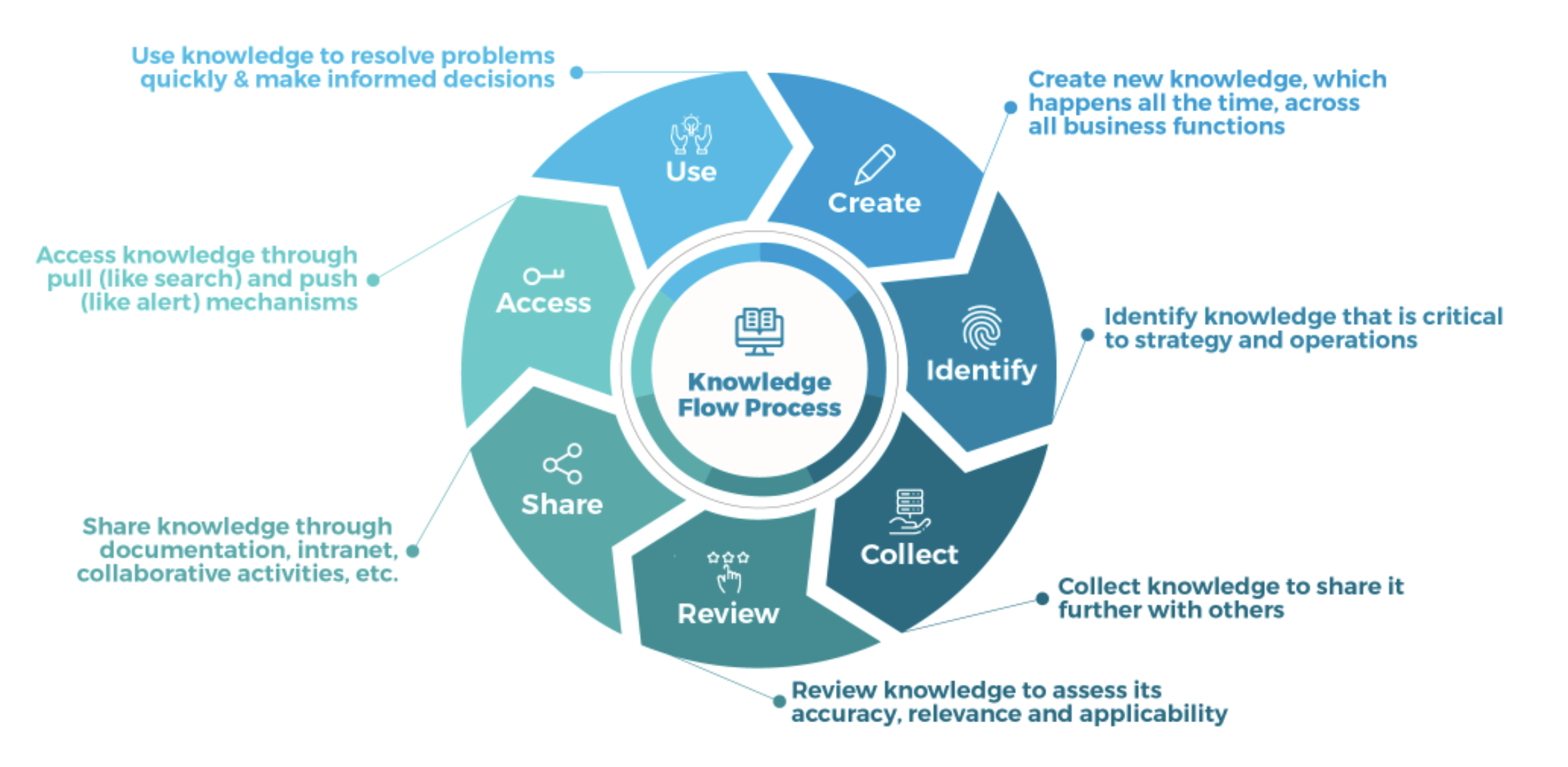
EUROfusion Knowledge Management Strategy
ref

Slide 11
EUROfusion Knowledge Management Strategy
EUROfusion KM Strategy expected to be submitted to the EUROfusion General Assembly in December 2023.
Contact: KM_strategy@euro-fusion.org
TRED Information Session: October 2023 - https://wiki.euro-fusion.org/wiki/IMSO_-_Training_and_Education
Stakeholder interviews with ITER, F4E, FSD, FTD, …
KM working groups (EUROfusion, UKAEA)
Propose Knowledge Capture workshop with EiroForum members, EUROfusion experts, ITER, NASA …
Have a question related to Operation
Question
1. What do I know?
-> Seminars, workshops, training to increase exposure
2. Who do I know who knows?
-> Support network building through events,
expert/publication/reference database
3. Reference material?
-> Create knowledge maps and knowledge base,
Collate operational documents and training material, create additional reference material
Found potential solution and/or people to discuss it with
[NASA Knowledge Reapplication Framework]
Solution

Slide 12
EUROfusion Knowledge Management Strategy
Have a question related to Operation
Question
Training and Education | Courses, Exposure through visits / communities of practices, textbook
Communities of Practice(s) - Networking | TF meetings, EON seminars, conferences Network: science hubs (JET)
Written material | Publications, internal reports Textbooks
Tools - Enable sharing/collaboration - How to ensure collected material is useful and used | SharePoint for work packages embed / connect within processes (e.g. AI search tools)
1. What do I know?
-> Seminars, workshops, training to increase exposure
2. Who do I know who knows?
-> Support network building through events,
expert/publication/reference database
3. Reference material?
-> Create knowledge maps and knowledge base,
Collate operational documents and training material, create additional reference material
Found potential solution and/or people to discuss it with
Solution

Slide 13
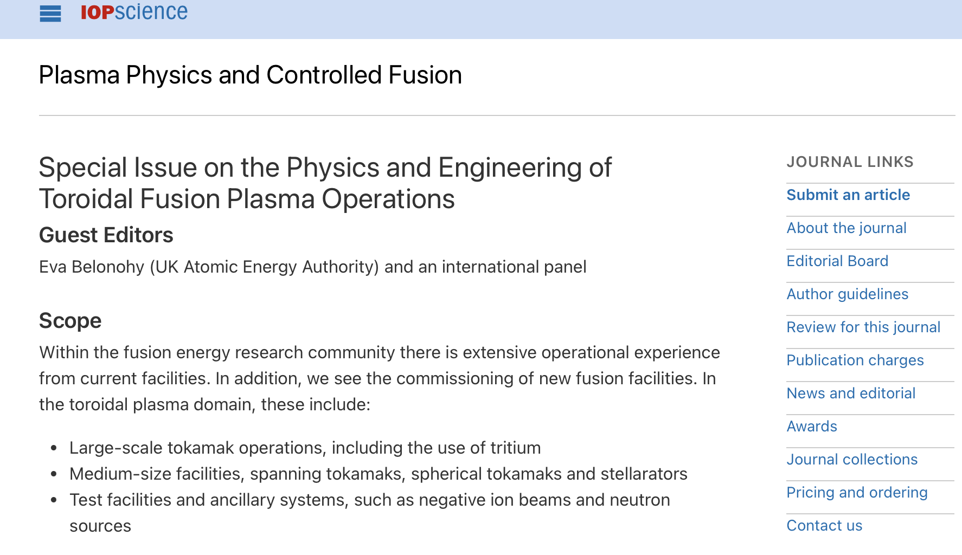
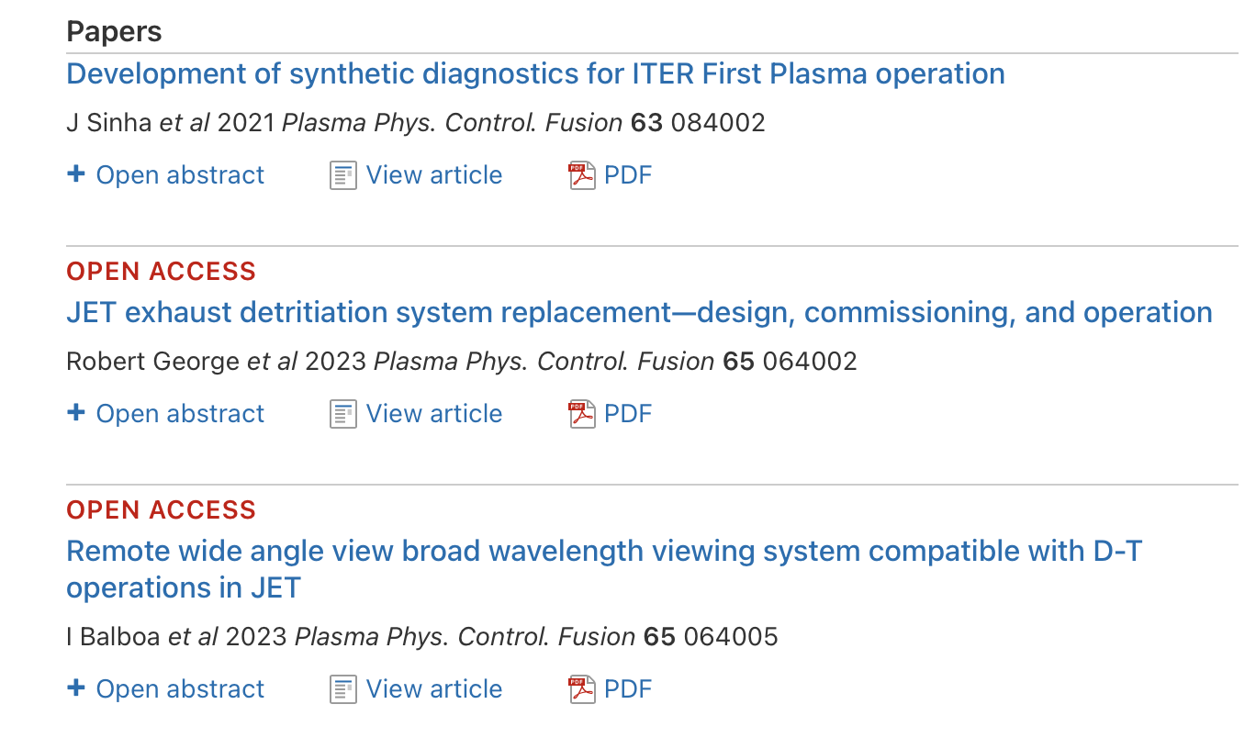
Experience – Publications: JET DT operations papers
PPCF Special Issue on Operations
International guest editors from US, Europe, Asia
Strong coordinated effort to publish JET DT Operations papers
JET Experience:
Needs strong senior management support and push to ensure time can be allocated to writing papers
First-time authors – unsure how to write a paper, how to write a paper on commissioning and operations
  Can start from internal reports, procedures…
  Support from a technical writer
  Monthly catch-up to discuss questions / challenges
2024: Renew efforts to publish commissioning/operations experience from other devices as well

Slide 14
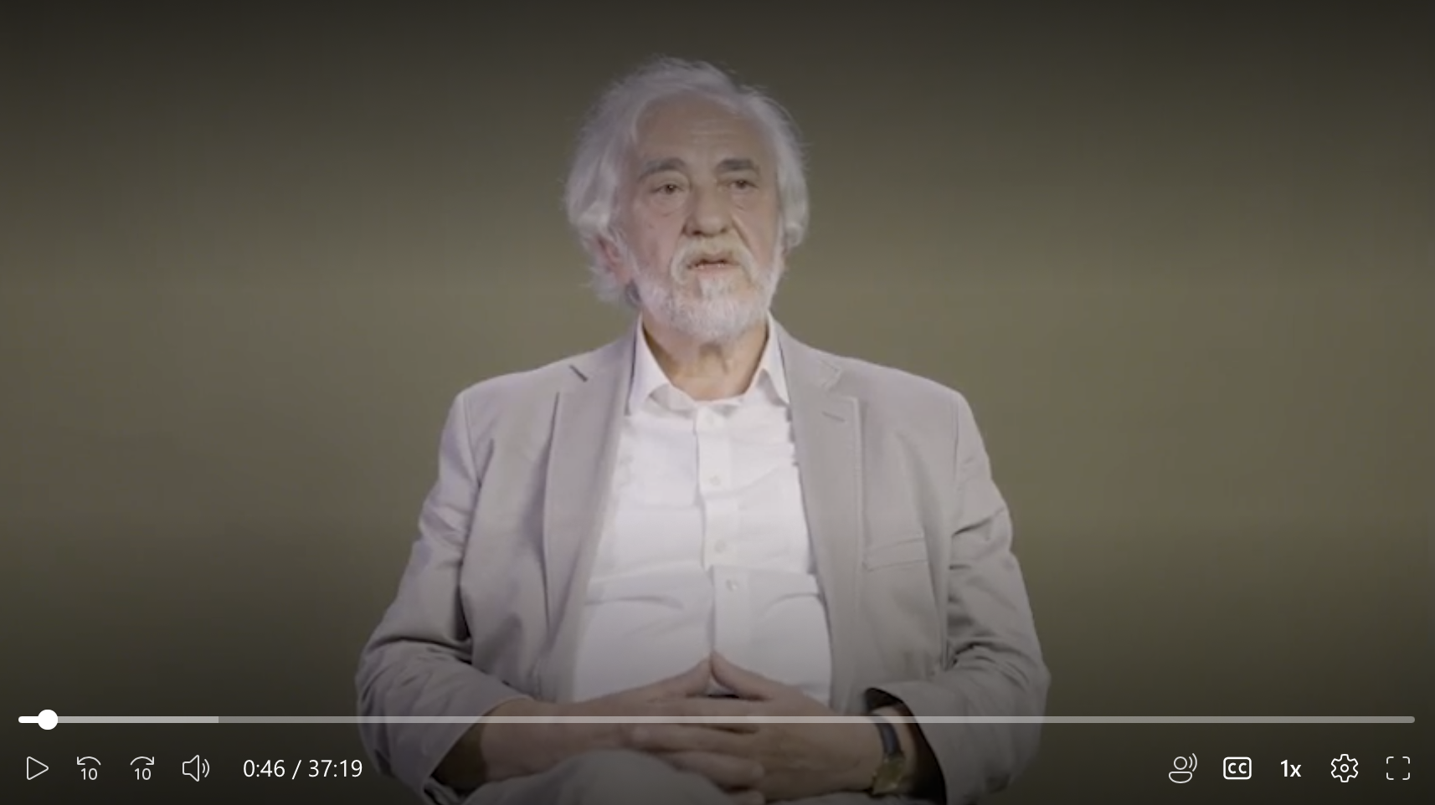
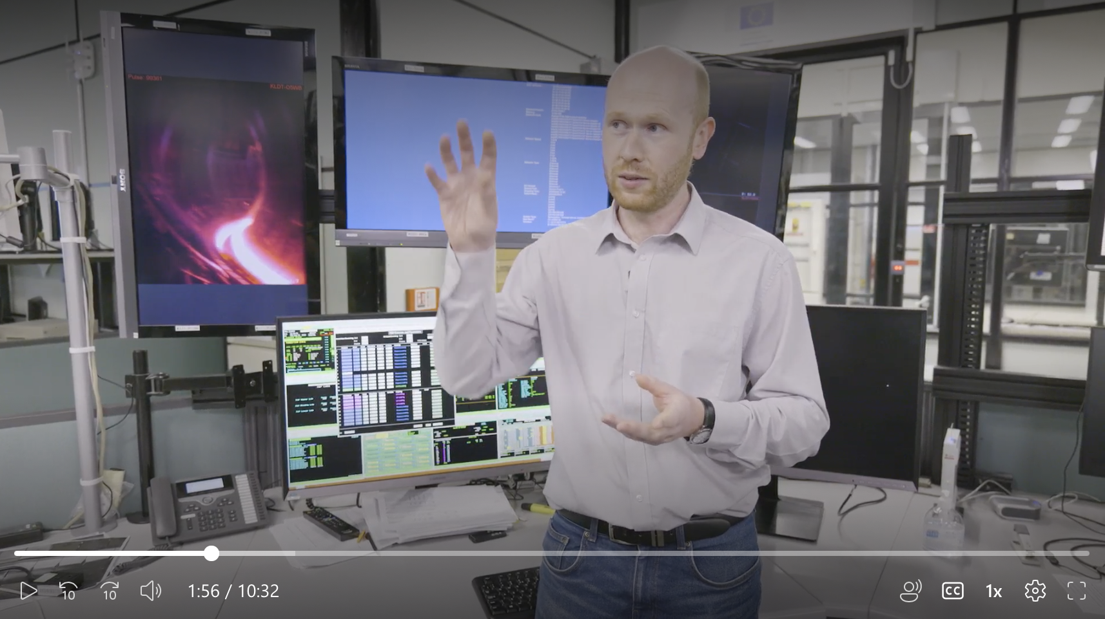
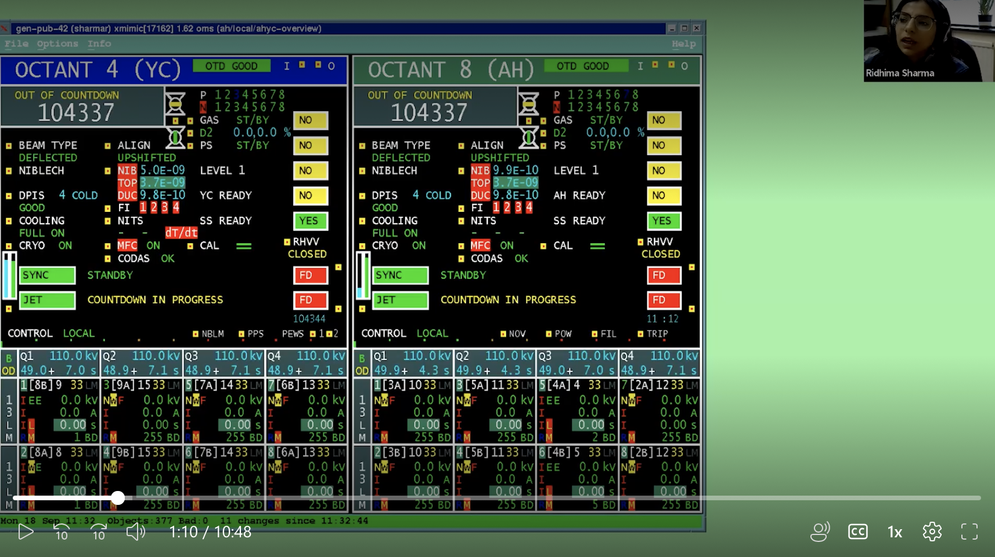
Experience – Knowledge Capture: JET Knowledge Capture Pilot Project
Pilot UKAEA project (June – September 2023)
3-person team (2 camera experts + project manager)
+ expert panel, interviewees
Pilot videos:
1. Lessons learned from the JET DTE2 campaign
2. Problem identification and solving of the DTE2 ILA water leak
3. Process of the NBI morning startup and NBI setup of a JET pulse
(ITER request, discussion with the EON NBI panel)
Objectives:
Learn how to do knowledge capture videos to capture know-how, culture, processes not captured in written documents
Explore how visual elements can provide value (e.g. screen capture)
Experiment with different video types (professional interview style vs. screen recordings)
Demonstrate value of videos to complement to peer-to-peer discussions (communities of practice), workshops/training, written material

Slide 15
Experience – Knowledge Capture: JET Knowledge Capture Pilot Project
Pilot UKAEA project (June – September 2023)
3-person team (2 camera experts + project manager)
+ expert panel, interviewees
Pilot videos:
1. Lessons learned from the JET DTE2 campaign
2. Problem identification and solving of the DTE2 ILA water leak
3. Process of the NBI morning startup and NBI setup of a JET pulse
(ITER request, discussion with the EON NBI panel)
Experience:
Critical to identify what to record. -> NBI start up video based on direct ITER request and topics discussed with the EUROfusion Operations Network on NBI operation
Documentary/lecturing style vs. screen capture with narration
Right level – introductory vs. advanced
Target audience selected were peers at other devices, ITER Operations Network

Slide 16
Experience - Communities of Practice: EUROfusion Operations Network
The EUROfusion Operations Network (EON) organizes workshops, seminars and training on dedicated operational topics open to all EUROfusion (and Broader Approach) experts under WPPrIO:
facilitate stronger connection between the operational groups of EUROfusion facilities to share operational experience to improve operational reliability and performance
improve commissioning, fault identification and resolution, identify opportunities for joint studies.
support development and training of operators, capturing/publication of experience
contribute to the EUROfusion preparation for the (integrated) commissioning and operation of ITER.
Step 1: Knowledge exchange and capture, network and community building -> main focus in 2022-23
Increase exposure by inviting all the relevant staff (engineers, physicists, technicians, students) and organizing all events online (reduce cost and allow participation) Accommodate busy operational schedules and future newcomers by recording all events and providing summaries. Focus heavily on discussion and practical operational know-how, experience Topics and structure formed by topic experts and community (bottom-up approach)
Step 2: Formalization of theory and practice of operations into concept of operations and training -> future
Identify commonalities and knowledge gaps, potential joint experiments Develop joint understanding and identify best practices based on multi-machine experience Refereed publications, develop concept/textbook of operations and operator training programs Improve and optimize machine performance and availability, develop & improve operator training

Slide 17
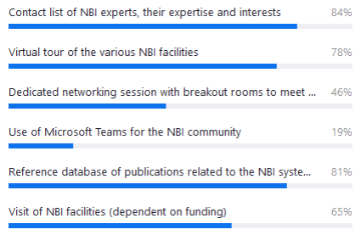
EON Communities of Practice Pilot: NBI network
Audience:
Joined the positive and negative neutral beam injection (NBI) communities in Europe and Japan (physicists, engineers, technicians, students, …) + invited external experts
Structure: monthly 2-hour seminars since May 2022 with 65-85+ participants
Overview talks focusing on a dedicated NBI systems
Structured discussion on a dedicated topic with short presentation from each device (protection systems, HV conditioning, beam and transmission lines, diagnostics, …)
Inclusive (physicists, technicians, engineers, students), online events
Recorded, transcription (for future smart search or “ChatGPT”)
Positive NBI teams
JET, MAST-U, JT-60SA, ASDEX Upgrade, COMPASS, Wendelstein-7X, TCV, TJ-II
Negative NBI teams
ELISE, BATMAN-Upgrade, SPIDER, MITICA, JT-60SA
By invitation
ITER, LHD
EON NBI subnetwork survey results
Experience
Valuable practical information otherwise unavailable identifying commonalties & differences
Strong continued interest from all devices including ITER
Potential offer of spare components, generating new ideas for local practices & joint studies
Increase discussion time even more by 2-4x
Interest in expert list, publication database, virtual tours, networking
New members in 2023:
University of Seville, F4E Garching (JT-60SA), F4E Barcelona (ITER)

Slide 18
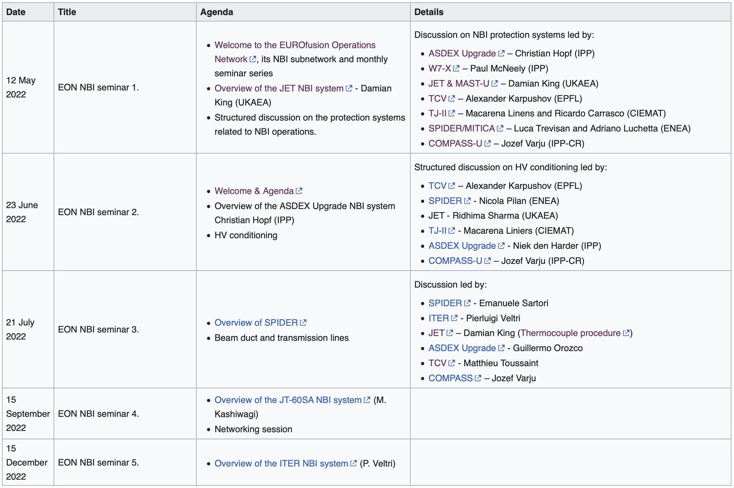
EON Communities of Practice Pilot: NBI network – 2022 seminars

Slide 19
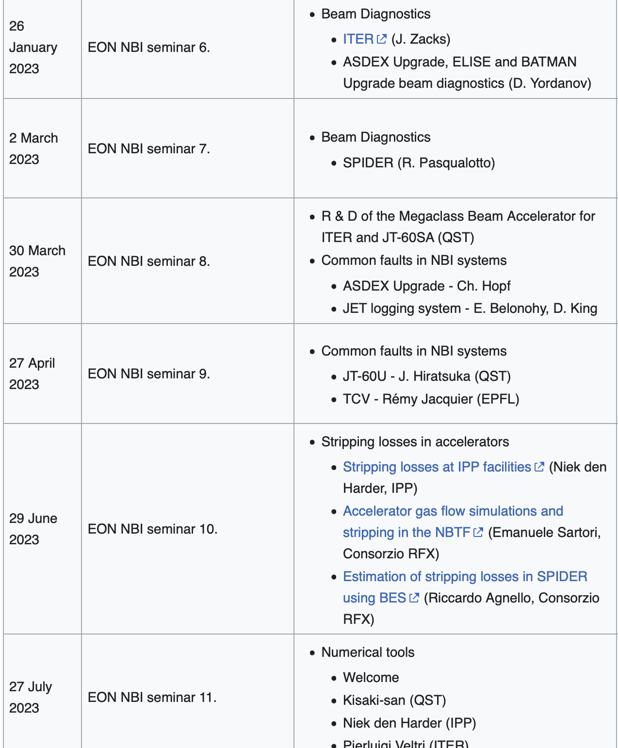
EON Communities of Practice Pilot: NBI network – 2023 activities
Continue monthly seminar series based on the community needs
Share openly operational experience (e.g. faults)
Networking session in 2022
New activities:
Expert register (name, affiliation, email, role, expertise and interests)
Resource database (relevant publications, reports, …)
Planned:
Share commissioning and operating procedures
ITER requests e.g. information on morning startup
-> JET knowledge capture video
Virtual tours

Slide 20
Session Leader Training
Session Leader (SL): physics pilot of a tokamak responsible for development of a pulse schedule based on discussion with the scientific coordinator. Manages the scientific roles in the control room and is the lead scientific contact to engineering competences.
JET SL Training:
1-2-week(s) course every few years since 1995
Practical control room training as SL2 (Optimal: 1 session/week)
Licensing based on plasma current & disruption force
Continuous training with seminars, forums, email updates (ensure exposure/awareness to current issues and solutions)
Machine/License | Time to license | No. of shifts to obtain license
Small device / Full | Weeks
Medium device / Full | Months
JET / license A (Ip<2MA) | 1+ year | 21 (13-43)
JET / license B (Ip<3MA) | 1+ year | 15 (8-22)
JET / Full (Ip<4MA) | 1+ year | 22.5 (21-24)
JET / Expert | 10+ years
Multi-machine or other control room role experience & exposure can reduce training time significantly.
Complexity & training time increases with plasma current & size
Basic plasma & plant operation knowledge allows full exploitation of a device including better scientific proposals and communication between scientific and engineering staff. (reference SLs to support scientific coordinators)
Training material from every JET SL course is available.

Slide 21


EON Training Pilot: Foundation Course on Session Leading and Operations
1-week or online EUROfusion Operations Network course on Session Leading and Operations planned in 2024
Aims:
-> Provide basic machine-independent background to tokamak operation
-> Improve preparation of experimental proposals and experimental sessions
-> Improve interaction between control room competencies
-> Recruit new session leaders
Target audience:
Students (MSc, PhD, Post-doc)
EUROfusion Grants
Scientific Coordinators, TFLs, PLs
Engineers, Researchers
Generic interest
Course outline:
Introduction, Operations Management
Coils and power supplies
Plasma shape control
Vacuum conditioning
Fueling (gas and pellet injection)
Heating systems (NBI, ECRH, ICRH)
Disruptions, predictions and mitigation (MGI, SPI)
Diagnostic setup
Breakdown and current ramp up, runaways
Protection systems
Real-time networks (scientific)
Termination and event handling
Operational tools
Continuous plant systems and IT systems
Plant and Plasma Control
Operation of stellarators
Scaling up operation towards ITER

Slide 22
Feedback
Internal within the publicly funded fusion programs | Physics | Engineering | Operations
1. Written material | Many - Publications in dedicated refereed journals, reports, PhDs, … | Publications in few refereed journals, reports, designs | Rare – Some publications, no dedicated journal. PPCF Special Issue with DT ops papers, commissioning/operations procedures
2. Communities of practice – share experience through peer-to-peer interactions | TF meetings, WP meetings, Many conferences, ITPA | Some conferences, WP meetings, workshops F4E communities of practice | ITER / EUROfusion Operations Networks JET session leaders
3. Training and Education | Many courses and plasma physics courses, many textbooks | Increasing number but not sufficient courses, 1-3 summer/winter schools, JIFS | Some local training, 1 lecture at Culham, 3 lectures at JIFS -> EON SL/Operations Course
4. Tools
External with industry and private companies - Intellectual Property considerations - FUTTA Technology Transfer to Industry - Separate discussion on private companies

Slide 23
Feedback?
What is missing in FSD work packages?
Best practices? What to do better?
E.g. start of students?
Training needs
Capturing/transferring tacit knowledge
Tools to share or access captured knowledge?

Slide 24
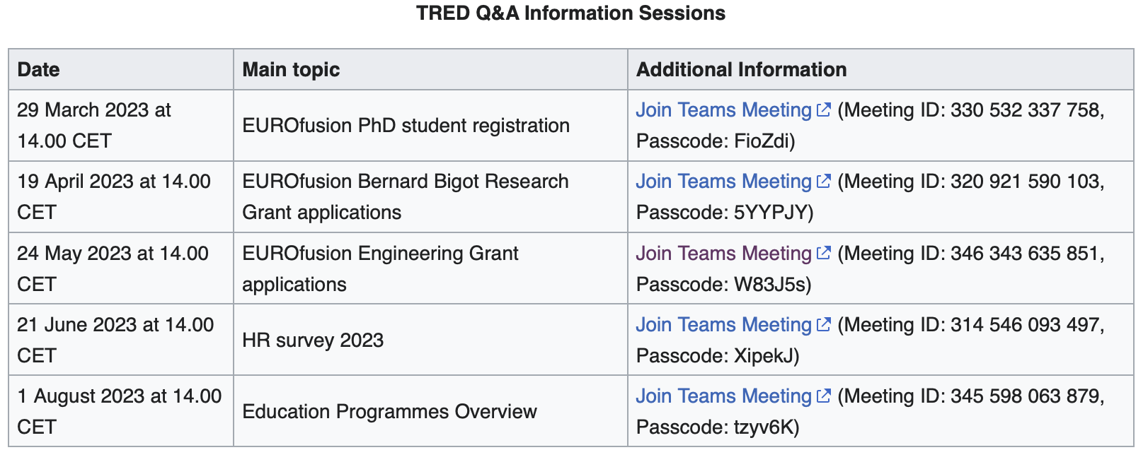
Plan forward
  Tools?
  Communities of practices – EON ECRH?, WPPrIO seminars/workshops?
  Education programs – EUROfusion and FuseNet, schools
  Courses – EON Foundation Course on Session Leading and Operations
Training and Education (TRED) wiki pages: https://wiki.euro-fusion.org/wiki/IMSO_-_Training_and_Education
-> Please join our monthly information sessions with any question or recommendation related to TRED

Slide 25

2024 ERG and EEG applications under evaluation by the expert panels
EUROfusion Bernard Bigot Research Grant (ERG)
2024 EUROfusion Bernard Bigot Research Grant
2-year post-PhD researcher grant, 10 grants per year
Within 2 years of completion of the PhD defense.
Individual project. Option to join EEG training seminars.
Status: Completed. Requesting approval by the Bureau
2024 EUROfusion Engineering Grant
Reduced from 3 to 2 years, increased grants from 15 to 20 per year.
Within 6 years post-Master in Engineering (or proven multi-year engineering experience).
Status: Interview process is ongoing. Selection expected to be approved at the October EUROfusion General Assembly.
Proposal:
Mid-EEG/ERG grants - presentation to TFLs/PLs and the EEG/ERG panel to provide feedback and support to the grantees to finish their projects.
ERG24 timeline | Date
Launch of the call | 27/02/2023
Deadline for proposals | 05/05/2023
Eligibility checks completed & Applications sent to the panel | 06/06/2023
Referees return assessment reports | 07/07/2023
1st Consensus meeting | 12/07/2023
Interviews | 24-31/07/2023
Bureau endorsement | 22/09/2023
EUROfusion Engineering Grant (EEG)
EEG24 timeline | Date
Launch of the call | 24/03/2023
Deadline for proposals | 05/06/2023
Eligibility checks & Applications sent to panel | 26/06/2023
Referees return assessment reports | *04/08/2023
1st Consensus meeting | 30/08/2023
Interviews - Ongoing | 18/09-6/10/2023
General Assembly endorsement | 10-11/10/2023

Slide 26
Contact me/us with any questions or recommendations: education@euro-fusion.org training@euro-fusion.org

