Slide 1
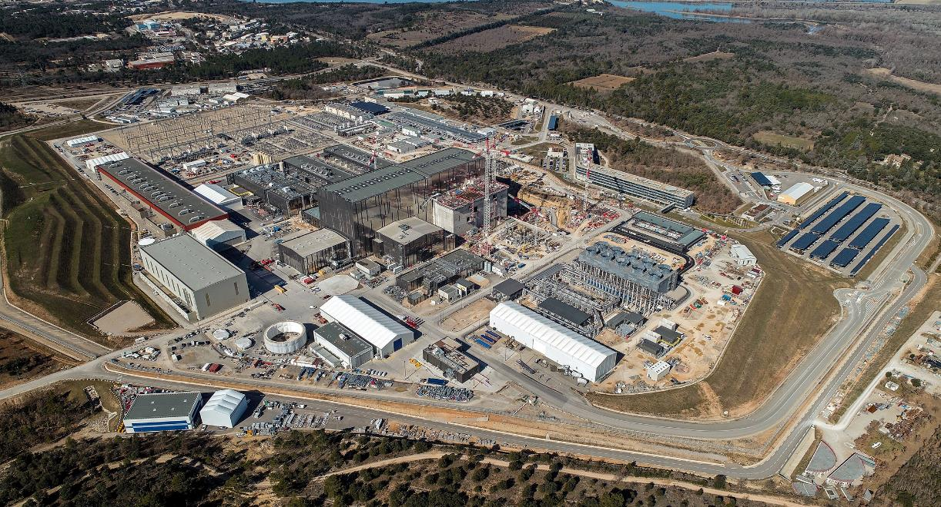
Status and Plans for High Physics Fidelity Plasma Simulators at ITER
S.H. Kim and F. Poli on behalf of ITER HFPS contributors
The views and opinions expressed herein do not necessarily reflect those of the ITER Organization

Slide 2
High Fidelity Plasma Simulators (HPFSs)
High fidelity plasma simulators are required to model complete integrated ITER scenarios, including core-pedestal-SOL transport, sources and stability, plasma-wall/target interactions, and magnetic/kinetic controls (incl. PF circuits)
To prepare ITER scenarios for ITER Research Plan and experimental campaigns,
To support for validation of ITER systems and components, and
To perform interpretative modelling of ITER pulses and physics studies
Current development and application of an HFPS based on JINTRAC and DINA
Recent investigation of an HFPS based on ETS components

Slide 3
High Fidelity Plasma Simulator (HPFS) based on JINTRAC and DINA
Current ITER HFPS development (contractual + IO) activities are based on integration of
JINTRAC (core-edge-SOL transport with sources and exhaust, and kinetic control),
DINA (free-boundary equilibrium evolution and magnetic control),
H&CD workflow (heating and current drive physics)
and implementation of new features (2D edge grid evolution, W wall source, etc.)
A first proto-type has been developed by applying loose and close code/physics coupling schemes and demonstrated with 15MA DT ITER scenario

Slide 4
Code/physics coupling scheme applied in the HFPS (JINTRAC + DINA)
In loose coupling, DINA and JINTRAC exchange full simulation results at the end of stand-alone runs of scenario or scenario segment (e.g. ramp-up)
DINA uses plasma profiles computed by JINTRAC and solves free-boundary equilibrium and current diffusion
JINTRAC uses plasma boundary evolution computed by DINA and solves prescribed boundary equilibrium, core-edge-SOL transport and sources
DINA and JINTRAC executed in an iterative manner with a convergence check (e.g time-trace of RMS deviation of the poloidal flux at the mid-plane between two equilibria) at each iteration step
In close coupling, DINA and JINTRAC exchange simulation results at each data exchange time-step
JINTRAC directly uses DINA free-boundary equilibrium and current diffusion without re-computing them
DINA uses JINTRAC plasma profile evolution and kinetic control
Iteration loop is not applied, but a small data-exchange time-step (~ a few ms) is used to maintain overall simulation performance

Slide 5
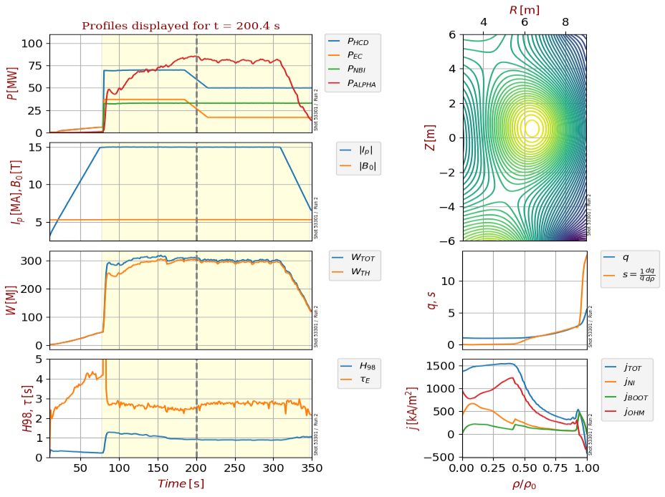
Close coupled simulation using the proto-type HFPS (JINTRAC (core) + DINA)
Data exchanged at every 10ms
Computational performance (w/o optimization)
DINA – 30 minutes (including IMAS overheads)
JETTO-TGLF – 10 minutes (36 processor for TGLF, optimised time-steps)
Coupling overhead* – 20 minutes (~ 1000 IMAS data exchanges with Δt=10ms )
* Application of persistent actor framework (PAF) with improved serialization/deserialization would be beneficial
DINA-JETTO-TGLF close coupling test run of ITER 15 MA 5.3 T DT scenario

Slide 6
Planned work for the HFPS (JINTRAC + DINA)
Demonstration (7.5MA/2.65T Hyd. + 10% He scenarios) with further improvement
Extended demonstration including free-boundary equilibrium, core-pedestal-SOL/div.
Application of pre-prepared 2D edge/SOL grid sequences generated from free-boundary equilibria
To be further extended to robust generation of 2D edge/SOL grids and demonstration against disturbances and transients
Synchronization of the plasma events across magnetic and kinetic aspects (e.g. STs, NTMs, Pellets, ELMs)
W wall source models into the core-edge integrated modelling
HFPS will adapt relevant physics and modelling developments within ITER Members

Slide 7
Strategic consideration of HFPS (JINTRAC + DINA)
ITER HFPS validation
Currently working with MAST-U team, another plan with TCV team – to extend validation activities within ITER Members (HL-3, JT-60SA, etc.)
Staged approach
Preparation of inputs data (incl. data mapping)
DINA free-boundary modelling with magnetic controller implementation
JETTO core transport modelling with HCD systems implementation
JINTRAC core-edge/SOL coupled simulations with SOL grid generation
DINA + JINTRAC simulations with SOL grid adaption to free-boundary equilibrium
Co-simulation capabilities using MUSCLE3 (PAF)
MUSCLE3 is being applied to JINTRAC by UKAEA team
MUSCLE3 is planned to be applied to DINA and Simulink controllers
Generalized User Interface
To use for all IMAS plasma simulators that follow a (to be defined) set of standards
To improve user experience and software/simulation/database management
Continuous collaboration with UKAEA teams is highly desired – Support from SC / EUROfusion!!

Slide 8
High Fidelity Plasma Simulator based on ETS components
Tentatively also called as ‘High Modularity Plasma Simulator (HMPS)’
A modular framework for Integrated Tokamak Simulations that allows:
A much more fine-grained selection of physics fidelities depending upon the use case of interest
Flexible trade-off of physics fidelity of interest versus computational time
Collaborative community contributions and engagement
Developing and testing components that can be exchanged with other frameworks
It does not replace existing frameworks/simulators (e.g. HFPS based on JINTRAC-DINA)
It rather supports their further development
It is developed around the concept of Persistent Actor Framework (PAF) – good candidate to maximally exploit the PAF (MUSCLE3) approach
Currently working with the ETS team and using the ETS-core as a component for the PDEs for time-dependent modelling
The HMPS will be developed initially around existing physics codes
New physics models will be developed, aiming at maximizing the use of shared algorithms and minimizing redundancy of calculations.

Slide 9
Plan and synergistic activities with EUROfusion
Currently putting together use cases to support the IRP
Scenarios for commissioning of systems with plasma, AFP, DT1 and DT2
To demonstrate that we can simulate these scenarios, requiring:
Support for benchmarking against existing simulations
Support to verify the implementation of self-consistent time loops
Support to validate the simulator and expand the use base
To support the development and growth of the HFPSs, we need:
Support from experts to integrate existing physics codes for MHD stability
Support to developers to adapt EU codes identified high priority for the HFPSs
Support for implementing self-consistent workflows for RF/MHD interactions and core-edge transport, including PWI
Establish standard procedure to access EUROfusion-funded EU code developments
HPC support (parallelization and optimization of codes and interfaces for HPC)

