Slide 1
Update on the TSVV11 High Fidelity Pulse Modelling and Pulse Design Tools activities
C. Bourdelle, F.J. Casson, M. Siccinio and the TSVV11 team
15th EUROfusion-IO Steering Committee on the joint development of IMAS
26/03/2024

Slide 2
Integrated modelling landscape, preparing tokamak operation
Model integration, longer plasma time frames
Requires faster yes accurate physics models
Physics understanding |  | Prepare (ITER) operation |  | Design future devices (DEMO)
1st principle codes | High Fidelity Pulse Simulators |  | Pulse Design Tools |  | System codes
Validation against measurements
The focus of the TSVV11 activity is on the physics understanding and validation
7ppy HFPS, 2-4 ppy PDT, 3 ppy ACH

Slide 3
outline
TSVV11 and IO interactions past & present
High fidelity pulse simulators (since April 2021)
Platform development progress and strategy
Physics driven validation
Large scale validation
Pulse Design Tools (Since Sept 2023)
Strategy 2024-2025
TSVV11 and IO interaction future

Slide 4
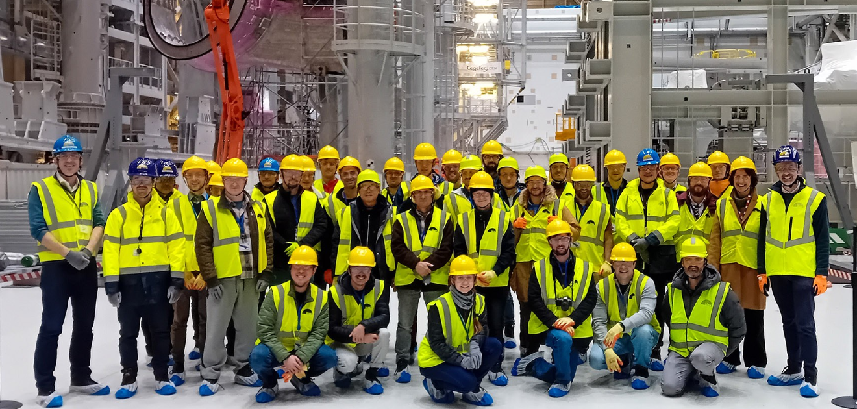
TSVV11 and IO interactions past & present
2nd in person TSVV11 meeting
37 persons meeting on-site, Eindhoven NL
20-24 March 2023
Every month, touch base informal meeting
TSVV11:
HFPS: C. Bourdelle, F.J. Casson J. Citrin A. Ho
PDT: M. Siccinio
ITER:
S. Pinches, O. Hoenen, M. Schneider, H-T Kim, F. Koechl, A. Polevoi, F. Poli
Goal: update on development strategy of HFPS/PDT, maximize synergy, TSVV11=validation of HFPS+PDT on EU tokamaks to optimize ITER operation
3rd in person TSVV11 meeting, Jan 22-26 2024, At ITER, > 50 participants

Slide 5
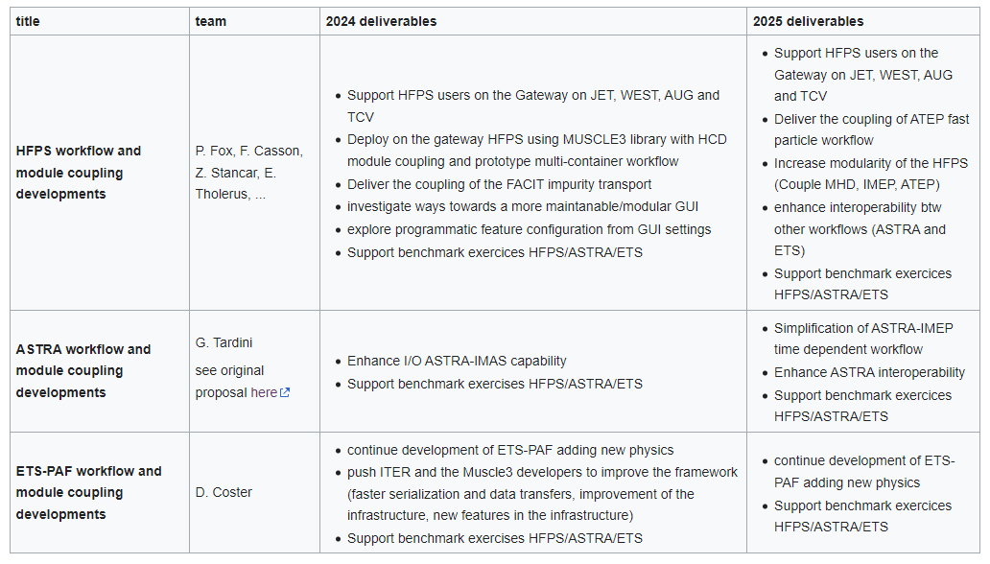
WP1: Integrating Modelling Workflow orchestration and module coupling framework, coordinator: F. J. Casson
Tbc. On-going finalization
Tbc. On-going finalization
Maximize synergy HFPS-ASTRA-ETS
Support benchmarks
Expected to be very usuful for ITER High Fidelity modelling tools benchmark, devt

Slide 6
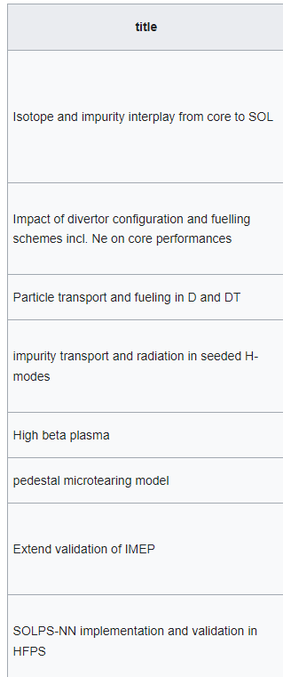
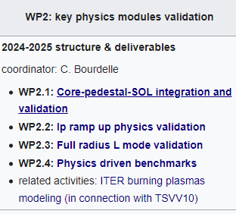
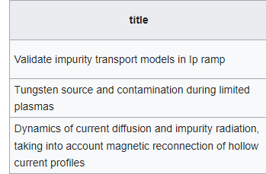
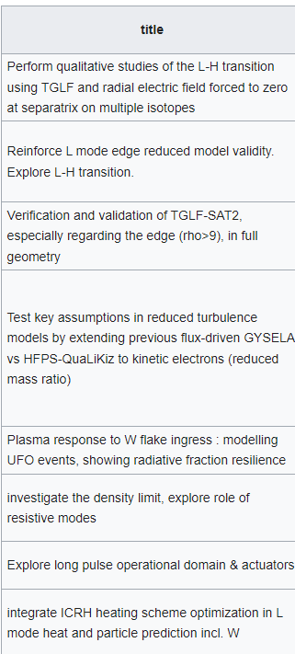
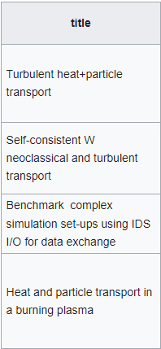
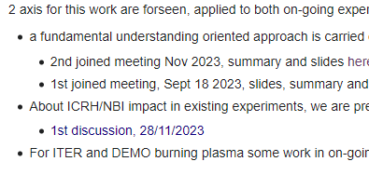
WP2: key physics modules validation, coordinator Clarisse Bourdelle

Slide 7
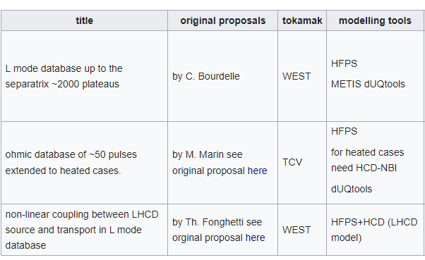
WP3: large scale validation, coordinator Clarisse Bourdelle
JET: > 5000 plateaus HFPS-QLKNN15D heat+particle validation
A. Ho et al (in prep.)
To be extended on TCV and WEST in 2024-2025 using TGLFsat2-HFPS and dUQtools (NL e-Science center)
predicted
predicted
predicted
measured
measured
measured

Slide 8
Pulse Design Tools, coordinator: M. Siccinio
Subgroup 1. Porting PD Tools on Existing Facilities.
Activity 1.1. METIS on COMPASS
Activity 1.2. FENIX on TCV
Subgroup 2. Development of Reduced Models and Workflow.
Activity 2.1. HPI2 Reduced Model for Pellet Ablation
Activity 2.2. Development of RAPDENS
Activity 2.3. Reduced Model for Neutral Density in the SOL
Activity 2.4. Development of DIV1D and Coupling to JETTO
Activity 2.5. Implementation of Reduced Model in Fenix
Activity 2.6. ASTRA/SPLEND1D coupling
Subgroup 3. Magnetic Equilibrium and Control for PS.
Activity 3.1. Breakdown Validation and Shape Control
Activity 3.2 METIS/DYON Workflow for Breakdown
Activity 3.3. NICE Development and Coupling to METIS
Activity 3.4. Coupling Fenix/MEQ
Goal for 2024:
- start from existing efforts and maximize the synergy and information exchange within EUROfusion.
- The convergence towards at least one machine independent PDT is targeted, and will be discussed in greater detail in an in-person meeting by the end of 2024.

Slide 9
Perspectives interaction IO/TSVV11 on High Fidelity integrated modelling and Pulse design Tools
Present working level interactions very good.
HFPS technical choices: good synergy between IO vision and on-going developments in HFPS/ASTRA and ETS towards python workflows, using Muscle3 library, IDS input and output
HFPS physics validation: win/win situation such that ITER tools are used and validated up to highest integrated modeling physics levels for heat, particle incl. W, radiation, RF+NBI, etc. Extending towards separatrix and SOL in 2024-2025. Also TSVV11 team can provide reference ASTRA/ETS/HFPS benchmarked cases to ITER for benchmark of new integrated modelling framework as needed.
PDT activity just starting. M. Siccinio will be working also 50% at ITER so very smooth link expected. By the end of 2025 EF/IO likely to have a shared devt and validation strategy.
Suggested opportunities for the future:
Open sourcing IMAS dictionary on-going at IO, open sourcing HFPS on EF side was our intend but Francis and I would need some support
On EF side needing: a faster FAIR access to all EU tokamak databases in IMAS format, incl. JET. ITER can likely help in gaining momentum here.
On EF side missing: Long term storage facility at Gateway with soft and hardware support. For reduced model training, for integrated modelling large scale validation storage etc. Maybe a synergy with ITER could help gain momentum.
For large scale validation synthetic diagnostics could be added, could be done in synergy with IMAS compatible ITER diags?
Towards PDT need faster yet accurate models. Priority and shared acceleration of the various models could be organized?

Slide 10
Back-ups

Slide 11
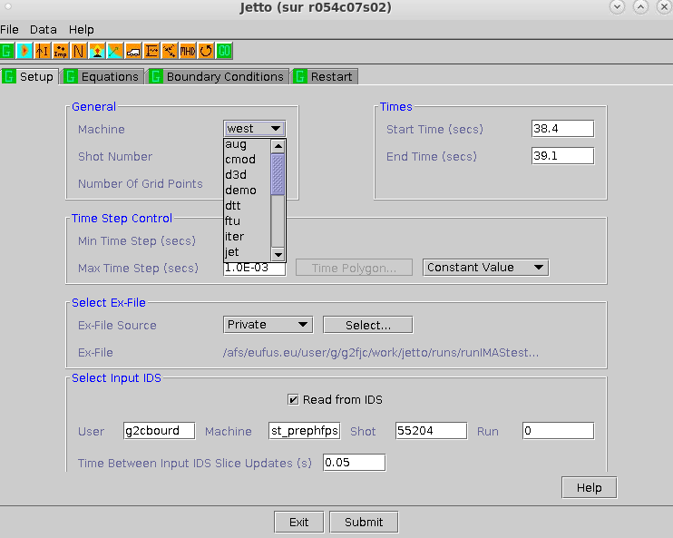
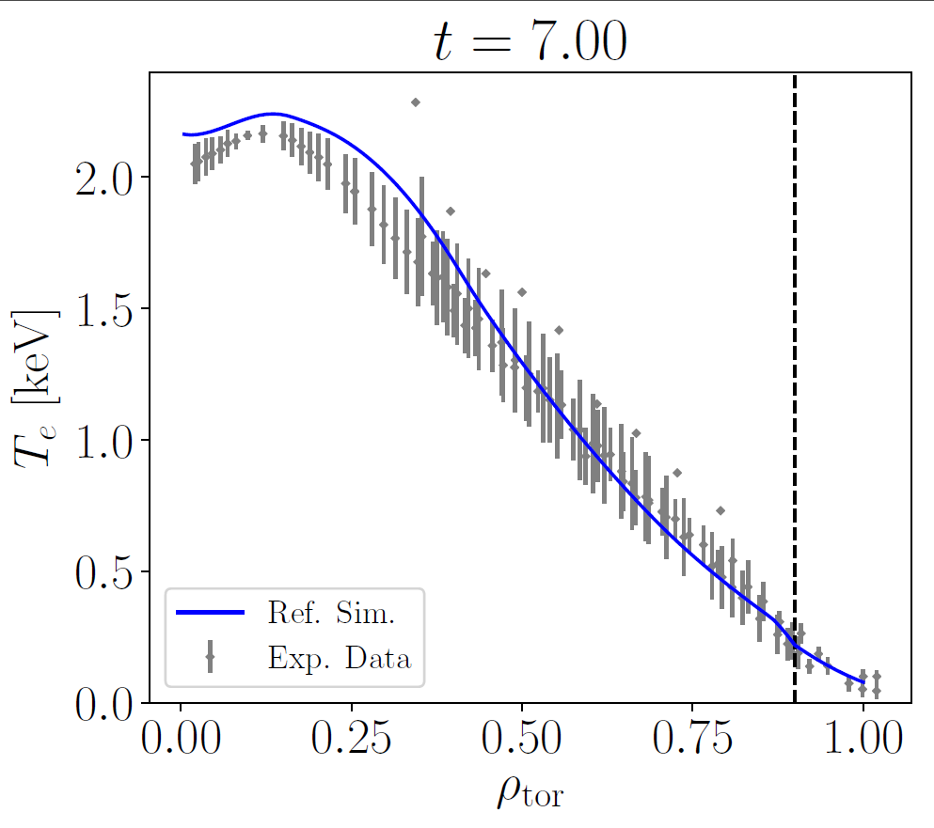
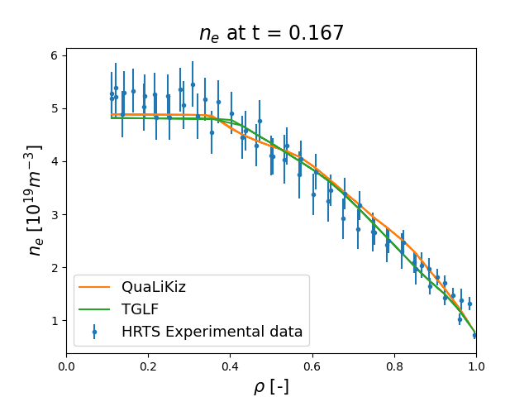
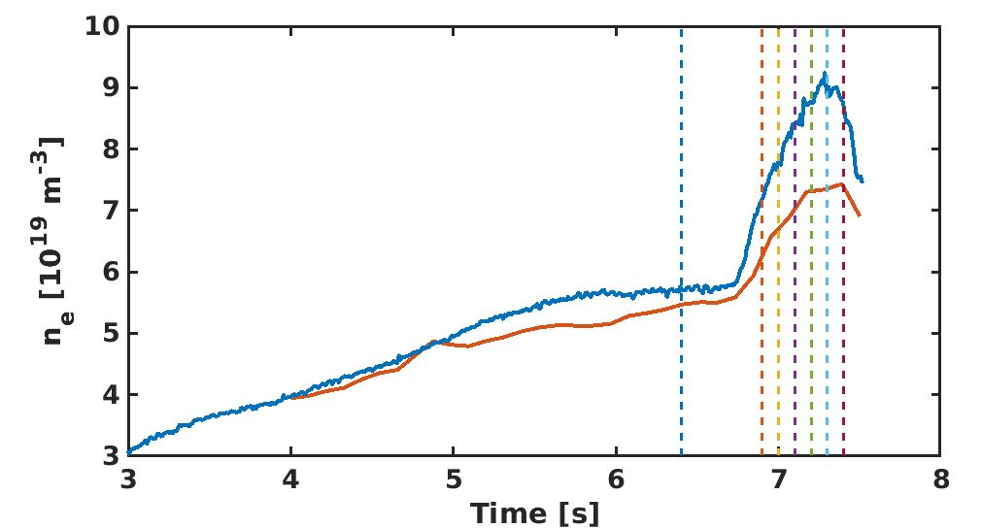
« The » High Fidelity Pulse Simulator
What is the High Fidelity Pulse Simulator?
Python-driven workflow based on IMASified JINTRAC (i.e. JETTO+EDGE2D, from the core to the SOL)
Workhorse for scenario preparation in ITER Physics Dept.
any IMASified physics module can be included
Coupled to experimental IMAS data from AUG, JET, TCV, WEST, on the EUROfusion Gateway
AUG
JET
TCV
WEST
Expt
HFPS-QuaLiKiz
$$ρ=0.5$$

Slide 12
A key tool: IMAS data structure
IMAS : Integrated Modelling and Analysis Suite Data Dictionary.
Chosen by IO for ITER future experimental data and present modelling in/output.
Machine and code generic. Capable of covering all experiment subsystems and plasma physics, extensible
Promoted as the standard to access all experimental results within EUROfusion in a unique data format in the FAIR and open science requirements
IMAS infrastructure includes:
Data Dictionary : machine generic
What data exist ?
What are they called ?
How are they structured ?
Data Access : functions to read/write objects
Workflow component generator : encapsulate physics codes to turn them into components that can be coupled in a workflow

Slide 13
A key tool: IMAS data structure
IMAS : Integrated Modelling and Analysis Suite Data Dictionary.
Chosen by IO for ITER future experimental data and present modelling in/output.
Machine and code generic. Capable of covering all experiment subsystems and plasma physics, extensible
Promoted as the standard to access all experimental results within EUROfusion in a unique data format in the FAIR and open science requirements
IMAS infrastructure includes:
Data Dictionary : machine generic
What data exist ?
What are they called ?
How are they structured ?
Data Access : functions to read/write objects
Workflow component generator : encapsulate physics codes to turn them into components that can be coupled in a workflow
ETS

Slide 14
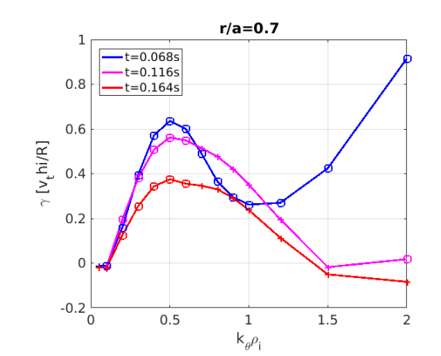
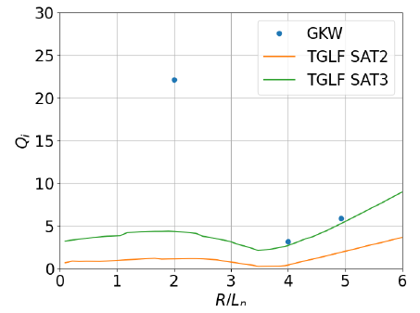
WP2-D1: Turbulent transport reduced models targeted validation, Y. Camenen
Focus on current ramp-up
Critical: need to minimize magnetic flux consumption while avoiding MHD instabilities
Target: TCV plasma with electron (Thomson Scattering) and ion (CXRS) measurements
Specific conditions: high Te/Ti, high q, high collisionality
Validate quasi-linear against non-linear gyrokinetic simulations
TEM dominated (R/Ln driven), especially in the early phase and at long wavelength, then hybrid TEM-ITG.
TGLF/GKW comparison for a R/Ln scan at r/a=0.5, t=0.068s
TEM threshold and stiffness versus R/Ln OK
Saturation level in the ITG branch largely underestimated
[Y. Camenen EPS 2023, TTF 2023]

Slide 15
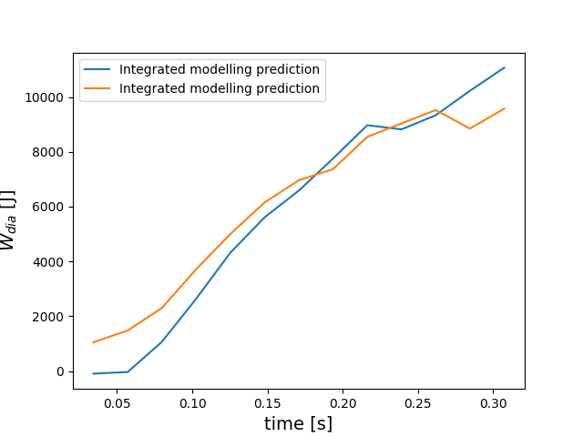
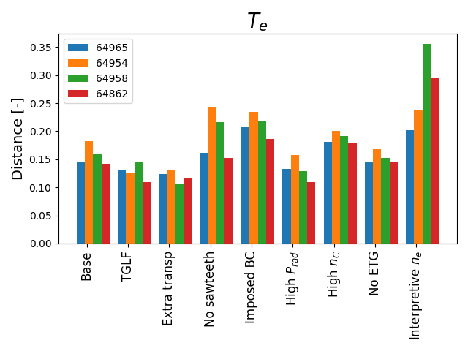
WP2-D1: Turbulent transport reduced models targeted validation, Y. Camenen
Focus on current ramp-up
The same settings on 4 TCV ramps
Extensive sensitivities to explore robustness
TGLF vs QuaLiKiz similar perf
Worse T_{e} prediction with n_{e} not predicted!
Integrated modelling of 4 TCV ramps
Predicting j, ne, nC, Te and Ti up to ρ=0.99
$$W_{dia}$$
Measured
Modelled
difference meas./model averaged in t, r
QuaLiKiz
WEST I_{P} ramp cases on-going
[M. Marin, TTF 2023]

Slide 16
WP2-D1: Turbulent transport reduced models targeted validation, Y. Camenen
Neural Network surrogate of QuaLiKiz extended to L mode edge parameters, incl. Ip ramps
Some overlap with QLKNN original hypercube [VanDerPlassche NF2020]
Far into the extreme range of parameters
Extension to more values of Ti/Te considered in the future
L. Chôné, VTT Advanced Computing Hub and TSVV11 members (K. VanDePlassche, J. Citrin)
Now available in the HFPS for testing
ACH

Slide 17
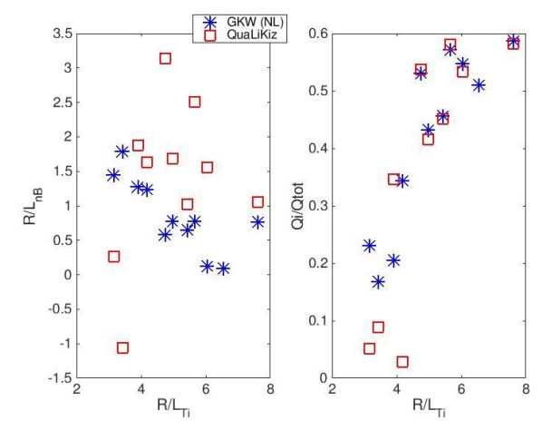
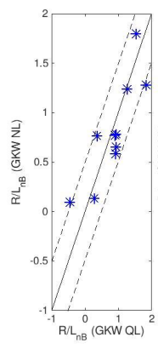
WP2-D3: Impurity transport, development of reduced models, verification and targeted validation. C. Angioni
Reduced model validation for turbulent transport of impurities
Boron, AUG database
QuaLiKiz Boron peaking at ρ=0.5 more scattered than GKW-NL
GKW QL~GKW NL
[P. Manas TTF2023]
[D. Fajardo TTF2023]

Slide 18
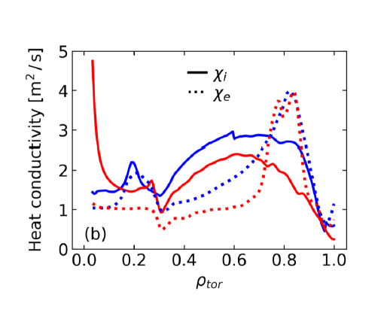
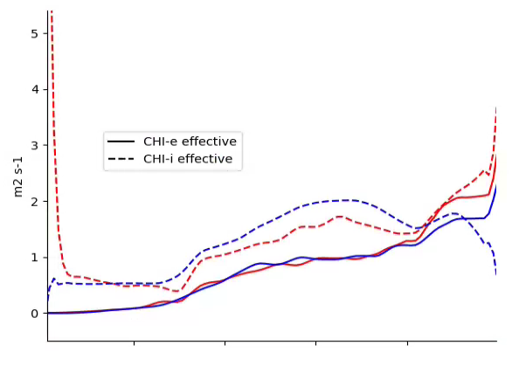
WP2-D3: Impurity transport, development of reduced models, verification and targeted validation. C. Angioni
Integrated modelling of radiative experiments
AUG: Radiative L-mode with X-point radiation, Ar seeding
ASTRA-TGLFsat2 up to ρ=1: Te, Ti, nD, nW, nAr predicted self-consistently
Improved ion and electron heat transport
WEST: X point radiative L mode, with N2 seeding
HFPS-TGLFsat 1 up to ρ=1: j, Te, Ti, nD, nW, nN predicted self-consistently
Improved ion heat transport, reduced W core peaking
[D. Fajardo TTF2023]
χ_{i,eff}
w/o N2
With N2
[S. Shi TTF2023]
χ_{e,eff}

Slide 19
WP4-HFPS systematic validation, A. Ho large scale simulation launching
https://github.com/duqtools/duqtools (open-source)]

Slide 20
WP4-HFPS systematic validation, A. Ho 1st results
JET extraction routine, EX2GK [A. Ho NF2019], generates IMAS data structure for HFPS initial/boundary conditions w/o manual adjustments
5721 plateaus (500 ms width) prepared
Automatically launched 5721 HFPS runs nothing predicted here ‘just’ sanity check
JINTRAC version:JINTRAC-IMAS, g2fjc / v230123, IMAS 3.37.0 (run on Gateway)

Slide 21
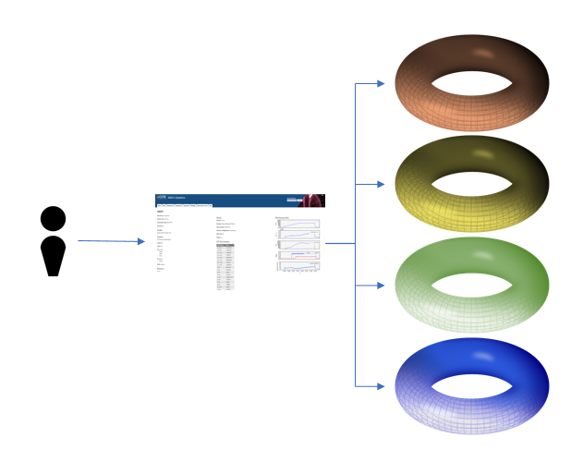
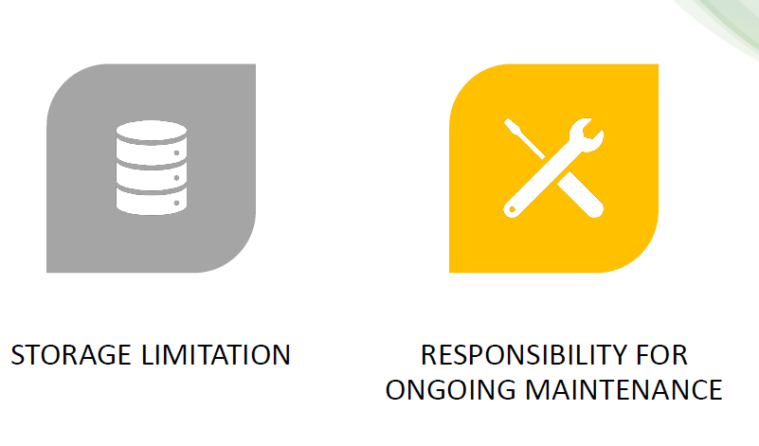
Large scale validation requires: access to experimental data and simulation database
Experimental data access:
4 scenarios proposed
A : Share physics metadata within the community (central catalogue)
B : Central access point for full data of all EU experiments
C : Add PIDs, links to publications + provenance
D : Opening data to the general public
Simulation database on Gateway available: simDB (also used by ITER)
Requires software and hardware support: Long Term Storage Facility see Gateway expert group 07/21 recommendation #6

Slide 22
Summary of the achievements
Integrated modelling EUROfusion community has a well organized framework (wiki, meetings, slack) to share results, exchange good practice, train new users
HFPS available on the Gateway to all, is running from AUG, JET, TCV and WEST IMAS data input, with a simulation database in place
Physics module validation (turb. in ramp up, impurity) through int. modelling on-going on physics driven integrated modelling works
Large scale validation tools in production
Gained momentum to agree on standards for IMAS python workflows/tools btw existing transport codes, with ITER Org., and hope for converging also with for e.g. MOSAIC at CFS

