Slide 1

FSD Science Coordination Meeting: Needs and plan for removal of tiles from JET-ILW
Jari Likonen (VTT) - Sub Project Leader for SPE
Anna Widdowson (UKAEA)

Slide 2
EUROfusion WPPWIE needs
Post-mortem analysis of JET tiles feeds directly into modelling done under PWIE SP D as well as to the ITER organization
Last chance to analyse tiles exposed to DT plasmas
Following slides show current planning for removal of components
Selection has been made with the following topics which are of interest to EUROfusion work programme
Tritium retention
  Validation of tritium retention predictions
  One poloidal cross section from divertor
  Set of tiles from inboard and outboard limiters
  Deposition monitors
LIBS comparison with fuel retention and deposition
  EUROfusion PWIE experiment during intervention in 2024
  Range of tiles for validation of LIBS analysis

Slide 3
EUROfusion WPPWIE needs
LID-QMS comparison of fuel retention
  WPTE RT22-06 LID-QMS experiments and gas balance comparison C46, C47, C45b
He interaction with tungsten (“tungsten fuzz”)
  WPTE RTHe-05 analysis of components following JET plasma experiment
  Tungsten lamellae tile 5 – stack B and A primarily
Microstructural changes in material
  EUROfusion PWIE - tungsten analysis
  Tile 5 tungsten lamellae and Langmuir probes
Dust collection
  One vacuuming but request to consider separate inner and outer divertor

Slide 4
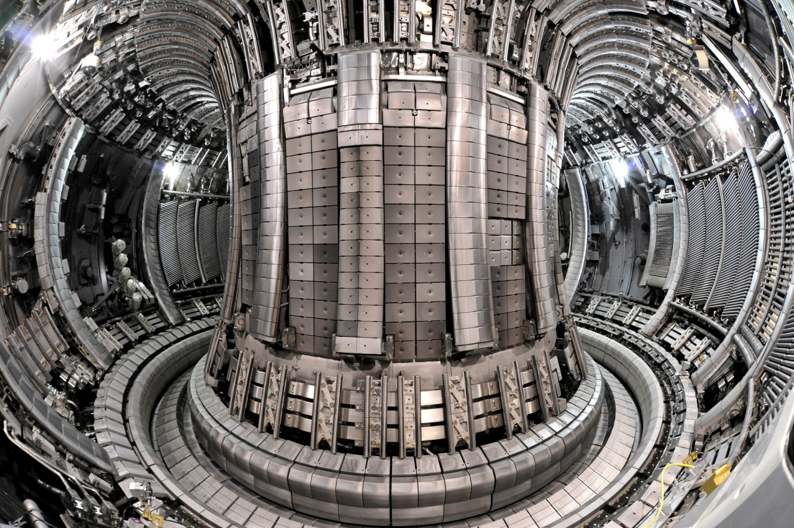
Typical PWIE materials for post-mortem analysis
MAIN CHAMBER
Upper Dump Plates (UDP)
Inner Wall Guard Limiters (IWGL)
Outer Poloidal Limiters (OPL)
Inner Wall Cladding (IWC)
Bulk Be
Be coated inconel
W – coated CFC
DIVERTOR
Inner & outer divertor
W-wedge, tile 5
W – coated CFC
Bulk W
PROBES
Rotating collectors
W sticking monitors
Mirrors, cassettes

Slide 5
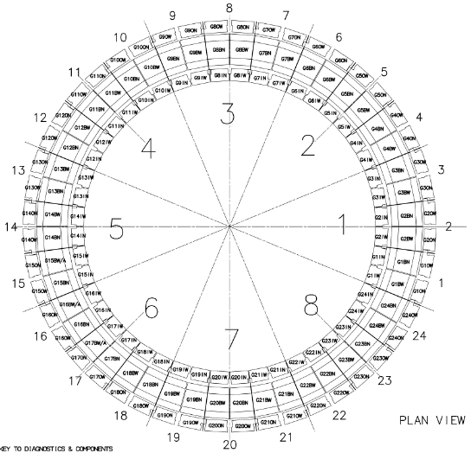
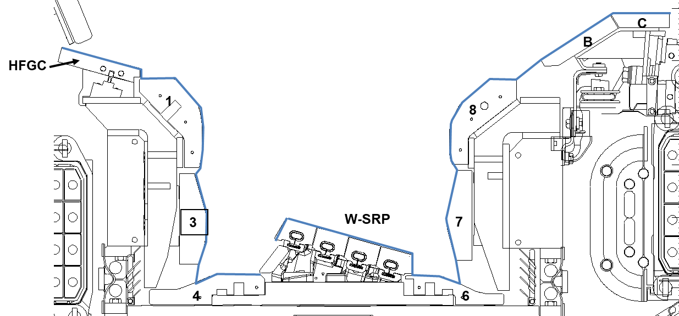
Dust collection: One vacuuming
inner & outer divertor
360° around divertor, excluding modules where tiles for analysis are located
Surfaces not to be vacuumed:
Module 14: 14IW, 14BW, 14W-WLBSRP,14N-WLBSRP, 14ON 14W-HFGCs, 14NHFGCs
Module 2: 2IW, 2ON
TBC: additional HFGC
Request to consider separate inner and outer divertor vacuuming
Collection <2g for both JET-ILW 2011-12 & 2013-14
Significantly lower than in JET carbon wall ~ 300 g

Slide 6
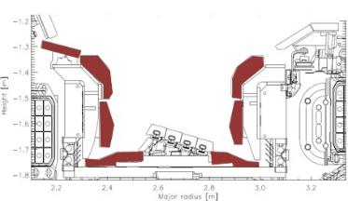
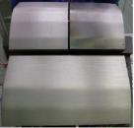
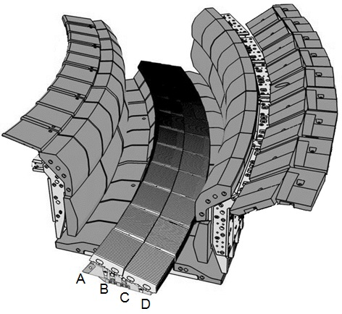
Module 14 Inner Wide
tile C
0
tile B
G1A
G1B
1
8
3
5
7
G3A
4
6
IW
G1A
G3A

Slide 7
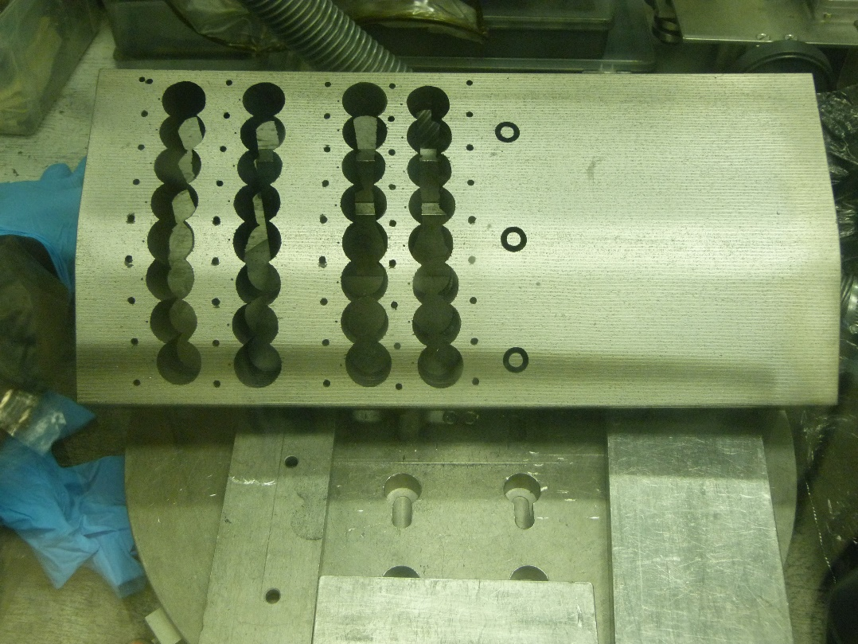
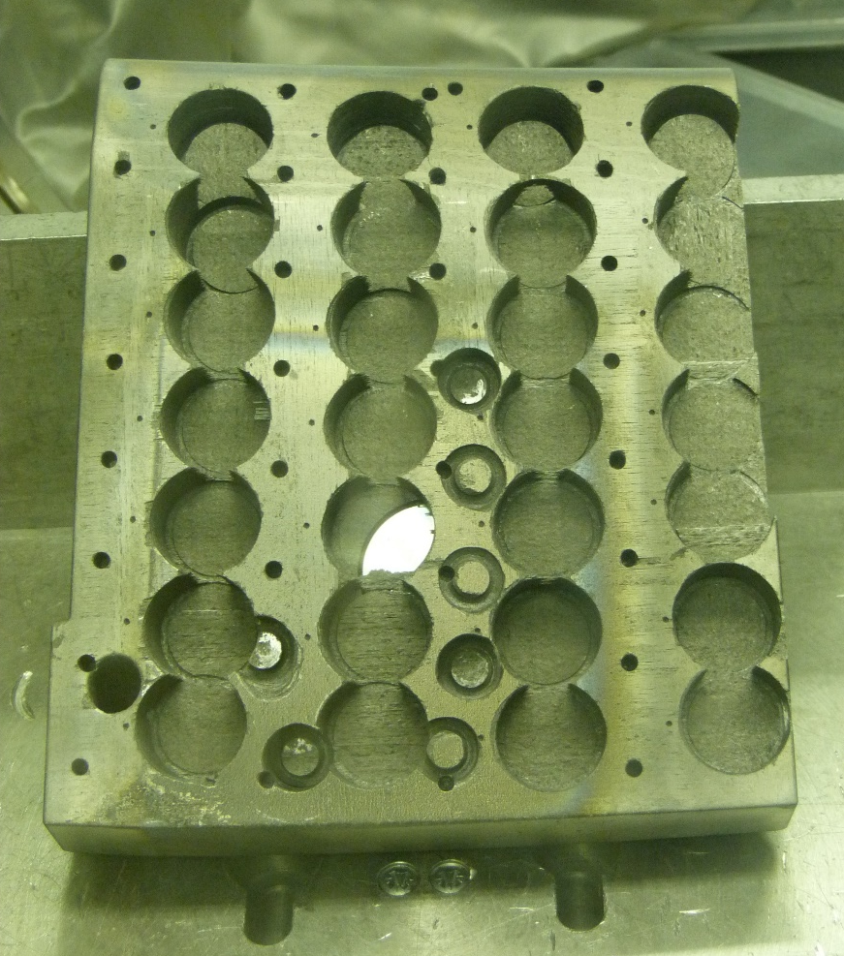
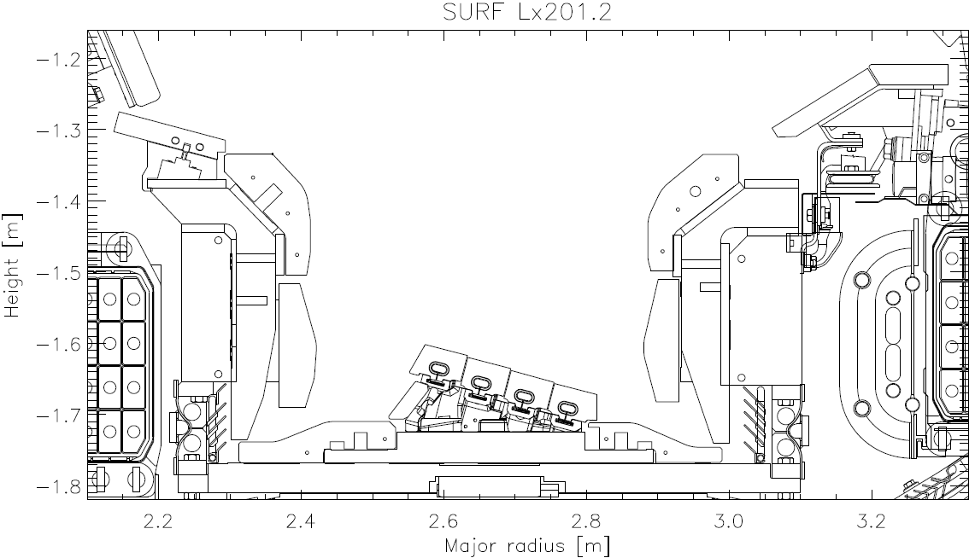
Sample preparation at VTT
HFGC 14NRH (2011-2016)
2ON G7A (2013-2016)
7c
7b
7a
7
8
8b
8c
7a
7b
7c
7d
6c
6a
6
6
6c
6b
5a
5b
5c
5
4
4c
4d
5c
5b
5a
3a
3b
3c
2
2c
4c
4b
4a
4
1b
1c
1d
1a
3c
3b
3a
3
NCSRD
CCFE
VTT
IST
IAP
2c
2b
2a
2
1c
1b
1a
1
7
CCFE
IST
VTT
MPG
ISSPUL
0
1
NCSRD
ISSPUL
VR, IAP
3
5
4

Slide 8
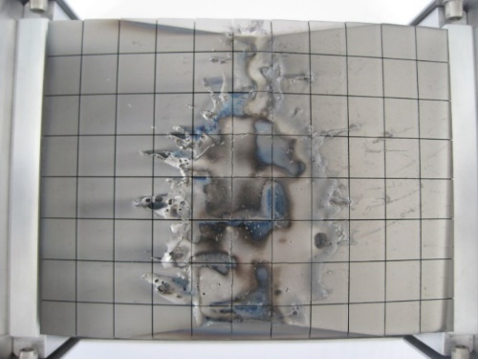
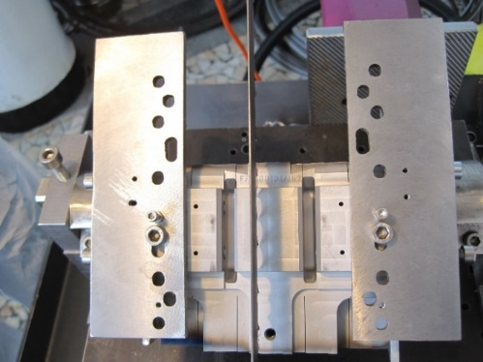
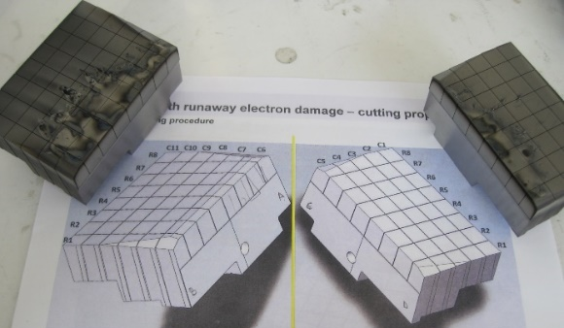
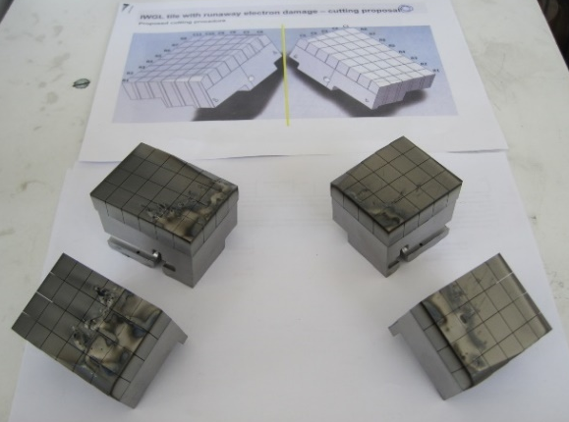
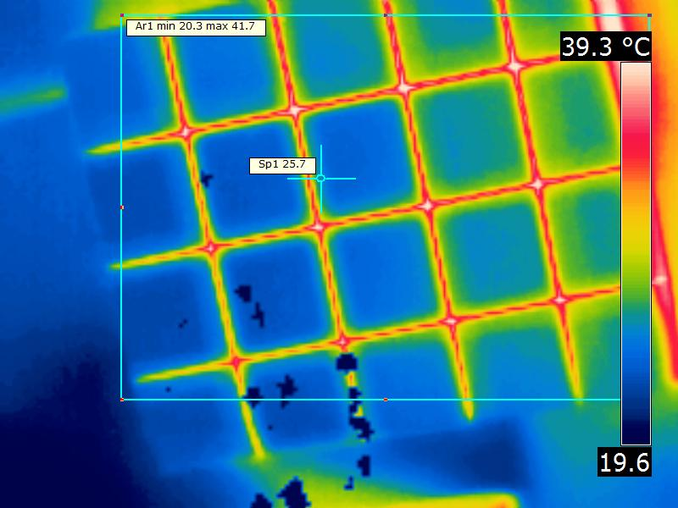
Sample preparation at IAP – Be tile with runaway electron damage
Cutting
Using the beryllium processing facility, cutting was performed on the Be RE damaged tile (1XR18 C3 IWGL)
Typical sample sizes: 10 mm x 10 mm x 10-12 mm or 10 mm x 10 mm x 2.5 mm
Any other size is possible with some constrains
During cutting the tile temperature did not exceed 58ºC
For temperature monitoring in real time a FLIR® E-Series Advanced Thermal Imaging Camera, (+/- 1 ºC ; 20-900 ºC) was used

Slide 9
DTE3 samples and analysis priorities under WPPWIE
Area | Location | Tiles | Priority | Analysis period | Aims, comments
Inner divertor (tiles 0,1,3) outer divertor (tiles 7,8) | First sector, Module 14 (Octant 5), LID-QMS section | LH14W (2011-2013) 14IWG1A (2019-2023) 14IWG3A (2011-2013) 2ONG7A (2019 2023) 2ONG8B (2019 2023) HFGC with no LID-QMS | 1 | 2025-2027 | LIBS Fuel retention, material migration
Floor tiles 4, 5, 6 | First sector, Module 14 (Octant 5) | 14BWG4A (2011-2013) 14W left side, option 2 (2011-2023) 14BWG6A (2011-2023) | 2 1 2 | 2026-2027 2025-2026 2026-2027 | LIBS Fuel retention, material migration Metallography RTHe-05 tungsten fuzz
Inner divertor (tiles 0,1,3), outer divertor (tiles 7,8) | Second sector, Octant 1 | HFGC 2WRH (2011-2023) 2IWG1B (2011-2023) 2IWG3A (2019-2023) 2ONG7A (2019-2023) 2ONG8B (2019-2023) | 3 | Only if module removed | Lines-of-sight for KS3
Floor tiles 4, 5, 6 | Second sector, Octant 8, module 23 | 23BNG4C 23N-LH (2011-2023) 23BNG6C | 3 | Only if module removed | Lines-of-sight for KT3
DIVERTOR
Notes:
PD: Plasma Devices as in PEP listed
HHF: High Heat flux as in PEP listed
IBF: Ion beam Facility as in PEP listed
Other facilties as in PEP listed

Slide 10
DTE3 samples and analysis priorities under WPPWIE
Area | Location | Tiles | Priority | Analysis period | Aims, comments
Inner wall guard limiter (IWGL) |  | 2XR9 (2019-2023) | 1 | 2025-2027 | LIBS Fuel retention
Inner wall guard limiter (IWGL) |  | 2XR19 (2019-2023) 2XR3 (2019-2023) | 2 2 | 2026-2027 2026-2027 | LIBS Fuel retention
Outer wall limiter (WPL) |  | 4D13 (2011-2023) | 1 | 2025-2027 | LIBS Fuel retention
Outer wall limiter (WPL) |  | 4D23 (2019-2023) 4D3 (2019-2023) | 2 | 2026-2027 | LIBS Fuel retention
Inner wall, KS3 |  | IWC 806 IWGL 8ZR9 | 2 | 2026-2027 | KS3 LOS
Inner wall cladding |  | 402, 411, 428 705C, 708C, 711C | 2 2 | 2026-2027 | LIBS Be, W ablation rate calibration Fuel retention
Inner wall |  | 7YC05, 7YC08, 7YC11, 7Z12L 7Z9L (2011-2023) | 2 2 | 2026-2027 | KS8 NB shine through W erosion over all ILW
Outer wall 4B wall bracket – mirrors and RC |  | 352, 353, 354, 356, 357 RC (2019-2023) | 2 | 2026-2027 | Mirrors pre-damaged, 0-20dpa
Outer wall dust collector – Oct 2 & 6 |  | Dust collector OU2, OU6 (2019-2023) | 2 | 2026-2027 | Be deposition Dust analysis
LIMITERS
INNER WALL
EROSION/
DEPOSITION
DIAGNOSTICS
Notes:
PD: Plasma Devices as in PEP listed
HHF: High Heat flux as in PEP listed
IBF: Ion beam Facility as in PEP listed
Other facilties as in PEP listed

Slide 11
DTE3 samples and analysis priorities under WPPWIE
Area | Location | Tiles/components | Priority | Analysis period | Aims, comments
Inner wall dust collector – Oct 4 & 6 |  | Dust collector IN4, IN6 (2019-2023) | 2 | 2026-2027 | Be deposition Dust analysis
Sticking monitors – inner wall Oct 3 & 5 |  | Sticking monitor Oct3, Oct5 (2019-2023) | 2 | 2026-2027 | Be sticking fraction on W D vs T sputtering
14 Narrow Tungsten Wedge (2011-2023) |  | Mirrors (4 pcs) Sticking monitor | 2 | 2026-2027 | Degradation in remote areas W substrates (3 pieces) for gross deposition in remote areas
Tungsten Tile 5 LBSRP 15W |  | Langmuir probes | 2 | 2026-2027 | Microstructural changes
Dump plates |  | 2B2C, 2B4C (2019-2023) | 3 | Only if resources still available | Fuel retention Melt damage
EROSION/
DEPOSITION
DIAGNOSTICS
TUNGSTEN
COMPONENTS
Notes:
PD: Plasma Devices as in PEP listed
HHF: High Heat flux as in PEP listed
IBF: Ion beam Facility as in PEP listed
Other facilties as in PEP listed

Slide 12
Identified issues
Current planning for removal of JET components will fulfill all EUROfusion needs
T amounts and activation information of JET tiles and components would be needed for planning of post-mortem analysis program under WPPWIE
Cutting of samples: CFC tiles at VTT-Finland and metallic components at IAP-Romania
Shipment of JET tiles and samples
  Licensed Type A containers required (divertor tiles HFGC and 1 can be very active)
  Who will acquire them (2 containers needed)?
  Licensing of the containers?
  Who will prepare the paperwork for radioactive shipments?
  Shipments will be paid by EUROfusion (VTT)
  Framework for EU-Japan collaboration (Broader Approach)?

Slide 13
Identified issues
A meeting to discuss about the shipments and interfaces need to be arranged
  Setup of a working group?
  Need to discuss about interfaces
Open question still is which laboratories can participate in the analysis program of DTE3 samples

