Slide 1
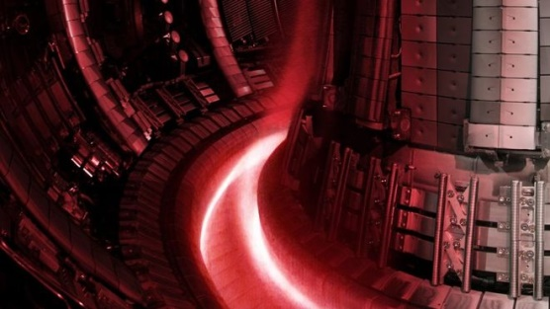









Needs and plan for Neutronics activities
Science Coordination meeting on JET decommissioning and FSD related activities
28 November 2023
Rosaria Villari
X. Litaudon, M. Dentan, N. Fonnesu, L. Packer, N. Terranova, R. Vila & PrIO SP5 team

Slide 2
Introduction
The EUROfusion technological exploitation of JET DT operations began in 2014 in the frame of WPJET3 program and it is currently ongoing within the SP-5 “Neutronics, Nuclear waste and Safety” within WPPrIO
Several technology-oriented experiments and analyses were performed in DT aimed at
  improving the knowledge of nuclear technology and safety
  developing and validating nuclear codes, data and experimental techniques
in preparation of ITER nuclear operations
JET DT experience is relevant for ITER technologies:
  Up to 10¹³ n/cm²/s neutron flux level as in rear ITER blanket- DFW
  cumulated DTE2+DTE3 neutron fluence up to 10¹⁶ n/cm² as in rear ITER port plugs at end of life & middle ITER port plugs- rear blanket at end of DT-1 phase
Many detectors and samples are installed inside and outside JET torus hall & timely retrieval is needed to maximize the scientific return
The needs include also support from UKAEA engineering & science staff to successfully complete the program and gain the maximum achievements for ITER benefit
Proposals for a Special issue on DTE2-DTE3 neutronics in Nuc. Fus or PPCF or FED to be issued in 2024

Slide 3
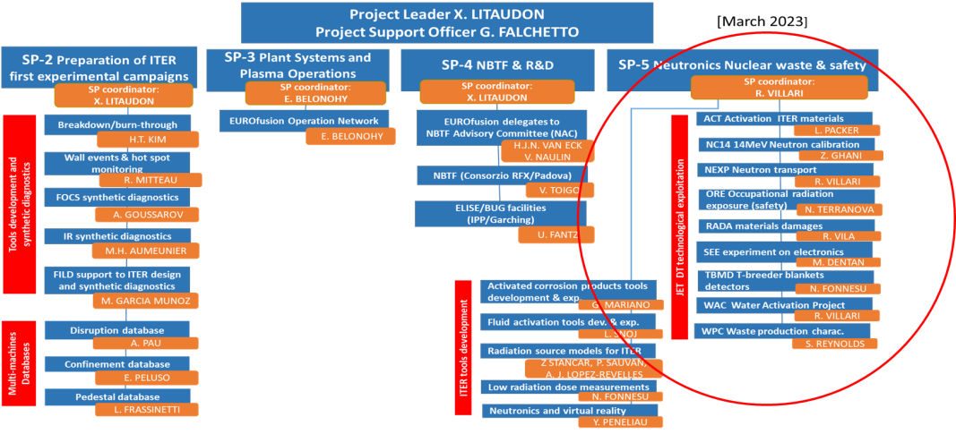










Technological exploitation of JET DT campaign
DT operations at JET offer a unique opportunity to study in real tokamak environment:
Calibration of neutron detectors
Activation and damage of materials, water & electronics
Tritium breeding & detectors
Validate nuclear codes
Develop advanced techniques
Collect & process nuclear safety data
Project | Task responsible | DD,TT, DTE2 | DTE3 | Detectors /samples in J1T | Detectors /samples outside TH | Equipments in J1D
NC-14 14 MeV Neutron calibration | Z. Ghani (UKAEA) | X-JO | X-JO | Neu diag |  | Neu diag
ACT Activation of ITER materials | Lee Packer (UKAEA) | x | x | LTIS & IE
RADA Radiation damage studies | R. Vila (CIEMAT) | x | x | LTIS |  | X
NEXP Streaming & Shutdown dose rate benchmark exp | R. Villari (ENEA) | x | x | several positions | various positions SW labirinth & SE chimney + pit | X
TBMD Test Blanket Module detectors - TBR | N. Fonnesu (ENEA) | x | x | Oct 8 & 3 |  | X
WACT Water activation exp | R. Villari (ENEA) |  | x |  | Oct 4 basement | X
SEE Single Event Effects on electronics | M. Dentan (CEA) |  | x |  | SE basement | X
ORE Occupational Radiation Exposure | N. Terranova (ENEA) | x | x
WPC Waste | S. Reynolds (UKAEA) |  | x
WPPrIO
SP5 collaboration
+
3

Slide 4
Summary of PrIO SP5 JET technology plan & needs
When | JO Activities for completion of the technological program: DTE3 post-analysis | For the sub-project
As long as possible | Keep IC power-on for shutdown dose rate measurements | NEXP
Jan’24- Feb ‘24 | WACT calibration in the basement | WACT
 | Retrieval,clearance, shipment to Greece of AF set 1 | NEXP
 | Collection & provision of detailed information on the WACT assembly & position | WACT
 | Retrieval of instrumentation in J1D and shipment to CIEMAT | RADA
 | Support from NEU group to analysis of the measurements | WACT
March ‘24 | Retrieval of sample holders & fibers after DT campaign from LTIS, clearance & shipments | ACT, RADA
 | Retrieval,clearance, shipment to Greece of AF set 2 and TLDs to Poland | NEXP
 | Provision of DD,TT and DT neutron yield rate data of 2023 campaigns | NEXP, WACT, ACT, SEE, RADA,TBMD, NC14
 | Results JET Neutron DT Plasma calibration (2021- 2023) | NEXP, WACT, ACT, SEE, RADA,TBMD, NC14
 | Provision of results of analysis of AF& PNS | SEE
 | Provision of Input data and documentation to simulate the water cooling circuits | WACT
 | Provide access to HP Method statements & Final reports intervention/maintenance | ORE
 | Support from CAD officer | NEXP, WACT
May ‘24 | Retrieval, clearance and shipment to ENEA Frascati of the two diamond detectors in the periscope port of octant 3 + acquisition chain of diamond detectors in KN5A cublicle in J1D | TBMD
When | Asset – II stage | Assets of sub-project
End of ‘24 | Retrieval of the 3 ICs from OCT 1 & 2 and 3 electrometers from J1D clearance and shipment to ENEA-Italy Retrieval of polyethilene moderators & shipment to IFJ (Poland) and NCSRD (Greece) | NEXP
 | Retrieval and shipment to ENEA Frascati of the diamond detector, preamplifier and TBM mock-up located in J1T in octant 8 | TBMD

Slide 5
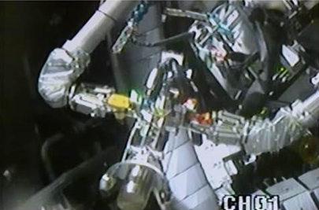
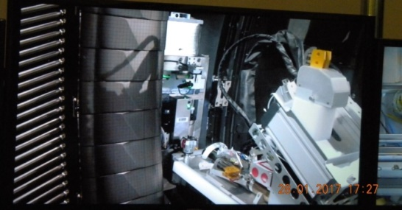
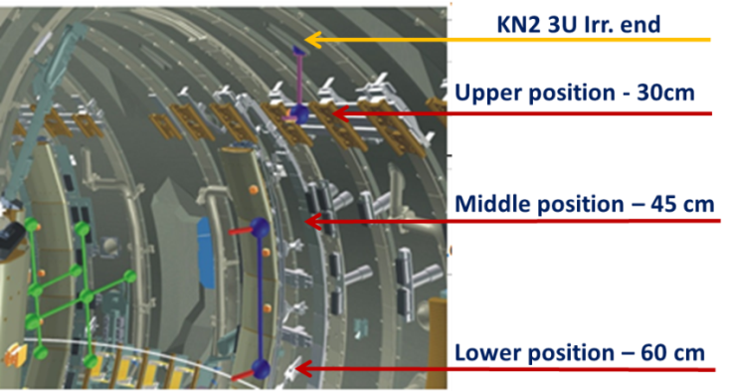
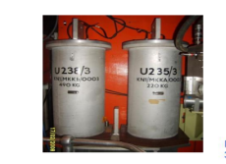
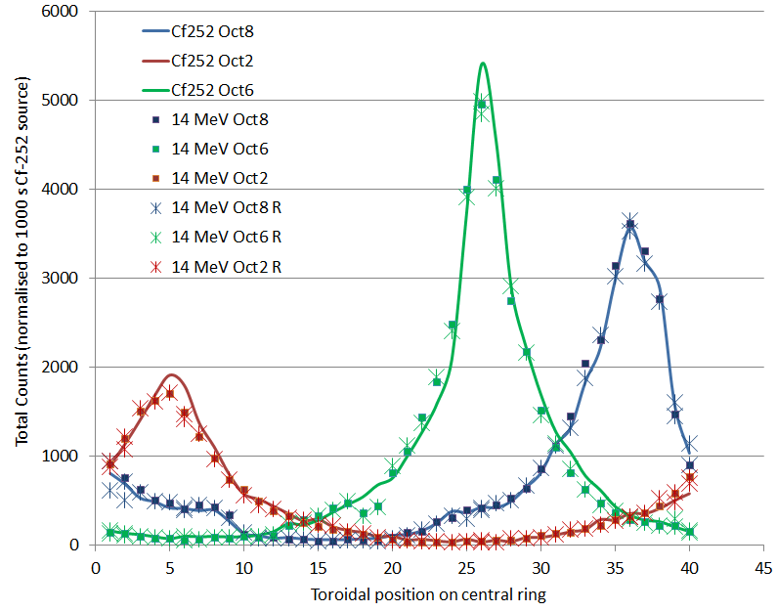
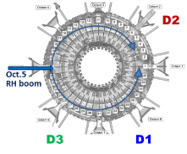
NC-14 Calibration of JET neutron detectors at 14-MeV neutron energy
Successfully achieved 14 MeV calibration of JET neutron detectors with Neutron Generator (NG) in 2017
NG intensity ~2 x10⁸ n/s
Diamonds & AF monitors
absolute calibration
KN2 Activation system chambers
KN1 ²³⁵U Fission chambers
Total uncertainty ±~6% well within target accuracy ≤ 10%
Successful operation in vessel of neutron generator + PS units + detectors + electronics with RH system
Demonstration of methodology
P. Batistoni et al. Nucl. Fusion 58 (2018)
Verification & validation of 14 MeV calibration following DT operations is in progress
relevant for neutron calibrations of ITER neutron detectors and absolute measurements of fusion power!
Provide accurate neutron yields for neutronics experiments
5

Slide 6
NC-14 14 MeV N calibration: what EUROfusion team needs?
1) Provision of neutron yield rate data from 2023 JET campaigns breakdown DD, TT & DT components
Why: These data are fundamental for all the analyses of NEXP, ACT, RADA, TBMD, SEE, WACT.
When: Possibly March 2024
Priority: HIGH- all analyses of the other projects depend on these data
2) Results JET Neutron DT Plasma calibration (2021- 2023) /Verification & validation of the methodology /Lesson learnt for ITER
- PrIO task assigned to Zamir Ghani (UKAEA) – postponed due to operation priorities
Why: These data are crucial for the demonstration of the methodology in view of possible ITER application
When: Possibly March 2024
Priority:HIGH- scientific relevance of 14 MeV N calibration experience at JET for ITER
NG

Slide 7
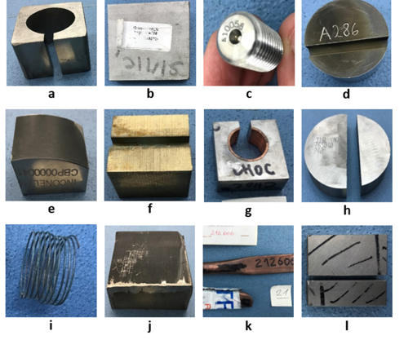
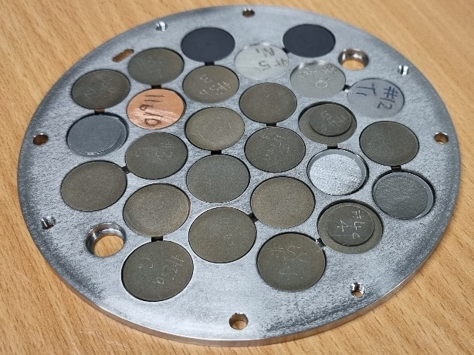
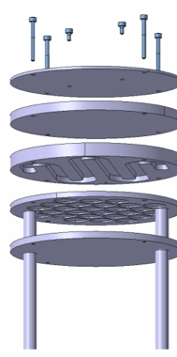


ACT: Activation of real ITER materials
Unique irradiation in tokamak under 14 MeV neutrons of REAL ITER materials used in the manufacturing of the main in-vessel components
  Activation measurements of irradiated ITER material samples and dosimetry foils in DT
  Characterization and data validation for the predictions of ITER materials activation
Long-term irradiation station assembly (LTIS)
For DTE2
715 days of irradiation
DT N flux
up to 2x10¹³ n/cm²/s
One order of magnitude less than ITER FW@500 MW
DTE2 N fluence
5x10¹⁵ n/cm²
27 ITER samples
Assembly location
JET plasma
  Nb3Sn, SS316L steels from various manufacturers, SS304B, Alloy 660, Be, W, CuCrZr, OF-Cu, XM-19, Al bronze, Nb3Sn, NbTi and EUROFER
L. Packer Nuclear Fusion (2021) 61 116057
New samples installed at JET for DTE3 on 8 Feb ‘23

Slide 8
ACT : what EUROfusion need?
Retrieval of sample holders after DT campaign from LTIS and clearance
Why: To carry-out the gamma spectra measurements in home labs (UKAEA, ENEA, IFJ, IPPLM, NCSRD)
When: within ASAP possibly within April 2024- depends on radiological protection constraints
Priority: HIGH+- the quantities of interest decay with time
The timing of retrieval affects the capability to measure relatively short-lived, e.g. half-life of Co-58 is ~71 days, Cr-51 ~27 days, Fe-59 ~45 days, Zr-95 64 days, W-185 ~45 days and there are many others including activation products from not expected impurities which might be recognised if timely measured!
2) Provision of DD, TT and DT data from 2023 campaigns- breakdown DD, TT & DT components
Why: These data are fundamental for the ACT analysis
When: Possibly March 2024
Priority: MEDIUM/HIGH – the analysis of the measurements & calculations relies on these data
NG
Contact: lee.packer@ukaea.uk

Slide 9
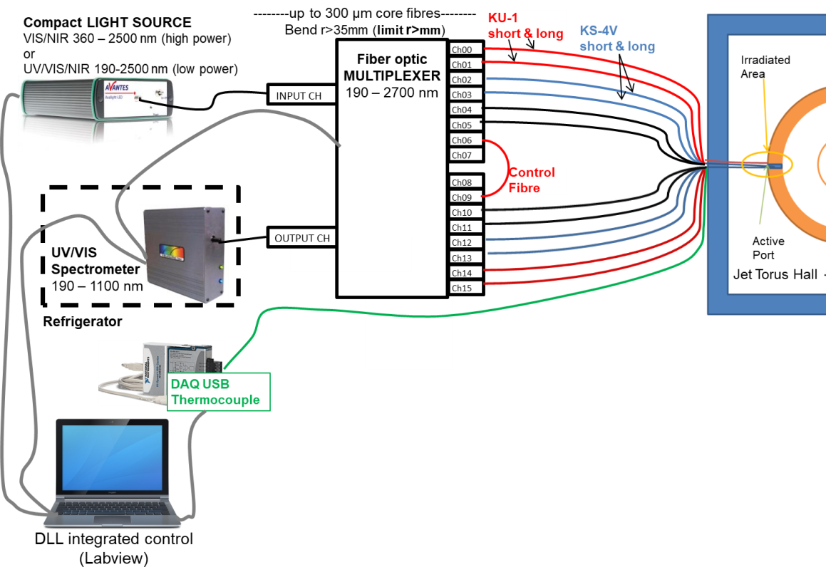
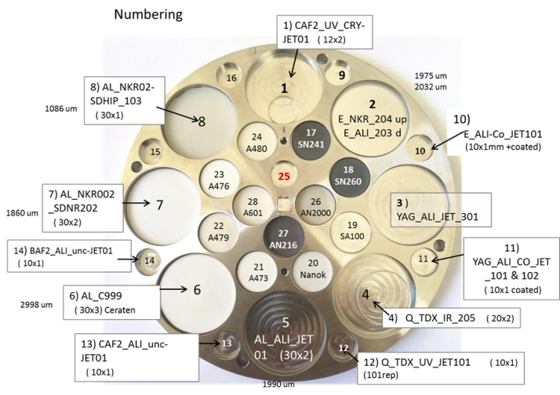
RADA Functional material damage studies
Assessment of functional materials physical properties degradation due to fast neutron and γ-ray irradiation during the TT and DT campaigns at JET
Combination of
  PIE of selected insulators (optical + dielectric)
  In-situ measurements of optical fibre evolution with accumulating DT pulses and recovery phases
The data can be used to validate simulation predictions of damage induced by fusion neutrons
Passive sample- LTIS holder
Characterized before irradiation
Installed in Sept. 2020 & in place for DD,TT & DTE2-DTE3
Cumulated DT N
fluence 10¹⁶ n/cm²
Retrieval & Analysis of irradiated samples in 2024
LTIS
Optical fibers
Real time testing of optical transmission during TT & DT
  OXIDES (polycrystalline & single crystal) : Aluminum Oxide , Mg-Al-Spinel and YAG Different suppliers
  Amorphous Oxide: Silica (2 grades) Nitrides: AlN and Si₃N₄ Fluorides: CaF₂ and BaF₂ & Diamond
More than 5000 pulses until Aug 2022 !
JO forced to cut the fibers during holders retrieval in Sept’22 – No DTE3
9

Slide 10
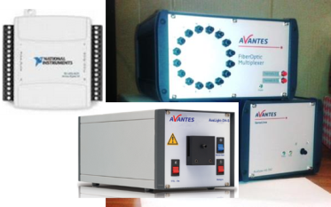
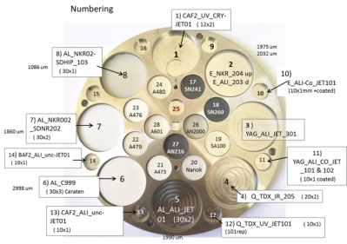
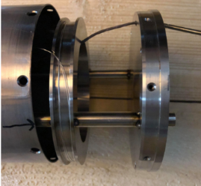
RADA : what EUROfusion need?
Retrieval of instrumentation in J1D and shipment to CIEMAT
Why: To carry-out the PIE in CIEMAT lab
When: Feb’24
Priority: MEDIUM/HIGH- instrumentation needed to carry-out PIE examination on damaged optical fiber
2) Retrieval of sample holder + optical fibers after DT campaign from LTIS, clearance & shipment to CIEMAT*
Why: To carry-out the PIE measurements in home labs (CIEMAT & DEMOKRITOS)
When: with ACT samples
Priority: MEDIUM/HIGH- Post irradiation measurements & analysis cannot start without samples
3) Provision of DD, TT and DT data from 2023 campaigns- breakdown DD, TT & DT components
Why: These data are fundamental for the RADA analysis
When: Possibly March 2024
Priority: MEDIUM/HIGH –RADA analysis relies on these data
Instrumentation (J1D)
- Fiber optic MULTIPLEXER 190–2700 nm (AVANTES)
- Compact Dual LIGHT SOURCE: UV-VIS - Deuterium
+Halogen (Avantes)
- UV/VIS Spectrometer 190 – 1100 nm (AVANTES)
- NI USB 6501 Module
NG
LTIS
RADA holder
*Shipment : CIEMAT (Spain) - Then the samples will be separated and some sent to DEMOKRITOS
Optical fibers
Recover the irradiated portion of the two optical fibres in the
spool behind the sample holder in LTIS position → PIE at Ciemat
This fibre portion can just be cut and added to the package of samples. (Note: Very fragile)
Contact: Rafael.vila@ciemat.es

Slide 11
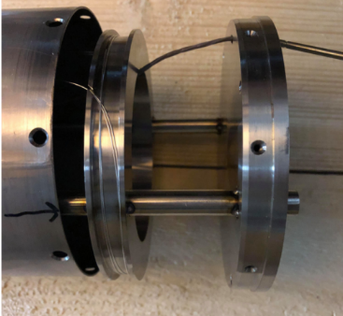
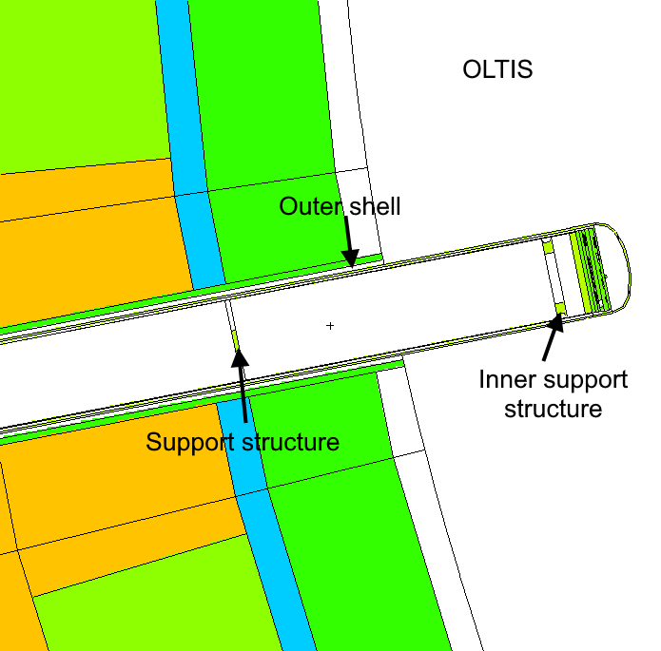
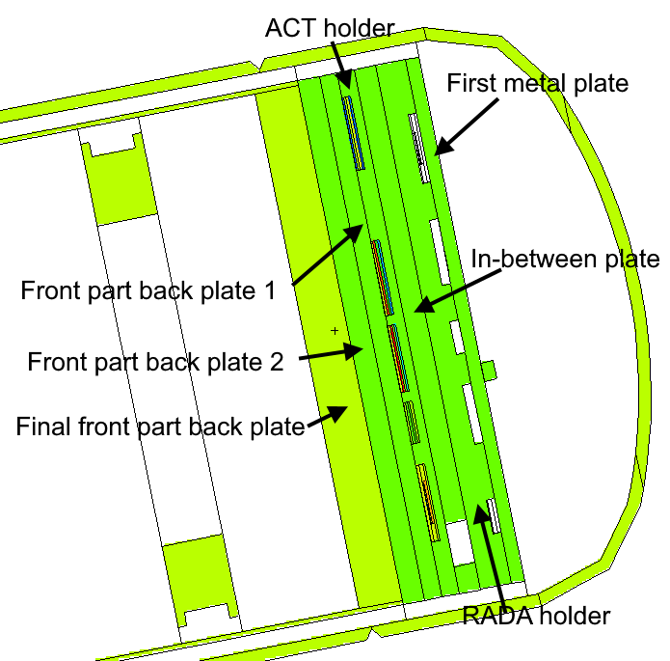

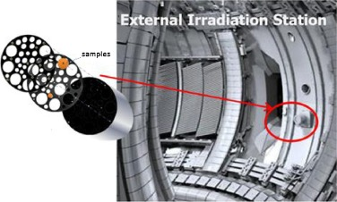
LTIS: ACT & RADA SAMPLE holders + optical fibers
2 Samples holders + 2 optical fibers in LTIS
LTIS Long Term irradiation Station in Oct 7
ACT holder
2 optical fibres in the spool
RADA holder
Assembly location
NO RH needed
Outside Vacuum boundary
Scaffolding needed
Use of Shielded drum
Transfer to MRF needed
Dose estimation in progress
JET plasma

Slide 12
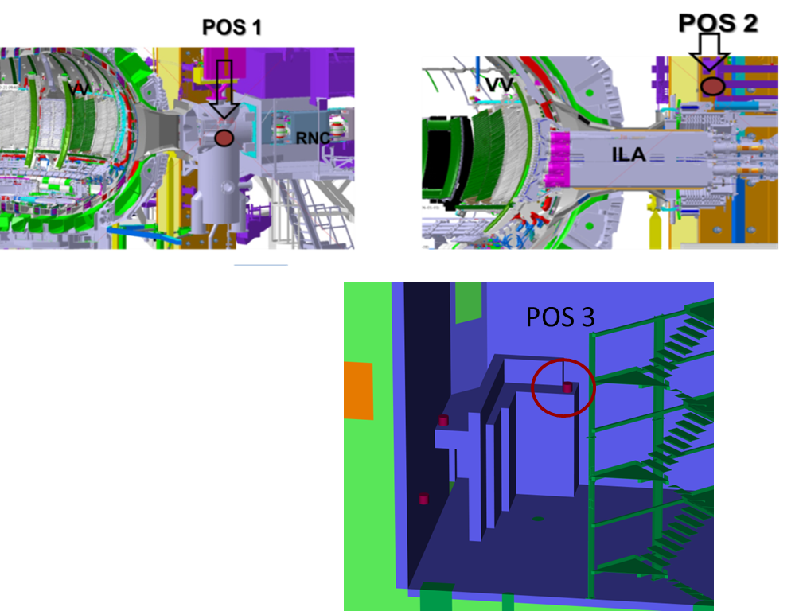
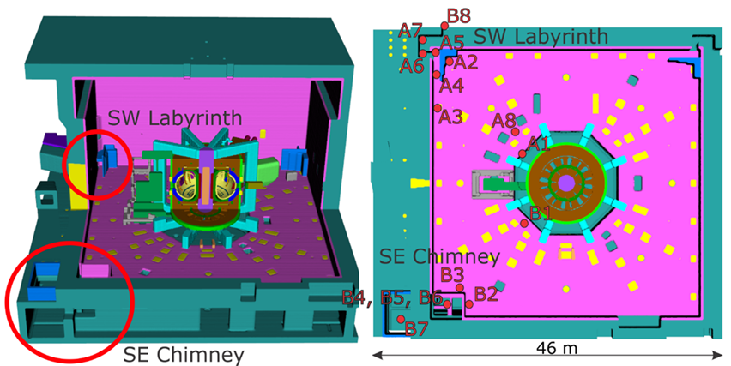


NEXP Neutron Streaming & Shutdown dose rate benchmark experiments
Neutronics experiments for validating in a real fusion environment the neutronics codes and nuclear data used in ITER nuclear analyses.
Neutron streaming in penetrations in large /complex volumes
Shutdown dose rate in maintenance area
Neutron fluence
Thermoluminescent detectors (TLDs)
Activation Foils (AF)
Shutdown dose rate
Ionisation chambers (IC)
  23 positions
  >40 m from the plasma
  8 orders of magnitude variation
  DT N fluence 10⁵ to 10¹³ n/cm²
  DT SDR 4μSv/h -20 mSv/h
[Batistoni, NF, 55, 053028 (2015)- Villari, FED,107,171 (2017)- Kos, FED, 147, 111252 (2019)- Naish, FED, 170, 112538 (2021)]
  Accurate measurements for quantitative comparison to simulations → Validation
  Several codes: MCNP, ADVANTG, TRIPOLI-4©, ADVANCED D1S, D1SUNED, R2SUNED, R2Smesh, MCR2S, N1S, ORNL R2S

Slide 13
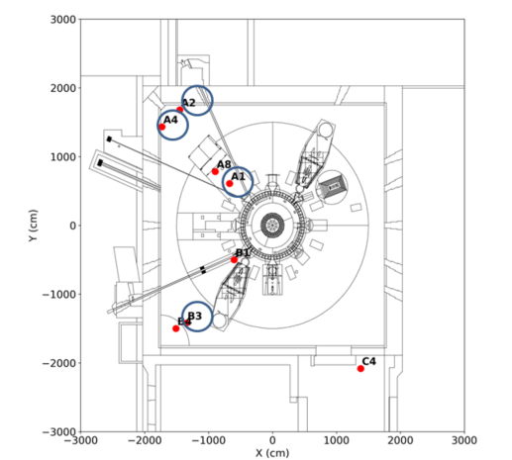
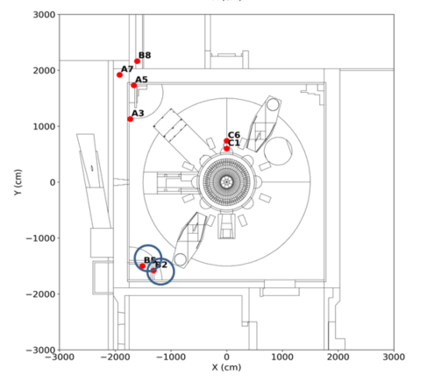
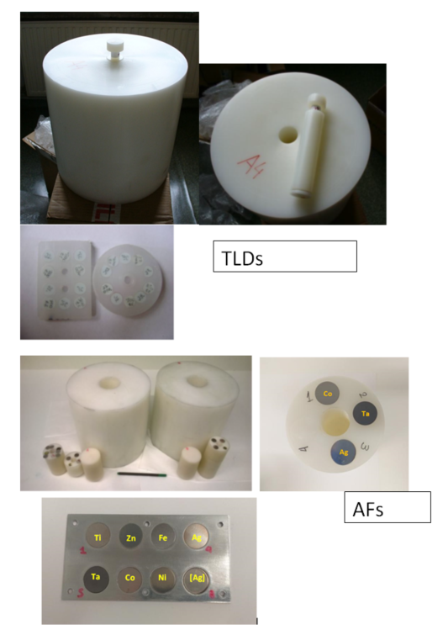
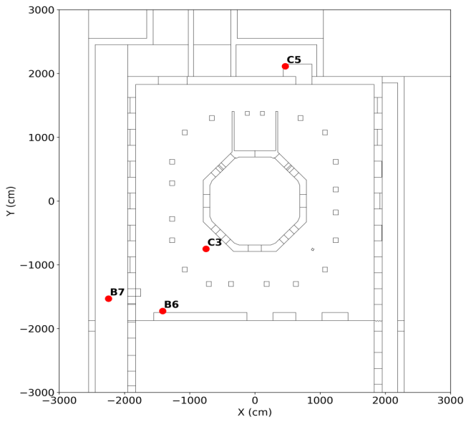
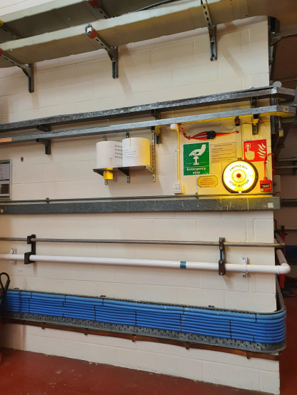
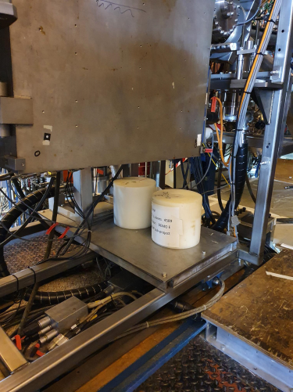
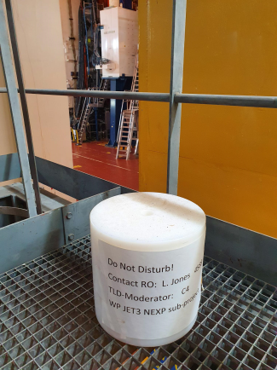
NEXP Streaming detectors & positions
TLDs installed in 21 positions & AFs in 6 positions (A1, A2, A4, B2, B3 and B5- blue circles) + bkg TLDs in L.Jones office
Midplane Ground floor Basement
B2
A1
TLDs
PE rods to be retrieved and sent to IFJ (Poland)
DEMO AF
PE rods to be retrieved and sent to NCSRD (Greece)
C4

Slide 14
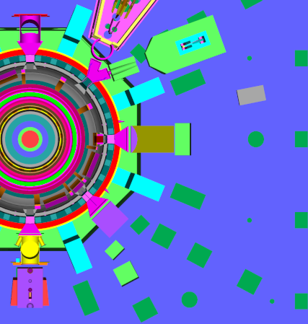
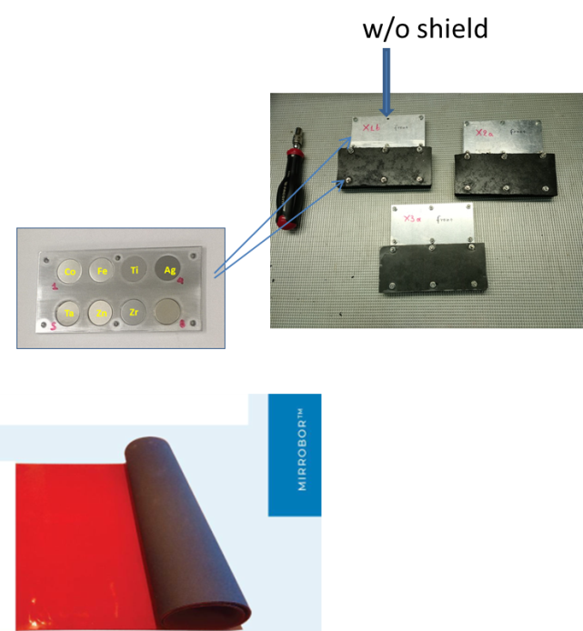
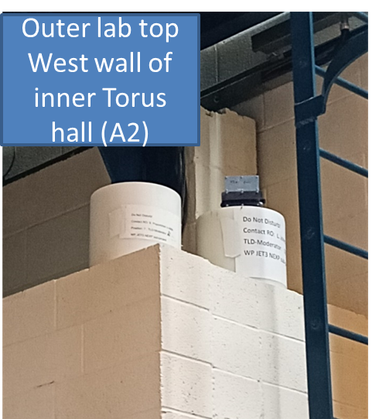
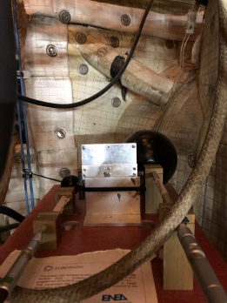
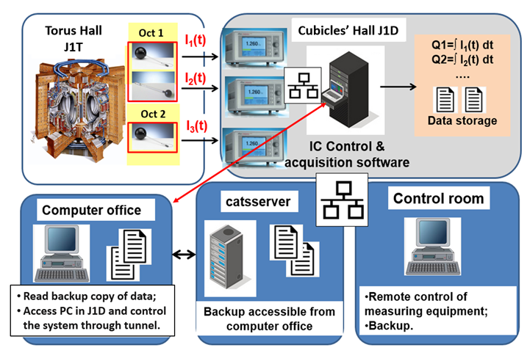
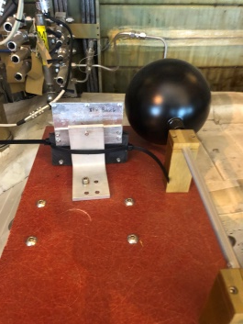
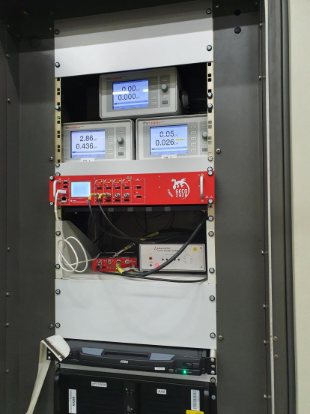
NEXP SDR detectors & positions
AF + B₄C flexible shield
AF
IC
big
IC small
X1,X2,X3
2
Pos 1
1
Pos 3
Mirrobor kindly procured by CERN
IC
big
AF
AF to be retrieved and sent to NCSRD (Greece)
B2
A1
C4
Online continuous
Gamma dose rate measurements with ICs since 2016-
IC should be operating even during 2024 shutdown!!
Pos 2
Electrometers of ICs

Slide 15
NEXP: what EUROfusion team needs?
Keep the power on in the J1D- KN5A cubicle for IC measurements during 2024 shutdown
Why: To carry-out the shutdown dose rate measurements in 2024
When: N/A- keep IC power-on as long as possible
Priority: HIGH+- Necessary to measure the temporal evolution of the dose rate during shutdown
2) Retrieval of Activation foils SET1(X3a-b,DEMO in B2, A4, B3, A2, B5), clearance and shipment to NCSRD,Greece
Why: To carry-out the activation measurements in NCSRD lab & assess B4C shielding efficiency
When: ASAP possibly within Jan 2024!
Priority: HIGH- low activation- the quantities of interest decay with time
3) Retrieval of Activation foils SET2 (X1a-b,X2a-b,DEMO E in A1), clearance and shipment to NCSRD,Greece
Why: To carry-out the activation measurements in NCSRD lab
When: ASAP possibly within March 2024!
Priority: HIGH- the quantities of interest decay with time
4) Retrieval of TLDs, clearance and shipment to IFJ,Poland
Why: To carry-out theTLDs measurements in IFJ lab
When: possibly with AF set 2 – if not, before April ‘24
Priority: HIGH- the cumulated background radiation can affect reliability in external positions
NG
Contact: Rosaria.villari@enea.it

Slide 16
NEXP: what EUROfusion team needs? Contd.
5) Provision of neutron yield rate data from 2023 JET campaigns breakdown DD, TT & DT components
Why: These data are fundamental for all the analyses of NEXP
When: Possibly March ‘24
Priority: HIGH- analyses and benchmark depend on these data
6) Provision of CAD and materials of specific components
Why: To update the neutronics model
When: March ‘24
Priority: MEDIUM/HIGH- Necessary for code benchmarking
JO Asset -II stage
Retrieval of the 3 ICs from OCT 1 & 2 and 3 electrometers from J1D clearance and shipment to ENEA-Italy
Retrieval of empty polyethilene moderators & ship back to IFJ (Poland) and NCSRD (Greece)
When: end of ‘24
Priority: LOW- asset recovery- no impact on scientific objectives
NG

Slide 17
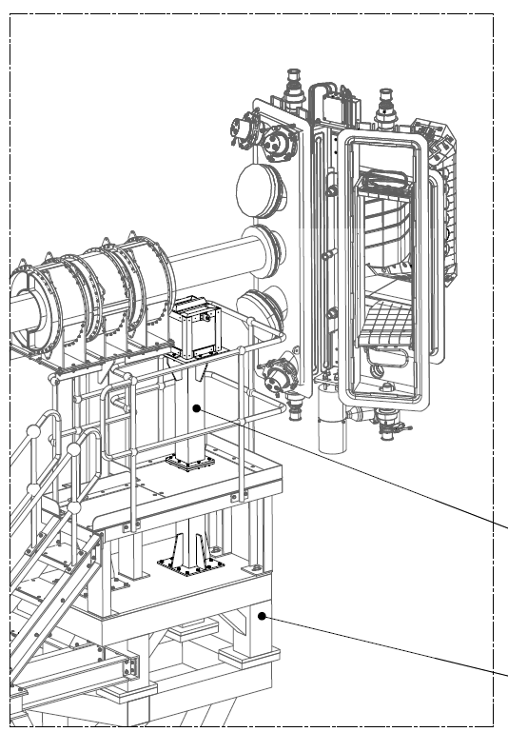
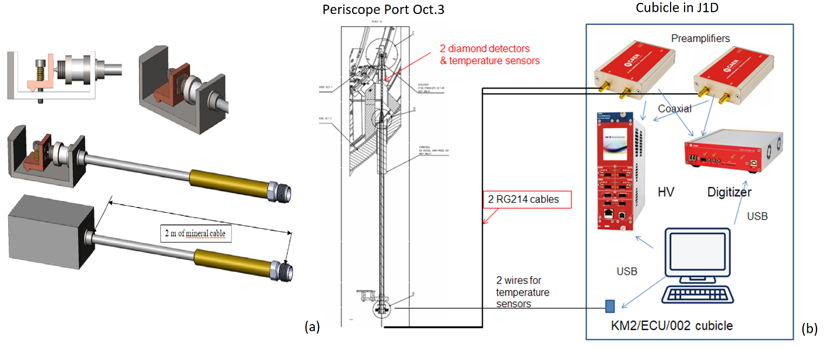
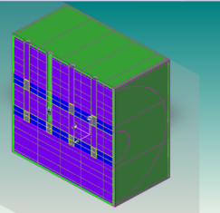
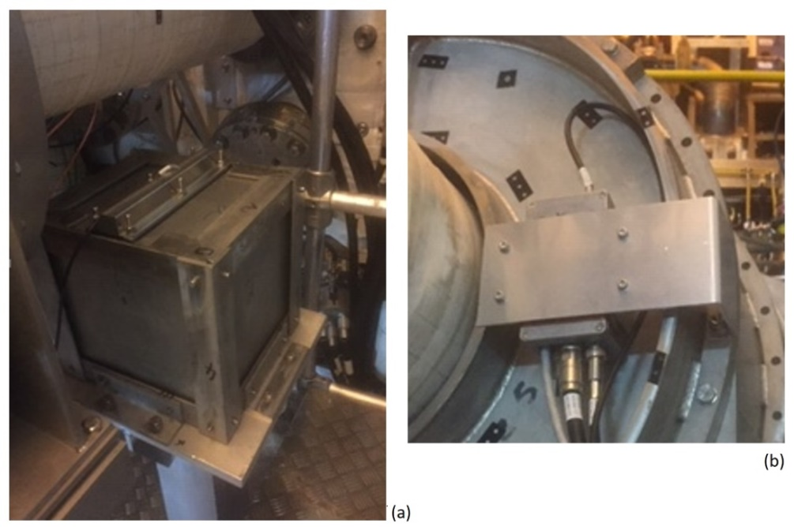
TBMD Test of detectors for TBM & mock-up experiment
Test of n/T detectors developed for TBM at JET & TBM mock-up experiment
HCPB TBM mock-up with diamond
located in Octant 8
Two Diamond detectors in Octant 3
Diamond detector inside
Diamond detectors installed in the periscope port of octant 3
Measurement chain from the periscope port to the cubicle KN5A located in J1D
TBM mock-up Preamplifier location
C_{MCNP}/E Tritium production relevant for TBR assessment

Slide 18
TBMD: what EUROfusion team needs?
1) Retrieval, clearance and shipment to ENEA Frascati of the two diamond detectors in the periscope port of octant 3
Why: To carry-out the post irradiation examination in home lab
When: possibly by May ‘24- depends on radiological protection constraints
Priority: MEDIUM- damage study
2) Retrieval and shipment to ENEA Frascati of acquisition chain of diamond detectors in KN5A cublicle in J1D
Why: To carry-out the post irradiation examination in home lab
When: together with 1
Priority: MEDIUM- damage study
JO Asset -II stage
Retrieval and shipment to ENEA Frascati of the diamond detector inside TBM mock-up located in J1T in octant 8
Retrieval and shipment to ENEA Frascati of the preamplifier of the TBM diamond detector located in J1T
Retrieval and shipment to ENEA Frascati of the TBM mock-up located in J1T in octant 8
When: no urgency- end of ‘24?
Priority: LOW- asset recovery- no impact on scientific objectives
NG
Contact: Nicola.Fonnesu@enea.it

Slide 19
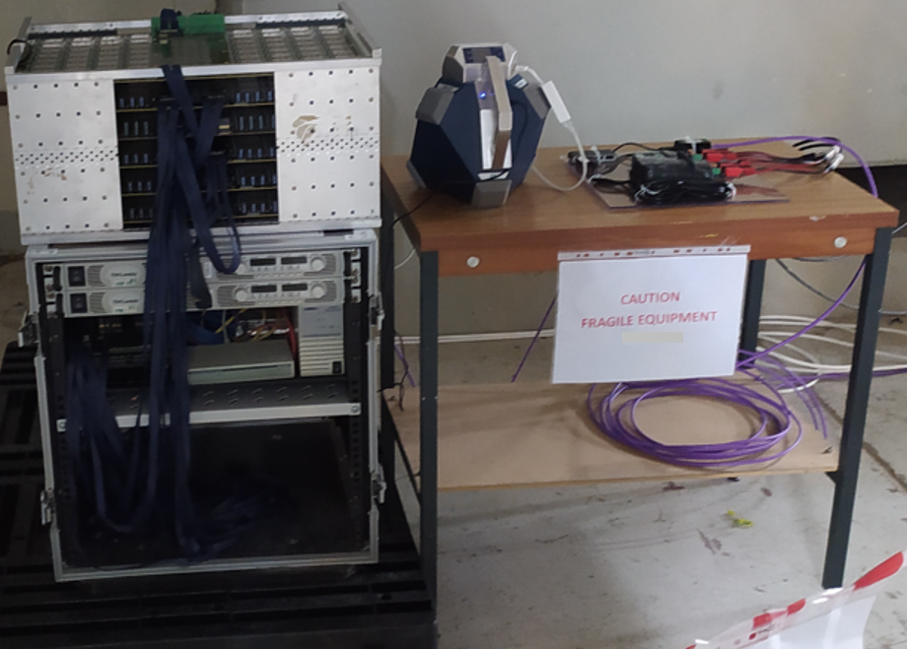
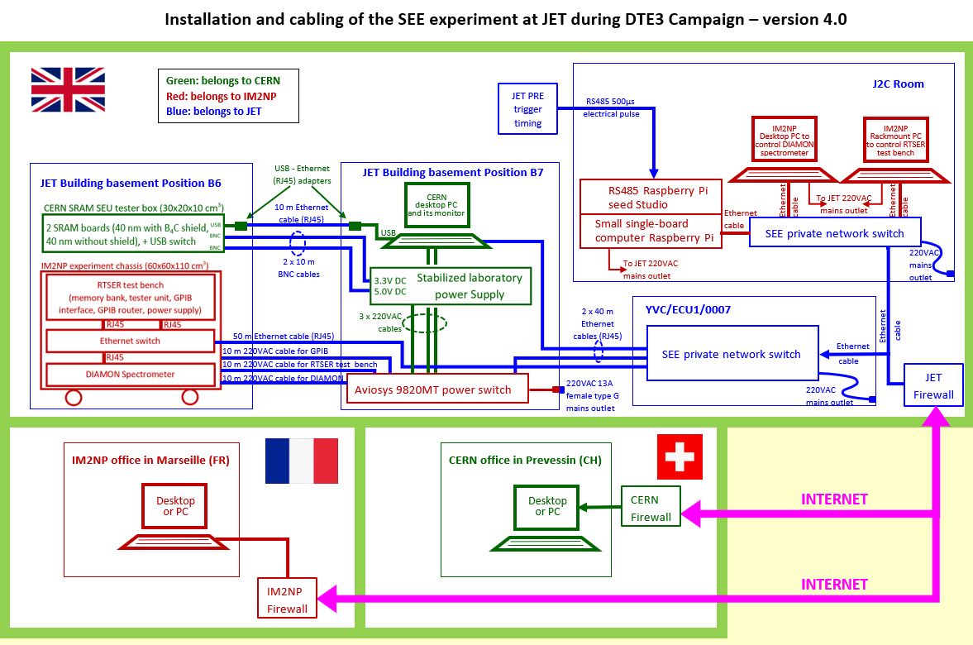
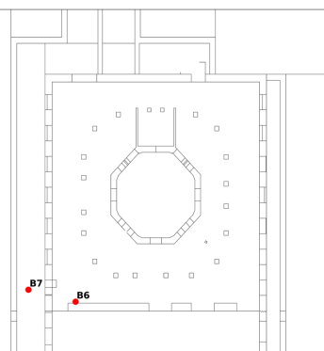
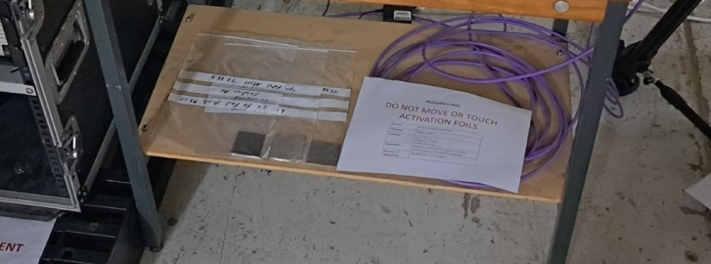



Single Event Effect (SEE) experiment on electronics during DTE3
Validation of the models/method of prediction of neutron-induced failures in electronic for modern tokamaks (e.g. ITER, DEMO, …) during DTE3
Complement D-D experiment on WEST and experiments at CERN for demonstration of equivalence study
SEE installation in B6
DIAMON
J2C server room
CERN test bench
IM2NP test bench
Installation in JET SE basement – early June ’23
UKAEA activation foils
Real Time Soft Error Rate (RTSER) test bench from IM2NP Institute (Aix-Marseille University)
384 memory chips (65 nm bulk SRAM, BPSG-free, manufactured by STM)- 3.226 Gbits
CERN ISSI test bench
40 nm SRAM from ISSI – 32 Mbits
DIAMON – Raylab + Activation foils+ PNS UKAEA
Neutron spectra
All equipments already retrieved and sent to other facilities for further neutron experiments.
19
Notes:
DIAMON Direction-aware Isotropic and Active neutron MONitor

Slide 20
SEE: what EUROfusion team needs?
1) Provision of neutron yield rate data from 2023 JET campaigns breakdown DD, TT & DT components + Results of AF & PNS analysis
Why: These data are fundamental for SEE analysis- correlation of bit-flips with exposure to neutrons
When: Possibly March ‘24
Priority: HIGH- SEE analyses depend on these data
NG
Contact: martin.dentan@cern.ch

Slide 21
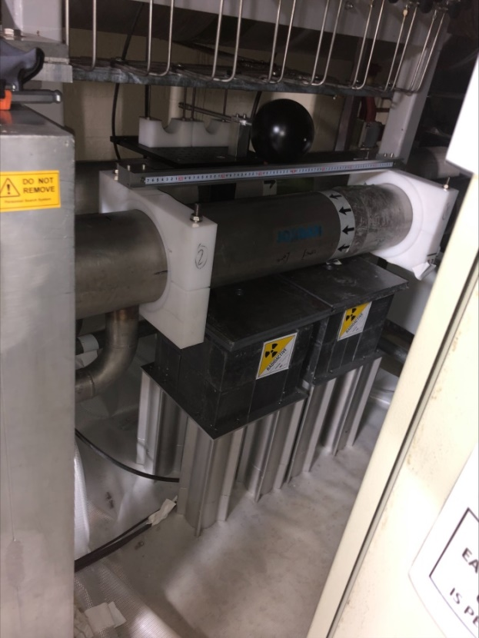
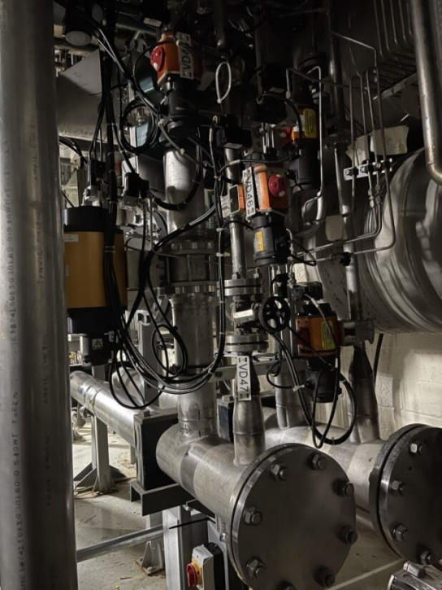
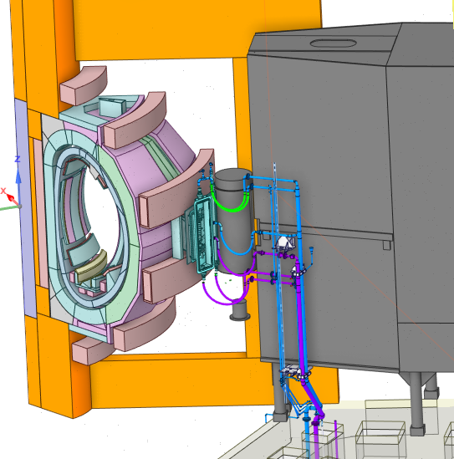
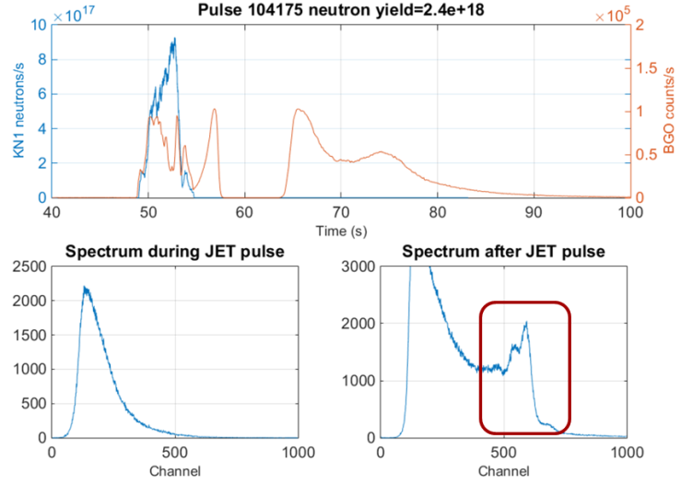
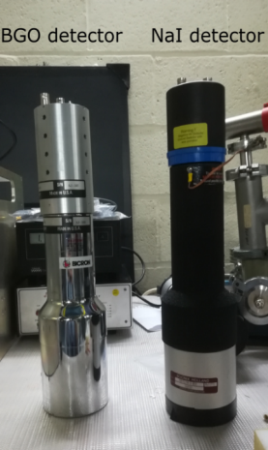
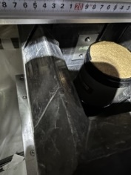


WACT JET water activation experiment during DTE3
Unique experiment in real tokamak water cooling loop under DT for the validation of water activation predictions in ITER – strong impact on ITER & DEMO
Location of WACT system
Outlet horizontal pipe
WATER ACTIVATION EXP ASSEMBLY
NBI duct scraper cooling loop Oct 4
Ionization Chamber
Oct 4 Basement
Pipe forest
BgO
Basement of octant 4
NaI
FIRST MEASUREMENTS OF WATER ACTIVATION IN TOKAMAK IN DT!
  Detectors
  Gamma spectrometers: NaI & BGO
  Dose rate: Ionization chamber*
Online acquisition-CODAS
*never worked due to wrong connectors
Measurements of γ from ¹⁶N decay
Post-analysis with Actiflow/Gammaflow, RSTM, FLUNED & DEMO tool in 2024
21

Slide 22
WACT: what EUROfusion team needs?
1) Calibration of the detectors in the basement of Oct 4 with gamma sources
Why: The calibration of BGO & NaI is fundamental for the correlation counts/N-16 decay & model validation
When: Jan’/Feb’24
Priority: HIGH+- the scientific relevance of the WACT experiment depend on the calibration
2) Collection & provision of detailed information on the assembly & position
Why: The accurate knowledge of the assembly (dimension, position & materials) is fundamental for the modeling & calculations of the efficiency to 6-7 MeV gamma
When: Jan’/Feb’24
Priority: HIGH- the scientific relevance of the WACT experiment depend on how accurate & precise is the N-16 decay measurement
3) Support on analysis of the DTE3 measurements from NEU group
Why: The detectors and electronics is from JO NEU group
When: Jan’-March’24
Priority: HIGH- the scientific relevance of the WACT experiment depend on how accurate & precise is the N-16 decay measurement
NG

Slide 23
WACT: what EUROfusion team needs? Cntd.
4) Provision of Input data and documentation to simulate the water cooling circuits
Why: Information necessary for modeling/analysis & validation
When: Jan’-March’24
Priority: HIGH- the scientific implication of the WACT experiment to validation of ITER relevant tools depend on how accurate & precise is the modeling
5) Support from CAD officer
Why: CAD necessary to build 3D models to make the multi-physics simulations with ITER relevant tools
When: possibly by March’24
Priority: MEDIUM/HIGH- the scientific implication of the WACT experiment to validation of ITER relevant tools depend on how accurate & precise is the modeling
6) Provision of neutron yield rate data from 2023 JET campaigns breakdown DD, TT & DT components
Why: These data are fundamental for all the analyses of WACT (measurements & calculations)
When: Possibly March ‘24
Priority: HIGH- analyses and benchmark depend on these data
NG

Slide 24



ORE Occupational Radiation exposure
Collection and processing of JET ORE data following DT corresponding to specific activities and operations finalized to meet specific ITER safety needs.
Generation of a well-structured work effort database for ITER-like ORE applications with modern DB-technologies allowing effective queries, facilitating ORE analyses with data acquisition, work effort analysis and validation through JET TT and DT experience.
Database design definition & architecture defined in 2022 by ENEA.
No data provided by UKAEA in 2022 & 2023- UKAEA tasks cancelled due to lack of HP manpower – ENEA 2023 task cancelled because of missing input
Past study
Replacement of detector in TBM mock-up
ORE: what EUROfusion team needs?
1) Access to Health Physics Method statements & Final reports intervention/maintenance from 2021
Why: These data are fundamental for ORE analyses- The JET experience is unique
When: Possibly by March ‘24
Priority: HIGH- ORE Database development & analyses and the implications to ITER depend on the access to this documentation
Contact: Nicholas.Terranova@enea.it

Slide 25
Summary of PrIO SP5 JET technology plan & needs
When | JO Activities for completion of the technological program: DTE3 post-analysis | For the sub-project
As long as possible | Keep IC power-on for shutdown dose rate measurements | NEXP
Jan’24- Feb ‘24 | WACT calibration in the basement | WACT
 | Retrieval,clearance, shipment to Greece of AF set 1 | NEXP
 | Collection & provision of detailed information on the WACT assembly & position | WACT
 | Retrieval of instrumentation in J1D and shipment to CIEMAT | RADA
 | Support from NEU group to analysis of the measurements | WACT
March ‘24 | Retrieval of sample holders & fibers after DT campaign from LTIS, clearance & shipments | ACT, RADA
 | Retrieval,clearance, shipment to Greece of AF set 2 and TLDs to Poland | NEXP
 | Provision of DD,TT and DT neutron yield rate data of 2023 campaigns | NEXP, WACT, ACT, SEE, RADA,TBMD, NC14
 | Results JET Neutron DT Plasma calibration (2021- 2023) | NEXP, WACT, ACT, SEE, RADA,TBMD, NC14
 | Provision of results of analysis of AF& PNS | SEE
 | Provision of Input data and documentation to simulate the water cooling circuits | WACT
 | Provide access to HP Method statements & Final reports intervention/maintenance | ORE
 | Support from CAD officer | NEXP, WACT
May ‘24 | Retrieval, clearance and shipment to ENEA Frascati of the two diamond detectors in the periscope port of octant 3 + acquisition chain of diamond detectors in KN5A cublicle in J1D | TBMD
When | Asset – II stage | Assets of sub-project
End of ‘24 | Retrieval of the 3 ICs from OCT 1 & 2 and 3 electrometers from J1D clearance and shipment to ENEA-Italy Retrieval of polyethilene moderators & shipment to IFJ (Poland) and NCSRD (Greece) | NEXP
 | Retrieval and shipment to ENEA Frascati of the diamond detector, preamplifier and TBM mock-up located in J1T in octant 8 | TBMD

Slide 26
Thank you!
Questions/Comments?

Slide 27
SPARES

