Slide 1
Update on integrated modelling of burning plasmas
C. Bourdelle et al
20/11/2023

Slide 2
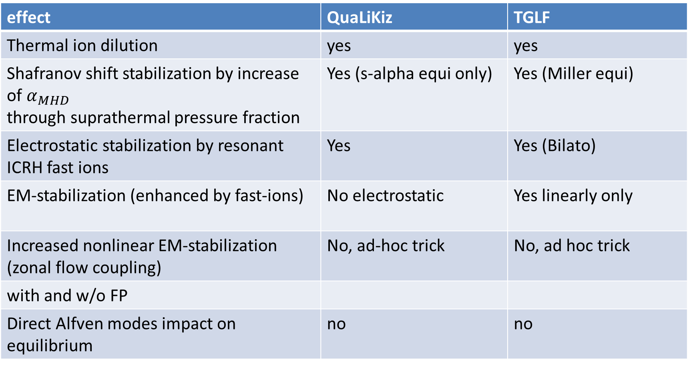
Fast particles and el-mag impacts in reduced models (recalling, Sept 2023)
effect | QuaLiKiz | TGLF
Thermal ion dilution | yes | yes
Shafranov shift stabilization by increase of $α_{MHD}$ through suprathermal pressure fraction | Yes (s-alpha equi only) | Yes (Miller equi)
Electrostatic stabilization by resonant ICRH fast ions | Yes | Yes (Bilato)
EM-stabilization (enhanced by fast-ions) | No electrostatic | Yes linearly only
Increased nonlinear EM-stabilization (zonal flow coupling) | No, ad-hoc trick | No, ad hoc trick
with and w/o FP
Direct Alfven modes impact on equilibrium | no | no

Slide 3
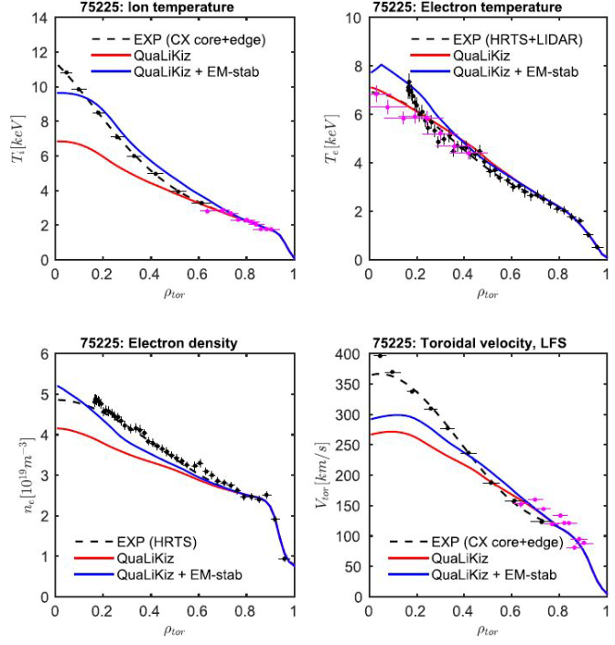
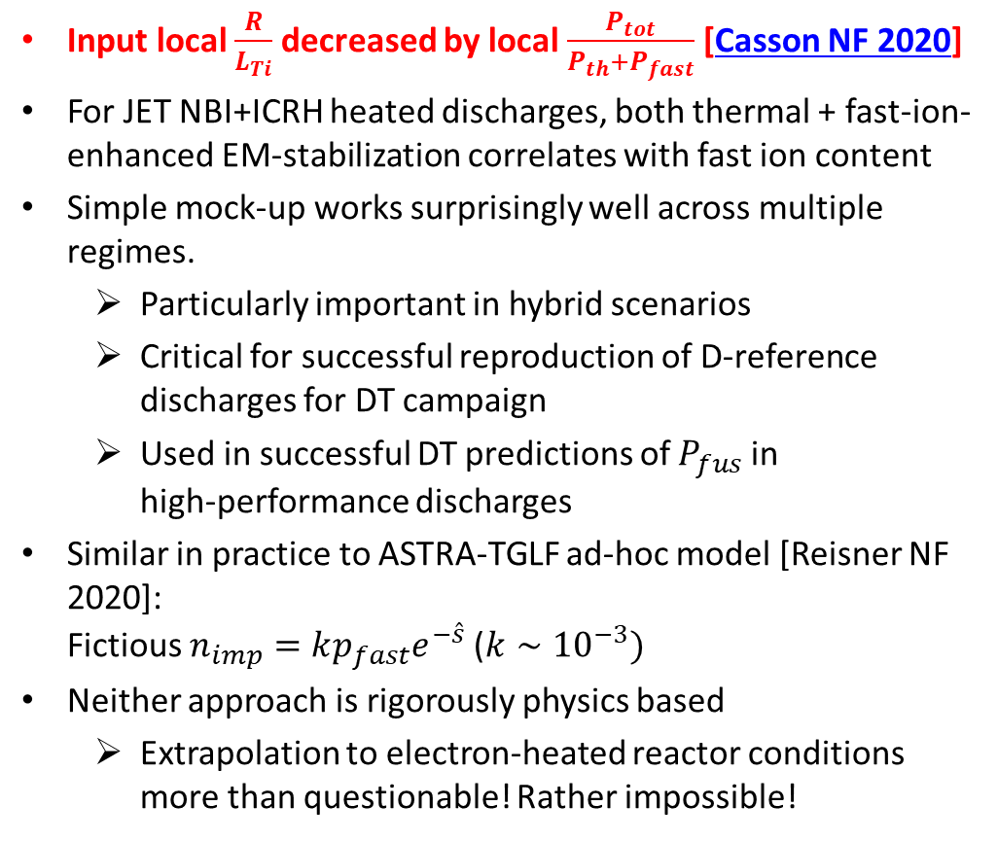
Ad hoc tricks to mimic NL stabilization (recalling, Sept 2023)
Input local $\frac{R}{L_{Ti}}$ decreased by local $\frac{P_{tot}}{P_{th}+P_{fast}}$ [Casson NF 2020]
For JET NBI+ICRH heated discharges, both thermal + fast-ion-enhanced EM-stabilization correlates with fast ion content
Simple mock-up works surprisingly well across multiple regimes.
  Particularly important in hybrid scenarios
  Critical for successful reproduction of D-reference discharges for DT campaign
  Used in successful DT predictions of $P_{fus}$ in
  high-performance discharges
Similar in practice to ASTRA-TGLF ad-hoc model [Reisner NF 2020]:
Fictious $n_{imp}=kp_{fast}e^{−\hat{s}}$ ($k∼{10}^{−3})$
Neither approach is rigorously physics based
  Extrapolation to electron-heated reactor conditions more than questionable! Rather impossible!

Slide 4
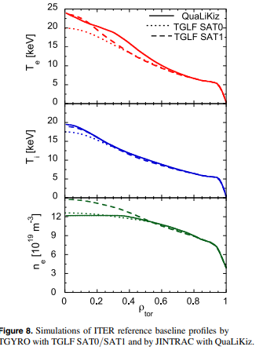
Nonetheless project to explore ad-hoc trick interplay with EP redistribution model, to look at non-linearities (C. Bourdelle, Ph Lauber et al)
(recalling, Sept 2023)
Since HFPS is an ITER tool, we propose to debug and test the workflow on an ITER Q=10 case (Florian’s case in Mantica's paper). Also modelled using GENE-QLNN Citrin NF2023
  Modify the transport model used so far, including turbulent transport of heat and particle using QLK ad-hoc EP stabilization.
  Make sure the proper IDS are read/written btw the workflows: (https://jira.iter.org/browse/IMAS-4297 )
    output produce alpha particle density and pressure,
    input allow for EP modified diffusion coefficients
  run at least a 10 s time frame with the QLK+ad-hoc model for heat and particle and the FP workflow computing the linear stability and modifying the FP diffusion
  study the potential non-linearity and identify some actuators (for example initial q profile? ECCD deposition? )
Start a DEMO scenario advised by Florian Koechl then switch on the FP workflow as done on ITER case

Slide 5
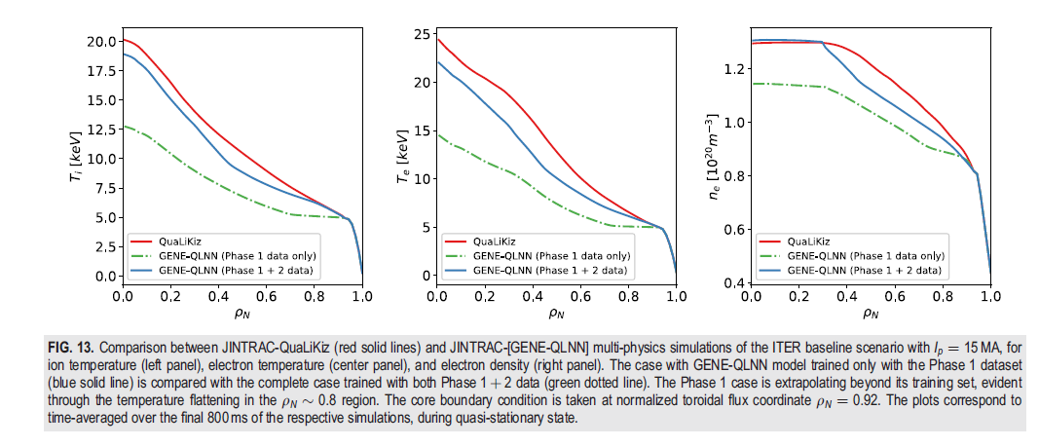
A parte, this ITER Q=10 case was also modelled using JETTO + GENE-QLNN (electrostatic without EP!) Citrin PoP2023
proof-of-principle of a heat and particle transport GENE quasilinear (QL) NN transport model.
Linear GENE runs on input parameters taken from the final state of the integrated modeling JETTO-QuaLiKiz
Dedicated nonlinear runs at midradius to validate a custom saturation rule
QL transport flux database fit with NN models.
GENE-QLNN in JETTO
NB: at this stage no plan to do local el-magnetic GENE NN, since global effects matter for burning plasmas, therefore stand by on this approach for higher fidelity integrated modeling

Slide 6
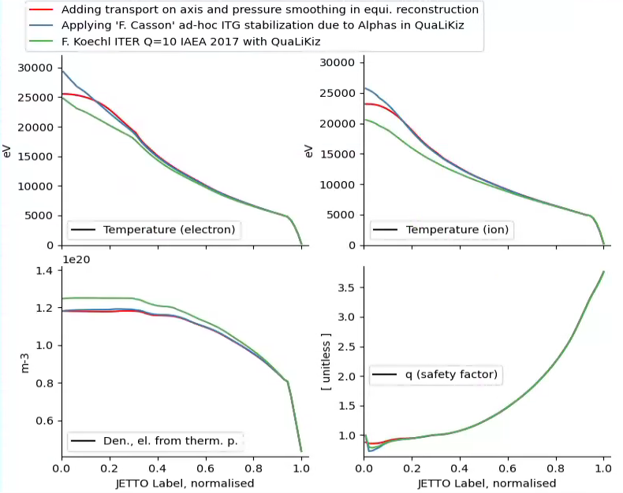

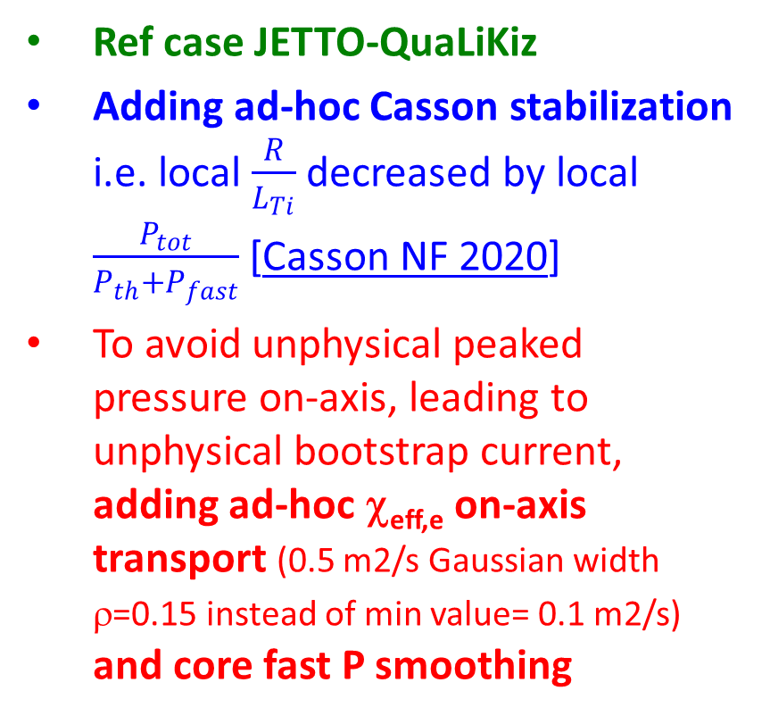
JETTO-QuaLiKiz ITER Q=10 modelling
Ref case JETTO-QuaLiKiz
Adding ad-hoc Casson stabilization i.e. local $\frac{R}{L_{Ti}}$ decreased by local $\frac{P_{tot}}{P_{th}+P_{fast}}$ [Casson NF 2020]
To avoid unphysical peaked pressure on-axis, leading to unphysical bootstrap current, adding ad-hoc χ_{eff,e} on-axis transport (0.5 m2/s Gaussian width ρ=0.15 instead of min value= 0.1 m2/s) and core fast P smoothing

Slide 7
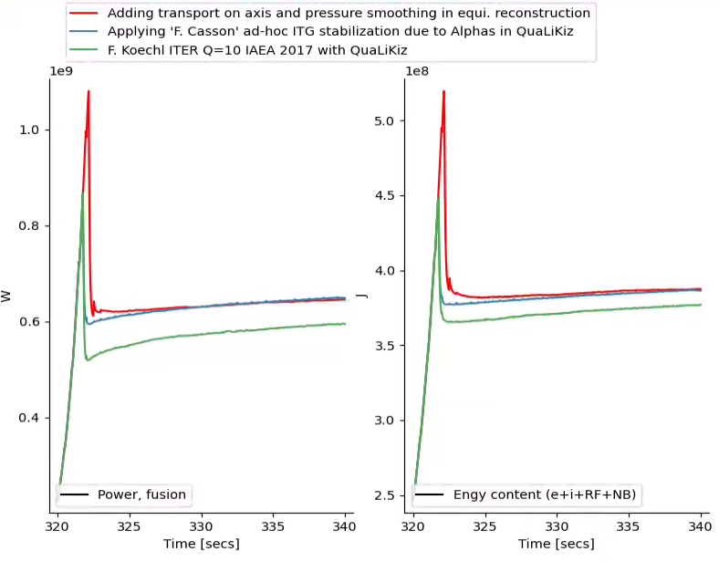
Impact of ad-hoc Casson on ITER Q=10 with JETTO-QuaLiKiz on Pfus +8.6% and Energy +2.9%
Ref case JETTO-QuaLiKiz
Adding ad-hoc Casson stabilization and P smoothing on-axis
+8.6%
646 MW
+2.9%
388 MJ
377 MJ
595 MW

Slide 8
What’s next?
guidance from domain mapping (as sketched below ?)
with global ORB5/GENE on when one can switch on ad-hoc stabilization
in integrated modelling framework
When EP IDS saved, we will start iteration ATEP and HFPS-QuaLiKiz+ad-hoc EP stab
To improve ad-hoc stabilization would need guidance from higher fidelity models
β_{fast}/β_{tot}
100%
Tf/Te=10
Tf/Te=100
EPM need global codes
50%
TAE, local codes OK (KBAE?)
Driving large fluxes
Marginally unstable TAE
Stabilized ITG, reduced fluxes
?
ITG-TEM
KBM/AITG
0%
β_{tot}

