Slide 1
Potentials for joint experiments on TJ-II, H-J, LHD and W7-X (HSX?)
… along CWGM Topics
Andreas Dinklage
19.11.2023

Slide 2
Joint experiments H-J, TJ-II, LHD, W7-X (HSX?)
Timeline for TJ-II and LHD: Dec.1st and Nov. 30th 2023
LHD: https://indico.euro-fusion.org/event/2832/attachments/5008/8779/2023_11_13_25thLHDCampaign_v231113a.pdf
TJ-II: https://indico.euro-fusion.org/event/2844/
W7-X: time line for additional proposals being worked out
Check for actions on Heliotron-J (communicate this discussion to Kaz Nagasaki)
Status HSX (communicate this discussion to Ben Geiger)
This meeting: identify topics for the submission of joint proposals and define specific next step actions for joint proposals (need acceptance of the PCs)
INCO 2024 proposals (missions outside Europe) by end of this week (by Wednesday to be on the safe side for processing) to eurofusion-wpw7x@ipp.mpg.de

Slide 3
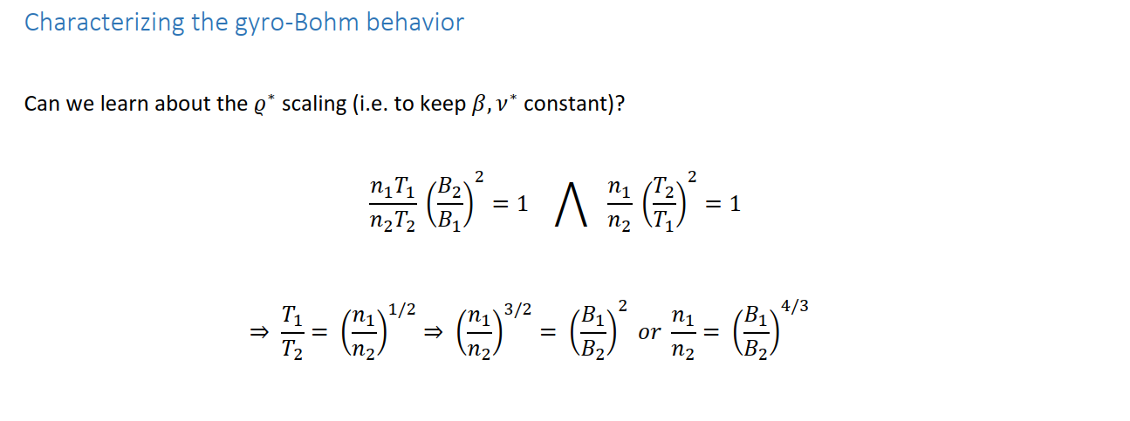
dinklage_17

