Slide 1
ATEP WP3.1-D2
Systematic statistical analysis of test particle transport (in the reduced model) and assessment of diffusive vs. non diffusive behaviors
ATEP Meeting 22/11/2023
End 2022 - WP3.1-D1 Validated 1D reduced model for EP transport in ITER/DTT
End 2023 - WP3.1-D2 Systematic statistical analysis of test particle transport and assessment of diffusive vs. non diffusive behaviours
End 2022 - WP3.2-D1 Insights into short- and long-time relaxation dynamics of a nonthermal plasma with intense energetic particle component
End 2023 - WP3.2-D2 Practical basic understanding of convective radial transport of energetic particles versus the possible non-local transport regimes

Slide 2
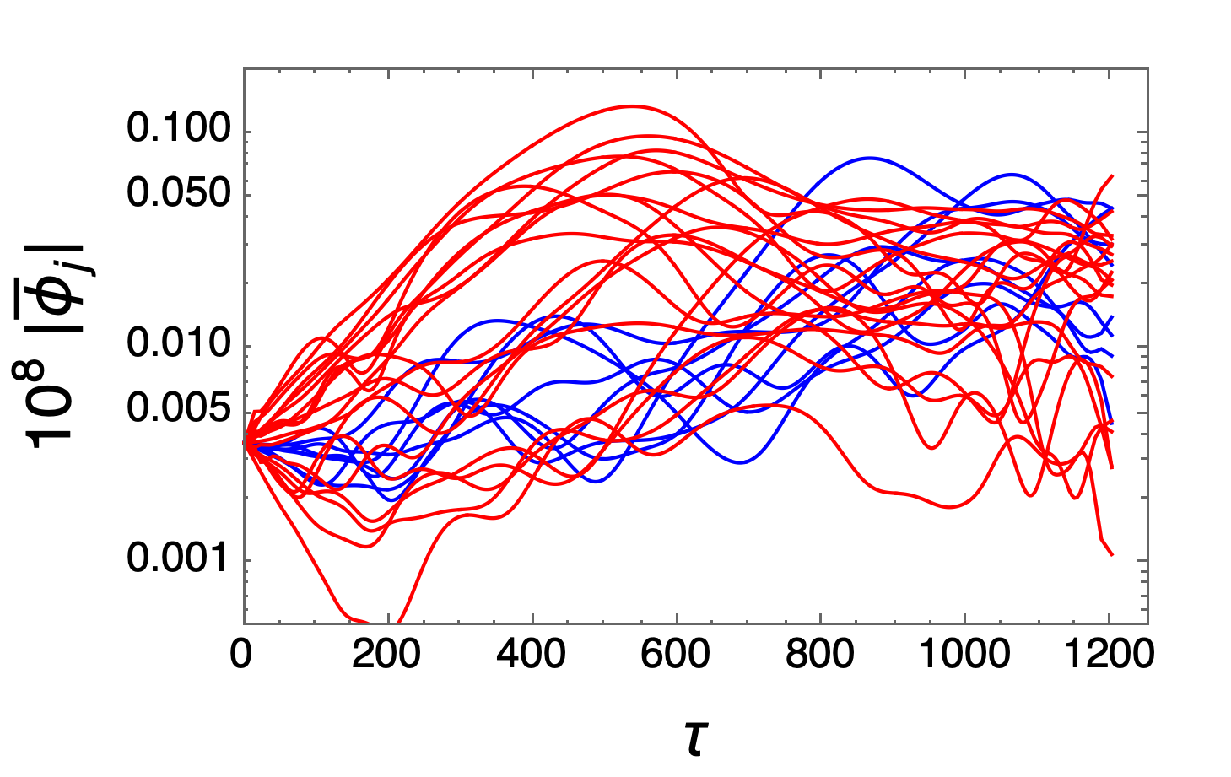
Introduction/Background
͏Local analysis o͏f mean square path already addressed for the ITER 15MA case
Scenario analyzed by means of 1D reduced model (Hamiltonian VP system).
Avalanche excitation of the low branch (linearly stable) yields to convective transport $({∼τ}^{2})$ aba
͏
M. Schneller, Ph. Lauber, S. Briguglio, PPCF 58, 014019 (2016)
(mean square path of tracers locally initialized close the the peaks)
N. Carlevaro, G. Montani, M.V. Falessi, Ph. Lauber, EPS22, P5a.113 ID : 32056

Slide 3
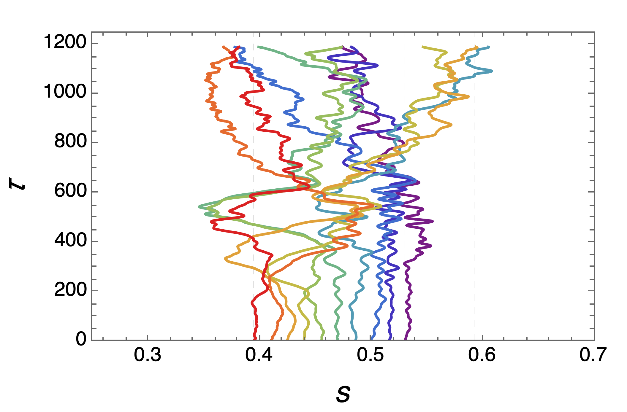
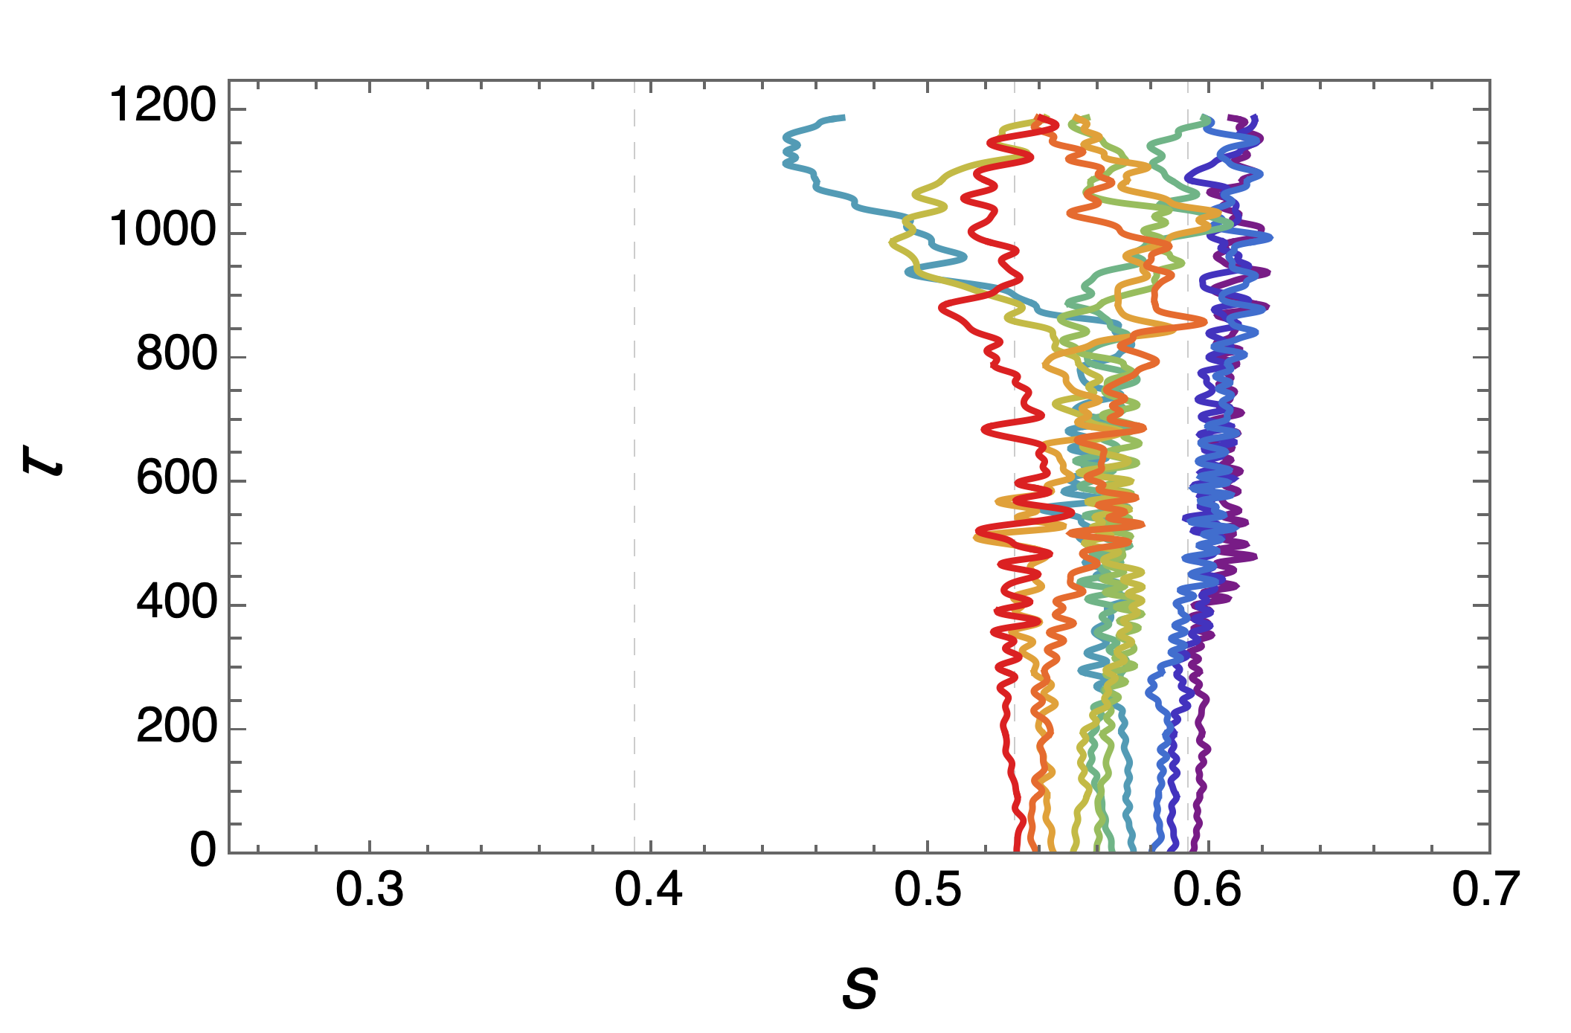
Advanced global statistics
͏Analysis of test particle trajectories evolved in assigned potential field --> evaluation of spatial displacements $δs=s\left(Δτ+τ\right)−s(τ)$.
10000 tracers and each trajectory $s_{i}\left(τ\right)$ is stored.
${δs}_{i}$ (for a given $Δτ$) calculated for a single trajectory --> histograms for all tracers/trajectories are built and normalized --> global PDF of spatial displacements.
͏Expectation for a pure diffusive model (QL) -> trajectories defined by random walk -> PDF expected to be a normal distribution with expected value $μ=0$ and variance $σ=2Dτ$
Gaussian model fit are done for the case under investigation. -> to quantify differences w/ diffusion/random walk
Trajectories $s_{i}\left(τ\right)$ are evaluated from $τ_{in}$ to $τ_{out}$(end of simulation) $τ_{in}≅400$ is set to avoid the pre-linear phase (particle are starting to interact w/ modes)
Quantitative diagnostic: fit goodness
Residuals: $y_{i}−f_{i}$
Residual square sum: ${SS}_{r}=\sum{{(y_{i}−f_{i})}^{2}}$
Square sum: ${SS}_{v}=\sum{{(y_{i}−\overline{y})}^{2}}$
Coefficient of determination: $R^{2}=1−\frac{{SS}_{r}}{{SS}_{v}}$
Best case (perfect model): $R^{2}=1$
(examples of single trajectories)

Slide 4
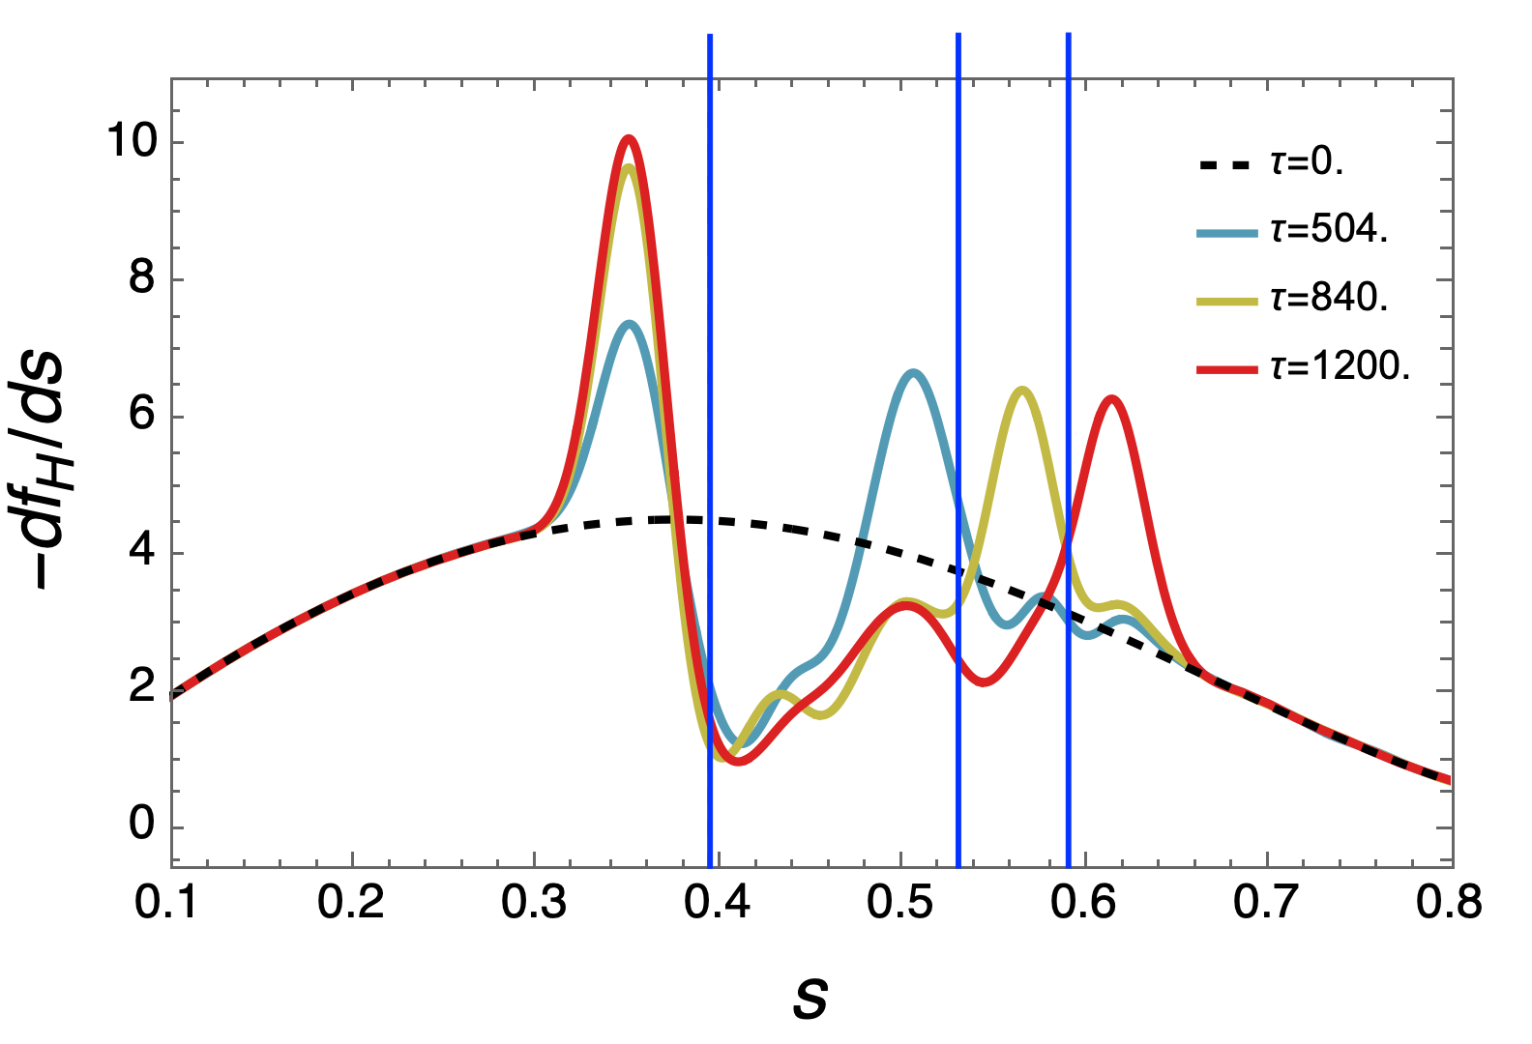
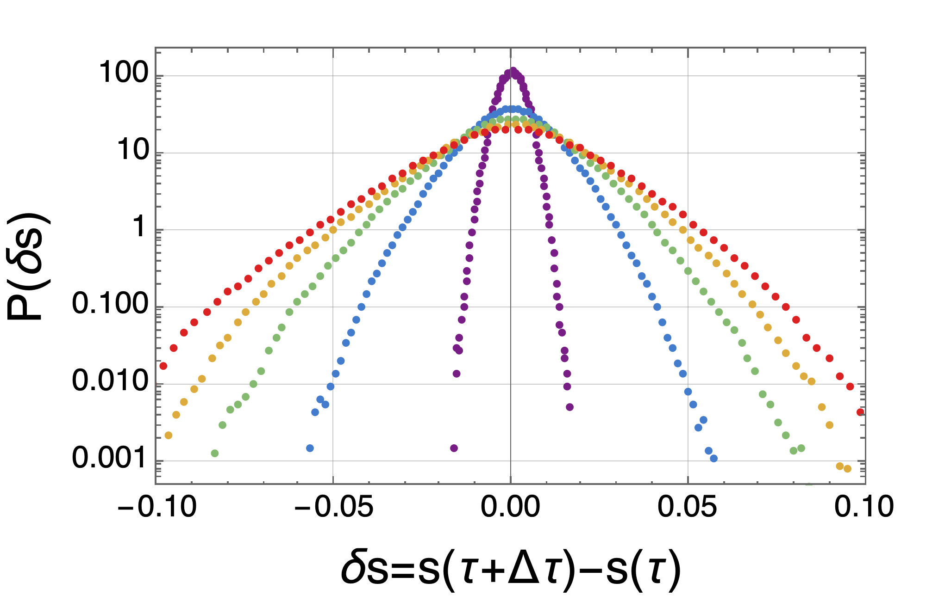
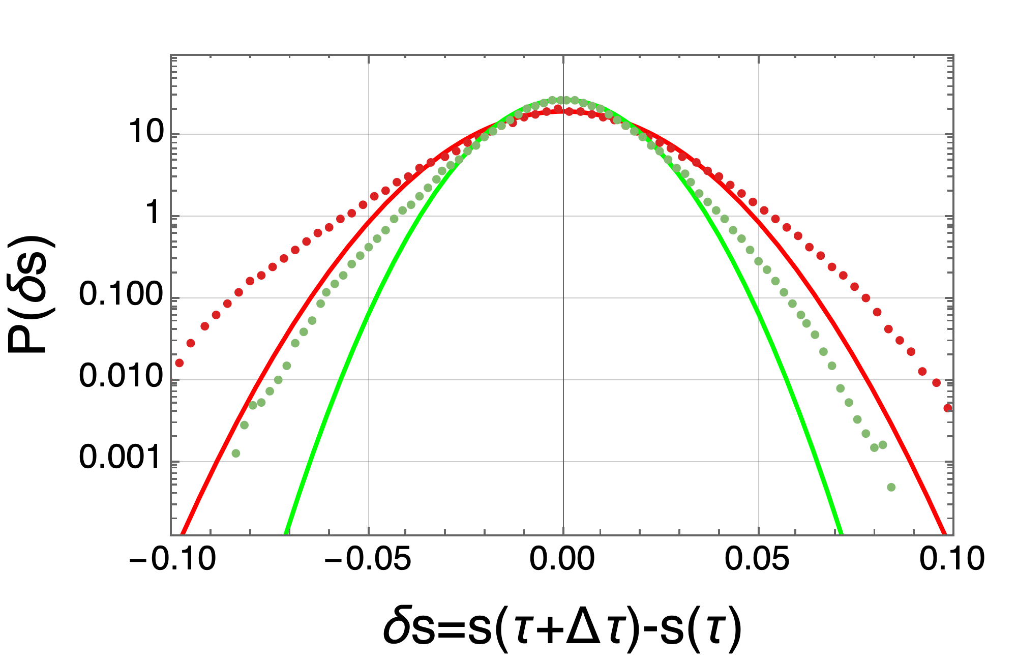
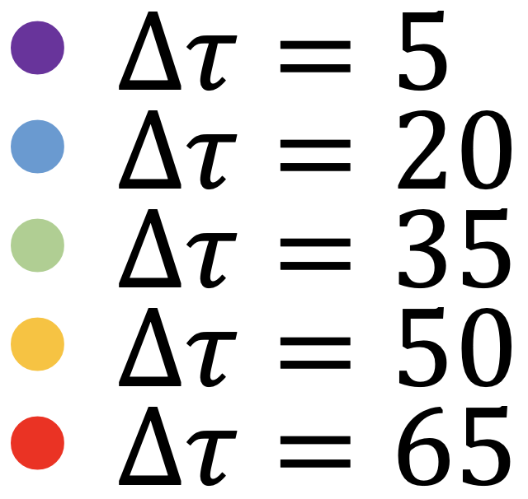
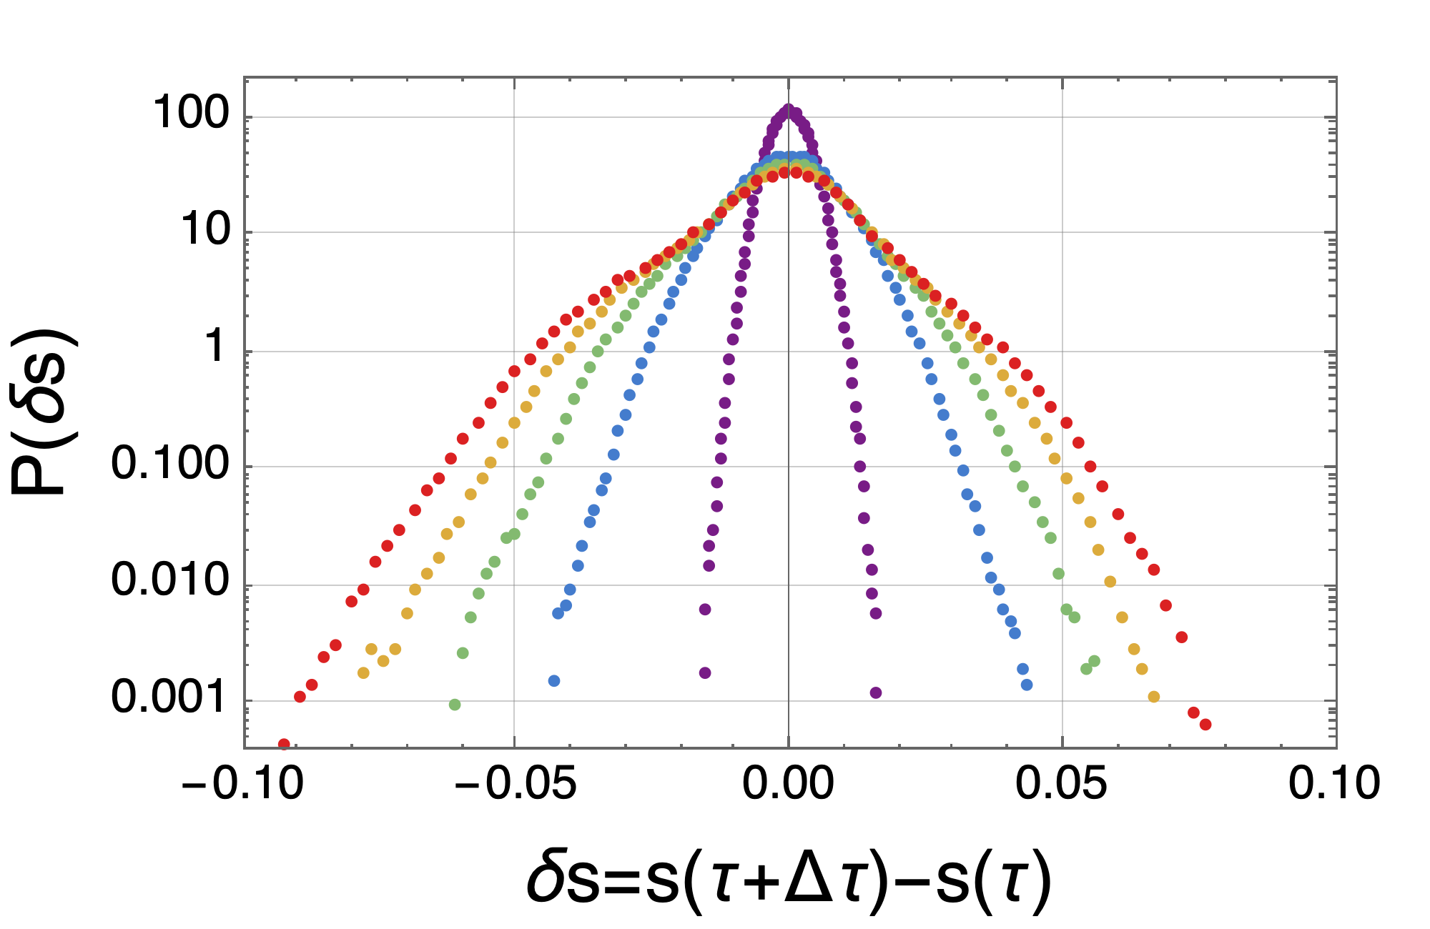
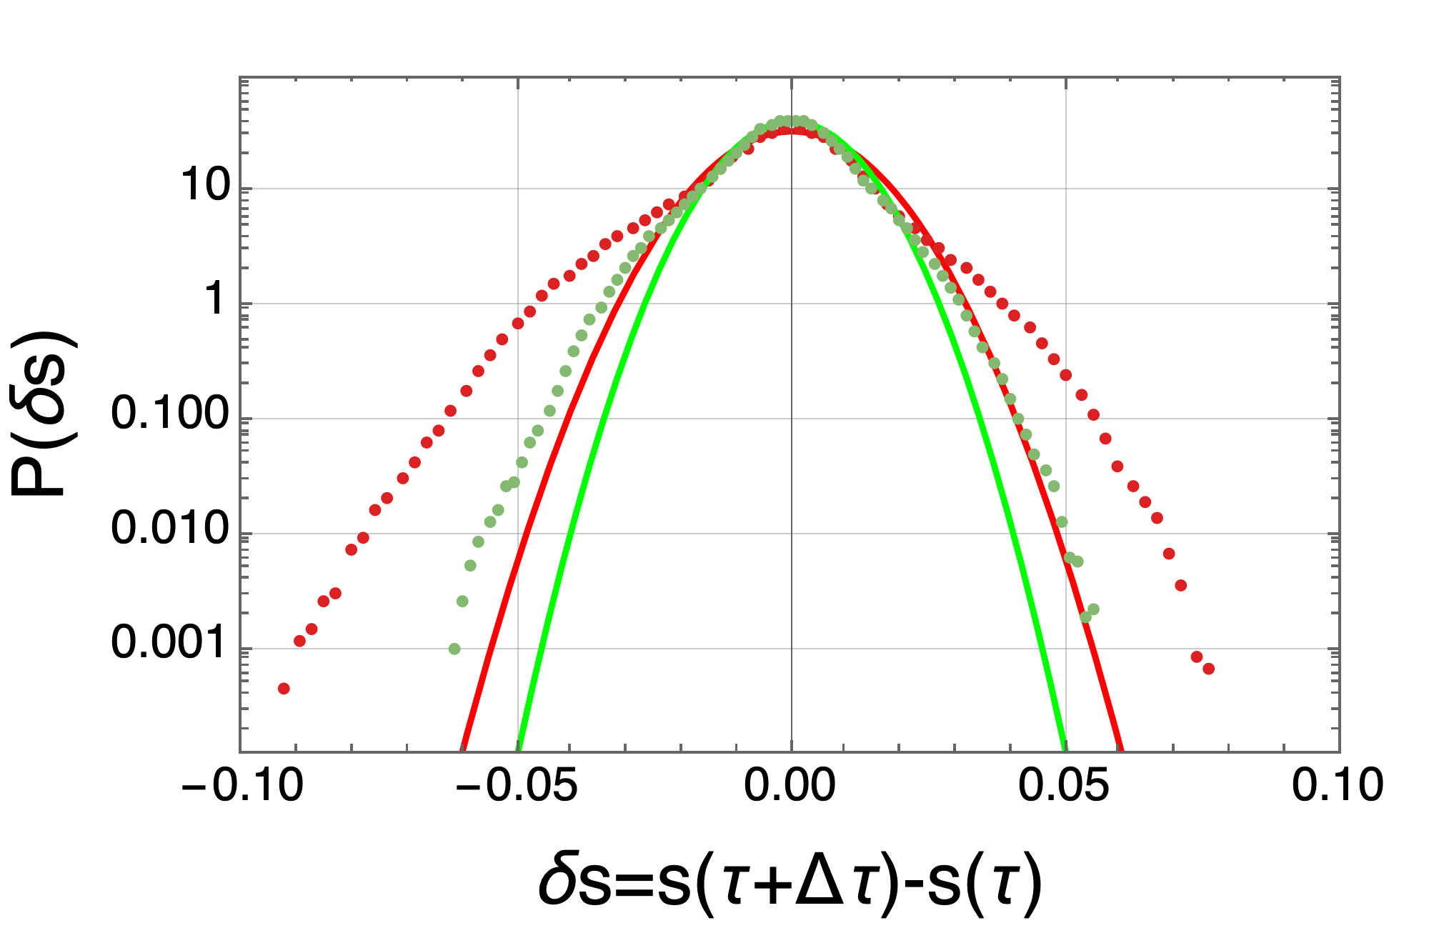
High vs low branch resonance populations
Tracer initialization equispaced in $s_{r1}$ ; $s_{rL}$
Tracer initialization equispaced in $s_{rL}$ ; $s_{r2}$
$∆τ=35$: $σ=0.01$4,
$R^{2}=0.995$
$∆τ=65$: $σ=0.020$,
$$R^{2}=0.992$$
Quantitative (although small) discrepancy w/ Gaussian model
$∆τ=35$: $σ=0.099$,
$R^{2}=0.985$
$∆τ=65$: $σ=0.012$,
$$R^{2}=0.970$$
Low branch: qualitative marked deviation from normal distribution.
Asymmetry of the PDF.
Non diffusive transport.

Slide 5
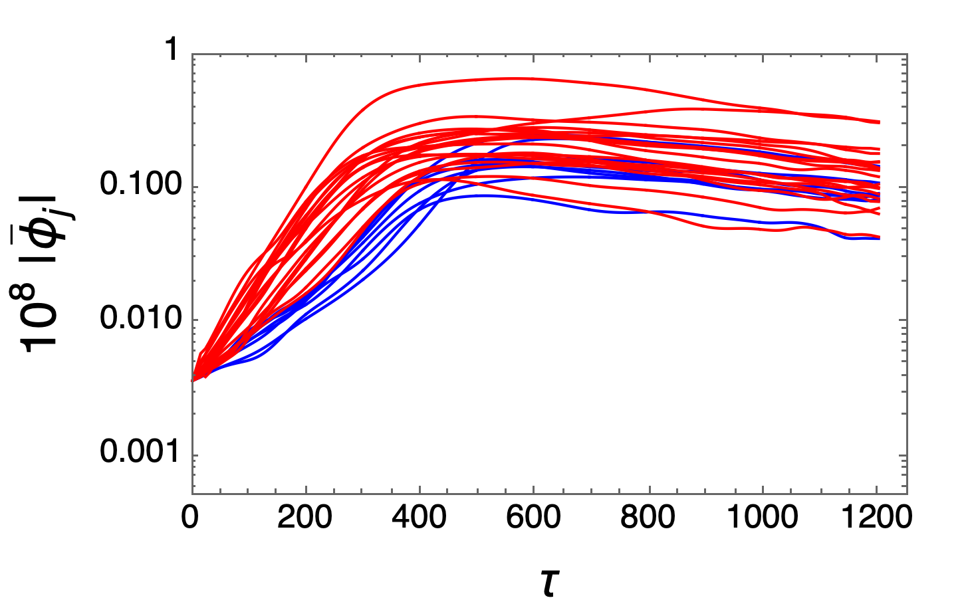
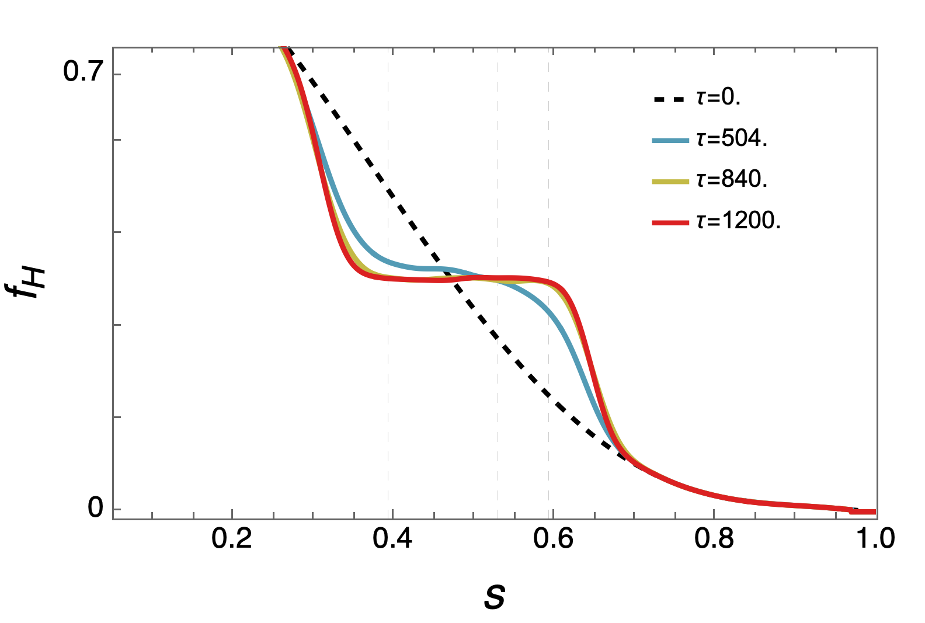
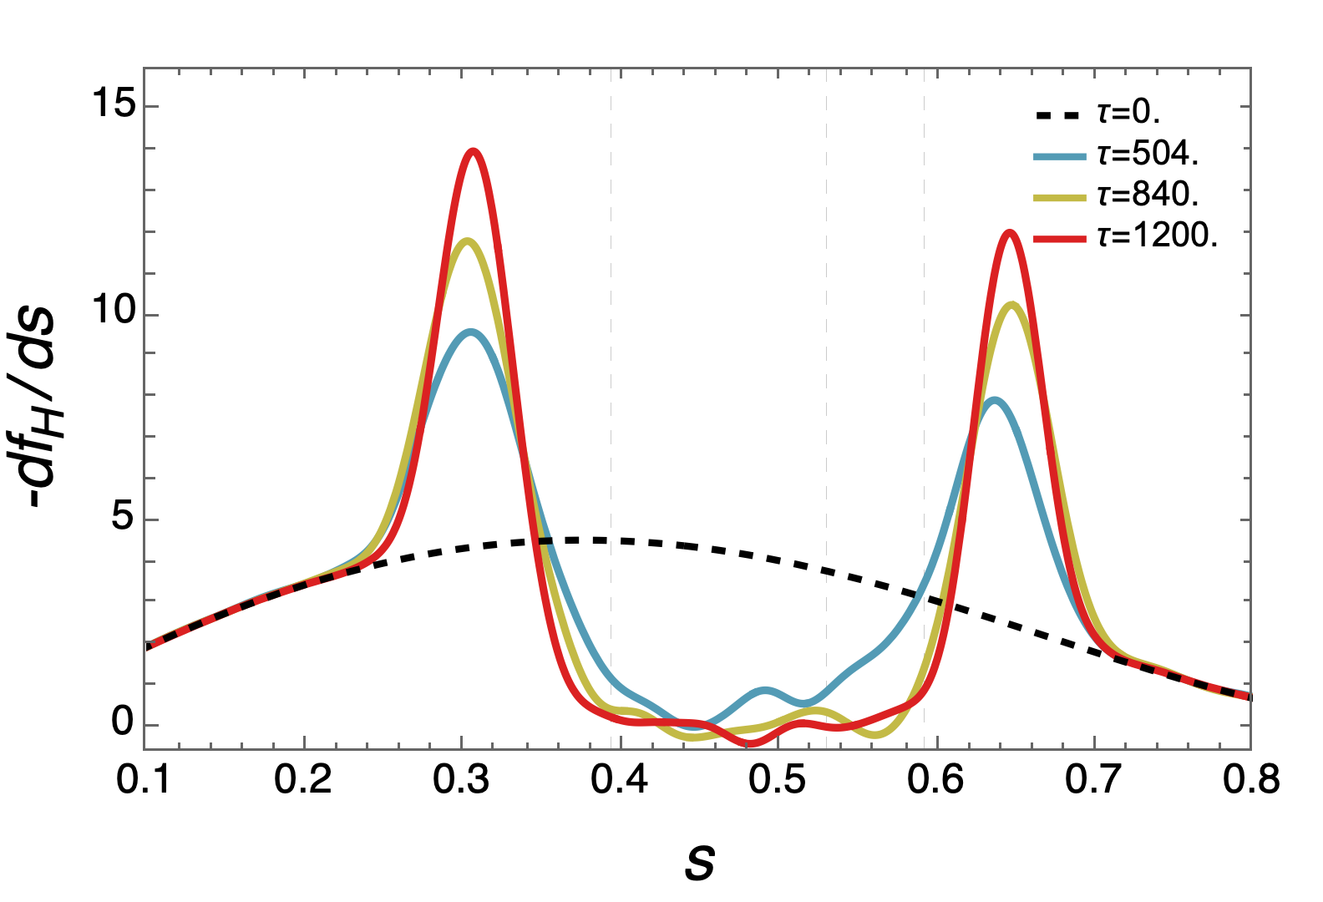
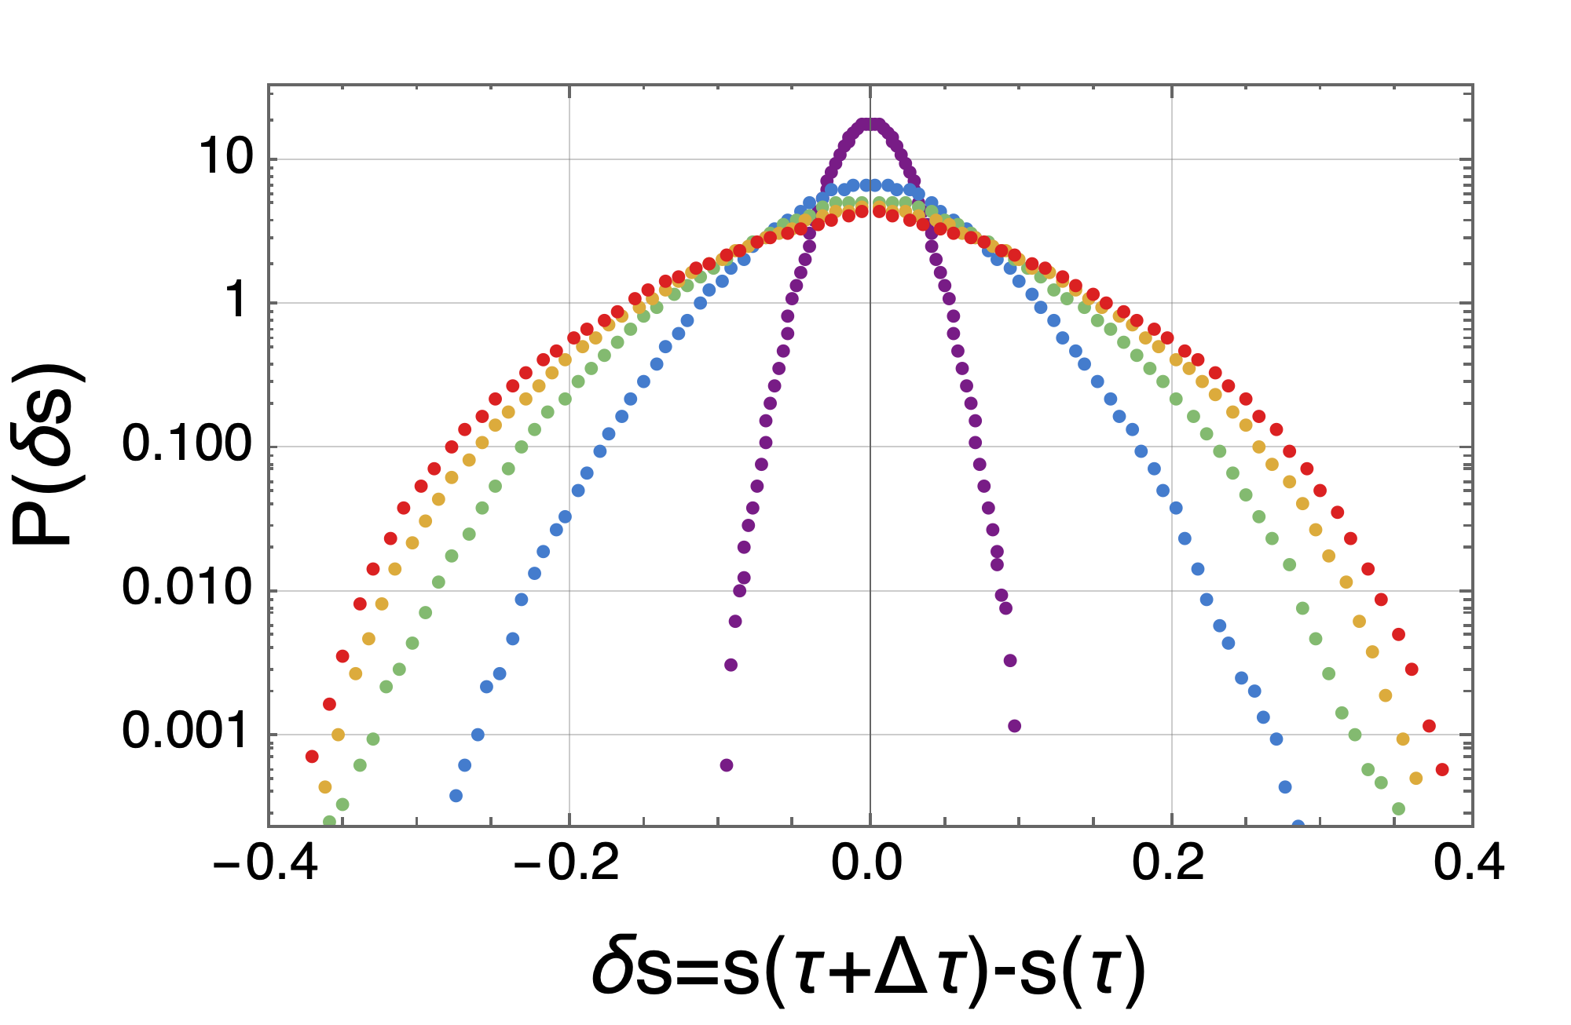
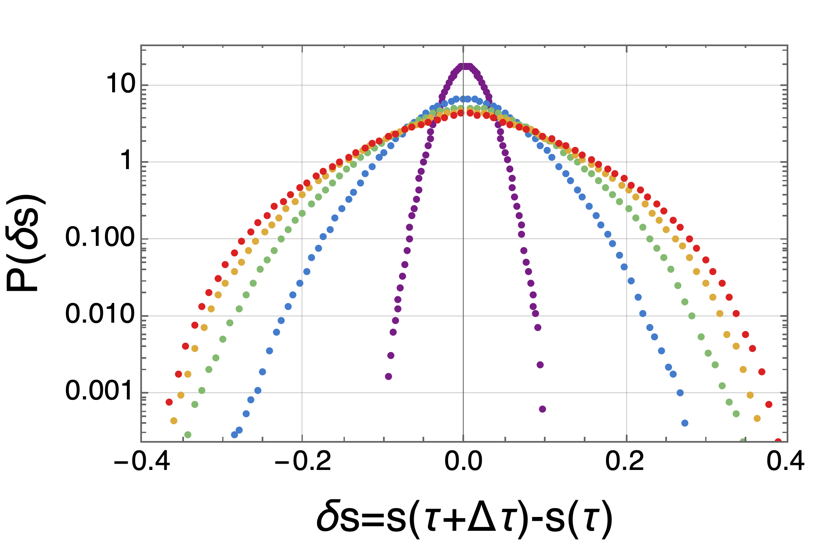
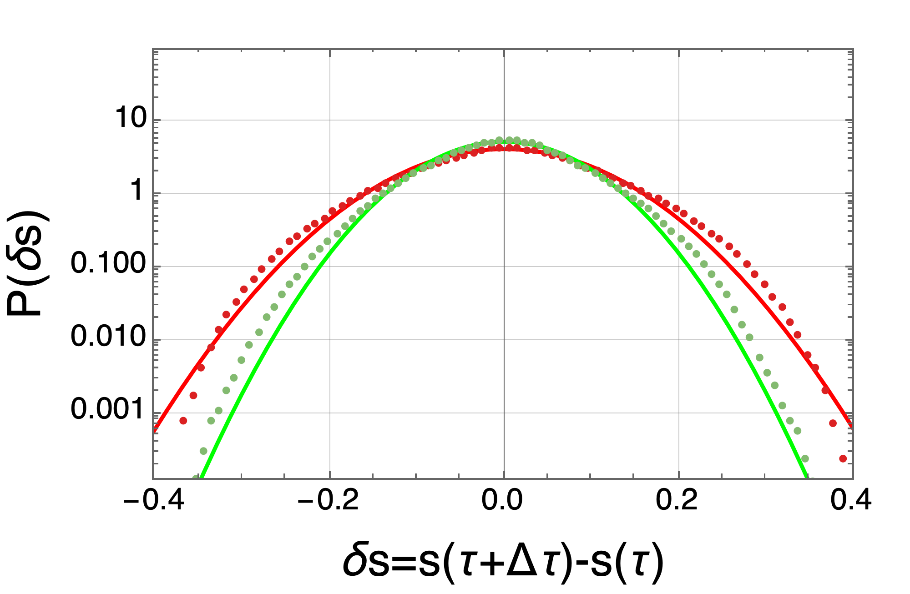
$⇒$ comparison with diffusive case
Ad hoc diffusive set up --> all mode are unstable and strong overlapped.
mode evolution
distribution function
$∆τ=35$: $σ=0.074$, $R^{2}=0.994$
$∆τ=65$: $σ=0.095$, $R^{2}=0.990$
$∆τ=35$: $σ=0.075$, $R^{2}=0.996$
$∆τ=65$: $σ=0.095$, $R^{2}=0.992$
still Gaussian
“Low branch” PDF is now almost perfect normal distribution (also the tail at large $δs$ is well fitted) -> comparison again indicates how the addressed ITER scenario is distant from a diffusive like scheme (failure of QL approach).

Slide 6
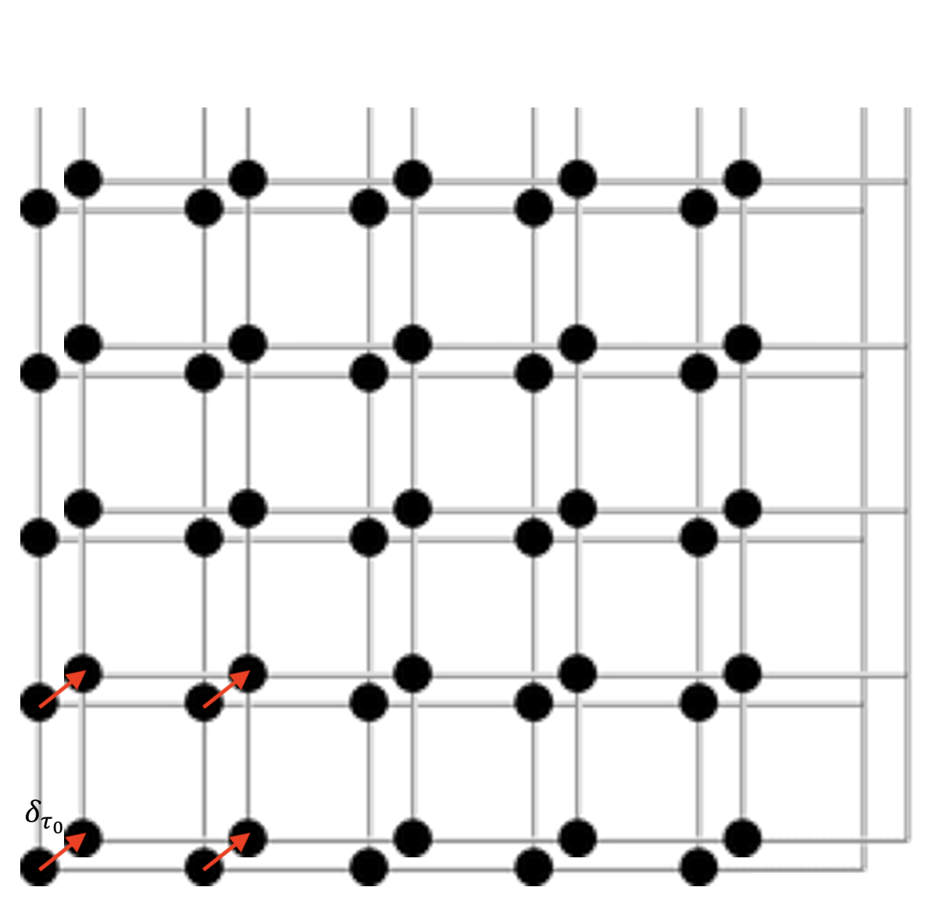
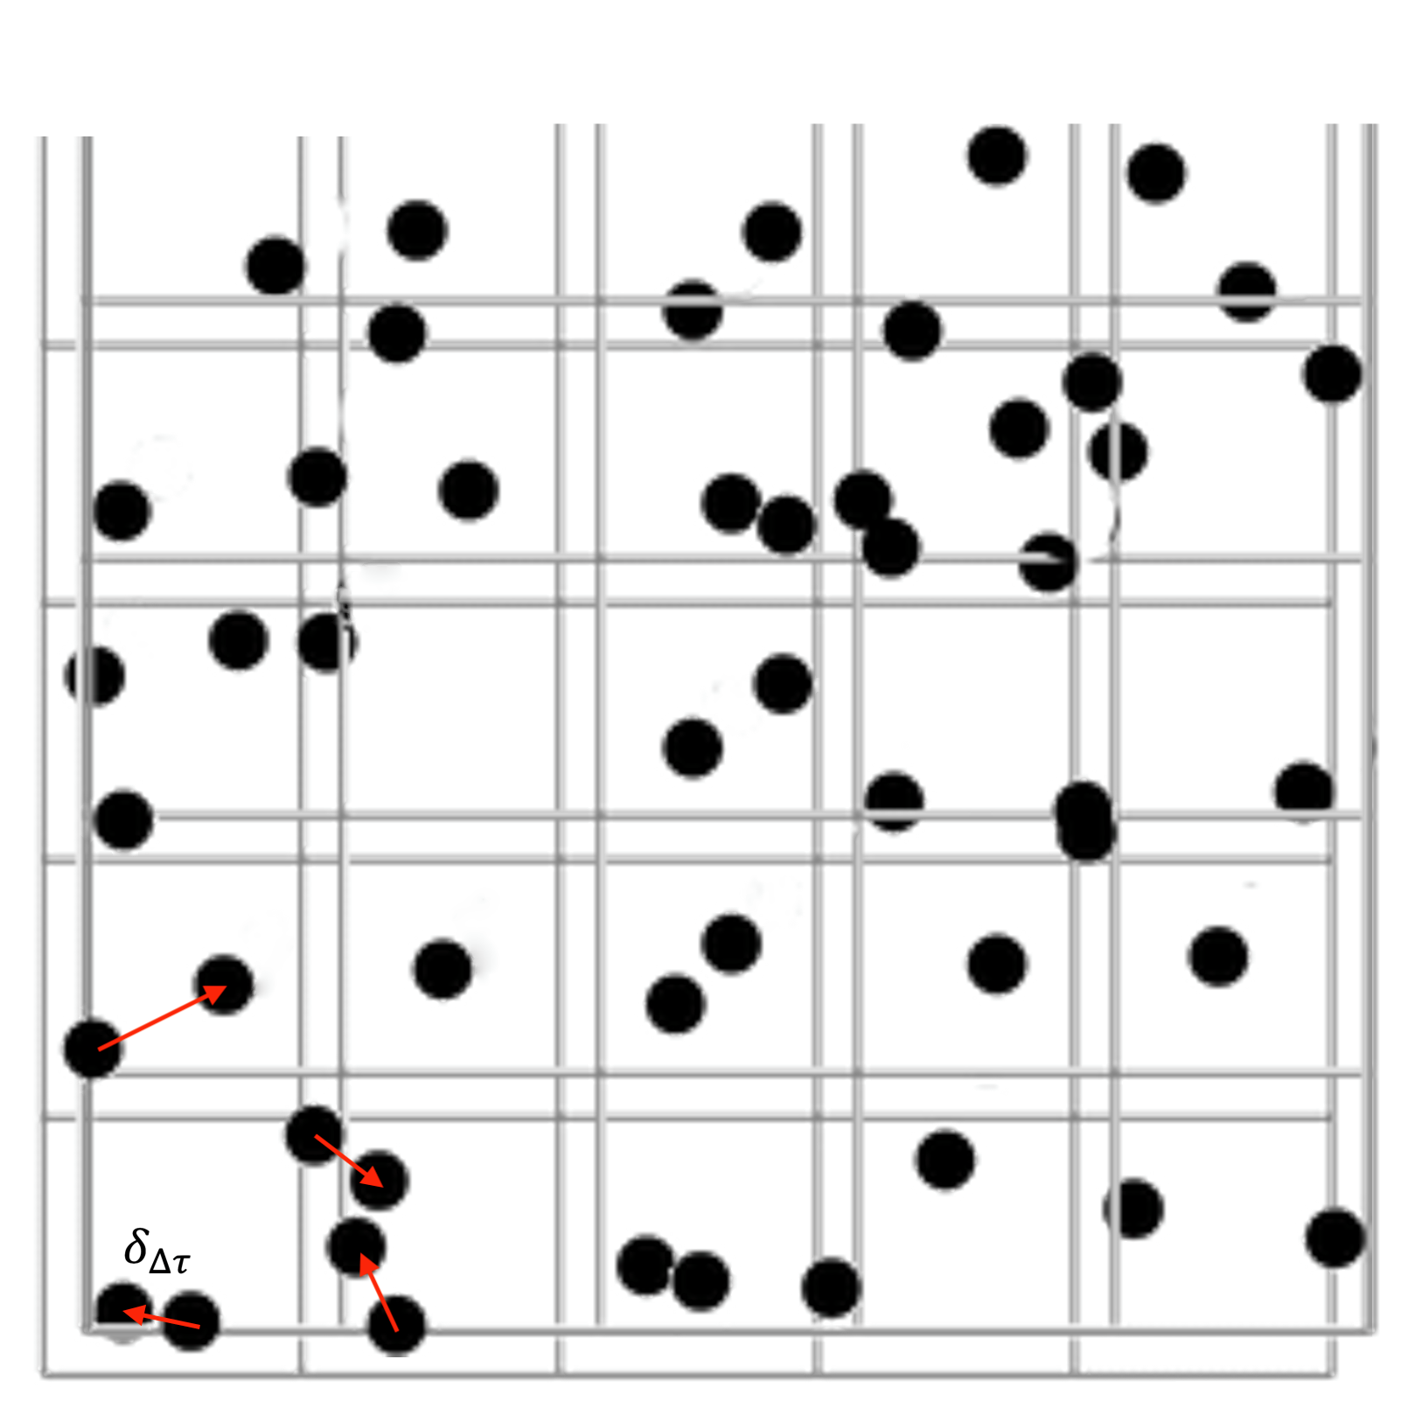
LCS diagnostics: reduced model phase space
͏Lagrangian Coherent Structures: most repulsive or attractive material lines (transport barriers). They are associated with peaked profiles of the Finite-Time Lyapunov Exponent (FTLE).
Evaluation of FTLE: $σ_{i,j}\left(τ_{0},Δτ\right)=σ\left(x_{i},p_{j},τ_{0},Δτ\right)=\ln\left({δ_{∆τ}}/{δ_{τ_{0}}}\right)/∆τ$
FTLE are calculate in the positions ${(x}_{i},p_{j})$ of the first grid.
$∆τ>0$: the curves where the FTLE field is peaked define repulsive transport barriers; $∆τ<0$: attractive transport barriers.
LCS - the maximum values of $σ_{i,j}$ from contour plots in the phase space.
$$τ_{0}$$
$$τ_{0}+Δτ$$
phase space
${(x}_{i},p_{j}$)

Slide 7
early + late dynamics
FTLE + spectrum evolution (mode amplitude).
Initial/final time are set to include $∆τ=±230$.
Tracers initialized at 5, 18, 26 resonances.
Early dynamics - linear mode evolution: -> particles clearly follow attractive barriers; -> dominance of a larger resonance, but with a very rich overlapping dynamics and substructure formation; -> evidence of different transport: high branch tracers cover a larger resonant portion and can interact simultaneously with more resonances.
Late dynamics (after $τ>550$): -> avalanche excitation of low branch; -> high branch transfer energy to low branch; -> evidence of emptying of small $s$ region and correspondent growing population of large $s$ (todo: quantify this effect in the phase space).

Slide 8
late dynamics
DC spectra is almost saturated -> diffusive dynamics is expected.
Tracers dynamics is very localized: -> small spread in the radial dimension -> convective like
Fast spread covering the whole resonant portion -> strong overlap as mark for diffusive like transport

Slide 9
Concluding remarks
A work merging (and extending) all these analyses is in preparation to be submitted.
The set up for the advanced statistical analysis is ready and fast: develop and improve these diagnostics and apply directly to TAE non linear dynamics.
͏External potentials + motion equation --> FTLE/tracer codes can be adapted to different scenarios.

Slide 10
Backup slides

Slide 11
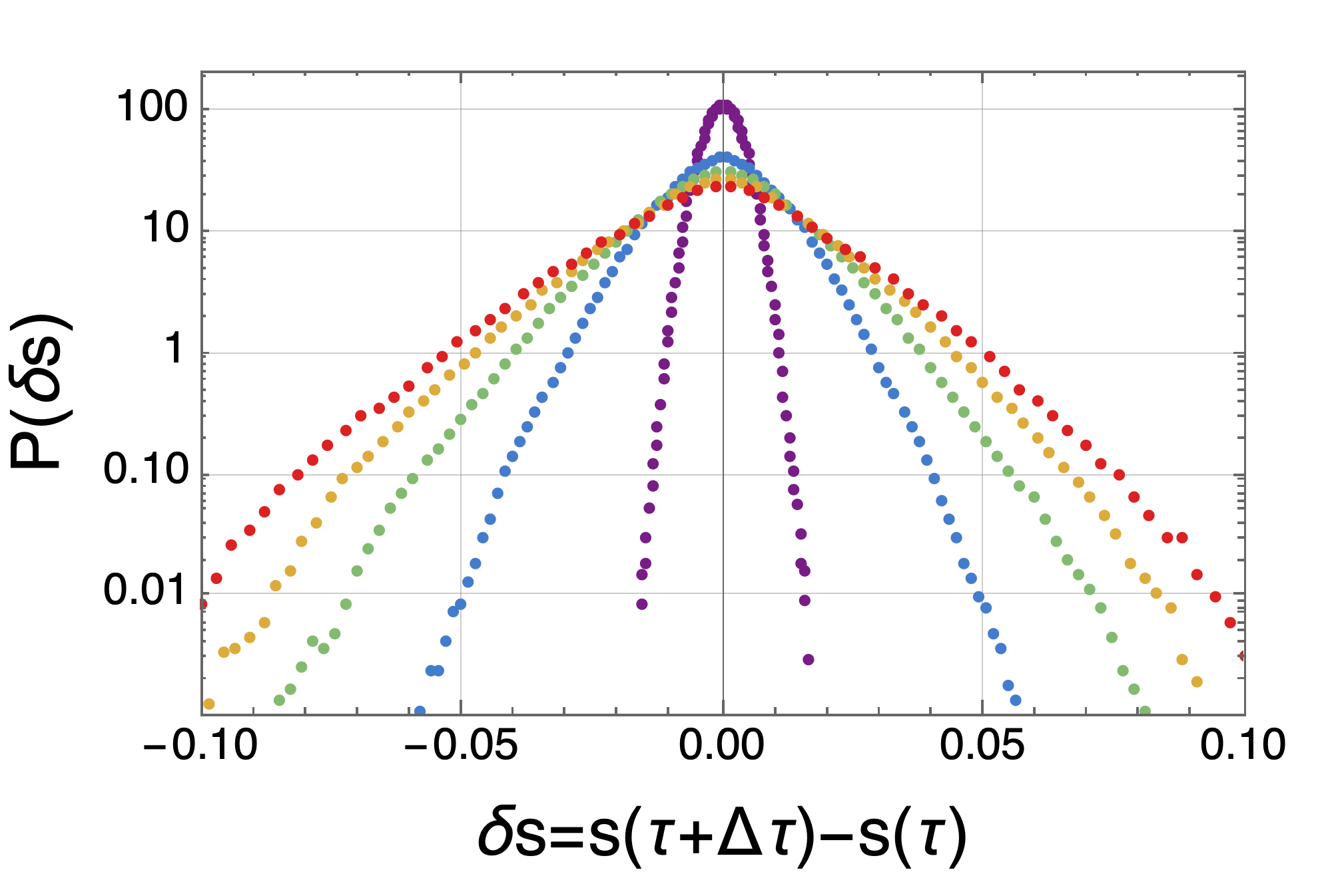
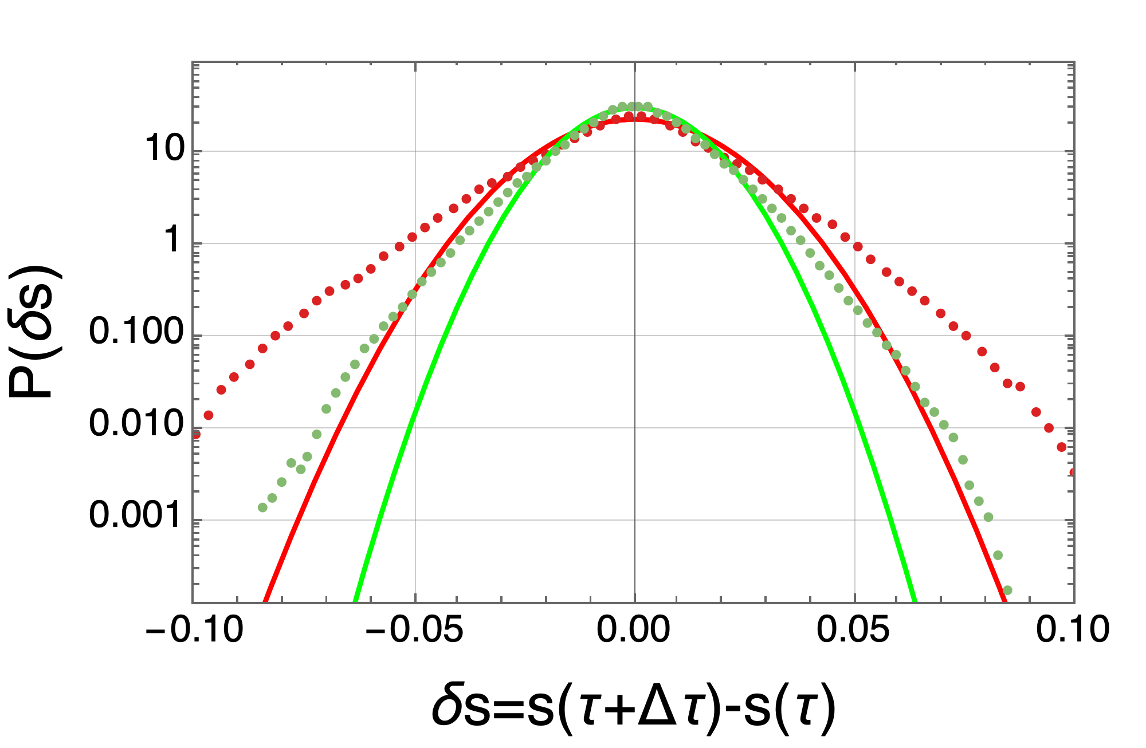
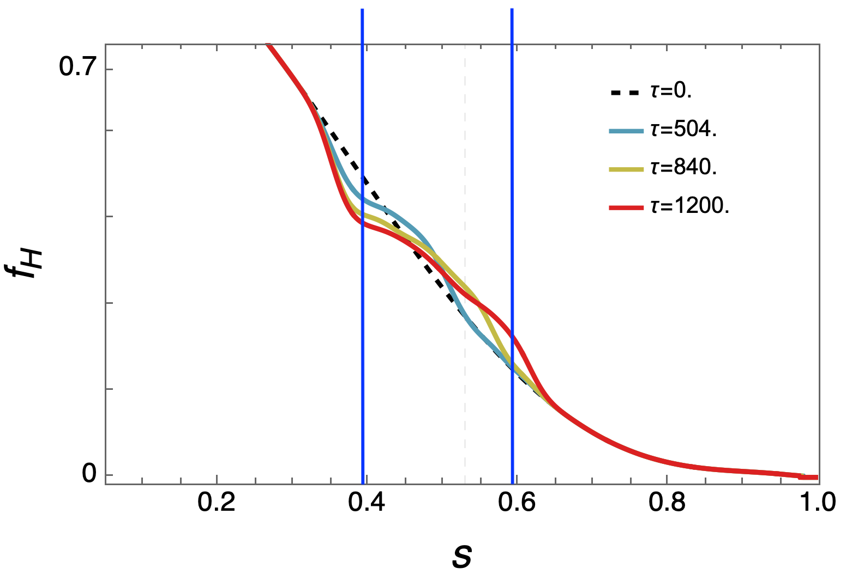
Global resonant population
Tracer initialization equispaced in $s_{r1}$ ; $s_{r2}$
$∆τ=35$: $σ=0.013$, $R^{2}=0.990$
$∆τ=65$: $σ=0.017$, $R^{2}=0.979$
Diffusive case
$∆τ=35$: $σ=0.074$, $R^{2}=0.995$
$∆τ=65$: $σ=0.095$, $R^{2}=0.991$
For small $∆τ$ PDF seems reasonably normal: well fitted by Gaussian -> the goodness of the fit is still lower than a pure diffusive case.

Slide 12
Analyzed cases
NL – Fully non linear scheme as previously described: reduced ITER 15MA scenario.
DC – Multi mode simulation for the pure diffusive case (as benchmark).

Slide 13
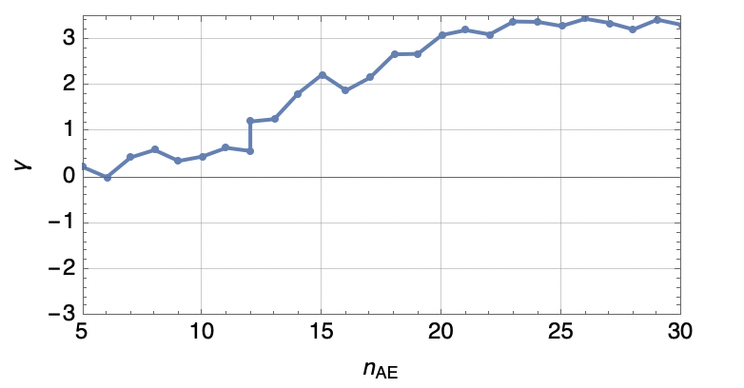
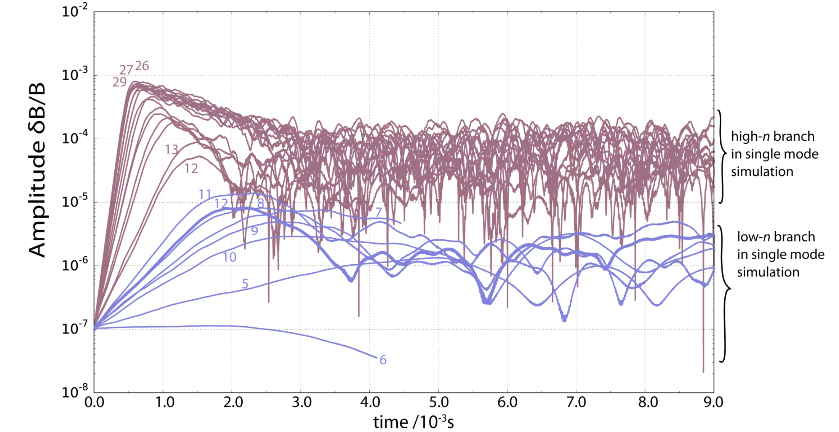
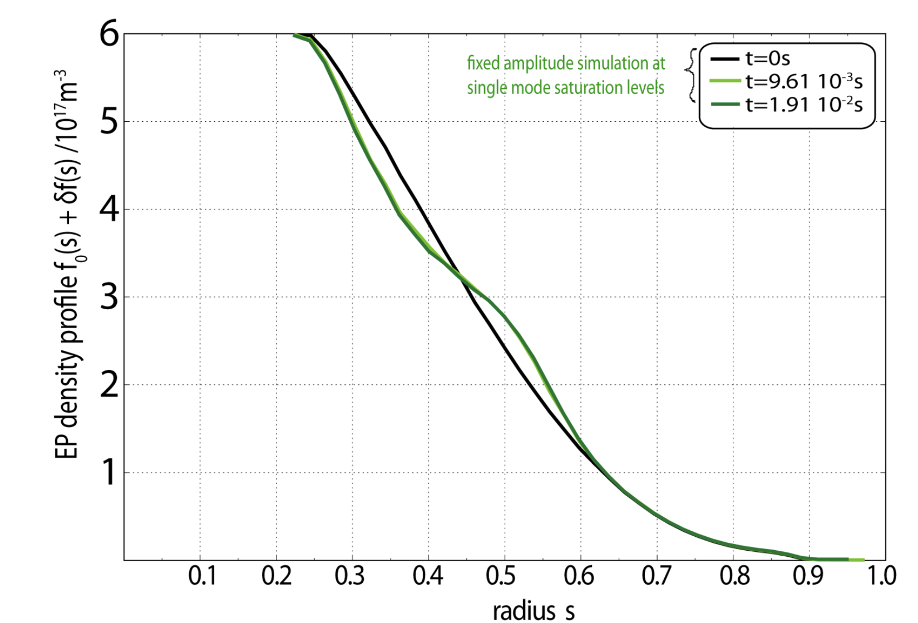
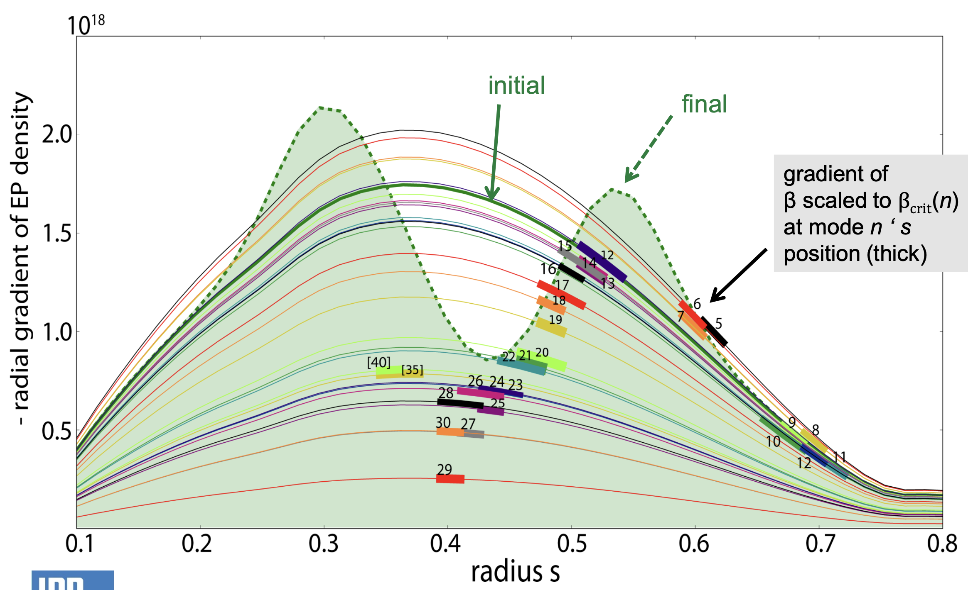
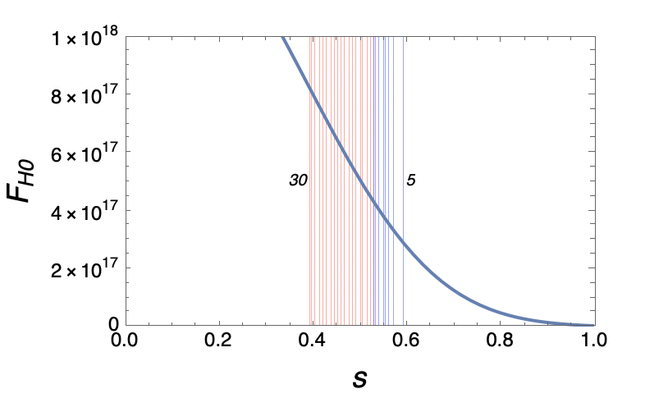
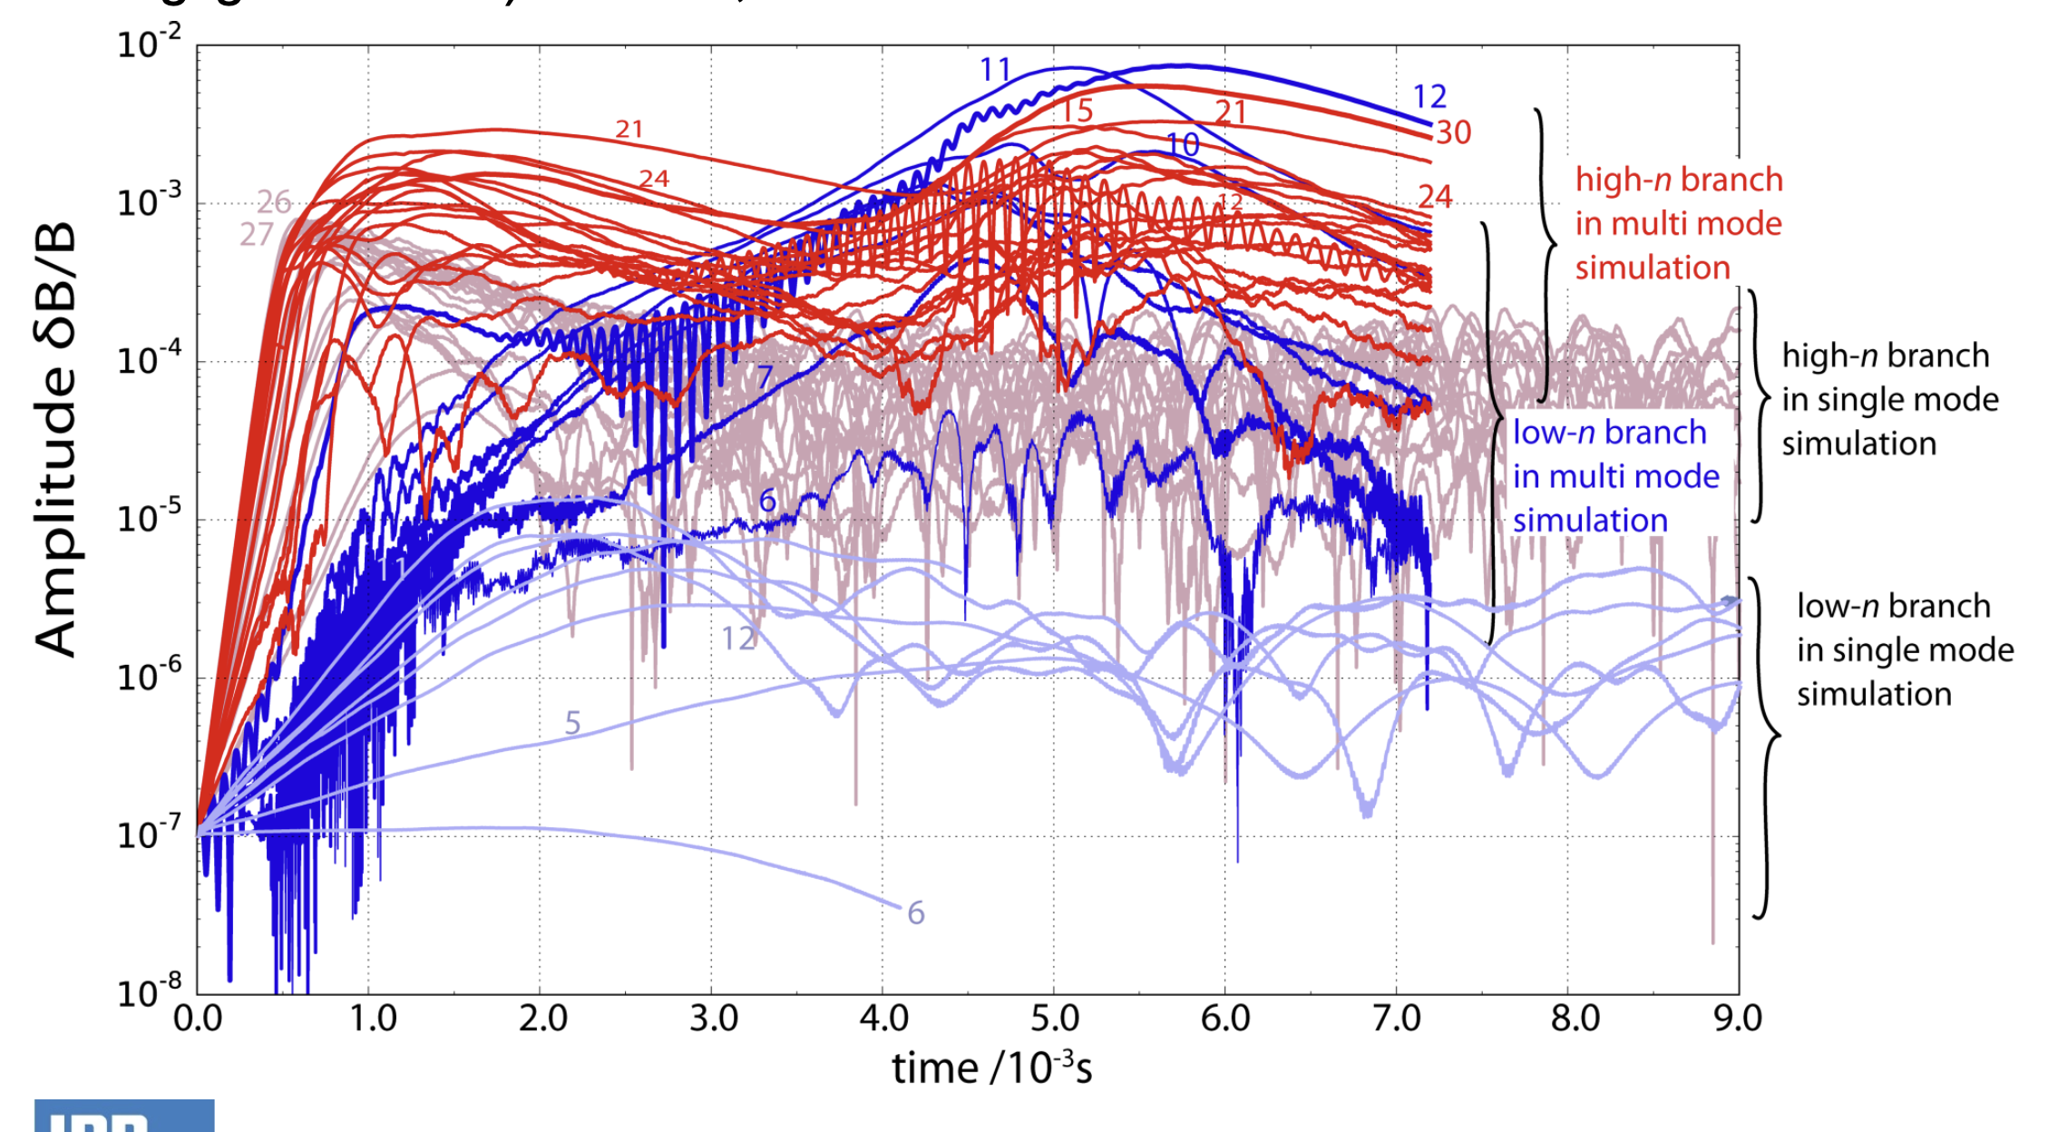
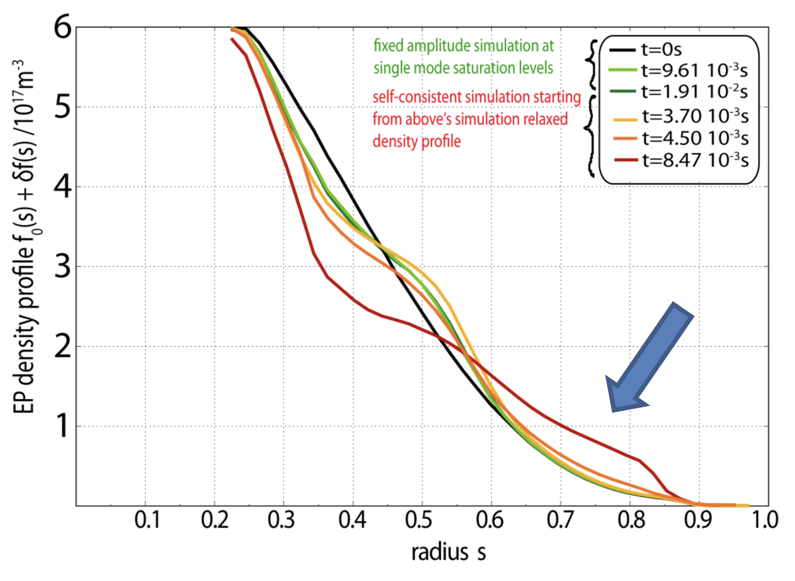
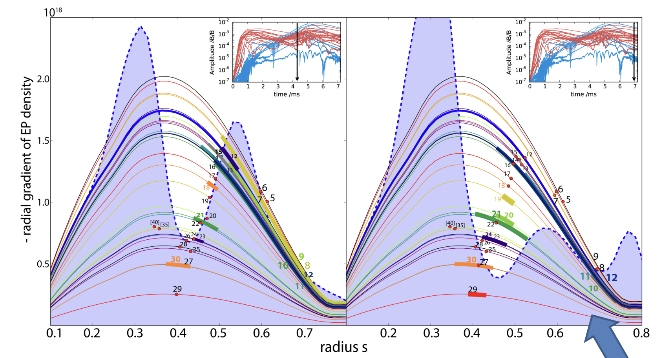
Default EP density – Reduced damping (1/6)
QL fixed modes
Single mode analysis
Non-linear multi mode
After 4ms -> differences

Slide 14
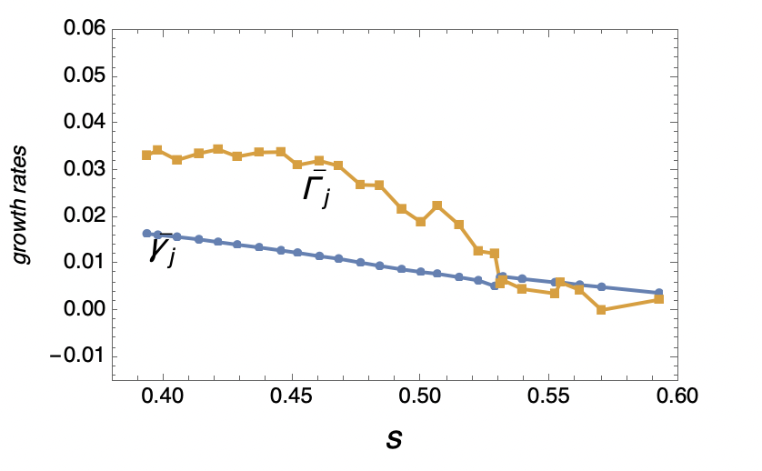
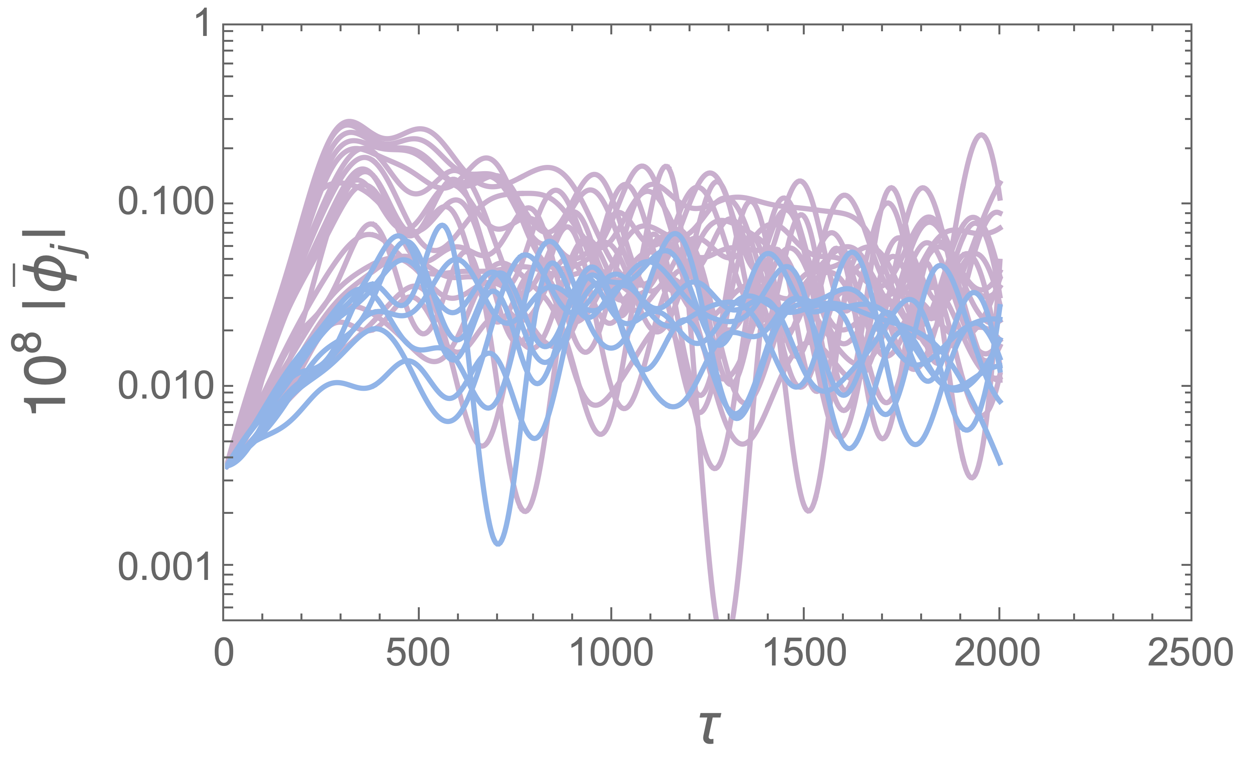
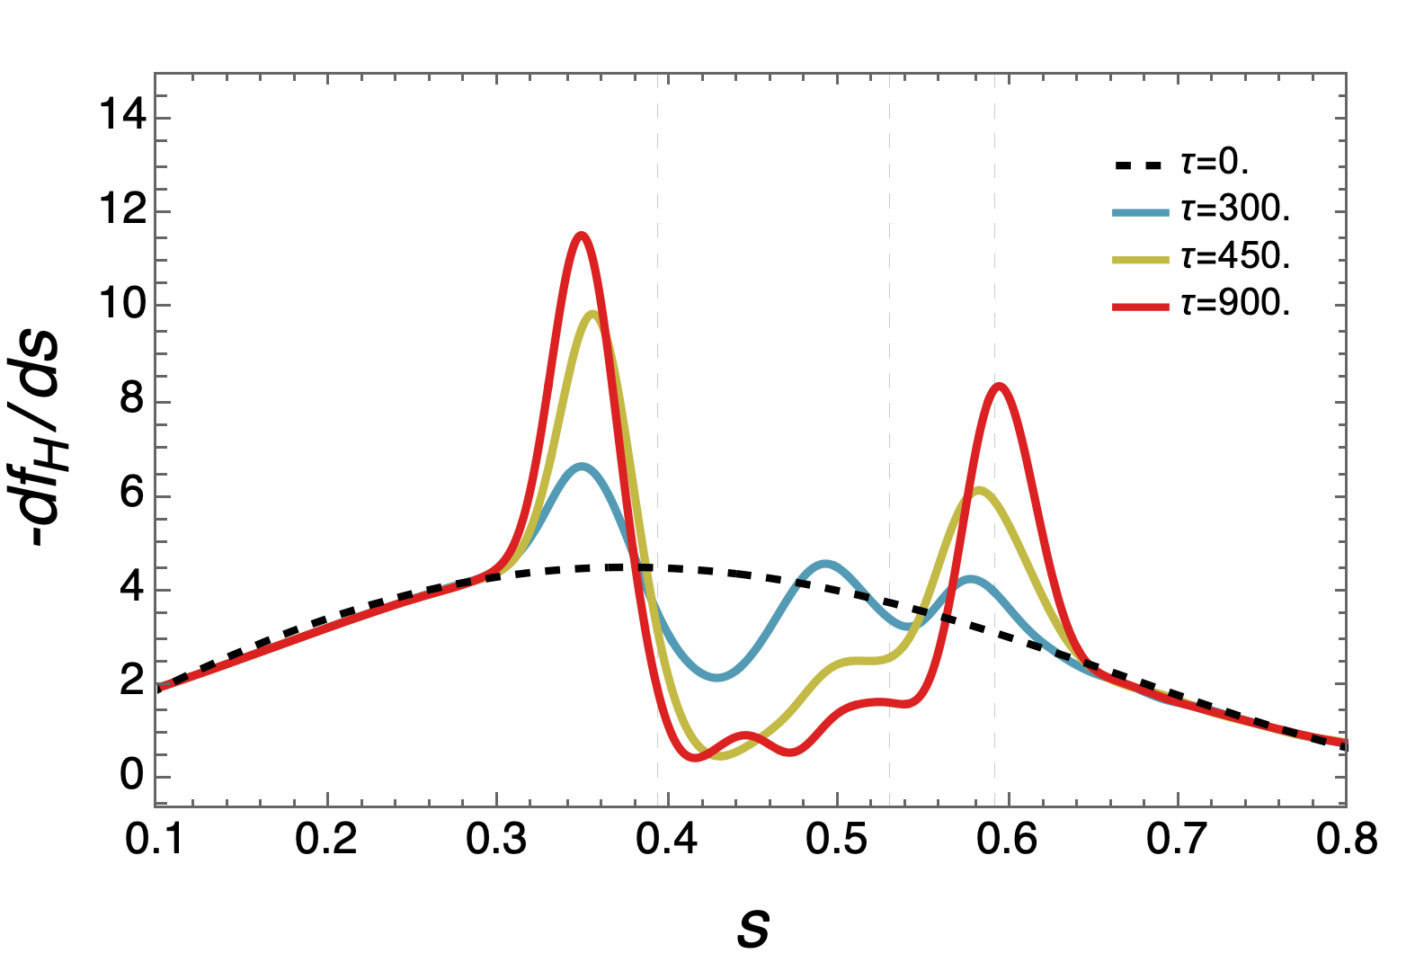
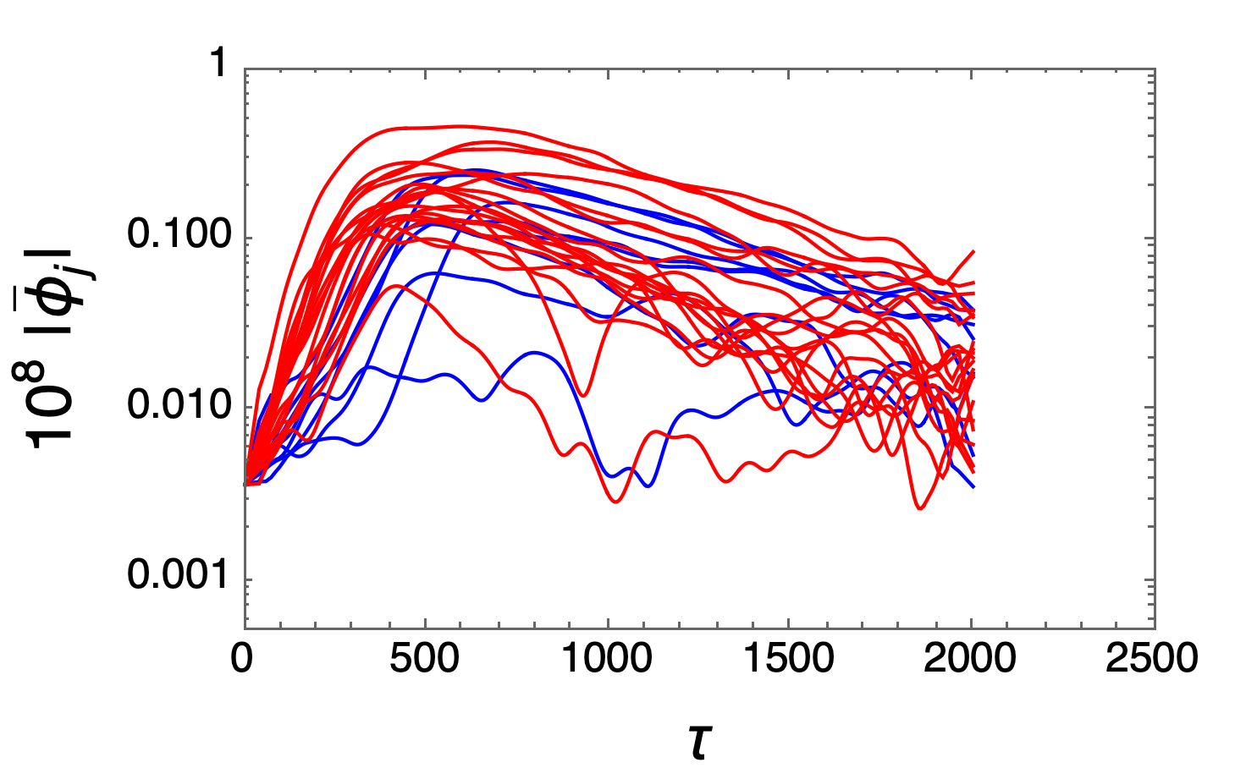
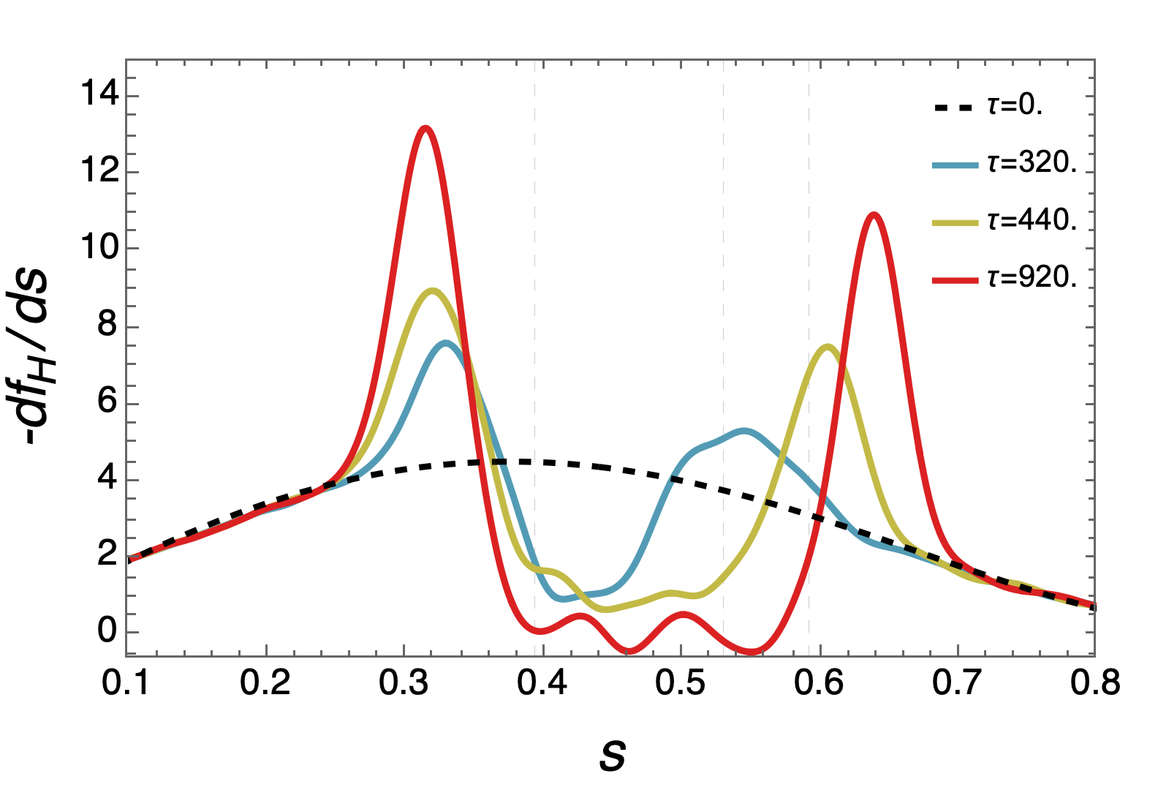
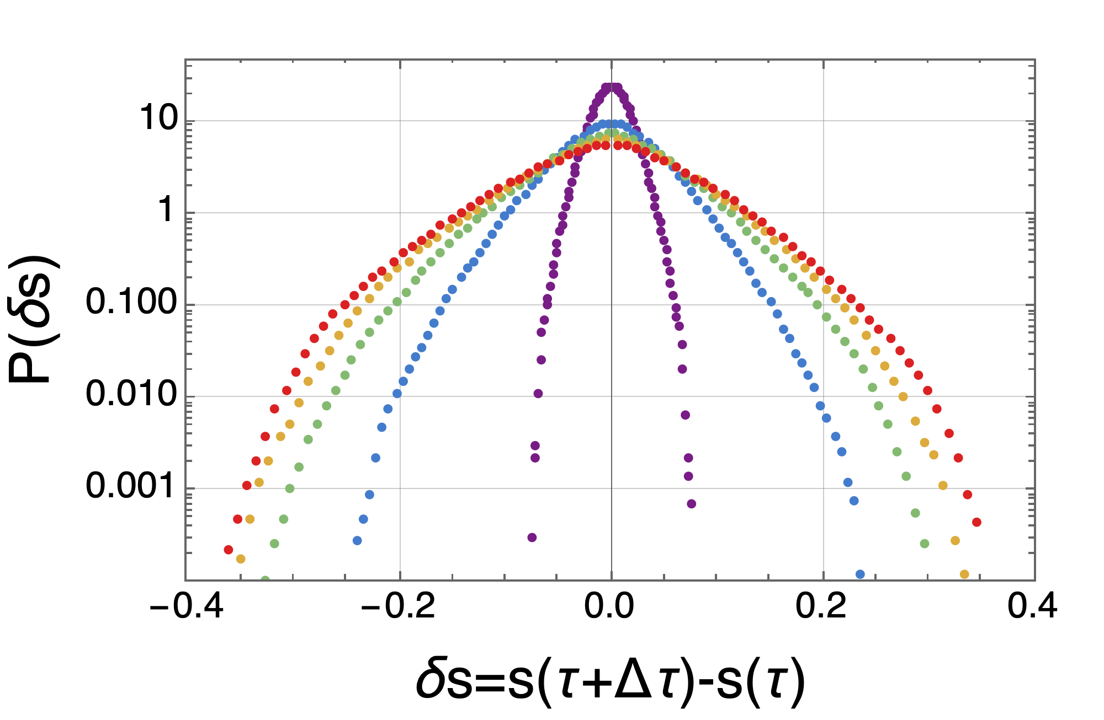
Map - Reduced damping (1/6)
QL fixed modes
Single mode analysis
Non-linear multi mode

