Slide 1
Study of fast ions confinement in QH-mode in DEMO
Progress Meeting
Guillermo Bustos, Cristian Sommariva, Jonathan Graves
April 21, 2020

Slide 2
Contents
Introduction
Description of the project
Progress
Future work

Slide 3
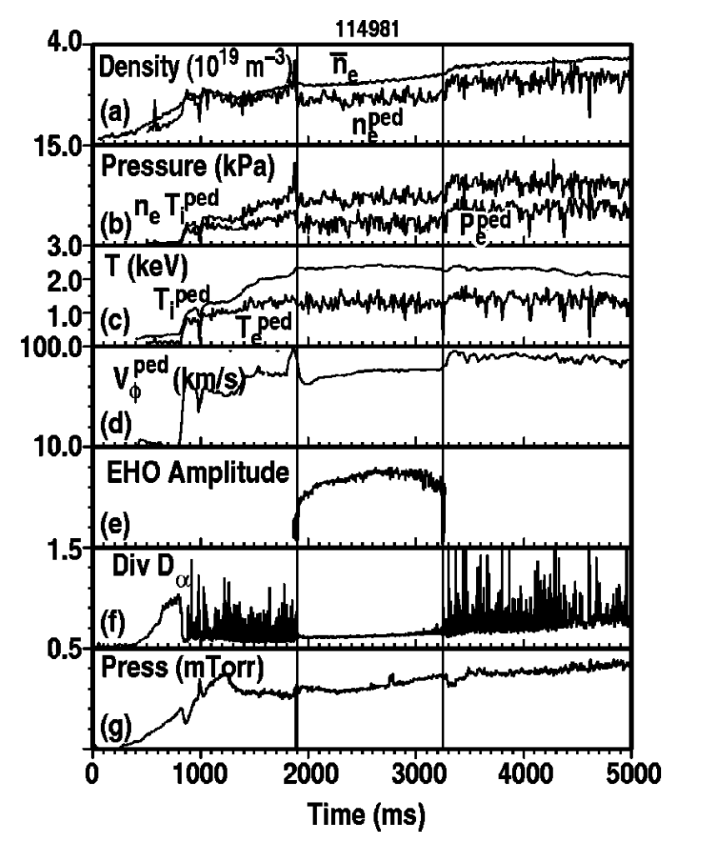
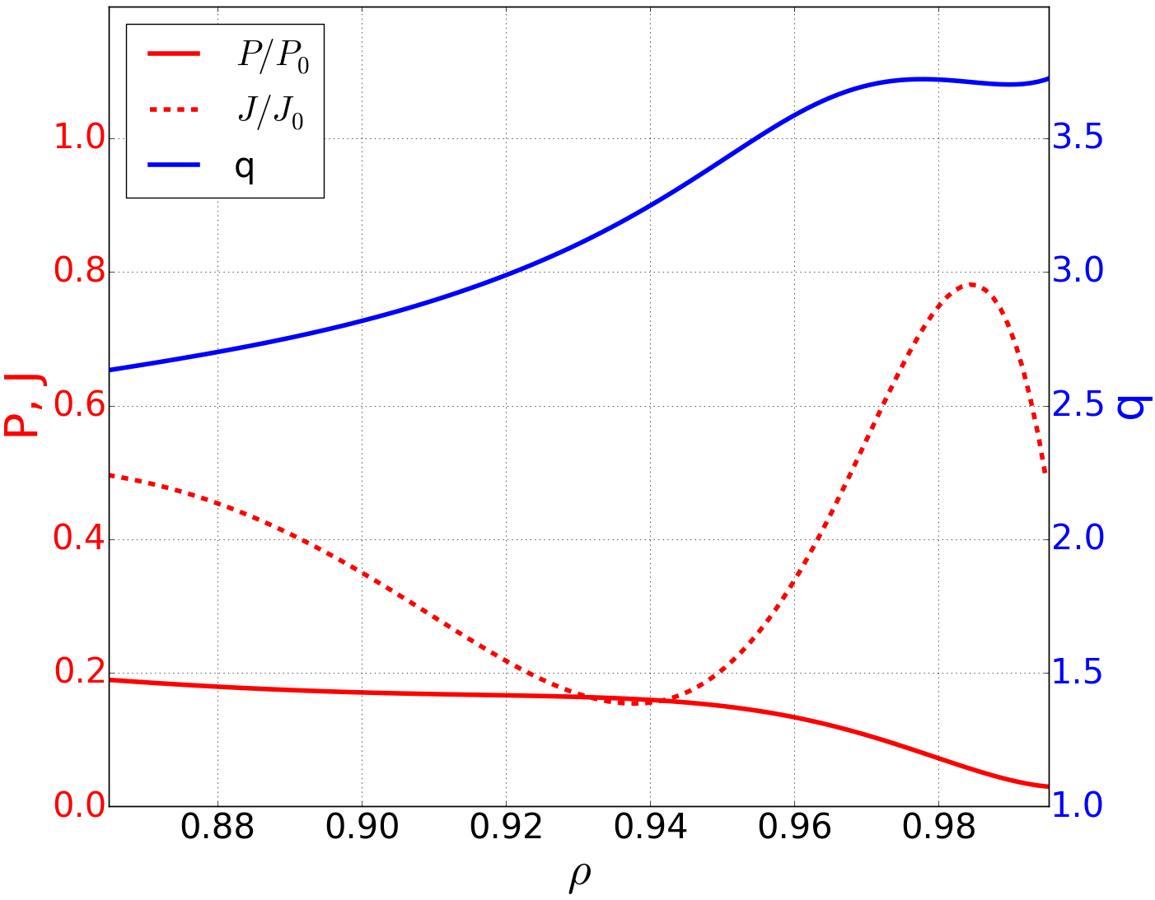
Introduction
In the Quiescent High confinement mode (QH-mode) ELMs are suppressed at similar plasma performance as in H-mode [Burrell, K. H. 2005]
Instead of ELMs, a low-n MHD instability (called Edge Harmonic Oscillation, EHO) saturates and provides necessary transport to sustain high pedestal.
One possible explanation for EHO is the exfernal mode theory in [Brunetti, D. 2018], [Brunetti, D. 2019], [Kleiner, A. 2019].
Key elements to access QH mode
Pressure pedestal
Low edge collisionality
ExB flow shear
Low collisionality + Pressure gradient = strong bootstrap current → Region of low magnetic shear at the pedestal region.
The presence of EHOs may degrade the confinement of fast ions with deleterious effects on DEMO peak performances
Trigger EHOs
Avoid ELMs

Slide 4
Description of the project
Assessments of fast ion confinement in plasma equilibria with EHO perturbations is required:
Perform fast ion confinement studies in DEMO 2019 equilibria with EHOs using the VENUS-LEVIS code [D. Pfefferlé, 2014].
VENUS-LEVIS simulates the distribution of marker particles (in this case, fast ions) in a background equilibrium (particularly needed is the magnetic geometry decomposed in Fourier modes).
For a plasma with EHO, we need a full 3D equilibrium containing edge corrugations. To obtain that, we use the Free-Boundary VMEC code [Hirshman, A. 1986].
The Free-Boundary VMEC code calculates the full nonlinear 3D equilibrium by minimizing the total energy (plasma + vacuum) subject to the restriction of $J×B=∇P$ .
PROS
Fast calculation of 3D saturated states. Particularly, we have experience obtaining the saturated states corresponding to known instabilities.
External Kink [Kleiner, A. 2018],[Cooper, W. A.]
Exfernal modes (identified as EHO) [Kleiner, A. 2019]
CONS
No wall: overestimation in the size of the saturated modes [Kleiner, A. 2018].
No flow: Even if flow is essential to arrive at the state, we are forced to assume that EHO can exist without flow.

Slide 5
Description of the project
QH-mode equilibrium for DEMO (Provided externally)
Reproduction QH-mode equilibrium with Free-Boundary VMEC code
STEP 1
STEP 2
Obtain edge corrugations (EHO) within the QH-mode baseline with Free-Boundary VMEC
Study of fast ions confinement in QH-mode in DEMO with VENUS-LEVIS
STEP 3

Slide 6
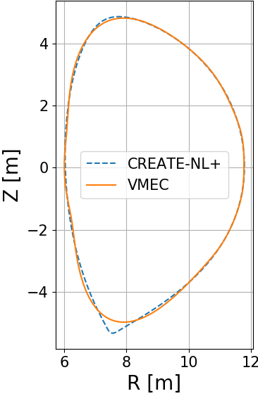
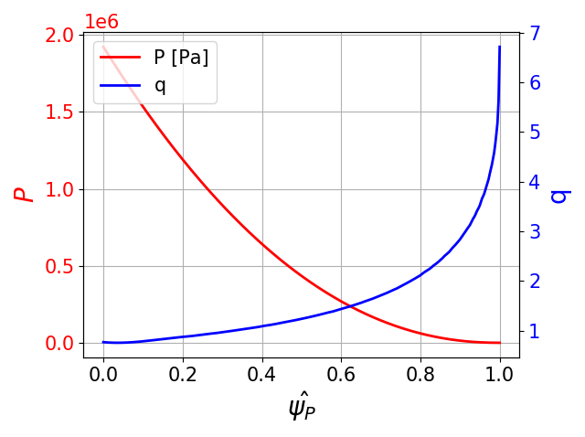
VMEC inputs
Pressure and current density (or rotational transform) profiles as a function of the normalized poloidal (or toroidal) magnetic flux.
A guess for the plasma boundary and magnetic axis.
A description of the coil system (including the toroidal field coils).
The current flowing through each of the coils.
The toroidal magnetic flux at the edge.
Plasma profiles and guess for the boundary are obtained from a CREATE-NL+ simulation of the QH-mode DEMO baseline (provided externally)
Boundary guess is approximated by a finite number of Fourier modes (8)

Slide 7
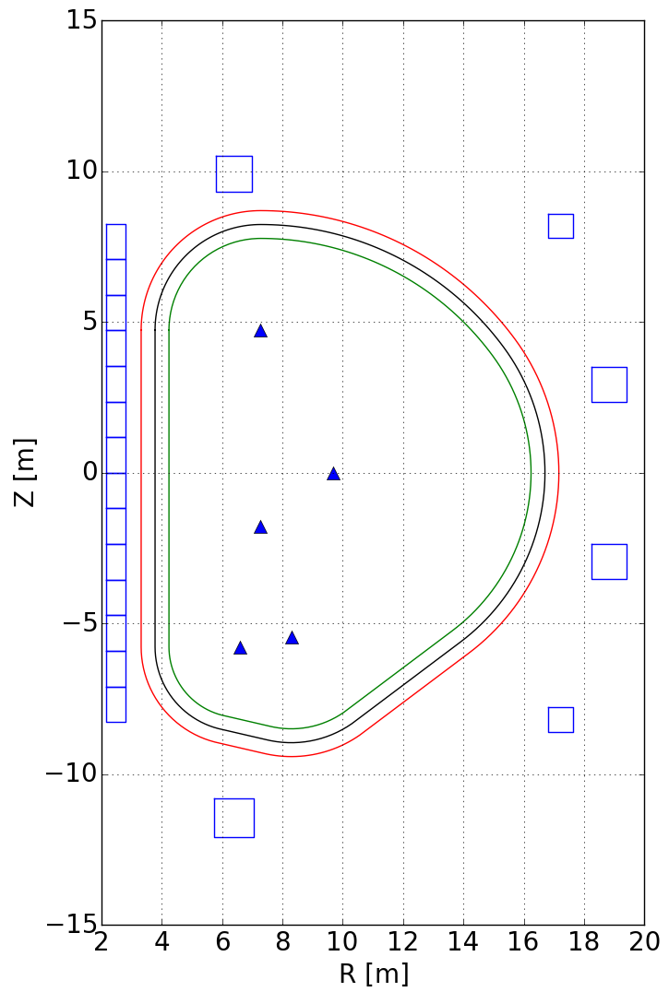
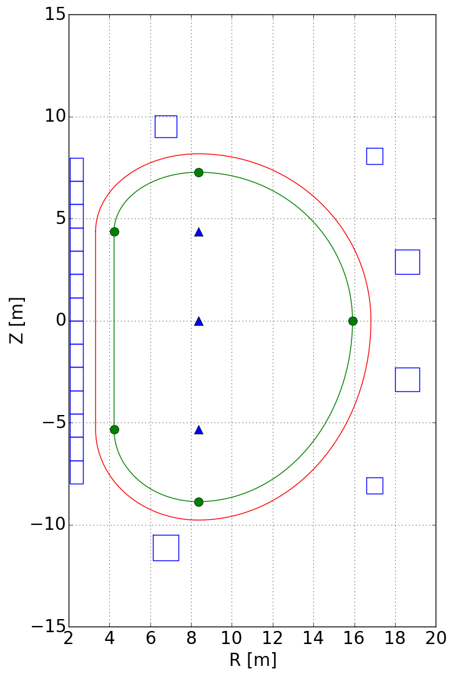
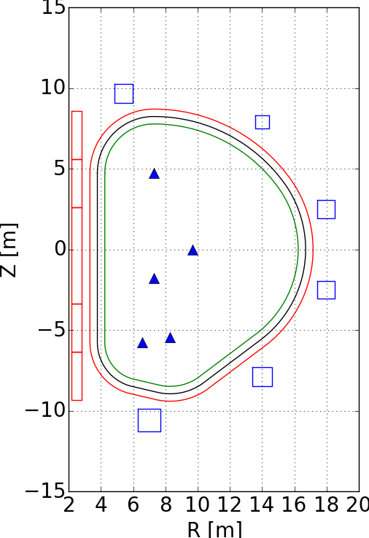
Coils
TFC: WPMAG baseline 2018
PFC: PROCESS run DEMO2018
TFC: PROCESS run DEMO2019
PFC: PROCESS run DEMO2019
TFC: WPMAG baseline 2018
PFC: Used in CREATE-NL+ sim
1
2
3
None coil set has stellarator symmetry → Need a robust equilibrium to find good convergence in VMEC.

Slide 8
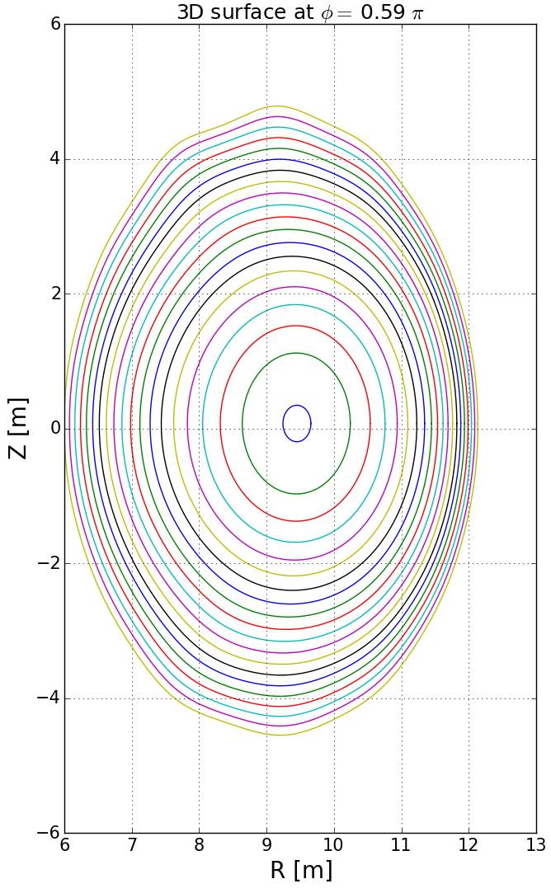
Current in coils
The current in the coils is specified in the PROCESS output file and can be used as an input in Free-Boundary VMEC code. (Coil set used: 2)
Results for 2D (n=0) equilibrium:
Poor convergence → Error in force balance: 10-3 N
B-topologies do not match.
To obtain a robust result several modifications to the original equilibrium were tried:
Rescaled / changed pressure profile
Massaged / changed q-profile
Varied: coil currents, resolution, B-axis position, toroidal flux, etc .…
None of it worked. PROCESS currents are only an approximation, based on 0D models.

Slide 9
Current in coils
Currents used in the CREATE-NL+ simulation (https://idm.euro-fusion.org/?uid=2NML4K).
 | SOF | EOF
ICS3U [MAt] | 13.63 | -5.94
ICS2U [MAt] | -1.42 | -29.11
ICS1 [MAt] | -9.6 | -58.23
ICS2L [MAt] | -7.17 | -29.11
ICS3L [MAt] | 25.14 | -12.44
IPF1 [MAt] | 14.19 | 2.32
IPF2 [MAt] | -5.22 | -5.89
IPF3 [MAt] | -5.12 | -6.08
IPF4 [MAt] | -3.98 | -3.64
IPF5 [MAt] | -7.76 | -8.98
IPF6 [MAt] | 15.46 | 10.25
3
Current in TFC not specified. Set to 4.0625E+06 A so to have a vacuum field of 5.74 T at geometric axis

Slide 10
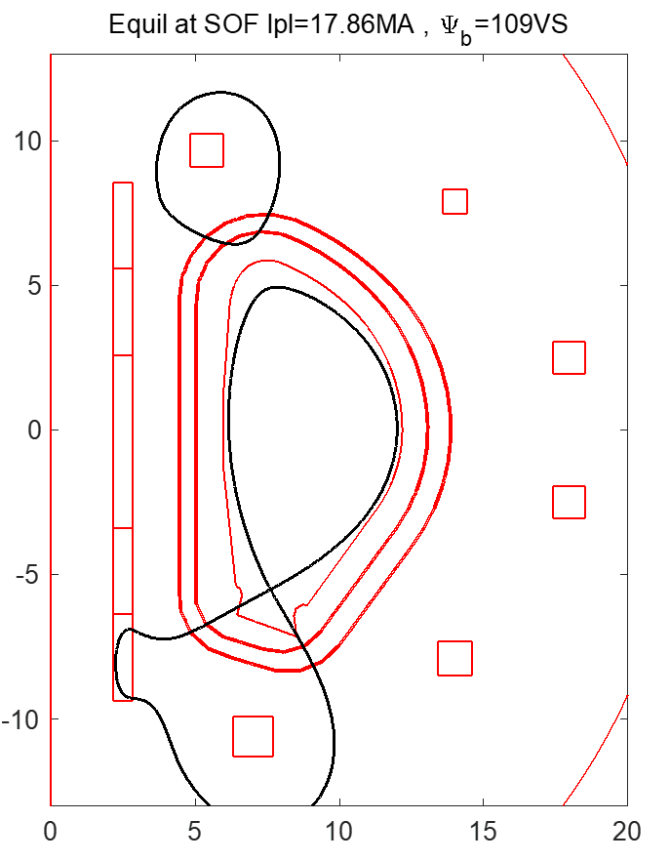
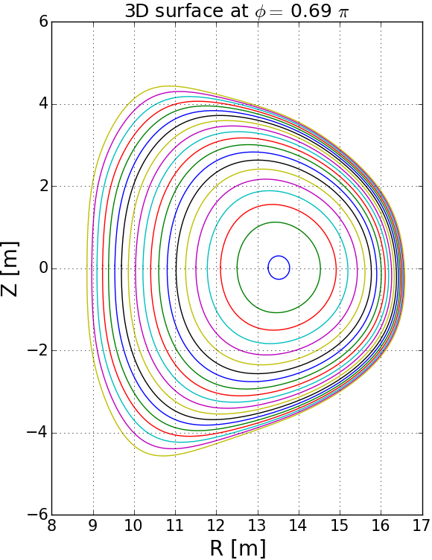
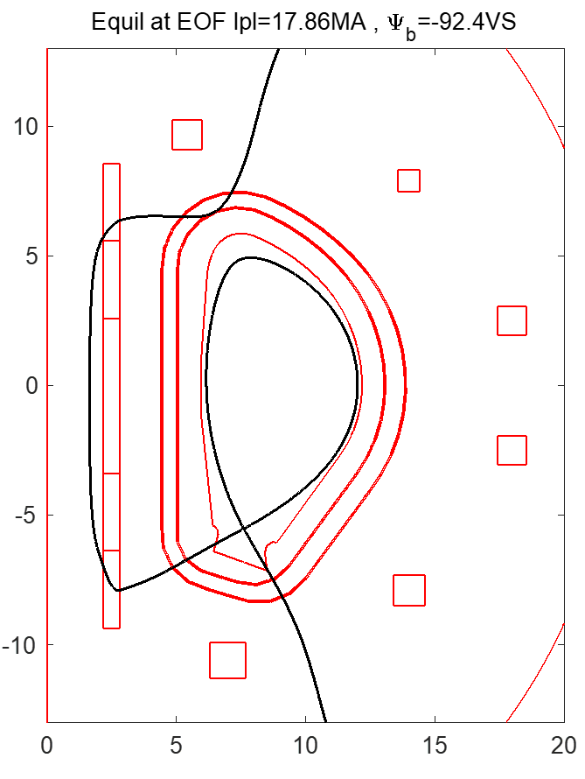
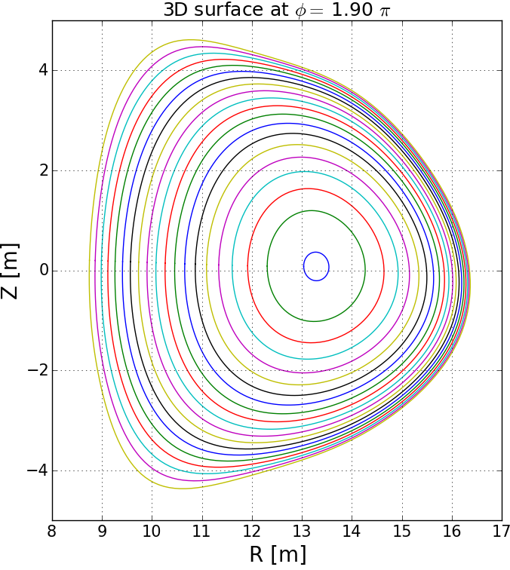
Results
Results for 2D (n=0) equilibrium:
Poor convergence → Error in force balance: 10-2 N
B-topologies do not match.
What are the differences between how the equilibrium is calculated in CREATE-NL+ and Free-Boundary VMEC?
Presence of a wall?
SOF
EOF

Slide 11
Current in coils
Possible solution: Recalculate the current in the coils
FREE boundary Grad Shafranov (FREEGS) code [github.com/bendudson/freegs] solves the Grad-Shafranov equation in the whole domain using Picard iterations.
It uses feedback control to calculate the currents in the coils that are consistent with the plasma profiles and some boundary constraints.
Why FREEGS?
Open source
Easy to install and use
Fast
Input for FREEGS:
Plasma profiles (obtained from CREATE-NL+ sim)
Geometry of the coils (coil set 3)
Boundary restrictions (location and flux of LCFS)
 | SOF | EOF | FREEGS
ICS3U [MAt] | 13.63 | -5.94 | 125
ICS2U [MAt] | -1.42 | -29.11 | 111
ICS1 [MAt] | -9.6 | -58.23 | 284
ICS2L [MAt] | -7.17 | -29.11 | 99.3
ICS3L [MAt] | 25.14 | -12.44 | 165
IPF1 [MAt] | 14.19 | 2.32 | 31.5
IPF2 [MAt] | -5.22 | -5.89 | 7.28
IPF3 [MAt] | -5.12 | -6.08 | 9.55
IPF4 [MAt] | -3.98 | -3.64 | 8.14
IPF5 [MAt] | -7.76 | -8.98 | 8.08
IPF6 [MAt] | 15.46 | 10.25 | 16.1
FREEGS CS currents are very large!

Slide 12
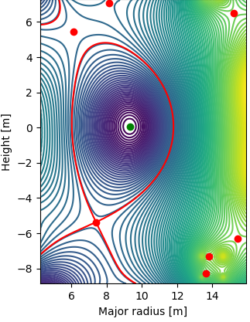
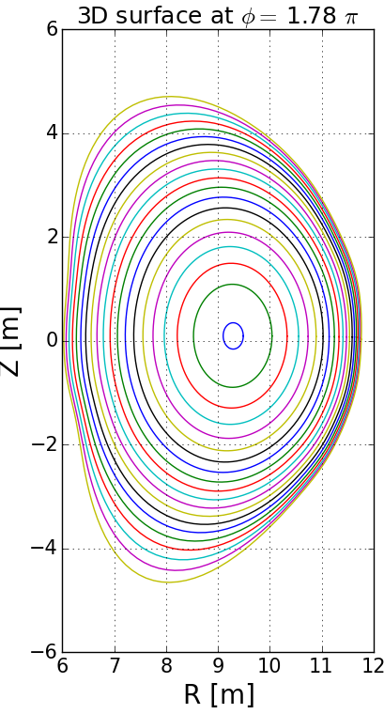
Results
Results for 2D (n=0) equilibrium:
Good convergence → Error in force balance: <10-9 N
Magnetic topology matches.
Robust equilibrium.
What are the differences between how the equilibrium is calculated in CREATE-NL+, FREEGS and Free-Boundary VMEC?

Slide 13
Future work
Tune the details in the recreated in Free-Boundary VMEC to replicate exactly the QH-mode baseline.
Make sure equilibrium is robust in 3D simulations (obtain the same equilibrium when allowing for higher toroidal (n) modes)
Vary the profiles in 3D simulations in order to get edge corrugations which can be identified as EHO (within the exfernal mode theory)
Perform fast ion confinement studies with VENUS-LEVIS in full 3D equilibrium solutions with EHO.
If time allows it:
Characterize the parameter space in which EHO can be triggered in DEMO geometry.
Study the effect of ion confinement in said parameter space.

Slide 14
Future work
QH-mode equilibrium for DEMO (Provided externally)
Almost done
Reproduction QH-mode equilibrium with Free-Boundary VMEC code
STEP 1
Next few weeks
STEP 2
Obtain edge corrugations (EHO) within the QH-mode baseline with Free-Boundary VMEC
Study of fast ions confinement in QH-mode in DEMO with VENUS-LEVIS
STEP 3
Next two months

Slide 15
References
Burrell, K. H., West, W. P., Doyle, E. J., Austin, M. E., Casper, T. A., Gohil, P., … Zeng, L. (2005). Advances in understanding quiescent H-mode plasmas in DIII-D. In Physics of Plasmas (Vol. 12, pp. 1–10). American Institute of Physics. https://doi.org/10.1063/1.1894745
Brunetti, D., Graves, J. P., Lazzaro, E., Mariani, A., Nowak, S., Cooper, W. A., & Wahlberg, C. (2018). Analytic stability criteria for edge MHD oscillations in high performance ELM free tokamak regimes. Nuclear Fusion, 58(1), 014002. https://doi.org/10.1088/1741-4326/aa9456
Brunetti, D., Graves, J. P., Lazzaro, E., Mariani, A., Nowak, S., Cooper, W. A., & Wahlberg, C. (2019). Excitation Mechanism of Low- <math display="inline"> <mrow> <mi>n</mi> </mrow> </math> Edge Harmonic Oscillations in Edge Localized Mode-Free, High Performance, Tokamak Plasmas. Physical Review Letters, 122(15), 155003. https://doi.org/10.1103/PhysRevLett.122.155003
Hirshman, S. P., van RIJ, W. I., & Merkel, P. (1986). Three-dimensional free boundary calculations using a spectral Green’s function method. Computer Physics Communications, 43(1), 143–155. https://doi.org/10.1016/0010-4655(86)90058-5
Kleiner, A., Graves, J. P., Cooper, W. A., Nicolas, T., & Wahlberg, C. (2018). Free boundary 3D ideal MHD equilibrium calculations for non-linearly saturated current driven external kink modes in tokamaks. Nuclear Fusion, 58(7), 074001. https://doi.org/10.1088/1741-4326/aac607
Cooper, W. A., Brunetti, D., Faustin, J. M., Graves, J. P., Pfefferlé, D., Raghunathan, M., … Aiba, N. (2015). Free boundary equilibrium in 3D tokamaks with toroidal rotation. Nuclear Fusion, 55(6), 063032. https://doi.org/10.1088/0029-5515/55/6/063032
Kleiner, A., Graves, J. P., Brunetti, D., Cooper, W. A., Medvedev, S., Merle, A., & Wahlberg, C. (2019). Current and pressure gradient triggering and nonlinear saturation of low- n edge harmonic oscillations in tokamaks. Plasma Physics and Controlled Fusion, 61(8), 084005. https://doi.org/10.1088/1361-6587/ab2444
D. Pfefferlé, W.A. Cooper, J.P. Graves, C. Misev, (2014) VENUS-LEVIS and its spline-Fourier interpolation of 3D toroidal magnetic field representation for guiding-centre and full-orbit simulations of charged energetic particles, Computer Physics Communications, Volume 185, Issue 12, 2014, Pages 3127-3140.

Slide 16
