Slide 1
SOLPS-ITER Demo Modelling
Update 2020-04-21
Fabio Subba

Slide 2
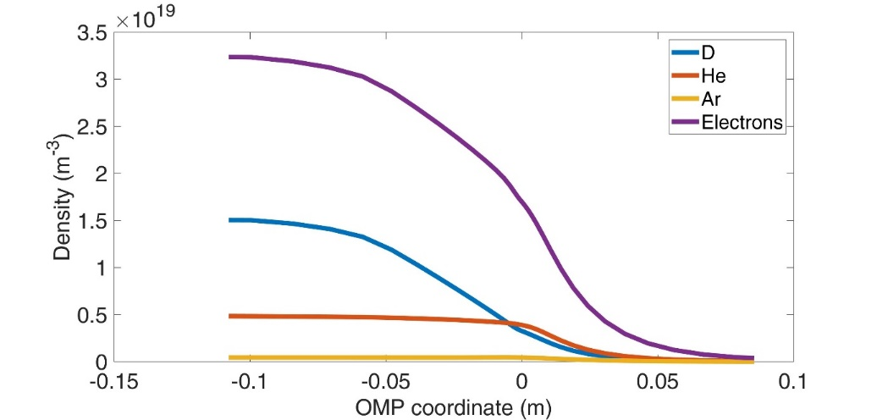
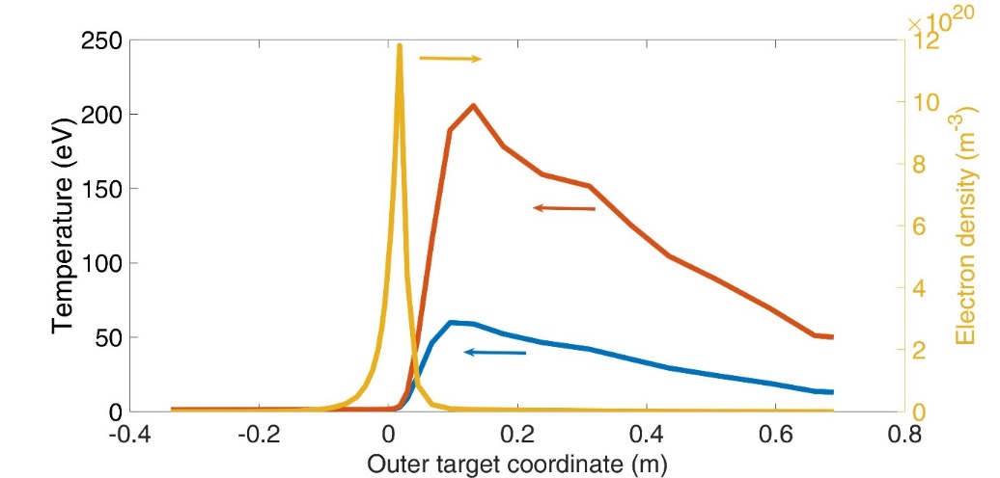
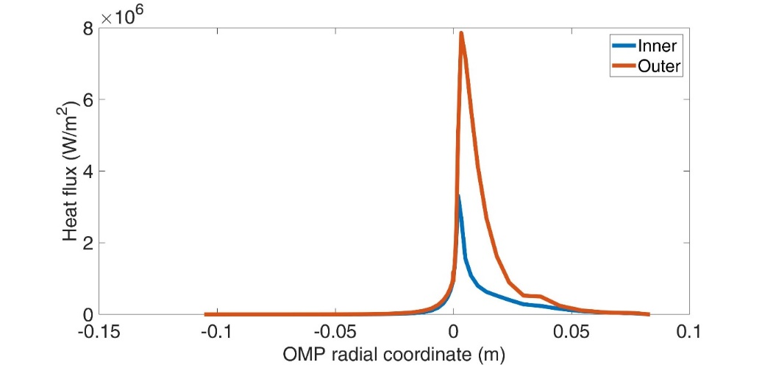
Reference Case (end of 2019)
Ions
Electrons
D+He+Ar plasma obtained
Relatively low upstream density (≤ 2e19 m⁻³)
Heat flux tolerable, but large temperature far from the separatrix ➔ sputtering concern
Need to explore different configurations

Slide 3
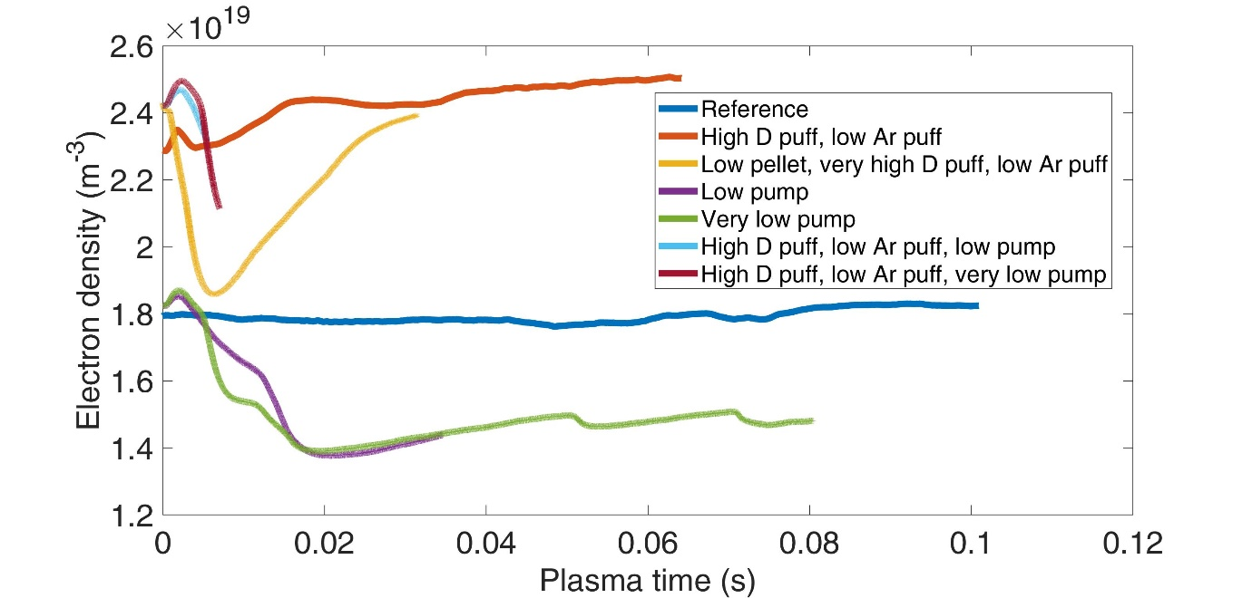
Performing Various Scans...
Upstream density

Slide 4
Performing Various Scans...
Upstream density

Slide 5
Performing Various Scans...
Upstream density

Slide 6
Performing Various Scans...
Upstream density

Slide 7
Performing Various Scans...
Upstream density

Slide 8
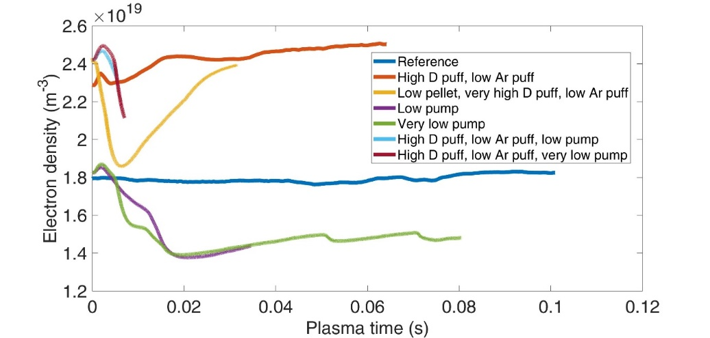
New Scans Various Traces
Upstream density

Slide 9
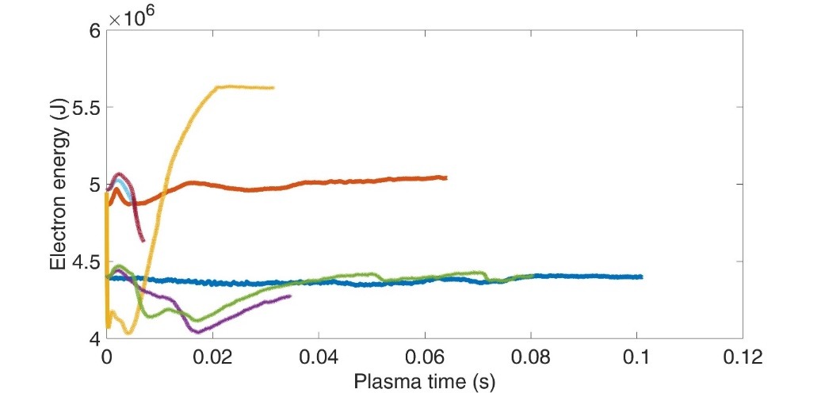
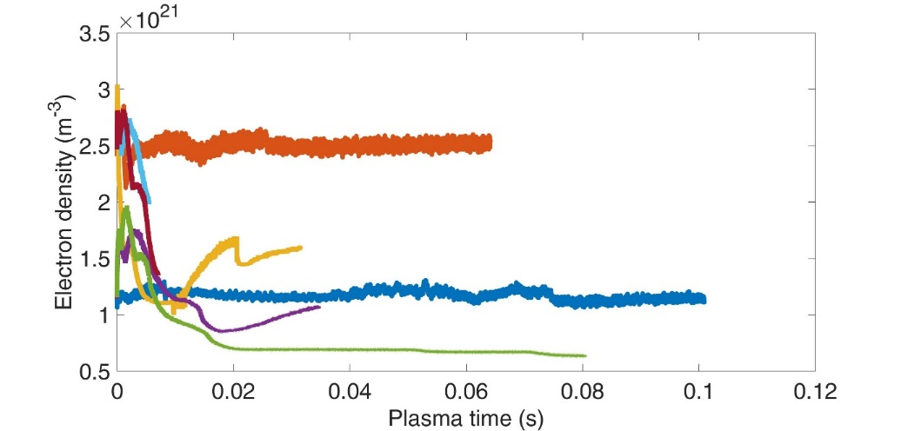
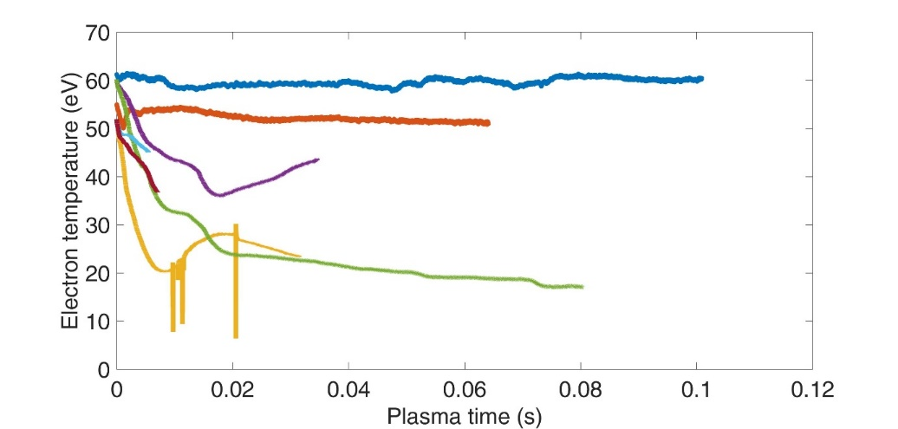
New Scans Various Traces
Electron energy content
Upstream density
Outer electron temperature (max)
Outer electron density (max)

Slide 10
Focus on Three Cases
Name | D pellet | D puff | Ar puff
Reference | 3e22 s-1 | 4.6e21 s-1 | 3e19 s-1
High D puff, low Ar | 3e22 s-1 | 1e22 s-1 | 1.5e19 s-1
ITER-like | 7e21 s-1 | 1e23 s-1 | 1.5e19 s-1
Additional cases (e.g. low pumping) still too far from steady state: not further considered here

Slide 11
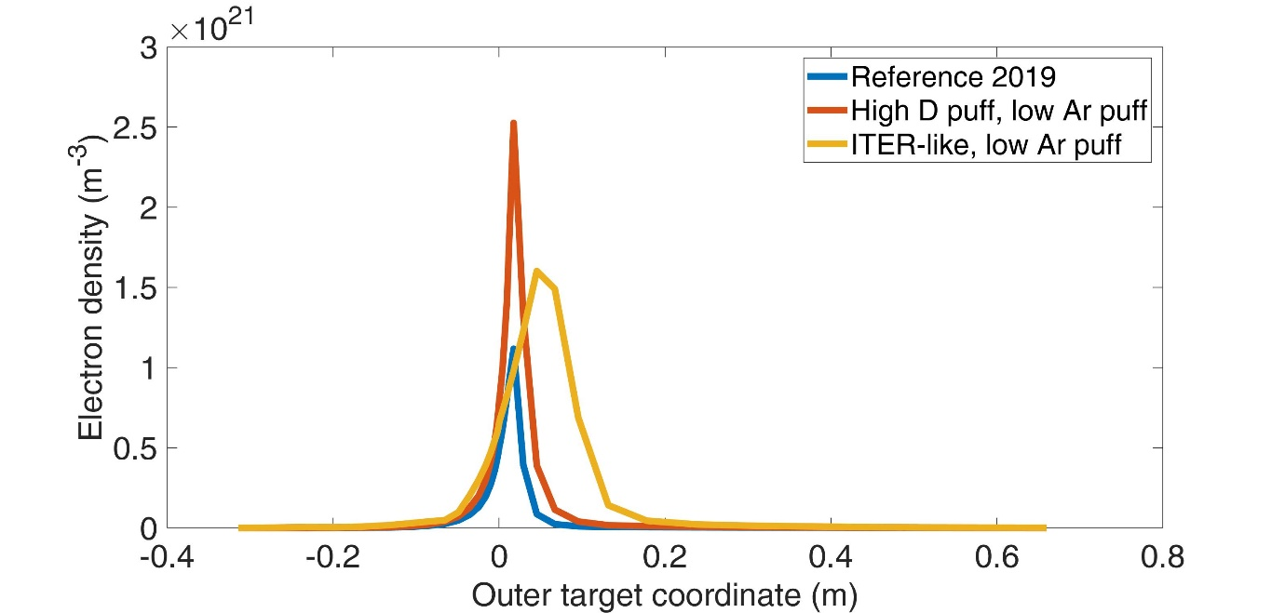
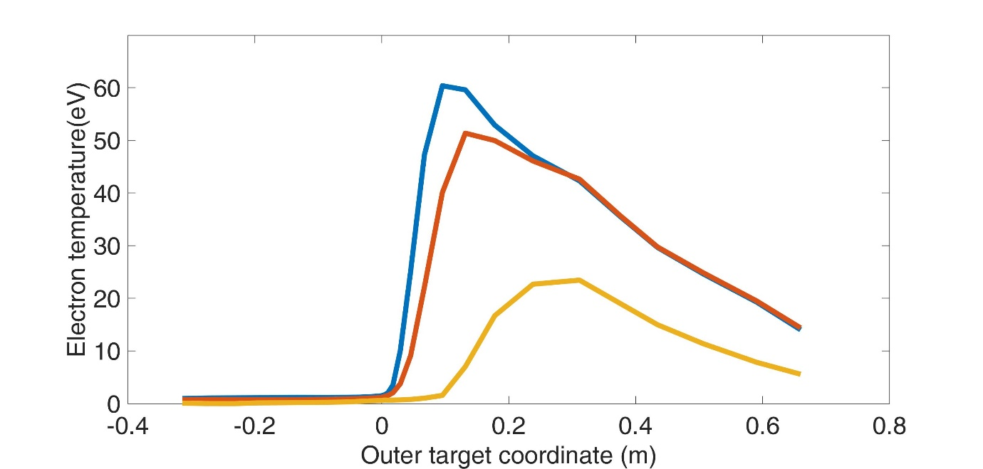
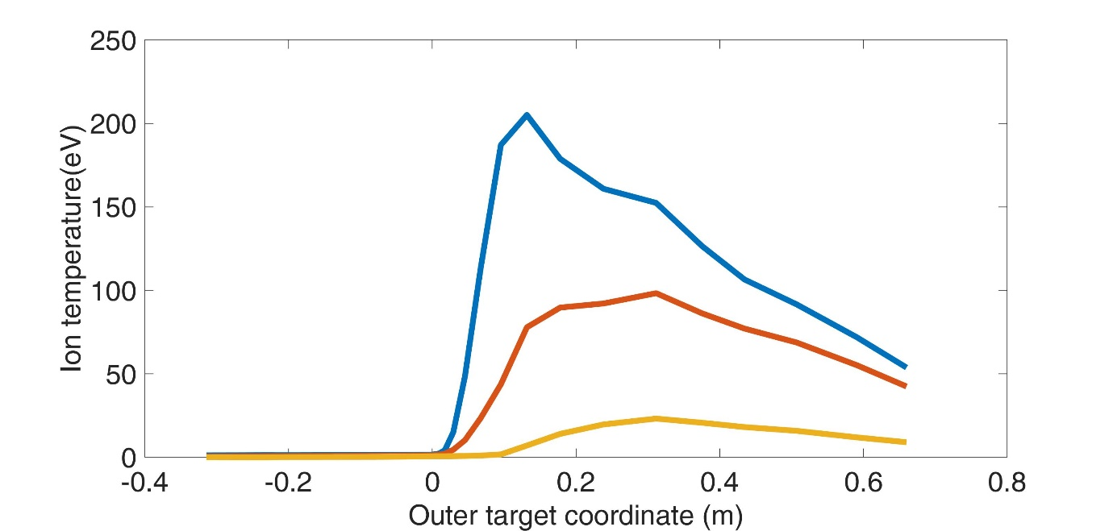
Most Performing – Target Quantities
Electron temperature
Electron density
Ion temperature
ITER-like: low pellet, high D puff (+ low Ar injection)
So far, most performing scenario (at the target)
Still rapidly evolving (time step ≤ 10⁻⁶ s)
Relatively low upstream density (still some margin form imrpvement)

Slide 12
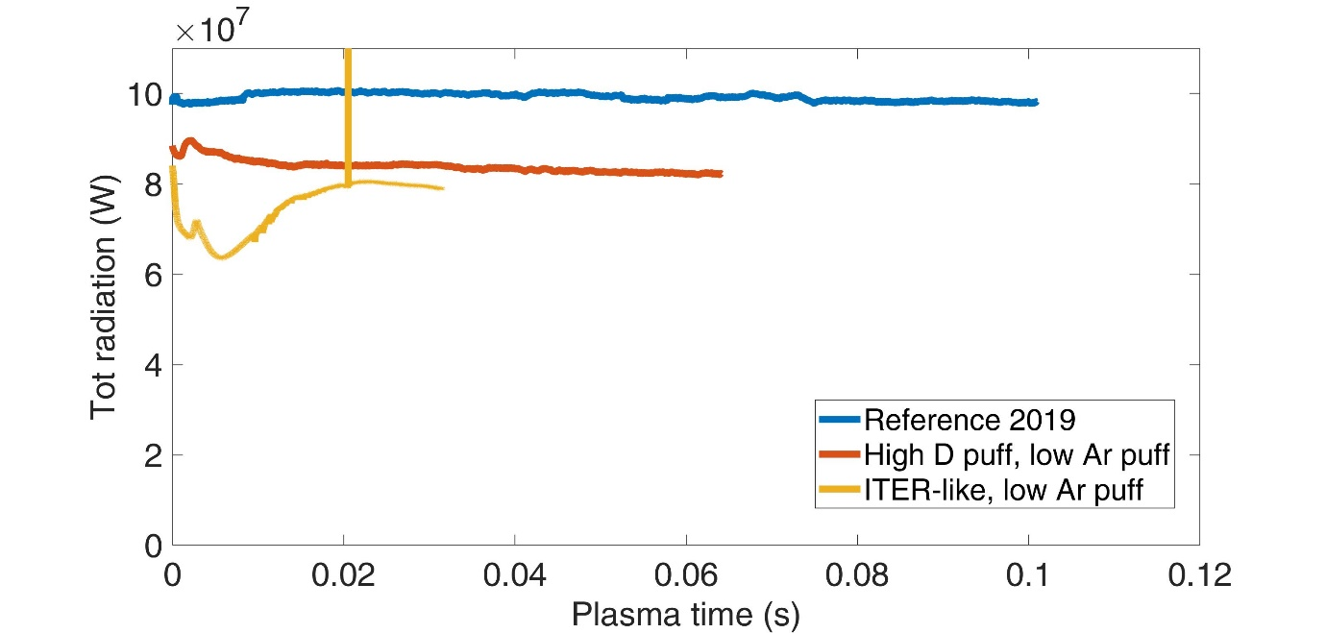
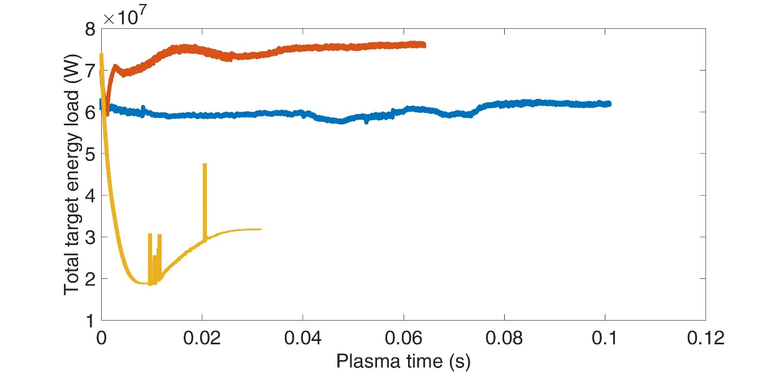
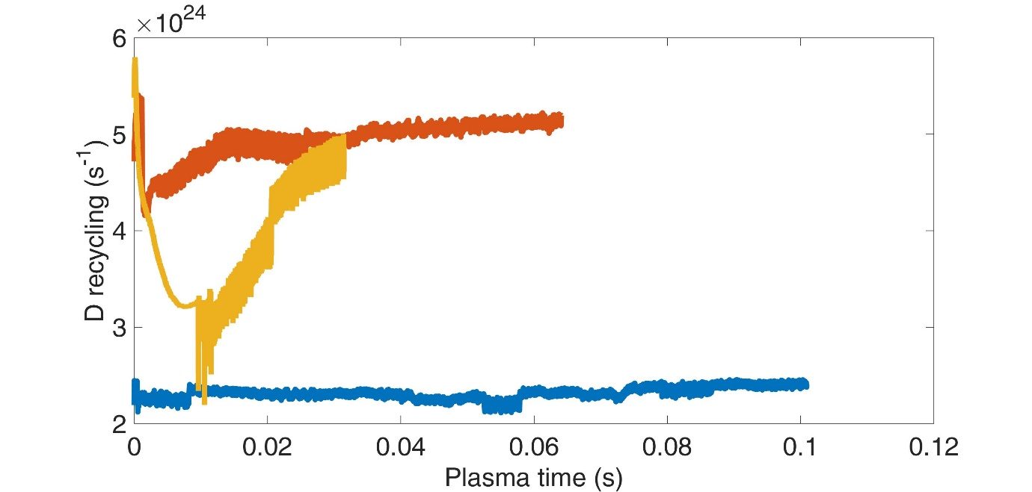
Most Performing – Draft Energy Balance
Load to targets
Radiation
Similarities between high-puff and ITER-like cases:
  Upstream density (currently ~2.4×10¹⁹ m⁻³)
  Recycling level (currently ~ 5×10²⁴ s⁻¹)
Differences:
  Total load to targets
  Target temperatures
Recycling level
To be Completed

Slide 13
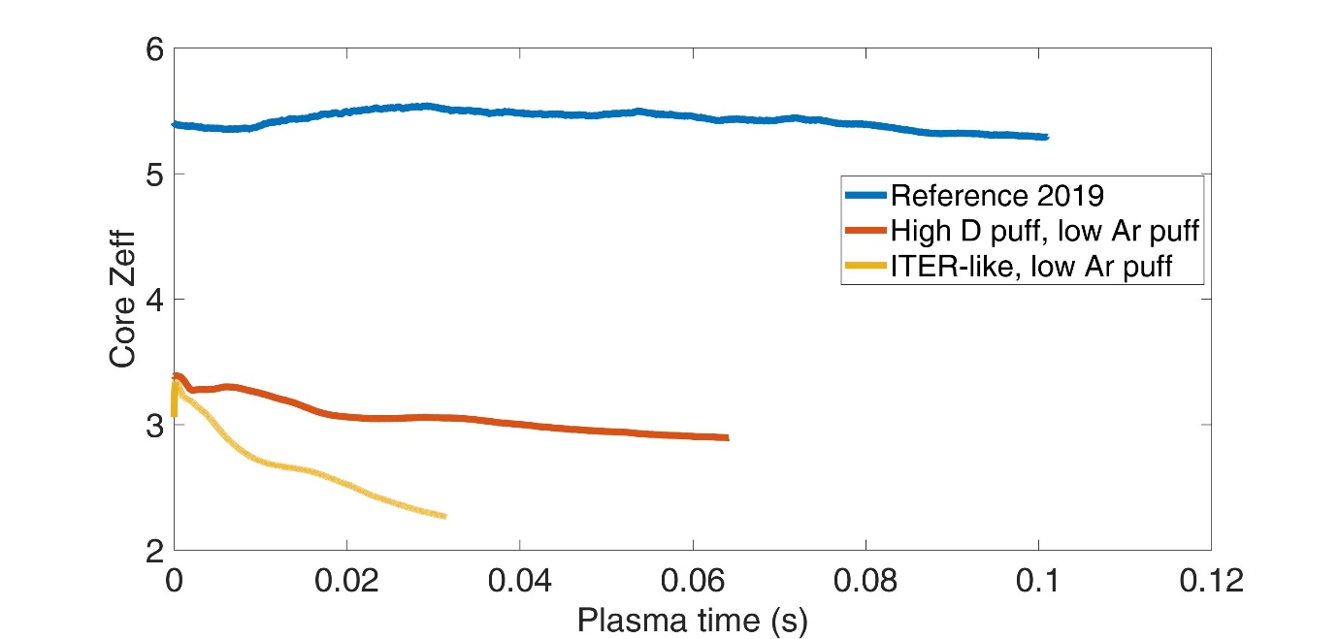
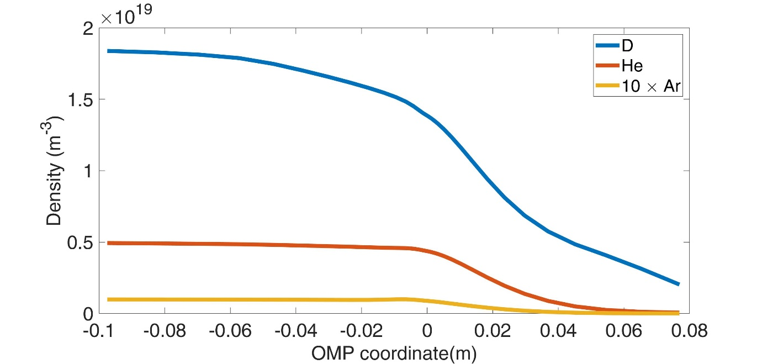
Most Performing - Impurities
Reference 2019 case not acceptable: too much impurities
Additional cases have more reasonable Zeff < 3 (still going down)
Target peak loads still reasonable:
  ~ 2MW/m² for the ITER-like case
  ~ 7 MW/m² for the high D puff, low Ar case
➔ Reference 2019 case was most likely overshooting the Ar puff
Zeff
Core densities (ITER-like)

Slide 14
Temporary Conclusions
Previous attempts were probably over-shooting the needed Ar content
No case steady-state, but some indications are (probably) possible
Now getting much cleaner plasma, and better divertor conditions
ITER-like configuration (low D-pellet, very high D puff) seems most promising ➔ acceptable?
Scan on pump level ongoing, too early to draw conclusions

