Slide 1
First measurements with a Coherence Imaging Charge Exchange Recombination Spectroscopy (CICERS) diagnostic at Wendelstein 7-X
R. Lopez-Cansino, V. Perseo, E. Viezzer, D.M. Kriete, O.P. Ford, T. Romba, P.Zs. Poloskei and the W7-X team

Slide 2
Motivation
Coherence Imaging Spectroscopy (CIS) [1] $→$ 2D maps of relevant plasma parameters:
$→$ High spatial resolution.
$→$ Monitor different regions of the plasma synchronously.
Existing CIS at W7-X $→$ Impurity flows in the Scrape-Off Layer (SOL).
CICERS: Same technique, different region $→$ Core:
CX emission lines on NBI (as done by standard CXRS).
Located within the LCFS $→$ Different experimental conditions than SOL CIS $→$ Dedicated optimization of the components required.
Scrape-Off Layer (SOL) CIS
[Courtesy of V. Perseo]
[1] J. Howard, J.Phys.B, 2010
1

Slide 3
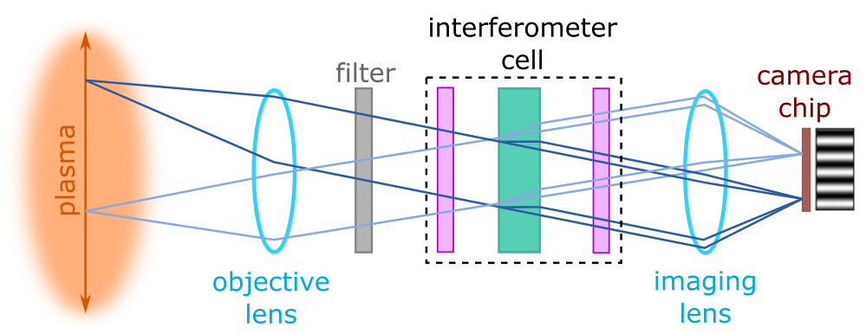
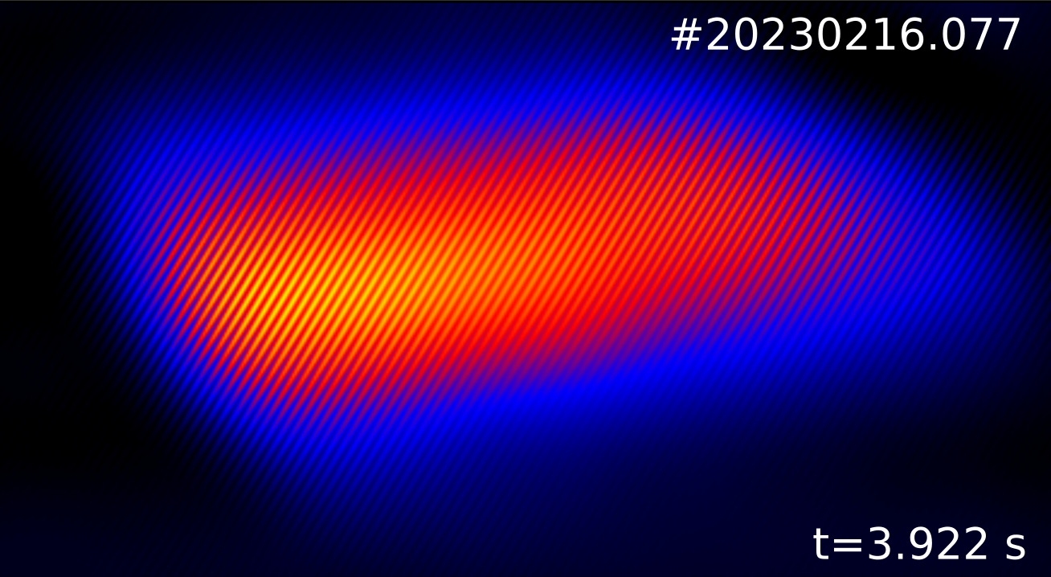
CIS basics
$$S=\frac{I_{0}}{2}(1+ζ cosΦ)$$
CIS $→$ Polarization interferometry with birefringent crystals.
[Courtesy of V. Perseo]
2

Slide 4
CIS basics
$$S=\frac{I_{0}}{2}(1+ζ cosΦ)$$
CIS $→$ Polarization interferometry with birefringent crystals.
Fringe pattern (S) described as:
CICERS Fringe pattern (S)
$$S=\frac{I_{CX}}{2}(1+ζ\cos{Φ})$$
$I_{CX}$: Intensity of CX radiation $∝n_{Z}$
$ζ$: Contrast $→$ Spectral line shape broadening $∝e^{−T_{i}}$
$Φ$: Phase shift$→$ Central Wavelength shift$∝v_{Z}$
2

Slide 5
CIS basics
$$S=\frac{I_{0}}{2}(1+ζ cosΦ)$$
CIS $→$ Polarization interferometry with birefringent crystals.
Fringe pattern (S) described as:
No spectral resolution$→$ CX line needs to be isolated from other spectral components:
Use of narrow bandpass filter (FWHM $∼2$ nm)
Best candidate $→$ CVI ($λ_{0}∼529.05$ nm)
CICERS Fringe pattern (S)
$$S=\frac{I_{CX}}{2}(1+ζ\cos{Φ})$$
$I_{CX}$: Intensity of CX radiation $∝n_{Z}$
$ζ$: Contrast $→$ Spectral line shape broadening $∝e^{−T_{i}}$
$Φ$: Phase shift$→$ Central Wavelength shift$∝v_{Z}$
2

Slide 6
Diagnostic design
Crystal set-up: Savart + delay plate.
Savart plate: Generates the fringe pattern. Adjusted to obtain desired fringe period.
Delay plate: Generates offset phase shift. Thickness ($L_{del}$) adjusted to optimize $T_{i}$ measurements.
3

Slide 7
Diagnostic design
Synthetic $T_{i}$ profile
Crystal set-up: Savart + delay plate.
Savart plate: Generates the fringe pattern. Adjusted to obtain desired fringe period.
Delay plate: Generates offset phase shift. Thickness ($L_{del}$) adjusted to optimize $T_{i}$ measurements.
Optimal $L_{del}$ for $T_{i}$ measurements:
Assessment of contrast sensitivity for a $5\%$ change in $T_{i}$ synthetic profile for different $L_{del}$.
3

Slide 8
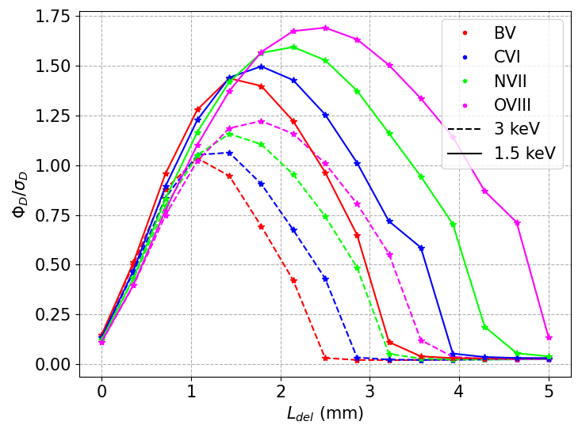
Diagnostic design
Crystal set-up: Savart + delay plate.
Savart plate: Generates the fringe pattern. Adjusted to obtain desired fringe period.
Delay plate: Generates offset phase shift. Thickness ($L_{del}$) adjusted to optimize $T_{i}$ measurements.
Optimal $L_{del}$ for $T_{i}$ measurements:
Assessment of contrast sensitivity for a $5\%$ change in $T_{i}$ synthetic profile for different $L_{del}$.
Velocity resolution:
SNR of phase shift contribution of $v_{Z}=1$ km/s to phase shift error $σ_{Φ}$.
3

Slide 9
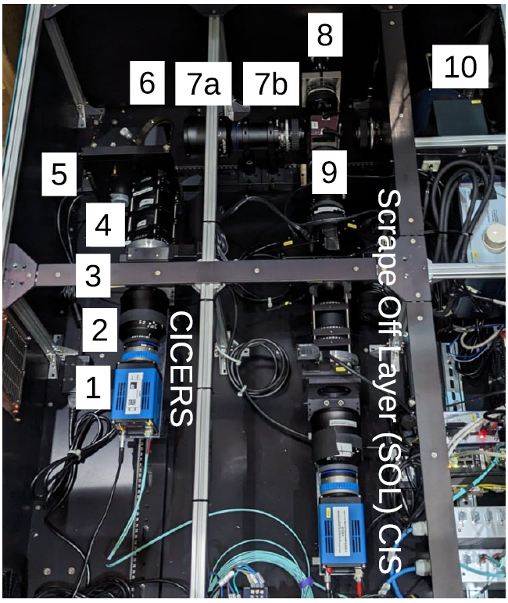
Diagnostic design
Crystal set-up: Savart + delay plate.
Savart plate: Generates the fringe pattern. Adjusted to obtain desired fringe period.
Delay plate: Generates offset phase shift. Thickness ($L_{del}$) adjusted to optimize $T_{i}$ measurements.
Optimal $L_{del}$ for $T_{i}$ measurements:
Assessment of contrast sensitivity for a $5\%$ change in $T_{i}$ synthetic profile for different $L_{del}$.
Velocity resolution:
SNR of phase shift contribution of $v_{Z}=1$ km/s to phase shift error $σ_{Φ}$.
Final set-up:
$L_{del}=2.5$ mm, $L_{Sav}=20$ mm
3

Slide 10
Experimental set up
Installed Feb. 2023 in port AEA21. View is directed towards NBI S3, S4.
Light from plasma directed to CICERS by fiber bundle.
Spatial calibration using frames with background radiation with Calcam [2].
Pixel-to-pixel spatial resolution of $∼1$ mm @ NBI S4. However, image is defocused to prevent fiber structures due to fiber bundle to be seen. True spatial resolution is $∼8$ pixels.
[2] S.Silburn, Calcam, 2022
4

Slide 11
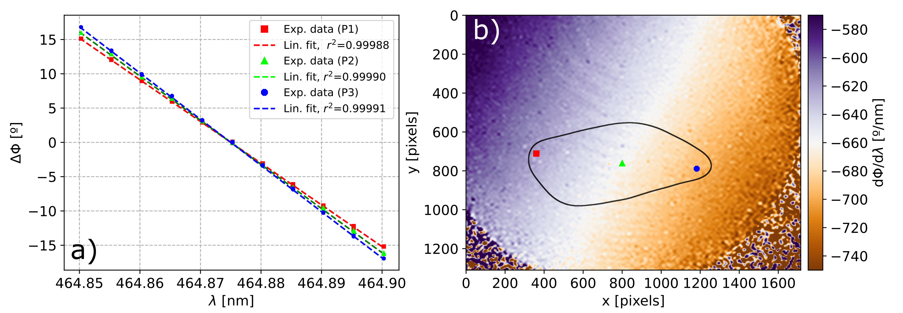
System characterization
Characterization for $T_{i}$ measurements: ${\frac{∂φ}{∂λ}}_{λ_{0}}$and $ζ_{I}$
${\frac{∂φ}{∂λ}}_{λ_{0}}$:
Scan around $λ_{0}$ with C-WAVE laser ($Δλ=5$ pm).
5

Slide 12
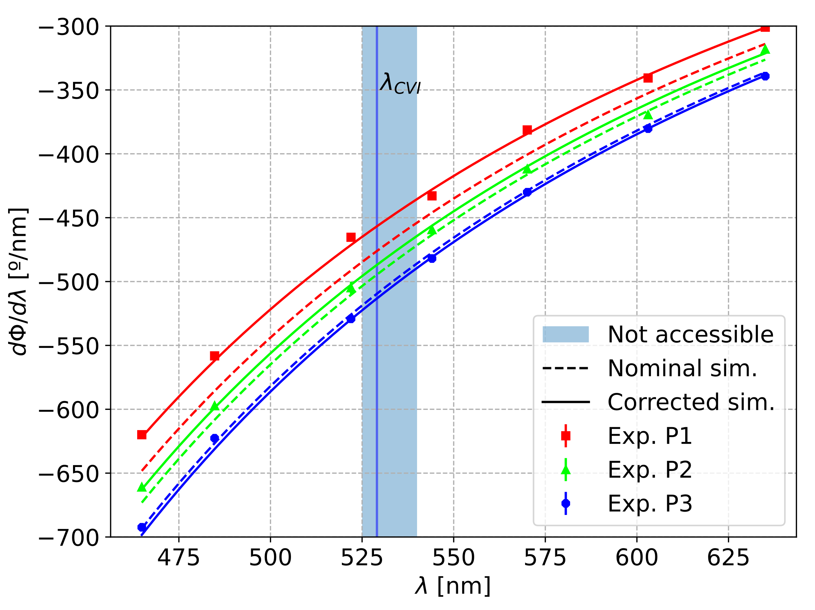
System characterization
Characterization for $T_{i}$ measurements: ${\frac{∂φ}{∂λ}}_{λ_{0}}$and $ζ_{I}$
${\frac{∂φ}{∂λ}}_{λ_{0}}$:
Scan around $λ_{0}$ with C-WAVE laser ($Δλ=5$ pm).
$λ_{CVI}$ not accessible $→$ ${\frac{∂φ}{∂λ}}_{λ_{0}}$characterized for several lines in the visible spectrum. Simulation results compared to experimental characterization and corrected accordingly.
5

Slide 13
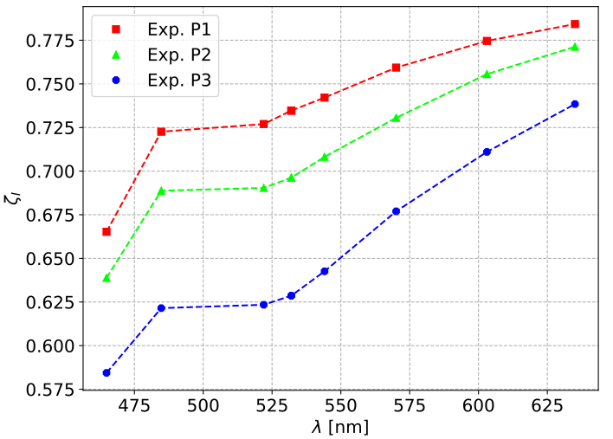
System characterization
Characterization for $T_{i}$ measurements: ${\frac{∂φ}{∂λ}}_{λ_{0}}$and $ζ_{I}$
${\frac{∂φ}{∂λ}}_{λ_{0}}$:
Scan around $λ_{0}$ with C-WAVE laser ($Δλ=5$ pm).
$λ_{CVI}$ not accessible $→$ ${\frac{∂φ}{∂λ}}_{λ_{0}}$characterized for several lines in the visible spectrum. Simulation results compared to experimental characterization and corrected accordingly.
$ζ_{I}$:
Determined from single interferogram.
Small dependence on $λ$.
$ζ_{I}(λ_{CVI})$ interpolated from data obtained in laser scans.
$$ζ=ζ_{I}ζ_{M}ζ_{D}∝e^{−\frac{T_{i}}{2m_{z}c^{2}}{\left({λ_{0}\frac{∂φ}{∂λ}}_{λ_{0}}\right)}^{2}}$$
5

Slide 14
Background subtraction in experimental frames
Measurements have a non-negligible contribution of background radiation (passive CVI + Bremsstrahlung)
Approach: Estimate $S_{Bkg}$ and substract it from $S$
ROI-scaled method:
Linear interpolation of background frames right before and after NBI S4 injection.
Scale each frame with ratio of intensity to linearly interpolated intensity in ROI.
Not rigourous, but valid for NBI blips and low $n_{e}$ ($∫n_{e}dl$ up to $∼4−5 m^{−2}$).
Rigourous approach is subject of future work.
6

Slide 15
Demodulation process and image denoising
Due to short exposure time used ($τ_{exp}∼20−50$ ms) and low intensity, noise levels are high.
7

Slide 16
Demodulation process and image denoising
Due to short exposure time used ($τ_{exp}∼20−50$ ms) and low intensity, noise levels are high.
Demodulation:
2DFFT $→$ signal manifests as 3 peaks $→$ $I(0)$, $I(±$)
Fourier-domain filtering $→$Reduce noise variance [3].
[3] J.Allcock, PhD thesis, 2021
7

Slide 17
Demodulation process and image denoising
Intensity $(I_{CX})$
Due to short exposure time used ($τ_{exp}∼20−50$ ms) and low intensity, noise levels are high.
Demodulation:
2DFFT $→$ signal manifests as 3 peaks $→$ $I(0)$, $I(±$)
Fourier-domain filtering $→$Reduce noise variance [3].
Interferogram parameters can be recovered from filtered peaks in Fourier space using the inverse 2DFFT.
Contrast $(ζ)$
[3] J.Allcock, PhD thesis, 2021
7

Slide 18
2D $T_{i}$ maps
Local values of $B$ are necessary:
CX radiation is localized in the point of closest approach to the nominal S4 injection direction along each Line of Sight (pixel)
Related eq. info for each pixel is computed with VMEC.
8

Slide 19
Comparison with CXRS $T_{i}$ profiles
Profile derived in NBI S4 nominal beam axis (solid black line).
Excellent agreement up to $r_{eff}∼0.4$ m.
Possible reason for discrepancy in the edge$→$ Background subtraction underestimation.
CXRS also suffers background subtraction problems in this region leading to underestimation of $T_{i}$ (sometimes).
9

Slide 20
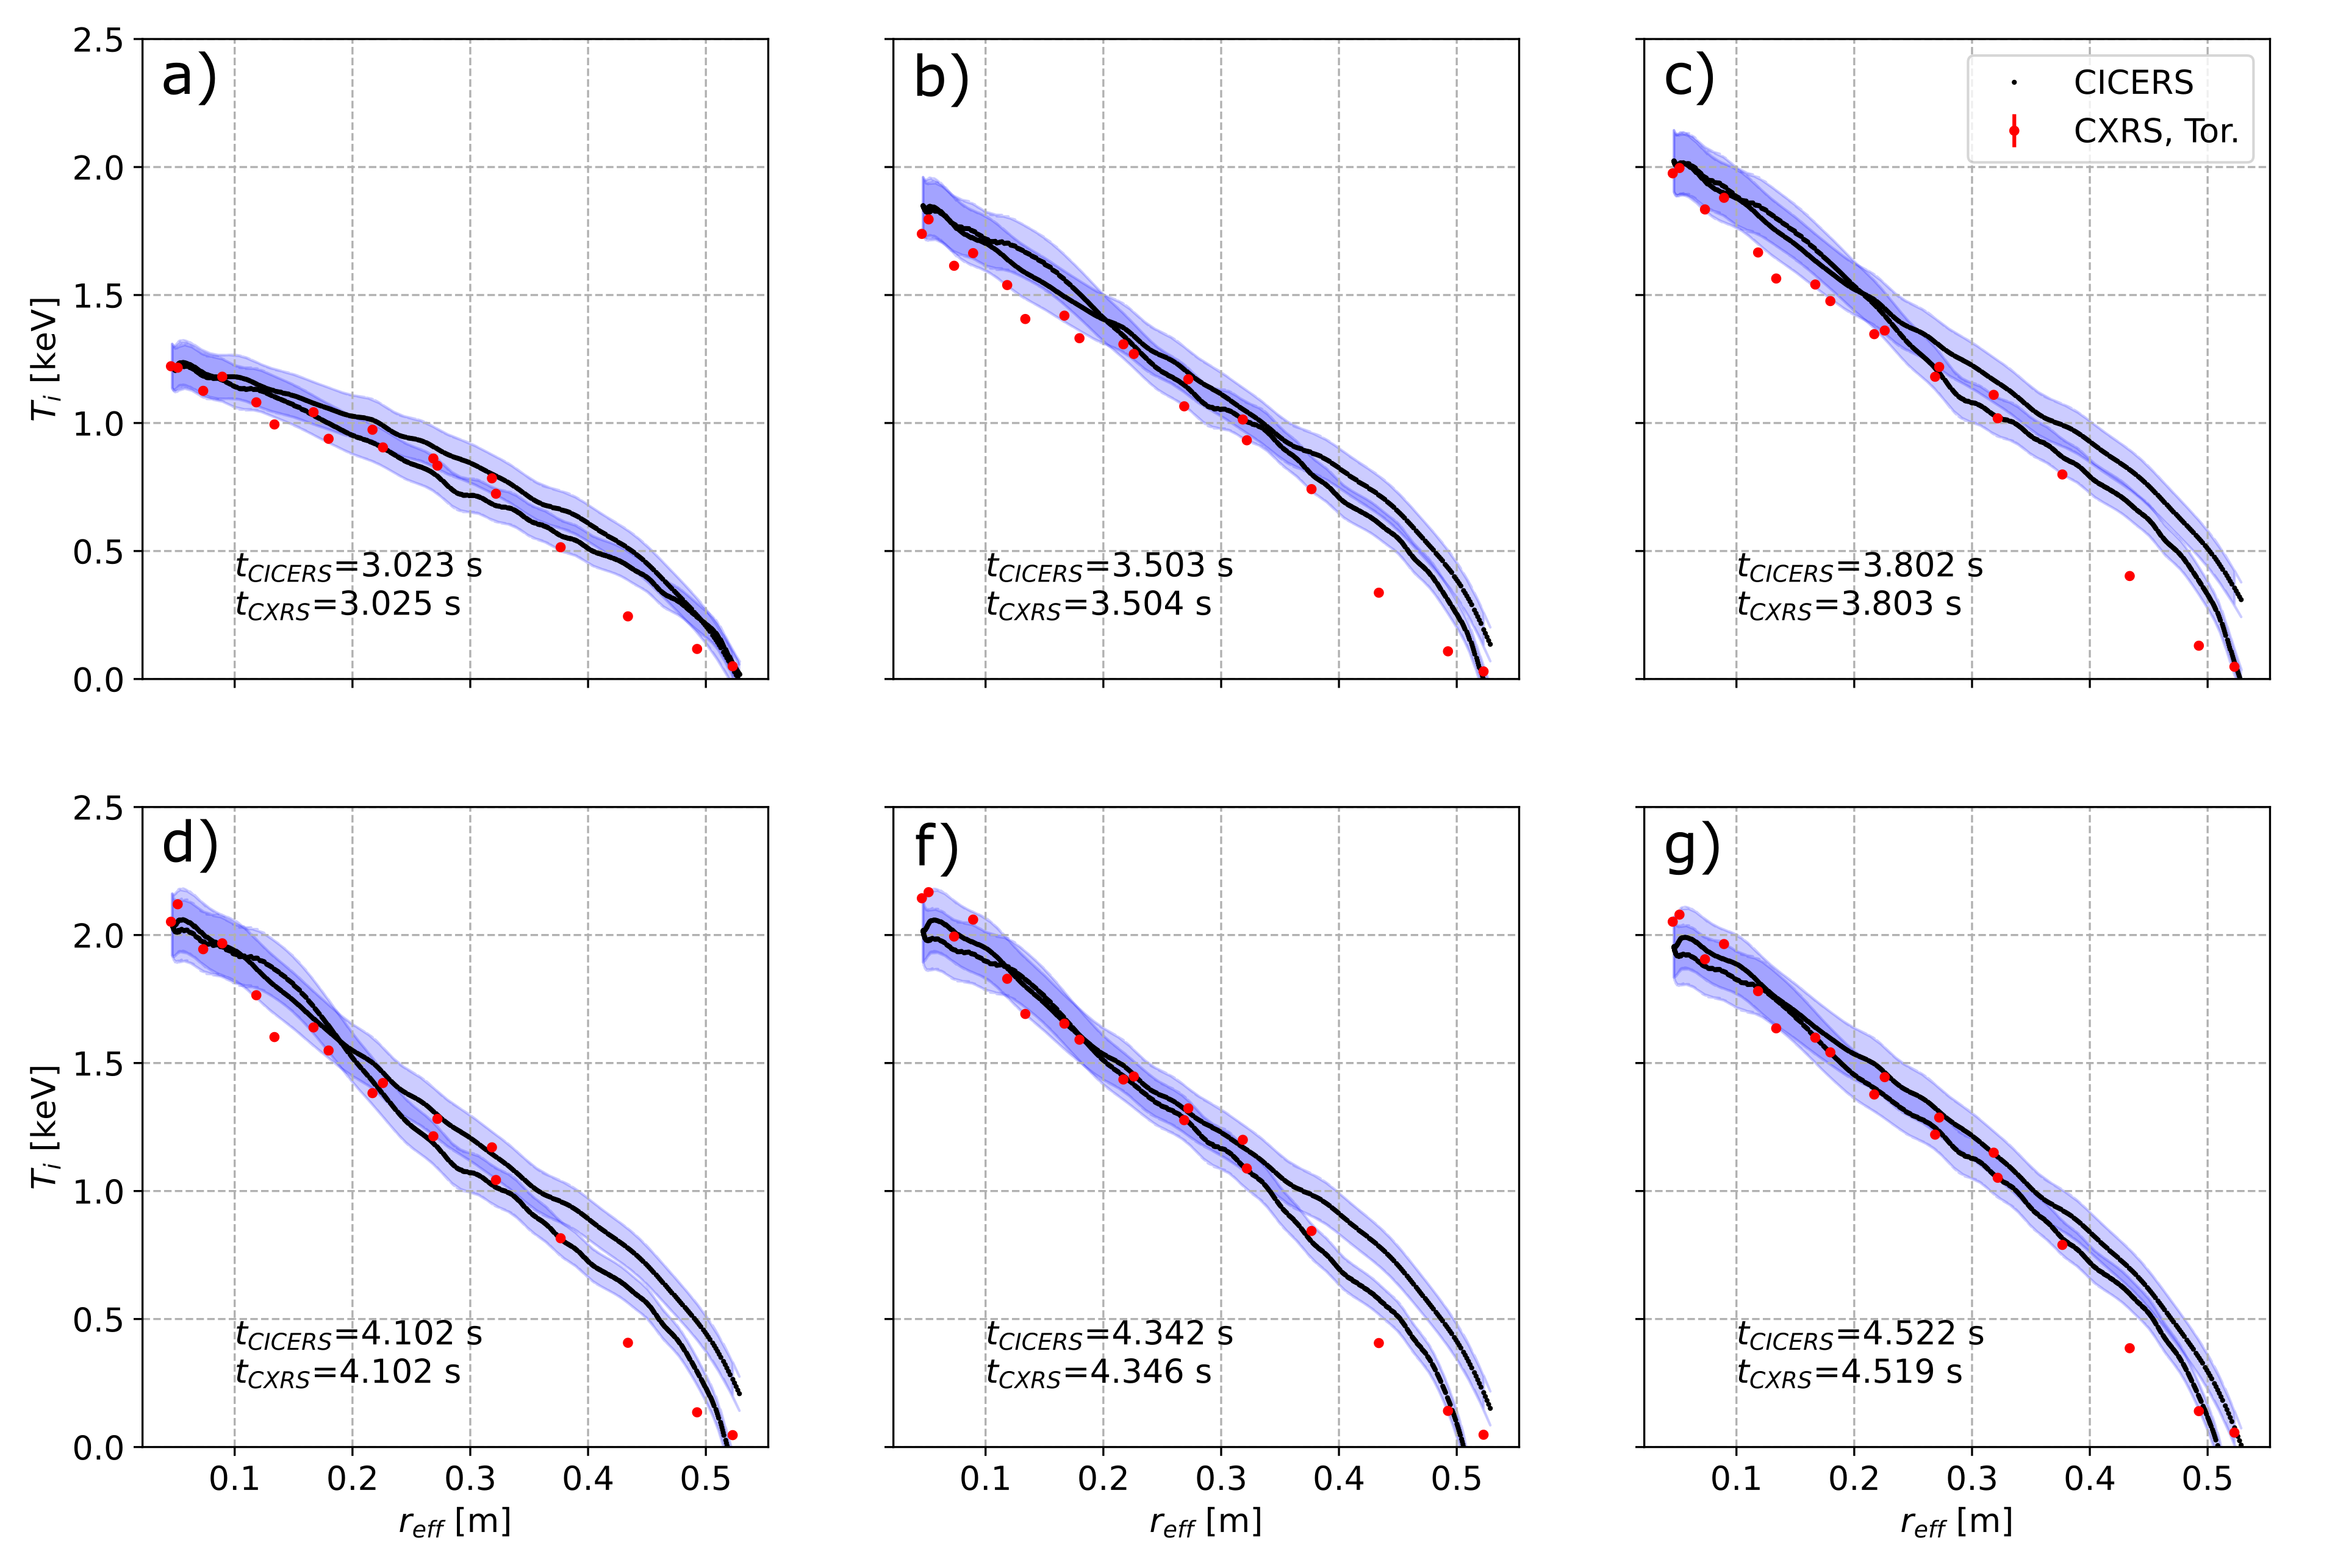
$T_{i}$ profiles comparison during plasma program
Same behaviour is observed for different timestamps along the discharge
10

Slide 21
$T_{i}$ evolution
11

Slide 22
Higher core $T_{i}$ measured by CICERS
CICERS and CXRS agreement is good when looking at equivalent profiles.
CICERS true core $T_{i}$ measurents ($T_{i}^{core}∼2.5$ keV) are higher than the extrapolated values from CXRS profiles ($T_{i}^{core}∼2.1−2.2$ keV).
Possible reason: Inaccuracies in flux surface mapping and presence of large $T_{i}$ gradients.
12

Slide 23
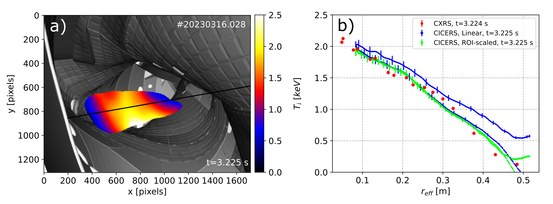
Linear interpolation vs. ROI-scaled: NBI blips
NBI S4 blips: comparison of linear interpolation vs. ROI-scaled background subtraction.
ROI-scaled works better both for continuous injection and blips.
Same characteristics as previous discharge shown are observed in $T_{i}$ map.
13

Slide 24
Conclusions
CICERS has been installed at W7-X.
Precise system characterization for $T_{i}$ measurements have been developed.
Signal processing is introduced:
Non-rigourous approach for background subtraction.
Image denoising.
First $T_{i}$ maps are derived:
Excellent agreement for ‘equivalent’ profiles.
Higher true core $T_{i}$ measured by CICERS.
Foreseen work:
Background substraction.
Derivation of $n_{Z}$ and $v_{Z}$.
14

Slide 25
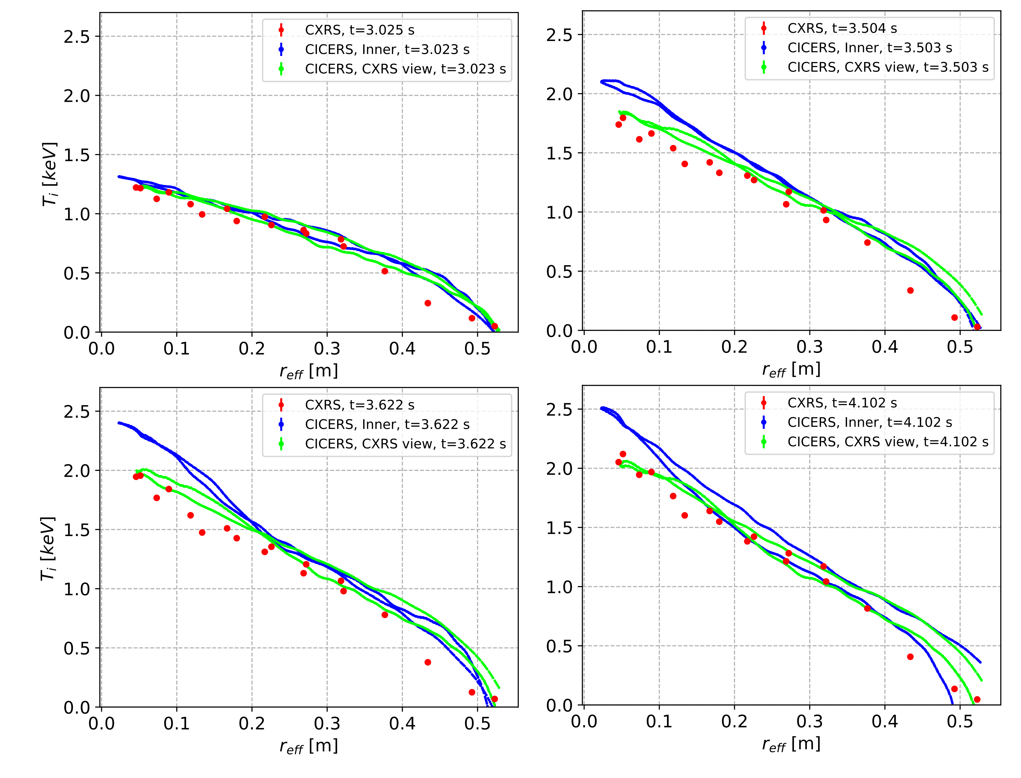
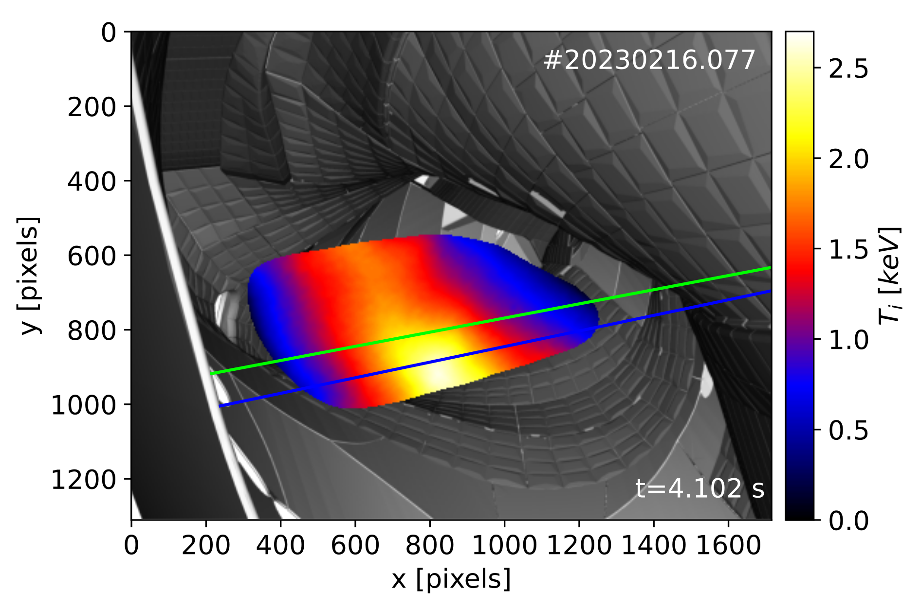
Backup
Core $T_{i}$ asymmetry during plasma program.

