Slide 1
Regression testing for ETS-6
Thomas Jonsson

Slide 2
Why? What’s needed?
Automated testing of many test cases is a requirement to avoid regressions.
Automated testing is also needed for Continuous Integration.
Recording the provenance of regression test cases is important to be able to repeat the the reference simulation.
We need to run regression test both on the Gateway and elsewhere.
If we were to compare simulations by comparing entire IDSs we need to fetch huge amounts of data (assuming >50 test-cases).
In a large database of test-cases we will need to categorise them.
Note: MMS testing for transport_solver should be part of regression testing for ets_core. Here we look to the full workflow.

Slide 3
Main ideas
Create a data-format and file-format for storing detailed provenance information of a simulation.
data-format=python-dictionary
file-format=yaml, or perhaps HDF5.
We may call such files simFile.
The simFile should include:
Workflow – filename, repo, version…
Paramfile – filename, repo, version…
Category – quality (verification and validation status), equations solved, transport-models used, heating systems used etc.
imasdb, where data is stored – user, machine, shot, run…(provenance info)
IDS fields of interest, e.g. a list including core_profiles.profiles_1d[:].electrons.temperature
User interface should include a series of easy-to-use scripts.

Slide 4
Script available for the user – single simulation (simFile)
simFromExistingRun
Create a simFile from an existing run.
simRun
Run a simulation (run Kepler) described by a paramfile, workflow... as specified on input.
Save the result as a simFile
The list of IDS-fields is provided by a template-file.
simVerify
Compare the result of a new simulation with the original simulation described in the simFile.
Option 1: Specify the new simulation on input.
Option 2: The new simulation could be create by the script itself, using the parameters in the simFile, but with a new ETS-installation and a new workflow and data output in a local imasdb.
simUpdateIDSs
Here you need to have a simFile.
You run this script to update the IDS information in the file. The new IDS information will be based on an input IDS-template file that describes the list of IDS-fields to store in the file.
Use case: Running a regression test gives you a false-positive since you have forgotten to compare an important IDS-field. In this case you don’t need to rerun your simulation, only update your simFile with an extended list of IDS-fields.

Slide 5
Preliminary implementation
The idea has been partly implemented in https://gforge6.eufus.eu/svn/keplerworkflows/trunk/imas/ETS/regression_testing
Design:
DATABASE (folder): a number of simFiles, i.e. benchmark cases.
TEMPLATE (folder): templates describing what IDS-fields to include in a simFile.
simTools – a class for simFiles
including creation, comparison and running Kepler.
All script on previous page implement.
Kepler execution still doesn’t work…
Once we get these working, will add also scripts to test all simFiles in the database.

Slide 6
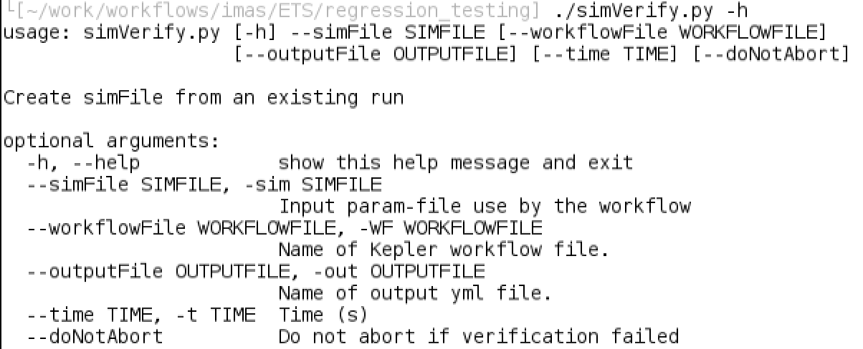
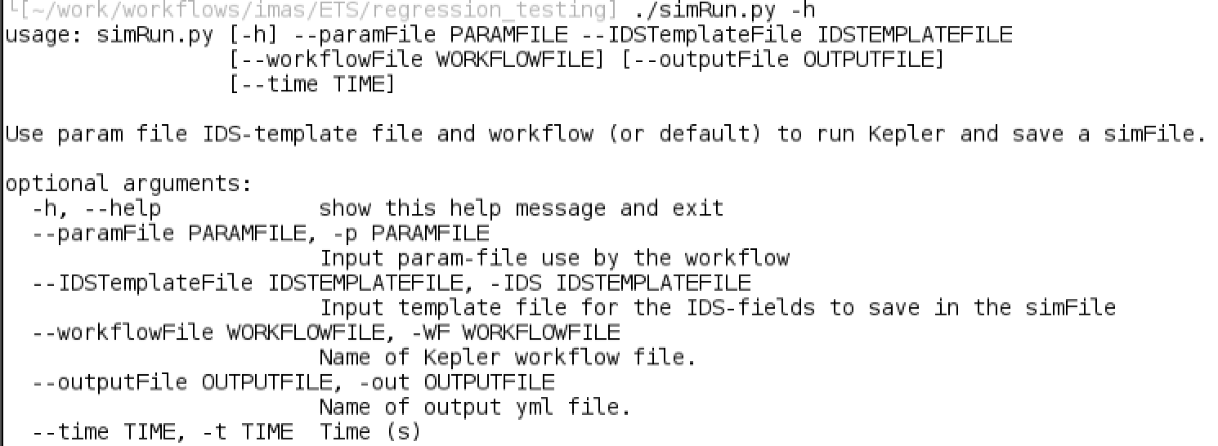
Function interfaces

Slide 7
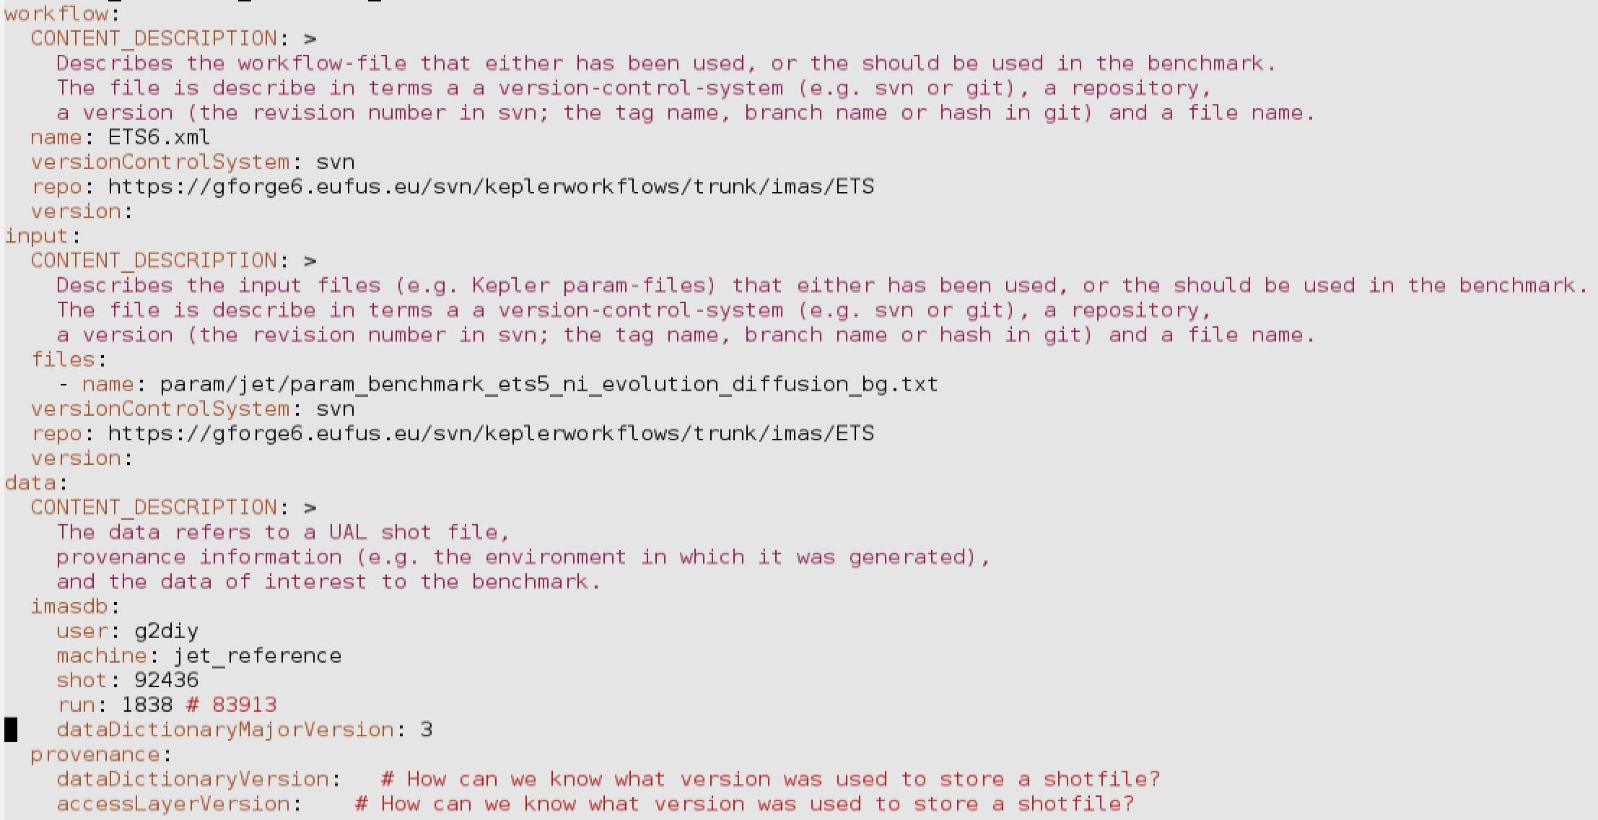
File format: Meta-data

Slide 8
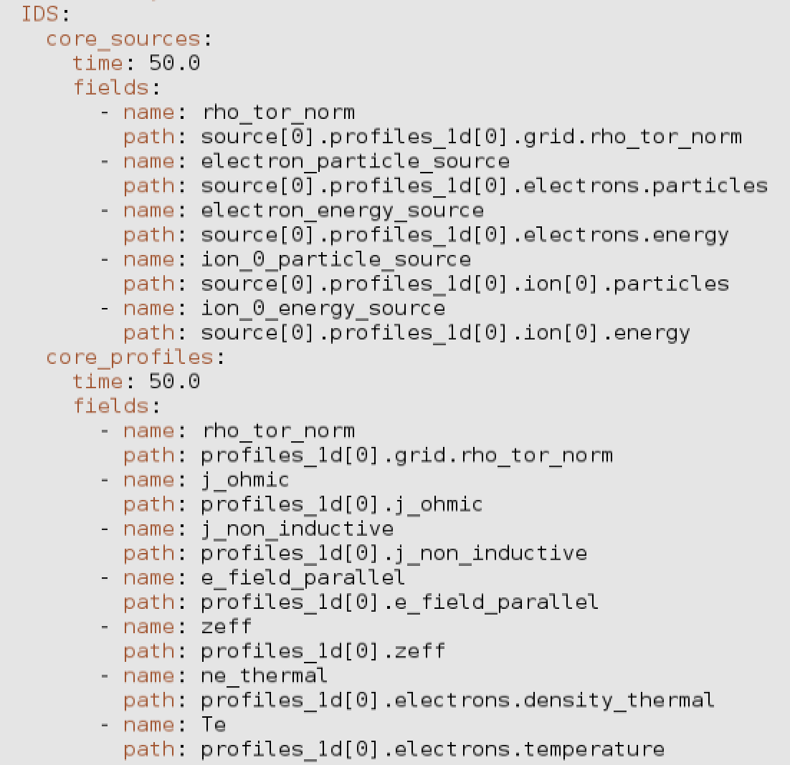
File format: IDS data
This is an example from a TEMPLATE file.
When data is imported a “value” field is added and a data array is inserted
See example for rho_tor_norm

