Slide 1
SOLPS-EIRENE IMAS interface status
Piotr Chmielewski, Dmitriy Yadykin, PSNC ACH

Slide 2
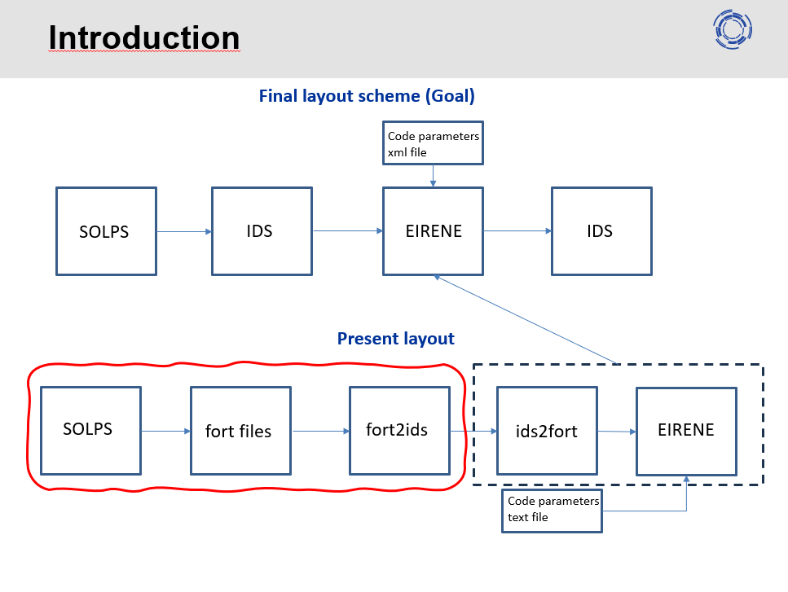
Layout
Present layout
SOLPS
fort files
fort2ids
Fort.33 – EIRENE grid nodes
Fort.34 – EIRENE grid triangles
Fort.35 – EIRENE grid triangle neigthbours
Fort.30 – B2.5 grid
Fort.31 – B2.5 plasma background

Slide 3
Layout
Present layout
SOLPS
fort files
fort2ids
Reading, putting to IDS and getting from IDS is done (Yurii Yakovenko)
Fort.33 – EIRENE grid nodes
Fort.34 – EIRENE grid triangles
Fort.35 – EIRENE grid triangle neigthbours
Fort.30 – B2.5 grid
Fort.31 – B2.5 plasma background

Slide 4
Current interface structure
Interface reads coordinated of vertex for each cell from fort.30 and save nodes (without dubplication of node coordinates)
Based on nodes object, cells have been created in the GGD:
grid_ggd%space(1)%objects_per_dimension(1)%object(iNode)
grid_ggd%space(1)%objects_per_dimension(3)%object(iCell)
For now the single subset have been defined which contains whole simulation domain

Slide 5
Current interface structure
Interface also read coordinated of vertex for each cell from fort.30 and save nodes (without duplication of node coordinates)
Based on nodes object, cells have been created in the GGD:
grid_ggd%space(1)%objects_per_dimension(1)%object(iNode)
grid_ggd%space(1)%objects_per_dimension(3)%object(iCell)
For now the single subset have been defined which contains whole simulation domain
Interface reads all variables of plasma background from the fort.31 file and put ion density, ion temperature, electron temperature, poloidal electron velocity, toroidal electron velocity, radial electron velocity, poloidal magnetic field, toroidal magnetic field and radial magnetic field components to defined subset.

Slide 6
Development plans
Ongoing work
Finalisation and testing putting to IMAS routine with plasma background data
Preparation of routine for getting data form IMAS
Plans for beginning of 2024
Merging script with Yuri script
Definition of new subsets
Addition input.eir file for IMAS

Slide 7
Possibilities of development
Thank you for attention

Slide 8
SOLPS-ITER and EIRENE interaction
SOLPS-ITER generates the following files
Fort.30 – B2.5 grid data
Mesh cell size, numer of cuts and cuts index
R,Z coordinates of 4 vertexes of cel for each cell
Fort.31 – B2.5 plasma background data
23 variables of plasma background for each cell: ion density, poloidal, radial and toroidal velocities, electron and ion temperature, etc.
Fort.33 – EIRENE grid nodes
Fort.34 – EIRENE grid triangles
Fort.35 – EIRENE grid triangle neigthbours
Input.eir – Set of parameters for models and boundaries

Slide 9
Notes
Notes:
What are EIRENE requirements/needs for subset division of data?
Which variables of plasma background from the fort.31 file are needed
Is there a need of recovering fort.30 file or fort.31 now? (in the future no)
What kind of data from input.eir are needed?

Slide 10
General Grid Structure
GGD
a data structure for storing grids of arbitrary structure, together with physical quantities given on these grids
each IDS contains the structures grid_ggd and ggd
grid_ggd – holds description of grid elements (nodes, cells, etc.) and relations between them
ggd – quantities on this grid
each physical quantity is “attached” to one or more grid subsets (for example, the subset of all grid points, of all grid cells, of SOL grid points, of separatrix edges etc.).
Specification of GGD can be found in the Data Dictionary of most IMAS IDS (type dd_doc command).

Slide 11
SOLPS-ITER and EIRENE interaction

