Slide 1

Updates related to CRM development
15.12.2024
D. Borodin

Slide 2
New projects/proposals
IAEA CRP: ”Providing the Flexible CRM Usable Standalone and Inside Edge Transport Codes Including EIRENE” (D. Borodin, D.Harting, S.Brezinsek)
➔ CollsionDB progress - https://db-amdis.org/collisiondb/
PSI conferende (May, 2024):
  “Lyman line opacities in tokamak divertor plasmas under high-recycling and detached conditions”
  (R.Chandra et al.)
  “Flexible CRM module associated with the EIRENE-NGM”
    (D.Borodin et al.)

Slide 3
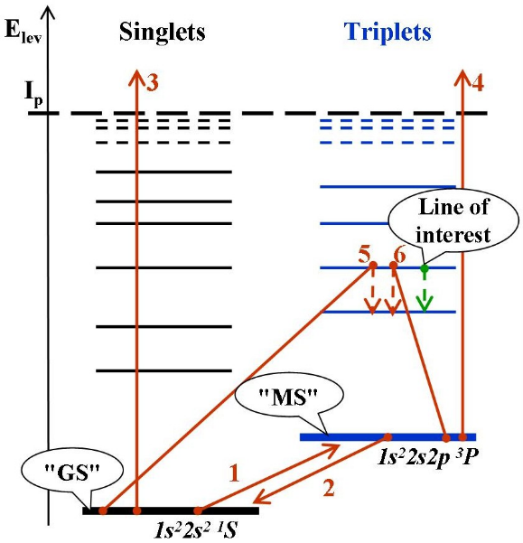
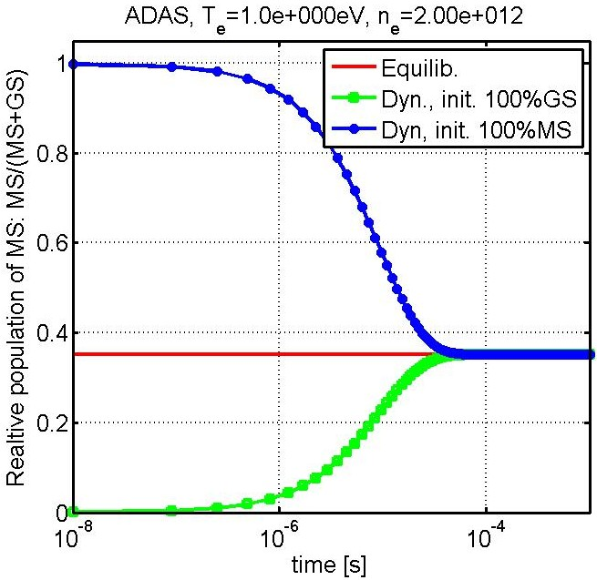
MS-effect for BeI (“generalised” MS 10⁻⁴s)
The system of 2 balance equations can be solved analytically . . .
ADAS, T_{e}=1eV, n_{e}=2*10¹²cm⁻³
Effective rates:
1,2) transitions <Ex..> between "GS" and "MS"
3,4) ionizations <Iz..> from "GS" and "MS"
5,6) line intensity (PEC – photon emission coefficient), contributions from "GS" and "MS"
MS-population tracking was introduced into ERO and demonstrated to be of significance by applications to PISCES-B, PSI-2 and JET-ILW (neutral Be, He, W)
For WI dedicated ADAS dataset was developed; various lower states bundling options (~10) tested etc.

Slide 4
ModCR interaction with EIRENE and other tools
YACORA
EIRENE
CRM condensing
(“ColRad”)
Interface
Standalone
EIRENE
Main loop
(“folneout”)
ModCR
Ploutos
ModCR
Flexible input files (JSON)
EIRENE
Post-processing
(spectroscopy, etc)
Data sources
MCCC, R-matrix, …

Slide 5

ModCR flow chat (standalone)
Input file (JSON)
CRM
Species
States
Transitions
Settings
New input
file (JSON)
Ploutos
Output file1
(JSON)
CRMs
Output file X
Tasks
Solver(s)
Task
Manipulate CRM
Analyse CRM
Solve (set of) case(s)
Produce output
Stationary
Dynamic
Analysis

Slide 6
Pipelenes of CRMs
ModCR
ModCR
Pick up +
combine
Pick up +
combine
CRMs
(JSON)
CRMs
(JSON)
CRMs
…
Analyse (eigenvec.)
Analyse (eigenvec.)
Test +
correct
Test +
correct
Ploutos
Alternatives!
Peculiar data, processes, assumptions
SA CRM
Solver
Data sources
AMJuel,
MCCC, R-matrix,
…
Branching ratios, S/XBs
Other practical data

Slide 7
Proposal for contribution to the CRP
We aim to optimise the condensing and abstractisation for the main loop of the A&M data of various types and resolutions for EIRENE and other edge plasma Transport codes
We should liaise the set of simulations cases and parameter studies in the interest of this CRP. Also the sets of data to be incorporated should be clear.
It is considerable also to start some full-scale SOLPS-ITER or EMC3-EIRENE cases
We should provide the ModCR-based pipelines (very positive ADAS “adfXX” experience!..) to produce the final JSON-based data. The resulting data is to be validated.
Should it be linked with the CRP on the seeded impurities?..
Ploutos-ModCR JSON should be in line with the CollisionDB – automatic conversions possible!
Do we need cross-sections (CS), resonances, differential CS, interpolation of fitting formulae?..

Slide 8
Thanks for the attention!

Slide 9
EIRENE: collisional-radiative model (CRM) challenges
EIRENE often uses effective (“condensed”) rates tabulated from a CRM.
isotopes: D₂, T₂, H₂, DT, HD, …, Be-H/D/T, N-xxx, …
vibrational (and rotational) states in molecules
treating non-stationary effects e.g. metastables (MS) in atoms (e.g. He)
improving performance for simulations on ITER/DEMO scales
facilitate UQ and design with EIRENE
control the exploding amounts of data

Slide 10
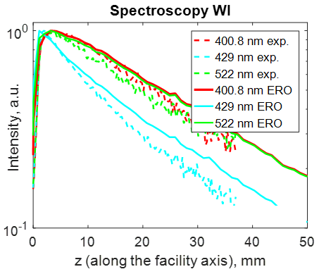
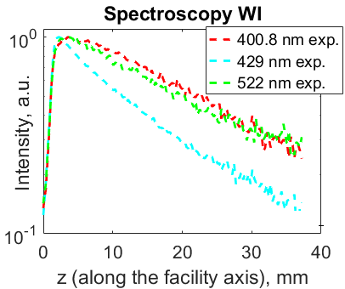
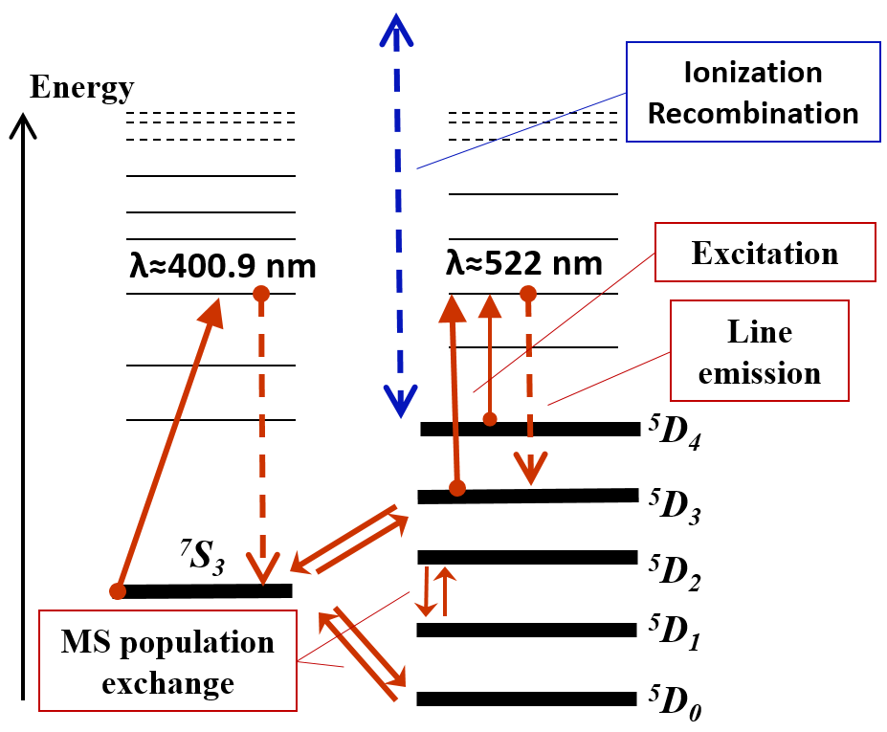


MS-effect for WI (PSI-2 linear plasma device, JET)
(PSI-2)
(PSI-2)
(PSI-2)
W⁰
line Intensity [a.u.]
line Intensity [a.u.]
ERO:
λ = 400, 429, 522 nm
Ar → W
target
Ar → W
target
Multiple options for state bundling are worth considering
Test in tokamak (JET ITER-like Wall): MS tracking reduces simulated line intensity by x1.7!
Dedicated ADAS’18 dataset
A.Eksaeva PhD-thesis, 2020

Slide 11
ModCR and the EIRENE Main loop
ModCR is supposed to provide:
“abstract reaction“ approach and this way reduce branching
tracking of internal states (“finer” structure, MS) as variables
user-defined “border” between states tracked as variables and as species
reverse compatibility with earlier simulations
high performance, seamless interface to EIRENE (so, FORTRAN…)
recent numerical solver, external (thus, upgradable)
Framework for systematic handling of reaction data
  ➔ Linked and reproducible (like in ADAS) data files

Slide 12
ModCR flow chat
Reading Input file (CRM + tasks, JSON)
What is done by now?
Reading CRMs + extra data
Creating total list of species-rates-reactions
→ sorting out and consistency checks
reading JSON
reading PLOUTOS CRM (JSON)
reading ADAS (adf11, adf15)
incorporating of solver (CVODE++)
started with sorting of states and reactions…
Some positive implications for EIRENE already: reorganisation of external libs
ModCR interfaces to EIRENE in pre-calculation phase should be very much alike to COLRAD
Performing data manipulation tasks
Sorting out the “active states” and the reduced reaction data, index abstractisation
solver task
Analysis, sorting, postprocessing tasks
ModCR output (mostly JSON, HDF5?..)

Slide 13
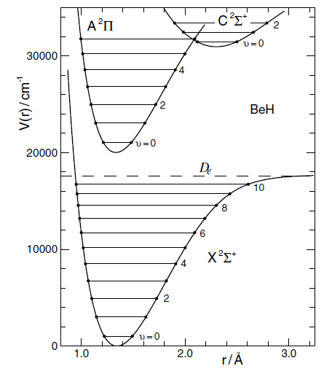
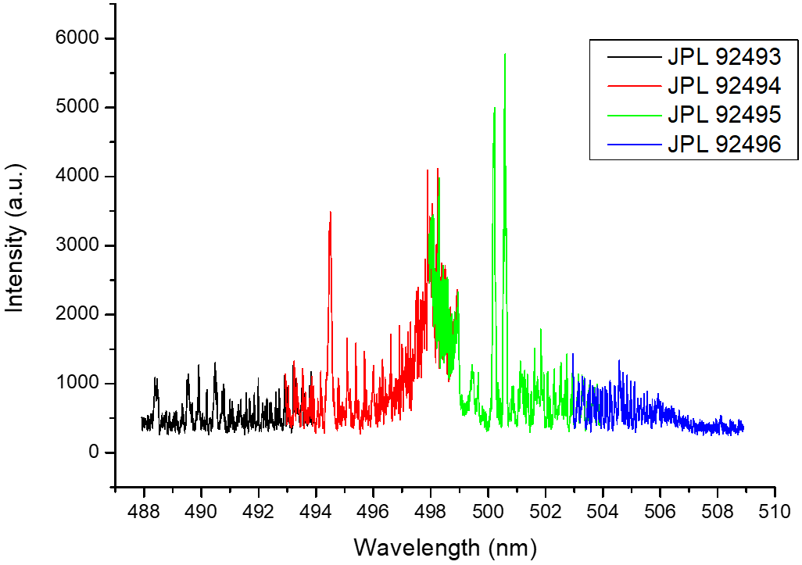
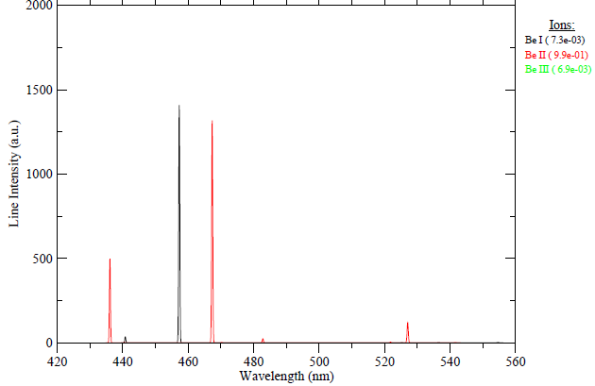
Atomic vs molecular spectroscopy (Be example)
Atomic spectroscopy (Be I)
Molecular spectroscopy
Energy levels and transitions
Energy levels for BeH molecule
Triplet
states
Ionization
Threshold
Singlet
states
2s4s ³S₁
935.8 nm
929 nm
2s3s ³S₁
2s3p ¹D₂
235.1 nm
457.3 nm
332 nm
2s2p ¹P₁
2s2p ³P_{0,1,2}
455 nm
234.9 nm
2s² ¹S₀
From: Smith College Experimental Atomic Physics Laboratory page
Model beryllium plasma spectrum
Electronic levels
(curve dependent on nuclear separation r) – transitions in visible/UV
From: NIST
Vibrational levels (transitions - FIR)
Rotational levels
(transitions - RF)
Courtesy
E.Pawelec
R. Le Roy et al, Journal of Molecular Spectroscopy (2006)

Slide 14
Thanks for the attention!

