Slide 1
TSVV3 – Regular advancement meeting 10/01/2024 – Task 2 & 3: sheath BC and RANS models Project news
P. Tamain

Slide 2
Today’s meeting agenda

Slide 3
End of year report
Report 2023 submitted successfully, thank you for your contributions
submitted version available on the Wiki: https://wiki.euro-fusion.org/wiki/TSVV-03#2023
For the “ITER case attempt” deliverable, the main report refers to a flash-report that I still need to finish and that will be posted on the Wiki

Slide 4
Work-plan 2024-2025
Document sent around for final validation
Please validate before Wednesday next week (17/01)

Slide 5
Annual meeting 2024
Proposal: hold annual in-person TSVV3 meeting in Leuven sometime in June?
Doodle to be sent this week
Avoid last week of June (busy in Leuven)

Slide 6
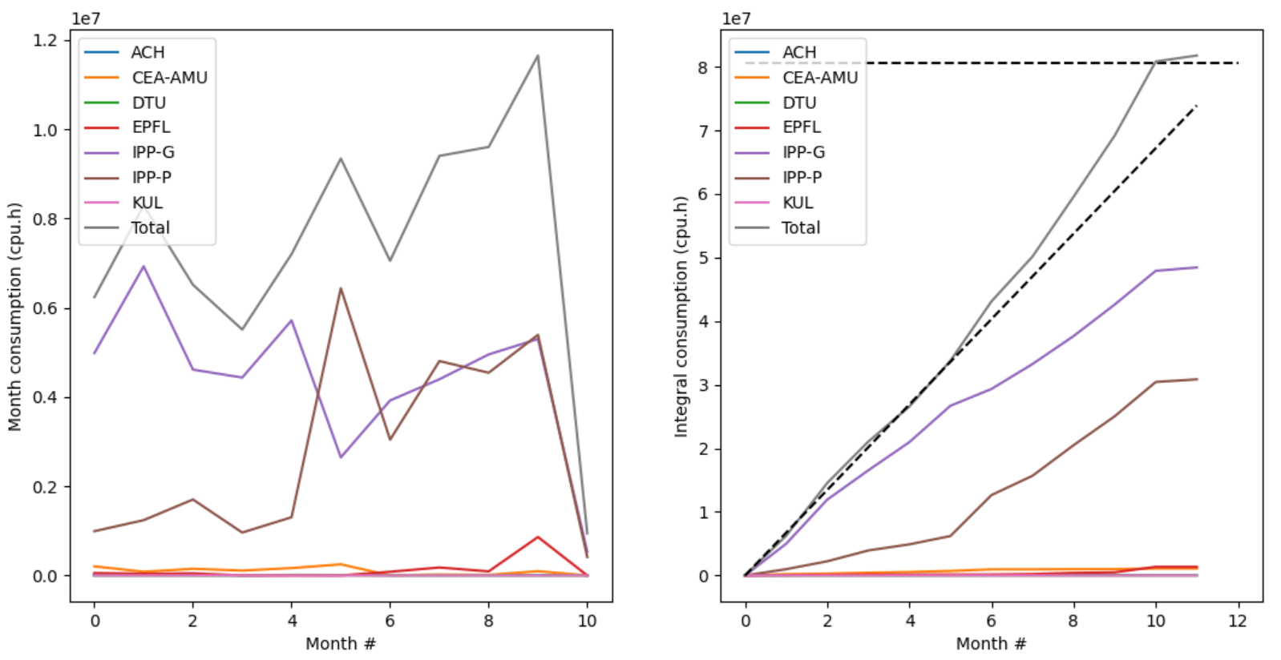
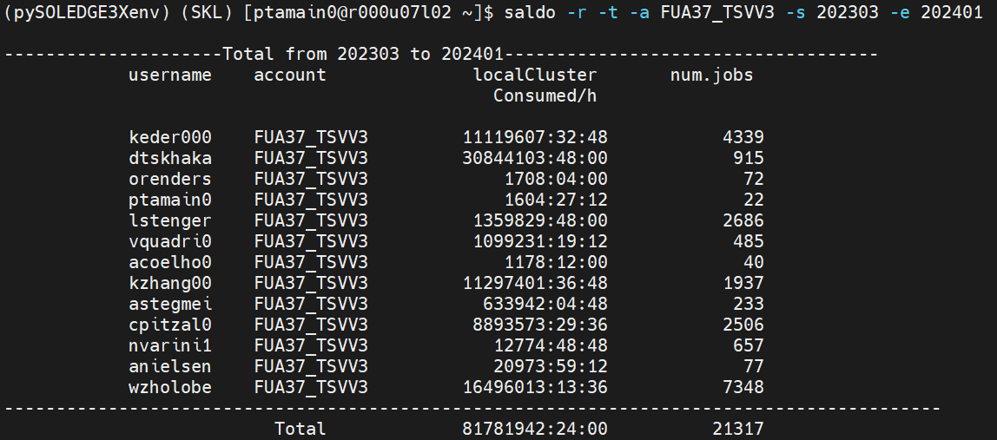
Marconi time usage – A3
Time allocation exhausted? Ask for extension somehow?
Plot (bugged) showed last month for info
Integrated year consumption (cpu.h)
Month #

Slide 7
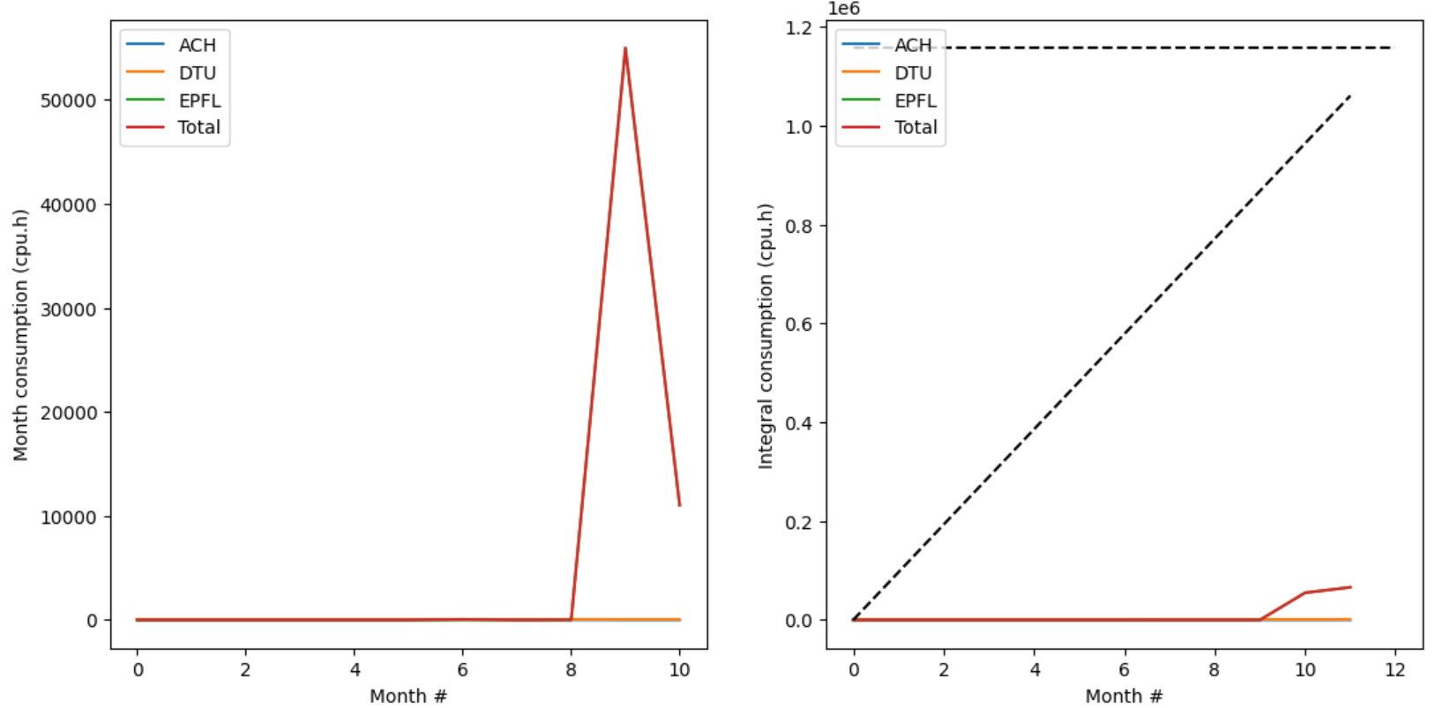
Marconi time usage - Leonardo
For info

Slide 8
Latest publications
PSI abstracts
M. Scotto d'Abusco et al : 19th December 2023 | DocumentID : 36656
: First integrated core-edge fluid simulation of ITER’s Limiter-Divertor transition with SolEdge3X-HDG.
Conference : 26th International Conference on Plasma Surface Interaction in Controlled Fusion Devices (PSI-26), Marseille, France, 12th May 2024.
I Kudashev et al : 19th December 2023 | DocumentID : 36650
: Core-edge transport modeling of a full WEST discharge with SOLEDGE-HDG
Conference : 26th International Conference on Plasma Surface Interaction in Controlled Fusion Devices (PSI-26), Marseille, France, 12th May 2024.
E Serre et al : 19th December 2023 | DocumentID : 36649
: Toward improving cross-field turbulent transport modelling in fluid simulations of tokamak: a k-epsilon model in SOLEDGE3X
Conference : 26th International Conference on Plasma Surface Interaction in Controlled Fusion Devices (PSI-26), Marseille, France, 12th May 2024.
Turbulence in 3D configurations
A.J. Coelho et al : 19th December 2023 | DocumentID : 36659
: Global fluid simulation of plasma turbulence in stellarators with the GBS code
Journal : Nuclear Fusion, .

Slide 9
Today’s meeting agenda
Upload presentations on https://indico.euro-fusion.org/event/2934/ or send to me please.

