Slide 1
2D turbulence simulations involving the new parallel model
Model updates, challenges and first results
Notes:
²

Slide 2
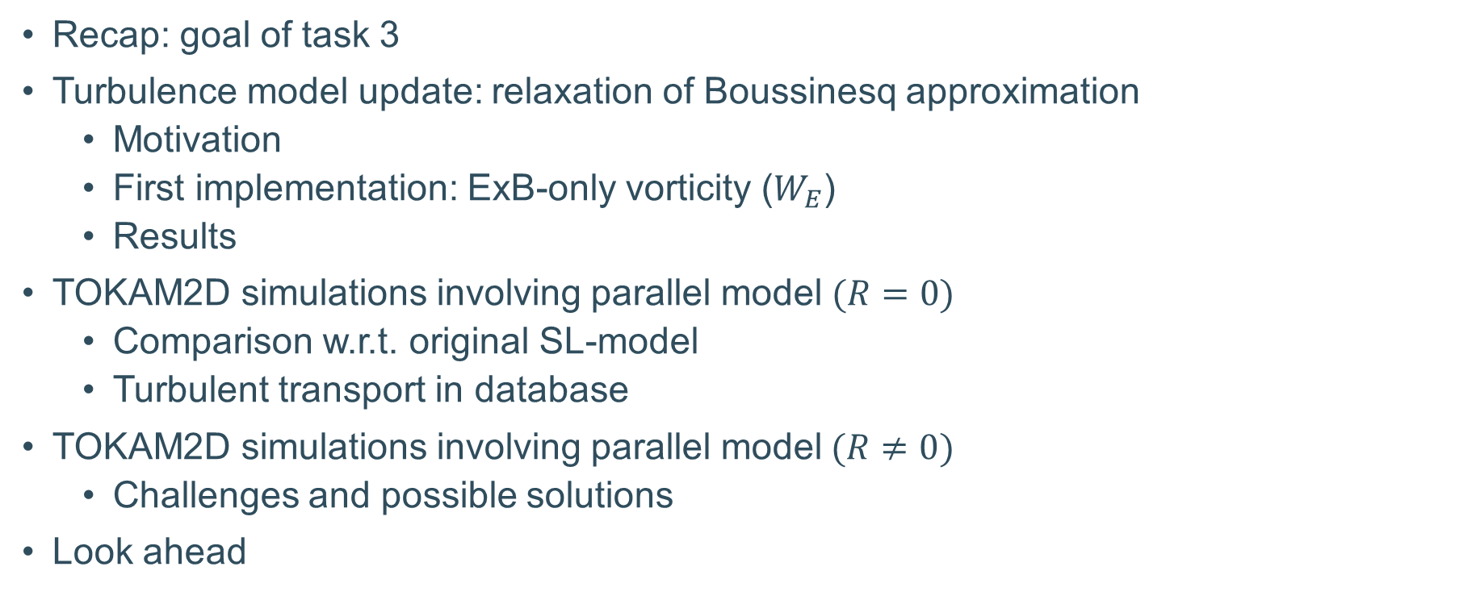
Content
Recap: goal of task 3
Turbulence model update: relaxation of Boussinesq approximation
  Motivation
  First implementation: ExB-only vorticity ($W_{E}$)
  Results
TOKAM2D simulations involving parallel model $(R=0)$
  Comparison w.r.t. original SL-model
  Turbulent transport in database
TOKAM2D simulations involving parallel model$(R≠0)$
  Challenges and possible solutions
Look ahead

Slide 3
Recap: goal of task 3
(Further) Development of consistent, reduced turbulence transport models
How:
  Studying the anomalous transport via turbulence simulations ...
    2D
      TOKAM2D
      HESEL
    3D
      SOLEDGE3X / GRILLIX
  ... proposing closure relations and inferring free coefficients
  Benchmark against 3D-codes & validate against experiments
$←$ proposed new model (density regimes)
Notes:
Consistent, reduced with aim to not need to manually tune the coefficients anymore (hence fixed values for the closure coefficients required)

Slide 4
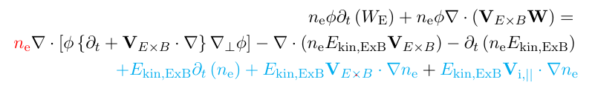
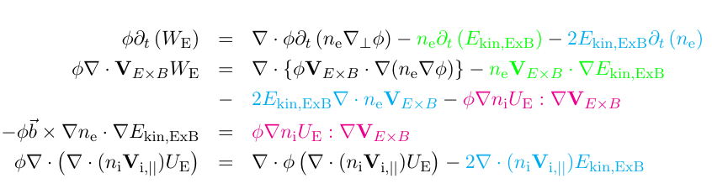

Relaxation of Boussinesq approximation
Motivation
Boussinesq approximation $⇒$ no energy theorem (Scott CH2 [1], Ross PhD [2])
Relaxation, improves theorem:
No exact theorem: $D∇_{⊥}^{2}n,νφ∇_{⊥}^{2}W$ & $S_{n}$
Ref: [1] DOI: 10.1088/978-0-7503-2504-2,
[2] A. Ross (2018), PhD: Extension of GRILLIX: Towards a global fluid turbulence code for realistic magnetic geometries
(obtained from https://mediatum.ub.tum.de/1452529 )

Slide 5

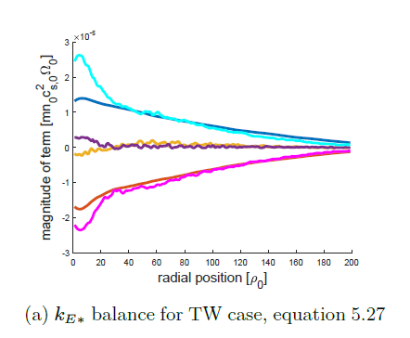

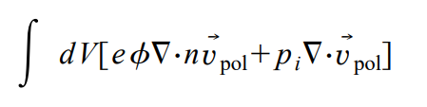
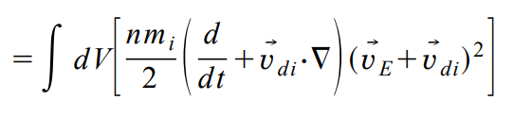
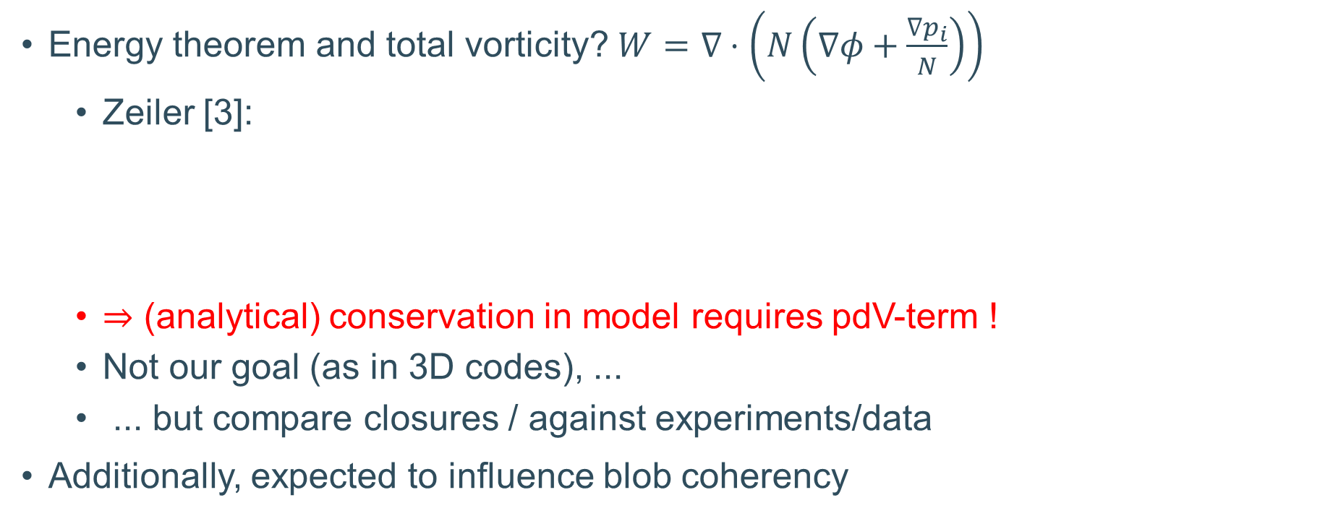
Motivation
RC, PhD[4]
Energy theorem and total vorticity? $W=∇⋅\left(N\left(∇φ+\frac{∇p_{i}}{N}\right)\right)$
  Zeiler [3]:
  $⇒$ (analytical) conservation in model requires pdV-term !
  Not our goal (as in 3D codes), ...
  ... but compare closures / against experiments/data
Additionally, expected to influence blob coherency
Ref [3]: DOI: https://doi.org/10.1063/1.872368
[4] R. Coosemans, PhD: Turbulence Closure Models for Plasma Edge Simulations of Magnetically Confined Fusion Reactors
Obtainable from: https://lirias.kuleuven.be/retrieve/664722

Slide 6


First implementation: ExB-only vorticity ($W_{E}$)
Model formulation similar to (n)SOLT [5]: $\left(W=∇⋅\left(N∇φ\right)\right)$
$W=∇⋅\left(N∇φ\right)$solved with method of Angus [6]
(Ion continuity equation: no $v_{pola}, v_{dia,i}$)
Ref [5]: DOI: https://doi.org/10.1063/5.0060524
[6]: DOI: https://doi.org/10.1063/1.4863503

Slide 7
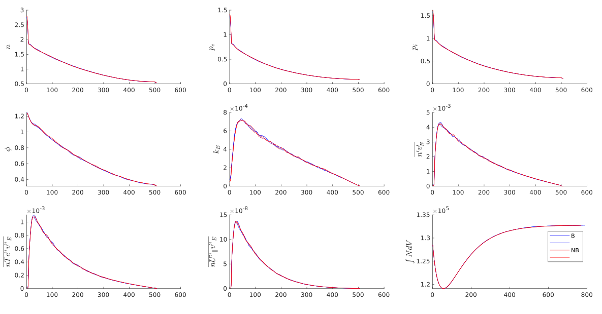
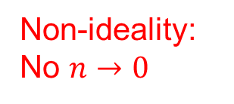
Effect of relaxation on mean-field quantities
Non-ideality:
No $n→0$
Similar profiles
Non-ideality:
Time averaging horizon
(no st.^3)

Slide 8
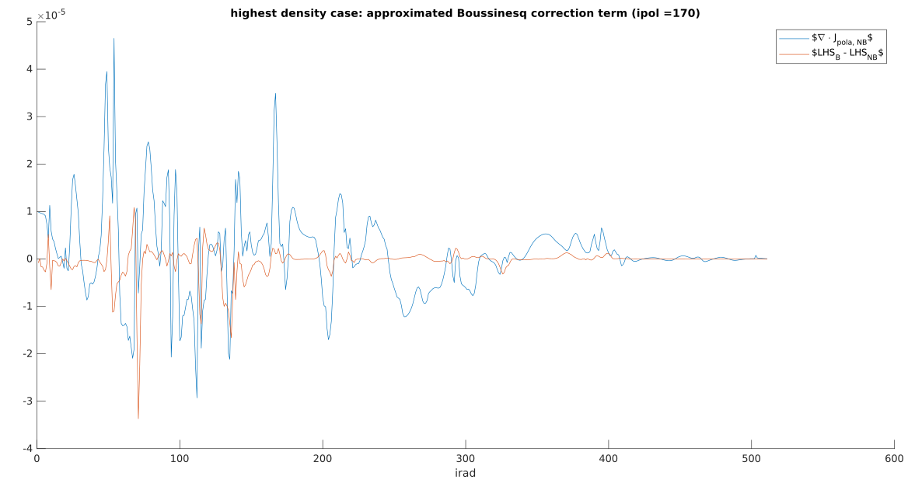

Similarity between Boussinesq and Non-boussinesq formulation?
Relation between LHS of W-eq in both formulations?
LHS NB-formulation
LHS B-formulation
‘exact’ B-correction term
= 0 ( in $W_{E}$-case)
Additional Correction term

Slide 9


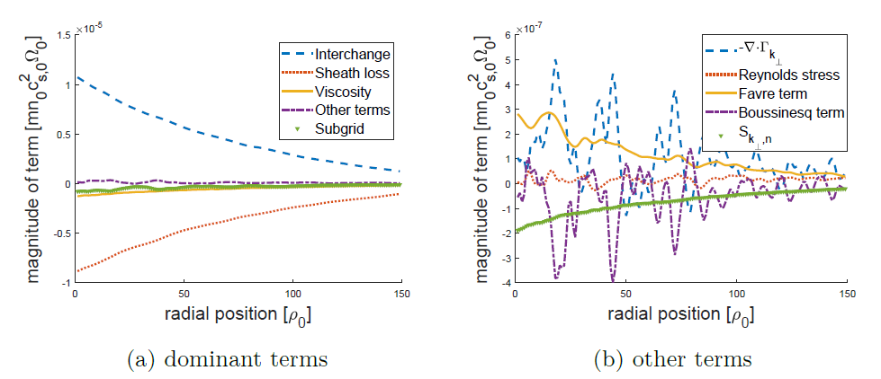
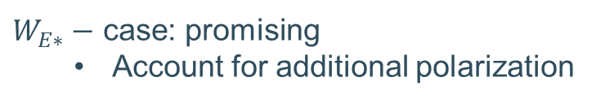

Similarity between Boussinesq and Non-boussinesq formulation?
Added value of NB-adaptation?
RC, PhD[4]
$W_{E}−$ case: seemingly limited
$W_{E∗}−$ case: promising
  Account for additional polarization
Ref [4] R. Coosemans, PhD: Turbulence Closure Models for Plasma Edge Simulations of Magnetically Confined Fusion Reactors
Obtainable from: https://lirias.kuleuven.be/retrieve/664722
Notes:
Added value: first, one could say, have written W equation conservatively (at least for the WE case, as for Wtot, might look differently)
Not so much it seems for WE, as could have maybe be expected from RC simulations (ioshtermal)

Slide 10
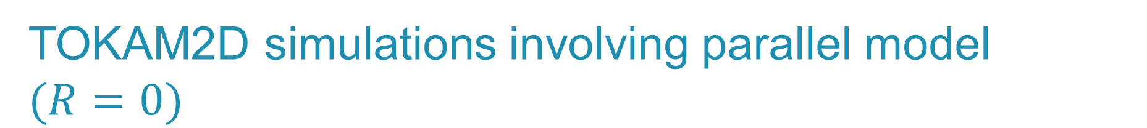
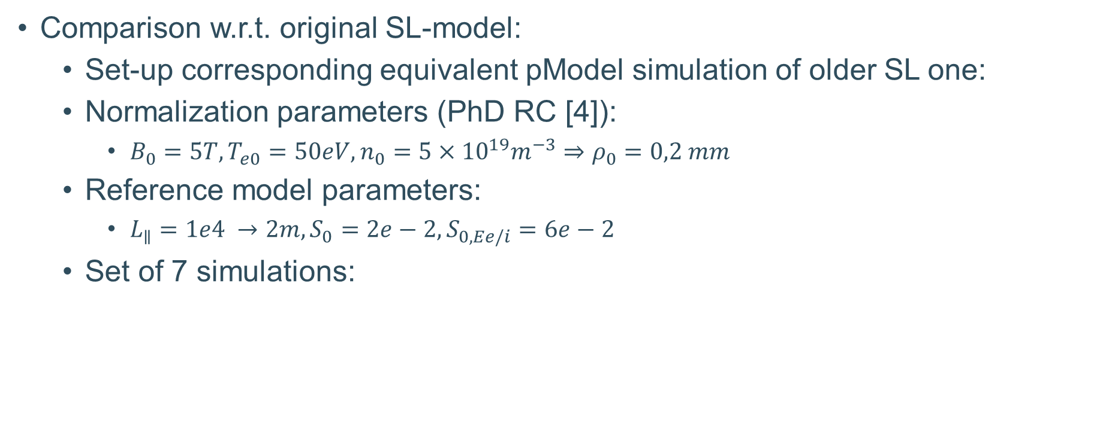

TOKAM2D simulations involving parallel model $(R=0)$
Comparison w.r.t. original SL-model:
  Set-up corresponding equivalent pModel simulation of older SL one:
  Normalization parameters (PhD RC [4]):
    $B_{0}=5T, T_{e0}=50eV, n_{0}=5×{10}^{19}m^{−3}⇒ρ_{0}=0,2 mm$
  Reference model parameters:
    $L_{∥}=1e4 →2m, S_{0}=2e−2, S_{0,Ee/i}$ $=6e−2$
  Set of 7 simulations:
(Note: $σ_{N}≜\frac{0,5}{L_{∥}}$as $Γ_{i,SE}=0,5n_{u}c_{s,u})$
Ref [4] R. Coosemans, PhD: Turbulence Closure Models for Plasma Edge Simulations of Magnetically Confined Fusion Reactors
Obtainable from: https://lirias.kuleuven.be/retrieve/664722

Slide 11
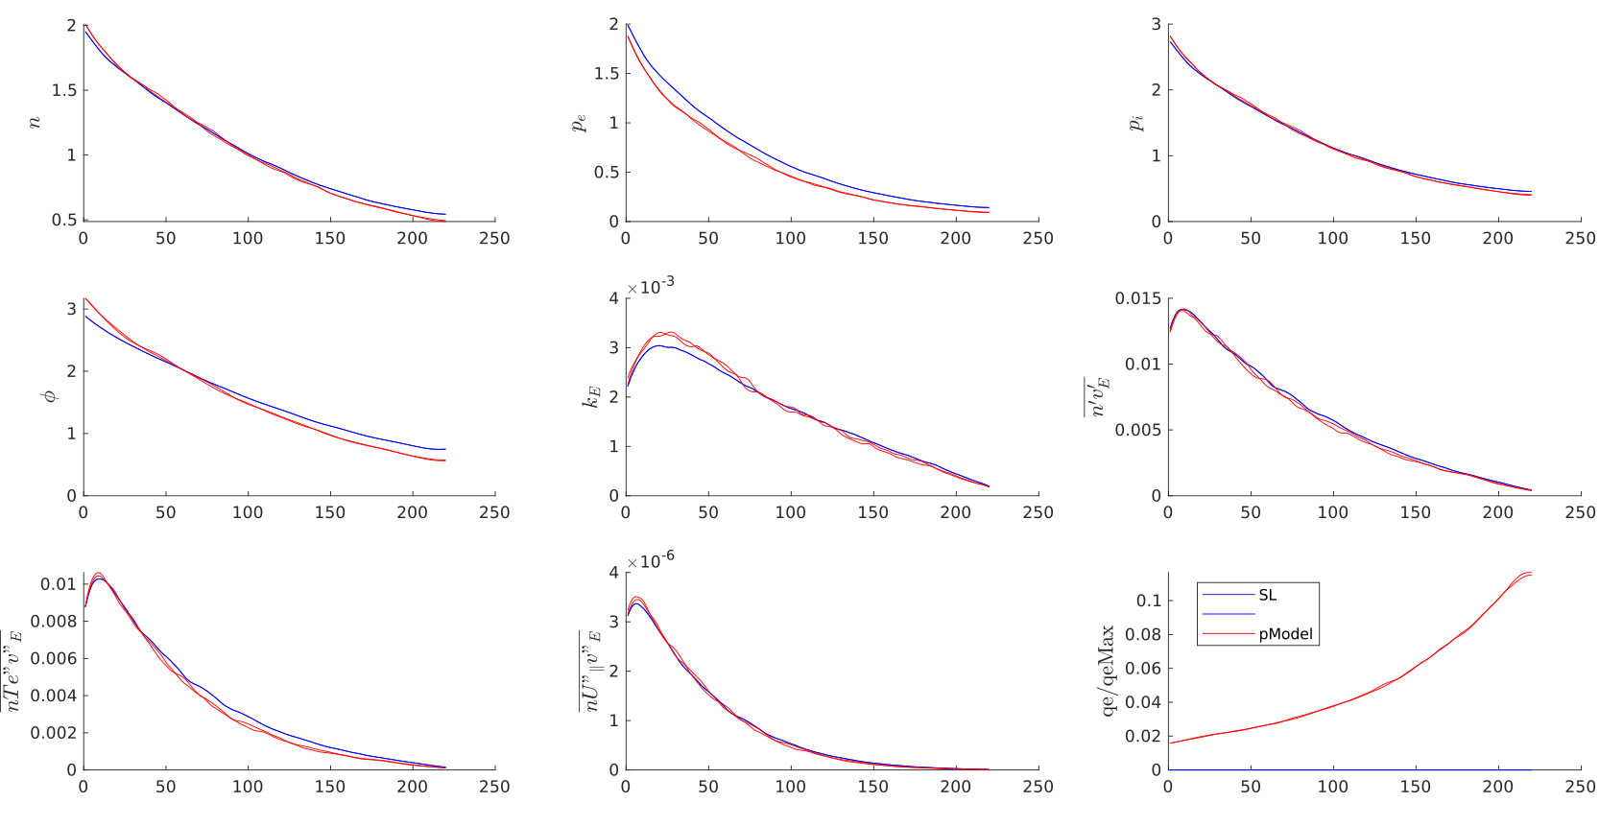
Reference case
Quiet similar profiles (also for ALL other cases)

Slide 12
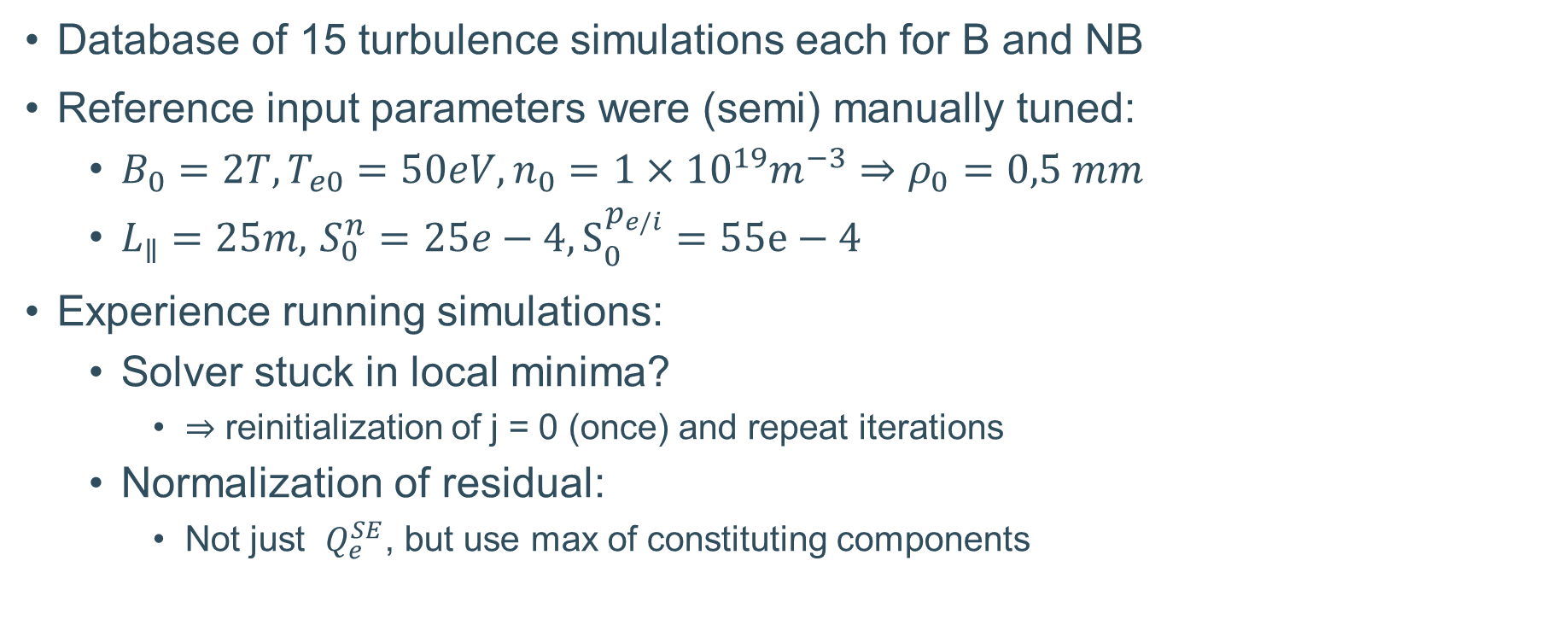
Turbulent transport in database
Database of 15 turbulence simulations each for B and NB
Reference input parameters were (semi) manually tuned:
  $B_{0}=2T, T_{e0}=50eV, n_{0}=1×{10}^{19}m^{−3}⇒ρ_{0}=0,5 mm$
  $L_{∥}=25m,$ $S_{0}^{n}=25e−4, S_{0}^{p_{e/i}}=55e−4$
Experience running simulations:
  Solver stuck in local minima?
    $⇒$ reinitialization of j = 0 (once) and repeat iterations
  Normalization of residual:
    Not just $Q_{e}^{SE}$, but use max of constituting components

Slide 13
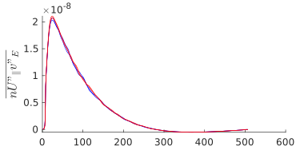
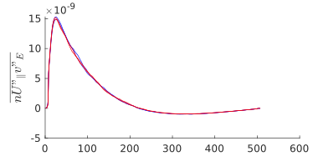
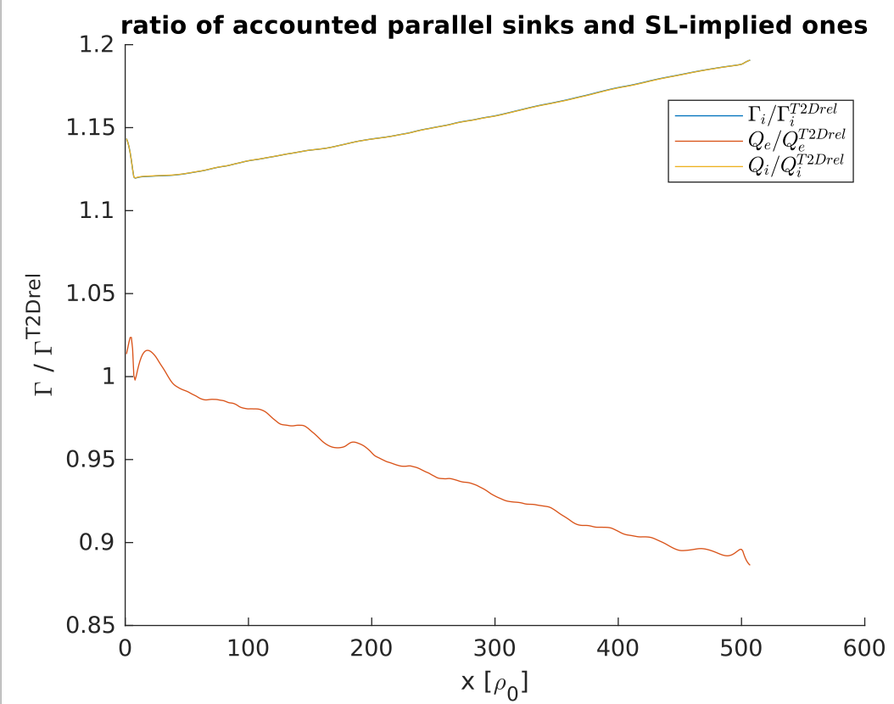
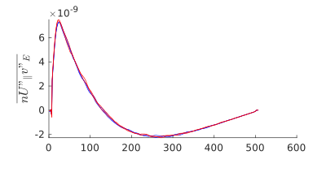

First exploratory results
Highest density case:
Relatively more particle than electron energy loss
$$S_{e/i}$$

Slide 14
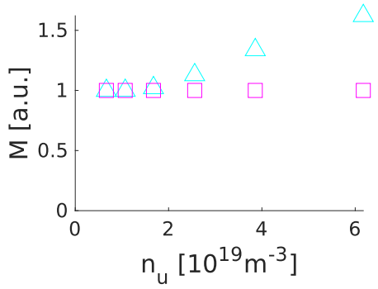
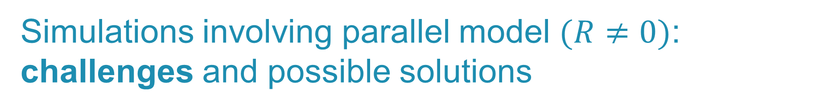


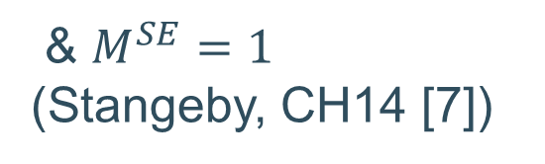
Simulations involving parallel model $(R≠0)$: challenges and possible solutions
Model assumes:
  momentum conservation along FT
  fixed length of (anisothermal) ionization region
Hence:
$⇒$generally, no solution with:
  R = 0 and $L_{iz}≠0$ (& $q_{e},q_{i}≥0$)
$$⇒{ Γ}_{sound}(T_{e},T_{i})=\frac{n_{u}\left(T_{eu}+T_{iu}\right)}{2\left(T_{e}+T_{i}\right)}\sqrt{T_{e}+T_{i}}$$
$$⇒{ Γ}_{sound}\left(T_{e}^{CZE},T_{i}^{CZE}\right)<{ Γ}_{sound}\left(T_{e}^{SE},T_{i}^{SE}\right)$$
$$S_{ion}≥{ Γ}_{sound}\left(T_{e}^{SE},T_{i}^{SE}\right) − { Γ}_{sound}\left(T_{e}^{CZE},T_{i}^{CZE}\right)$$
& $M^{SE}=1$ (Stangeby, CH14 [7])
Ref [7] https://doi.org/10.1201/9780367801489

Slide 15
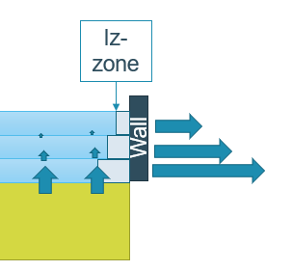
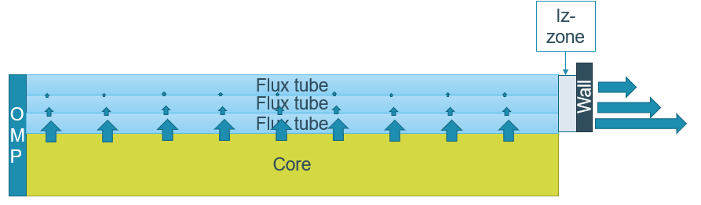
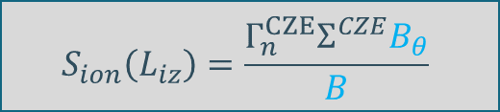

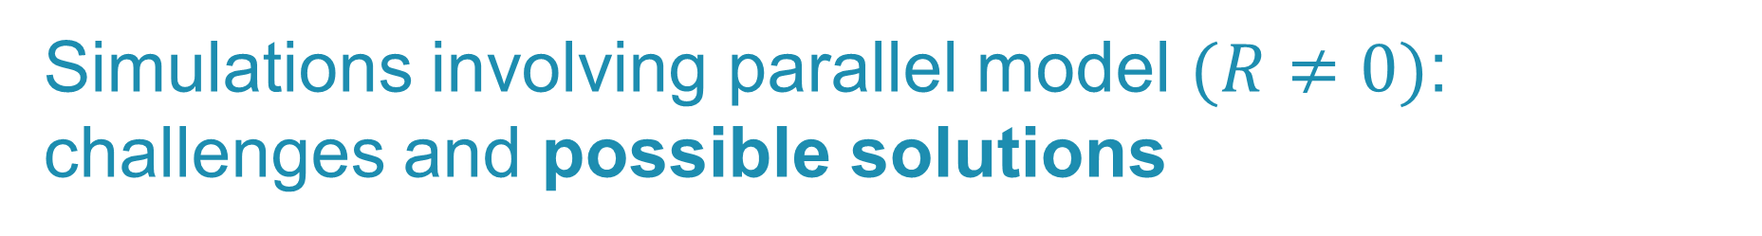
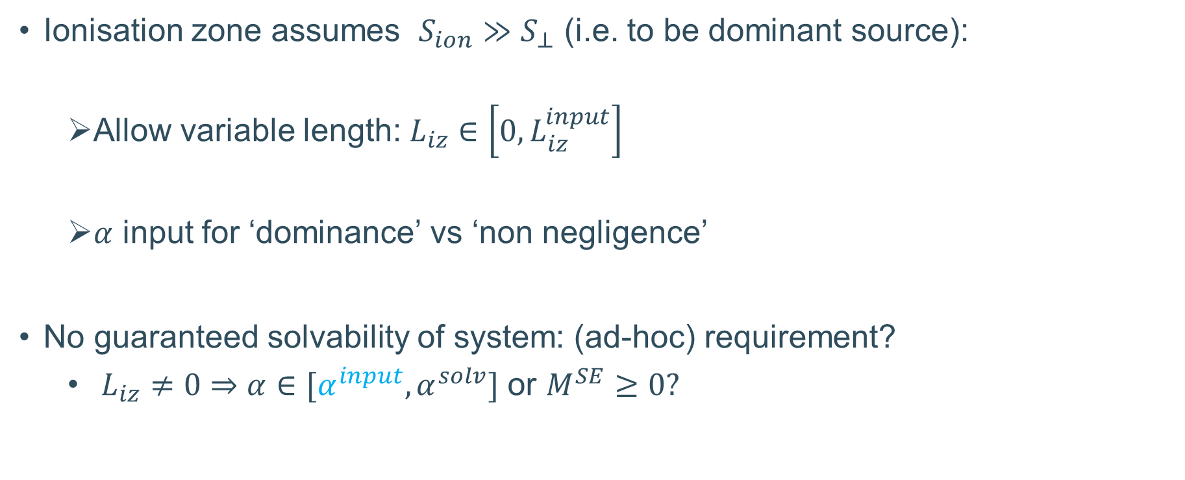
Simulations involving parallel model $(R≠0)$: challenges and possible solutions
Ionisation zone assumes $S_{ion}≫S_{⊥}$ (i.e. to be dominant source):
  Allow variable length: $L_{iz}∈\left[0,L_{iz}^{input}\right]$
  $α$ input for ‘dominance’ vs ‘non negligence’
No guaranteed solvability of system: (ad-hoc) requirement?
  $L_{iz}≠0$ $⇒$ $α∈[α^{input}, α^{solv}]$ or $M^{SE}≥0?$
$$S_{ion}\left(L_{iz}\right)=αS_{⊥}$$
$$S_{ion}\left(L_{iz}\right)=\frac{Γ_{n}^{CZE}Σ^{CZE}B_{θ}}{B}$$
Notes:
If Liz = 0 then alpha needs to be smaller or be equal to the input. (cfr with R = 0, Liz = 0, even though one might specify and alpha of 0,1)
MSE > 1 would be weird? That it would only occur for the far SOL region, as I would expect it to give most problems there. (Since in the near sol, he found already solutions for L = Linput, so that the requirement of alpha would only reduce its size and hence Tdrop over the zone)

Slide 16
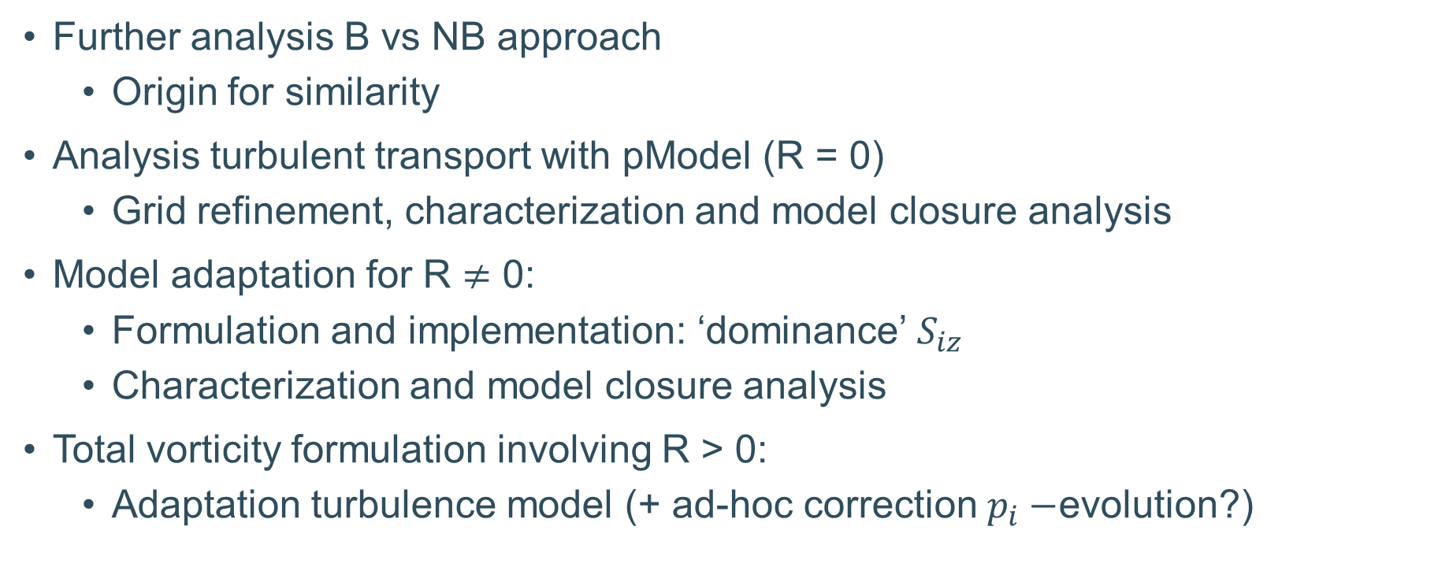
Look ahead
Further analysis B vs NB approach
  Origin for similarity
Analysis turbulent transport with pModel (R = 0)
  Grid refinement, characterization and model closure analysis
Model adaptation for R $≠$ 0:
  Formulation and implementation: ‘dominance’ $S_{iz}$
  Characterization and model closure analysis
Total vorticity formulation involving R > 0:
  Adaptation turbulence model (+ ad-hoc correction $p_{i}−$evolution?)
Analysis of 3D cases SOLEDGE3X and GRILLIX

Slide 17
Questions & suggestions?

Slide 18
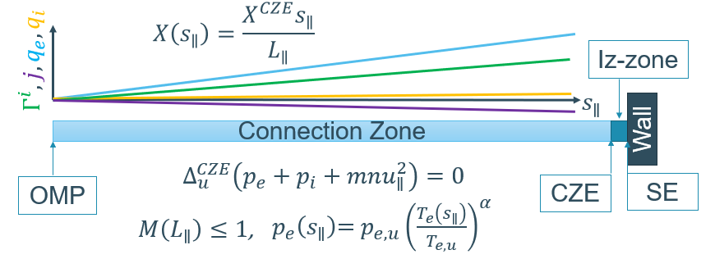
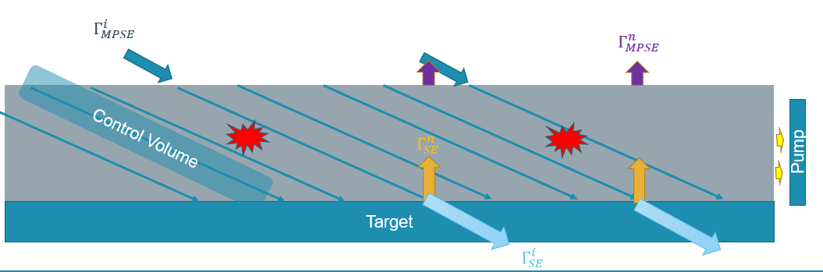
Back-up: parallel model

