Slide 1
TSVV3 – Regular advancement meeting 24/01/2024 – TCVX23 Validation update Project news
P. Tamain

Slide 2
Today’s meeting agenda

Slide 3
Annual meeting 2024
Proposal: hold annual in-person TSVV3 meeting in Leuven sometime in June
Doodle sent this morning: https://doodle.com/meeting/participate/id/bk6OvB6a
Planning for 3 days
Mondays = “Monday am to Wednesday pm”
Wednesdays = “Wednesday am to Friday pm”

Slide 4
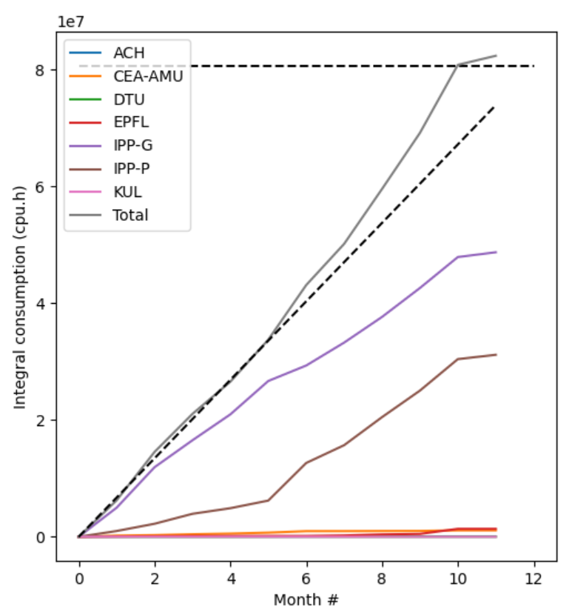
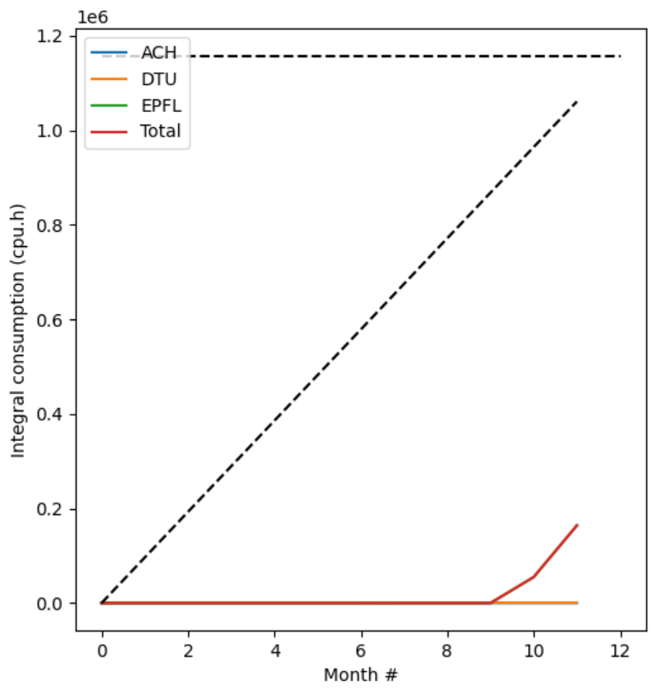
Marconi time usage
Asked for possibility to extend allocation on A3
Feedback a priori positive (to be confirmed) => 150 knode.hours requested
Marconi – A3
Leonardo

Slide 5
Latest publications
No new input on pinboard since last meeting

Slide 6
Today’s meeting agenda
Upload presentations on https://indico.euro-fusion.org/event/2935/ or send to me please.

