Slide 1
Advanced fluid atom models for plasma boundary simulations
W. Van Uytven, W. Dekeyser, N. Horsten, M. Blommaert, M. Baelmans
TSVV-3: 6/3/2024

Slide 2
Scope of current development work
Advanced fluid neutral models (AFN):
fluid model for H/D/T atoms consistently derived from kinetic description for dominant CX
Current scope
steady state
mean-field plasma model (SOLPS-ITER)
single species (all results deuterium)
no neutral-neutral collisions
no fluid molecules

Slide 3
References
Articles
  original derivation and implementation in MATLAB
    Horsten, N. et al. NF 57.11 (2017): 116043. ( + references therein)
  implementation in SOLPS and improvements for realistic cases
    Blommaert, M., et al. CtPP 58.6-8 (2018): 718-724.
    Van Uytven, W. et al. CtPP 60, 5-6 (2020), e201900147.
    Van Uytven, W. et al. NF (2022), 086023.
    Van Uytven, W. et al. NME (2022), 101255.
PhD manuscripts
    PhD N. Horsten, KU Leuven, 2019
    PhD W. Van Uytven, KU Leuven, 2023

Slide 4
Transport model

Slide 5
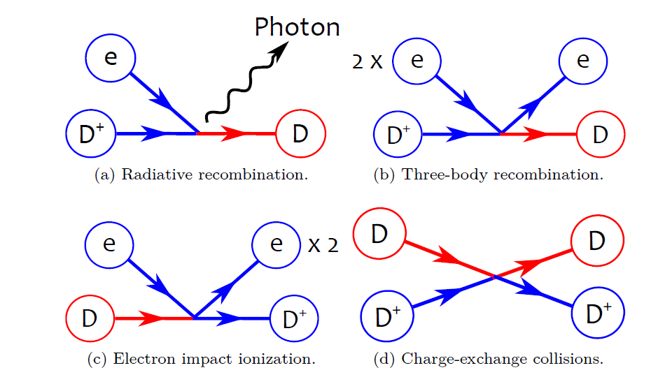


Transport model for the atoms
Continuity
atom density
atom particle source
$$\frac{∂n_{a}}{∂t}+∇⋅Γ_{a}^{n}=S_{a}^{n}$$
atom particle flux density
$S_{a}^{n}=n_{e}n_{i}K_{r}−n_{e}n_{a}K_{i}$
  [PhD N. Horsten, KU Leuven, 2019]
recombination
ionization

Slide 6



Transport model for the atoms
Momentum
momentum source
stress tensor
$$m\frac{∂\left(n_{a}V_{a}\right)}{∂t}+∇⋅\left(m n_{a}V_{a}V_{a}+Π_{a}\right)=−∇p_{a}+S_{a}^{m}$$
pressure gradient
$$Π_{a}=−η_{a}(∇V_{a}+{\left(∇V_{a}\right)}^{T}−\frac{2}{3}\left(∇⋅V_{a})I \right)$$
atom viscosity
$$η_{a}=\frac{p_{a}}{(n_{i}K_{CX,m}+n_{e}K_{i})}$$
$$S_{a}^{m}=m(\left(n_{i}n_{e}K_{r}+n_{a}n_{i}K_{CX,m }\right)V_{i}−\left(n_{e}n_{a}K_{i}+n_{a}n_{i}K_{CX,m }\right)V_{a})$$
Momentum-linearized CX rate coeff.

Slide 7

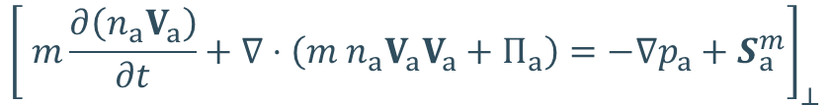



Transport model for the atoms
drift-advective term
implemented and tested for first time
[Van Uytven, W. et al. NME (2022), 101255]
Perpendicular momentum
$${\left[ m\frac{∂\left(n_{a}V_{a}\right)}{∂t}+∇⋅\left(m n_{a}V_{a}V_{a}+Π_{a}\right)=−∇p_{a}+S_{a}^{m}\right]}_{⊥}$$
$$Γ_{a,⊥}^{n}=−D_{a}^{p}∇_{⊥}p_{a}+n_{a,eq}V_{i,⊥}$$
pressure-diffusion
$$D_{a}^{p}=\frac{1}{m(n_{i}K_{CX,m}+n_{e}K_{i})}$$
$$n_{a,eq}=\frac{n_{i}n_{e}K_{r}+n_{a}n_{i}K_{CX,m}}{n_{i}K_{CX,m}+n_{e}K_{i}}$$
Particle fluxes
$$Γ_{a,θ}^{n}=n_{a}b_{θ}V_{a,||}−D_{a}^{p}{b_{φ}^{2}∇}_{θ}p_{a}+b_{θ}n_{a,eq}(V_{i,⊥}^{ExB}+V_{i,⊥}^{(dia)})$$
Used for all non-drift simulations
$$Γ_{a,r}^{n}=−D_{a}^{p}∇_{r}p_{a}+n_{a,eq}(V_{i,r}^{ExB}+V_{i,r}^{(dia)})$$
Tested for first time on C-mod case

Slide 8
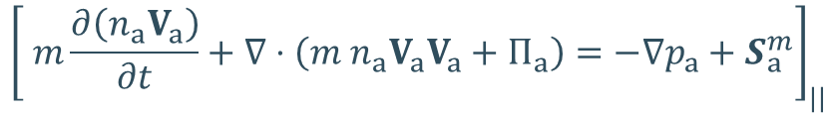



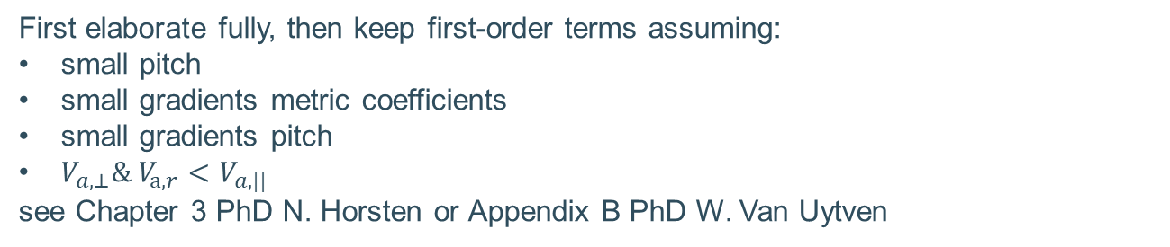
Transport model for the atoms
Parallel momentum
$${\left[ m\frac{∂\left(n_{a}V_{a}\right)}{∂t}+∇⋅\left(m n_{a}V_{a}V_{a}+Π_{a}\right)=−∇p_{a}+S_{a}^{m}\right]}_{||}$$
First elaborate fully, then keep first-order terms assuming:
small pitch
small gradients metric coefficients
small gradients pitch
$V_{a,⊥}\& V_{a,r}<V_{a,||}$
see Chapter 3 PhD N. Horsten or Appendix B PhD W. Van Uytven
$$m\frac{∂\left(n_{a}V_{a,||}\right)}{∂t}+∇⋅Γ_{a}^{||m}+∇_{||}p_{a}=S_{a}^{||m}+S_{c}^{||m}$$
$$Γ_{a,θ}^{||m}=m V_{a,||}Γ_{a,θ}^{n} −η_{a}∇_{θ}V_{a,||}$$
$$Γ_{a,r}^{||m}=m V_{a,||}Γ_{a,r}^{n} −η_{a}∇_{r}V_{a,||}$$

Slide 9
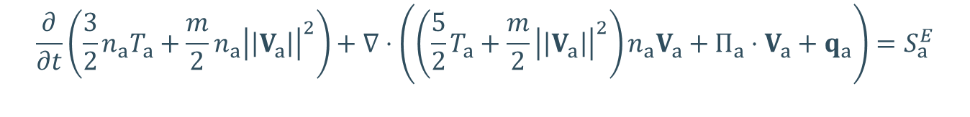


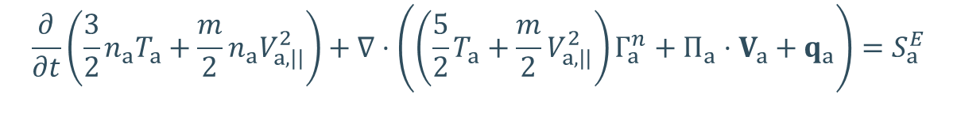
Transport model for the atoms
Energy equation
$$\frac{∂}{∂t}\left(\frac{3}{2}n_{a}T_{a}+\frac{m}{2}n_{a}{\left|\left|V_{a}\right|\right|}^{2}\right)+∇⋅\left(\left(\frac{5}{2}T_{a}+\frac{m}{2}{\left|\left|V_{a}\right|\right|}^{2}\right)n_{a}V_{a}+Π_{a}⋅V_{a}+q_{a}\right)=S_{a}^{E}$$
assume ${\left|\left|V_{a}\right|\right|}^{2}≈V_{a,|| }^{2}$: effect of this assumption not yet investigated
$$\frac{∂}{∂t}\left(\frac{3}{2}n_{a}T_{a}+\frac{m}{2}n_{a}V_{a,||}^{2}\right)+∇⋅\left(\left(\frac{5}{2}T_{a}+\frac{m}{2}V_{a,||}^{2}\right)Γ_{a}^{n}+Π_{a}⋅V_{a}+q_{a}\right)=S_{a}^{E}$$
See Chapter 3 PhD N. Horsten or
Appendix B PhD W. Van Uytven which terms are kept
$$κ_{a}=\frac{5}{2}\frac{p_{a}}{m(n_{i}K_{CX,m}+n_{e}K_{i})}$$
$$q_{a}=−κ_{a}∇T_{a}$$
$$S_{a}^{E}=\left(n_{i}n_{e}K_{r}+n_{a}K_{CX,m} \right)\left(\frac{3}{2}T_{i}+\frac{m}{2}V_{i,||}^{2}\right)−(n_{a}n_{e}K_{i}+n_{a}{n_{i}K}_{CX,m})(\frac{3}{2}T_{a}+\frac{m}{2}V_{a,||}^{2})$$

Slide 10
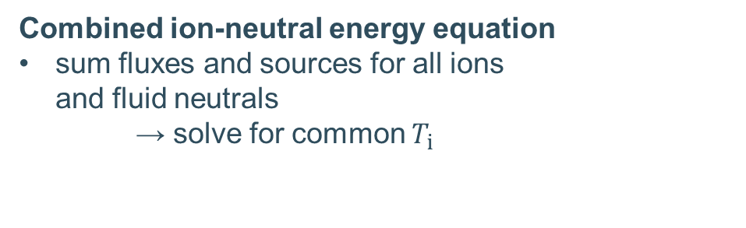
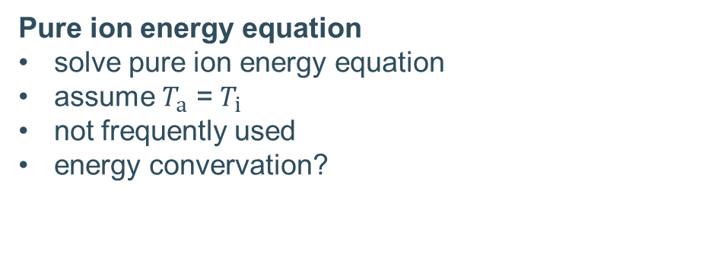
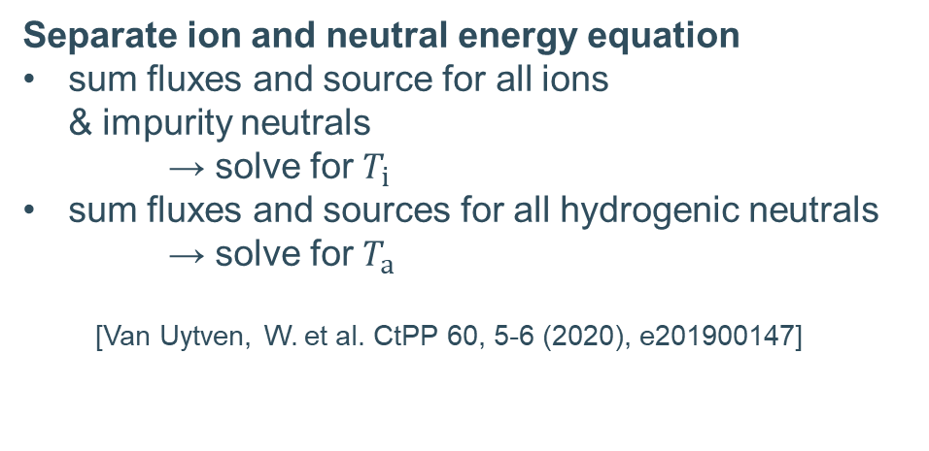
Transport model for the atoms
Energy equation
In SOLPS-ITER: internal energy equation instead of total one
Combined ion-neutral energy equation
sum fluxes and sources for all ions
and fluid neutrals
→ solve for common $T_{i }$
Separate ion and neutral energy equation
sum fluxes and source for all ions
& impurity neutrals
→ solve for $T_{i}$
sum fluxes and sources for all hydrogenic neutrals
  → solve for $T_{a}$
  [Van Uytven, W. et al. CtPP 60, 5-6 (2020), e201900147]
Pure ion energy equation
solve pure ion energy equation
assume $T_{a}$ = $T_{i}$
not frequently used
energy convervation?

Slide 11

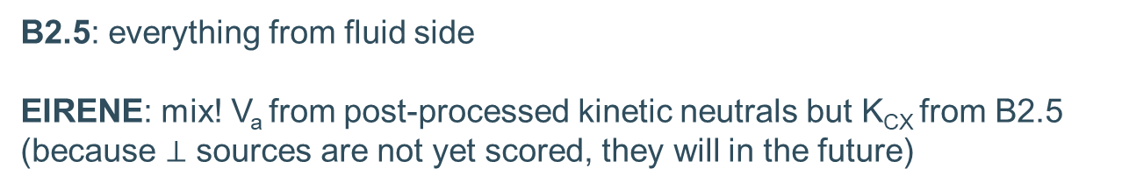
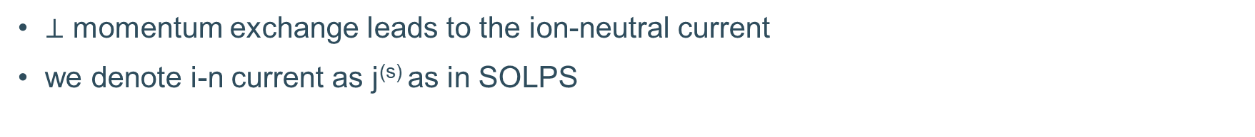


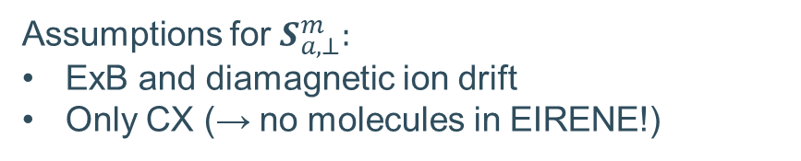
Ion-neutral current
$⊥$ momentum exchange leads to the ion-neutral current
we denote i-n current as j^{(s)} as in SOLPS
$$j^{(s)}=−S_{a}^{m}×\frac{B}{B^{2}}$$
Assumptions for $S_{a,⊥}^{m}:$
ExB and diamagnetic ion drift
Only CX (→ no molecules in EIRENE!)
$$S_{a,⊥}^{m}=K_{CX,m}n_{i}n_{a}(V_{i,⊥}^{ExB}+V_{i,⊥}^{(dia)}−V_{a,⊥})$$
B2.5: everything from fluid side
EIRENE: mix! V_{a} from post-processed kinetic neutrals but K_{CX} from B2.5
(because $⊥$ sources are not yet scored, they will in the future)
$$S_{a,r}^{m}=K_{CX,m}n_{i}n_{a}(V_{i,r}^{ExB}+V_{i,r}^{(dia)}−V_{a,r})$$
[Van Uytven, W. et al. NME (2022), 101255]

Slide 12
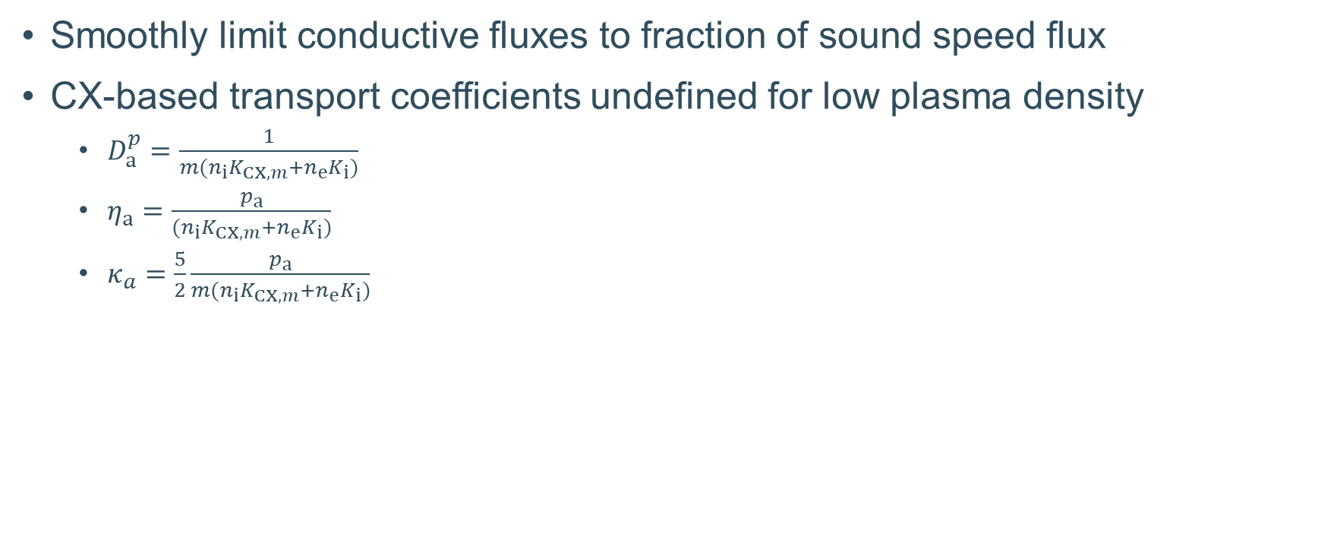
Flux limiters
Smoothly limit conductive fluxes to fraction of sound speed flux
CX-based transport coefficients undefined for low plasma density
  $D_{a}^{p}=\frac{1}{m(n_{i}K_{CX,m}+n_{e}K_{i})}$
  $η_{a}=\frac{p_{a}}{(n_{i}K_{CX,m}+n_{e}K_{i})}$
  $κ_{a}=\frac{5}{2}\frac{p_{a}}{m(n_{i}K_{CX,m}+n_{e}K_{i})}$

Slide 13
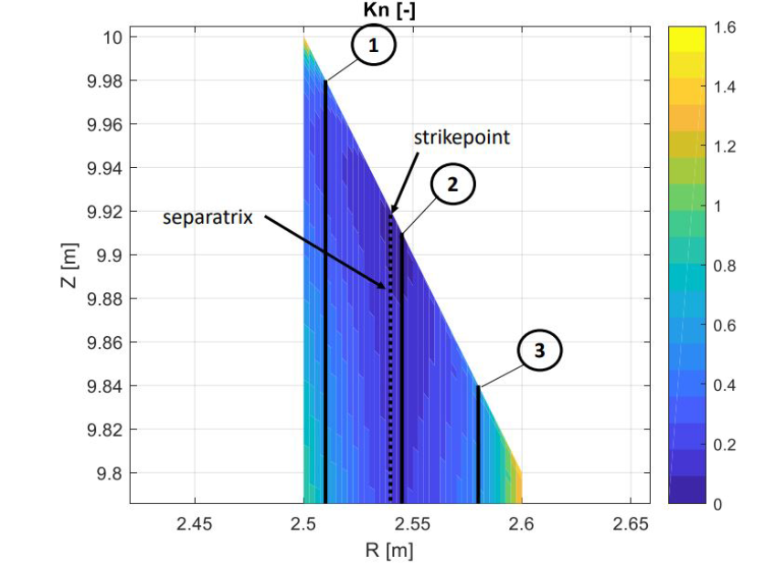
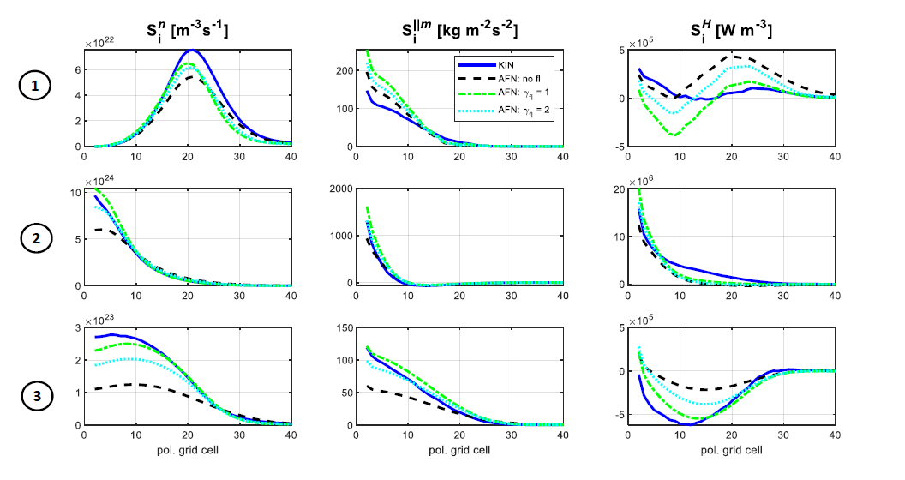
Flux limiters

Slide 14
Boundary conditions

Slide 15
Neutral boundary conditions
ions (D⁺ )
ion recycling
atoms (D)
D
atom-only models:
Immediate Franck-Condon dissociation
molecules (D₂)
D₂
D
atoms (D)
atom reflection
atoms (D)
Notes:
TODO: trim toevoegen

Slide 16
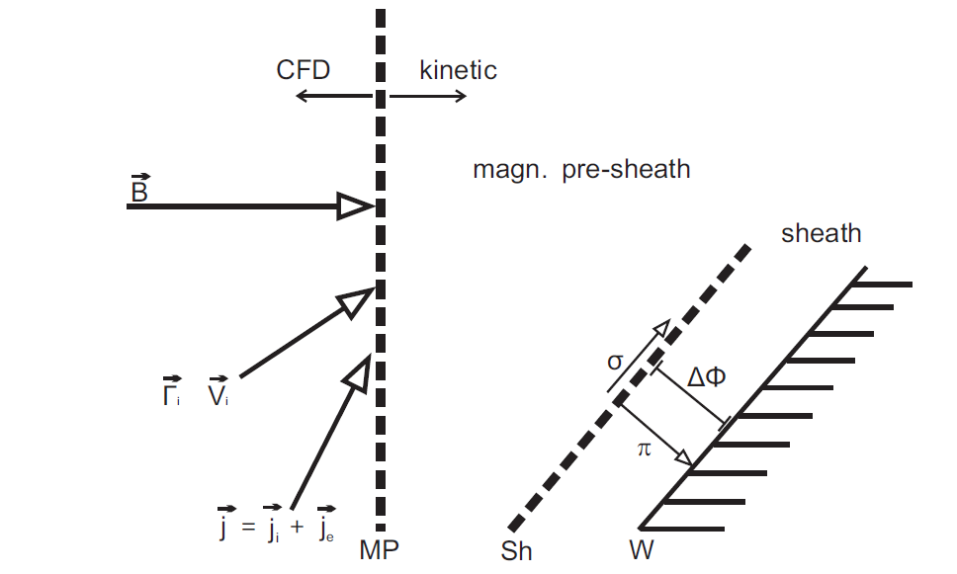
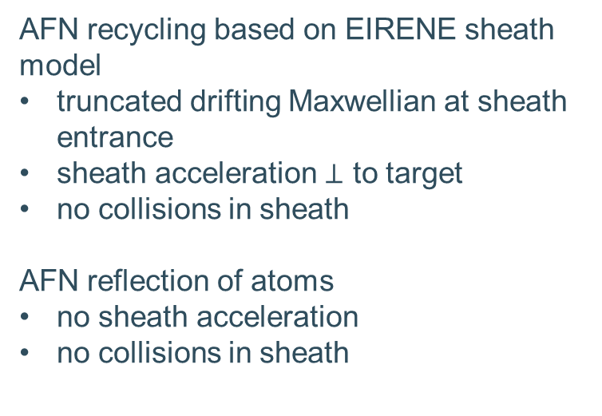
EIRENE sheath model
AFN recycling based on EIRENE sheath model
truncated drifting Maxwellian at sheath entrance
sheath acceleration $⊥$ to target
no collisions in sheath
AFN reflection of atoms
no sheath acceleration
no collisions in sheath

Slide 17
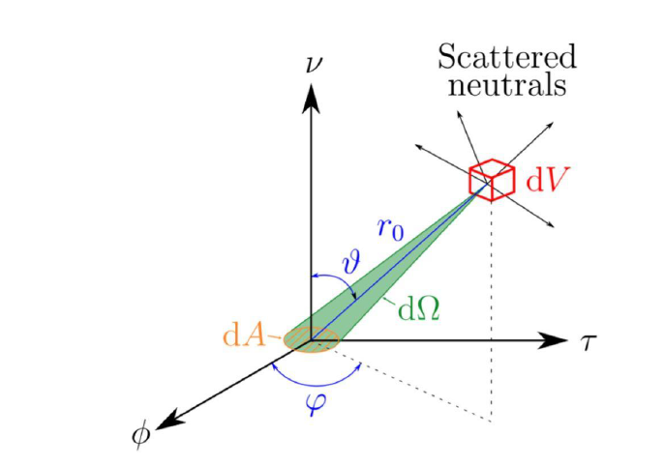
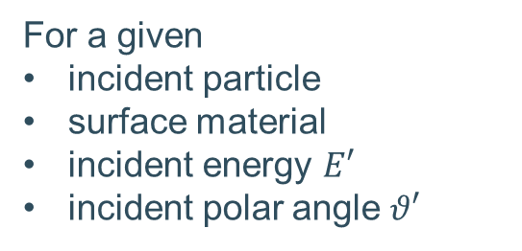
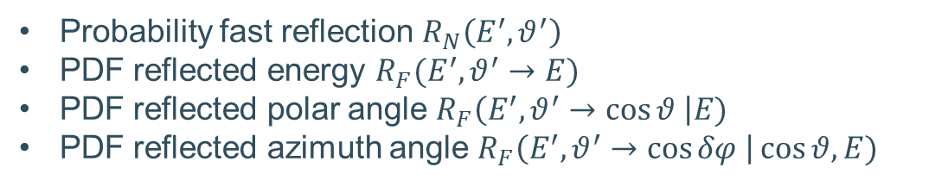
EIRENE kinetic BCs: TRIM
For a given
incident particle
surface material
incident energy $E′$
incident polar angle $θ′$
Probability fast reflection $R_{N}\left(E^{′},θ^{′}\right)$
PDF reflected energy $R_{F}(E^{′},θ^{′}→E)$
PDF reflected polar angle $R_{F}\left(E^{′},θ^{′}→\cos{θ} \right|E)$
PDF reflected azimuth angle $R_{F}\left(E^{′},θ^{′}→\cos{δφ} \right|\cos{θ, E})$
TRIM database
Shorthand notation: $R_{fast}\left(v^{′}\right)$ and $R\left(v^{′}→v\right)$

Slide 18

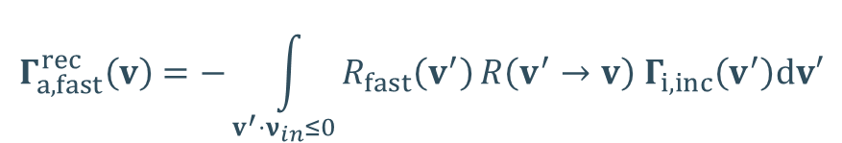

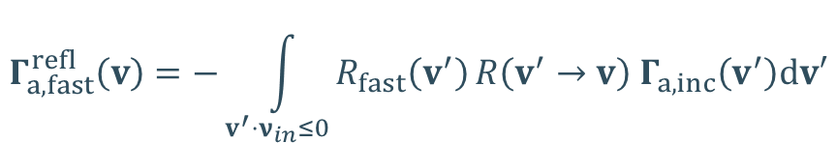
Advanced fluid neutral boundary conditions
Incorporate TRIM reflection kernel in fluid BCs
$$Γ_{a,fast}^{rec}\left(v\right)=−\int_{v^{′}⋅ν_{in}≤0}{R_{fast}\left(v^{′}\right)}R\left(v^{′}→v\right){ Γ}_{i,inc}\left(v^{′}\right)dv′$$
$$for v⋅ν_{in}≥0$$
probability fast reflection
sheath-accelerated ion Maxwellian
reflection kernel
$$Γ_{a,fast}^{refl}\left(v\right)=−\int_{v^{′}⋅ν_{in}≤0}{R_{fast}\left(v^{′}\right)}R\left(v^{′}→v\right){ Γ}_{a,inc}\left(v^{′}\right)dv′$$
$$for v⋅ν_{in}≥0$$
Estimated incident atom distribution

Slide 19
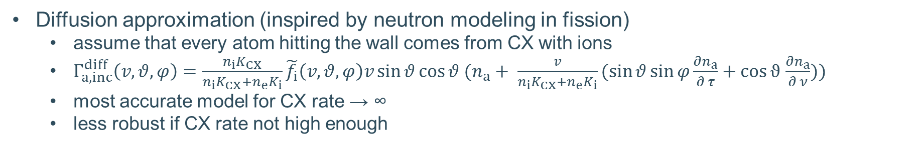
Incident atom distributions
Diffusion approximation (inspired by neutron modeling in fission)
  assume that every atom hitting the wall comes from CX with ions
  $Γ_{a,inc}^{diff}\left(v,θ,φ\right)=\frac{{n_{i}K}_{CX}}{n_{i}K_{CX}+n_{e}K_{i}}\tilde{f_{i}}\left(v,θ,φ\right)v\sin{θ\cos{θ (n_{a}+ \frac{v}{n_{i}K_{CX}+n_{e}K_{i}}(\sin{θ\sin{φ\frac{∂n_{a}}{∂ τ}+\cos{ϑ}}}}}$ $\frac{∂n_{a}}{∂ ν}))$
  most accurate model for CX rate → ∞
  less robust if CX rate not high enough

Slide 20
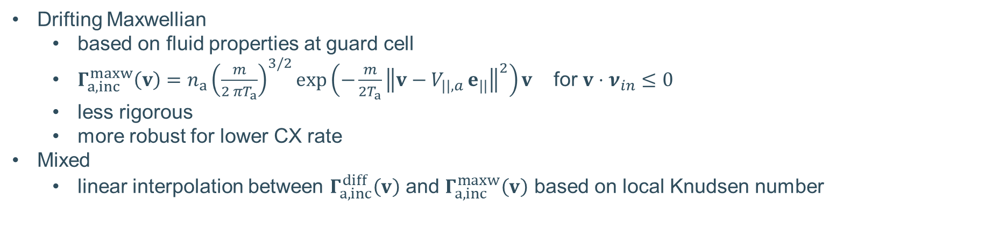
Incident atom distributions
Drifting Maxwellian
  based on fluid properties at guard cell
  $Γ_{a,inc}^{maxw}\left(v\right)=n_{a}{\left(\frac{m}{2 πT_{a}}\right)}^{3/2}\exp\left(−\frac{m}{2T_{a}}{\left\|v−V_{||,a }e_{||}\right\|}^{2}\right)v$ for $v⋅ν_{in}≤0$
  less rigorous
  more robust for lower CX rate
Mixed
  linear interpolation between $Γ_{a,inc}^{diff}\left(v\right)$ and $Γ_{a,inc}^{maxw}\left(v\right)$ based on local Knudsen number

Slide 21

Net fluid boundary fluxes
$Γ_{a,μ}=Γ_{a,μ}^{refl}+Γ_{a,μ}^{rec}+Γ_{a,μ}^{therm}−Γ_{a,μ}^{inc}$

Slide 22
Advanced fluid neutral boundary conditions
$$\left[Γ_{a,fast}^{n} Γ_{a,fast}^{||m} Γ_{a,fast}^{E}\right]=\int_{v}{{\left[1 m v⋅e_{||} \frac{m}{2}{\left|\left|v\right|\right|}^{2}\right]}^{T}\left(Γ_{fast}^{rec}(v)+Γ_{fast}^{refl}\left(v\right)\right)⋅ν_{in}dv}$$
Macroscopic fast reflected+recycled fluxes
If we assume molecules dissociate at targets:
$\left[Γ_{a,therm}^{n} Γ_{a,therm}^{||m} Γ_{a,therm}^{E}\right]=Γ_{a,therm}{\left[1 \frac{{2 b}_{θ}\cos{α}}{3} m v_{th} \frac{m}{2}v_{th}^{2}\right]}^{T}$
What is not fast reflected/recycled and not pumped
Velocity associated with energy of atoms from dissociation

Slide 23
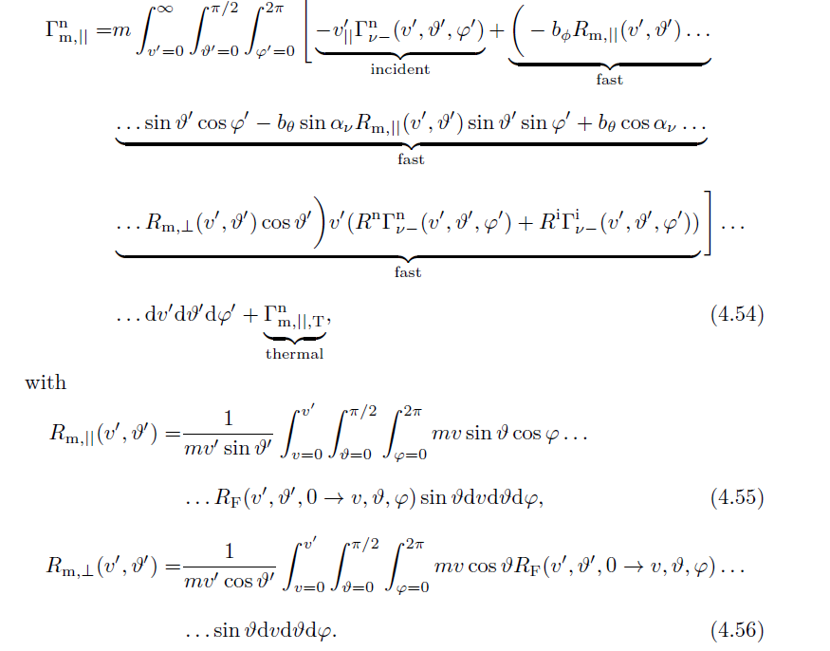
Practical implementation
write out integrals in full to get lovely expressions

Slide 24
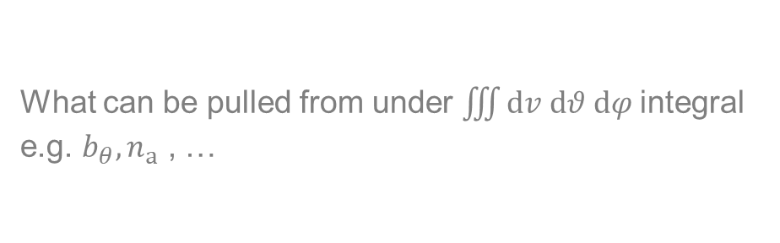
Practical implementation
check what can be pulled outside of integrals
numerically integrate remainder in pre-processing and store in database
$$Γ_{μ}=Γ_{μ,inc}+ \sum_{k}{A_{μ}^{k}\int_{v=0}^{∞}{\int_{θ=0 }^{\frac{π}{2}}{\int_{φ=0 }^{2 π}{g_{μ}^{k}\left(v,θ,φ,R\right){\tilde{f}}_{i/a}\left(v,θ,φ;δ_{sh}^{pot,k},V_{i/a},T_{i/a}\right)dv dθ dφ }}}}$$
What can be pulled from under $\iiint{dv dθ dφ }$integral
e.g. $b_{θ}, n_{a}$ , …
Pre-computed databases as a function of $T_{i/a}, { M}_{φ,i/a}, δ_{sh}^{pot}$

Slide 25
Results

Slide 26
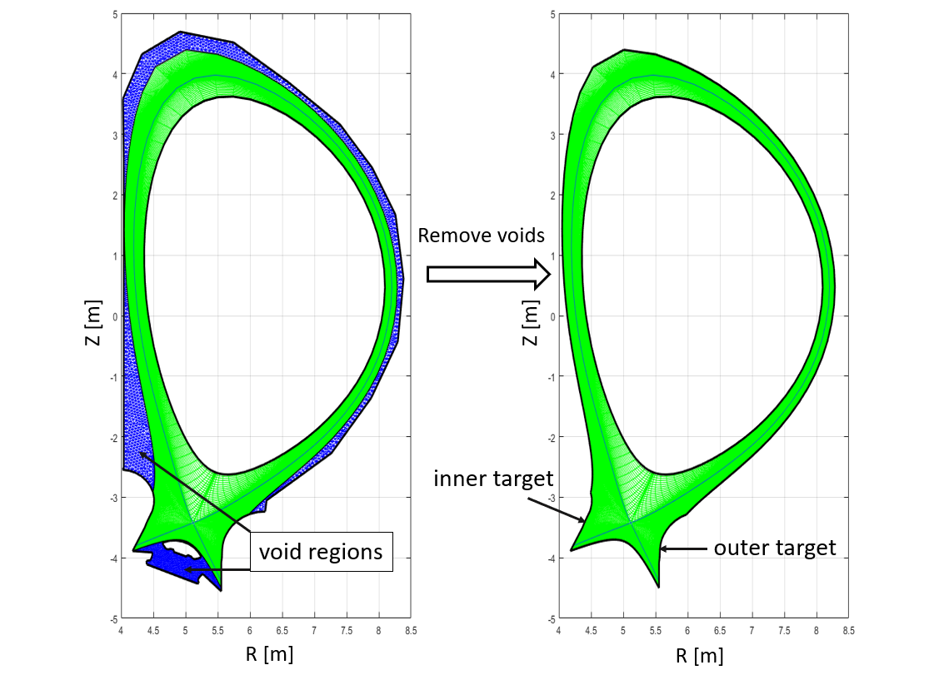
Simplified ITER case

Slide 27
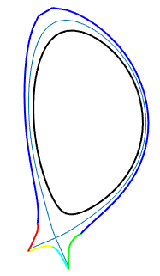
ITER case with beryllium targets
With fluid atoms + separate atom temperature
Plasma profiles along outer target
With fluid atoms
With kinetic atoms

Slide 28
ITER case with tungsten targets
Plasma profiles along outer target
Ion-atom collisionality too low

Slide 29
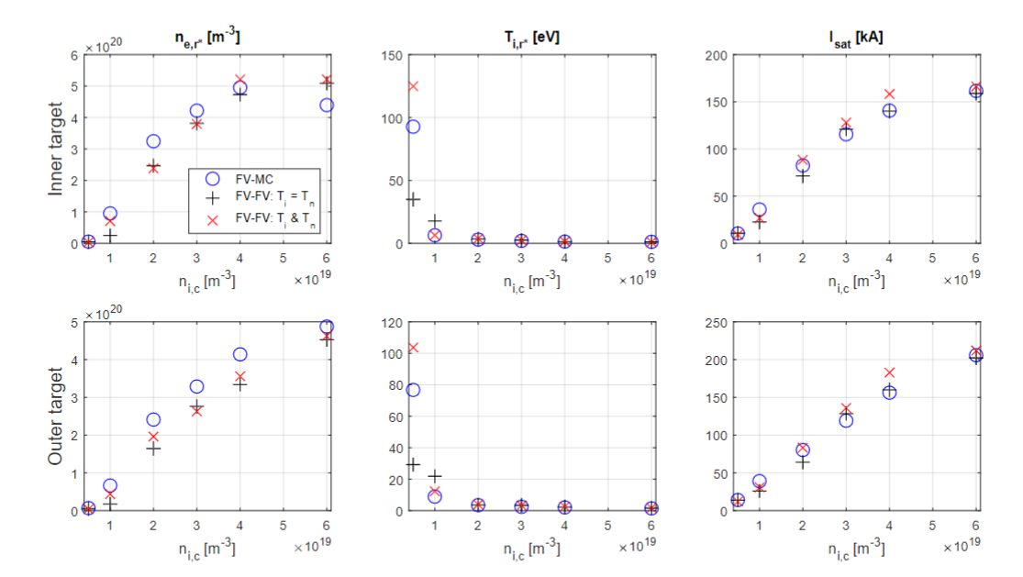
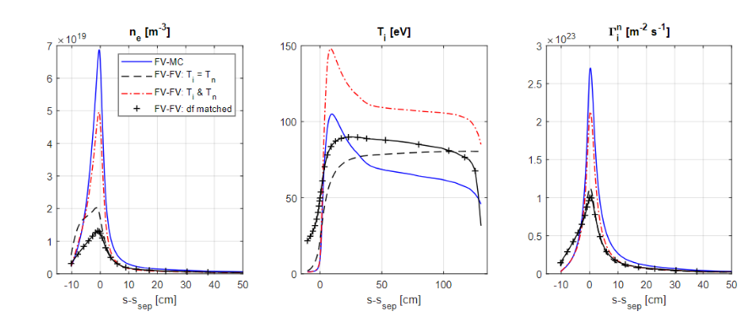
Density scan: Be-Be

Slide 30
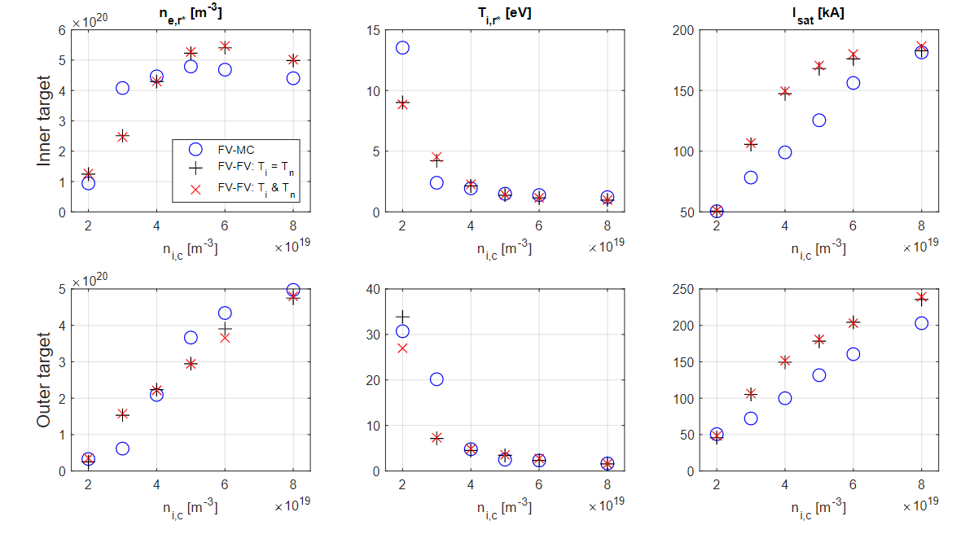
Density scan: W-Be

Slide 31
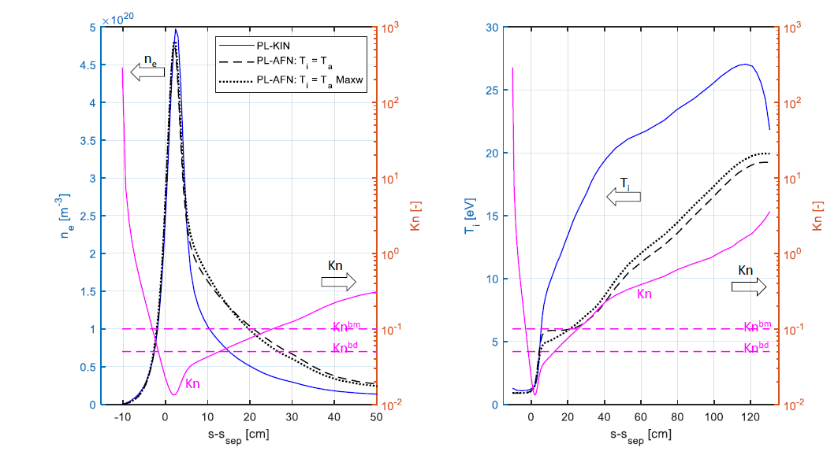
All previous cases with ‘mixed’ approach for incident atom assumption
Using Maxwellian everywhere gives similar results
Using Diffusion approach everywhere leads to code crash

Slide 32
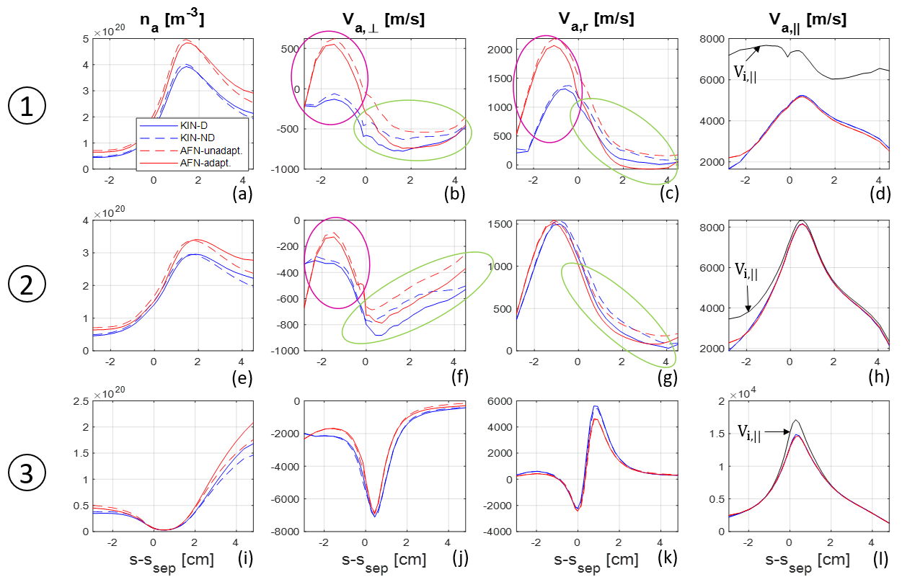
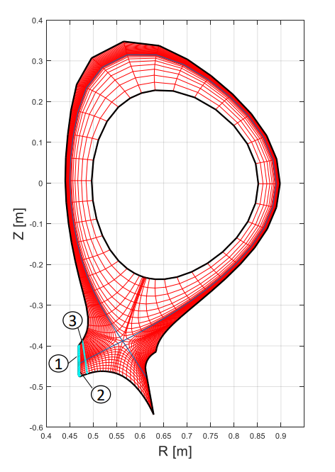
Neutral velocities C-mod case
[Van Uytven, W. et al. NME (2022), 101255]

Slide 33
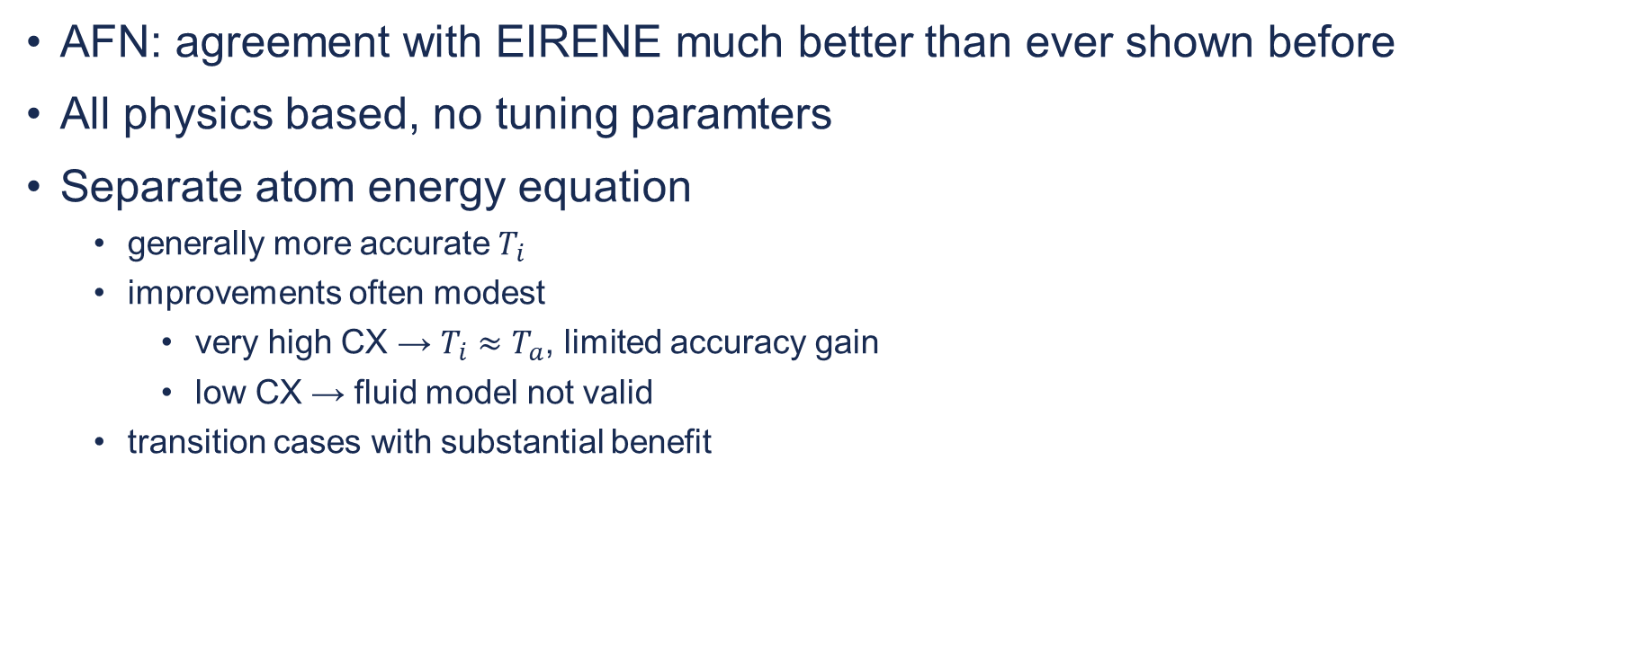
Conclusions
AFN: agreement with EIRENE much better than ever shown before
All physics based, no tuning paramters
Separate atom energy equation
  generally more accurate $T_{i}$
  improvements often modest
    very high CX → $T_{i}≈T_{a}$, limited accuracy gain
    low CX → fluid model not valid
  transition cases with substantial benefit

Slide 34
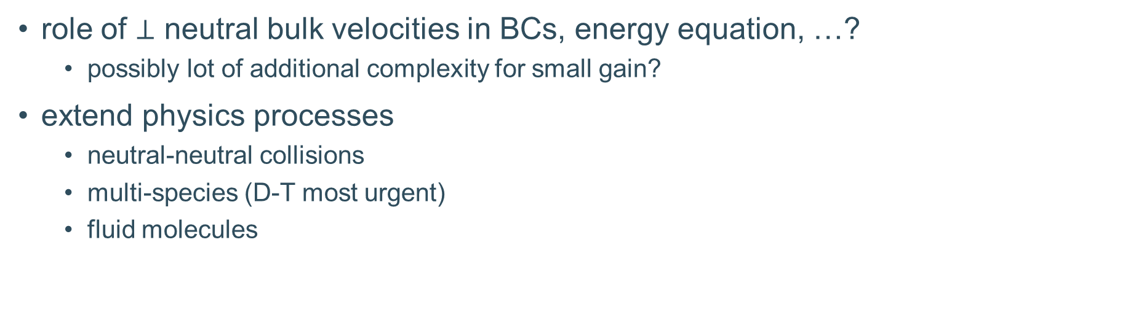
Future work
role of $⊥$ neutral bulk velocities in BCs, energy equation, …?
  possibly lot of additional complexity for small gain?
extend physics processes
  neutral-neutral collisions
  multi-species (D-T most urgent)
  fluid molecules
Extending BCs much easier when assuming truncated drifting Maxwellian for incident atoms

Slide 35
References
Articles
  original derivation and implementation in MATLAB
    Horsten, N. et al. NF 57.11 (2017): 116043. ( + references therein)
  implementation in SOLPS and improvements for realistic cases
    Blommaert, M., et al. CtPP 58.6-8 (2018): 718-724.
    Van Uytven, W. et al. CtPP 60, 5-6 (2020), e201900147.
    Van Uytven, W. et al. NF (2022), 086023.
    Van Uytven, W. et al. NME (2022), 101255.
PhD manuscripts
    PhD N. Horsten, KU Leuven, 2019
    PhD W. Van Uytven, KU Leuven, 2023

Slide 36
Back-up slides

Slide 37
Effect of drifts on kinetic neutral solution
Standard approach → “MC-D”
Drifts in plasma model, but remove drifts from background for EIRENE → “MC-ND”
Comparing “MC-D” and “MC-ND” allows to separate effect of drifts on the neutral solution from effect of drifts on the plasma itself
[Van Uytven, W. et al. NME (2022), 101255]
Notes:
Next, we will zoom in on the effect of drifts on the neutral solution itself. For kinetic neutrals, this can be done as follows:
In the standard case, we calculate the neutral solution with a high number of MC particles on a plasma background which includes the drift velocities.
We can now do the same, but remove the drift velocities from the plasma background.
By comparing these two results, we can separate the effect of the drifts on the neutrals, from the effect of the drifts on the plasma itself.

Slide 38
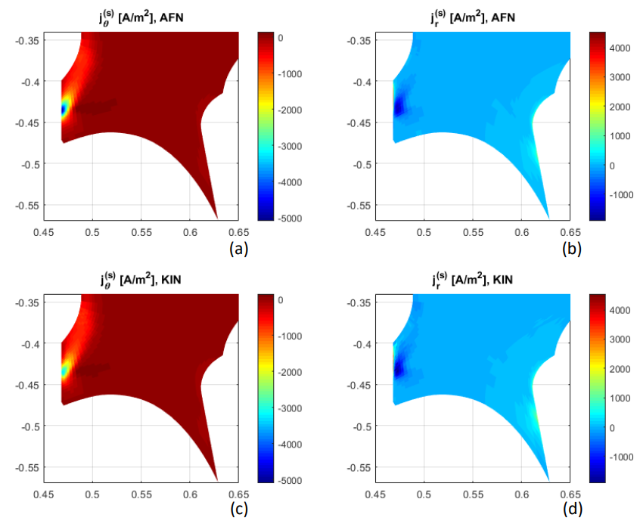
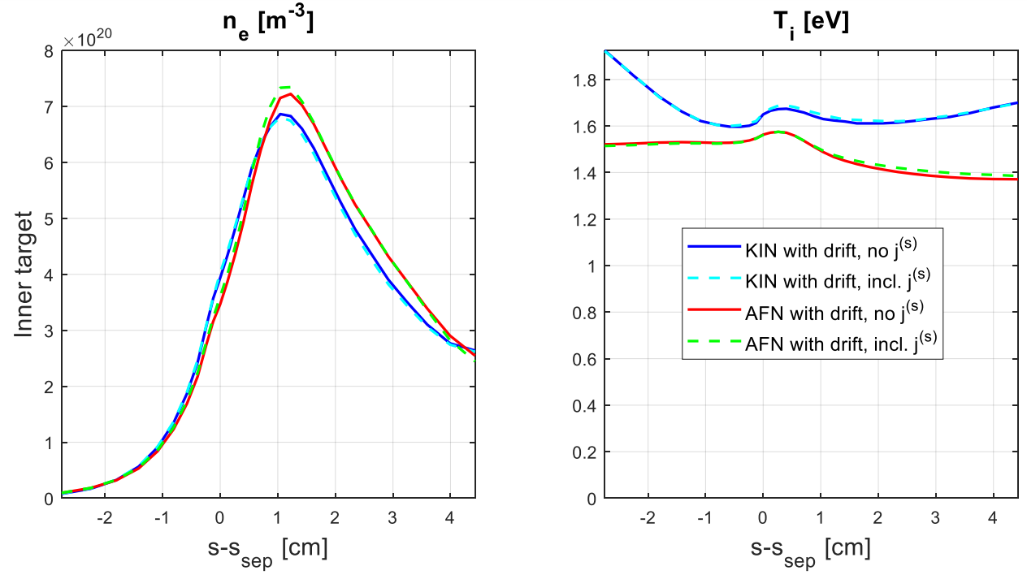
i-n current in C-mod case
Qualitative agreement
Effect of i-n current on solution was very small for C-mod case
  → should be tested on other cases as well
[Van Uytven, W. et al. NME (2022), 101255]

Slide 39
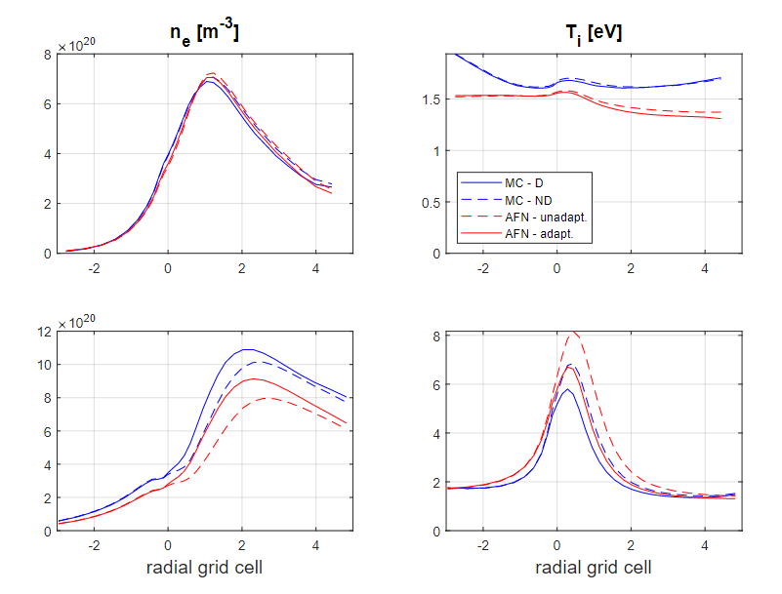
Coupled solution
Full effect of drifts on kinetic neutral solution
inner target
Partial effect of drifts on fluid neutral solution
due to new advection term
20 mm before
inner target
→ with new $⊥$ transport term, fluid-kinetic discrepancies are no larger than they were without drifts
Notes:
The same conclusions follows when we look at the coupled plasma-neutral solution. With the new transport term included, the fluid-kinetic discrepancies are no larger than they were without drifts.

Slide 40
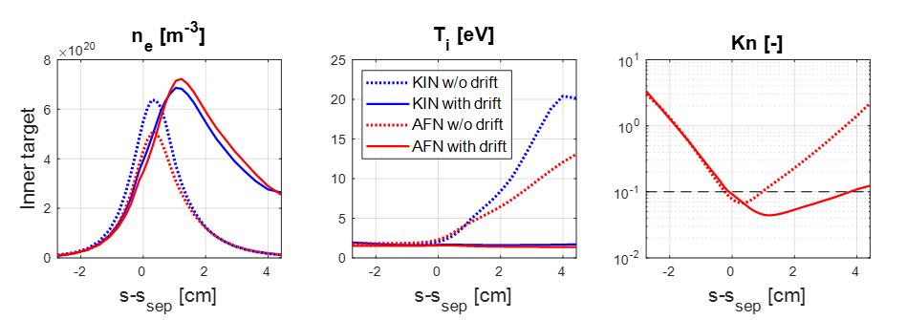
Alcator C-mod case with drifts
Plasma profiles along inner target
With unadapted AFN model
[Van Uytven, W. et al. NME (2022), 101255]

