Slide 1
TSVV3 – Regular advancement meeting 10/07/2024 – TCVX23 experiments + code IMASification Project news
P. Tamain

Slide 2
Today’s meeting agenda

Slide 3
Marconi report
Still expecting report contributions for GBS, GRILLIX and SOLEDGE3X (expected Monday last week)
Please provide them asap
pay attention to distinguishing FUA37_TSVV3 (conventional) and FUAL7_TSVV3 (GPU)

Slide 4
Delay of Marconi’s replacement
Replacement of Marconi not before October
From July 31st, the current machine will be extended but only at half of its capacity
Overall this will result in a drastic reduction of our cpu time budget (Marconi less powerful than new machine + only ½ of the machine left)
No official numbers available yet

Slide 5
Future EUROfusion HPC - CPU

Slide 6
Future EUROfusion HPC - GPU

Slide 7
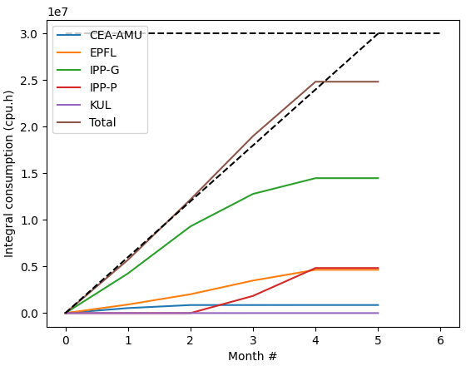
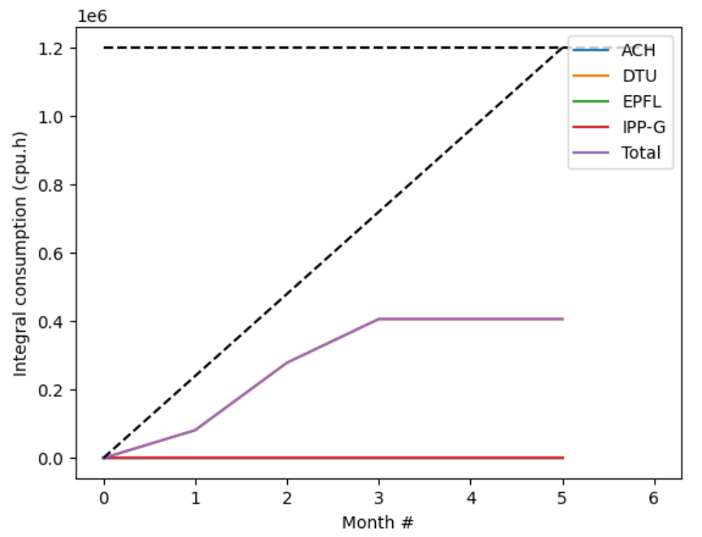
MARCONI usage update
FUA38_TSVV3 (CPU)
FUAL8_TSVV3 (GPU)

Slide 8
ACH support request
Campaign for application for ACH support in 2025 open until October 4th
Requests sent individually to code contact person, but I would like to synch things from the TSVV3 point of view to ensure reasonable balance and alignment with the project
Prepare requests for September 16th in sight of dedicated discussion at meeting on September 19th

Slide 9
Training for WPTE modelers
Will of WPTE TFL to extend the user base of TSVV codes for WPTE applications
Practical path no defined yet, but TFLs investigating the idea of organization training sessions if interest identified

Slide 10
E-TASC General meeting
“E-TASC General Meeting” organized in Garching November 11-15
Agenda and objectives of meeting still not fully clear
Travel money available for PI + (1-2) other contributors
Depending on objectives of meeting, might be good to have some of you join the discussions

Slide 11
Latest publications (1)
TCV experiments validations
D. Mancini et al : 7th May 2024 | DocumentID : 37825
: The role of toroidal field direction in simulations of tokamak plasma in detached conditions
Conference : 26th International Conference on Plasma Surface Interaction in Controlled Fusion Devices (PSI-26), Marseille, France, 12th May 2024.
H Bufferand et al : 14th June 2024 | DocumentID : 38090
: Global 3D full-scale turbulence simulations of TCV-X21 experiments
Conference : 26th International Conference on Plasma Surface Interaction in Controlled Fusion Devices (PSI-26), Marseille, France, 12th May 2024.
V. Quadri et al : 7th December 2023 | DocumentID : 36554
: Edge plasma turbulence simulations in detached regimes with the SOLEDGE3X code
Conference : 26th International Conference on Plasma Surface Interaction in Controlled Fusion Devices (PSI-26), Marseille, France, 12th May 2024.

Slide 12
Latest publications (2)
Linear systems
M. Guido et al : 3rd May 2024 | DocumentID : 37808
: Subspace Acceleration for a Sequence of Linear Systems and Application to Plasma Simulation
Conference : SIAM Conference on Applied Linear Algebra (LA24), Paris, 13th May 2024.
Mean field simulations up to the first wall in reactor relevant conditions
S Sureshkumar et al : 20th June 2024 | DocumentID : 38137
: First SOLEDGE3X-EIRENE simulations of the ITER Neon seeded burning plasma boundary up to the first wall
Conference : 26th International Conference on Plasma Surface Interaction in Controlled Fusion Devices (PSI-26), Marseille, France, 12th May 2024.

Slide 13
Summer break
Cancelling next 2 regular meetings
Next one possibly on August 21st… if voluntary contributions (contact me!)

Slide 14
Today’s meeting agenda
Upload presentations on https://indico.euro-fusion.org/event/2947/ or send to me please.

