Slide 1
Transport equations and flux descriptions
Most transport codes are derived from the work by Hinton/Hazeltine (Rev. Mod. Phys 1976)
Assumes:
A Grad-Hogan type equilibrium – transport splitting
Using a toroidal flux based radial grid (see previous bullet)
Robustly derived for pressure and density evolution (assuming neoclassical transport)
Anomalous terms introduced a bit ad hoc (0, 3/2 or 5/2 See Stringer et al)
Momentum transport possibly a bit less discussed - but see E. Fable for a potentially very relevant exposition for ETS.
Makes some different assumptions in terms of dynamic quantities (n_e, vs n_i)

Slide 2
Where some codes differ
OneTwo is using a poloidal flux based grid
Introduces evolution equations for some of the metrics
TSV, I think, is not using the grad-hogan approach but a variant deviced by Jardin and Hirschman
ETS is different in that it
Keeps the ion-ion equilibration timescales - and hence allow for different evolution of the (temperatures) for each species - more common to assume that Ti is equal for all and sum over the ion energy equations – stability (ETS:R2)
Keeps a rotation equation for each ion species
Implies that poloidal velocities are not necolassical
Is likely not possible to implement in view of available sources and diffusivities (ETS:R1)

Slide 3
D, V and flux $\tilde{Γ}$ in IDS ( a consistent model)
The total flux through a flux surface is an invariant quantity under coordinate transformations (scalar):
$$ΓV^{′}=<\vec{Γ} ∙∇ρ>V^{′}= \left[−D \frac{∂n}{∂ρ}<|{∇ρ|}^{2}>+nV_{p}<\left|∇ρ\right|>\right]V′$$
here $ΓV^{′}=\tilde{Γ}A;and V^{′}<|∇ρ|>=A$.
A is the Surface area of the flux surface labelled by $ρ$. I.e., we are expressing the flux through the contravariant component of the flux.
The expression within the brackets is what is used internally in TCI (and some other transport codes) as part of the flux surface average transport equation.
TCI provide D [m^2/s], V [m/s] and $ΓV^{′ }[\frac{particles}{s}]$. And similarily for the heat transport.
The $\tilde{Γ}$ (flux density) is what is prescribed for the IDS and CPO definitions together with the D, V as described here.

Slide 4
ETS and, for example, ASTRA is not using this format and ETSv6 is currently not (?) converting properly:
$$ΓV^{′}= \left[−D \frac{∂n}{∂ρ}+ nV_{p}\right]<|{∇ρ|}^{2}>V′$$
This means that V has an implicit rho dependence (makes cross run comparisons problematic) and there might be a systematic error in the use of the pinch terms.
Need to manage the differences properly.

Slide 5
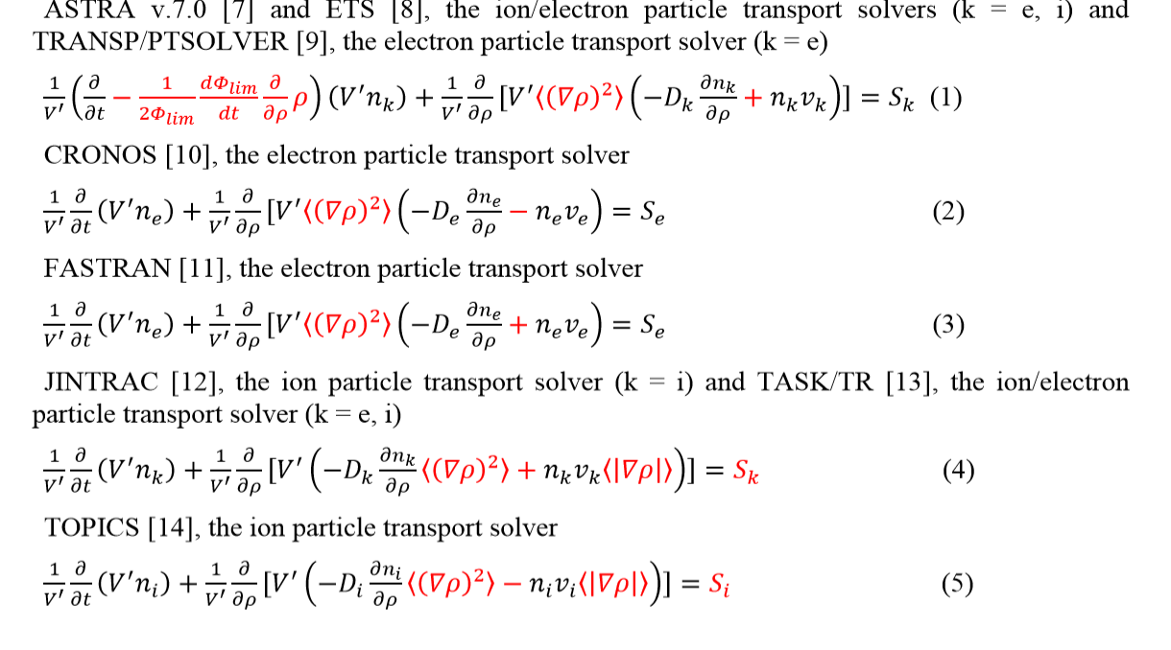
For the purpose of discussion: Density evolution as a model equation From YS. NA Nucl.Fusion 2019

Slide 6
A trinity of dependences
A proper implementation requires a consistent use and understanding of
The underlying transport equations
The invariant formulation of the fluxes (and for our solvers the splitting into D,V)
What the models provide in terms of transport estimates
In all steps the choices are independent BUT the mappings in between are of course not!
GLUE elements:
Interface definitions (IDS, CPOs) - currently defining D, V and flux $\tilde{Γ}$
Internal models (ETS internal types, TCI) – need mappings

Slide 7
Motivation for keeping the IDS formulation
No change is needed if the ”TCI” model is assumed
Possble to compare D, V and flux directly in IDS without knowing a priori the form of the transport equations
Some convenience in including models formulated in simple geometry (s-alpha etc).
Flux is consistent with what typically is calculated from turbulence codes etc Implementation in ETS (and most other codes) requires a D,V splitting (most ignores off-diagonal terms)
Currently assumed to be a property/responsibility of the model
Tricks to go from flux to D,V for linear model exists
Numerical differentiation

Slide 8
A quick note on peaking factors and flux splitting
Two extremes: Flux only vs full transport matrix
Most models are based on fluxes being the fundamental out put quantity
NOT easy or VERY expensive to do D,V splitting in most cases (requires numerical differentiation or other tricks) – Ab-initio modelling and QLK models (but even NEO is problematic )
NCLASS provides a full transport matrix covering all contributions to the transport of species i from all species j, and can specify this out put in at least three different formats of the transport (see Houlberg PoP, 1997, or NTCC)
$\sum_{j}{\left(−\frac{D_{j,i}^{T}}{T_{j}} \frac{∂T_{j}}{∂ρ} −\frac{D_{j,i}^{p}}{p_{j}} \frac{∂p_{j}}{∂ρ} \right)}n_{i}+ n_{i}V_{n}+n_{i}V_{EB}+n_{i}V_{ext}= \left[−D_{i} \frac{∂n_{i}}{∂ρ}+n_{i}V_{n}+n_{i}V_{EB}+n_{i}V_{ext}\right]$= $\left[−D_{i} \frac{∂n_{i}}{∂ρ}<|{∇ρ|}^{2}>+n_{i}V_{p}<\left|∇ρ\right|>\right]$

Slide 9
Peaking factors
Care need to be excercised in terms of defining peaking factors, with:
$ΓV^{′}= \left[−D \frac{∂n}{∂ρ}+ nV_{p∗}\right]<|{∇ρ|}^{2}>V′$= $\left[−D \frac{∂n}{∂ρ}<|{∇ρ|}^{2}>+nV_{p}<\left|∇ρ\right|>\right]V′$
As $V_{p∗}$ and $V_{p}$ are not the same quantities akthough in this particular formualtion the D’s are!
Source free steady states gives
$$\frac{{ V}_{p}}{D}= \frac{∂\log{n}}{∂ρ}\frac{<|{∇ρ|}^{2}>}{<\left|∇ρ\right|>}=\frac{∂\log{n}}{∂r}$$
And
$$\frac{{ V}_{p∗}}{D}= \frac{∂\log{n}}{∂ρ}$$

Slide 10
What I did not have time to get into - model based strategies for splitting fluxes
- Internal to models
- BDS prescitions
- Arbitrariness for everything but linear models…..
Intentionally not blank – further details follow – time permitting

Slide 11
ETS.R1 - Momentum transport
Current implementation: One equation per species
In principle correct
Lacks means of describing source terms
Requires a description for anomalous poloidal velocities
In general not available
No strong experimental evidence for the need
Requested implementation in v6.0 : A single momentum (rigid body?) equation
Well described in literature (and other codes)
Sufficient with neoclassical poloidal velocities (Otherwise overprescribed)
Consistent with available sources and model descriptions

Slide 12
ETS.R2 – Ion Heat transport
Current implementation: One equation per species excluding impurities
In principle correct IFF all ion-ion equilibriation terms included
Not fully consistently done in ETS v5.2 (introduces a fast time scale in the system)
Current implementation is largely ok - but oformally only for trace impurities
Requested implementation in v6.0 : A single ion heat equation
Assume all Ti equal and sum energy equation over ALL species
Fast thermal ion/ion equilibration cancels out exactly
Possibly better stability with the solvers
Drawback is that for some heavily driven systems this fails - keep old as backdrop?

Slide 13
Invariance as validation
Total flux need to be invariant under coordinate transformations - simple test:
Allow for different rho definitions in input ($\tilde{ρ}=ρ$/a, and $ρ$) and test for total flux.
Not all models have the same set of requriements in terms of grids and in some cases a specific grid is assumed.
Need to pass around knowledge of which grid we are using inside TCI
New variable i_gridtype = 0,1,2 is introduced in TCI2
0 – unknown and set default for backwards compatibility, 1 – normalized rho and 2 - unnormalized.
Test data generated that are consistently done in onw or the other to facilitate testing
Led to update to interfaces in some cases -
(WEILAND had a small shift in pinch terms) othe rmodels have been adapted itnernally

