Slide 1
TSVV3 – Regular advancement meeting 04/09/2024 – Project update, no specific topic Project news
P. Tamain

Slide 2
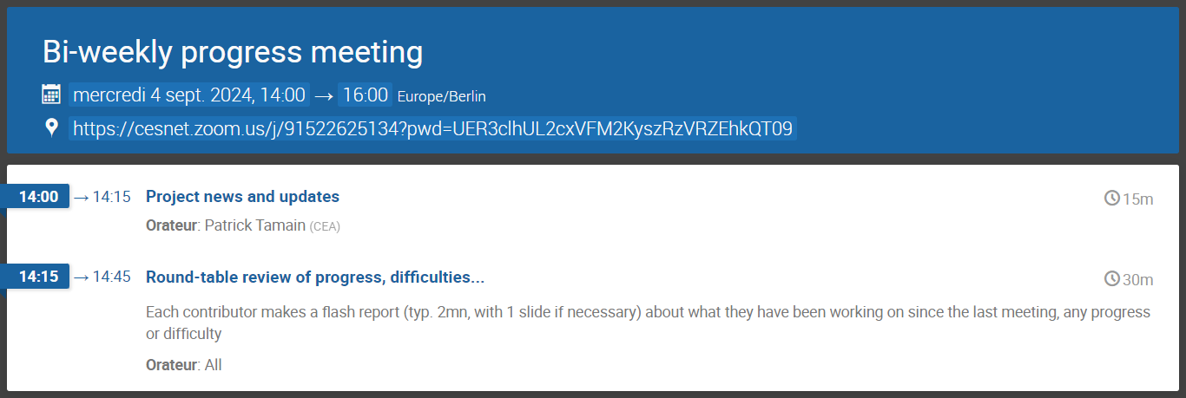
Today’s meeting agenda

Slide 3
Marconi news
Report for cycle 7 submitted this summer:
https://wiki.euro-fusion.org/images/6/6a/Reporting_Marconi_Fusion_cycle7_TSVV3.pdf
Marconi allocation extended until 28/02/2025
Linear extension, but scaled ½ for CPU partition due to only ½ machine
Skylake partition: 47,633,810 cpu.h = 992,371 node.h
Leonardo: 2,456,704 cpu.h = 76,772 node.h
Start of Pythagoras hopefully earlier (11/2024?)

Slide 4
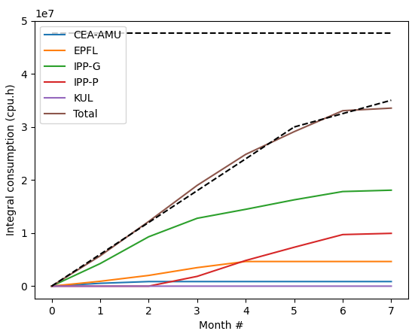
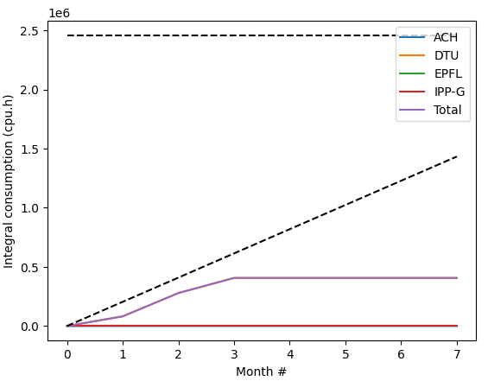
Marconi usage update
CPU
GPU

Slide 5
E-TASC General meeting
“E-TASC General Meeting” organized in Garching November 11-15
Agenda and objectives of meeting still not fully clear
Travel money available for PI + (1-2) other contributors
Depending on objectives of meeting, might be good to have some of you join the discussions

Slide 6
ACH support request (reminder)
Campaign for application for ACH support in 2025 open until October 4th
Requests sent individually to code contact person, but I would like to synch things from the TSVV3 point of view to ensure reasonable balance and alignment with the project
Prepare requests for September 16th in sight of dedicated discussion at meeting on September 18th

Slide 7
Latest publications
Nothing new in the summer to report Status of PSI presentations / papers? (esp. Davide and Konrad)

Slide 8
Today’s meeting agenda
Upload presentations on https://indico.euro-fusion.org/event/2951/ or send to me please.

