Slide 1
TSVV3 – Regular advancement meeting
18/09/2024 – Project update, ACH resource requests 2025
Project news
P. Tamain

Slide 2
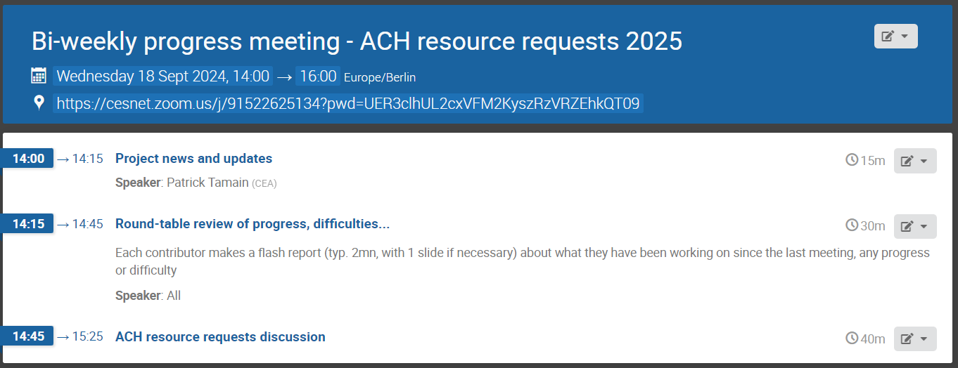
Today’s meeting agenda

Slide 3
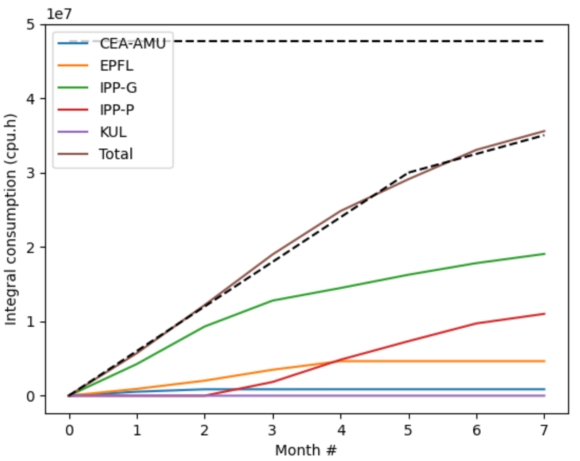
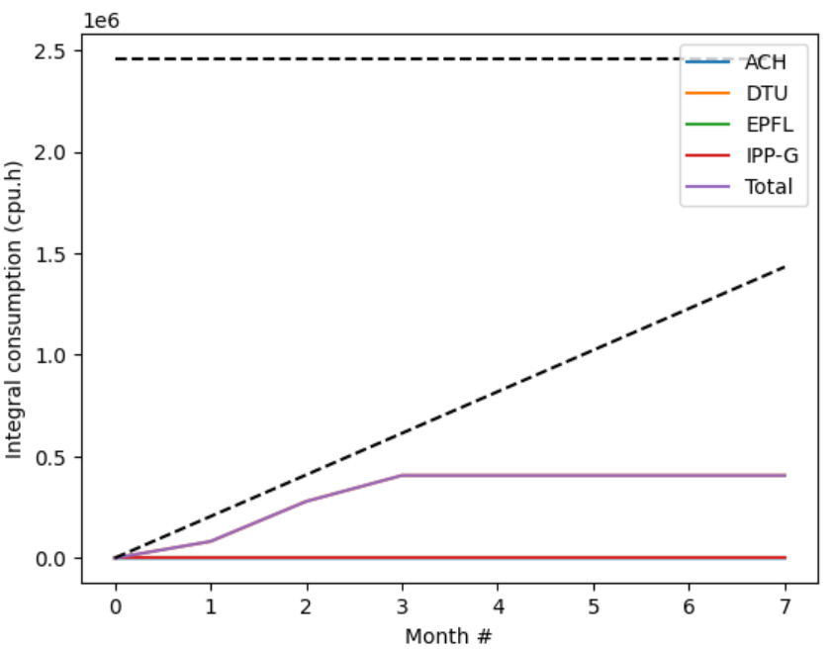
Marconi usage update
CPU
GPU

Slide 4
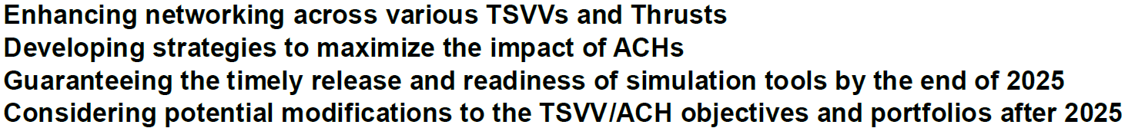
E-TASC General meeting
  “E-TASC General Meeting” organized in Garching November 11-15
  Agenda and objectives of meeting still not fully clear
  Travel money available for PI + (1-2) other contributors
    Depending on objectives of meeting, might be good to have some of you join the discussions
  Registration requested (e-mail forwarded this morning)

Slide 5
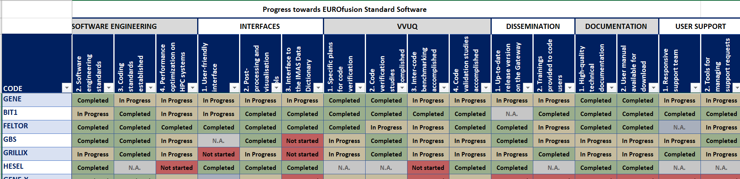
EUROfusion standard software survey
  Requested to updated status of codes w/r EUROfusino standard software requirements
  Feedback by October 9th please (IMASification +!)

Slide 6
Latest publications
Neutrals
K. Eder et al : 14th September 2024 | DocumentID : 38797
: Self-consistent plasma-neutrals fluid modeling of edge and SOL turbulence in diverted tokamaks
Journal : Plasma Physics and Controlled Fusion, .
Turbulence in H-mode
W. Zholobenko et al : 17th September 2024 | DocumentID : 36998
: Tokamak edge-SOL turbulence in H-mode conditions simulated with a global, electromagnetic, transcollisional drift-fluid model
Journal : Nuclear Fusion, .

Slide 7
Today’s meeting agenda
Upload presentations on https://indico.euro-fusion.org/event/2952/ or send to me please.

