Slide 1
TSVV3 – Regular advancement meeting
02/10/2024 – Project update, complex geometries
Project news
P. Tamain

Slide 2
ACH support requests
  I will submit the ones of:
    SOLEDGE3X: no change
    GBS: reduction on HPC pms as discussed with Davide & Paolo
    FELTOR: change to priority “high”
  BIT1 submitted through other TSVV
  Quid of GRILLIX?

Slide 3
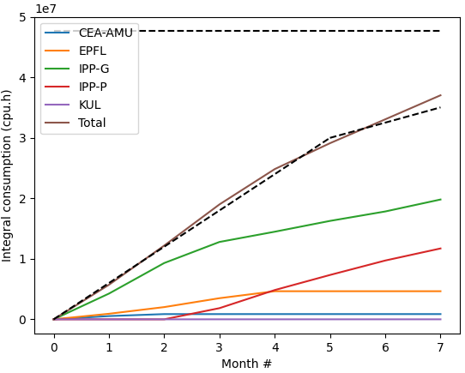
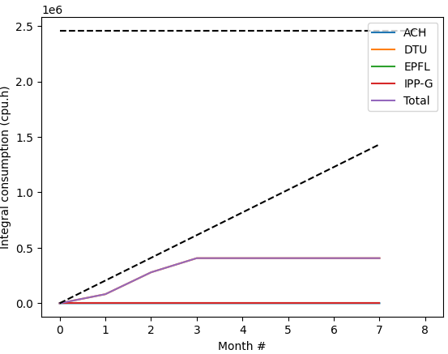
Marconi usage update
CPU
GPU

Slide 4
Marconi / Pitagora news
  Informal info: delays are to be expected w/r start time of Pitagora
  Negotiations with Cineca on-going concerning how to maintain a minimum availability of HPC during that time
    Might lead to additional reductions of Marconi hours in the last part of this cycle

Slide 5
Call for HPC resources cycle 9
  Call open for next cycle, based on Pitagora a priori
  Official deadline = November 18th
    But ETASC General meeting the week before so internal deadline 8th
    Feedback requested for Friday October 25th

Slide 6
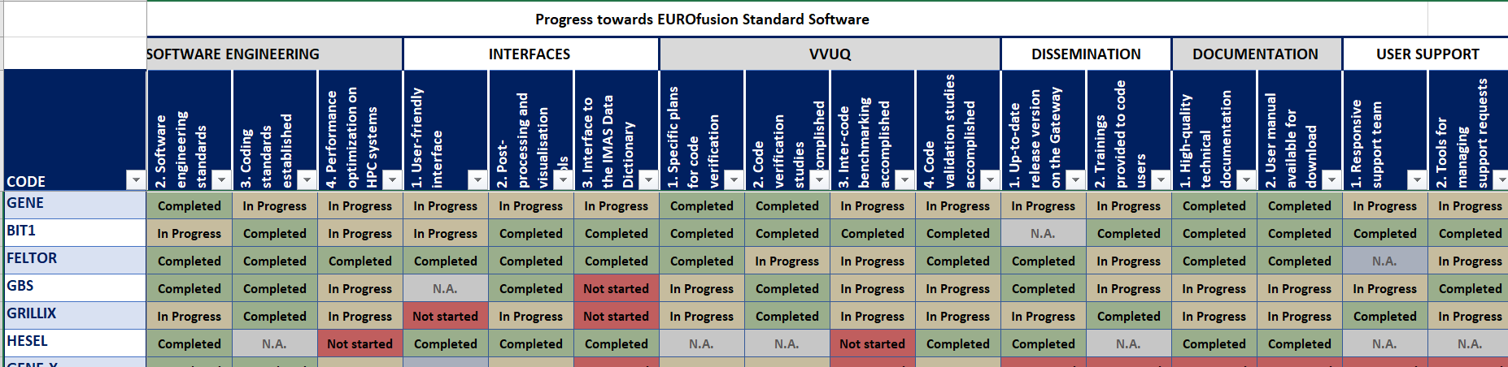
EUROfusion standard software survey
  Requested to updated status of codes w/r EUROfusion standard software requirements
  Feedback by October 9th please (IMASification +!)

Slide 7
E-TASC General meeting
  “E-TASC General Meeting” organized in Garching November 11-15
  Draft agenda out + more precisions given from meeting yesterday:
    rapid review of TSVV projects + needs of WPs
    Long time for poster session: project status and plans (I will ask for input)
    Many break-away sessions, opportunity to discuss topics across TSVVs: neutrals modelling, sheath models… => good opportunity for discussion
  Travel money available for PI + (1-2) other contributors
    Registration requested

Slide 8
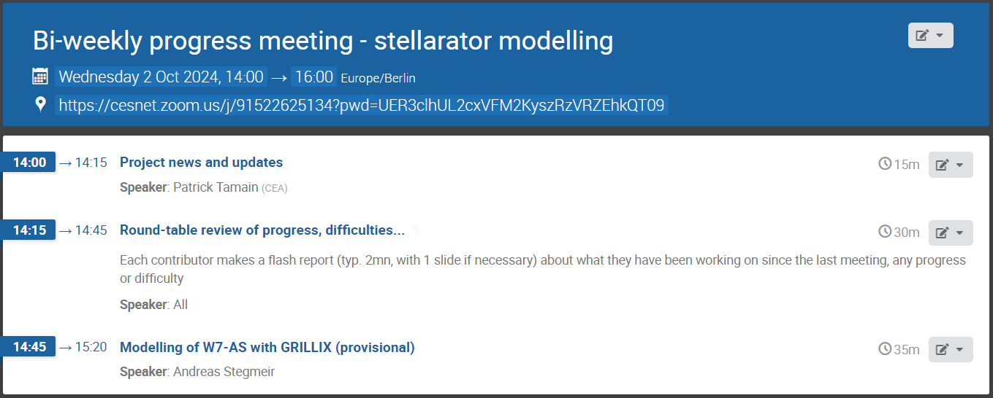
Today’s meeting agenda
Upload presentations on https://indico.euro-fusion.org/event/2953/ or send to me please.

